Slide 1
Pigmentary disorders
GHADA BIN SAIF, MD
Associate professor & Consultant Dermatologist
hair and Aesthetic specialist

Slide 2
Objective
Pathogenesis, features and management of different pigmentary disorders including:
Freckle
Different types of Melanocytic naevi
Melasma
Vitiligo

Slide 3
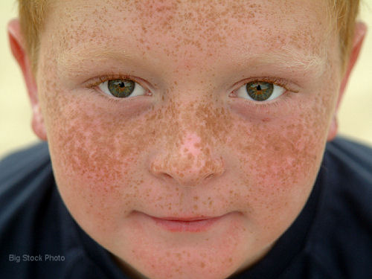
Freckle (lentigo)
Overactivity of an increased no. of melanocytes.
Fair individuals
Sun exposure in genetically predisposed individuals
Sun sensitivity----sun block
TTT: Pigmented laser (recurrence)

Slide 4
Melanocytic naevi (mole)
Common
Concern : ? early malignant melanoma
Types:
Acquired MN : very common, small, uniform, no need for ttt.
? Change in size, shape, edge, color
Atypical naevi (dysplastic): larger with one or more atypical signs; risk of mm in the subject.

Slide 5
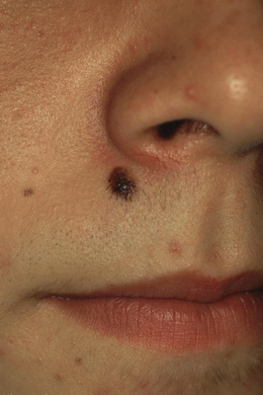
Acquired melanocytic nevus

Slide 6
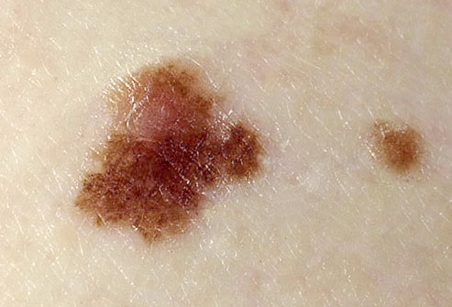
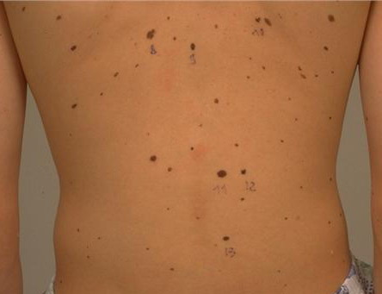
Atypical naevus (dysplastic)

Slide 7
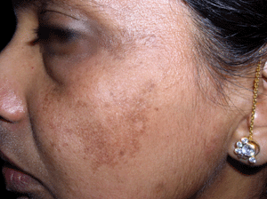
Melasma (chloasma)
Hormonally-stimulated increase in melanogenesis
Face
Pregnancy, OCP
Darkly pig skin, Sun expoure
TTT: sun block, bleaching

Slide 8
Vitiligo
-Acquired cut. depigmentation
-Kobner phenomena
Causes
Genetic
Autoimmune dis.
Neural
Natural coarse?
Varied

Slide 9
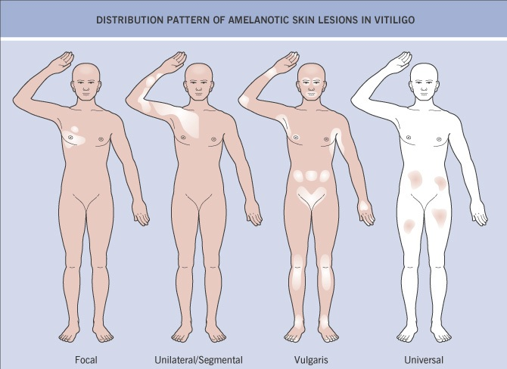

Slide 10
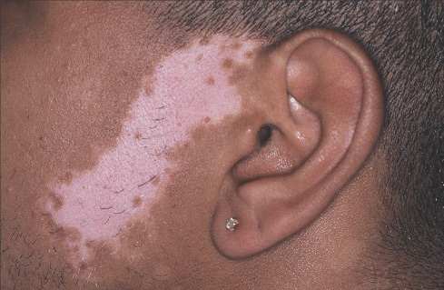

Slide 11
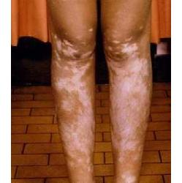

Slide 12
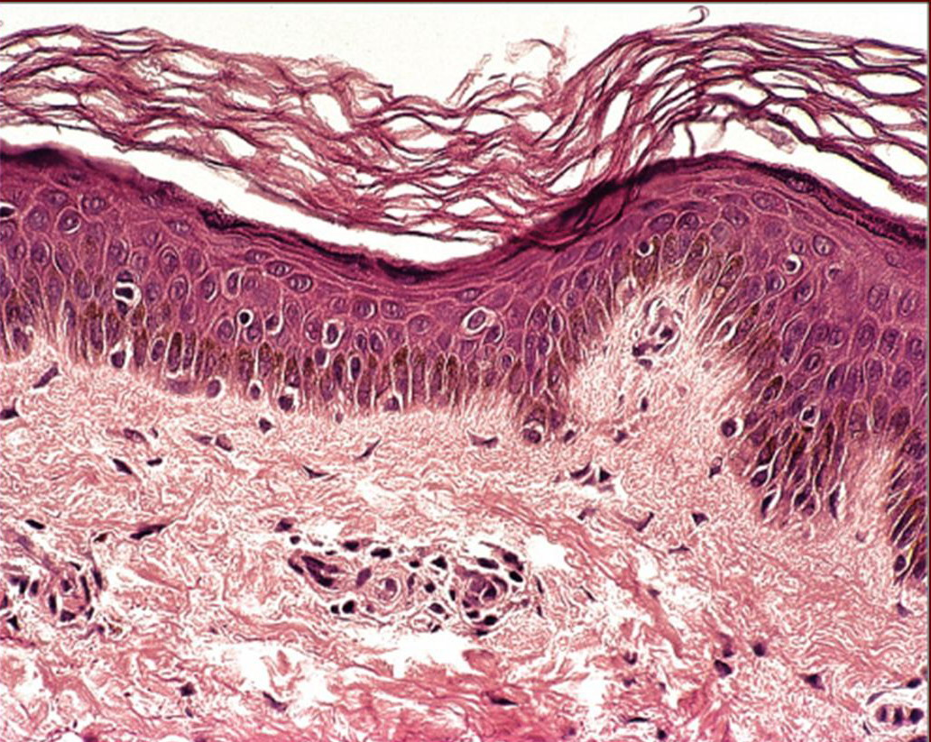
Why? Loss of normal melanocytes
Dopa stain

Slide 13
Special studies
T4, TSH, FBS
ANA/Ro/La (prior to PUVA)

Slide 14
TREATMENT
Sunscreen (sunburn, koebnerization, tanning)
Limited:
Class 3 topical GC
Topical Tacrolimus
Topical PUVA
Excimer laser
Resistant, Stable of 2 years : Surgical
Generalized
Phototherapy
Universal:
Bleaching agent

