Slide 1
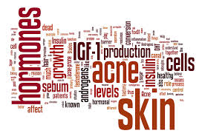
Acne and Acneiform Eruptions

Slide 2
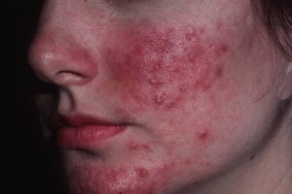
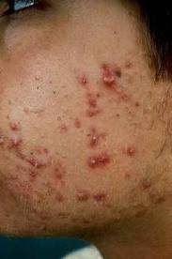
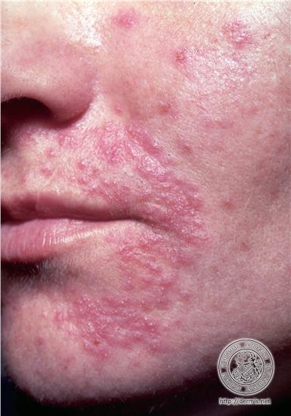
Hidradenitis
supprative
Rosacea
Perioral dermatitis
Acne

Slide 3
Acne Vulgaris
Multifactorial disease of pilosebaceous unit.
Affects both males and females.
The most common dermatological disease.
Mostly prevalent between 12-24 yrs.
Affects 8% between 25-34, 4% between 35-44.

Slide 4
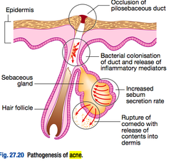
Pathogenesis:
Ductal cornification and occlusion
(micro-comedo).
Increased sebum secretion (Seborrhoea).
Ductal colonization with propioni
bacterium acnes.
Rupture of sebaceous gland and
inflammation.

Slide 5
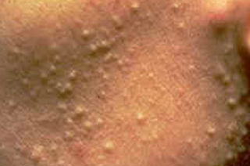
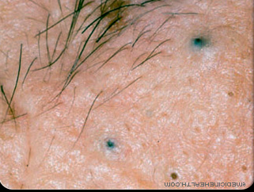
Specialized terms
Microcomedone:
Hyperkeratotic plug made of sebum and keratin in follicular canal.
Closed comedo ( whitehead):
Closed follicular orifice, accumulation of sebum and keratin
Open comedo ( blackhead):
Opened follicular orifice packed with melanin and oxidized lipids

Slide 6
Clinical Features
Acne lesions are divided into:
Inflammatory (papules,pustules,nodules,cyst)
Non inflammatory (open, closed comedons).
The comedons are the pathognomonic lesion
Seborrhoea.
Post inflammatory hyper pigmentation .
Scarring (Atrophic or Hypertrophic).

Slide 7
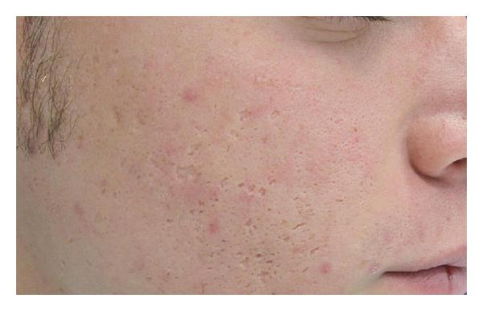
Clinical features

Slide 8
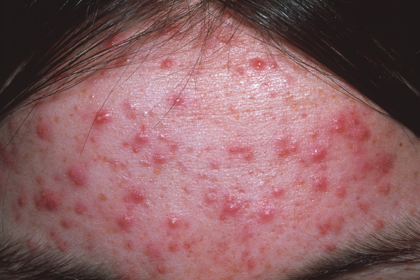
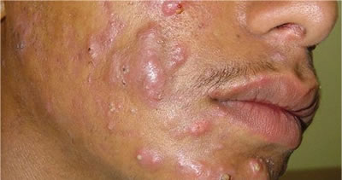
Clinical features
When follicles rupture into surrounding tissues they result in:
Papules.
Pustules.
Nodules.
Cysts.

Slide 9
Clinical Features
Lesions predominate in sebaceous gland rich
regions (face, upper back, chest & upper arms)
The severity of acne ranges from mild, moderate ,
severe according to the predominant lesion.
Comedon predominance is considered to be mild,
while extensive papulopustules and nodules or cysts are considered severe.

Slide 10
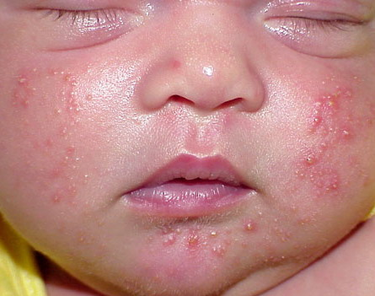
Acne Subtypes
1-Neonatal acne
Onset between 0-6 w of age.
Characterized by closed comedons
Resolve spontaneously within 1-3 months.
No relation with later development of acne.

Slide 11
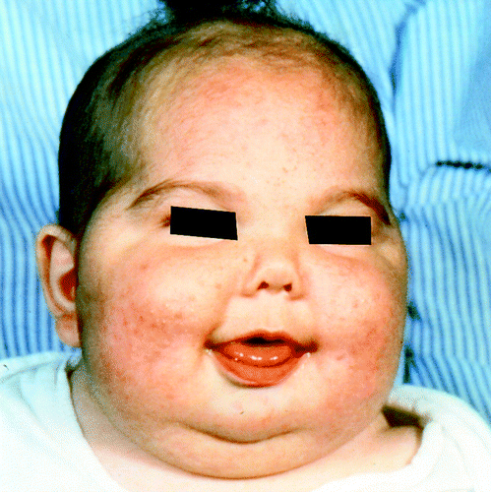
Acne Subtypes
2-Infantile Acne
Onset between 3-6 m
Characterized by inflammatory lesions
Can be associated with precocious androgen secretion secondary to brain hamartoma and astrocytoma

Slide 12
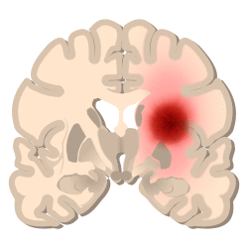
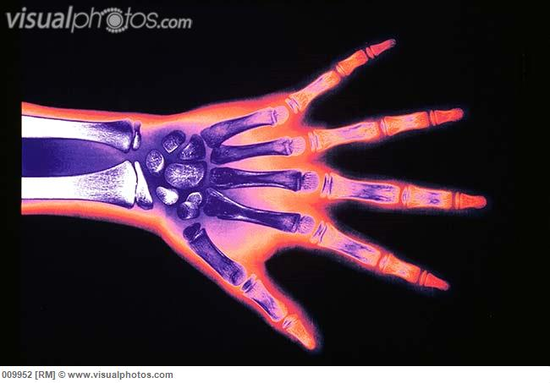
Acne Subtypes
Endocrinology examination (LH) and bone age are important.
There is increased risk of development of severe acne

Slide 13
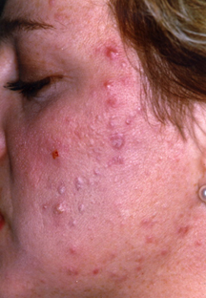
Acne Subtypes
3- Teenage Acne
More in boys
Mainly comedonal
May be the first sign of puberty

Slide 14
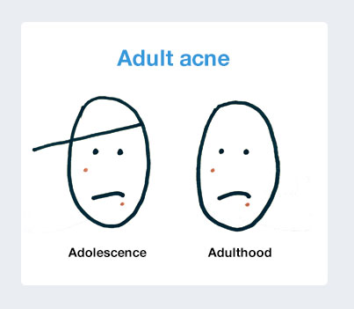
Acne Subtypes
4.Adult Acne
Affect adult above 25 years
Can be continuation of teenage acne or start denovo
IF associated with hirsutism , irregular periods evaluate for hyper secretion of adrenal ,ovarian androgens (e.g. Polycystic ovary syndrome)

Slide 15
Acne Subtypes
5. Drug induced Acne
Steroids, Iodides, Bromides, INH, Lithium,Phenytoin, epidermal growth factor inhibitors (cetuximab) cause acniform eruption.
The characteristic feature of steroids acne is the absence of comedons and monomorphic lesions as small pustules and papules all looking alike

Slide 16
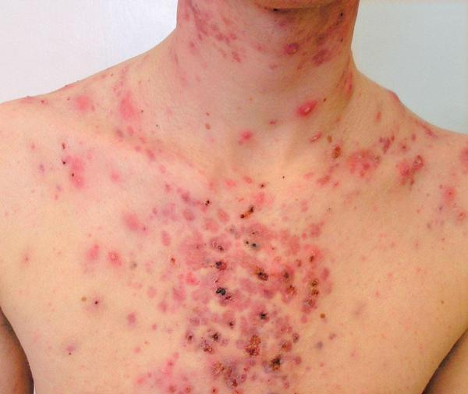
Acne Subtypes
6-Acne Conglobata:
Highly inflammatory; with comedons, nodules abscesses, draining sinuses, over the back and chest .
Often persist for long periods.

Slide 17
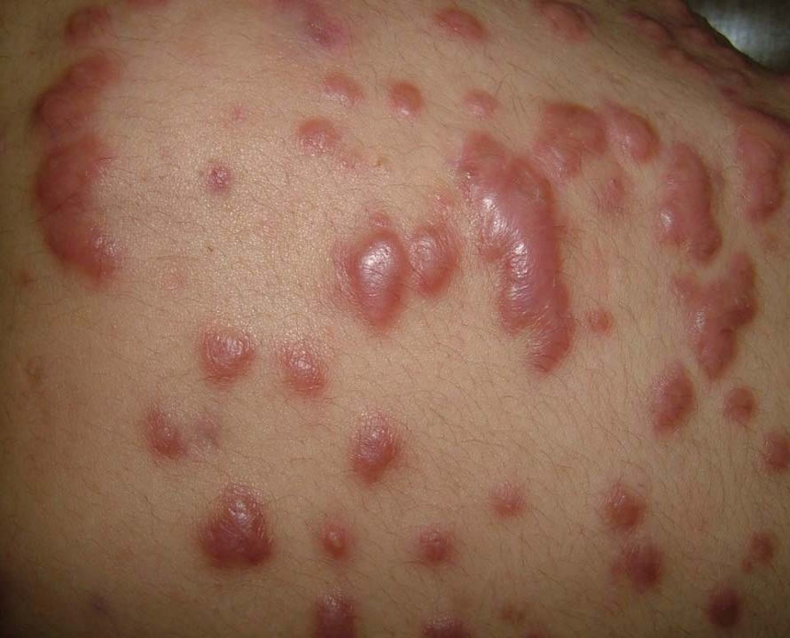
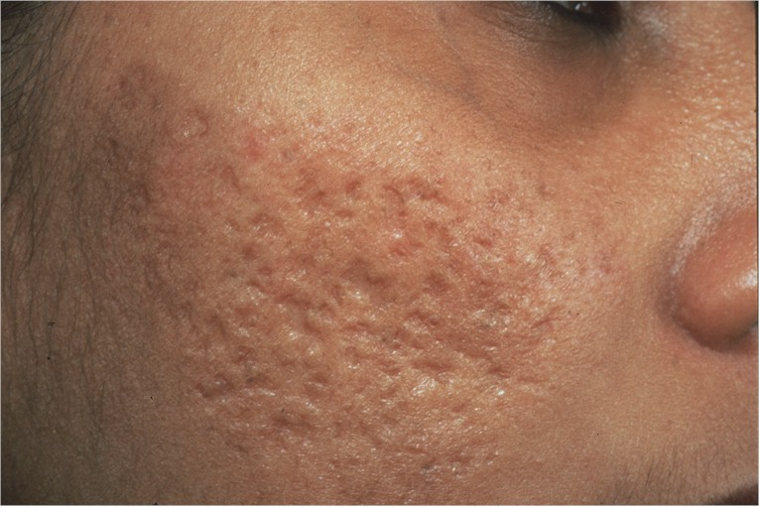
Acne Subtypes
Affect males in adult life (18-30 years).
Heals with scars (Depressed or Keloidal).

Slide 18
Acne Subtypes

Slide 19
Acne Subtypes
8-Occupational Acne:
Due to contact with oils – tars –chlorinated hydrocarbons used in the synthesis of insecticides and solvents.
Lesions appear at site of contact including large comedons, papules, pustules,nodules.
The most serious form is the chloracne due to systemic effect (liver damage –CNS involvement, decrease lung vital capacity)

Slide 20
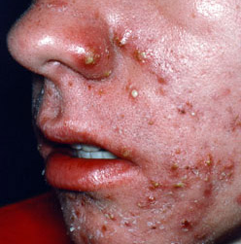
Acne Subtypes
9-Gram NegativeFolliculitis:
Infection with G –ve organisms (Klebsiella, proteus, E.coli)
Seen in patients under chronic antibiotic acne treatments
Superficial pustules without comedons or even cysts involving from intranasal area to chin and cheeks.
Response to ampicillin, Isotretenoin, TMP-SM.

Slide 21
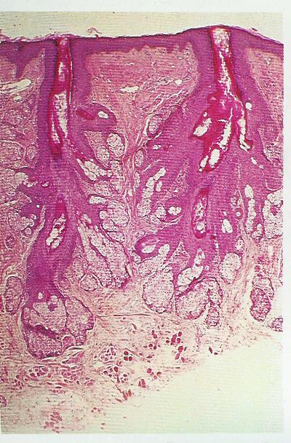
Obstructed duct
Sebaceous gland
Obstructed sebaceous duct

Slide 22
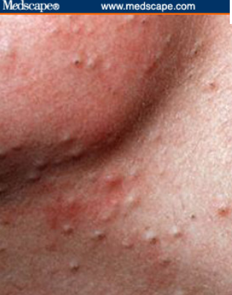
Closed and open comedones

Slide 23
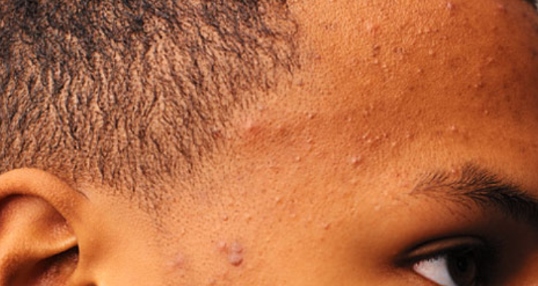
Closed and open comedones

Slide 24
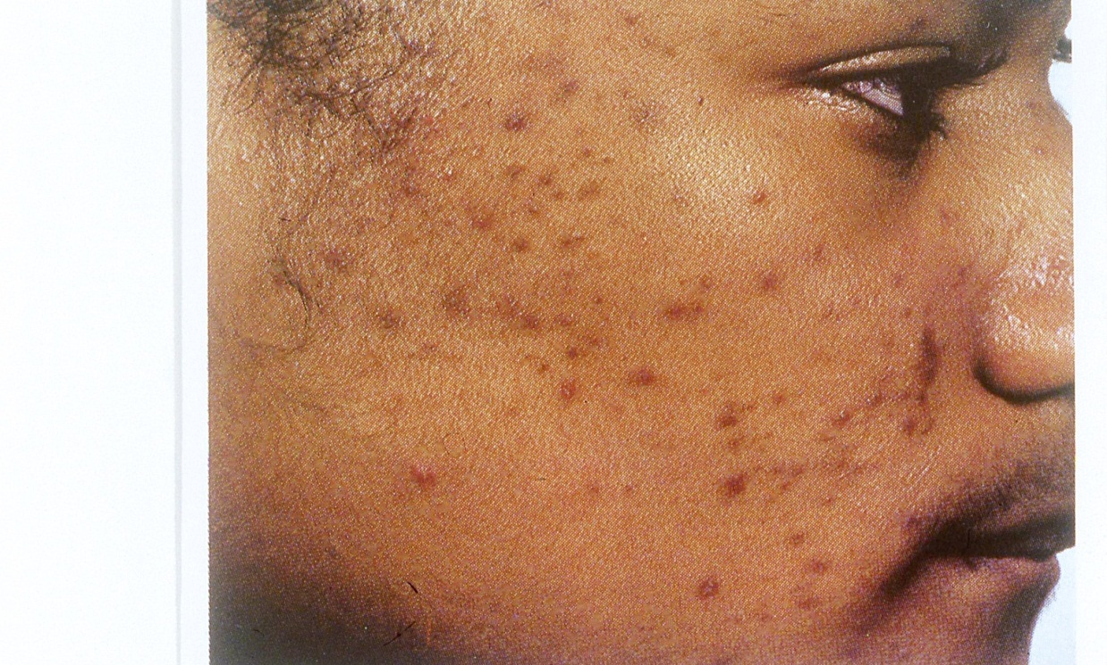
Marked post inflammatory hyperpigmentation

Slide 25
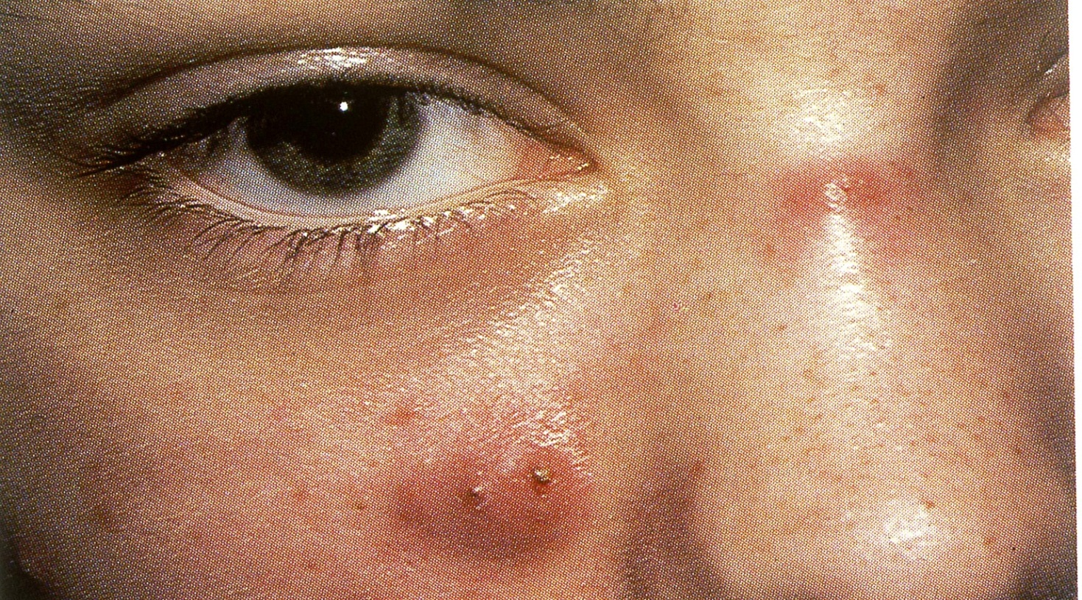
Nodules

Slide 26
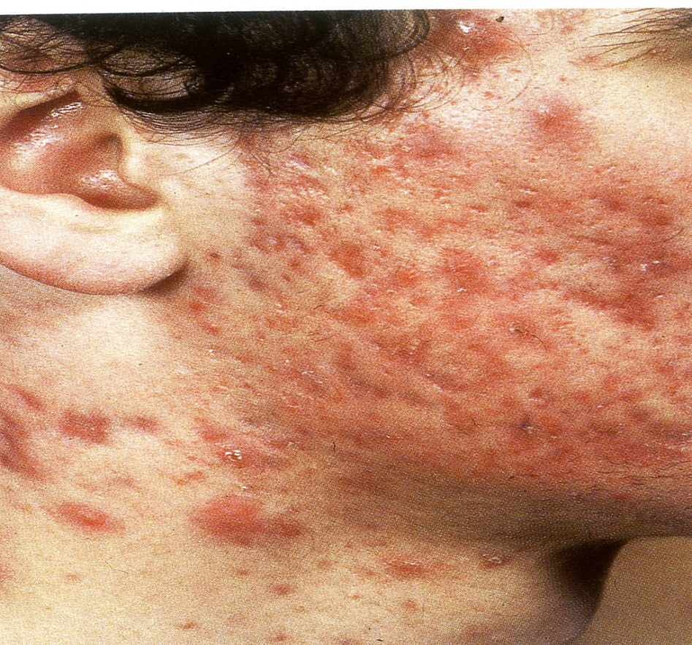
Acne conglobata with nodules and scars

Slide 27
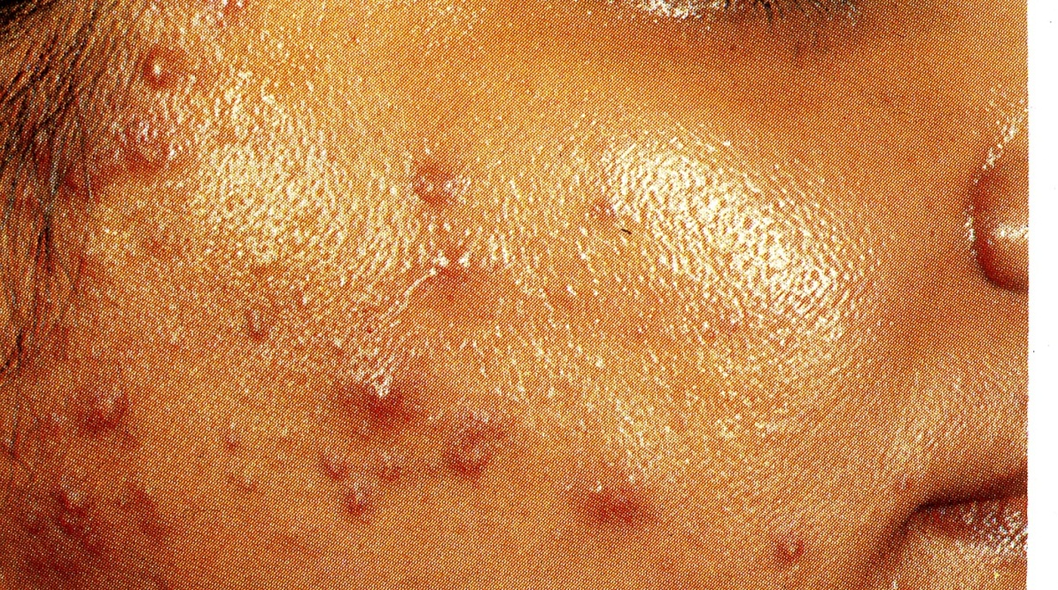
Seborrohea and papules , pustules

Slide 28
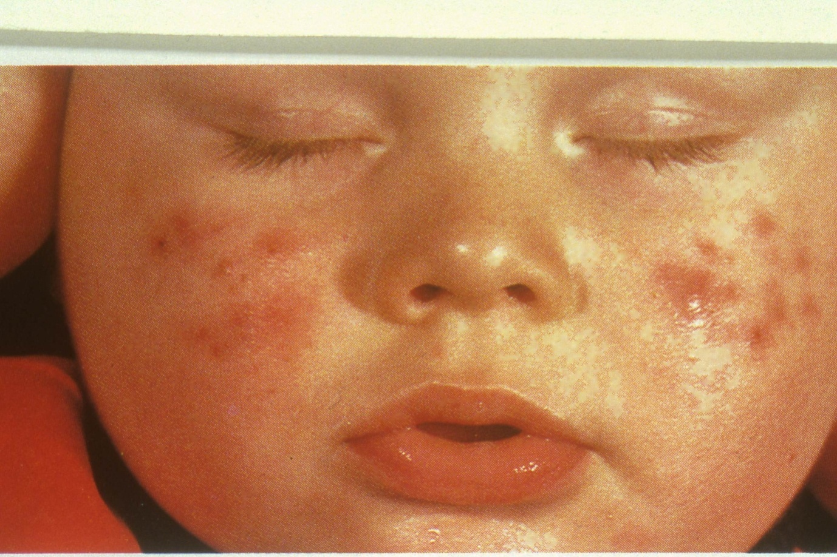
Neonatal acne

Slide 29
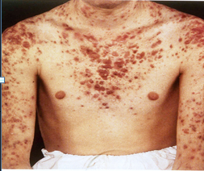
Nodules , Keloides

Slide 30
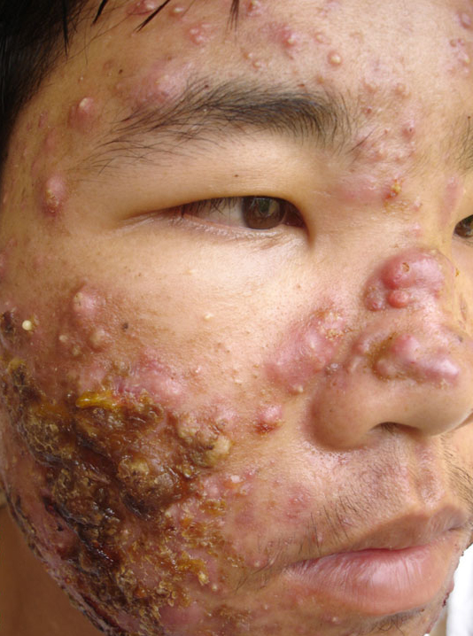
Acne fulminans
Nodules , pustules closed comedones,papules, pus .

Slide 31
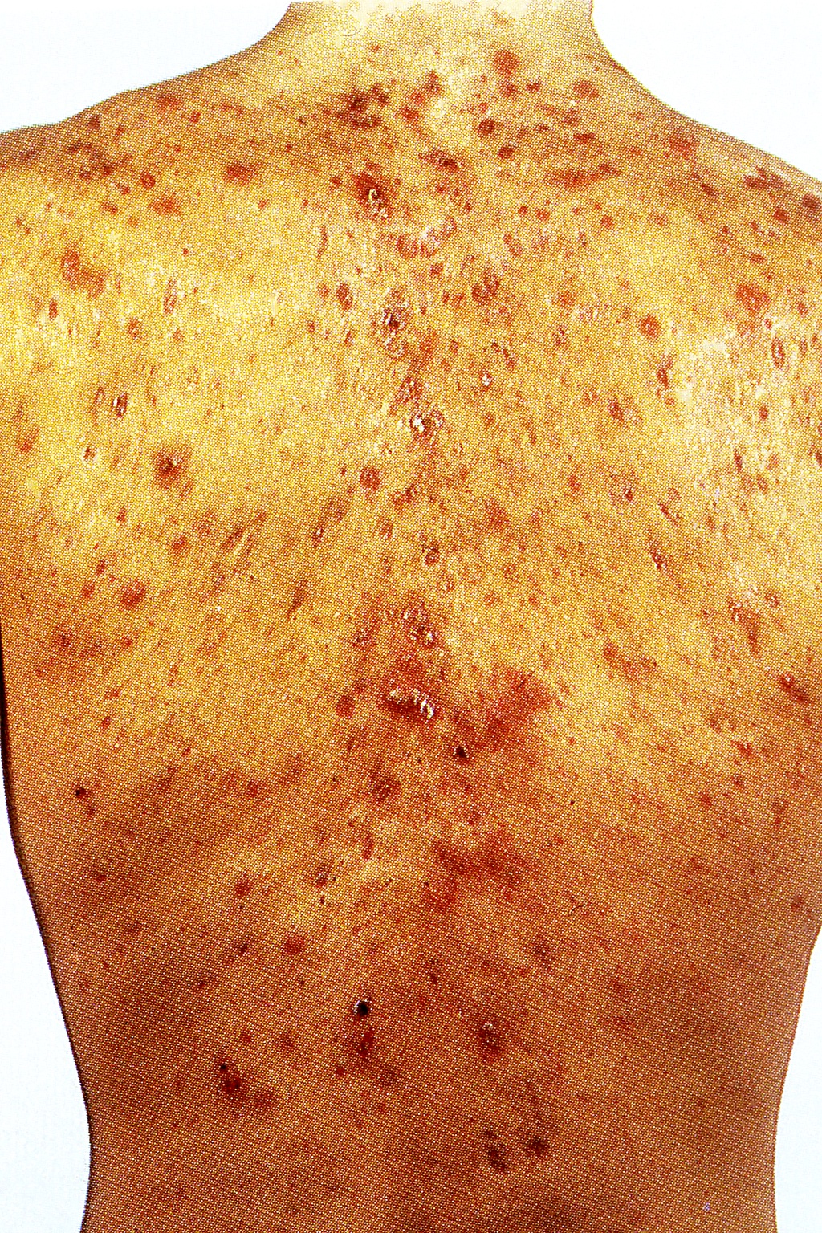
Acne conglobata
Scars, Nodules, Keloides, Sinuses

Slide 32
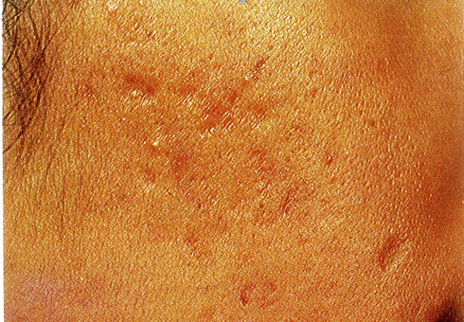
Acne rolling and boxcar scars

Slide 33
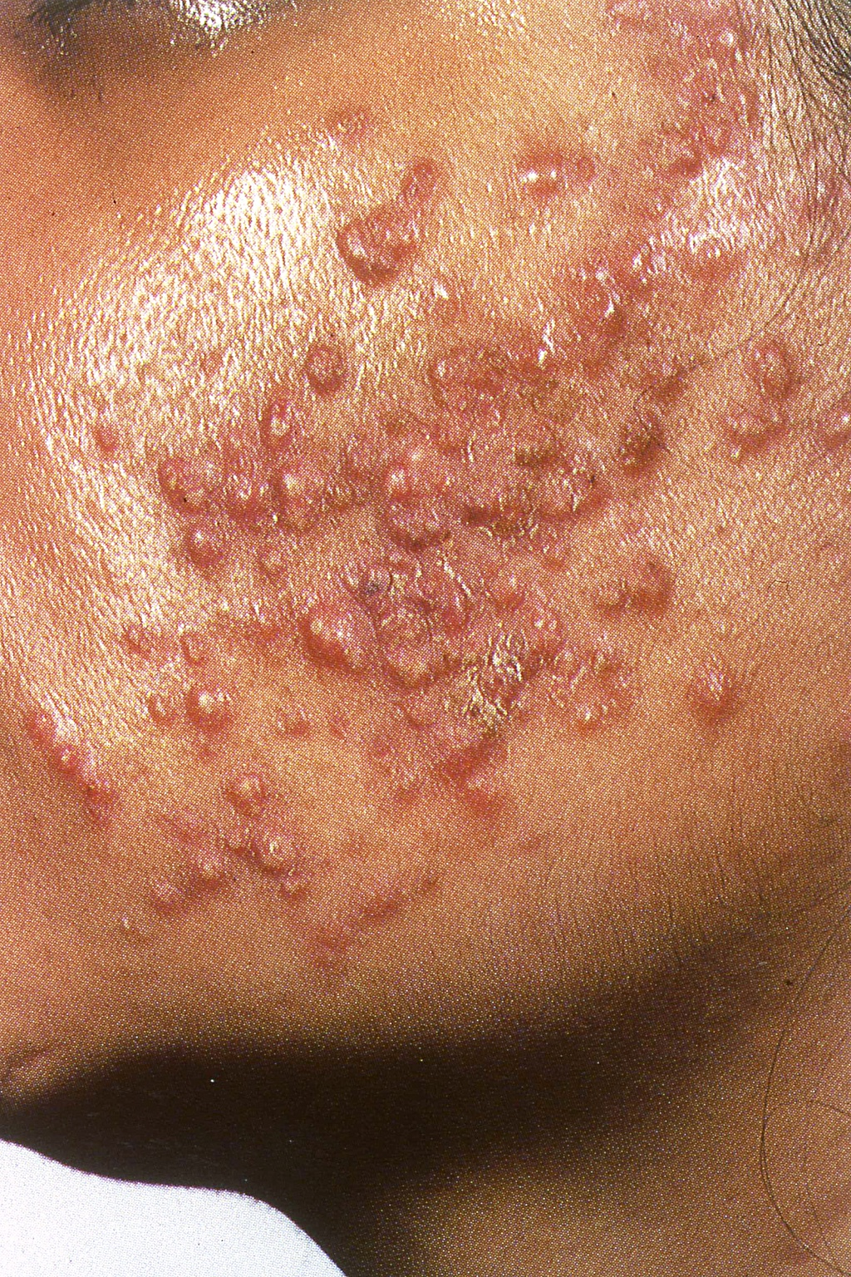
Monomorphic steroid acne

Slide 34
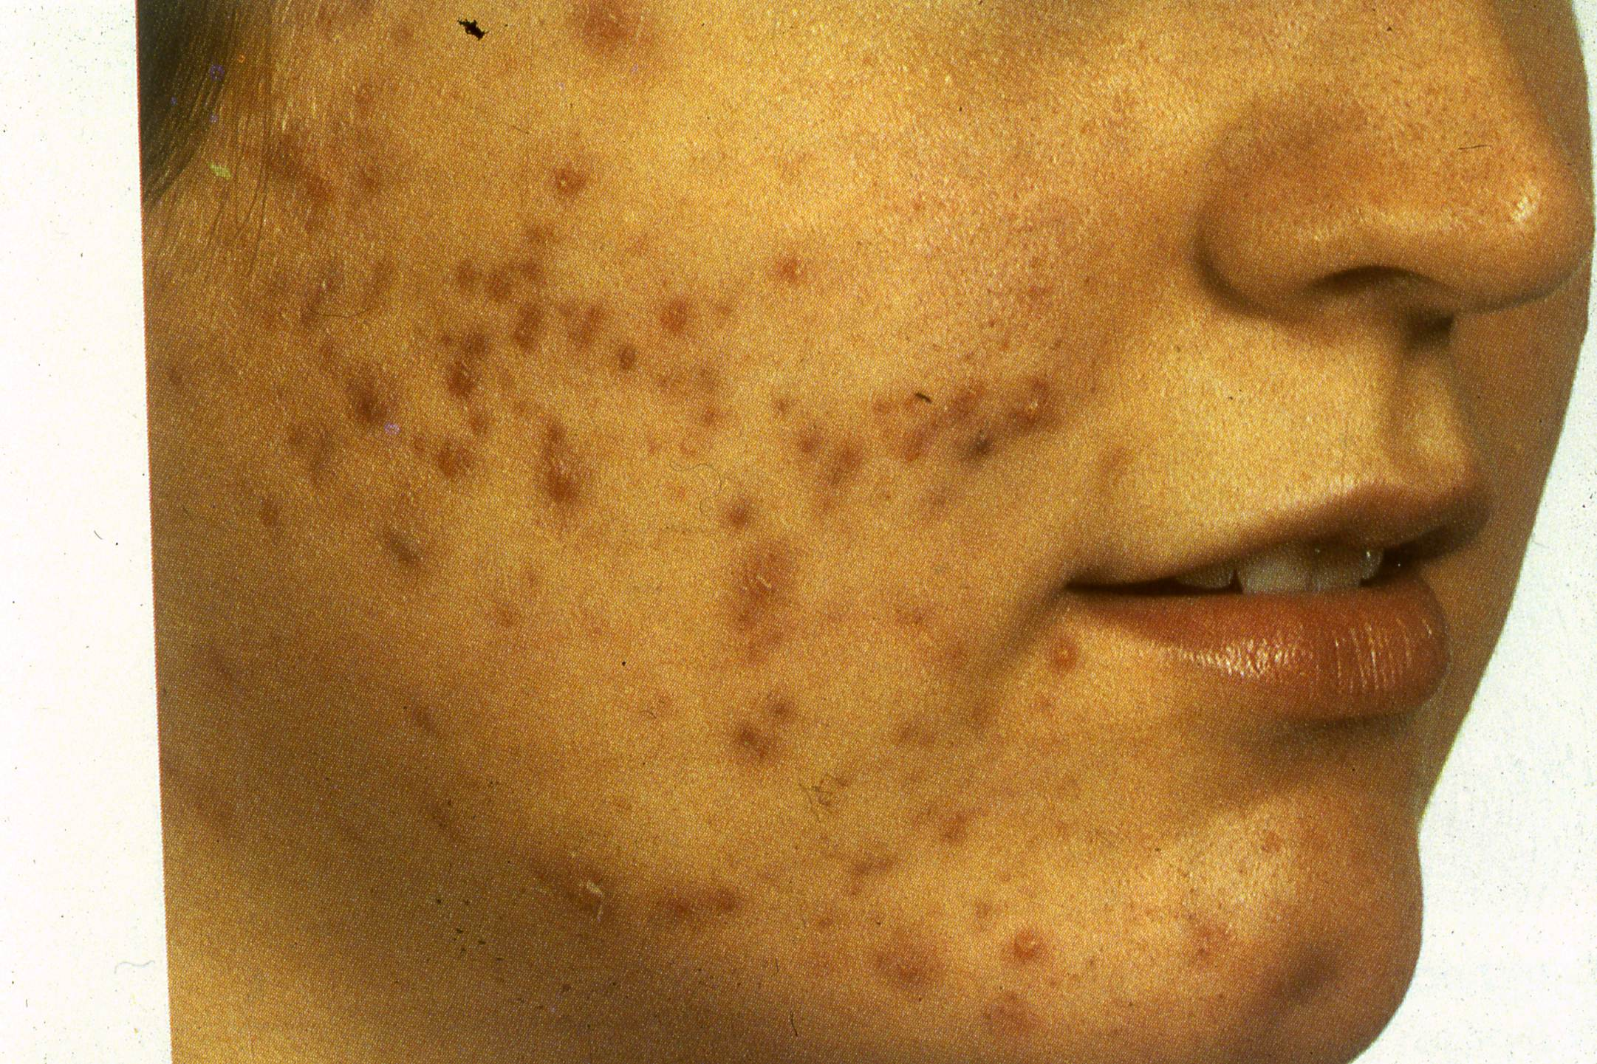
Postinfammatory hyperpigmentation, papules , pustules

Slide 35
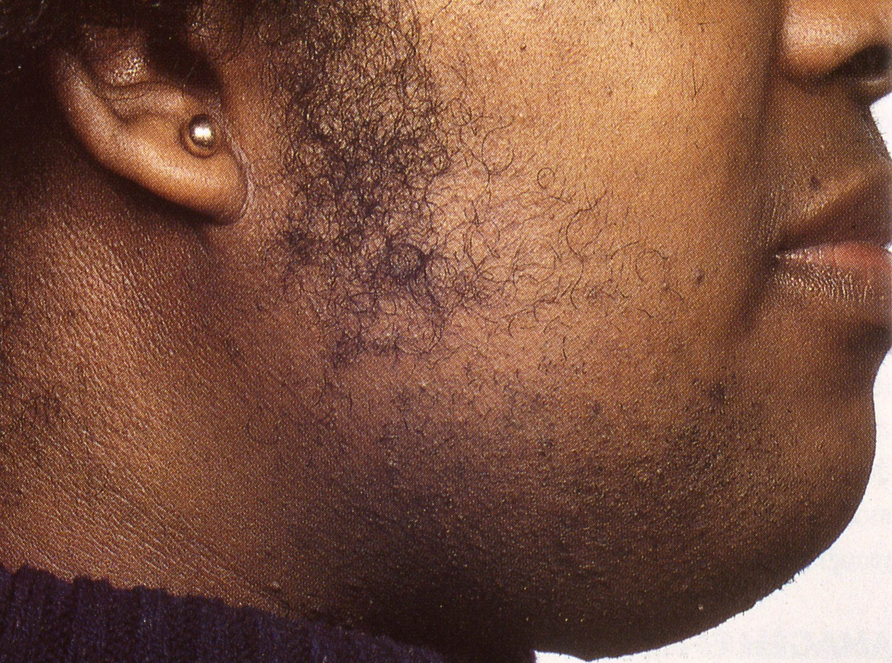
Hirsutism and closed comedones

Slide 36
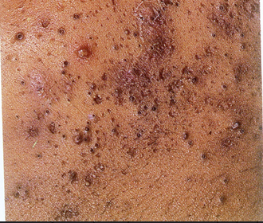
Open comedones, papules ,pustules

Slide 37
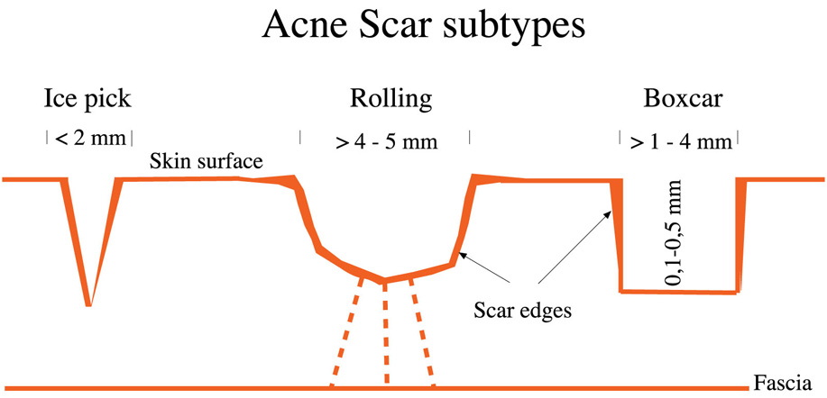

Slide 38
Acne Keloidales

Slide 39
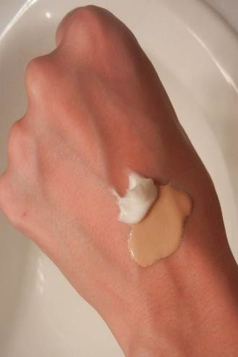
: Aggravating Factors
Diet has no relation to acne
Pre menstrual flare
Sweating
UV radiation
Stress
Friction
Cosmetics
Hair removal laser

Slide 40
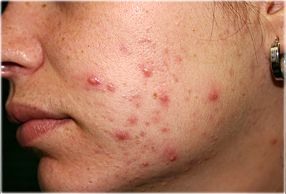
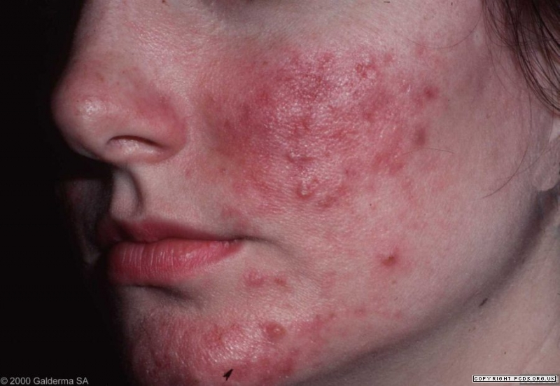
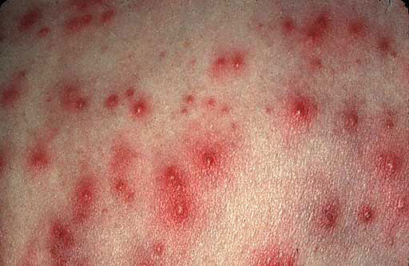
Differential Diagnosis
Rosacea
Folliculitis

Slide 41
ACNE TREATMENT - Goals
Decrease scarring
Decrease unsightly appearance
Decrease psychological stress
Explain length of treatment , may be several months and initial response may be slow but must persevere .

Slide 42
Principles in treating acne:
Reverse the altered keratinization.
Decrease the intra-follicular P.acnes.
Decrease sebaceous gland activity.
Decrease inflammation.

Slide 43
Treatment
Miscellaneous | Oral | Topical
Laser resurfacing | Antibiotics: | Benzoyl peroxide
Chemical peel | Doxycycline | Retinoic acid
Comedo extraction | Minocycline | Adaplene
Dermaberasion | Erythromycin | Resorcinol,Sulfer
Intralesional steroid | Retinoids: | Azeliac acid
CROSS | Isotretinoin | Antibiotics:
 | Hormones: | Clindamycin
 | Antiandrogens | Erythromycin
 | OCP

Slide 44
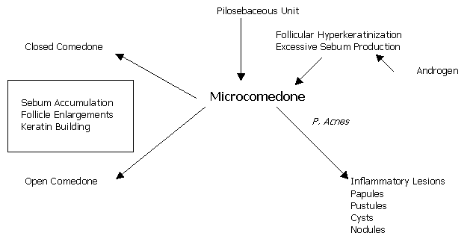
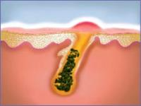
Topical Therapy
Benzoyl peroxide:
High antibacterial activity
Drying effect
Could cause irritation and contact dermatitis
Retinoic Acid:
Comedolytic activity
Advice patient not to expose to sun as it may lead to burn
Salicylic Acid:
Comedolytic, less potent than retinoic acid

Slide 45
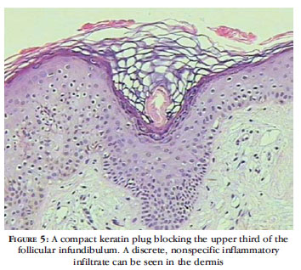
Topical Therapy:
Resorcinol and sulfur: are keratolytic
Azeliac acid: antibacterial and bleaching.
Topical treatment result is noticed within 2 months

Slide 46
Treatment
Drug | Dose | Recommendation and Duration
Tetracycline | 0.5 BD | Taken on empty stomach to promote absorption Not to be taken with milk or antacid Not to be given to pregnant women “Why”?
Erythromycin | 0.5 g BD | For pregnant women with bad acne
azithromycin | 250mg | 3 consecutive days/w for pregnant women
Doxycycline | 100 mg/day | Can be taken with food, photosensitivity.
Minocycline | 100 mg/day | Drug could cause blue – black pigmentation in scars, lupus, hepatitis, photosensitive drug rash
Clindamycin |  | Could cause pseudo membranous colitis
Trimethoprim Sulphamethoxazole |  | Used only in resistant cases .
Isotretinoin |  | Give long term remission Given in resistant acne

Slide 47
Acne treatment
Systemic Antibiotic:
have to be used for 6 months
Hormonal:
OCP consider less androgenic progestogen eg marvelon/cilest, but increased risk of DVT
Consider cyproterone acetate (antiandrogen) with oestrogen(dianette) . flutamide (antiandrogen)
Isotretinoin [Accutane]:
Vitamin A analogue

Slide 48
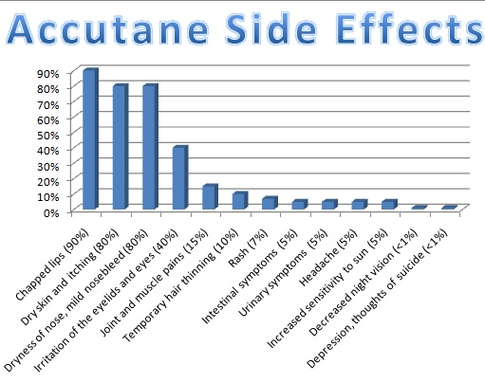
Treatment
Side Effects of Isotretinoin:
Dryness of mucous membranes [Chelitis, Conjunctivitis].
Headache and increased intracranial pressure [Pseudotumor cerebri]
Isotretinoin should not be given with tetracycline.

Slide 49
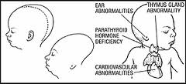
Treatment
Bone and joint pains.
Increases triglycerides and cholesterol or LFT
Patients should avoid pregnancy 4 w after discontinuation of drug because of teratogenicity.

Slide 50
Treatment
CROSS
Comedo extraction

Slide 51
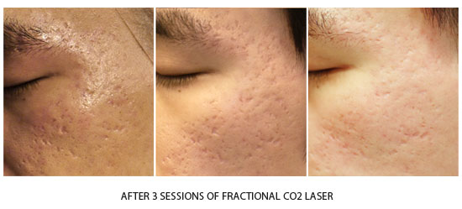
treatment

Slide 52
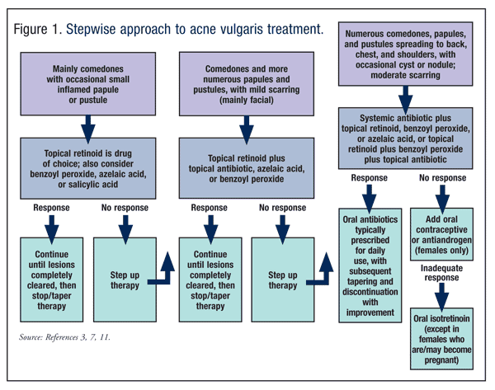

Slide 53
Take home massage
A avoid squeezing and manipulation
C comply with medication
N no cosmetics and moisturizers
E early treatment to avoid scaring

Slide 54
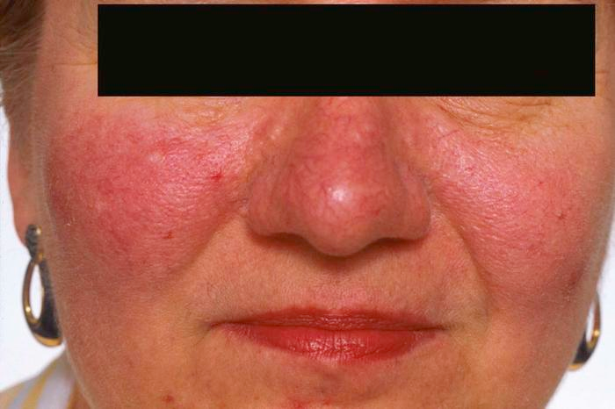
Rosacea
Definition:
Papules and Papulo- pustules in the center of the face against vivid erythematous background with telangi-ectasia.
Incidence:
Common in 3rd and 4th decade
Peaks between 40-50.

Slide 55
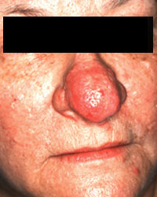
Rosacea
Common in fair skin.
Women are affected more than men but rhinophyma is more in men.

Slide 56
Rosacea Pathogenesis:
Unknown
Genetic predisposition (38% have a relative).
Sunlight and heat.
Constitutional predispostion to flushing & blushing.
Demodex folliculorum mite.
H. Pylori infection

Slide 57
Clinical Findings
The hall mark is:
Episodes of flushing and erythema in butterfly distribution.
Papules and pustules.
Erythema and telangiectasia.
Absent comedons.
Granulomas [firm papules].

Slide 58
Clinical Findings
Localization:
The nose, cheeks ,chin, forehead, glabella.
May involve ears, chest.

Slide 59
Clinical findings
Types of Rosacea:
Erythematotelangictatic
Papulopustular.
Ocular.
Phymatous.

Slide 60
Complications
Rhinophyma:
Swelling of the nose due to sebaceous gland hyperplasia

Slide 61
Complications
Eye complications:
Occurs in 50% of cases including
Blepharitis
Conjunctivitis
Keratitis
Iritis
Eyelid telangi-ectasia.

Slide 62
Associated diseases
MARSH syndrome =
Melasma
Acne
Rosacea
Seborrheic dermatitis
Hirsutism

Slide 63
Differential Diagnosis
SLE (erythema only)
Acne (comedons)
Seborrheic dermatitis ((no pustules
Perioral dermatitis
SLE
SEB DERM
Perioral Derm

Slide 64
Malar erythema

Slide 65
Malar erythema and scales

Slide 66
Telangictasia, papules , blepharitis , conjunctivites

Slide 67
Papules on erythematous background

Slide 68
Rhinophyma

Slide 69
Rhinophyma

Slide 70
Papules on erythematous background , telangictasia

Slide 71
Treatment
Schedules are determined by stage & severity.
General measures:
The skin of rosacea patients is delicate to physical insults.
Patient should use mild soaps or diluted detergents.
Protection against sunlight by sunscreen
Avoid hot drinks and heat.

Slide 72
Treatment
Topical | Systemic
1.Topical antibiotics Clindamycin Erythromycin | Tetracycline reduces erythema
2. Metronidazole –affects papules or pustules but no effect on erythema | Oxy-tetracycline
3. Imidazoles e.g. Ketoconazole cream – has anti-inflammatory action | Minocycline
4. 2-5% sulfur lotion,sulfacetamide | Doxycycline
5. Isotretinoin 0.1% in cream | Isotretinoin in resistant phymas cases (0.1 -0.2 mg/kg)
Antiparasitic : Lindane, permethrin Benzyl benzoate, Crotamiton | Metronidazole 500 mg for 20-60 days
Sunscreen, Vascular laser | Azithromycin

Slide 73
Treatment
Topical:
Metronidazole gel 0.75%
Erythromycin 2% gel bid
Systemic:
Minocycline 100 mg bid till clear then taper
Doxycycline 100 mg bid then taper
Tetracycline 500 mg bid till clear and tapered
Anti H. pylori therapy.

Slide 74
Take home massage
R recognize triggers.
O ocular hygiene.
S sunblock.
A avoid hot food.
C comply with instructions.
E early treatment.
A avoid scrubs and harsh cleansers.

Slide 75
Perioral dermatitis
Occurs mainly in young women.
Discrete & confluent papulo- pustules over the perioral or periorbital skin sparing the vermilion border of lips.
No comedons.

Slide 76
Perioral dermatitis
Predominant in females at 20- 30 years of age.
Aggravated by topical steroids and moisturizers.
Occasionally itchy or burning or feeling of tightness.

Slide 77
Female with papules over chin

Slide 78
Papules , pustules, no comedones

Slide 79
Differential Diagnosis
Acne.
Rosacea.
Seborrheic Dermatitis.
Atopic Dermatitis.
Allergic Contact Dermatitis.
Atopic dermatitis
Allergic contact dermatitis

Slide 80
Treatment
Wean patients of topical steroid.
Stop any moisturizers.
In pregnant mild cases use topical antimicrobial therapy with metronidazole gel and erythromycin solution.
Pimecrolimus cream in steroid induced perioral dermatitis.
Topical anti acne medication like adaplene and azelaic acid.
In severe cases oral doxycycline or minocycline .
Isotretinoin for resistant cases.

Slide 81
Hidradenitis Supprativa
Chronic supprative scarring disease of apocrine gland bearing skin (axillae, anogenital region ,under female breast).
Associated with obesity
Develops in 2nd and 3rd decades.

Slide 82
Pathogenesis:
Unknown
Apocrine duct occlusion.
Dilatation and rupture of apocrine gland.
Secondary bacterial infection and draining sinuses.
Genetic predisposition[38% have a relative affected].

Slide 83
Clinical Presentation
Intermittent pain and tenderness.
Pus drainage.
Double headed comedons [characteristic lesion].
Nodules, abscess, sinus tracts, scarring
Submammary, axillary , inguinal regions are common in females.
Perineal involvement occurs more in males.

Slide 86
Associated findings:
The follicular occlusion tetrad including:
Extensive acne vulgaris (conglobata variety)
Perifolliculitis of the scalp
Pilonidal sinus
Acne conglobata
Perifolliculitis
Hidradenitis supprativa

Slide 87
Associated findings
Crohn’s disease in 39% of patients
Irritable bowel syndrome
Sjogren syndrome

Slide 88
Sinuses, nodules, connecting tracts

Slide 89
Double headed comedones

Slide 90
tracts , sinuses

Slide 91
Management
Medical :
Intralesional triamcinolone acetonide for acute lesions
Antibiotics (minocycline erythromycin)
Retinoids (Acitretin better than isotretinoin
Antiandrogens.
Biological therapy

Slide 92
Management
Surgical:
Incision and drainage of abscess better avoided
Excision of sinus tracts and chronic nodules
Complete excision of the area and grafting.
CO2 laser.
graft

Slide 93
Have a good day

