Slide 1
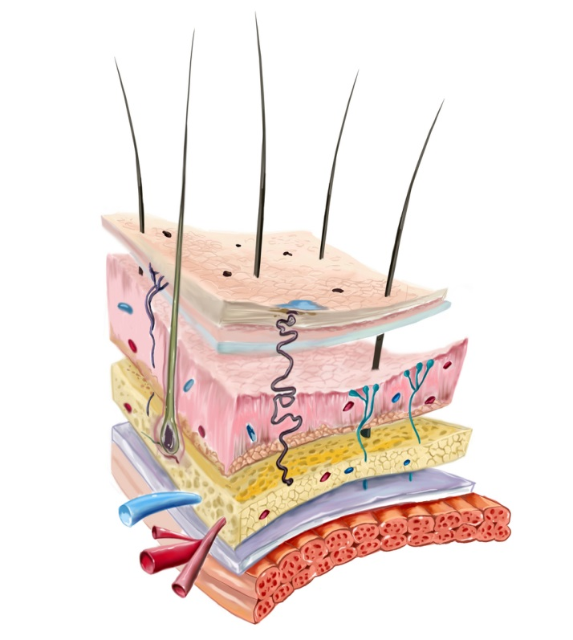
INTRODUCTION TO DERMATOLOGY
Dr. AMAL AL-BALBEESI

Slide 2
Objectives of the course:
To know the normal skin structure.
To be able to take proper history.
To be able to describe lesions by using proper dermatological terminology.
To be able to formulate a differential diagnosis.
To be able to diagnose and treat common skin disorders.
To be familiar with dermatologic emergencies

Slide 3
Lecture outlines
Function , Structure of the skin.
Approach to dermatology patient.
Descriptive terms and morphology of skin lesions.
Reaction patterns.
Topical therapy and others.

Slide 4
Introduction to dermatology
The skin is a complex, dynamic organ.
It is the largest organ of the body.

Slide 5
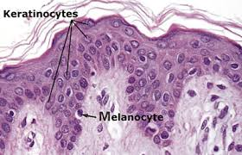
Introduction to dermatology
It consist of many cell types called Keratinocytes
Specialized structures like the Basement Membrane.
It serves multiple functions that are crucial to health and survival.
Notes:
D

Slide 6
Function:
Barrier to harmful exogenous substance & pathogens
Prevents loss of water & proteins
Sensory organ protects against physical injury
Regulates body temperature
Important component of immune system
Vitamin D production by absorbing UVB
Has psychological and cosmetic importance such as hair, nails

Slide 7
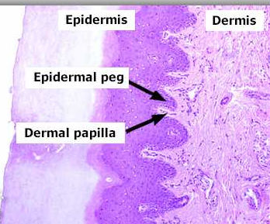
Skin Structure
The skin consists of:
Epidermis
Basement membrane
Dermis
Subcutaneous tissue
Skin appendages

Slide 8
Skin Structure
Epidermis: Consist of several zones
Basal layer (stratum basale): columnar dividing cells.
Spinous layer (stratum spinosum): polyhedral cells
attached by desmosomes.
Granular layer (stratum granulosum): flat cells
containing keratohyaline granules.
Cornified layer (stratum corneum ):dead cell with no organells.
7

Slide 9
Skin Structure
Basal cell layer:
Rest on the basement
membrane ; divides
continuously and move
upwards.
Melanocytes are dendritic cells lying between basal cells in a ratio of 1:10 .
They synthesize melanin stored in melanosomes.

Slide 10
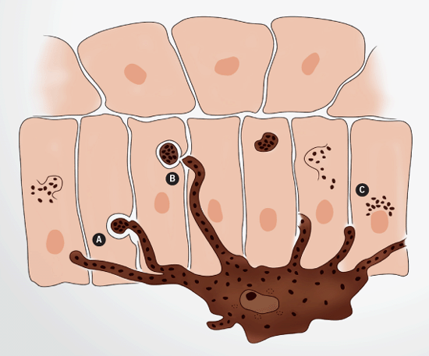
Skin Structure
Melanosomes are transferred to adjacent cells by means of
dendrites thus forming the
Epidermal Melanin Unit
The size of melanosomes and
packaging differentiate white
from dark skin.
The number of melanocytes are equal in white and dark skin.
1:36

Slide 11
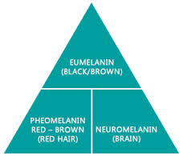
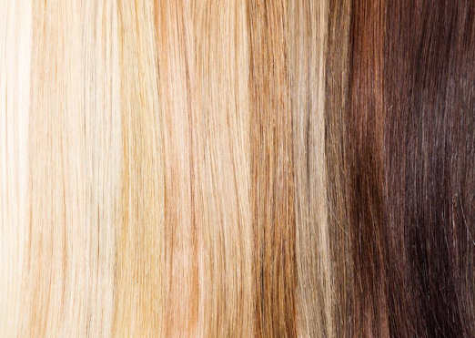
Skin structure
There are 2 types of melanin in the skin and hair.
Eumelanin gives black or blond hair color.
Pheomelanin gives red hair color.
Skin color depends on melanin and other pigments like carotene and hemoglobin.
Melanin is photoabsorbant.

Slide 12
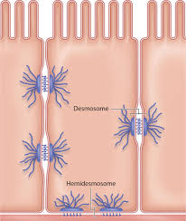
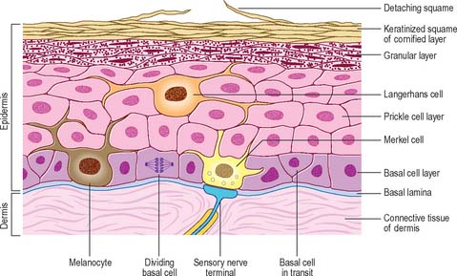
Skin Structure
Spinous cell layer:
Adhere to each other by Desmosomes (complex
modification of the cell
membrane ).
Desmosomes appear like spines hence the designation Stratum Spinosum.
Langerhan cells are antigen presenting present in abundance

Slide 13
Skin Structure
Granular cell layer :
Diamond shaped cells.
Cytoplasm is filled with
Keratohyaline granules.
Thickness of this layer is proportional to the
thickness of the stratum
cornium layer .
In thin skin it is 1 -3- cell
layers and 10 cell layers in
thick skin like palms and soles.

Slide 14
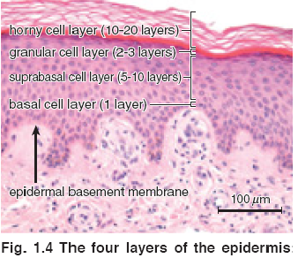
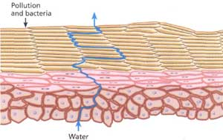
Skin Structure
Stratum corneum layer:
The cells in this layer
have no nucleus . It is 25
cell layer .
Cells have thick envelope that resist chemicals, bacteria.

Slide 15
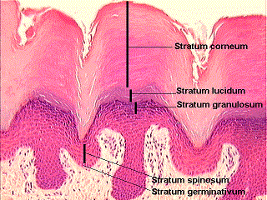
Skin Structure
Stratum lucidum is found
in thick skin below
Stratum cornium.

Slide 16
Basement membrane
It is a pink undulated homogenous area between the epidermis and dermis.
It consist of number of proteins.
It is the site of attack injury in blistering diseases.

Slide 17
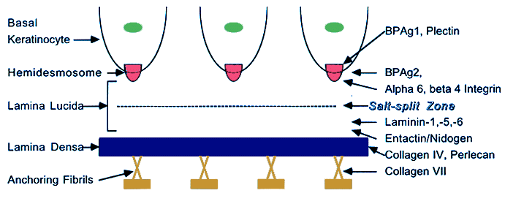
Skin Structure
Basement membrane
Formed by:
Plasma membrane of basal cells and hemidesmosomes
Thin clear amorphous
space (lamina lucida)
An electron dense area
(lamina densa ).
Anchoring fibrils that anchors the epidermis to dermis .

Slide 18
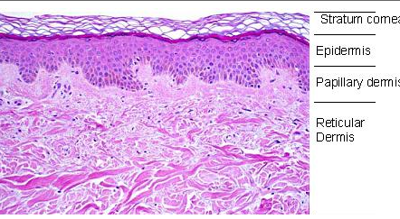
Skin structure
Dermis is divided into
Papillary dermis
Reticular dermis
Consists of :
1. Collagen fibers
Provides strength
Thin fibers in papillary dermis but thick and coarse in the reticular dermis .

Slide 19
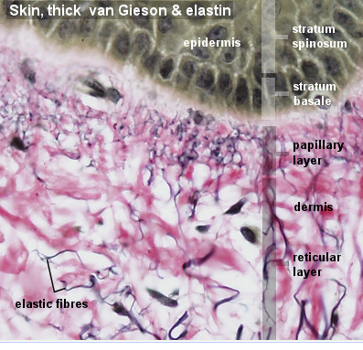
Skin Structure
2. Elastic Fibers.
Provides elasticity
Protection against
shearing forces.

Slide 20
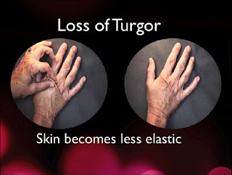
Skin structure
3. Ground substance Binds water and maintains the skin turgor.
4. Blood vessels.
To nourish the overlying
epidermis also.
5. Fibroblasts
Produce the above
elements..

Slide 21
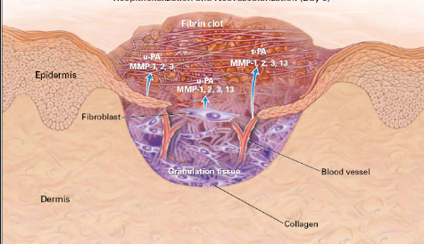
Skin Structure
Function of dermis:
It provides nourishment to the epidermis and interact with it during wound repair.
It gives the skin its strength, elasticity, and softness.

Slide 22
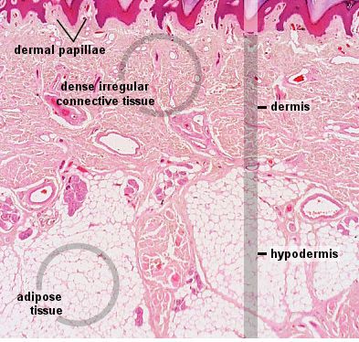
Skin structure
Subcutaneous Fat:
Composed of lipocytes
Inflammation of the subcutaneous fat is called panniculitus

Slide 23
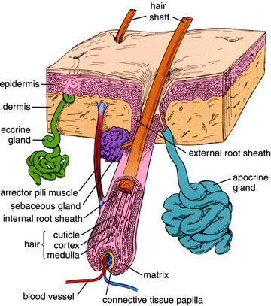
Skin Structure
Skin Appendages include:
Eccrine/ apocrine sweat glands.
Sebaceous glands.
Hair Follicles.
Nails

Slide 24
Skin appendages
Eccrine sweat glands
Tubular structures open
freely on the skin; not attached to hair follicles.
Under the influence of
cholinergic stimuli.

Slide 25
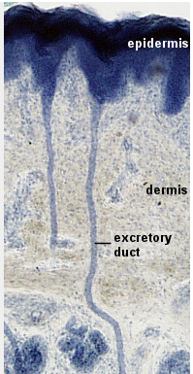
Skin appendages
Eccrine sweat glands.
Present everywhere except
The vermilion border ; nail beds ; labia minora ; glans
Abundant in palms ; soles.

Slide 26
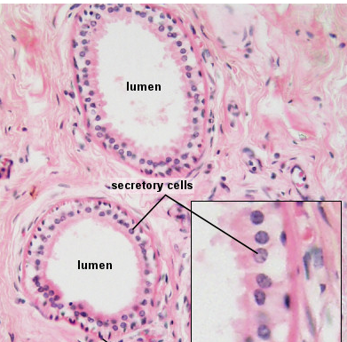
Skin appendages
Apocrine sweat glands:
Secrete viscous material that give musky odor when acted upon by bacteria

Slide 27
Skin appendages
Apocrine sweat glands:
Present in the axillae ;
anogenital area ; modified
glands in the external ear
canal ; the eye lids ( moll’s
glands ) ; and areolae.
Under adrenergic stimuli.

Slide 28
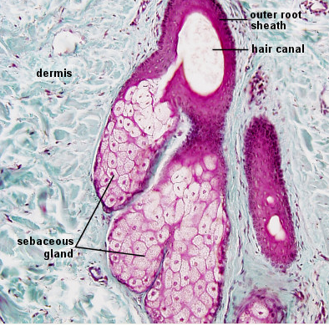
Skin appendages
Sebaceous glands:
Attached to hair follicles or
open freely.
Present in the scalp,
forehead,face, upper chest
except palms and soles.

Slide 29
Skin appendages
Sebaceous glands:
In the areola as Montgomery tubercles .
In the eye lids as Meibomian
glands.
Ectopic glands in the mucous
membrane are called fordyce spots.
Sebaceous glands are under the control of androgens.

Slide 30
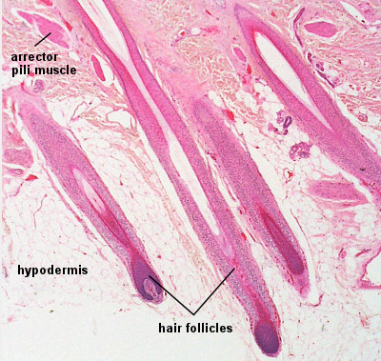
Skin Appendages
Hair follicles:
The hair follicle with it’s attached sebaceous gland
Form the Pilosebaceous
Unit.

Slide 31
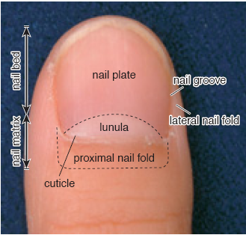
Skin appendages
Nails.
The nail plate is formed of hard keratin.
Proximal nail fold
morphology can be altered in connective tissue disease .

Slide 32
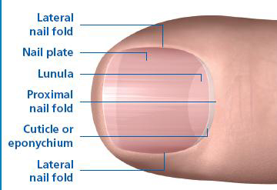
Skin appendages
The lunula is the visible
part of the matrix.
The matrix covers the
midportion of the distal Phalanx.
Fingernails grow 3mm/month.
Toenails grow 1mm/month.
matrix

Slide 33
Skin appendages
Nails can be affected in systemic and skin diseases.

Slide 34
Cornification (keratinization)
The terminal differentiation of
keratinocytes into dead horny cell (corneocyte).
The total process takes approximately 2 months.

Slide 35
Cornification (keratinization)
It involves the formation of
keratin polypeptides.
Abnormalities in this process secondary to abnormal immune response such as in psoriasis leads to roughness and scaling of the skin.

Slide 36
Lecture Outlines
Function, Structure of the skin
Approach to dermatology patient.
Descriptive terms and morphology of skin lesions
Reaction patterns
Topical therapy and others

Slide 37
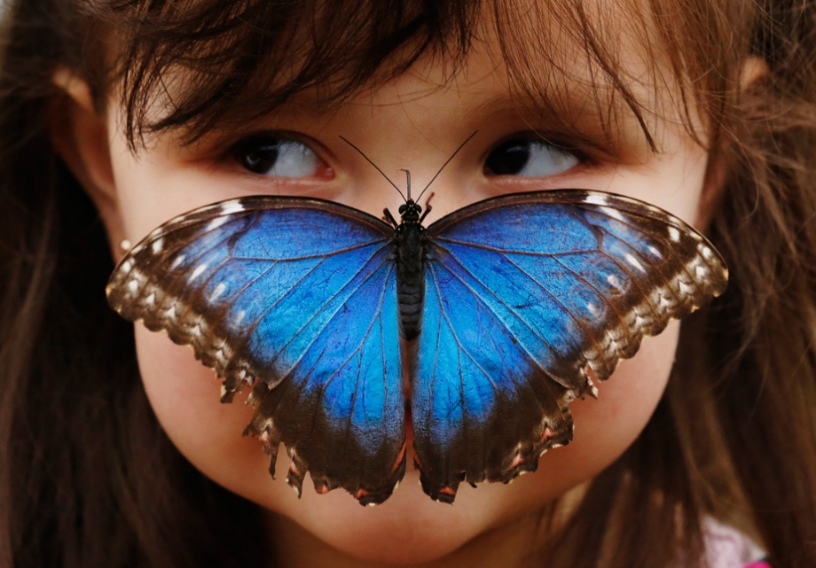
Approach to Dermatology Patient
Step 1: Start with basics
Age
Race
Sex
Occupation

Slide 38
Approach to Dermatology Patient
Step 2 :
Present complaints.

Slide 39
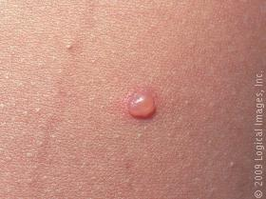
Approach to Dermatology Patient
History of skin lesion
Onset - when?
Where? site of onset.
Extension of lesions.
Evolution.
Itchy/ painful
Provocative factors (sun ,
cold, friction).
Treatment.
Evolution

Slide 40
Approach to dermatology patient
Past medical history.
Family history.
Drug history.
Recreational and social history.

Slide 41
Examination
Use good light when examining a patient.
Examine nails & mucous membrane.

Slide 42
Examination:
Describe the general
appearance of patient.
Describe distribution of lesions
Describe arrangement of
Lesions (configuration)
Describe the type of the lesion
Describe the shape.
Describe the color, size.

Slide 43
Examination:
Palpation
Look for consistency, mobility, depth and tenderness.

Slide 44
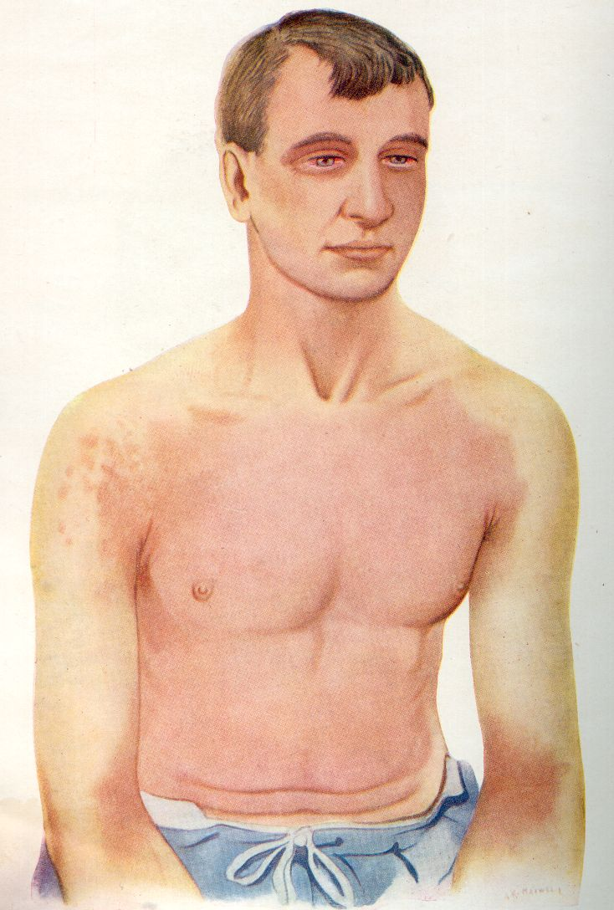
Distribution
Generalized: can be
I. Symmetrical
A. Universal (head to toe)
B. Bilateral

Slide 45
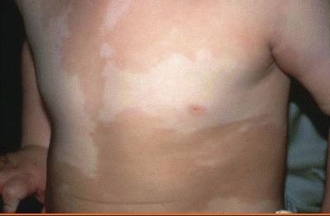
Distribution
II. Asymmetrical
A.Diffuse
B.Unilateral

Slide 46
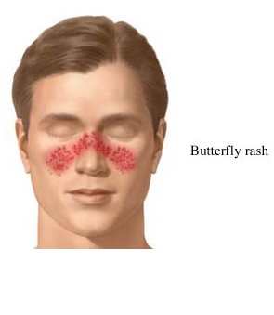
Distribution
Localized to:
Acral
Sun exposed.
Trauma sites.
Flexures.
Specific part.

Slide 47
Lecture outlines
Function , Structure of the skin.
Approach to dermatology patient.
Descriptive Terms and morphology of skin lesions.
Reaction patterns.
Topical therapy.

Slide 48
Descriptive Terms (Arrangement)

Slide 49
Descriptive Terms
Photodistribution:
Lesions occurring over sun exposed skin. Protected areas remain free of lesions.

Slide 50
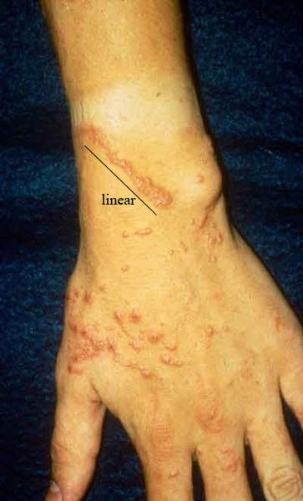
Descriptive Terms
Linear:
Forms a line .

Slide 51
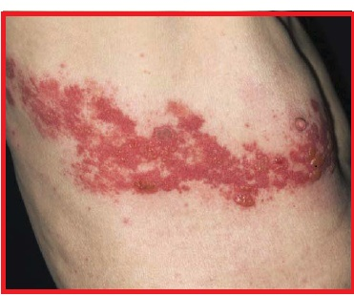
Descriptive Terms
Dermatomal
Occurring within the distribution of nerve

Slide 52
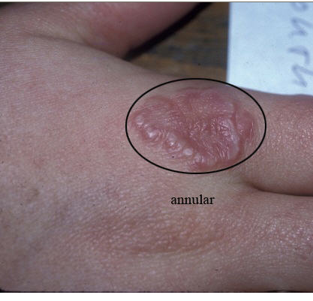
Descriptive Terms
Annular
Ring like .

Slide 53
Descriptive Terms
Herpitiform/Grouped
Lesions grouped in a manner similar to herpes simplex lesions

Slide 54
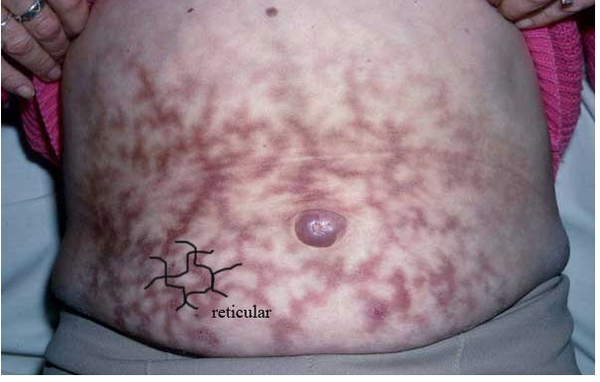
Descriptive Terms
Reticular
Net like .

Slide 55
Descriptive Terms
Verrucous, warty, papillomatous:
Surface consisting of finger like projections.

Slide 56
Descriptive Terms
Nummular/discoid:
Refers to round, coin like lesions.

Slide 57
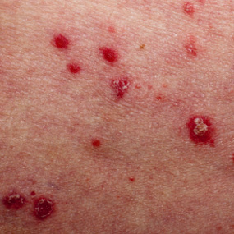
Descriptive Terms
Guttate:
Drop like, “en gouttes”.

Slide 58
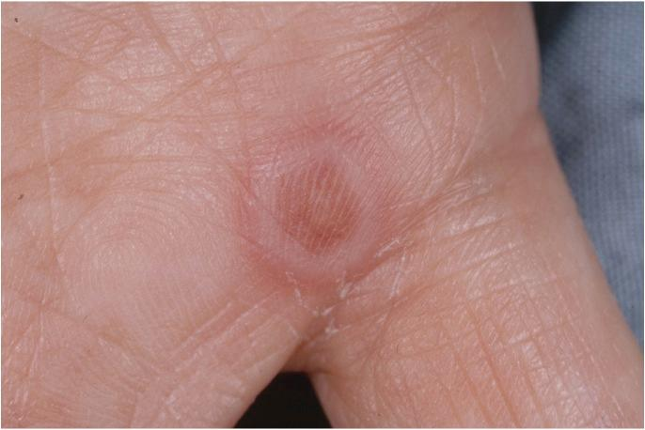
Descriptive Terms
Targetoid:
Round lesions with concentric border and a dark center.
Iris like.

Slide 59
Descriptive Terms
Umbilication:
Round depression in the center.

Slide 60
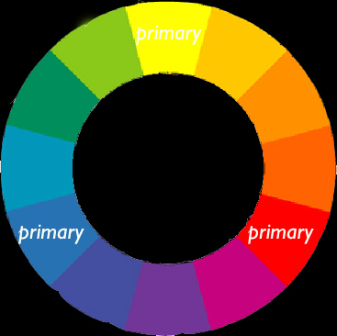
Morphology
Skin lesions are divided :into
Primary =Basic lesion.
Secondary= Develop
during evolution of skin disease or created by scratching or infection

Slide 61
Morphology
There are two steps in establishing the morphology of any given skin condition:
Careful visual and tactile inspection
Application of correct descriptors
Morphology includes:
The type of the lesion.
The shape of lesion (oval. round, bizarre, geographic)
The margination of the Lesion (well defined, ill defined)
Color of the lesion.
Configuration ( relation of lesions to each other.)
Distribution.

Slide 62
Morphology
Primary lesion:
Macule/patch
Papule/plaque
Nodule /Cyst
Wheal
Secondary lesions:
Excoriation
Erosion
Scale
Fissure
Ulcer

Slide 63
Morphology
Primary lesions:
Vesicle/bulla
Pustule
Purpura
Burrow
Secondary lesions:
Excoriation
Erosion
Scale
Fissure
Ulcer

Slide 64
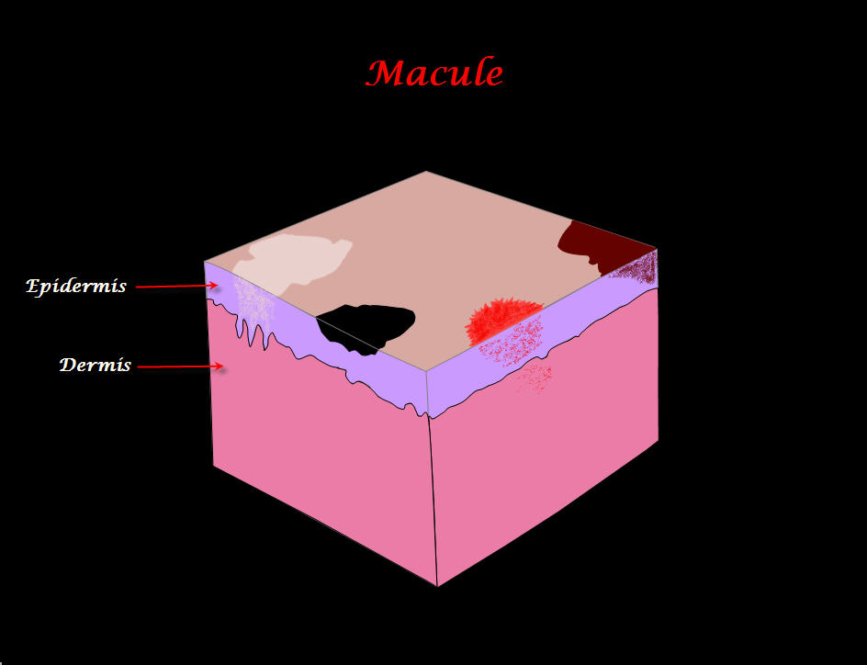
Primary Skin Lesions
Macule :
Flat circumscribed
discoloration that lacks surface elevation or depression.

Slide 65
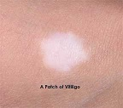
Primary lesions
Patch:
Flat circumscribed skin
discoloration; a large
macule more than 1cm.

Slide 66
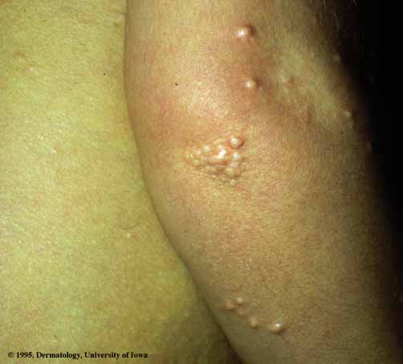
Primary Skin Lesions
Papule :
Elevated, Solid lesion
< 0.5cm in diameter.
Notice color and surface
changes eg.Umblicated,
Keratotic,Papillomatous,
Flat topped.

Slide 67
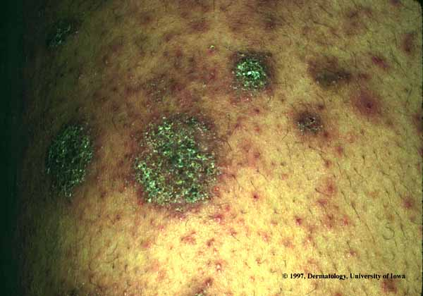
Primary Skin Lesion
Plaque:
Elevated, solid confluence
or expansion of papules,
> 0.5 (lacks a deep component ).

Slide 68
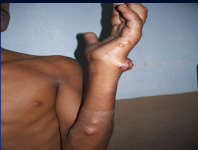
Primary Skin Lesions
Nodule :
Elevated, Solid lesion.
> 0.5 cm in diameter;
with deep component.

Slide 69
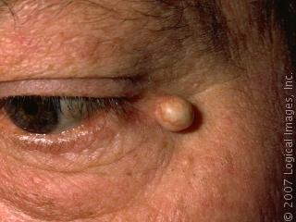
Primary Skin Lesions
Cyst:
Nodule that contains fluid or semisolid material.

Slide 70
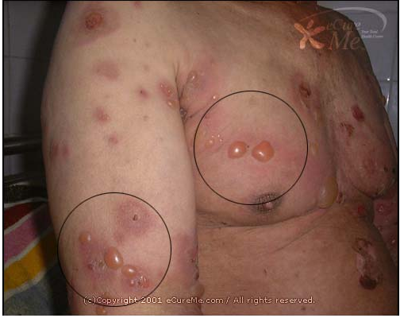
Primary Skin Lesions
Vesicle:
Elevation that contains clear fluid.
Bulla:
Localized fluid collection. >0.5cm in diameter a large vesicle.

Slide 71
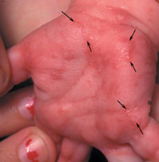
Primary Skin Lesions
Burrow:
Linear tunnel in the
epidermis induced by scabies mite.

Slide 72
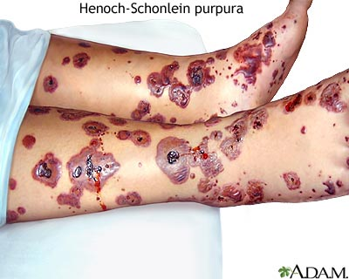
Primary Skin Lesions
Purpura:
Extra-vasation of red
blood cells giving non-blanchable erythema.

Slide 73
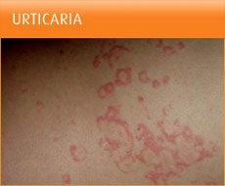
Primary Skin Lesion
Wheal:
Firm, edematous plaque that is evanescent (short lived)and pruritic; a hive.

Slide 74
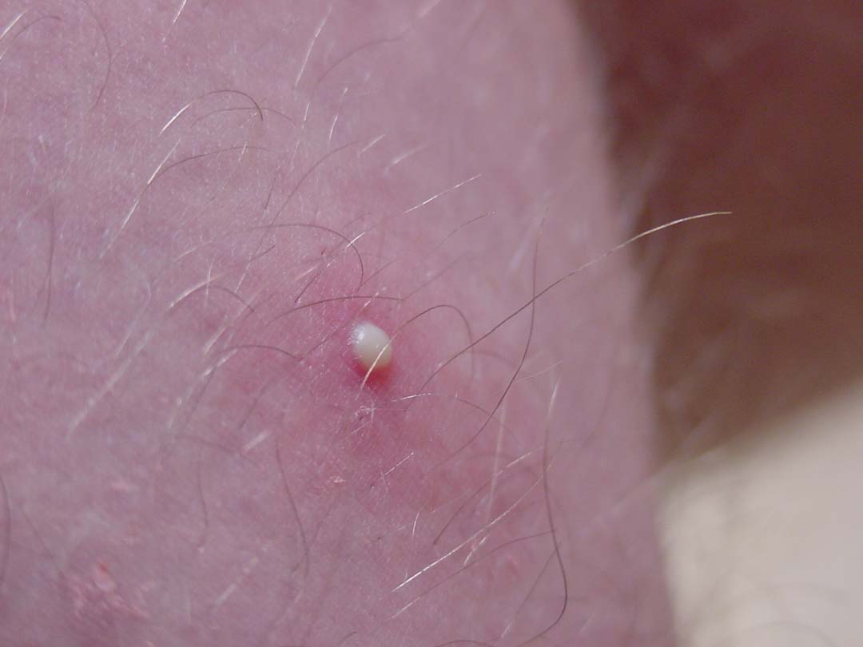
Primary Skin Lesions
Pustule:
Elevation that contains
purulent material.

Slide 75
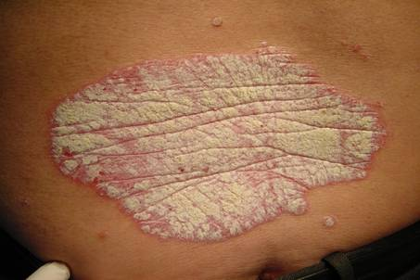
Secondary Skin Lesions
Scale:
Thick stratum cornium

Slide 76
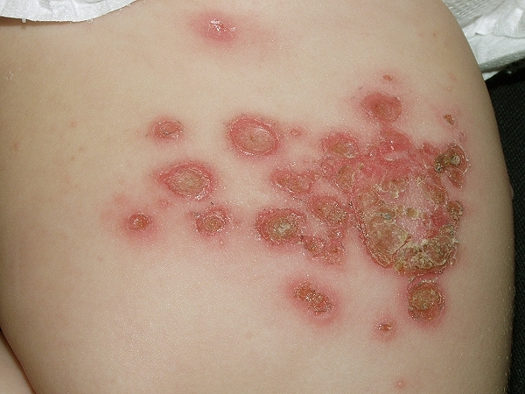
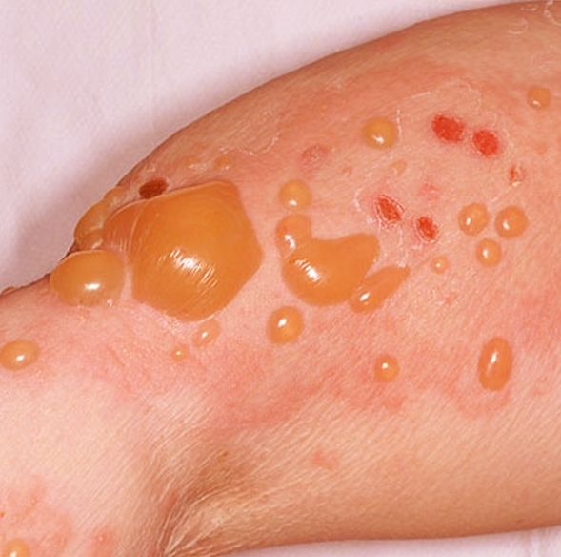
Secondary Skin Lesion
Crust:
A collection of cellular debris, dried serum and blood .
Antecedent primary
lesion usually a vesicle, bulla, or pustule.

Slide 77
Secondary Skin Lesions
Erosion:
A partial focal loss of
epidermis that heals without scarring.

Slide 78
Secondary Skin Lesions
Excoriation :
Linear erosion induced by scratching.

Slide 79
Secondary Skin Lesions
Fissure :
Vertical loss of epidermis
and dermis with sharply
defined walls: crack in skin.

Slide 80
Secondary Skin Lesion
Ulcer :
A full thickness focal loss of epidermis and dermis; heals with scarring.

Slide 82
Secondary Skin Lesions
Scar:
A collection of new connective tissue; may be Hypertrophic or
atrophic.
Implies dermoepidermal damage

Slide 83
Secondary Skin Lesions
Lichenification:
Increased skin markings
secondary to scratching.

Slide 84
Specialized Terminology
Sclerosis:
Hardening of the skin .
Skin is un-pinchable .

Slide 85
Quiz
Size
Type
Color
Surface
Margination
Configuration
Distribution
Bilateral well defined yellow rectangular plaques

Slide 86
Quiz
Size
Type
Color
Surface
Margination
Configuration
Distribution
Keratotic papillomatous skin colored plaque

Slide 87
Quiz
Size
Type
Color
Surface
Margination
Configuration
Distribution
Umblicated pearly papules, some are grouped

Slide 88
Quiz
Size
Type
Color
Surface
Margination
Configuration
Distribution
Annular erythematous scaly plaque

Slide 89
Quiz
Size
Type
Color
Surface
Margination
Configuration
Distribution
Grouped tense vesicles on erythematous base

Slide 90
Quiz
Size
Type
Color
Surface
Margination
Configuration
Distribution
Yellow crust, erosions, flaccid bulla on erythematous base

Slide 91
Quiz
1 cm cyst with telangiectasia

Slide 92
Quiz
Unilateral erythematous patch over the cheek , inner canthus, and upper lip

Slide 93
Lecture Outlines
Function , Structure of the skin.
Approach to dermatology patient.
Descriptive Terms and morphology of skin lesions.
Important signs and Investigations.
Reaction patterns.
Topical therapy and others.

Slide 94
Important Sign in Dermatology:
NIKOLSKY SIGN:
Rubbing of apparently
normal skin induce blistering.
Seen in pemphigus vulgaris
and toxic epidermal necrolysis (TEN)

Slide 95
Important Signs in Dermatology
AUSPITZ SIGN
Removal of scale on top of a red papule produces bleeding points
Seen in psoriasis

Slide 96
Important Sign in Dermatology:
Koebner’s phenomenon:
Trauma to the skin re- produce certain diseases like
a. Psoriasis
b. Vitiligo
c. Lichen planus.
d. Warts.

Slide 97
Important Signs in Dermatology
DERMATOGRAPHISM:
Firm stroking of the skin
produces erythema and wheal.
Seen in physical urticaria.
In patient with atopy, stroking produces white dermatographism rather than red.

Slide 98
Investigations
Wood’s lamp:
Produces long wave UVL (360 nm)
Useful in:
Tinea Versicolor-yellowish green flourescence
Tinea Capitis -yellow green
flourescence in M.canis, M.
andouini

Slide 99
Investigations
Woods lamp :
Vitiligo - Milky white.
Erythrasma –coral red flourescence.
Melasma becomes more intensefied.

Slide 100
Investigation:
KOH preparation for fungus:
Cleanse skin with alcohol Swab.
Scrape skin with edge of microscope slide onto a second microscope slide.

Slide 101
Investigation:
KOH preparation for fungus:
Put on a drop of 10% KOH.
Apply a cover slip and
warm gently
Examine with microscope
objective lens.

Slide 102
Investigation:
Tzank smear :
Important in diagnosing
Herpes simplex or VZV
(multinucleated giant cells)
Pemphigus Vulgaris
(acantholytic cells).

Slide 103
Investigation:
Tzank smear:
Select a fresh vesicle.
De-roof and scrape base of the vesicle.
Smear onto a slide.
Fix with 95% alcohol.
Stain with Giemsa stain.
Examine under microscope.

Slide 104
Investigation
Prick test :
Put a drop of allergen
containing solution
A non bleeding prick is
made through the drop.
After 15-20 min the
antigen is washed and the
reaction is recorded.

Slide 105
Investigation
Prick test :
Positive test shows
urticarial reaction at site of prick.
Detects immediate-type
IgE mediated reaction.
Emergency therapeutic
measures should be
available in case of anaphylaxis.

Slide 106
Investigations
PATCH SKIN TEST
Important in contact dermatitis.
Select the most probable
substance causing dermatitis.
Apply the test material over the back.

Slide 107
Investigations
Read after 48 & 72 hr. Look for (erythema, edema, vesiculation)
Positive patch test showing
erythema and edema.
In severe positive reaction
vesicles may be seen.

Slide 108
Investigation
SKIN PUNCH BIOPSY
Clean skin with alcohol.
Infiltrate with 1-2%
xylocaine with adrenaline.
Rotate 2-6 mm diameter
punch into the lesions.

Slide 109
Investigation
Lift specimen and cut at
base of lesion.
Fix in 10% formalin
For Immunoflourescence
Put in normal saline.
Suture if 5 mm is used.

Slide 110
Investigations
Direct immunoflouresence DIF
Used to diagnose autoimmune diseases e.g.
Pemphigus Vulgaris
Bullous pemphigoid

Slide 111
Investigations
Direct immunoflouresence ( DIF)
Detects immunoglobulin
and complement deposits in skin.
The deposits will give a green fluorescence

Slide 112
Investigations
Direct immunoflouresence DIF
Fluorescence will be noted if
immunoglobulin deposits are found
intercellular between the
epidermal cells as in
pemphigus vulgaris
or the Basement membrane
zone as in bullous pemphigoid.

Slide 113
Investigation:
Indirect ImmunoFluorescence : IDIF
Detect auto antibodies in the serum.
It is used:
To confirm a diagnosis
To differentiate between bullous diseases.
To monitor disease activity.

Slide 114
Lecture Outlines
Function , Structure of the skin.
Approach to dermatology patient.
Descriptive Terms and morphology of skin lesions.
Important signs and Investigations.
Reaction patterns.
Topical therapy and others.

Slide 115
Reaction Patterns
Skin has limited number of responses to stimuli whether inflammatory or neoplastic.
These responses are called reaction patterns.
Reaction patterns aid in formulating differential diagnoses.

Slide 116
Reaction Patterns
Psoriasiform:
Well defined erythematous
Papules or plaques with thick scale.
Differential diagnosis
Psoriasis.
Lichen simplex chronicus

Slide 117
Reaction Patterns
Pityriasiform:
Papules and plaques with
delicate scales.
Pityriasis rosea

Slide 118
Reaction Pattern:
Lichenoid :
Flat topped polygonal
papules.
Differential diagnosis
Lichen planus
Lichenoid drug reaction

Slide 119
Reaction Patterns
Bullous:
Differential diagnosis:
Pemphigus Vulgaris
Bullous Pemphigoid

Slide 120
Reaction Patterns
Pustular:
Differential diagnosis:
Folliculitis
Varicella
Pustular psoriasis

Slide 121
Reaction Patterns:
Eczematous:
Pruritic, ill defined erythematous edematous, vesicular eruption.
Differential diagnosis
Atopic dermatitis.
contact dermatitis.

Slide 122
Lecture Outlines
Function , Structure of the skin.
Approach to dermatology patient.
Descriptive Terms and morphology of skin lesions.
Important signs and Investigations.
Reaction patterns.
Topical therapy and others.

Slide 123
Topical Therapy
A wide variety of topical
agents are available.
Delivers the drug to target site.
IF the lesion is dry -wet it
IF wet -dry it.(Golden rule).

Slide 124
Topical Therapy
Topical drugs consist of
Active substance and vehicle :
Active substance: like steroids, antimicrobial agents.
Vehicle:
Is the base in which the active ingredient is dispersed.

Slide 125
Topical therapy
Topical steroids side effects:
Atrophy and striae.
Telangiectasia and purpura.
Masking the initial lesion.
Perioral dermatitis and rosacea or acne.
Systemic absorption.
Tachyphylaxis. (sudden loss of response)
Hypertrichosis and hypopigmentation.

Slide 126
Topical therapy
Guidelines regarding steroid use:
Avoid high potency steroid on flexures and face.
Avoid high potency steroid in children.
Avoid use for extended periods of time.

Slide 127
Topical Therapy
Wet compresses - dries wet lesions.
Like acetic acid, KMNO4
Wet compresses are:
Antibacterial.
Cause debridement.
Suppress inflammation.

Slide 128
Topical Therapy
Creams are mixture of oils and water in which the active substance is dispersed.
Creams are white in color- useful in folds.

Slide 129
Topical Therapy
Ointments are primarily
grease.
They are useful in dry lesions.
They Preserve moisture.
Like petrolatum jelly and
mineral oil.
Ointments are applied to
dry skin.
Are translucent.

Slide 130
Topical Therapy
Gels are mixtures of
propylene glycol and water.
Sometimes they contain
Alcohol.
They are translucent and are best used in wet disorders and hairy regions.

Slide 131
How much to use?
Finger tip unit:
The amount of cream/ointment expressed from 5mm nozzle.
It weighs 0.5g.
It covers 2 hand units.

Slide 132
Finger Tip Unit

Slide 133
How to calculate the disease surface area?

Slide 134
Other therapeutic modalities
Phototherapy machine/NBUVB

Slide 135
Hand and feet narrow band UVB

Slide 136
Vitiligo treated by NBUVB
Other indications include psoriasis
Lichen planus
Eczema

Slide 137
Liquid nitrogen gun.
(Cryotherapy)
Used to treat warts.

Slide 138
Electric cautery
Used to destroy skin tags
Malignant tumors.

Slide 139
Quiz
Linear nodules with ulceration

Slide 140
Quiz
Multiple erosions

Slide 141
Annular bulla
Quiz
Erosions, crusts, annular bullae

Slide 142
plaques
scar
hyperpigmentation
erosion
scales
Quiz
Scales, plaques,scars,erosion,hyperpigmentation

Slide 143
Quiz
Confluent flat topped papules forming plaques

Slide 144
Quiz
Erythematous papules

