Slide 1
Lupus Erythematosus
Dr. Abdullah ALAKEEL
Assistant professor & consultant
Department of Dermatology

Slide 2
LE
The term "lupus erythematosus" was first used in 1851 by a French physician named Pierre Cazenave. "Lupus" is the Latin word for "wolf," and "erythema" is the Greek word for "redness” .
The distinctive butterfly rash associated with Lupus resembles the bite marks of a wolf attack. The other theory says that the frightening facial marks on people's faces were similar to the distinctive marks on wolf's faces themselves.

Slide 3
LE
What is it ?
Chronic inflammatory small vessel vasculopathy that affects the skin in the majority of cases. Cutaneous lesions are a source of disability & ,on many occasions, an indicator of internal disease.

Slide 4
LE
Pathogenesis:
LE is a multifactorial disease with genetic and immunopathologic abnormalities.
Important predisposing factors:
- Genetic predisposition : HLA-B8, -DR2, -DR3…, various polymorphisms: TNF-R gene, CD19 gene…
- Complement defects: C1q, C1r, C1s, C4, C2 (skin &renal dis.)
- Exogenous factors: : UV radiation & medications
- Individual factors: hormone status, altered immune status.
- Transplacental transfer of maternal autoantibodies (anti-SSA, anti-SSB) can lead to neonatal LE.

Slide 5
LE
Classification:
1- Chronic cutaneous LE: almost exclusively skin findings:
- Discoid lupus (DLE)
- Lupus tumidus
- Lupus profundus
2- Subacute cutaneous LE (SCLE): predominently skin finding, mild systemic involvement.
3- Systemic LE (SLE): primarily systemic involvement

Slide 6
Chronic cutaneous LE
Definition:
Chronic scarring erythematosquamous lesions primarily in sun exposed skin; synonym: discoid lupus erythematosus.
Epidemiology:
F>M (2-3:1), appears 15-60 yrs of age.

Slide 7
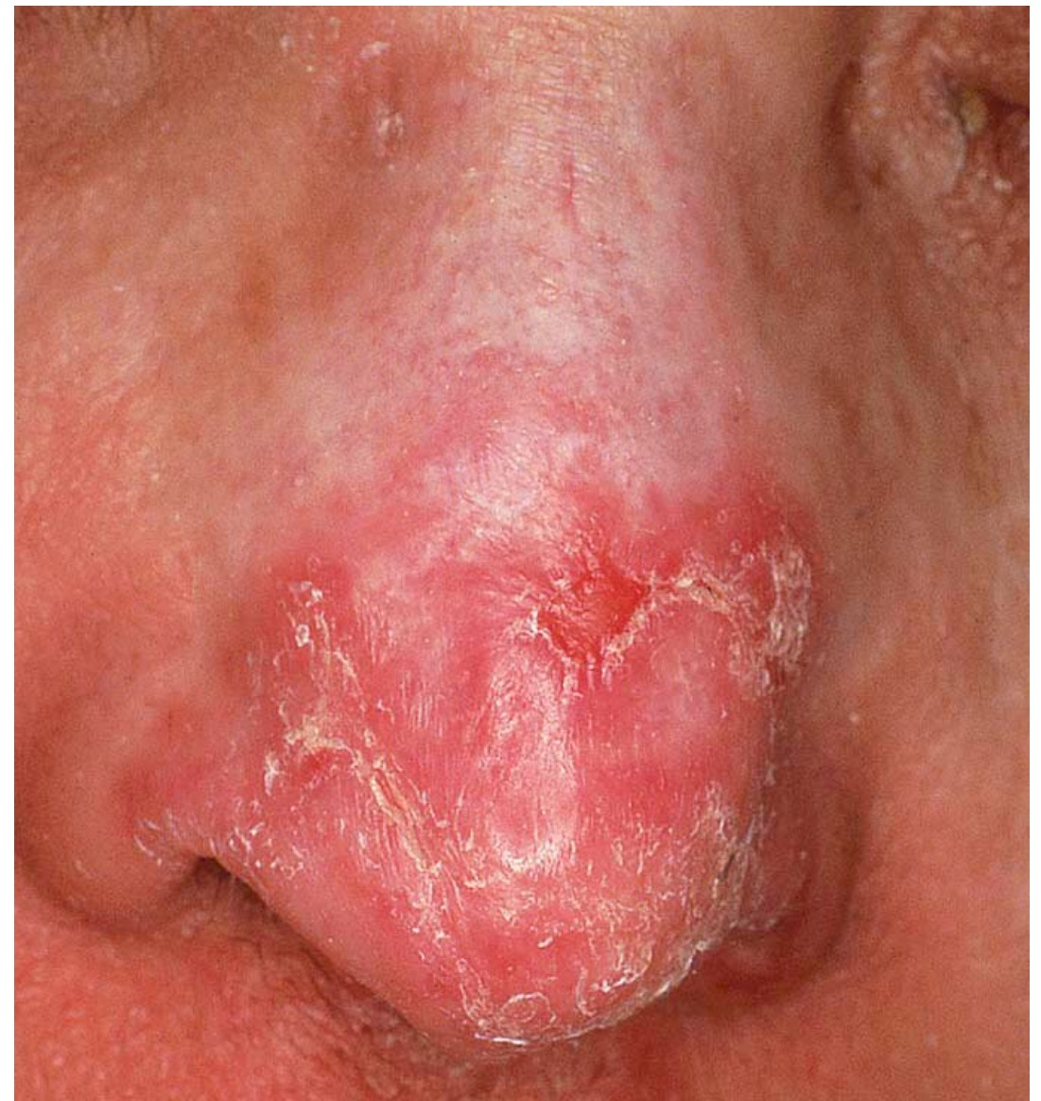
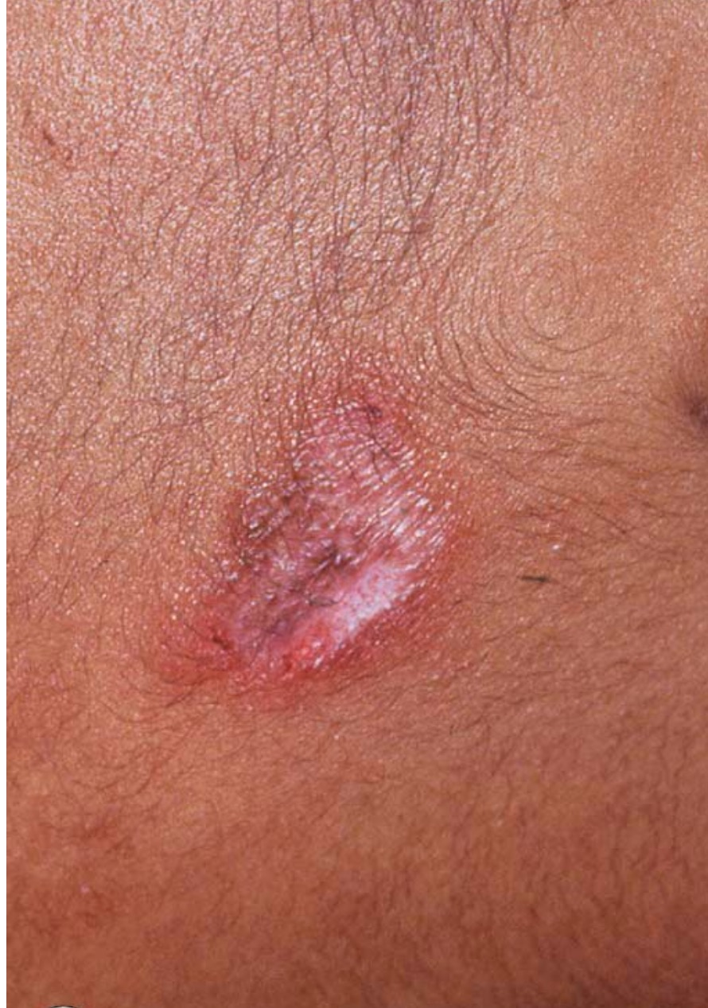
Photo

Slide 8
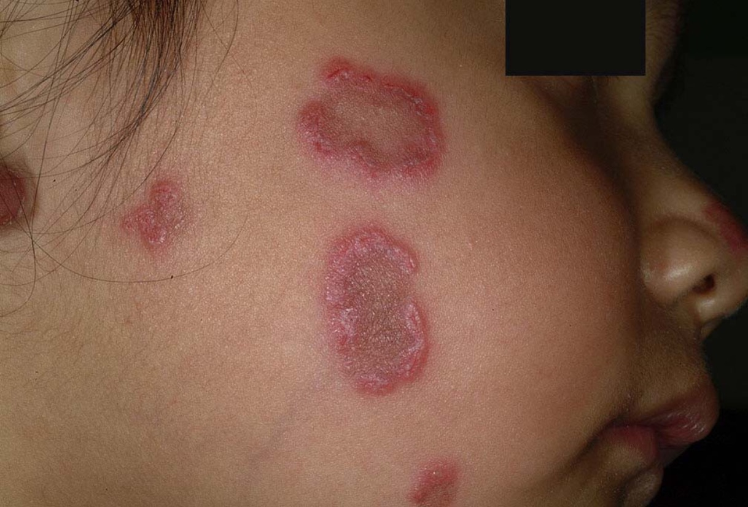

Slide 9
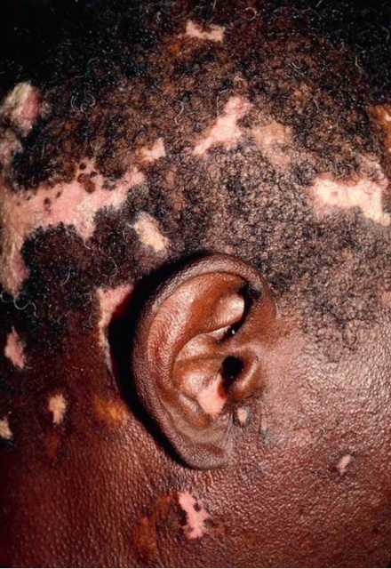

Slide 10
DLE
Clinical features:
- Erythematous well-circumscribed persistent plaques with follicular hyperkeratosis, telengiectases; heal with scarring, peripheral hyperpigmentation and central hypopigmentation.
- Sites : sun exposed areas; scalp, forehead, cheeks, nose, ears, upper lip and chin.
- Common causing of scarring alopecia especially in blacks.
- Small percentage of patients develop SLE.
Histology: epidermal atrophy with vacuolar degeneration of basal cells, telengiectases, follicular plugs, lymphocytic infiltrate in dermis.

Slide 11
DLE
Diagnostic approach:
- Skin biopsy
- Direct immunofluorescence: deposits of IgG & C3 along the basement membrane in 80 % of affected skin, nonexposed skin always negative.
- Labs: negative or low-titer ANA
- Exclude SLE

Slide 12
DLE
Differential diagnosis:
1- Psoriasis (silver scale)
2- Rosacea ( pustules, ears spared)
3- Tinea faciei (KOH examination)
4- Granuloma faciale( brown color, no scarring)

Slide 13
DLE
Therapy :
Sun avoidance and high potency sunscreens.
Short term high-potency topical corticosteroids.
Topical immunomodulators ( pimecrolimus, tacrolimus).
Cryotherapy or IL corticosteroids for stubborn lesions.

Slide 14
DLE
Systemic Rx for wide spread, recalcitrant disease:
Antimalarials: hydroxychloroquine 200-400 mg dailyor chloroquine 250 mg.
Dapsone 50-100mg daily.
Thalidomide: 50-200mg daily (watch for neuropathy)
N.B : In general : cutaneous lesions are not an indication for systemic corticosteroids in LE.

Slide 15
Subacute cutaneous LE
Definition :
Widespread , photosensitive skin disease, mild systemic involvement, charecterictic autoantibody pattern & good prognosis.
Epidemiology: F>M (8:1)

Slide 16
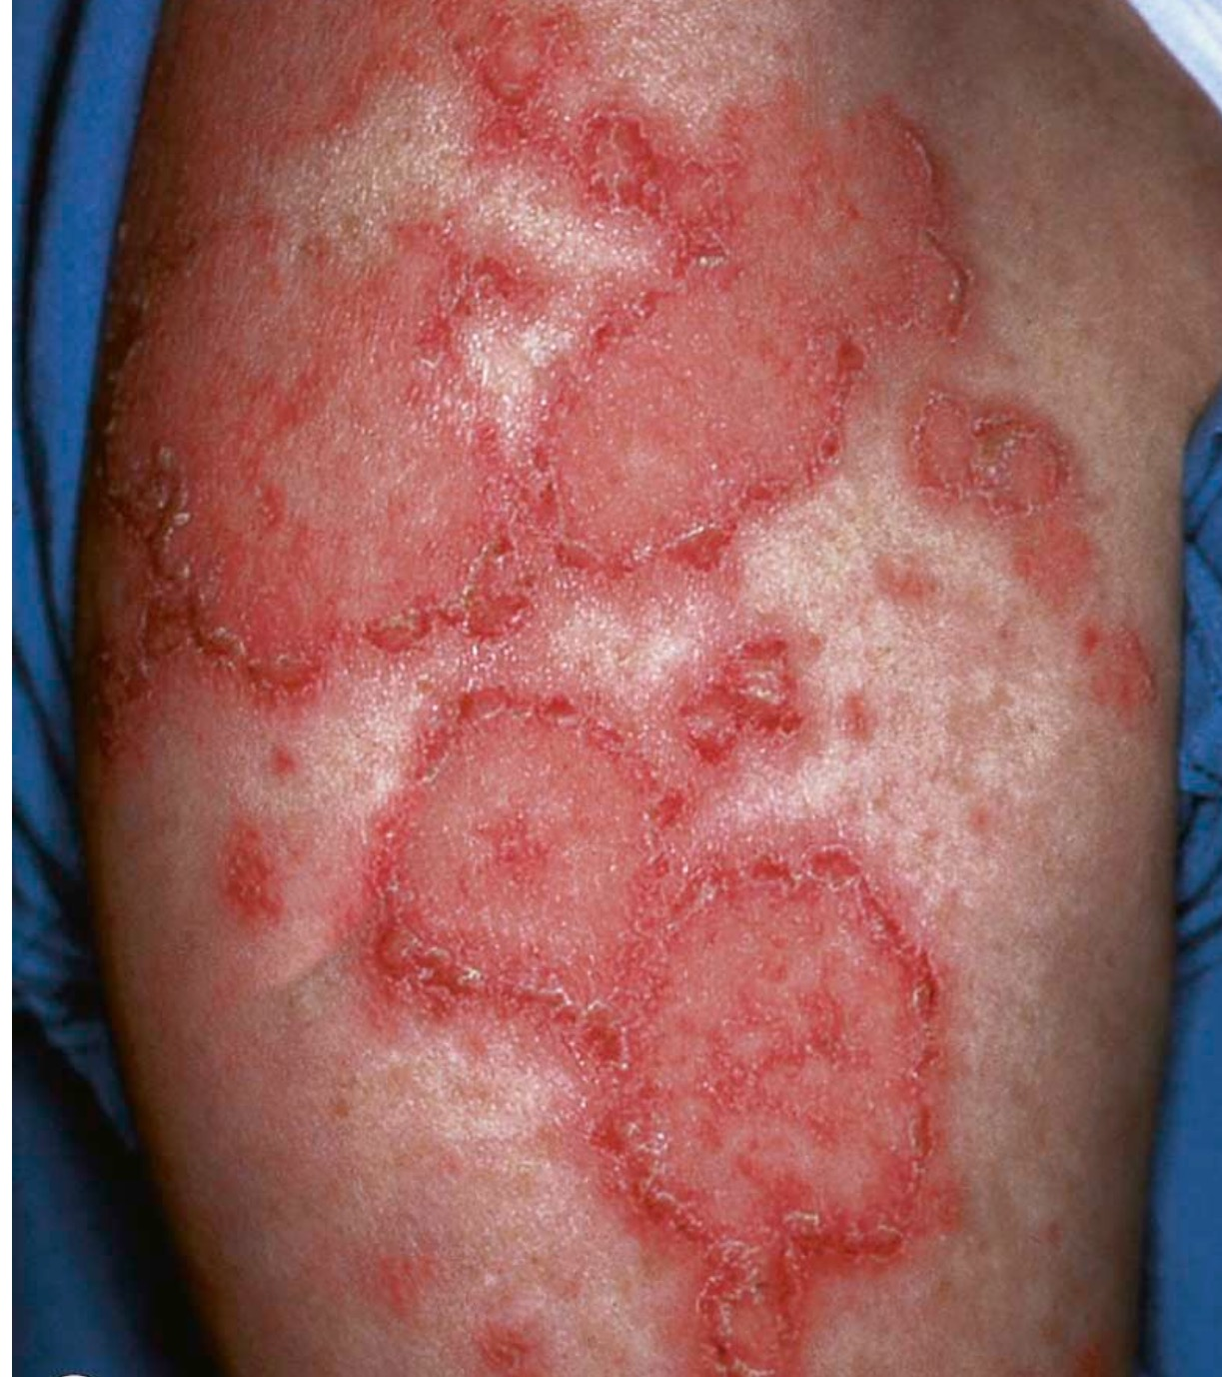

Slide 17
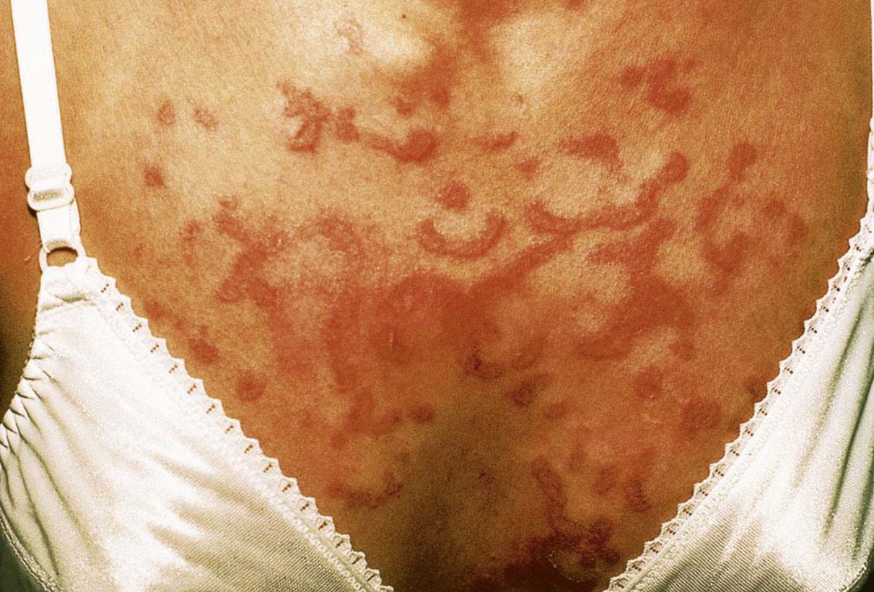

Slide 18
SCLE
Clinical features:
Symmetrical widepread nonscarring erythematous patches & plaques. Usually light exposed areas: trunk and arms.
Sometimes annular or targetoid lesions.
Often arthralgia, rarely renal disease.
Histology: interface dermatitis with vacuolar degeneration & superficial dermal infiltrates.

Slide 19
SCLE
Diagnostic approach:
1- biopsy
2- deposits of IgG & C3 along BM in lesional lesions 50-60 %; in normal skin in 10-20%.
Labs: positive for anti SSA & SSB and low titer anti-dsDNA antibodies.
DDx:
1- Tinea corporis
2- Tinea versicolor

Slide 20
SCLE
Therapy :
Same as DLE.
Emphasis on sun avoidance and sunscreens.
Antimalarials usually necessary for either skin or arthritis,NSAIDS for joint pain.

Slide 21
SLE
Epidemiology:
Gender: Affects women > men 6:1
In prepubertal 3:1
Ethnicity : African-american > caucasian
They develop the disaease at an early stage and higher mortality rate.

Slide 24
SLE
Clinical features:
A) Cutaneous lesions
1- Butterfly rash
2- Discoid lesions
3- Alopecia (scarring)
4- nail folds changes : damaged cuticles with telengiectasia
5- oral lesions: palatal erythema or erosions
6- Bullous lesions
B) Systemic lesions:
The ACR criteria: 4 or more , accepted SLE.

Slide 25
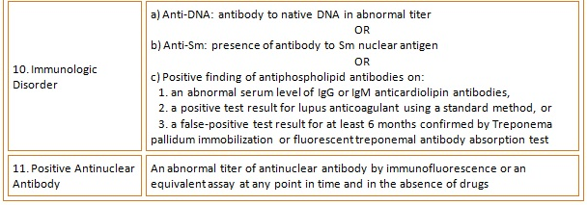

Slide 26
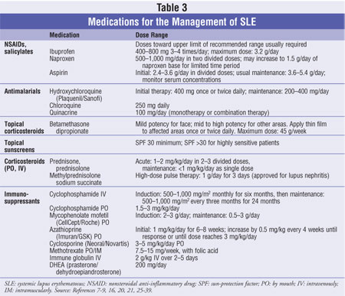
SLE

Slide 27
SLE
NB: With rare exceptions, cutaneous disease should not be taken as an indication for systemic therapy except for antimalarials.

Slide 28
Drug induced LE
Definition:
Clinical syndrome resembling LE, induced by various medications, features anti-histone antibodies, usually resolve when drugs are stopped.
Responsable medications:
- Biologicals: IFNa,b , anti-TNF
- antihypertensives: hydralazine, methyldopa
- antiarrhythmic agents: procainamide, quinidine
- anticonvulsants: phenytoin
- others: minocycline, chlorpromazine, isoniazid

Slide 29
Drug induced LE
Clinical features:
Similar to SLE but less severe.
Arthritis most common.
Procainamide causes serositis & pulmonary disease; renal, CNS and skin involvement uncommon.
Therapy :
STOP medication; manage as SLE but expect remission.

Slide 30
Dermatomyositis (DM) and Polymyositis
Definition :
Uncommon group of diseases with loss of muscle strength secondary to autoimmune muscle damage.
Polymyositis: NO cutaneous involvement
Dermatomyositis: BOTH muscular and cutaneous abnormalities.
Epidemiology: F>M 2:1. in adults >50 yrs often paraneoplastic.

Slide 31
DM
Classification:
1- Polymyositis
2- Adult dermatomyositis: typical onset 40 yrs.
3- Juvenile dermatomyositis: more acute with vasculitis (GI hemorrhage) later calcification, lipodystrophy.
4- Paraneoplastic dermatomyositis: later onset associated with breast, head & neck carcinomas.
5- Amyopathic dermatomyositis: DM with no evidence of muscle involvement over 6 months follow up.

Slide 32
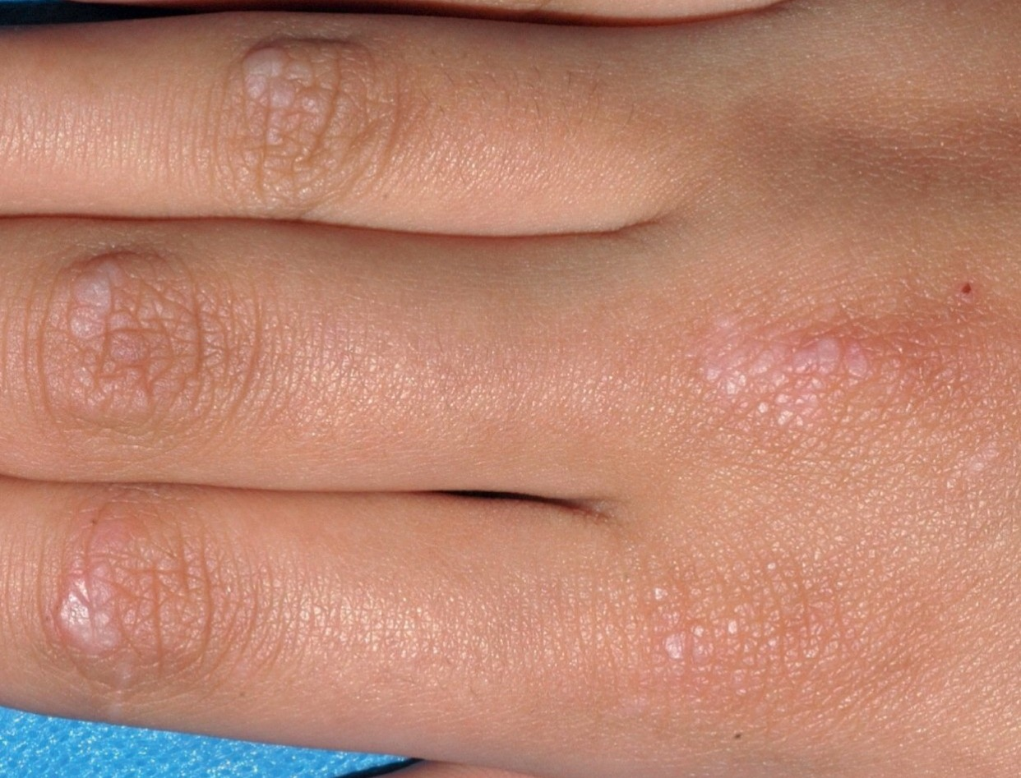

Slide 33
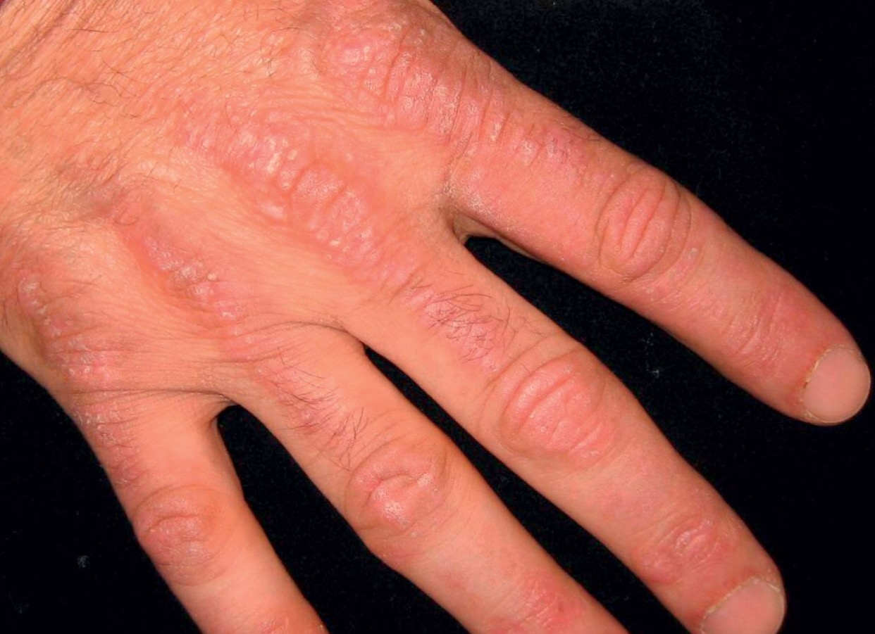

Slide 34
DM
Clinical features:
Muscles: pain and weakness in shoulder & hip girdle muscles, typical problems include combing hair, getting out of chairclimbing stairs , standing up. Difficulty swallowing.
Skin : periorbital & eyelid edema (heliotrope lids), lichenoid papules over finger joints & knuckles (gottron sign), erythematous macules & plaques on upper back, shoulders & back of neck (shawl sign)
V-sign similar to shawl but appears on the front of chest.

Slide 36
DM
Raynaud phenomenon:
Nail fold telengiectasia
Fissures and ulcers on tips of fingers ( mechanic’s hand).
Arthritis : usually peripheral: 25% have morning stiffness.
Mucosa: 10-20 % have oral ulcers.
Calcinosis : distinctive of JDM.
Lungs: more common with anti-jo1: 20% pulmonary fibrosis.

Slide 37
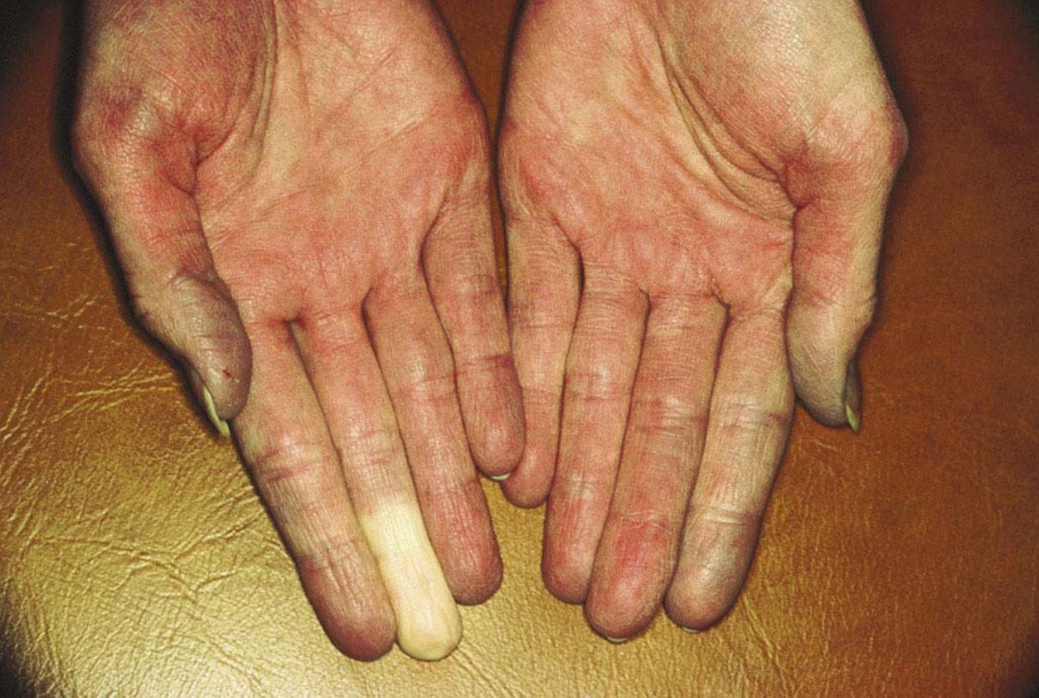

Slide 38
DM
GI : children: vasculitis& frequent GI ulcerations & hemorrhage. Adults: motility problems may occur.
Heart: asymptomatic ECG: occasionally myocarditis/ myopathy.

Slide 39
DM
Diagnostic approach:
1- EMG
2- MRI: displays inflamed muscles
3- Muscle biopsy: most reliable diagnostic test showing varying stages of necrosis & regeneration with inflammatory infiltrate.
Polymyositis: CD8+, DM : CD4+

Slide 40
DM
Labs:
Sed rate & CRP elevated in 50%
Creatine kinase (CK) is the best marker
24 hour urine creatine level >200 mg is diagnostic
Other enzymes : AST,LDH
Serology:
Myositis-specific antibodies (MSA) : in <50% of patients.
Anti Jo-1 (antisynthetase): in 20%, with lung disease & Raynaud phenomenon.
Anti-SRP (signal recognition protein) : acute disease.
Anti-Mi2 (helicase) : DM, good outlook.
Others: RF (10%), ANA (20%), NO anti-DNA antibodies
Anti-PM-SCL (anti-PM1); for PM/systemic sclerosis overlap

Slide 41
DM
Biopsy : RARELY diagnostic.
General evaluation : CXR, ECG, echocardiogram pulmonary function.
Searching for underlying tumor in patients > 50 years of age with suspicious history. ( ovarian carcinoma..).

Slide 42
DM
Therapy:
Corticosteroids : PO and taper, or pulse therapy, monitoring CK.
Immunosuppressants: MTX, azathioprine.
Cyclophosphamide & cyclosporine are less effective
IVIG: resistant cases, children with vasculitic component & steroid induced DM
Antimalarials: helps cutaneous lesions, topical steroids, sunscreen.
Paraneoplastic: appropriate Rx of underlying malignancy.

Slide 43
Morphea
Definition:
Cutaneous sclerosis w/o systemic involvement.
Epidemiology : uncommon F>M 3:1, incidence around 2/100000 per year.
Pathogenesis: poorly understood, association woth Borrelia Burgdorferi, circulating autoantibodies support immune role.

Slide 44
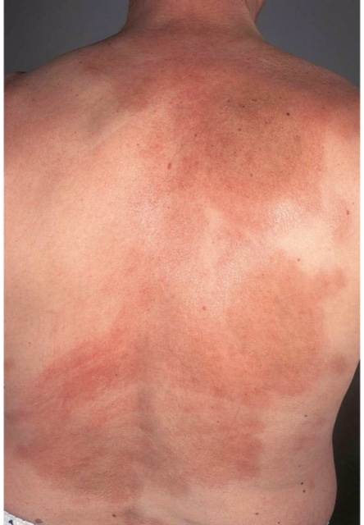

Slide 45
Morphea
Clinical features:
Classic morphea:
Circumscribed sclerotic plaque with ivory center & red violet periphery (lilac ring)
Systemic findings uncommon, raely malaise or Raynaud.
Variants:
Plaque form.
Atrophoderma of Pasini & Pierini
Guttate
Nodular
Linear
Coup de sabre
Hemifacial atrophy (Parry-Romberg syndrome)
Lichen sclerosis et atrophicus- like lesions

Slide 46
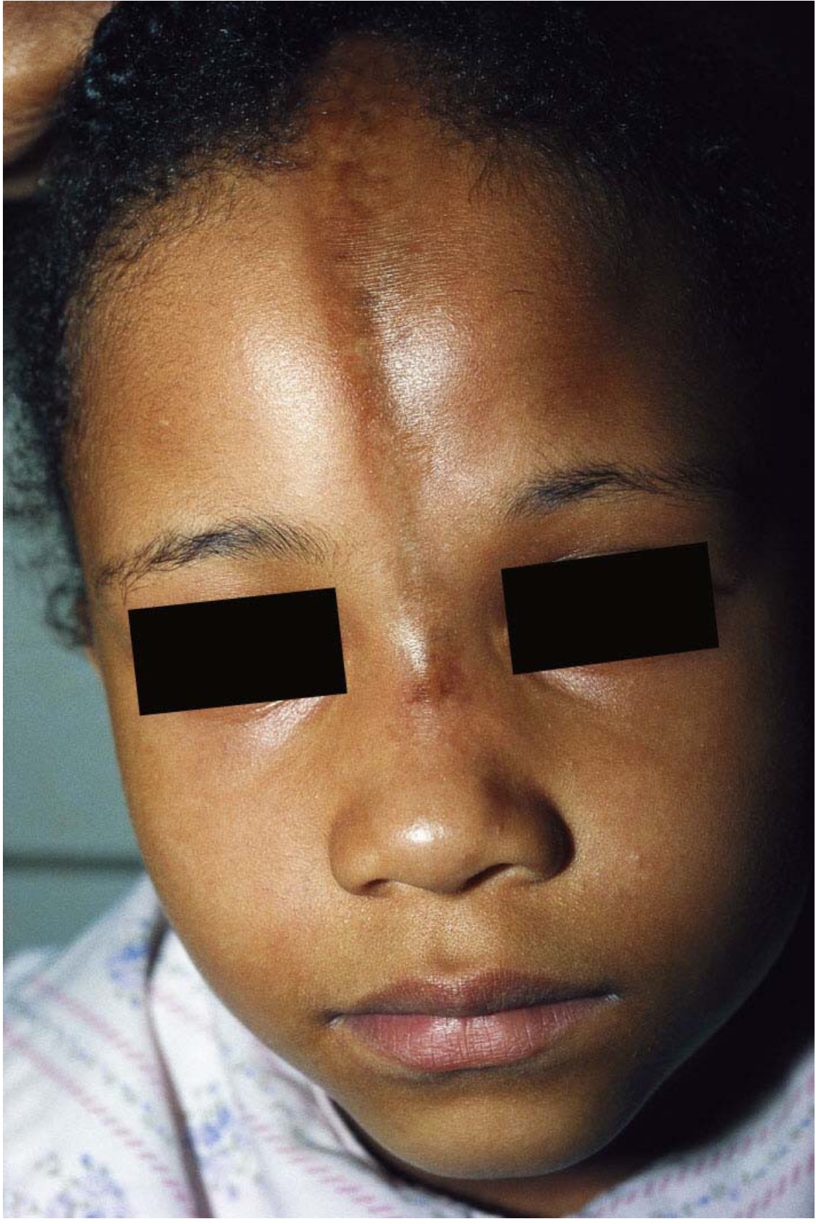

Slide 47
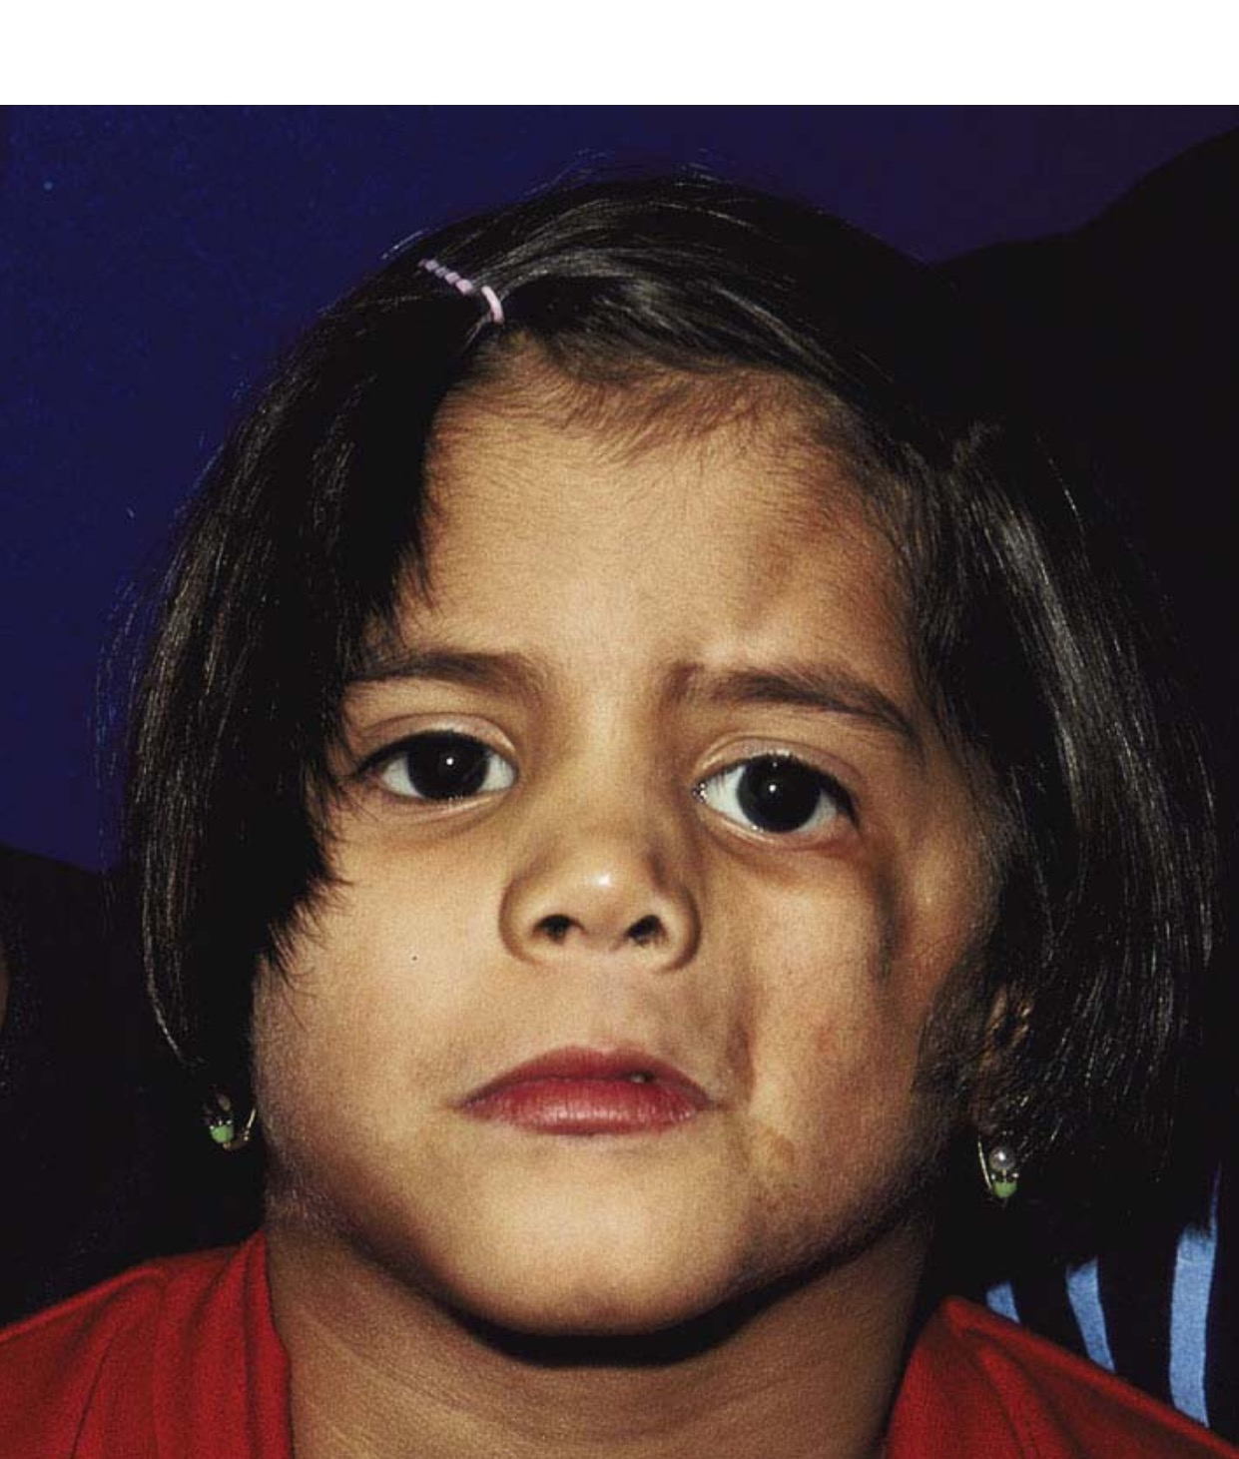

Slide 48
Morphea
Diagnostic:
Skin biopsy can confirm diagnosis.
ANA and anti ssDNA may be found in linear widespread morhea
Therapy:
High potency topical corticosteroids.
PUVA or UVA

Slide 49
Lichen sclerosis
Definition: Dermatosis that present with either porcelain-white papules & plaques or atrophy.
Epidemiology : F>M
Clinical features: similar to morphea, smaller white papules (en confetti) on trunk, especially upper back
Genitals: women: white atrophic lesions over vulva, labia minora,clitoris may spread to perianal, sometimes mistaken for abuse, pruritic ++.
Men: common cause of phimosis, usually NOT pruritic, resolves after circumcision
N.B: slight risk for SCC, to be monitored.

Slide 50
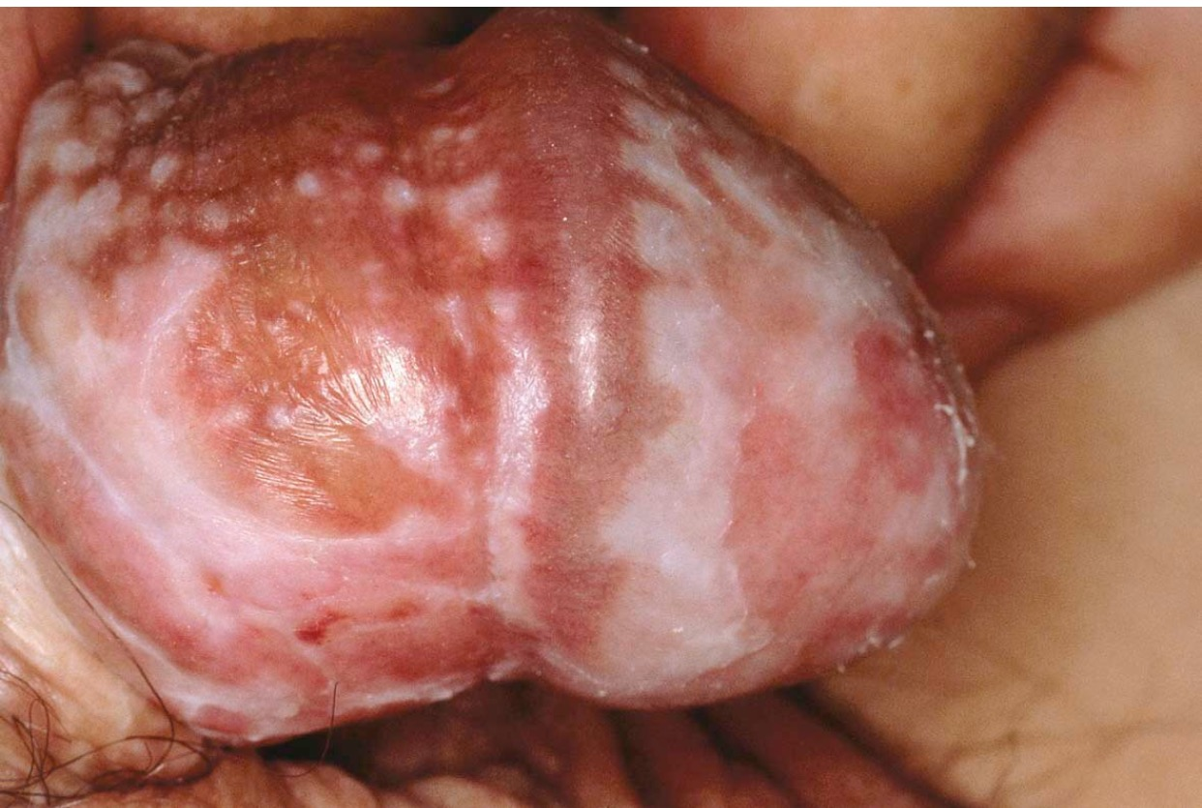

Slide 51
Lichen sclerosis
Therapy:
High potency topical corticosteroids
Topical immunomodulators (tacrolimus or pimecrolimus) for long term maintenance.

Slide 52
Systemic Sclerosis
Definition : AI, multiorgan disease with diffuse sclerosis of connective tissue favoring skin, lung, GI & kidneys.
Epidemiology: F>M 5:1, but men have worse prognosis,incidence: 1-2/100000 per year .
Pathogenesis:
Genetic predisposition (HLA-DR3,-DR5..)
Vessel damage as primary event
Increased production: type I,III & IV collagen, fibronectin & proteoglycansin affected connective tissue.

Slide 53
SS
Classification :
Acral sclerosis types I,II (limited)
Systemic sclerosis: starts on trunk, severe facial involvement.
CREST syndrome:
Calcinosis, Raynaud phenomenon, Esophageal disease, Sclerodactyly, Telengiectasia.

Slide 55
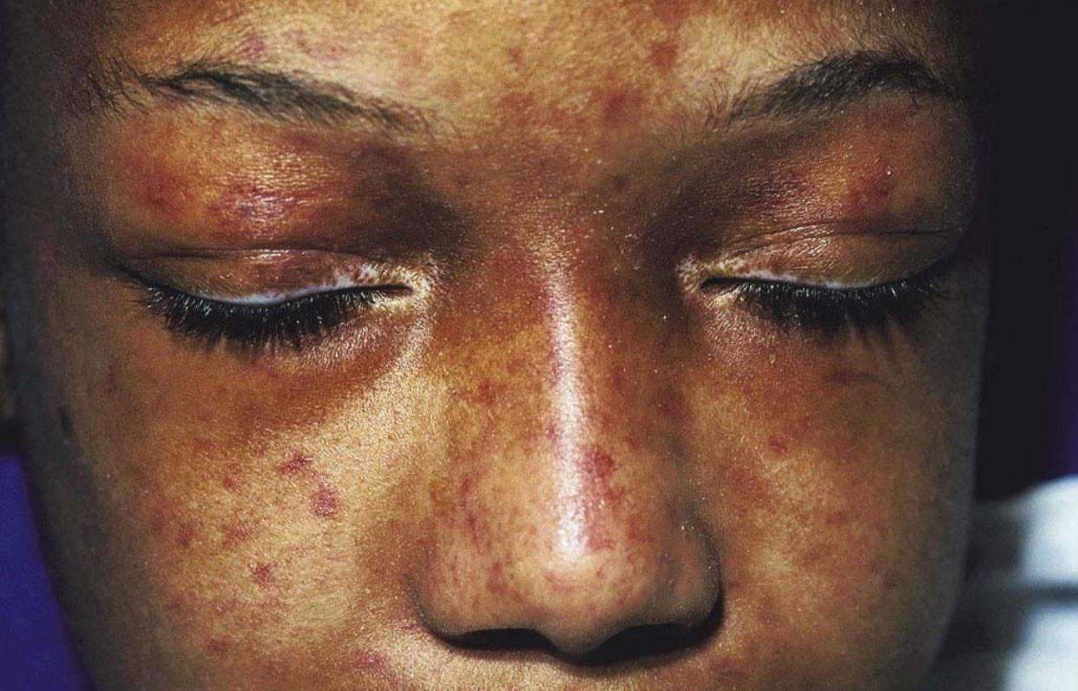

Slide 56
SS
Clinical features:
Hands: puffy hands, sclerodactyly, tightening, reduced motion, fingertip ulcers, calcinosis.
Face: microstomia, reduced facial expressions.
Diffuse sclerosis: sometimes restriction of respiratory motion.
Raynaud phenomenon:
Confetti like hypopgmentation: mistaken for vitiligo, more dramatic in blacks.

Slide 57
SS
Systemic findings:
GI tract: reduction tongue motility, swallowing problems, sicca syndrome, impaired esophageal motility.
Lungs: skin restricts motion, pulmonary fibrosis.
Kidneys: HT, nephrosclerosis.
Heart: subtle & late; MC fibrosis, pericardial effusion.
Liver: primary biliary cirrhosis.
MS: arthralgias, muscle atrophy
Bones: acro-osteolysis
Teeth: widening of periodontal membrane

Slide 58
SS
Diagnostic approach:
Skin:
Lungs: CXR, pulm diffusion studies
Skeleton: XR for osteolysis, calcifications.
GI: esophageal manometry, scintigraphy
Heart: ECG,echo
Kidneys: renal function, urine status

Slide 59
SS
Labs:
Routine ( CBC, LFT, sed rate, CRP)
Serology:
ANA (>90%).
Anti SCL-70 (30-70%)
Anti RNA (<5%); poor outlook
Anti-centromere ab : in type I & CREST.
Anti-DM-Scl in overlap
Rheumatoid factor ( + in 30%)

Slide 60
SS
Therapy:
Raynaud: NO smoking,avoidance of cold, Ca channel blocker (nifedipine,diltiazem..)
Calcification: surgery
Ulcers: occlusive dressing
Sclerosis: systemic CS, perhaps combined with azathioprine. MTX, cyclosporine, cyclophosphamide can be tried.
Aspirin: pain relief and inhibition of platelet function

Slide 61
SS
Therapy :
Internal organ involvement :
ACE inhibitors for renal HT.
PPI for esophageal dysfunction
Prostacycline : pulmonary HT, cyclophosphamide for interstitial lung disease.
Physical therapy: for contractures

Slide 62
Thank you !

