Slide 1


Slide 2
Blistering Diseases
Abdulmajeed Alajlan
Associate Professor
Hair Transplant & Laser
Department of Dermatology- KSU

Slide 3
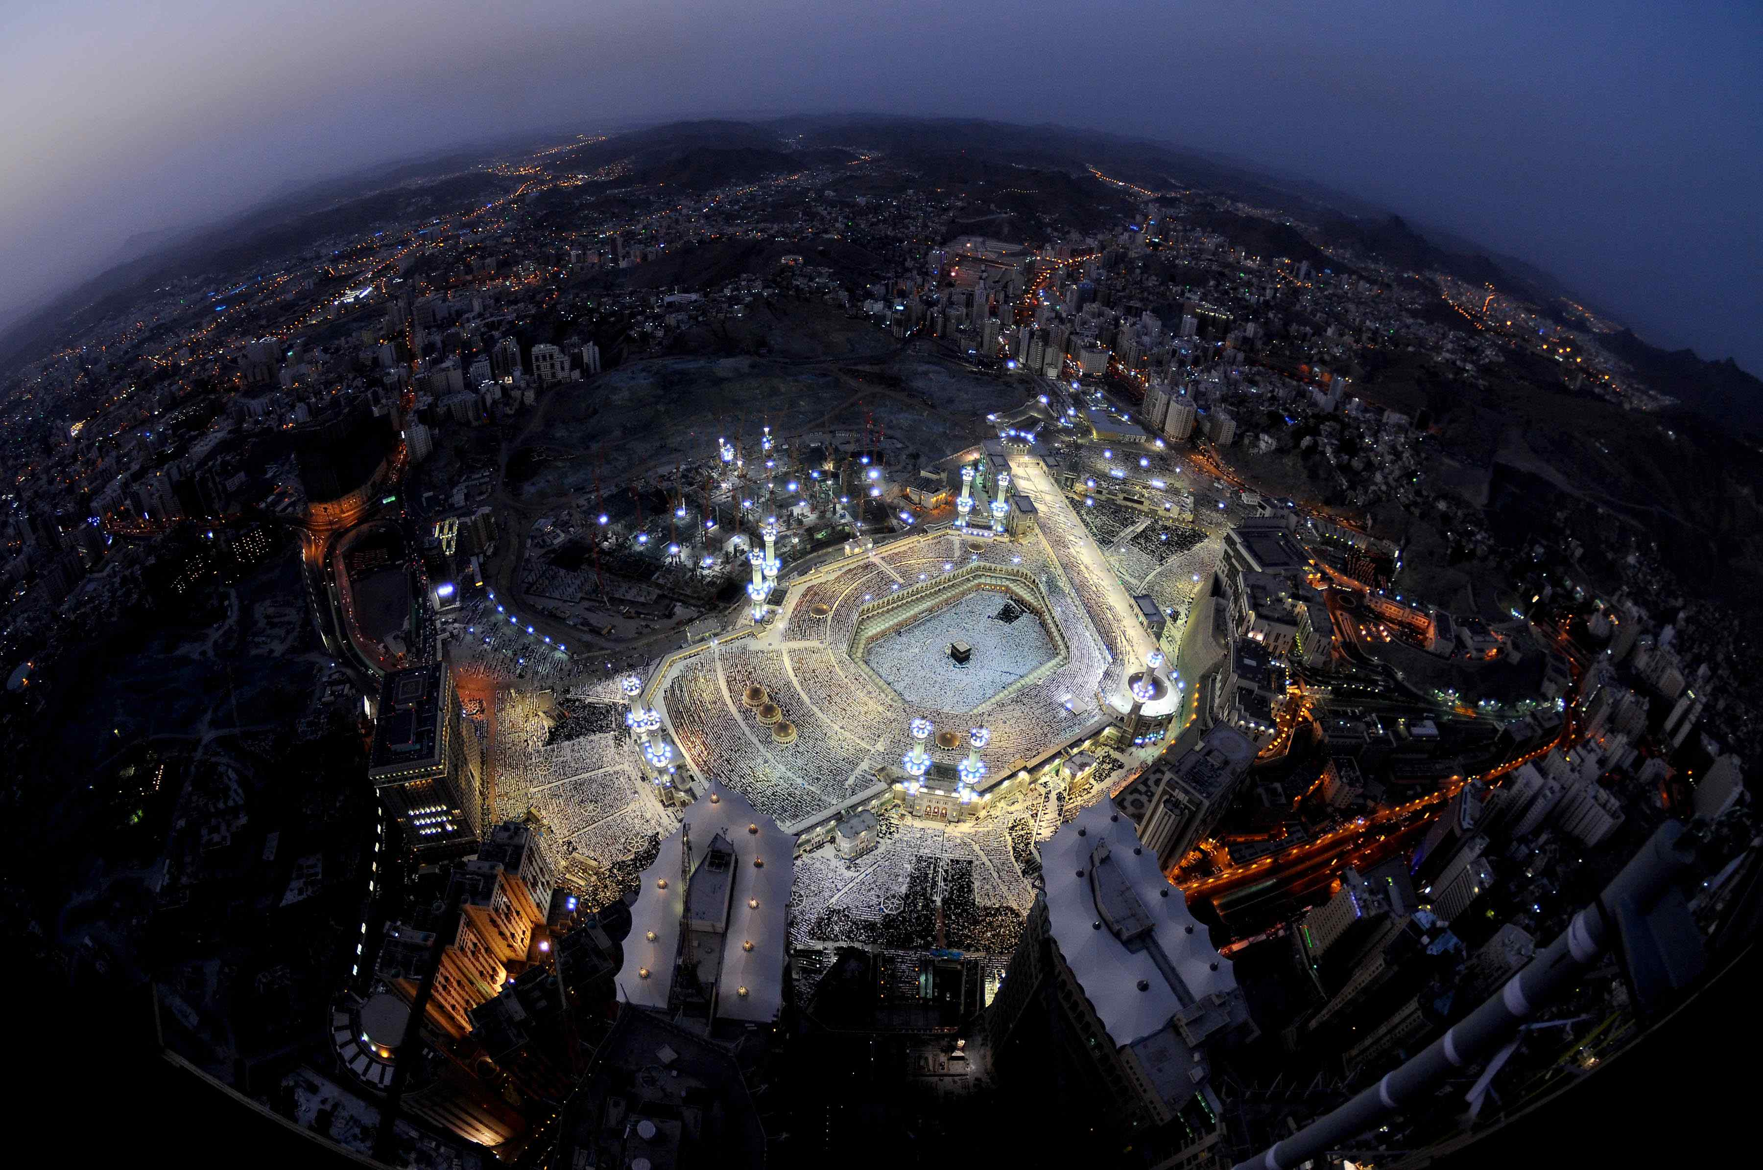

Slide 4
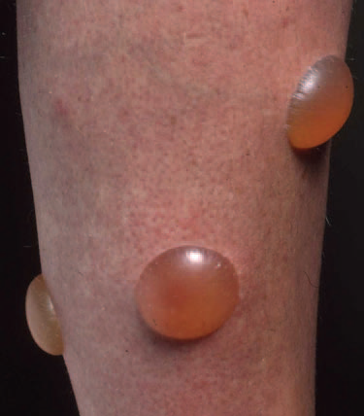
Blistering Diseases
Objectives
To know the definition
& classification of Blistering diseases
To recognize the primary presentation of different types of main blistering diseases
To understand the possible pathogenesis of the main types of blistering diseases
To have an overview about managements lines of these diseases

Slide 5
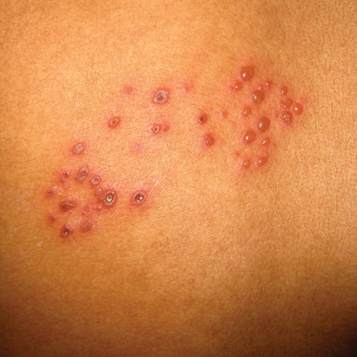
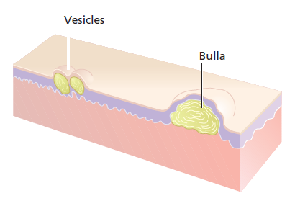

Slide 6
definition
Vesicles and bullae are raised lesions that contain fluid.
A vesicle is less than 0.5 cm in diameter.
A bulla is larger than 0.5 cm in diameter.

Slide 7
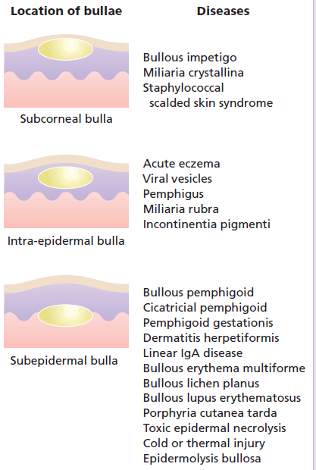
CLASSIFICATION OF VESICULOBULLOUS DISEASES
INTRA EPIDERMAL BLISTERS
The lesion is formed within the
epidermis
SUB EPIDERMAL BLISTERS :
Lesions formed between the
epidermis and the dermis

Slide 8
PEMPHIGUS VULGARIS
BULLOUS PEMPHIGOID
CHRONIC BULLOUS DISEASE OF CHILDHOOD
PARANEOPLASTIC PEMPHIGUS

Slide 9
Blistering Diseases
Objectives
To know the definition
& classification of Blistering diseases
To recognize the primary presentation of different types of main blistering diseases
To understand the possible pathogenesis of the main types of blistering diseases
To have an overview about managements lines of these diseases

Slide 10
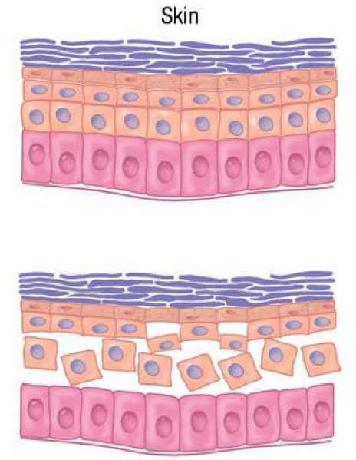

Slide 11
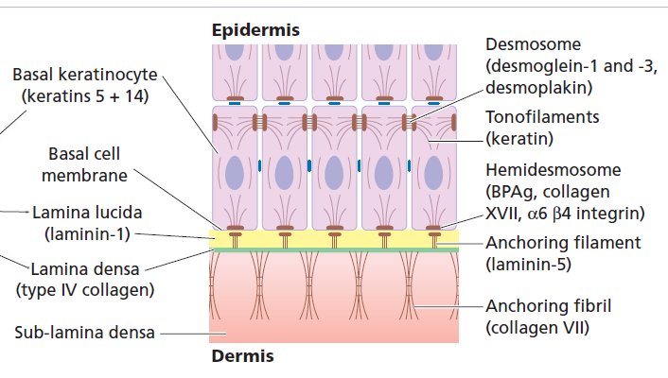
Dermo-edidermal junction

Slide 12
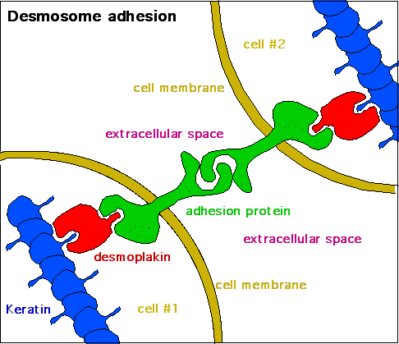

Slide 13
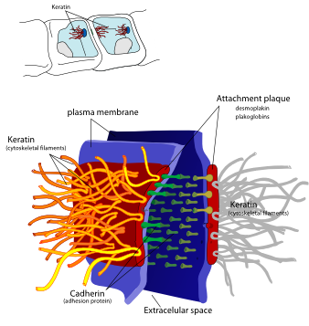

Slide 14
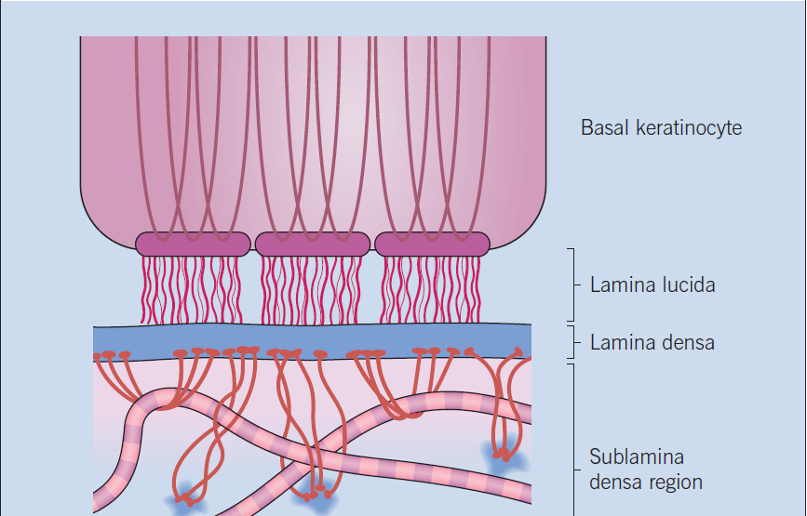
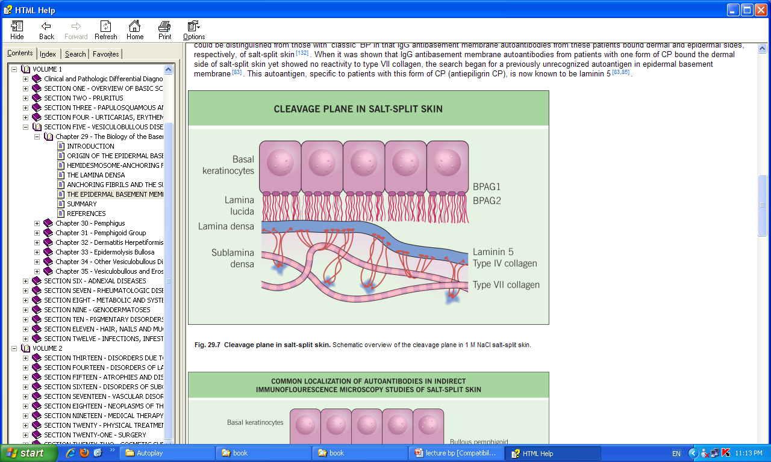

Slide 15
PEMPHIGUS VULGARIS
BULLOUS PEMPHIGOID
CHRONIC BULLOUS DISEASE OF CHILDHOOD
PARANEOPLASTIC PEMPHIGUS

Slide 16
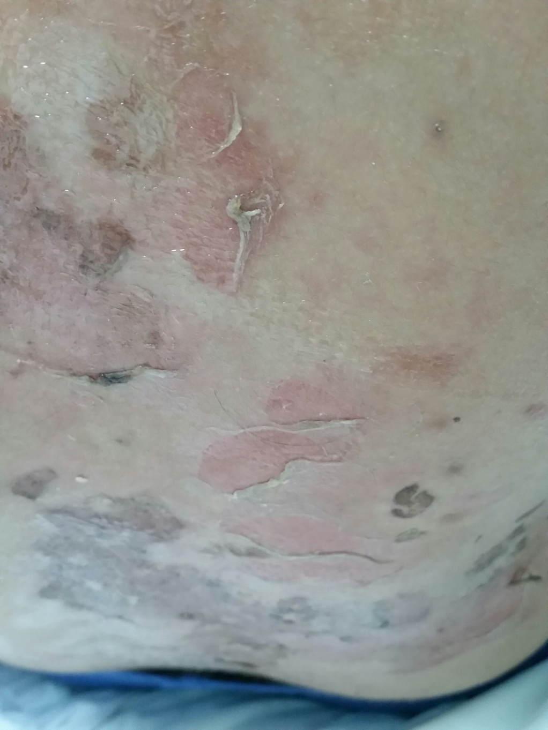
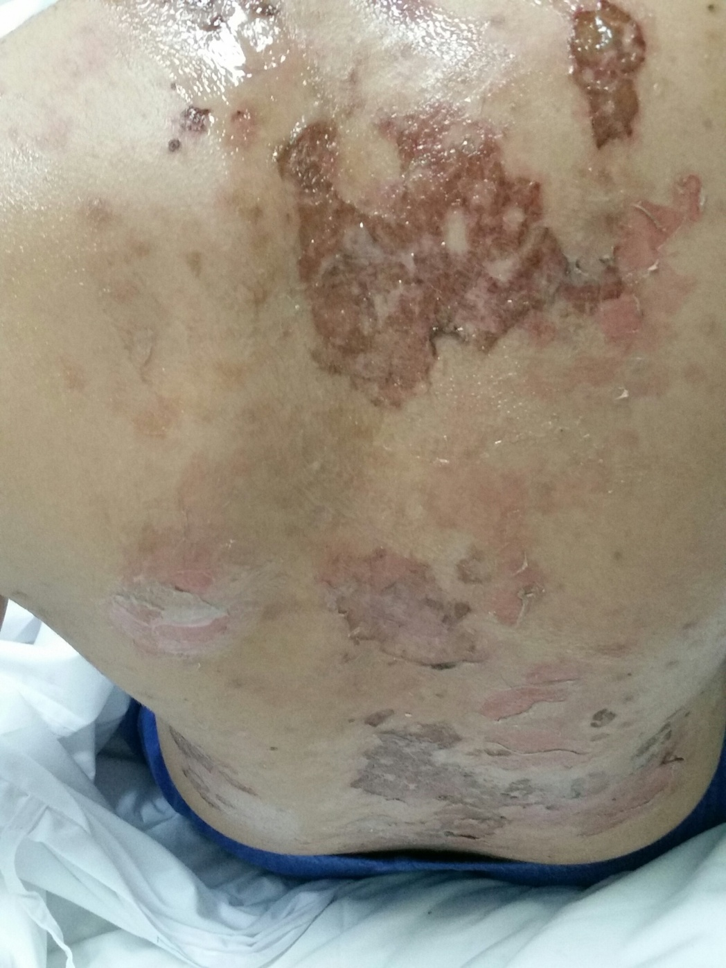

Slide 17
Accurate pathological diagnosis requires 2 biopsies of a small newly formed lesion and perilesional skin for immunopathological studies.

Slide 18
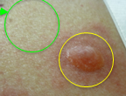
Diagnostic tests
Routine histology
  Lesional sample –small bulla or edge of large one.
Direct immunofluorescence
  Perilesional sample
Indirect immunofluorescence
  Patient’s serum is added to specific substrates that express antigen of interest.
Electron microscopy.

Slide 19
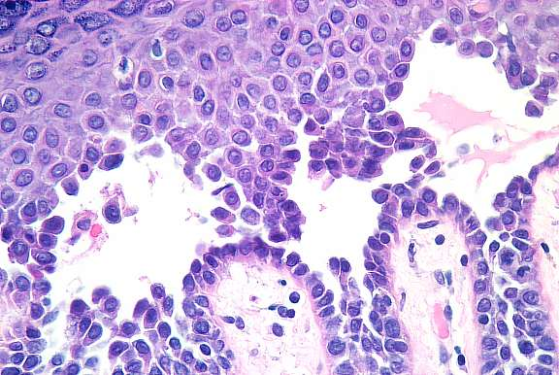
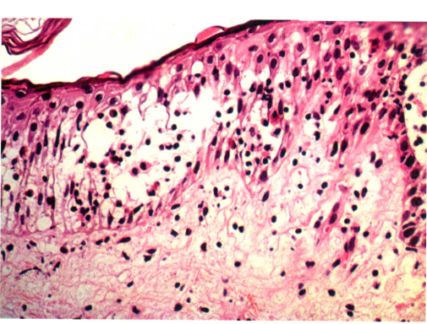
Routine histology

Slide 20
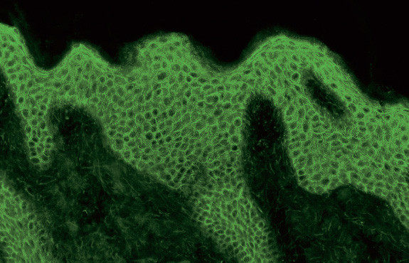
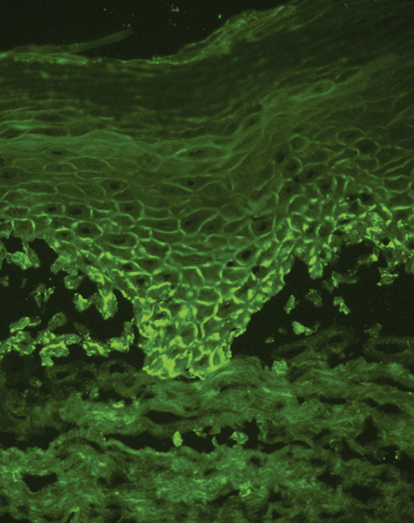
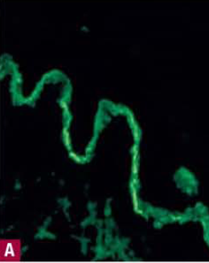
immunofluorescence
IgG
C3
IgA

Slide 21
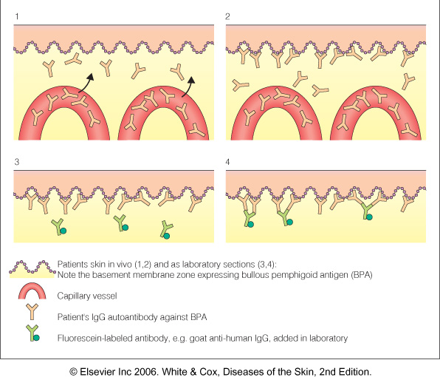

Slide 22
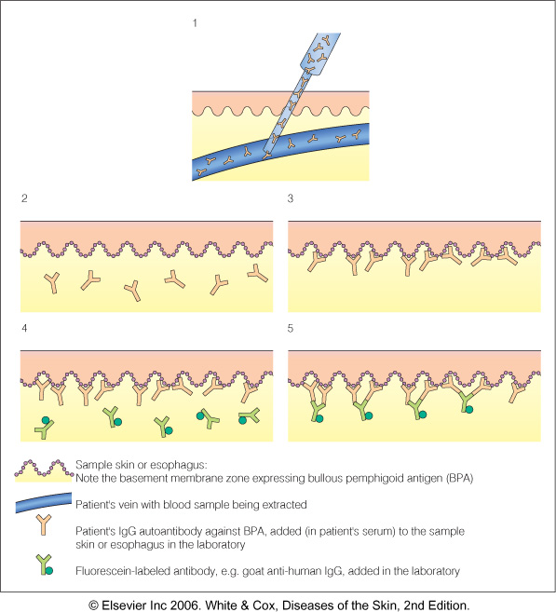

Slide 24
PEMPHIGUS VULGARIS
BULLOUS PEMPHIGOID
CHRONIC BULLOUS DISEASE OF CHILDHOOD
PARANEOPLASTIC PEMPHIGUS

Slide 25
Blistering Diseases
PEMPHIGUS VULGARIS

Slide 26
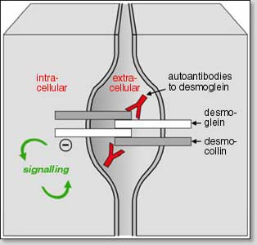
Pemphigus
Pemphigus is a group characterized by blistering of the skin and mucous membranes.
Auto-antibodies against
DESMOSOMES in epidermis and mucosal surface.

Slide 28
Four sub-clinical varients :
Pemphigus Vulgaris: is the most common Pemphigus variant, and the form usually responsible for oral lesions
Folacious, vegetens, erythematosus

Slide 29
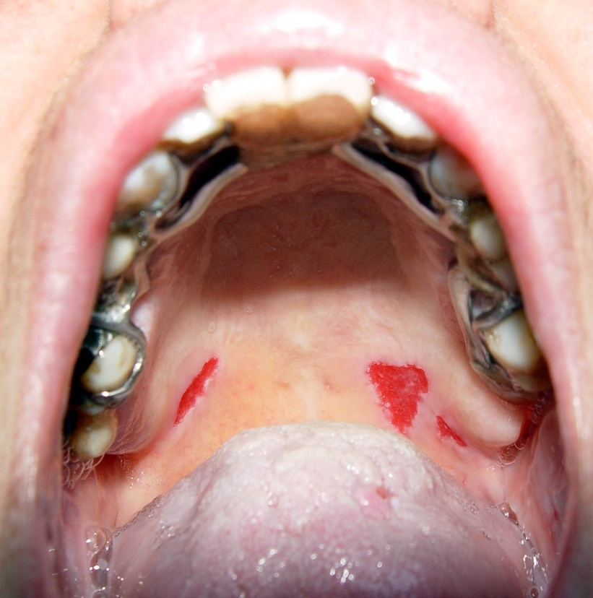
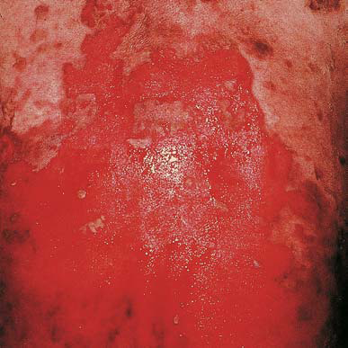

Slide 30
Pemphigus Vulgaris
Begins with erosions on mucous membrane then other skin areas.
Very painful.
+ve Nikolsky’s sign

Slide 31
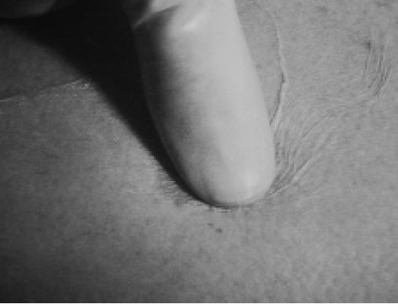
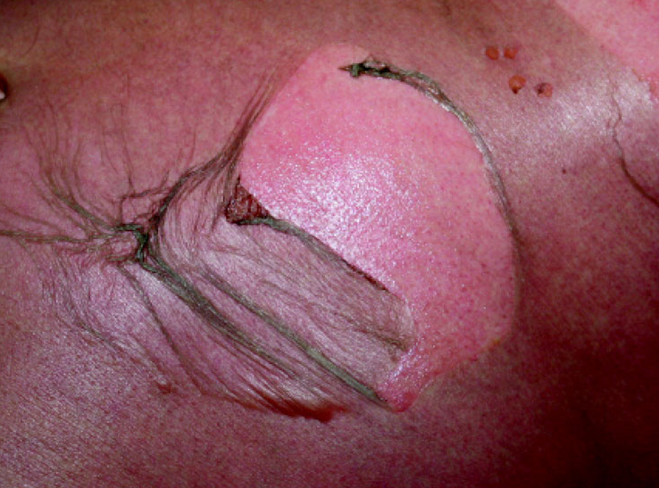
+ve Nicholsky sign
  Twisting pressure on normal skin shears skin.

Slide 32
Pemphigus Vulgaris
Begins with erosions on mucous membrane then other skin areas.
Very painful.
+ve Nikolsky’s sign.
Age: middle-age 40-60 years.
Secondary infection and disturbance of fluid and electrolyte balance are common complications .

Slide 33
Pathology and immunopathology

Slide 34
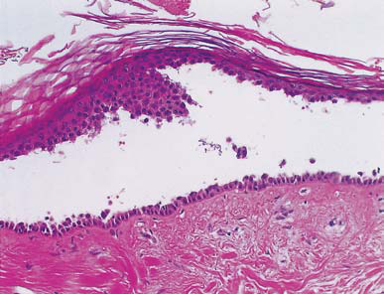
Acantholysis
Immunofluorescence
IgG and C3

Slide 35
Treatment
High dose systemic steroids 60-100 mg of prednisolone.
Immunosuppressive agent such as azathioprine cyclophosphamide , Methotrexate or mycophenolate
Patient will probably have to remain on systemic steroids for long time.
Antibiotics; to treat superinfection

Slide 36
Biological Rx:
1- Rituximab
IV
86% free of disease after 3 y
2-IVIG (intravenous immunoglobulin)

Slide 37
Drug induced blistering diseases

Slide 38
Drug-induced PV
Drugs can induce PV
Drugs reported most significantly in association with PV are;
Penicillamine
Captopril
Anti epiliptic phenytoin and carbamazepine

Slide 39
PEMPHIGUS VULGARIS
BULLOUS PEMPHIGOID
CHRONIC BULLOUS DISEASE OF CHILDHOOD
PARANEOPLASTIC PEMPHIGUS

Slide 40
Paraneoplastic pemphigus
The least common and most severe type of pemphigus is paraneoplastic pemphigus (PNP). This disorder is a complication of cancer,
usually lymphoma and Castleman's disease. It may precede the diagnosis of the tumor. Painful sores appear on the mouth, lips, and the esophagus.
Complete removal and/or cure of the tumor may improve the skin disease,

Slide 41
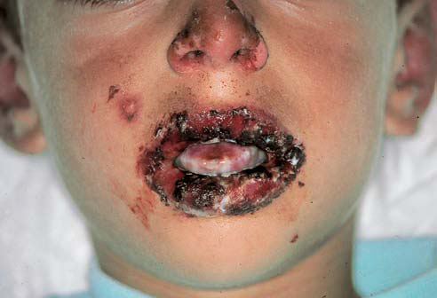

Slide 43
immunofluorescence
IgG
C3
IgA

Slide 44
PEMPHIGUS VULGARIS
BULLOUS PEMPHIGOID
CHRONIC BULLOUS DISEASE OF CHILDHOOD
PARANEOPLASTIC PEMPHIGUS

Slide 45
Bullous pemphigoid
Characterized by large blisters on an erythematous base.
Mainly in older age group more than 60 y.
The prognosis is usually good.

Slide 46
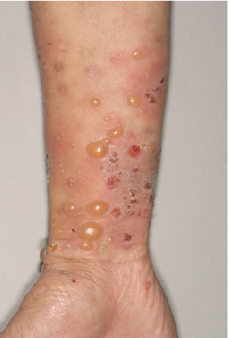
Clinical features
Elderly patents.
Large tense blisters on upper arms and thighs.
Eczematous base .
Itch rather than pain.
Oral lesions are less frequent than pemphigus.

Slide 48
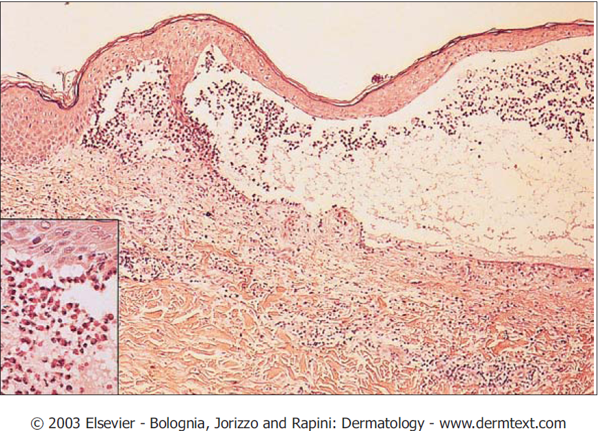
Pathology
Sub epidermal between epidermis and dermis the epidermis forms the roof of the blister.
Antigens identified are BP 1 and BP 2.
Immunoglobulin and complement are deposited in the lamina lucida of the basement membrane in a linear band.

Slide 50
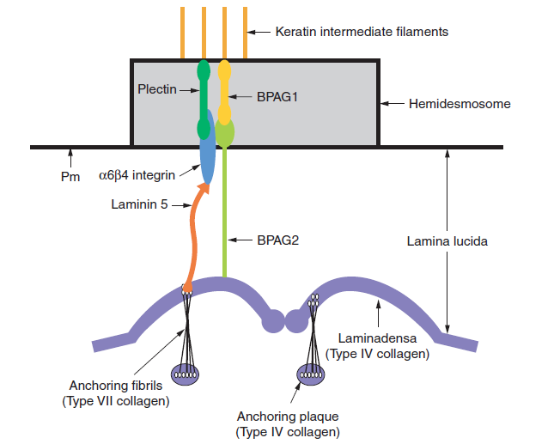

Slide 51
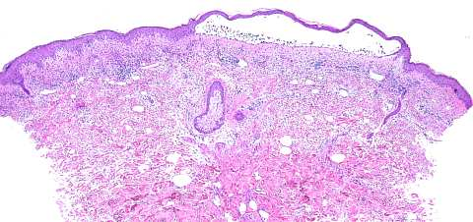
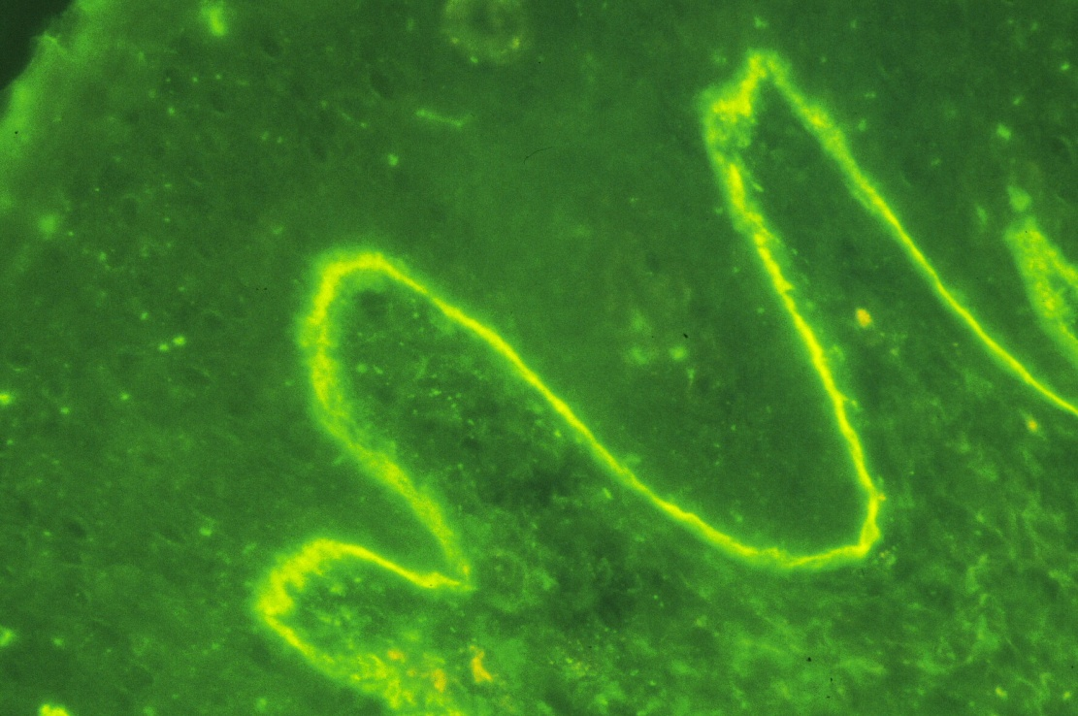

Slide 52
Treatment
Mild may also respond very well to potent or moderately potent topical steroids alone.
Severe pemphigoid :Systemic steroids , but unlike pemphigus, it may be possible to discontinue.
The addition of either azathioprine enable the oral steroid dose to be reduced more rapidly.

Slide 53
PEMPHIGUS VULGARIS
BULLOUS PEMPHIGOID
CHRONIC BULLOUS DISEASE OF CHILDHOOD
PARANEOPLASTIC PEMPHIGUS

Slide 54
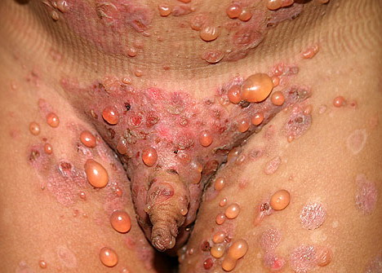
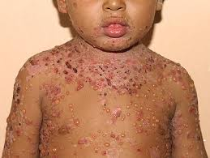
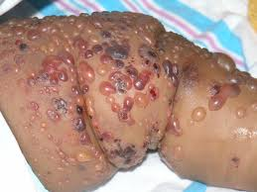
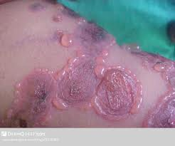

Slide 55
CLINICAL FEATURES
Circular clusters of large blisters like the type seen in pemphigoid (cluster of jewels)
It involves the perioral area, lower trunk, inner thighs and genitalia
Blistering may
spread all over the body

Slide 56
INVESTIGATION
Skin Biopsy will show subepidermal splits
Direct IF reveals IgA along the BM of the epidermis in a linear pattern

Slide 59
TREATMENTS
Oral dapsone 50-200mg daily (Ad/E)
Sulphonamides and immunosupressants
Erythromycine
Flucloxacillin : 7 cases reported from KKUH

Slide 60
PEMPHIGUS VULGARIS
BULLOUS PEMPHIGOID
CHRONIC BULLOUS DISEASE OF CHILDHOOD
PARANEOPLASTIC PEMPHIGUS

Slide 61
Blistering Diseases
Objectives
To know the definition
& classification of Blistering diseases
To recognize the primary presentation of different types of main blistering diseases
To understand the possible pathogenesis of the main types of blistering diseases
To have an overview about managements lines of these diseases

Slide 62

Thank you

