Slide 1
Hair disorders
Mohammed A. AlShahwan MD
Assistant professor & Consultant Dermatologist

Slide 2
Objective
Normal anatomy of hair follicle and hair cycle
Causes, features and management of non scarring alopecia
Causes and features of scarring alopecia
Causes and features of Excessive hair growth

Slide 3
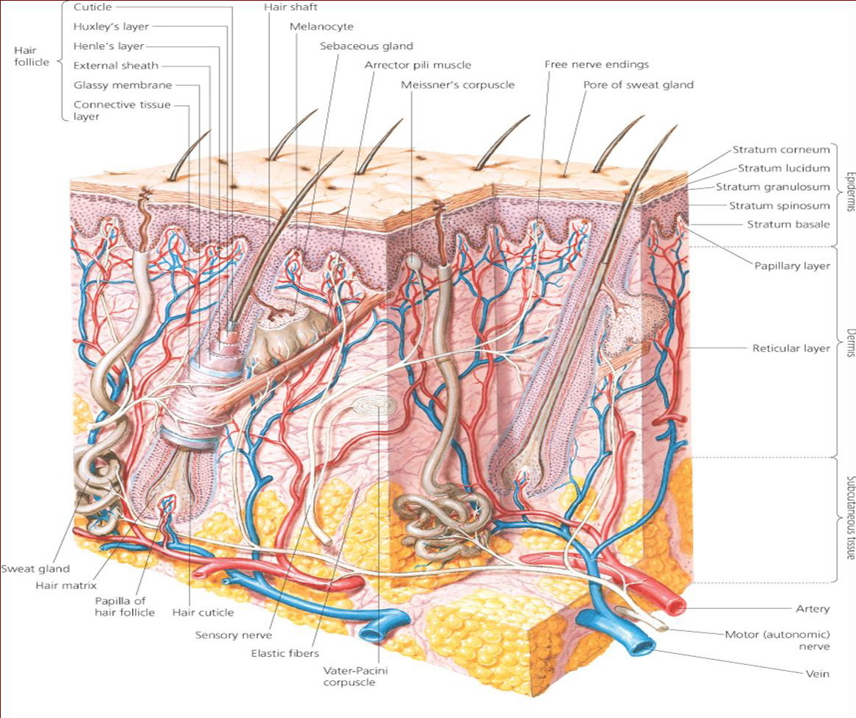

Slide 4
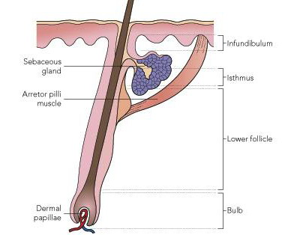

Slide 5
Hair Types
Vellous
Terminal

Slide 6
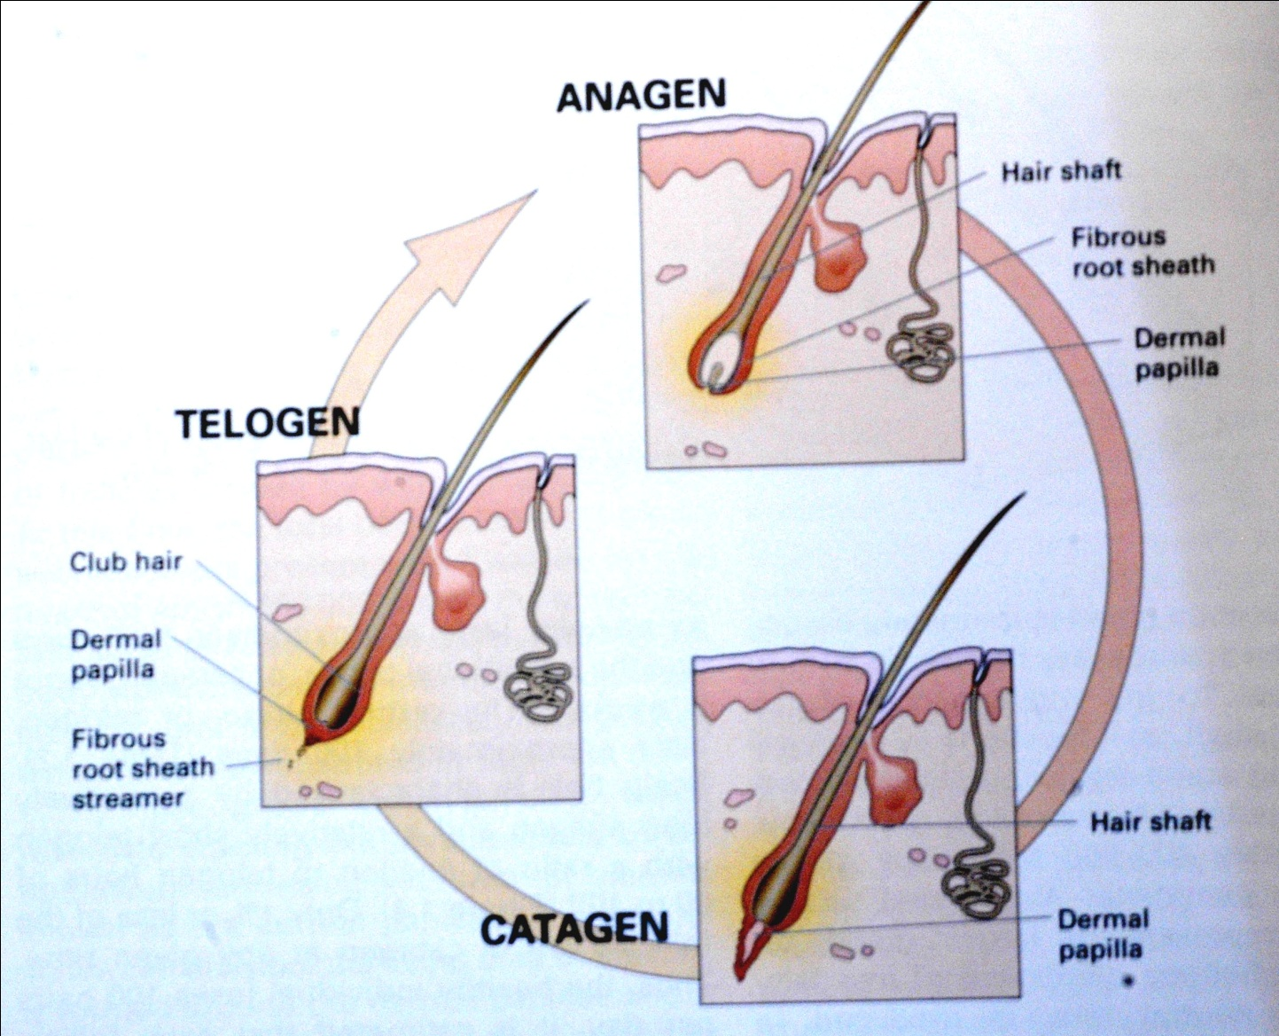
Hair Cycle

Slide 7
How many hairs in the body
5 millions hairs in the body
100,000 in the scalp
Growth rate
0.3mm/day for scalp hair

Slide 8
Alopecia
None Scaring
(Reversible)
Scaring
(Irreversible)

Slide 9
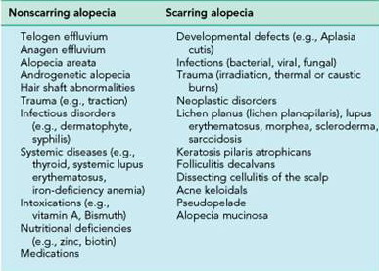

Slide 10
Alopecia Areata

Slide 11
Sudden hair loss ( localized or generalized)
Alopecia Areata affects up to 2%
75% Self recovery with 2-6 months
30% +ve Family history
Autoimmune

Slide 12
Clinical findings
Well demarcated non-scarring hairless patch
Exclamation point
Nail: pitting, ridges

Slide 13
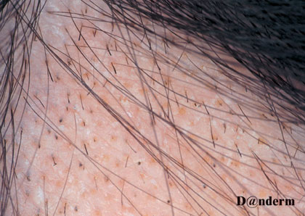
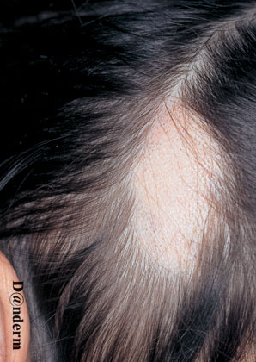

Slide 14
Types of alopecia areata
- Localized partial
- Localized extensive
- Alopecia ophiasis
- Alopecia totalis
- Alopecia universalis

Slide 15
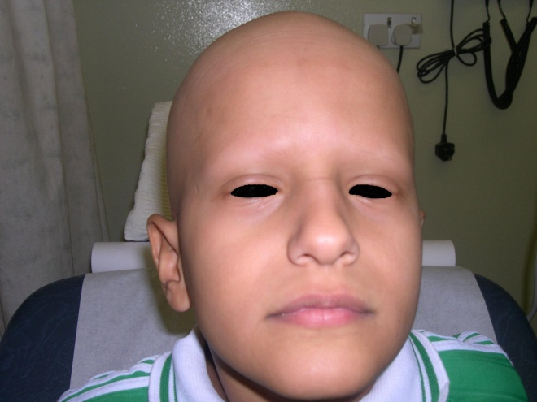
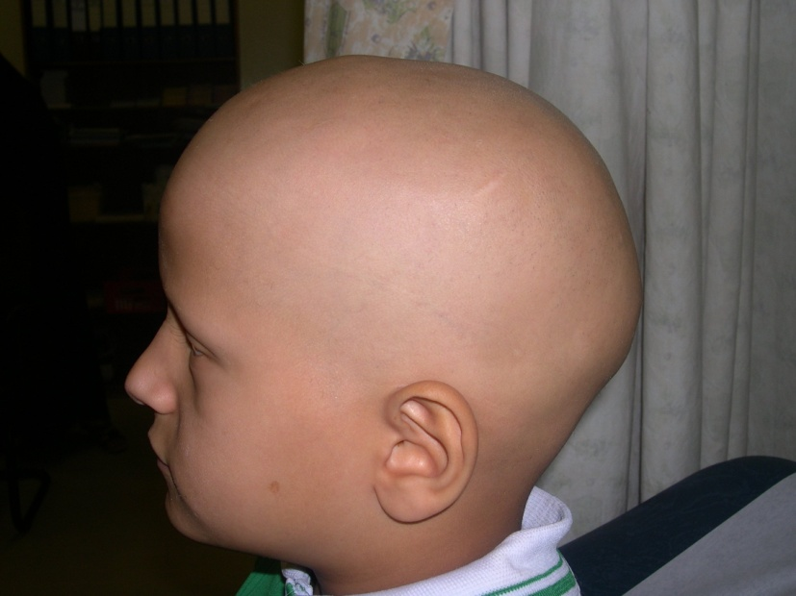
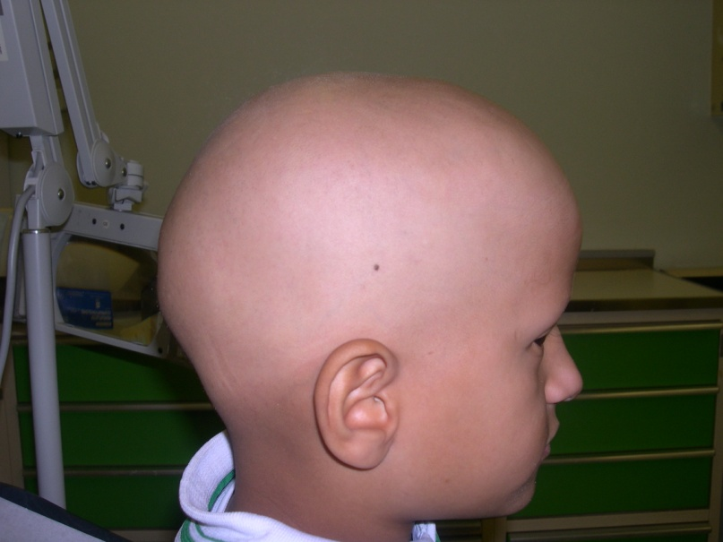
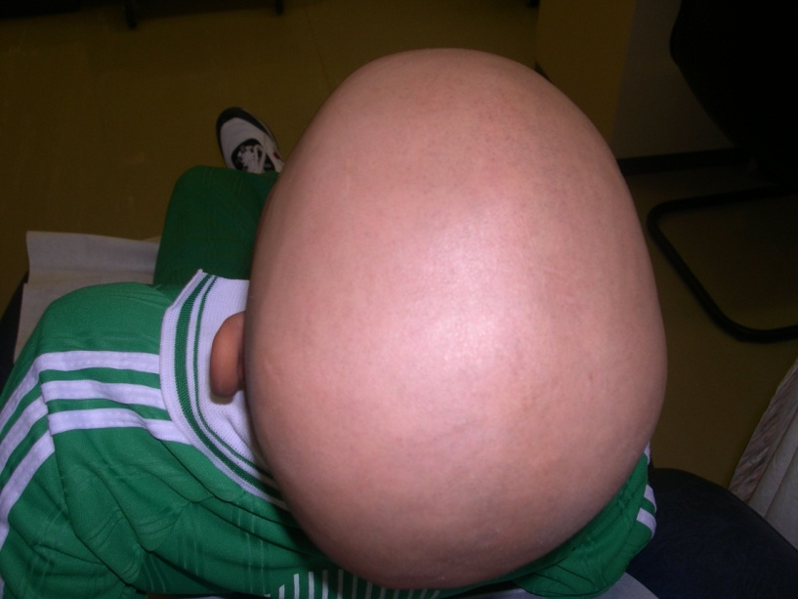
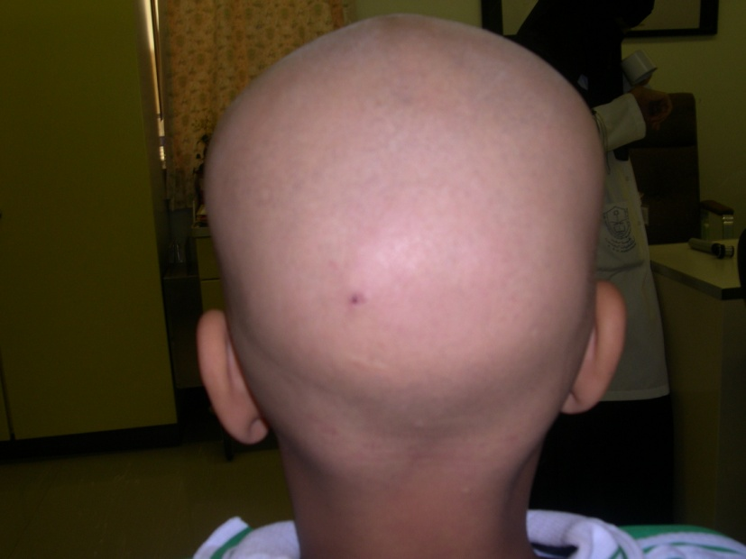

Slide 16
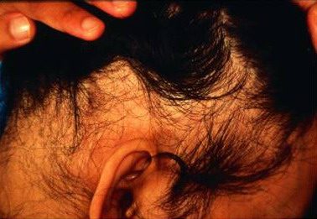

Slide 17
Bad prognostic signs
Young age
Atopy
Alopecia totalis, universalis, ophiasis
Nail changes

Slide 18
Treatment
1. Observation
2. Intralesional Corticosteroids
3. Skin Sensitizers
Anthraline
Diphencyclopropenone (DPCP)
others

Slide 19
Others
Topical steroids &Minoxidil
Systemic Steroids
Cytotoxic Rx
Phototherapy (PUVA)

Slide 20
Androgenetic Alopecia
(Male and Female Pattern Hair Loss)

Slide 21
Androgen dependent loss of scalp hair
Androgenetic Alopecia affects up to 50% of males and 40% of females
Autosomal dominant with variable penetrance
85% : +ve family history

Slide 22
5 ALPHA Reductase
Testosterone
DihydorTestosterone (Active)
Miniaturization of Terminal Hairs

Slide 23
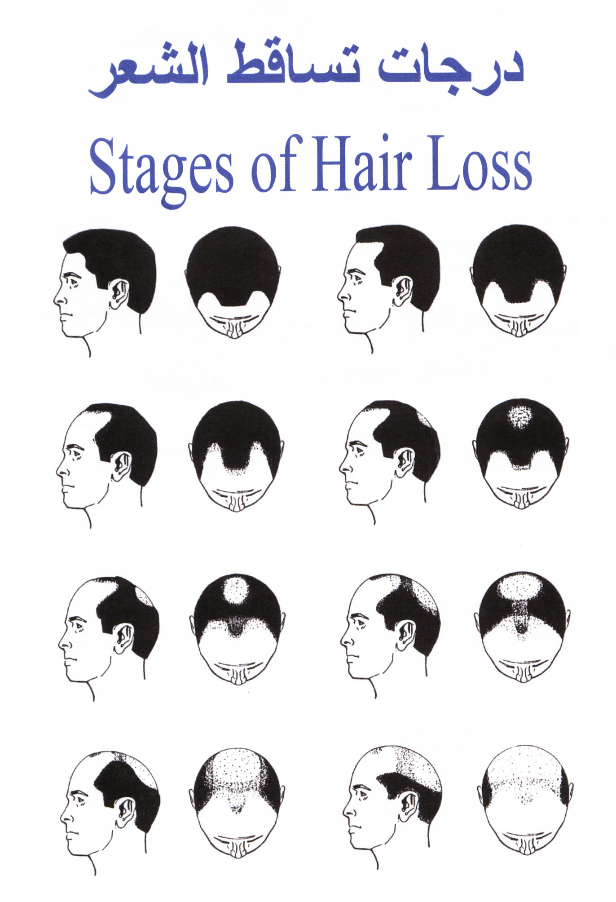
Male Pattern Hair Loss

Slide 24
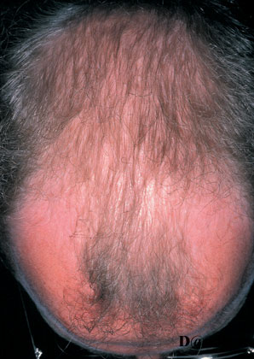

Slide 25
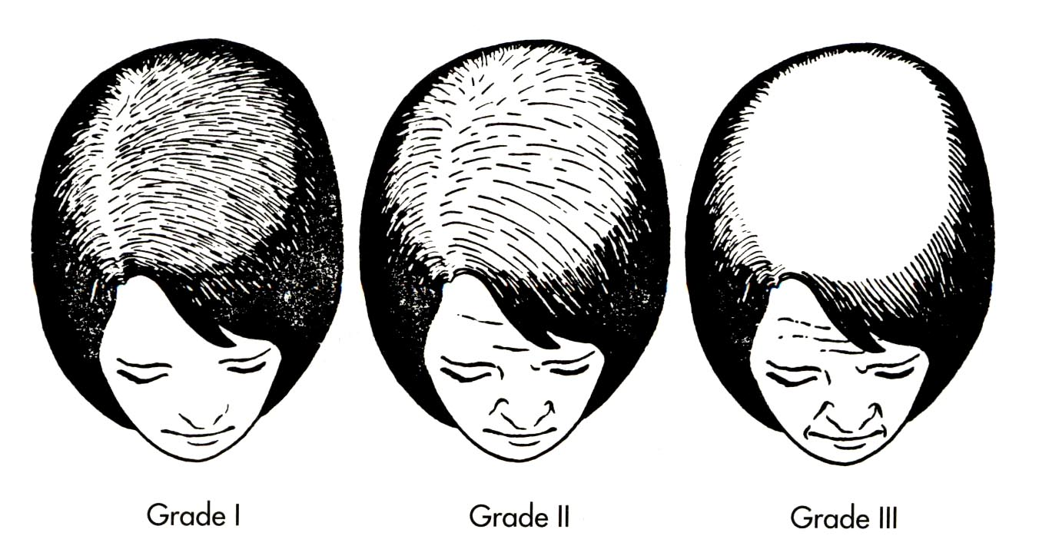
Female Pattern Hair Loss

Slide 26
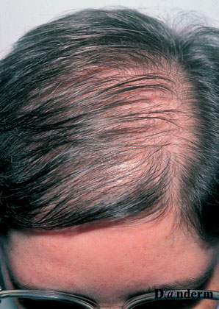

Slide 27
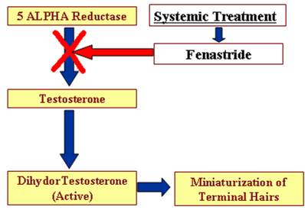
Treatment
Topical: Minoxidil 2%- 5% solution
Systemic:
Finastride
Spironolactone
OCPs
Hair transplant

Slide 28
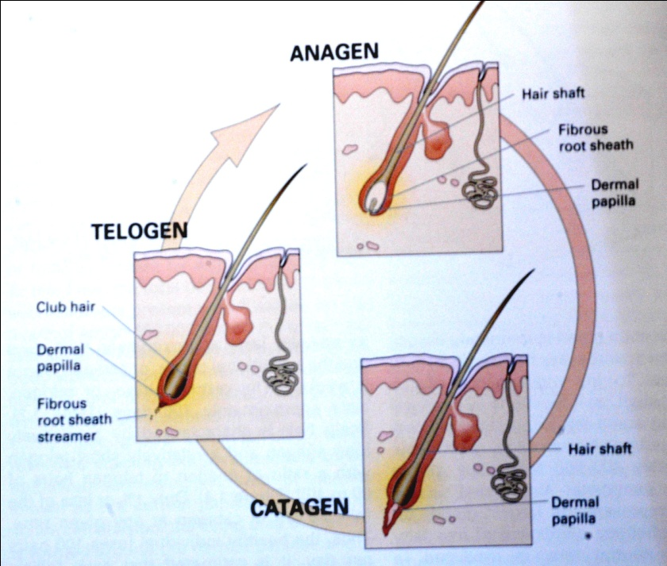
Telogen effluvium
Acute alopecia
Reversible (but may be become chronic)
3-4 months

Slide 29
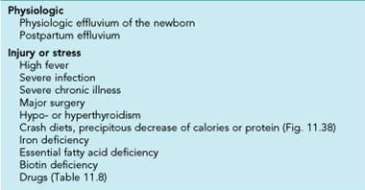

Slide 30
Treatment
Remove or treat the cause
Minoxidil 2%-5% Solution

Slide 31
Anagen effluvium
Always related to cytotoxic chemotherapy
Acute and severe alopecia
Mostly reversible but not always

Slide 32
Scarring Alopecia
SLE—DLE
LP
Sarcoidosis
Leprosy
Kerion
Trauma

Slide 33
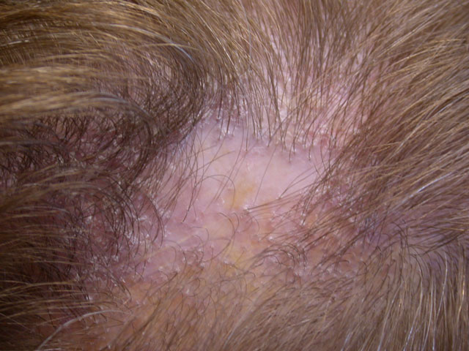

Slide 34
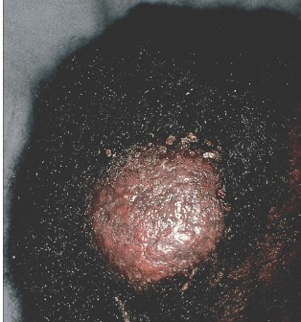

Slide 35
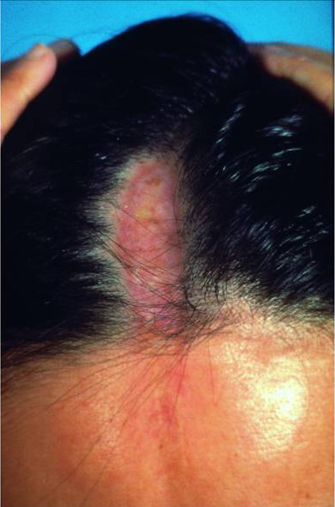

Slide 36
Excessive hair growth

Slide 37
Hirsutism
Excess growth of androgen-dependent hair in a male pattern affecting Female
Causes: Adrenal, pituitary, Ovarian (PCO), Turner syn., iatrogenic (drug), Idiopathic (the commonest)

Slide 38
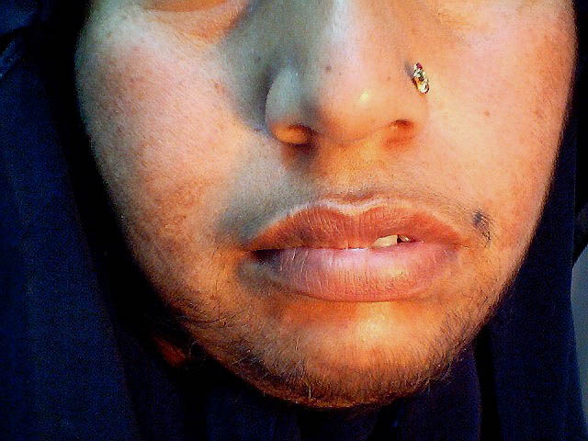
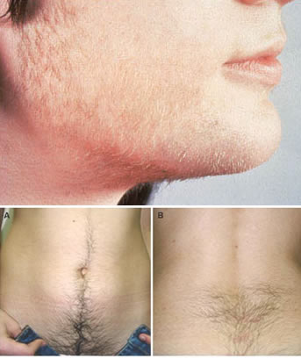

Slide 39
Hypertrichosis
Excess growth of hair in a non-androgenic pattern affecting both sex
Causes:
Congenital
Acquired: drug, porphyria, endocrine (thyroid , anorexia nervosa )

Slide 40
