Slide 1
Pigmentary disorders
Mohammed A. AlShahwan MD
Assistant professor & Consultant Dermatologist

Slide 2
Objective
Pathogenesis, features and management of different pigmentary disorders including:
Freckle
Different types of Melanocytic naevi
Melasma
Vitiligo

Slide 3
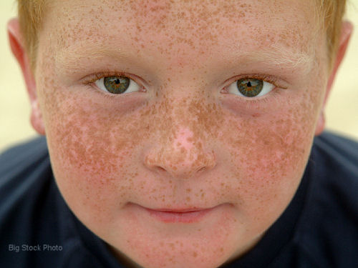
Freckle (Lentigo)
Overactivity of an increased no. of melanocytes.
Fair individuals
Sun exposure in genetically predisposed individuals
Sun block & bleaching cream
Pigmented laser (recurrence)

Slide 4
Melanocytic naevi (mole)
Acquired MN : very common, small, uniform, no need for treatment except ABCD
( ? Change in size shape, edge, color)
Congenital MN: variable size could be Giant CMN (Bathing trunk) could harbor “Malignant melanoma”
Atypical naevi (dysplastic): larger with one or more atypical signs “4 or more: risk of malignant melanoma in the subject”.

Slide 5
Blue naevi : deep-blue color and common on face, hand or feet.
Halo naevi: compound naevi with halo of depigmentation.
Spitz naevi: common on children face with pink or pale brown color and in adult carry the risk of transformation to malignant melanoma

Slide 6
Acquired melanocytic nevus

Slide 7
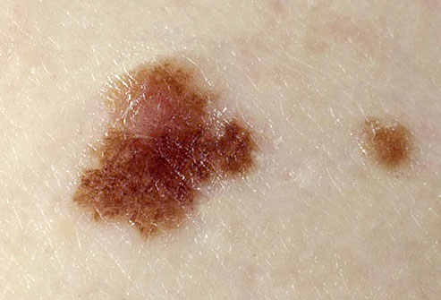
Atypical naevus (dysplastic)

Slide 8
Congenital melanocytic nevus

Slide 9
Halo naevus

Slide 10
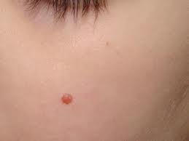
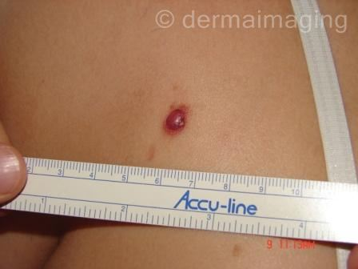
Spitz nevus

Slide 11
Blue naevus

Slide 12
Melasma (chloasma)
Genetically programmed increase in melanogenesis
Affecting the Face
Could be induced by Pregnancy, OCP
and excessive Sun exposure
Treatment: sun block & bleaching cream

Slide 13
Vitiligo
Acquired depigmentation
“Kobner phenomena”
Causes
Genetic
Autoimmune disease.
Neural
Cytotoxicity.
Natural coarse
Variable

Slide 17
Loss of normal melanocytes
“Dopa stain”

Slide 18
TREATMENT
Limited:
Class 3 topical corticosteroids
Topical Tacrolimus
Topical PUVA
Excimer laser
Resistant but Stable of 2 years : Surgical treatment
Generalized:
Phototherapy (NBUVB ,PUVA)
Bleaching agent

