Slide 1
ACNE VULGARIS
Medical Students curriculum 2014
Salman M S AlSaad, MD
American Board of Dermatology
Head of Dermatology Unite at KAUH

Slide 2
Why Acne is important?

Slide 3
Importance
85% adolescents experience it
Prevalence of comedones (lesions) in adolescents approaches 100%
Acne vulgaris is the most common cutaneous disorder in the U.S.
10 percent of all patient encounters with primary care physicians.
Pts can experience significant psychological morbidity and, rarely, mortality due to suicide.
Important that physicians are familiar with Acne Vulgaris and its treatment.

Slide 4
Pathogenesis:

Slide 5
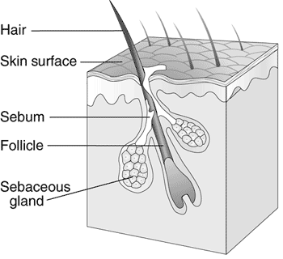
pilosebaceous units in the dermis
These units consist of hair follicle and the associated sebaceous glands.
They are connected to the skin by a duct(infundibulum) through which the hair shaft passes.
The cause of acne is an increase in the activity of the sebaceous glands and the epithelial tissue lining the infundibulum.

Slide 6
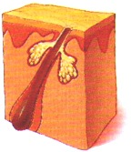
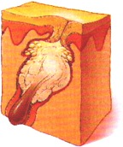
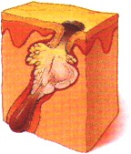
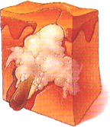
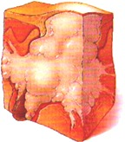
Etiology, signs and symptoms
Acne vulgaris is a disease of pilosebaceous follicles.
Factors:
Retention hyperkeratosis.
Increased sebum production.
Propionibacterium acnes
within the follicle.
Inflammation

Slide 7
Types and Definitions

Slide 8
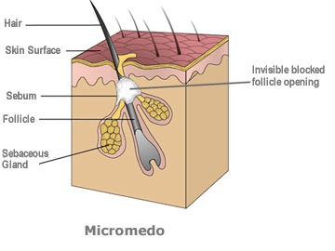
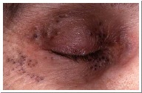
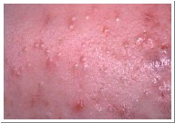
Microcomedone
hyperkeratotic plug made of sebum and keratin in follicular canal
Closed comedones (whiteheads)
Open comedo (blackhead)

Slide 9
Inflammatory Acne
Acne characterized by inflammation surrounding the comedones, papules, pustules, and nodulocystic lesions. it may cause permanent scarring.
Normal sebum does not contain free fatty acids and is nonirritating, however, in the presence of biolytic enzymes produced by P.acne) , triglycerides of the sebum are split and release fatty acids which are irritating to the tissue.
The inflamed follicle or pustules either heal in about a week or develop in to cyst or sterile abscesses, which can lead to scaring.

Slide 10
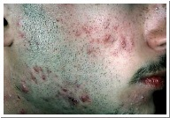
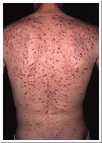
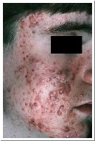
Cysts
when follicles rupture into surrounding tissues, resulting in papule/pustule/nodule.

Slide 11
Severity of Acne
Typical mild acne: comedones predominate
More severe cases: pustules and papules predominate, heal with scar if deep
Acne Conglobata: suppurating cystic lesions predominate, and severe scarring results

Slide 12
Aggravating Factors
Change in sebaceous activity and hormonal level (e.g. before or during premenstrual cycle)
High humidity conditions
Local irritation or friction
Rough or occlusive clothing
Cosmetics( having greasy base)
Diet; chocolate, nuts, fats colas, or carbohydrates.
Oils greases , or dyes in hair product.

Slide 13
Medications That Can Cause Acne
ACTH
Azathioprine
Barbiturates
Isoniazid
Lithium
phenytoin Disulfiram
Halogens
Iodides
Steroids
Cyclosporine
Vitamins B2,6,12

Slide 14
Treatment of Acne Vulgaris
depends on type of clinical lesions
Microcomedone matures in 8 weeks
Therapy must continue beyond this time frame
considerable heterogeneity in the acne literature, and no clear evidence-based guidelines are available

Slide 15
Ingredients in OTC products
Sulfur 2-10 % other forms, such as zinc sulfide or sodium thiosulfate.
Sulfur presents a paradox in that it helps resolve formed comedones but may promote the formation of new ones. Due to this comedogenic effect, the use of salicylic acid or resorcinol is preferred.
Resorcinol and salicylic acid;

Slide 16
Ingredients in OTC products
Benzoyl peroxide;(5 to 10%)a primary irritant.
Salicylic acid is used in concentration of o.5 to 2%.
Applied at night after washing the affected area with soap and water.
Resorcinol(1 to 4%) may produce a dark brown scale on some black- skinned people.

Slide 17
Tretinoin Transe retinoic acid
The acid form of vitamin A, is a strong primary irritant.
The products are applied at night. They cause a feeling of warmth or slight stinging . Optimum results occur in3 to 4 months.
Care should be taken to avoid touching with eyes, nose, and mouth with tretinoin.
Exposure to strong sunlight should be avoided because of the increased sensitivity of the skin.
Does not cause the toxic effects of a large doses of vitamin A

Slide 18
Antibiotics
Tetracycline and some other antibiotics orally administered reduce bacterial population and the concentration of the fatty acids in the sebaceous follicle.
Topical antibacterial agents generally are ineffective, because acne is not an infection.

Slide 19
Antibiotics
ERYTHROMYCIN:
Erythromycin reduce level of fatty acid of the follicles.
It is lipid soluble antibiotics which can penetrate the sebaceous follicle.

Slide 20
Comedonal acne
Other topical agents:
Useful when topical retinoids not tolerated
Salicylic acid (promotes desquamation)
Azelaic acid (antimicrobial, reduces hyperpigminetation)
Gycolic acid
Sulfur in OTC rx (keratolytic)

Slide 21
Mild to moderate inflammatory acne
Benzoyl peroxide: (antimicrobial, anticomedonal, pregnancy risk C)
Topical antibiotic
Combination of both
Combination rx more effective than mono in increased inflammatory lesions.

Slide 22
Moderate to severe acne:
Oral isotretinoin
Reduces sebaceous gland size/sebum production
regulates cell proliferation and differentiation
Effect last 1 yr after cessation
Only med altering course of A. Vulgaris

Slide 23
Moderate to severe acne: oral isotretinoin
Adverse effects can be severe:
Inc TG, teratogenic, bone marrow suppression, hepatotoxicity, top 10 drugs for suicide/depression reports.
FDA practice rules:
2 negative pregnancy tests before rx
Pregnancy test each month (bring pt in)
Pregnancy risk pts must use 2 contraceptive for at least 1 mo prior to rx.

Slide 24
Moderate to severe acne:
Oral antibiotics
-Tetracycline - erythromycin
- minocycline - TMP-SMX
- doxycycline - clindamycin
Given daily over 4-6 mo, with taper.

Slide 25
Patient FAQs
Soaps, detergents remove sebum but do not alter production
Avoid occlusive clothing
Water based cosmetic better than oil based
Diet modification no role in Rx

Slide 26
Acne Related Disorders

Slide 27
Rosacea

Slide 28
Rosacea
facial flushing
erythema
telangiectasia
coarseness of skin
inflammatory papulopustular eruption resembling acne.

Slide 29
Rosacea

Slide 30
Types
• Erythematotelangiectatic type
• Papulopustular
• Phymatous
• Ocular

Slide 31
Erythematotelangiectatic type
Central facial flushing, often accompanied by burning or stinging
Redness usually spares the periocular skin
Skin typically has a fine texture that lacks a sebaceous quality characteristic of other subtypes
Erythematous areas of the face at times appear rough with scale, likely due to chronic, low-grade dermatitis
Frequent triggers to flushing include acutely felt emotional stress, hot drinks, alcohol, spicy foods, exercise, cold or hot weather, and hot baths and showers
Patients report that the burning or stinging is exacerbated when topical agents are applied

Slide 32
Papulopustular rosacea
This is the classic presentation of rosacea; features include the following:
Patients are typically women of middle age
Patients usually present with a red central portion of the face containing small erythematous papules surmounted by pinpoint pustules
Patient may describe a history of flushing
Telangiectasias are likely present but may be difficult to distinguish from the erythematous background in which they exist

Slide 33
Phymatous rosacea
Marked skin thickenings and irregular surface nodularities of the nose, chin, forehead, 1 or both ears, and/or the eyelids

Slide 34
Ocular rosacea
Blepharitis
Conjunctivitis
Inflammation of the lids and meibomian glands
Interpalpebral conjunctival hyperemia
Conjunctival telangiectasias

Slide 35
Treatment
control triggers
First line : Topical metronidazole
Topical azelaic acid
sulfacetamide products
topical acne medications
Topical and oral antibiotics.

Slide 36
Neonatal Acne
First four weeks of life
Develops a few days after birth
Facial papules or pustules
Cases that persist beyond 4 weeks or have an onset after
R/O acne cosmetic, acne venenata, drug-induced acne

Slide 37
SAPHO Syndrome
Synovitis, Acne, Pustulosis, Hyperostosis, and Osteomyelitis
Acne fulminans, acne conglobata, pustular psoriasis, and palmoplantar pustulosis
Chest wall is most site of musculoskeletal complaints

Slide 38
Acne Conglobata
Conglobate: shaped in a rounded mass or ball
Severe form of acne characterized by numerous comedones, large abscesses with sinuses, grouped inflammatory nodules
Suppuration
Cysts on forehead, cheeks, and neck

Slide 39
Acne Conglobata
Occurs most frequently in young men
Follicular Occlusion Triad: acne conglobata, hiradenitis suppurva, cellulitis of the scalp
Heals with scarring
Treatment; oral isotretinoin for 5 months

Slide 40
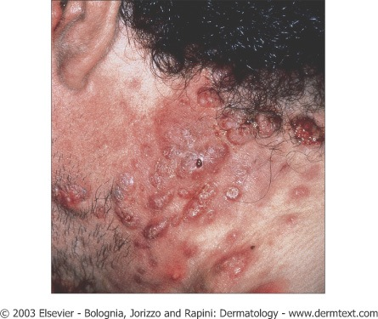
Acne Conglobata

Slide 41
Acne Fulminans
Rare form of extremely severe cystic acne
Teenage boys, chest and back
Rapid degeneration of nodules leaving ulceration
Fever, leukocytosis, arthralgias are common
Tx; oral steroids, isotretinoin

Slide 42
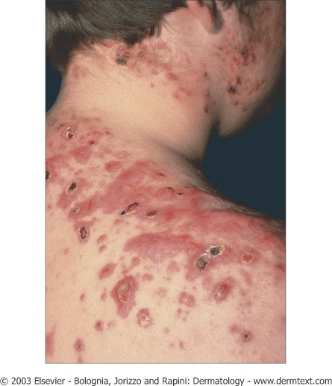
Acne Fulminans

Slide 43
Tropical Acne
Nodular, cystic, and pustular lesions on back, buttocks, and thighs
Face is spared
Young adult military stationed in tropics

Slide 44
Acne Venenata
Contact with acnegenic chemicals can produce comedones
Chlorinated hydrocarbons, cutting oils, petroleum oil, coal tar
Radiation therapy

Slide 45
Acne Cosmetica
Closed comedones and papulopustules on the chin and cheeks
May take months to clear after stopping cosmetic product
Pomade Acne; blacks, males, due to greases or oils applied to hair

Slide 46
Acne Detergicans
Patients wash face with comedogenic soaps
Closed comedones
TX; wash only once or twice a day with non-comedogenic soap

Slide 47
Acne Aestivalis
Aka; Mallorca acne
Rare, females 25-40 yrs
Starts in spring, resolves by fall
Small papules on cheeks, neck, upper body
Comedones and pustules are sparse or absent
Tx; retinoic acid, abx don’t help

Slide 48
Excoriated Acne
Aka; picker’s acne
Girls, minute or trivial primary lesions are made worse by squeezing
Crusts, scarring, and atrophy
TX; eliminate magnifying mirror, r/o depression

Slide 49
Acneiform Eruptions
Originate from skin exposure to various industrial chemicals
Papules and pustules not confined to usual sites of acne vulgaris
Chlorinated hydrocarbons, oils, coal tar
Oral meds; iodides, bromides, lithium, steroids (steroid acne)

Slide 50
Gram Negative Folliculitis
Occurs in patients treated with antibiotics for acne over a long-term
Enterobactor, Klebsiella, Proteus
Anterior nares colonized
Tx; isotretinoin, Augmentin

Slide 51
Acne Keloidalis
Folliculitis of the deep levels of the hair follicle that progresses into a perifolliculitis
Occurs at nuchal area in blacks or Asian men
Not associated with acne vulgaris
Hypertrophic connective tissue becomes sclerotic, free hairs trapped in the dermis contribute to inflammation
Tx; intralesional Kenalog, surgery

Slide 52
Hiradenitis Suppurativa
Disease of the apocrine gland
Axillae, groin, buttocks, also areola
Obesity and genetic tendency to acne
Tender red nodules become fluctuant and painful
Rupture, suppuration, formation of sinus tracts

Slide 53
Hiradenitis Suppurativa
Most frequently axillae of young women
Men usually groin and perianal area
Follicular keratinization with plugging of the apocrine duct; dilation and inflammation

Slide 54
Hiradenitis Suppurativa
Oral antibiotics, culture S. aureus, gram-negatives
Intralesional steroids, surgery
Isotretinoin helpful in some cases

Slide 55
Dissecting cellulitis of the scalp
Uncommon suppurative disease
Nodules suppurate and undermine to form sinuses
Scarring and alopecia
Adult black men most common, vertex and occiput

Slide 56
Dissecting cellulitis of the scalp
Tx; intralesional steroids, isotretinoin, oral abx, surgical incision and drainage

Slide 57
Pyoderma Faciale
Postadolescent girls, reddish cyanotic erythema with abscesses and cysts
Distinguished from acne by absence of comedones, rapid onset, fulminant course and absence of acne on the back and chest
Tx; oral steroids followed by isotretinoin

Slide 58
THANK YOU!

