Slide 1
بسم الله الرحمن الرحيم

Slide 2
Objectives
Gross applied anatomy of the ear
Nerve supply of the external and middle ears and the principles of referred earache
Central connection of the vestibulo- cochlear nerve
Physiology of the external, middle and inner ears

Slide 3
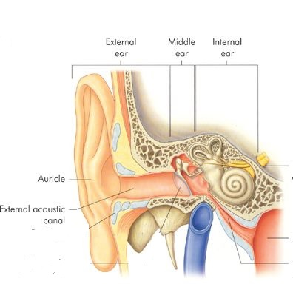
ANATOMY OF THE EAR

Slide 4
EXTERNAL EAR
Auricle
External Canal

Slide 5
The auricle
Lobule

Slide 6
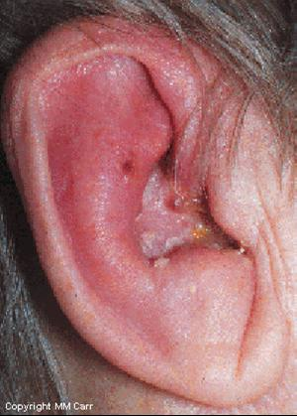
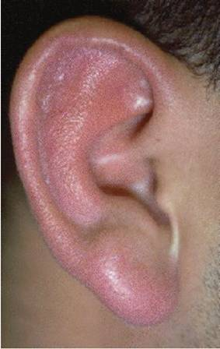
Perichondritis
Erysipelas

Slide 7
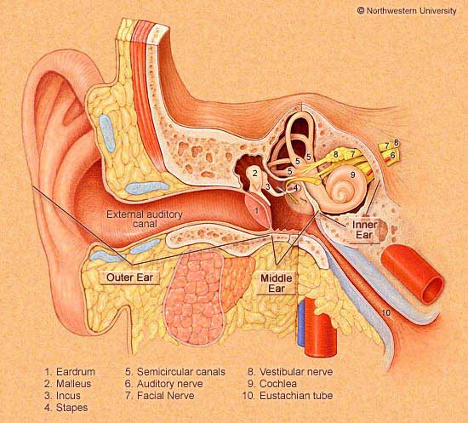
The External Auditory Canal

Slide 8
The External Auditory Canal
Lateral third
Cartilagenous Wall

Slide 9
The External Auditory Canal
Lateral third
Medial two thirds
Cartilagenous Wall
Bony wall

Slide 10
The External Auditory Canal
Lateral third
Medial two thirds
Cartilagenous Wall
Hair follicles
Ceruminous glands
Sebacous glands
Bony wall

Slide 11
The External Auditory Canal
Lateral third
Medial two thirds
Cartilagenous Wall
Hair follicles
Ceruminous glands
Sebacous glands
Bony wall
No glands or hair follicles

Slide 12
The External Auditory Canal
Lateral third
Medial two thirds
Cartilagenous Wall
Hair follicles
Ceruminous glands
Sebacous glands
Present at birth
Bony wall
No glands or hair follicles

Slide 13
The External Auditory Canal
Lateral third
Medial two thirds
Cartilagenous Wall
Hair follicles
Ceruminous glands
Sebacous glands
Present at birth
Bony wall
No glands or hair follicles
Develops after Birth

Slide 14
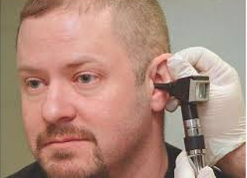

Slide 15
ANATOMY OF THE EAR
External Ear
Middle Ear Cleft
Inner Ear

Slide 16
MIDDLE EAR CLEFT
Eustachian tube (Pharyngo-tympanic)
Tympanum (Middle Ear Cavity)
Mastoid Antrum and Air Cells

Slide 17
MIDDLE EAR CLEFT
Eustachian tube (Pharyngo-tympanic)
Tympanum (Middle Ear Cavity)
Mastoid Antrum and Air Cells

Slide 18
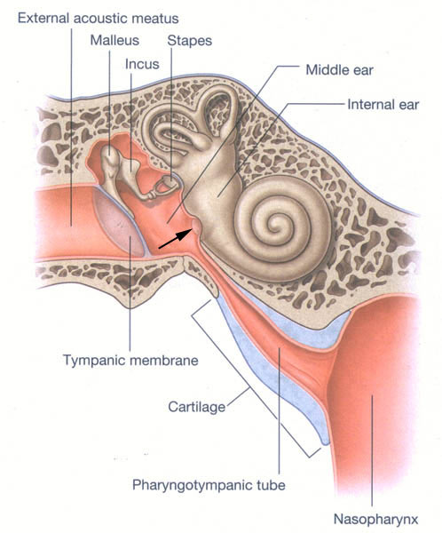
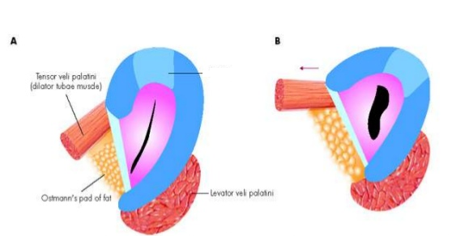
MIDDLE EAR CLEFT
Eustachian (Pharyngo-Tympanic) Tube

Slide 19
MIDDLE EAR CLEFT
Eustachian (Pharyngo-Tympanic) tube
Tympanic cavity (Middle ear cavity)

Slide 20
WALLS OF TYMPANIC CAVITY

Slide 21
WALLS OF TYMPANIC CAVITY
Roof
Floor
Anterior wall
Posterior wall
Lateral wall
Medial wall

Slide 22
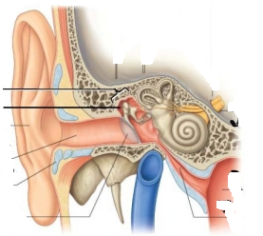
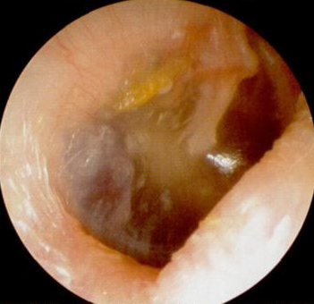
WALLS OF TYMPANIC CAVITY
Tegmen tympani
Roof
Floor

Slide 23
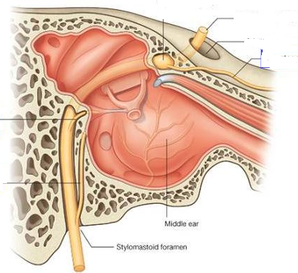
WALLS OF TYMPANIC CAVITY
WALLS OF TYMPANIC CAVITY
Roof
Floor
Anterior wall
Posterior wall
Roof
Floor
Anterior wall
Posterior wall

Slide 24
WALLS OF TYMPANIC CAVITY
Roof
Floor
Anterior wall
Posterior wall

Slide 26
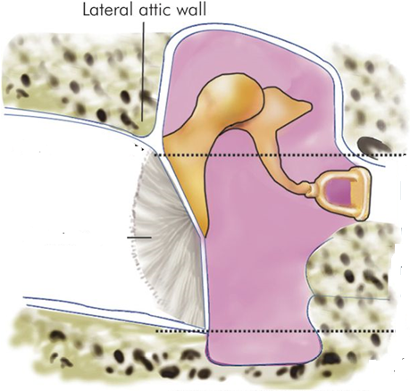
WALLS OF TYMPANIC CAVITY
Roof
Floor
Anterior wall
Posterior wall
Lateral wall

Slide 27
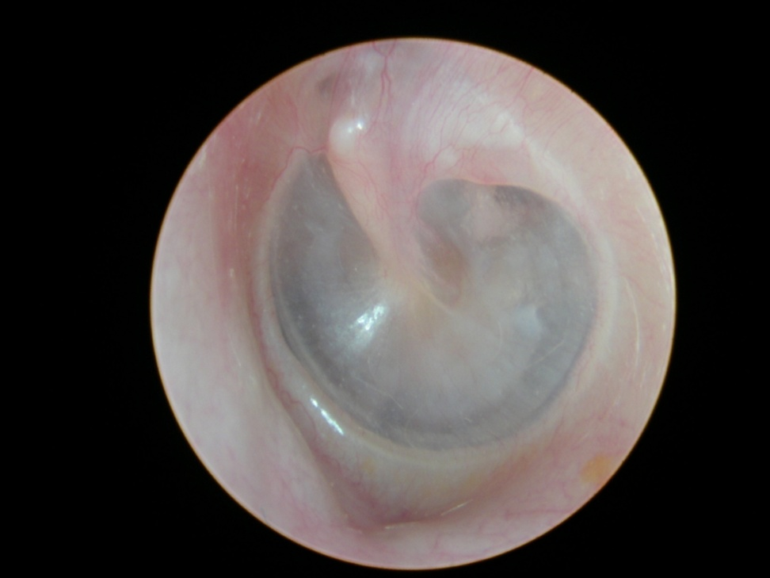
WALLS OF TYMPANIC CAVITY
Roof
Floor
Anterior wall
Posterior wall
Lateral wall
Membrana Flaccida
Annulus
Malleus
Membrana tensa

Slide 28
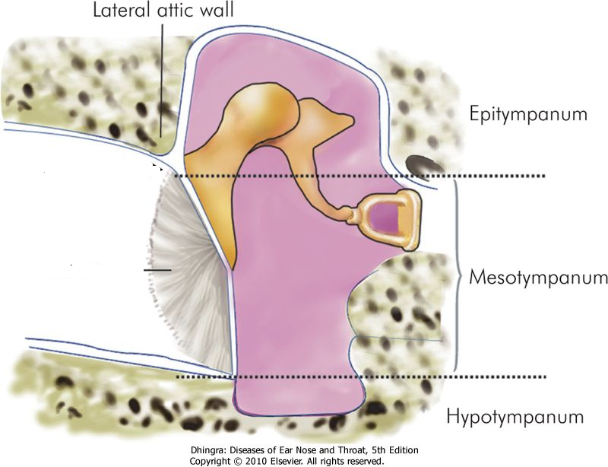

Slide 29
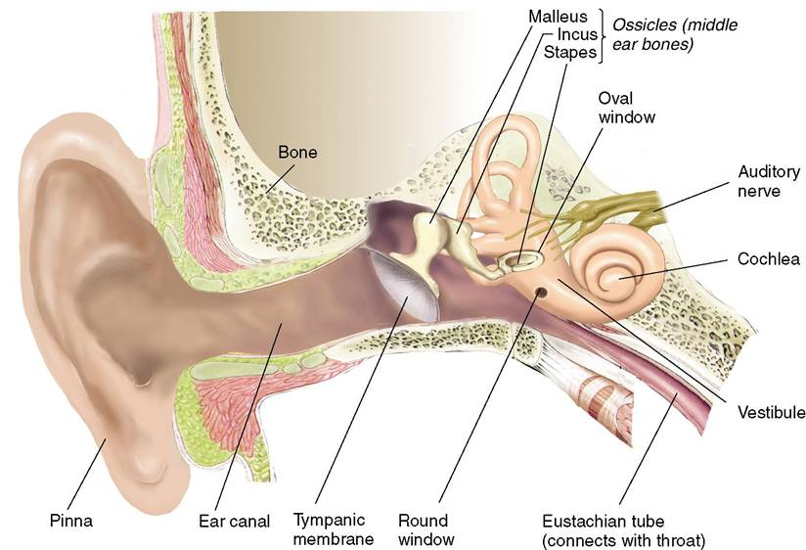
WALLS OF TYMPANIC CAVITY
Roof
Floor
Anterior wall
Posterior wall
Lateral wall
Medial wall

Slide 30
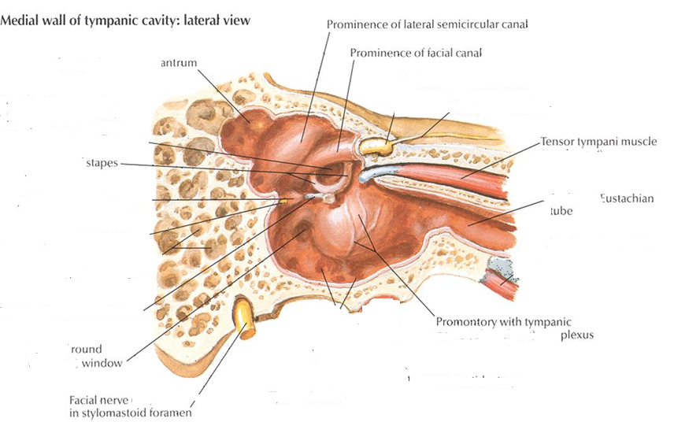

Slide 31
MIDDLE EAR CLEFT
Eustachian (Pharyngo-tympanic) Tube
Tympanic (Middle Ear) Cavity
Mastoid antrum and air cells

Slide 32
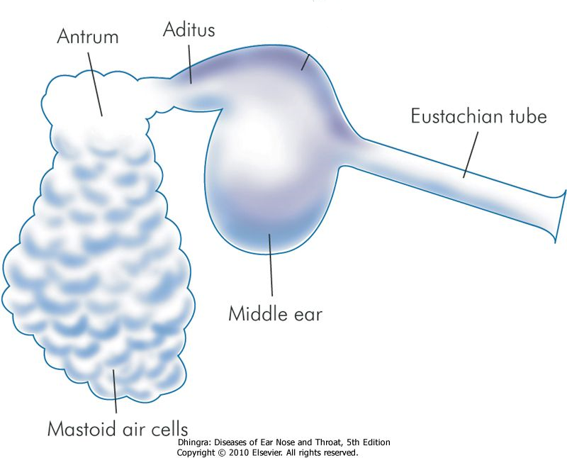
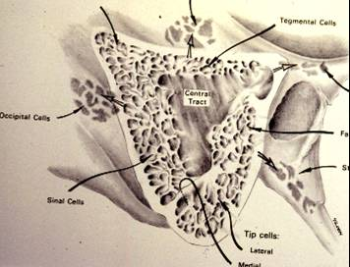
Mastoid Antrum & Air cells

Slide 33
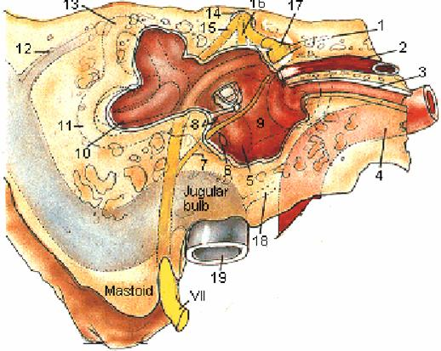
Mastoid Antrum & Air cells

Slide 34
CONTENTS OF MIDDLE EAR CAVITY
Air

Slide 35
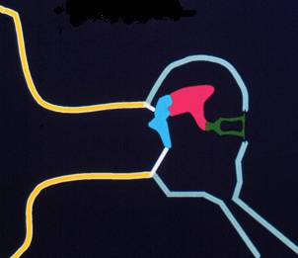
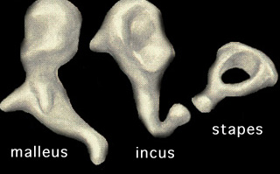
CONTENTS OF MIDDLE EAR CAVITY
Air
Ossicles
Malleus, Incus & Stapes

Slide 36
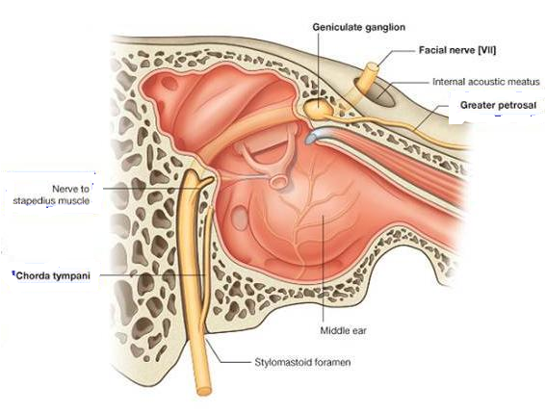
CONTENTS OF MIDDLE EAR CAVITY
Air
Ossicles
Muscles
Tensor tympani
Stapedius

Slide 37
CONTENTS OF MIDDLE EAR CAVITY
Air
Ossicles
Muscles
Nerves
Tympanic plexus
Chorda tympani

Slide 38
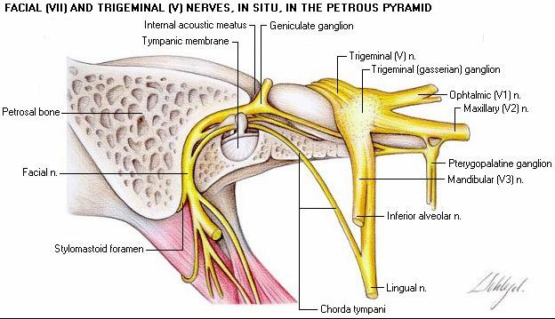

Slide 39
LINING OF MIDDLE EAR
Mucous membrane : ciliated columnar anteriorly and cuboidal or flat elsewhere

Slide 40
SENSARY SUPPLY OF MIDDLE AND EXTERNAL EAR
Cervical II & III ( great auricular and lessor occipital)
V cranial nerve ( auriculotemporal)
IX cranial nerve (tympanic or Jacobson’s)
X cranial nerve ( auricular or Arnold’s)
? VII cranial nerve

Slide 41
Referred Earache
Pain in the ear referred from a territory sharing its sensory innervation with the external or middle ear

Slide 42
Referred Earache
Cervical II & III
Cervical spondylosis, neck injury etc.
V cranial nerve
Dental infections, sinonasal diseases etc.
IX cranial nerve
Tonsillitis, post-tonsillectomy, carcinoma etc.
X cranial nerve
Tumors of hpopharynx, larynx & esophagus

Slide 43
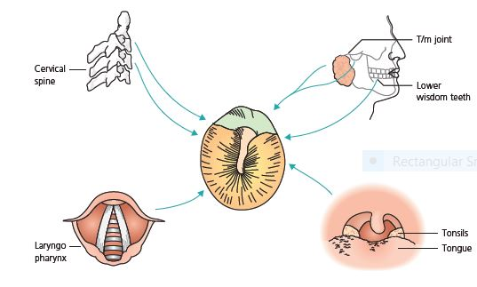
Referred Earache

Slide 44
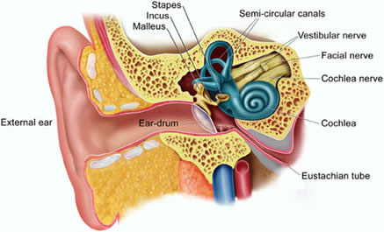
ANATOMY OF INNER EAR

Slide 45
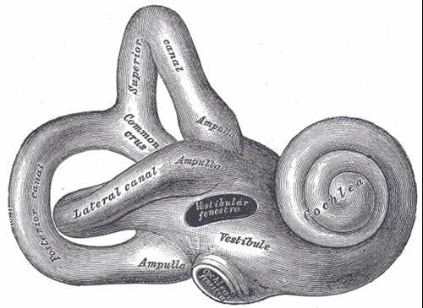
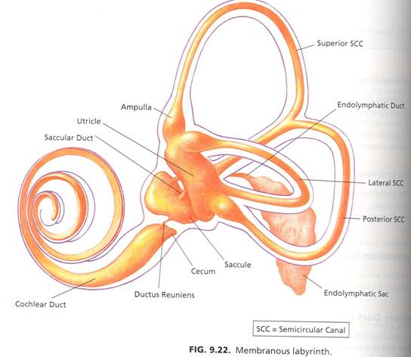
ANATOMY INNER EAR
Bony Labyrinth
Membranous Labyrinth

Slide 46
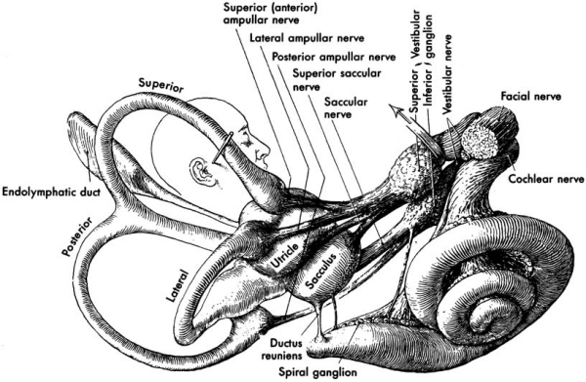

Slide 47
CONTENTS OF MEMBRANOUS LABYRINTH
Endolymph
Sensory epithelium

Slide 48
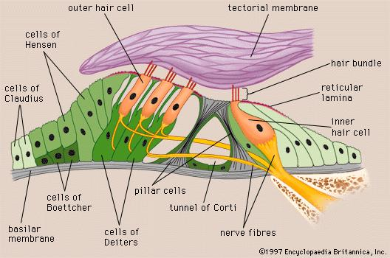
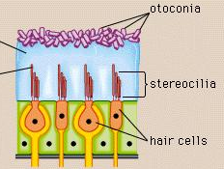
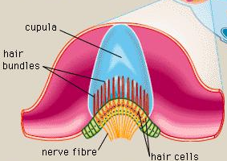
INNER EAR SENSORY EPITHELIUM
Cochlea: organ of Corti
Utricle & saccule: maculae
Semicircular canals: cristae

Slide 49
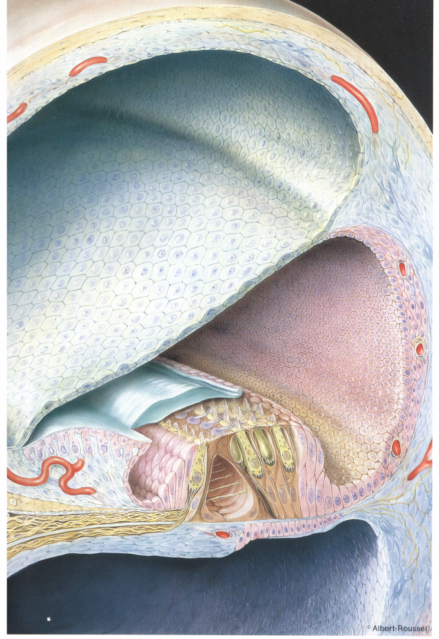

Slide 50
The vestibulo-cochlear nerve

Slide 51
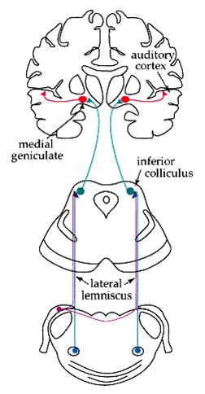
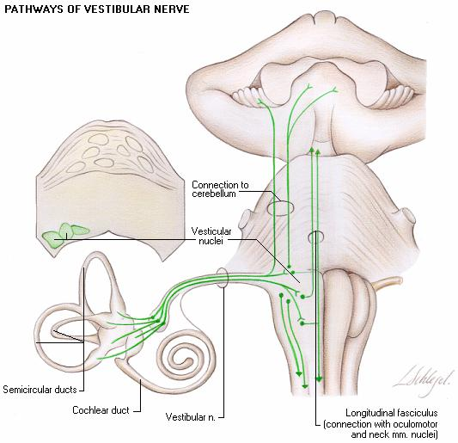
Central Connections

Slide 52
PHYSIOLOGY OF THE EAR

Slide 53
FUNCIONS OF THE EXTERNAL EAR
Protection of the middle ear
Curvature
Cerumen
Auditory functions:
Sound conduction
Increase sound pressure by the resonance function

Slide 54
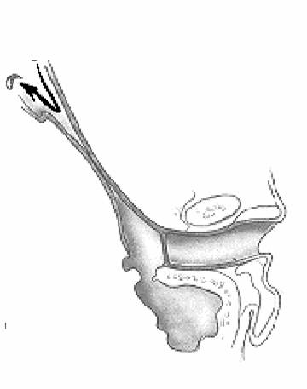
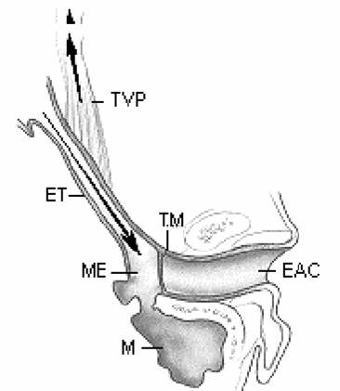
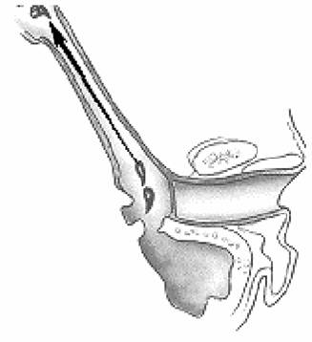
FUNCTIONS OF THE EUSTACHIAN TUBE
Protection
Ventilation
Drainage

Slide 55
FUNCIONS OF THE MIDDLE EAR
Conduction of sound
Transformer mechanism
Hydraulic action
Ossicular leverage

Slide 56
FUNCIONS OF THE MIDDLE EAR
Conduction of sound
Transformer mechanism
Hydraulic action
Ossicular leverage
Protection to the inner ear
stapedial reflex

Slide 57
FUNCIONS OF THE INNER EAR
Hearing Function:
Transduction of sound to action potentials

Slide 58
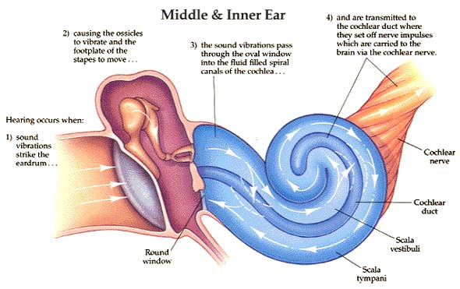

Slide 59
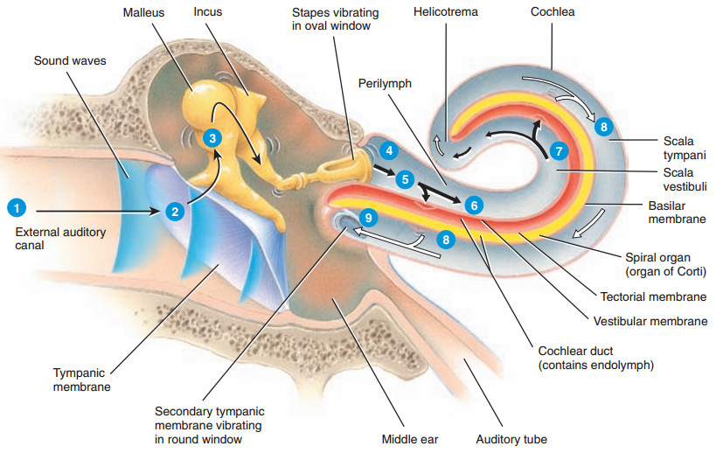

Slide 60
FUNCIONS OF THE INNER EAR
Hearing Function:
Transduction of sound to action potentials
Vestibular Function:
Participate in maintaining body balance

Slide 61
THE BALANCE SYSTEM
C. Cortex
Cerebellum
BRAIN-STEM

Slide 62
THE BALANCE SYSTEM
Vestibular
Proprioceptive
Visual
INPUT
C. Cortex
Cerebellum
BRAIN-STEM

Slide 63
THE BALANCE SYSTEM
Vestibular
Proprioceptive
Visual
INPUT
C. Cortex
Cerebellum
BRAIN-STEM
OUTPUT
Ocular muscles
Postural muscles

Slide 64
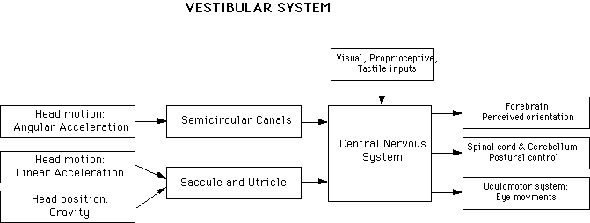

Slide 66
Diseases of External Ear & AOM

Slide 67
Objectives
Recognize the congenital anomalies of the external ear
Diagnose and treat wax accumulation
Diagnose and treat the common external ear inflammatory conditions
Discuss the pathology, clinical features and management of AOM

Slide 68
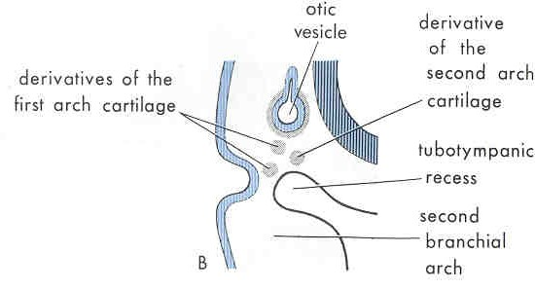
Development of the ear
External and Middle ears from the 1st and 2 ^{nd} pharyngeal arches.
Inner ear from the hind brain

Slide 69
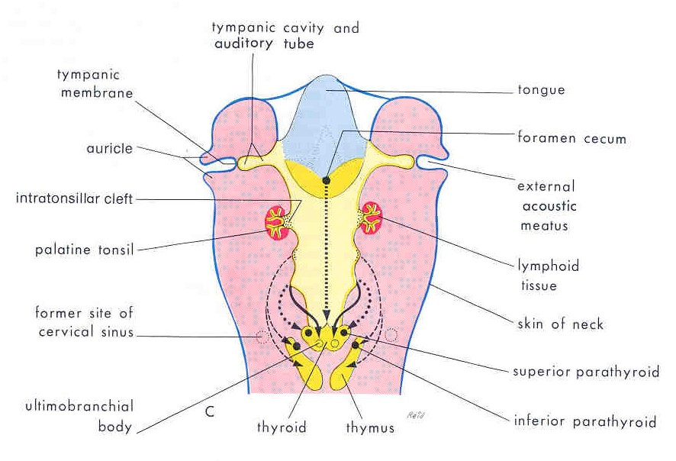
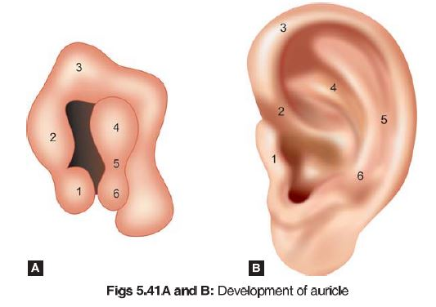

Slide 70
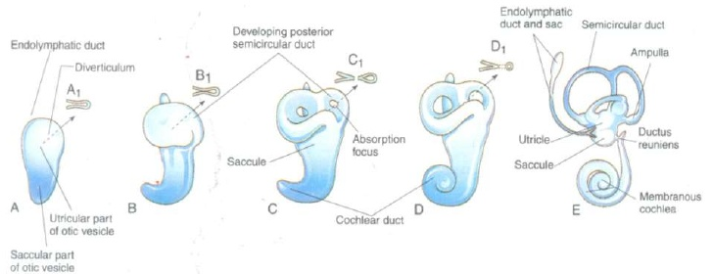

Slide 71
DISEASES OF THE EXTERNAL EAR

Slide 72
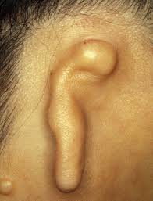
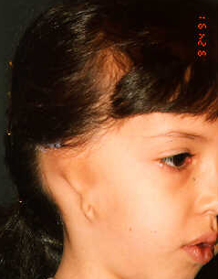
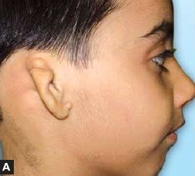
CONGENITAL MALFORMATIONS
Anotia & microtia

Slide 73
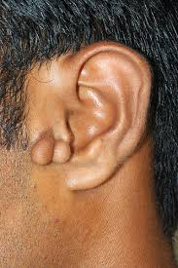
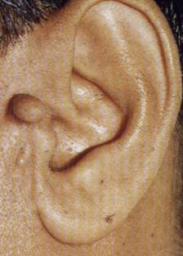
CONGENITAL MALFORMATIONS
Anotia & microtia
Accessory auricle

Slide 74
CONGENITAL MALFORMATIONS
Anotia & microtia
Accessory auricle

Slide 75
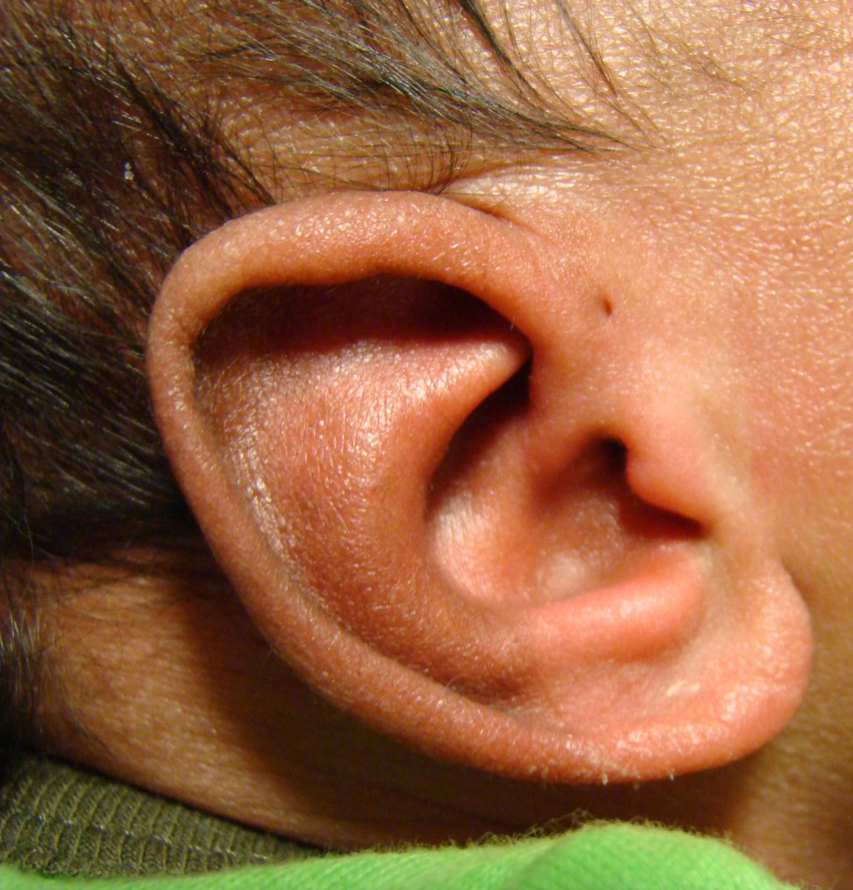
CONGENITAL MALFORMATIONS
Anotia & microtia
Accessory auricle
Pre auricular sinus

Slide 76
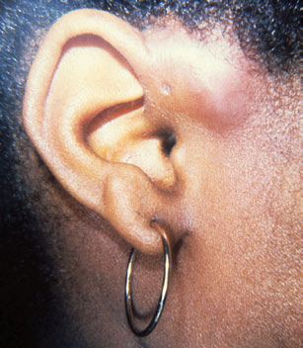
CONGENITAL MALFORMATIONS
Anotia & microtia
Accessory auricle
Pre auricular sinus

Slide 77
CONGENITAL MALFORMATIONS
Anotia & microtia
Accessory auricle
Pre auricular sinus

Slide 79
CONGENITAL MALFORMATIONS
Anotia & microtia
Accessory auricle
Pre auricular sinus

Slide 80
CONGENITAL MALFORMATIONS
Anotia & microtia
Accessory auricle
Pre auricular sinus
Protruding ear

Slide 84
Trauma to the Auricle
Laceration

Slide 87
Trauma to the auricle
Hematoma auris

Slide 88
Complication
Cauliflower ear

Slide 89
Treatment

Slide 90
PERICHONDRITIS OF THE PINNA
Usually follow trauma (hematoma auris, surgical, frostbite, burn) or otitis externa
Commonly caused by Pseudomonas
Fever, pain, redness and swelling.

Slide 91
PERICHONDRITIS OF THE PINNA
Usually follow trauma (hematoma auris, surgical, frostbite, burn) or otitis externa
Commonly caused by Pseudomonas
Fever, pain, redness and swelling.

Slide 92
PERICHONDRITIS OF THE PINNA
Usually follow trauma (hematoma auris, surgical, frostbite, burn) or otitis externa
Commonly caused by Pseudomonas
Fever, pain, redness and swelling.

Slide 93
PERICHONDRITIS OF THE PINNA
Usually follow trauma (hematoma auris, surgical, frostbite, burn) or otitis externa
Commonly caused by Pseudomonas
Fever, pain, redness and swelling
.

Slide 94
PERICHONDRITIS OF THE PINNA
Usually follow trauma (hematoma auris, surgical, frostbite, burn) or otitis externa
Commonly caused by Pseudomonas
Fever, pain, redness and swelling
Treatment is by antibiotics
.

Slide 95
Complication
Cauliflower ear

Slide 97
OTITIS EXTERNA

Slide 98
DEFINITION
An acute or chronic infection of the whole or a part of the skin of the external ear canal

Slide 106
Predisposing Factors
Local trauma from scratching the canal with a cotton swab, fingernail ….etc
Frequent swimming
Warm and humid climate
Use of hearing aids or earplugs
Diabetes or an immunocompromised state
Skin conditions: eczema,seborrhea, etc

Slide 107
Clinical features of otitis externa
Itching
Pain
Tenderness and swelling
Otorrhea
? Deafness
Changes in the lumen and skin of EAM

Slide 108
Clinical types of otitis externa
Localize O.E ( furuncle)

Slide 109
Clinical types of otitis externa
Localize O.E ( furuncle)

Slide 110
Clinical types of otitis externa
Localize O.E ( furuncle)
Diffuse infective O.E.

Slide 111
Clinical types of otitis externa
Localize O.E ( furuncle)
Diffuse infective O.E.

Slide 112
Clinical types of otitis externa
Localize O.E ( furuncle)
Diffuse infective O.E.
Otomycosis

Slide 113
Clinical types of otitis externa
Localize O.E ( furuncle)
Diffuse infective O.E.
Otomycosis

Slide 114
Clinical types of otitis externa
Localize O.E ( furuncle)
Diffuse infective O.E.
Otomycosis
Bullous myringitis

Slide 115
Clinical types of otitis externa
Localize O.E ( furuncle)
Diffuse infective O.E.
Otomycosis
Bullous myringitis

Slide 116
Clinical types of otitis externa
Localize O.E ( furuncle)
Diffuse infective O.E.
Otomycosis
Bullous myringitis
Herpetic O.E

Slide 117
Clinical types of otitis externa
Localize O.E ( furuncle)
Diffuse infective O.E.
Otomycosis
Bullous myringitis
Herpetic O.E

Slide 118
Clinical types of otitis externa
Localize O.E ( furuncle)
Diffuse infective O.E.
Otomycosis
Bullous myringitis
Herpetic O.E
Eczematous and seborrheic O.E.

Slide 119
Clinical types of otitis externa
Localize O.E ( furuncle)
Diffuse infective O.E.
Otomycosis
Bullous myringitis
Herpetic O.E
Eczematous and seborrheic O.E.

Slide 120
Management of otitis externa
Swab for culture and sensitivity

Slide 121
Management of otitis externa
Swab for culture and sensitivity
Ear toilet

Slide 122
Management of otitis externa
Swab for culture and sensitivity
Ear toilet

Slide 123
Management of otitis externa
Swab for culture and sensitivity
Ear toilet
Keep the ear dry
Local medications

Slide 124
Management of otitis externa
Swab for culture and sensitivity
Ear toilet
Keep the ear dry
Local medications

Slide 125
Management of otitis externa
Swab for culture and sensitivity
Ear toilet
Keep the ear dry
Local medications
Systemic medications
Surgery may be required in chronic cases

Slide 126
Acute necrotizing (malignant) otitis externa
An acute Pseudomonas infection of the skin of the external ear canal which has spread to the adjacent bone. It occurs mostly in elderly diabetic patients.

Slide 127
Complications

Slide 128
DIAGNOSIS
Diabetes
Advanced age
Severe otalgia
Granulation tissue & sequestra
Cranial nerves involvement
Radiology

Slide 130
TREATMENT
Control of diabetes
Anti Pseudomonas antibiotics
Local treatment and debridement
The role of surgery remains controversial

Slide 131
MISCELLANEOUS CONDITIONS OF THE EXTERNAL EAR

Slide 132
WAX
Mixture of ceruminous and sebaceous glands secretion
Normally is expelled from the canal aided by movements of the jaw
When accumulated it may cause deafness, earache or tinnitus

Slide 134
WAX
Treatment is by removal using syringing, suction or instrumentation

Slide 135
Irrigation (syringing)

Slide 136
Suction

Slide 137
Instrumentation

Slide 138
Instrumentation

Slide 139
KERATOSIS OBTURANS
Accumulation of desquamated epithelium in the bony canal
It may be associated with sinusitis, bronchiectasis or primary ciliary dyskinesia
Usually cause deafness and pain
Treatment is periodic removal

Slide 140
ACUTE OTITIS MEDIA

Slide 141
DEFINITION
Acute infection of the mucous membrane lining of the middle ear cleft

Slide 142
PREDISPOSING FACTORS

Slide 143
PREDISPOSING FACTORS
Age

Slide 144
PREDISPOSING FACTORS
Age
Maleness

Slide 145
PREDISPOSING FACTORS
Age
Maleness
Bottle feeding

Slide 146
PREDISPOSING FACTORS
Age
Maleness
Bottle feeding
Climate

Slide 147
PREDISPOSING FACTORS
Age
Maleness
Bottle feeding
Climate
Crowded living conditions

Slide 148
PREDISPOSING FACTORS
Age
Maleness
Bottle feeding
Climate
Crowded living conditions
Heredity

Slide 149
PREDISPOSING FACTORS
Age
Maleness
Bottle feeding
Climate
Crowded living conditions
Heredity
Associated conditions: cleft palate, immunodeficiency, ciliary dyskinesia, Down syndrome, and cystic fibrosis

Slide 150
ROUTE OF INFECTION
Eustachian tube
External auditory canal
Blood borne

Slide 151
BACTERIOLOGY
Streptococcus pneumonia
Haemophilus influenzae
Branhamella catarrhalis
Streptococcus pyogens
Staphylococcus aureus

Slide 152
PATHOLOGY

Slide 153
CLINICAL PICTURE
Tubal occlusion
Suppurative inflammation
Tympanic membrane rupture
Resolution

Slide 154
CLINICAL PICTURE
Tubal occlusion
Discomfort, autophony, retracted drum
Suppurative inflammation
Tympanic membrane rupture
Resolution

Slide 155
CLINICAL PICTURE
Tubal occlusion
Discomfort, autophony, retracted drum
Suppurative inflammation
Fever, sever earache, deafness, bulging drum
Tympanic membrane rupture
Resolution

Slide 156
CLINICAL PICTURE
Tubal occlusion
Discomfort, autophony, retracted drum
Suppurative inflammation
Fever, sever earache, deafness, bulging drum
Tympanic membrane rupture
Otorrhea.
Temp & earache subside
Resolution

Slide 157
CLINICAL PICTURE
Tubal occlusion
Discomfort, autophony, retracted drum
Suppurative inflammation
Fever, sever earache, deafness, bulging drum
Tympanic membrane rupture
Otorrhea
Temp & earache subside
Resolution

Slide 159
TREATMENT
Symptomatic
Antimicrobials
Amoxycillin/clavulanic acid
Tri-methoprim-sulphamethoxazole
Cefaclor, cefixime
Erythromycin-sulfisoxazole
Decongestant
Myringotomy
Ear toilet and local antibiotics

Slide 160
RECURRENT ACUTE OTITIS MEDIA

Slide 161
DEFINITION
Three or more attacks over a 6-months period

Slide 162
TREATMENT
Long-term low dose antimicrobials
Ventilation tube insertion

Slide 164
OFFICE HOURS Prof. YOUSRY EL-SAYED
Flat 407 - Building 5 - King Abdel-Aziz University Hospital
Mondays from 11 am to 1 pm
Thursdays 11 am to 1 pm

Slide 165
THANK YOU

