Slide 1
Nose & PNS Imaging
Prof. surayie Al Dousary
RHINOLOGY CHAIR DIRECTOR
www.rhinologychair.org
www.profseraye.com

Slide 2
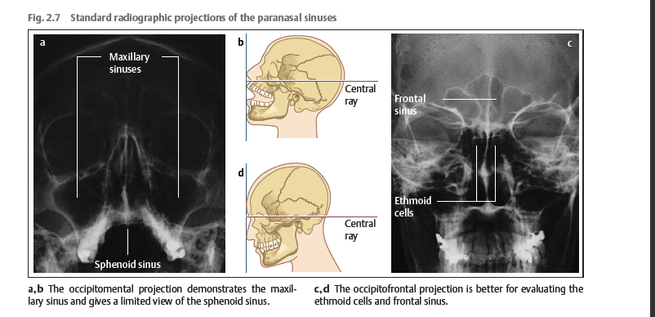
Plain Radiography

Slide 3
Plain Radiography
Lateral
Submentovertex

Slide 4
Computed Tomography
Study Type
  Coronal perpendicular 2 Hard Palate
  Axial Paralell 2 Hard Palate
  Reformatted Sagital
  Multiplannr CT Scan

Slide 5
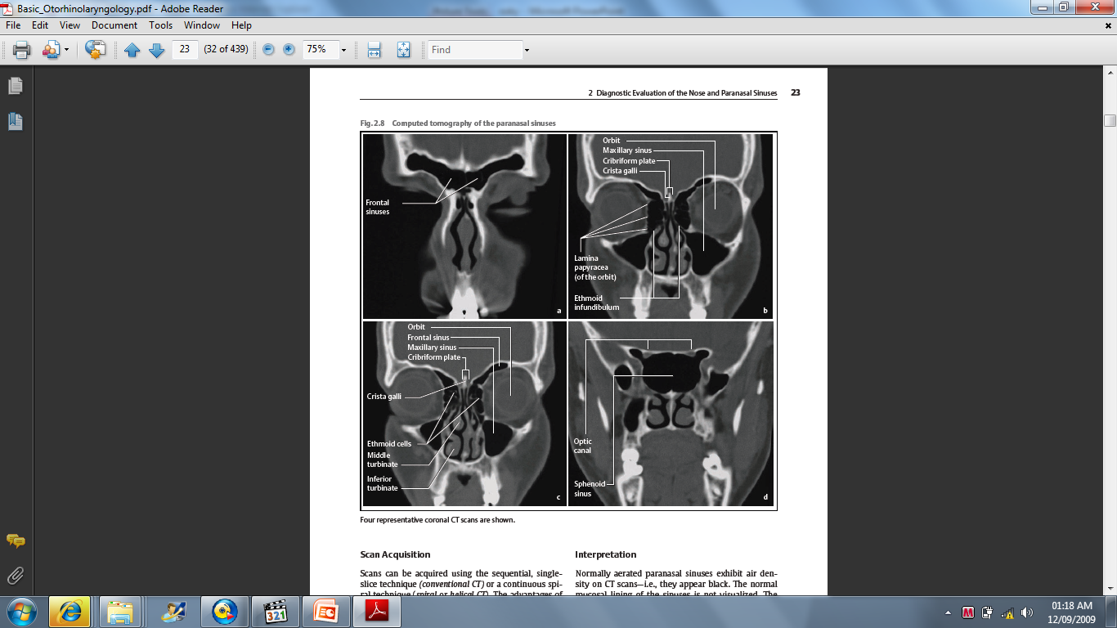
Coronal CT Scan

Slide 6
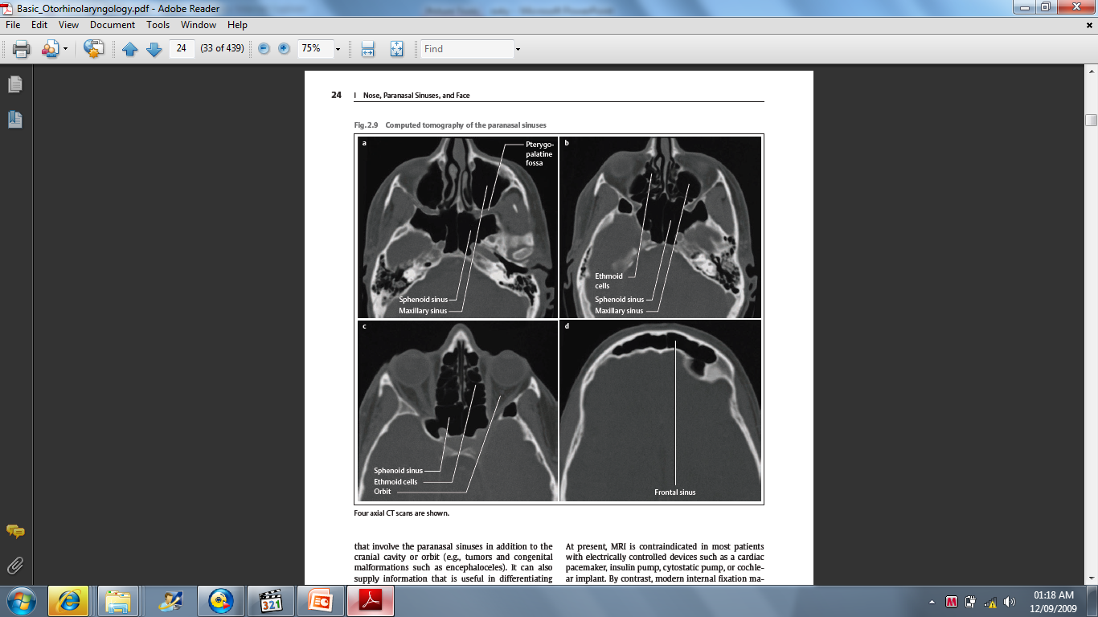
Axail CT Scan

Slide 7
Indications for PNS CT scan
Gold standard for CRS
Planning surgery or failed medical management
Indications
  Clinical unresponsiveness to medical therapy
  Immunosuppressed patient
  Severe symptoms or signs
  Life threatening complications

Slide 8
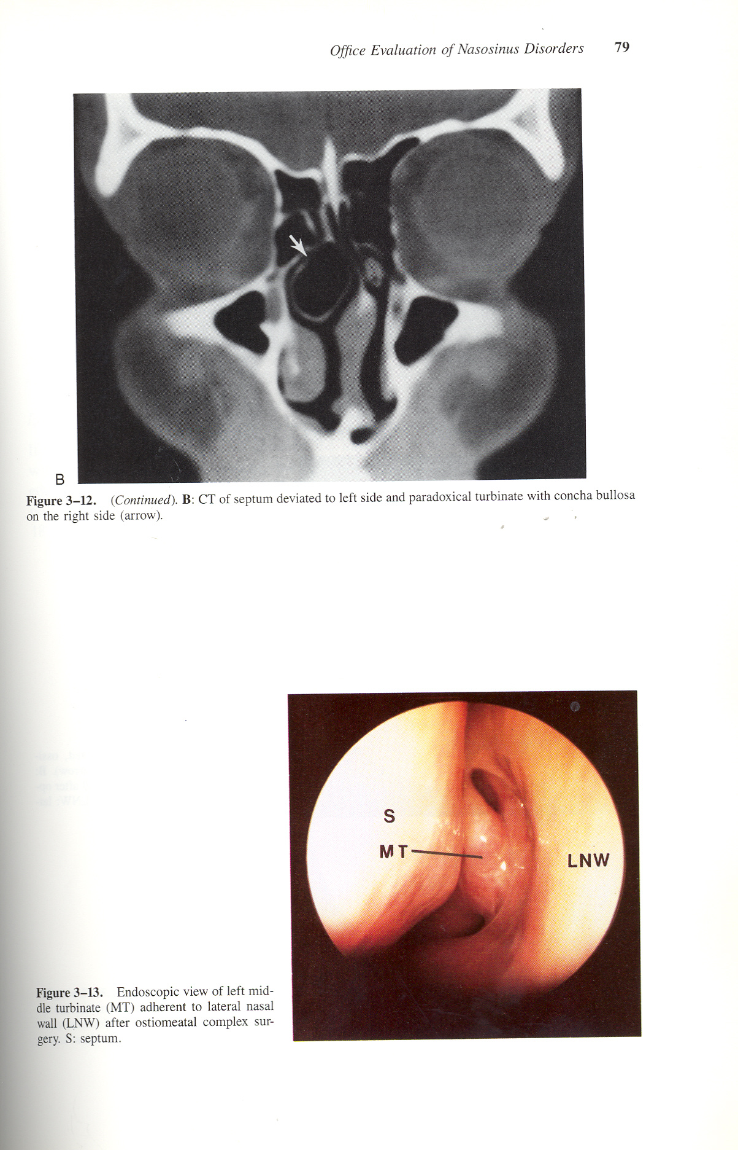
Concha Bullosa

Slide 9
Axial and Coronal CT SCAN

Slide 10
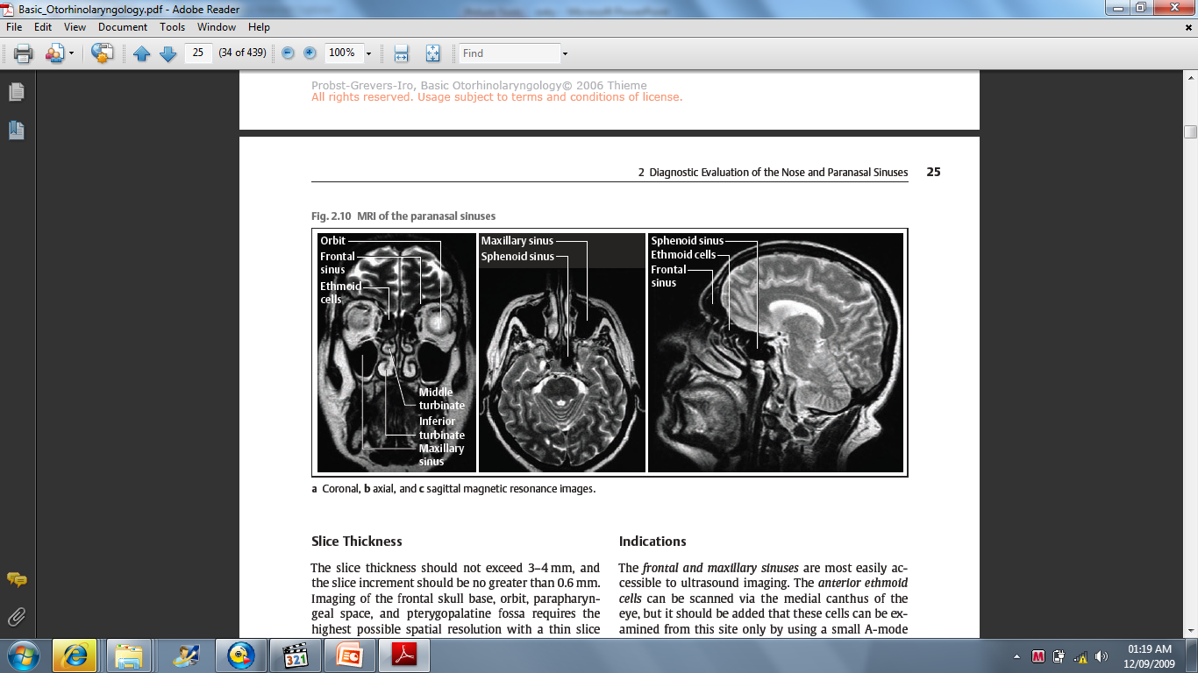
MRI PNS
Indicated for Disease Extension

Slide 11
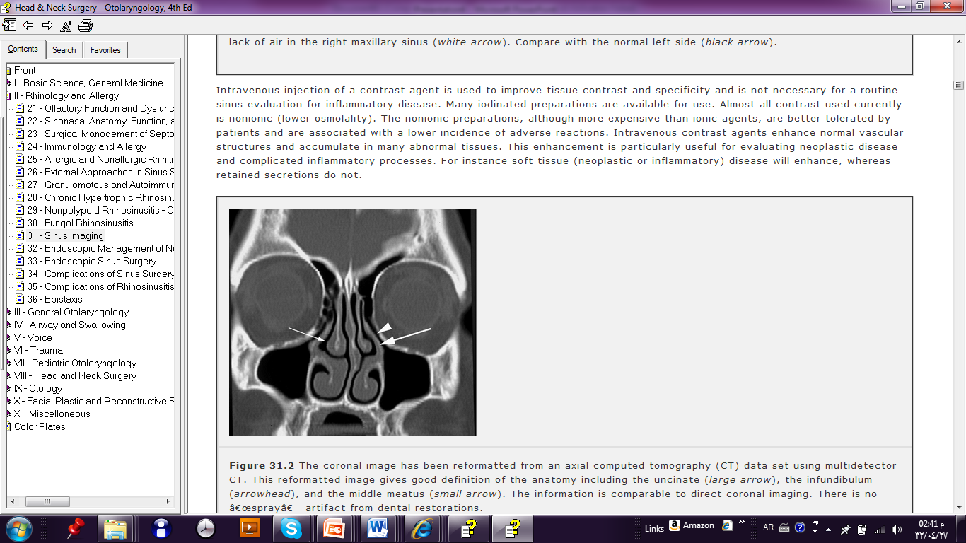
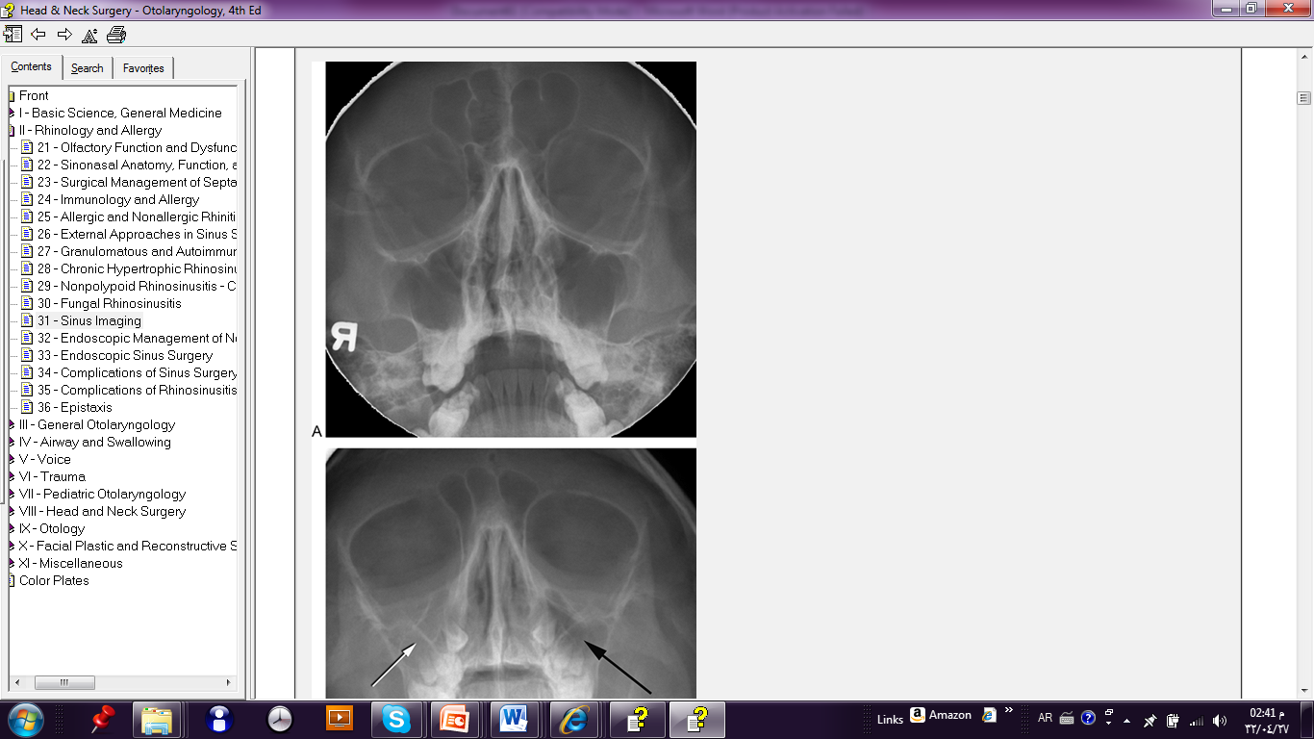
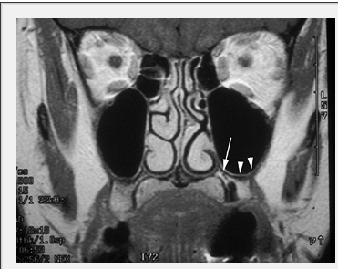
Plain X Rays vs CT PNS

Slide 12
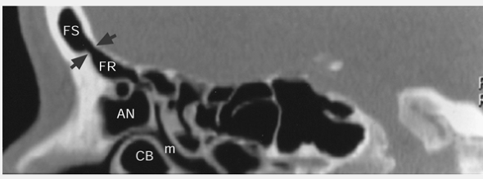
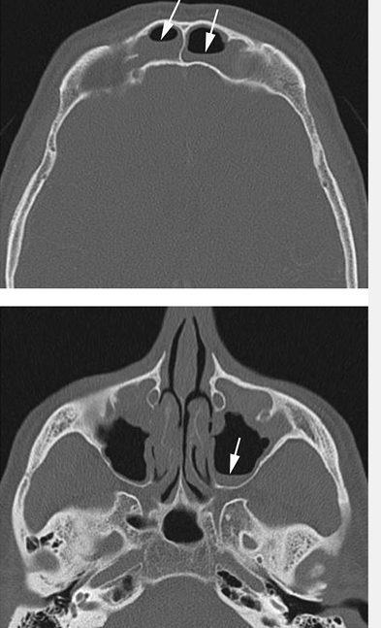
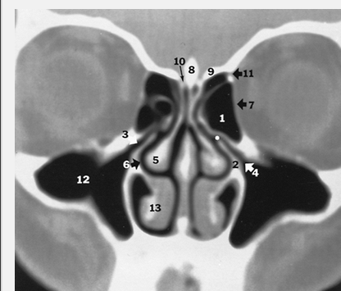
Nose & PNS Imaging

Slide 13
Indications
CRS \ AFS
Preoperative (FESS)
Complications

Slide 14
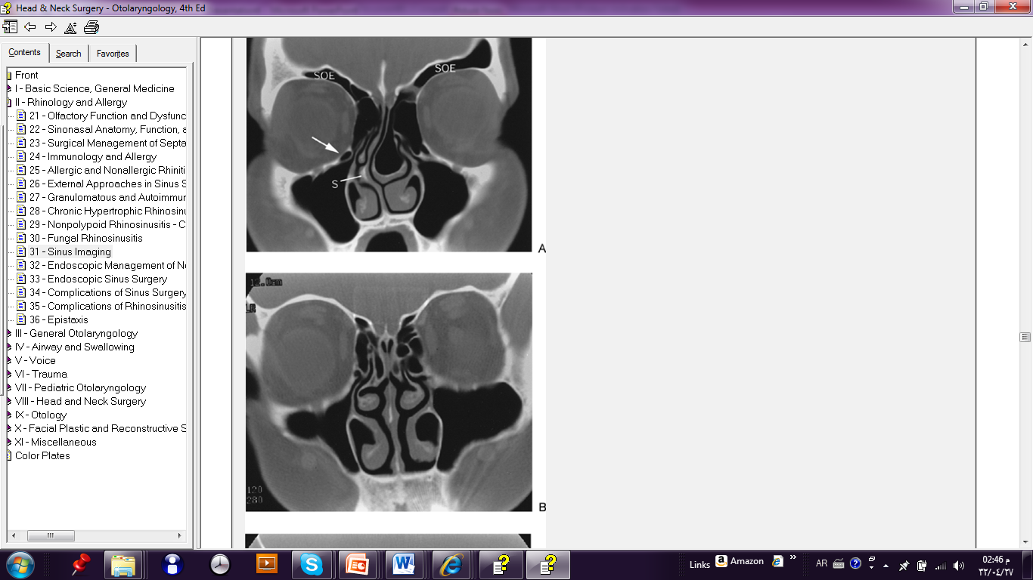
Anatomic Variations

Slide 15
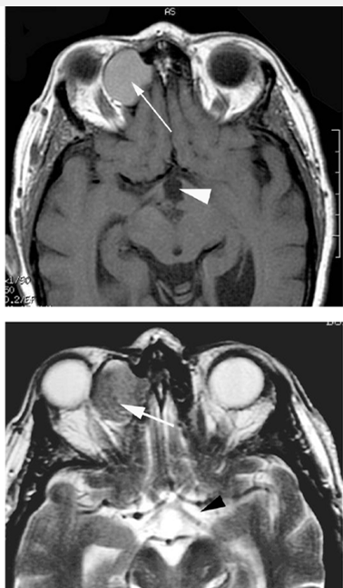
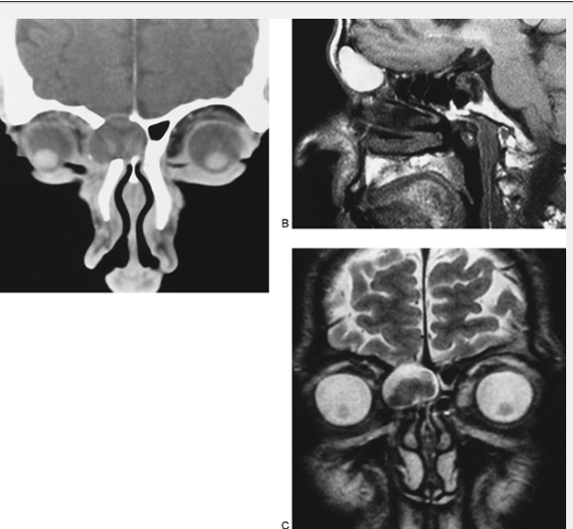
CT Scan vs MRI

Slide 16
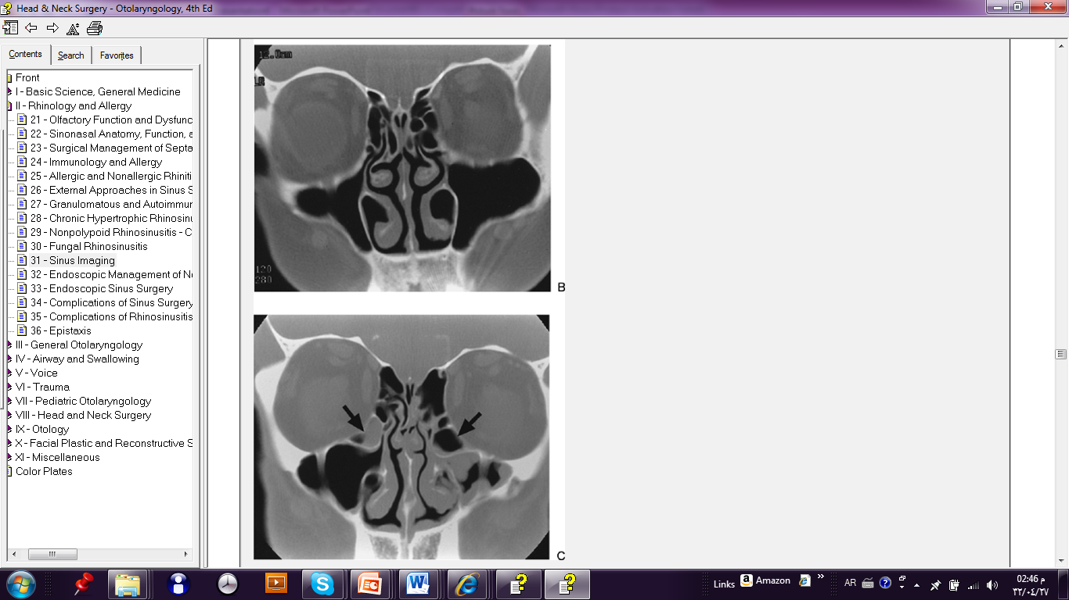
CRS

Slide 17
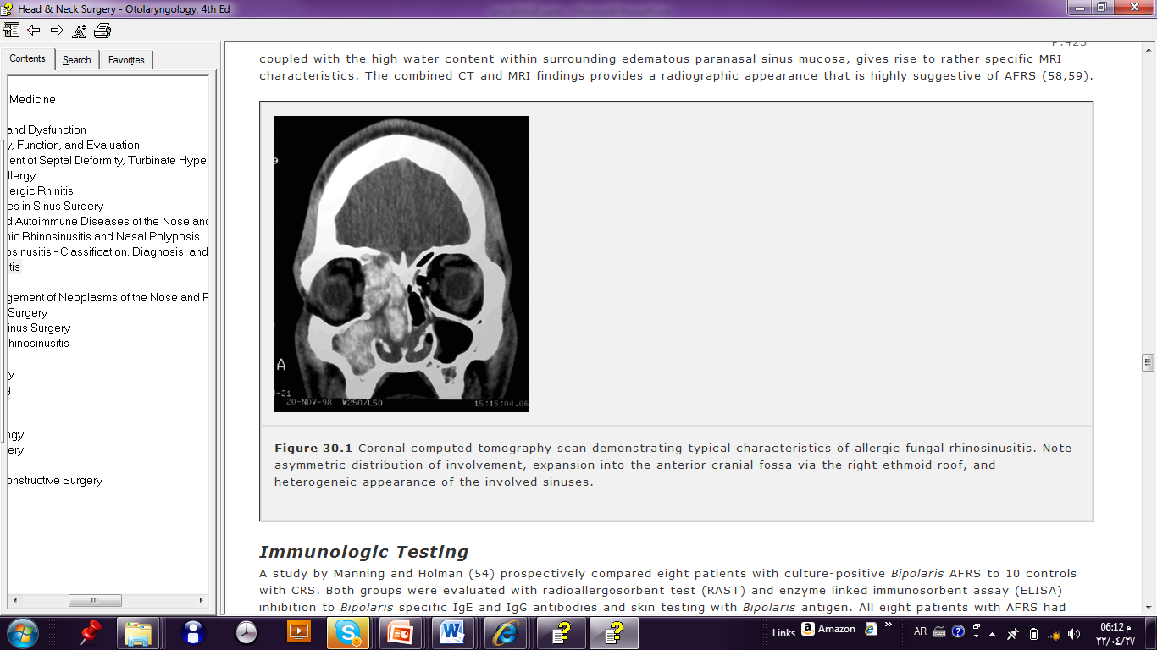
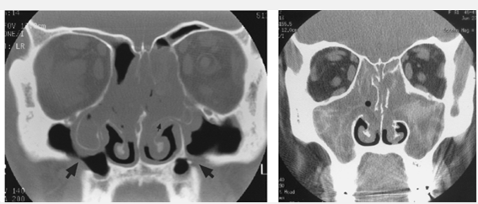
AFS

Slide 18
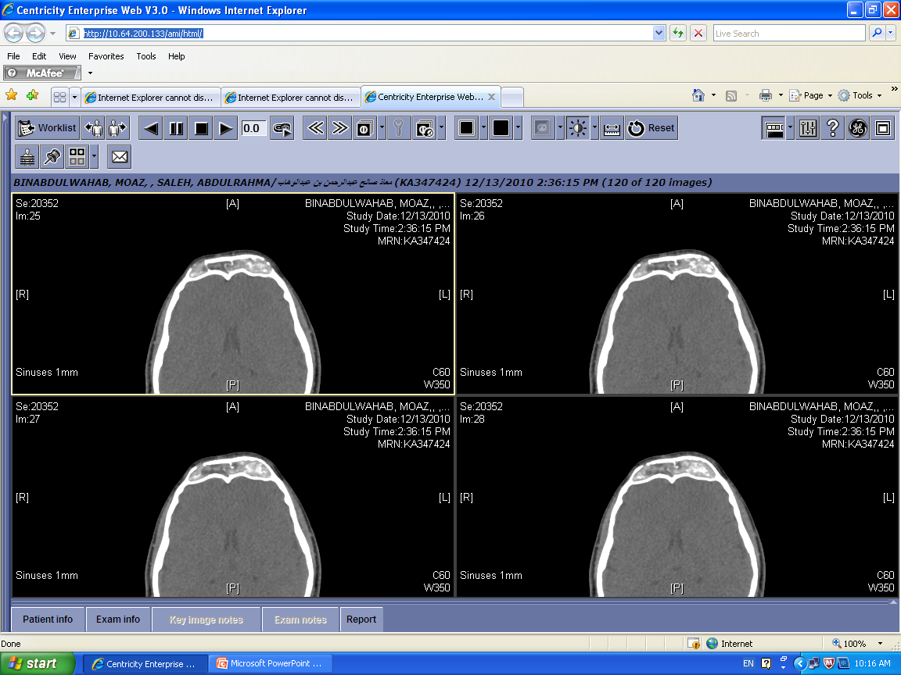
AFS

Slide 19
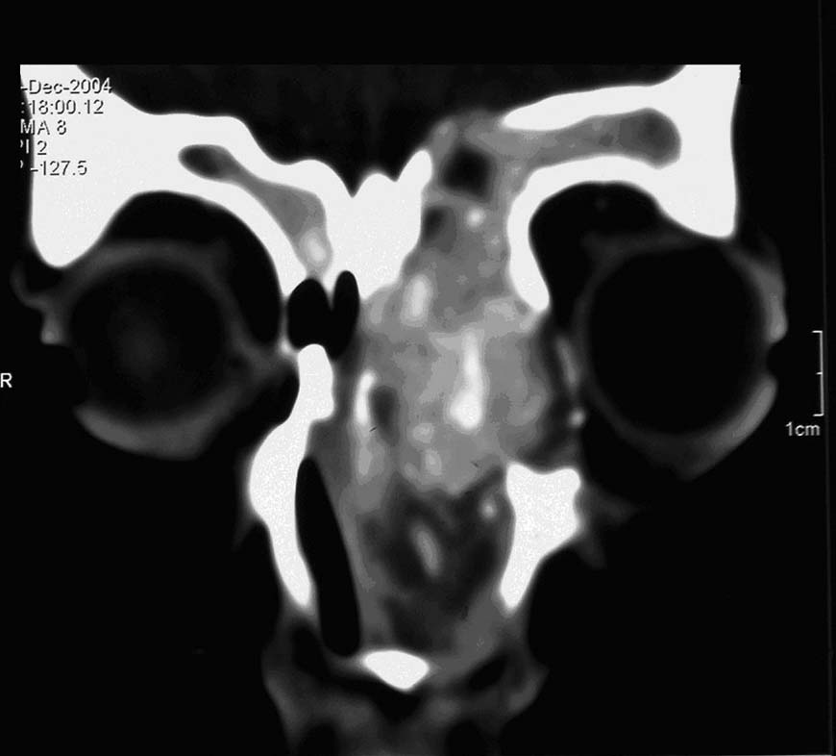
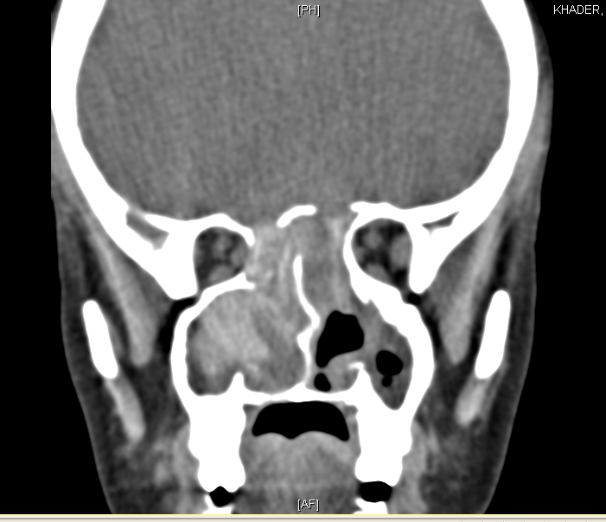
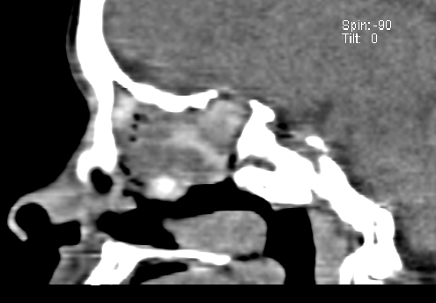
AFS & Skull Base Erosion

Slide 20
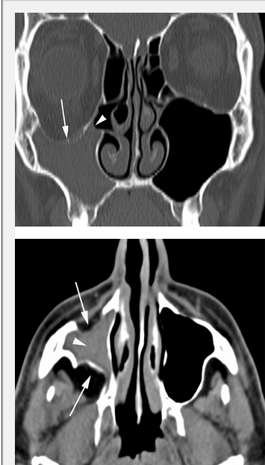
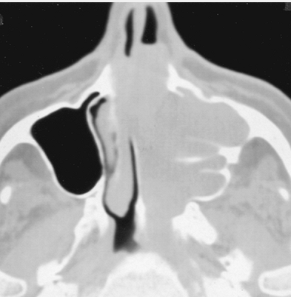
Unilateral Pathology

Slide 21
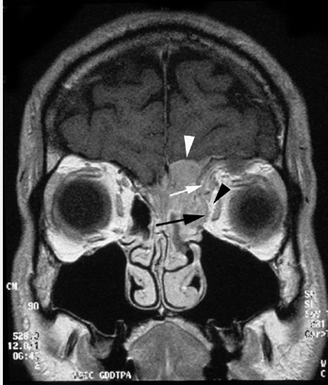
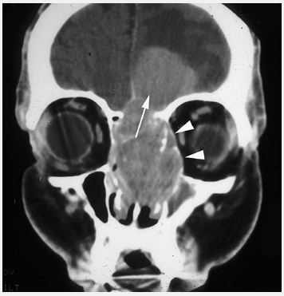
Pathology Extensions

