Slide 1
Anatomy of Nose and Paranasal Sinus
Prof. Surayie Al Dousary
Director of rhinology research chair
www.rhinologychair.org
www.profseraye.com

Slide 2
Nose and Paranasal Sinuses I
anatomy
antomy -external nose &nasal cavity, paranasal sinuses,
(blood supply,
{nerve supply} in brief),
physiology
function- nose & paranasal sinus,
congenital anomalies (in brief)
{choanal atresia}

Slide 3
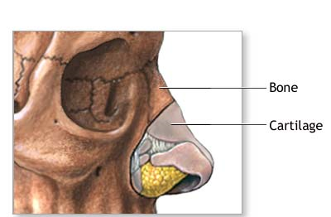
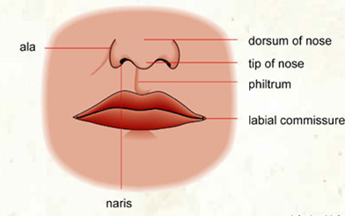
The Nose
The nose consists of the external nose and the nasal cavity,
Both are divided by a septum into right and left halves.

Slide 4
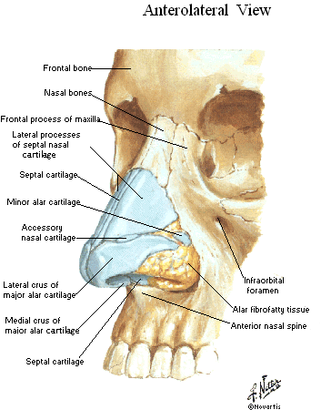
External Nose
The framework of the external nose is made up above by the
  nasal bones
  the frontal processes of the maxillae
  the nasal part of the frontal bone
Below, the framework is formed of plates of hyaline cartilage

Slide 5
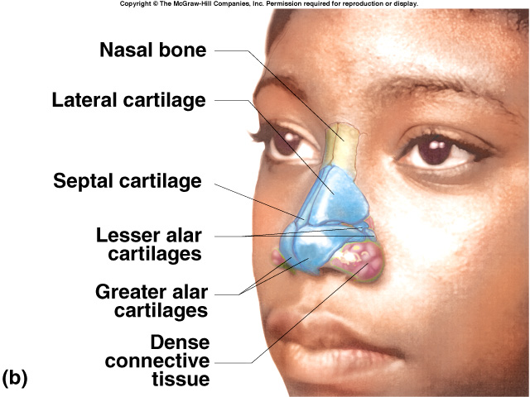
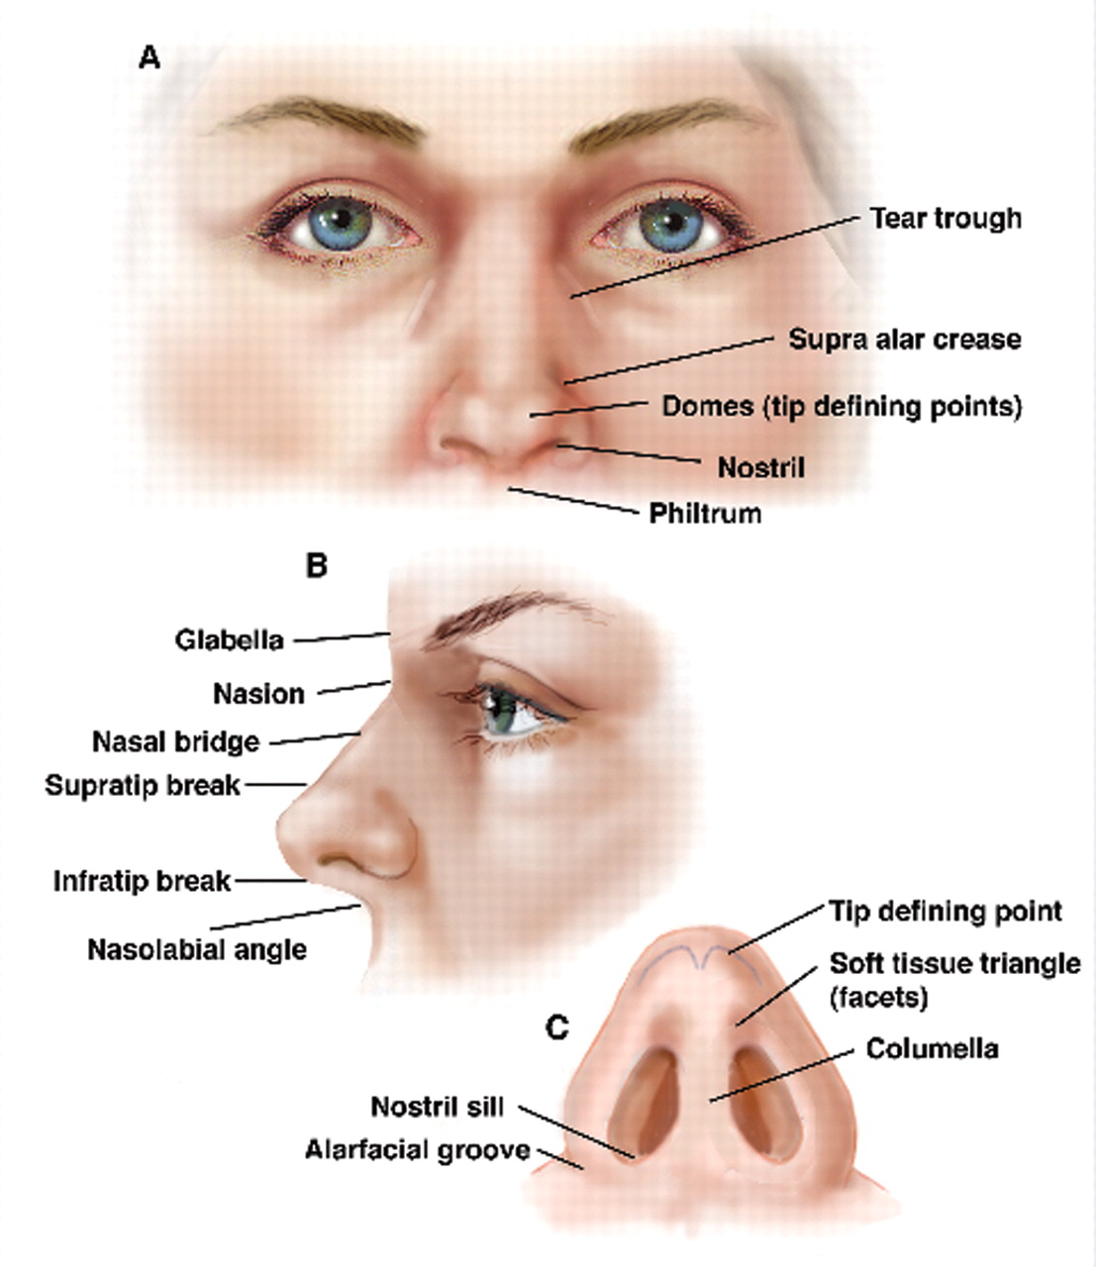
External Nose

Slide 6
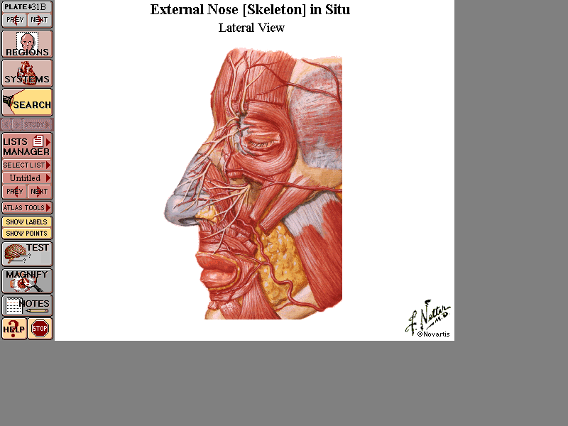
Nasal Muscles
Procerous elevate the skin of dorsum
Nasalis compressor of naris
Dilators naris
Depressor septi
External Nose

Slide 7
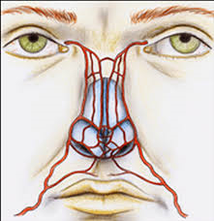
Blood Supply of the External Nose
The skin of the external nose is supplied by branches of the ophthalmic and the maxillary arteries.
The skin of the ala and the lower part of the septum are supplied by branches from the facial artery.

Slide 8
Nerve Supply of the External Nose
The infratrochlear and external nasal branches of the ophthalmic nerve (CN V)
The infraorbital branch of the maxillary nerve (CN V).

Slide 9
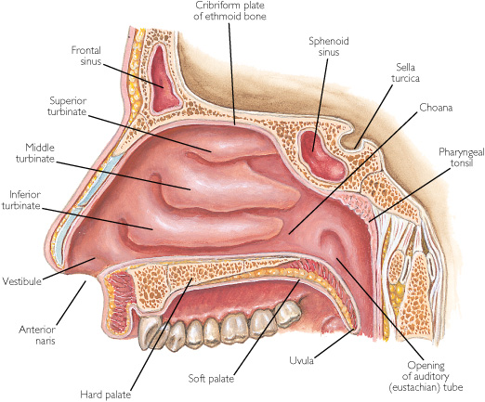
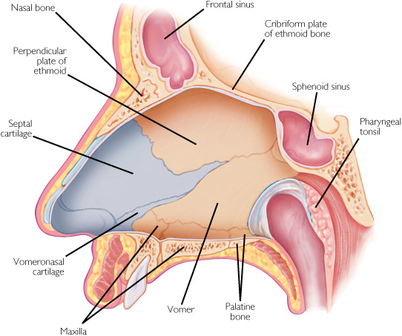
Nasal Cavity
The nasal cavity has
  Floor
  Roof
  Lateral wall
  Medial wall or septum

Slide 10
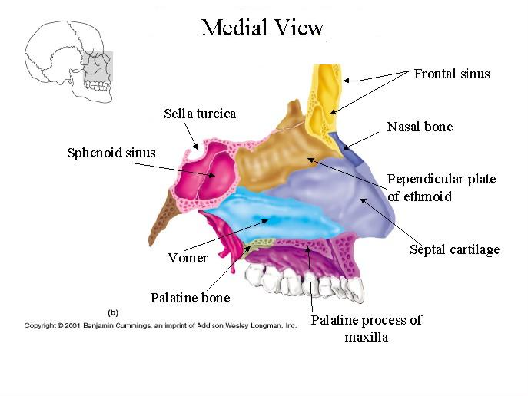
The Floor of Nasal Cavity
Palatine process of maxilla
Horizontal plate palatine bone

Slide 11
The Roof of Nasal Cavity
Narrow
It is formed
  anteriorly beneath the bridge of the nose by the nasal and frontal bones,
  in the middle by the cribriform plate of the ethmoid,
  located beneath the anterior cranial fossa,
  posteriorly by the downward sloping body of the sphenoid

Slide 12
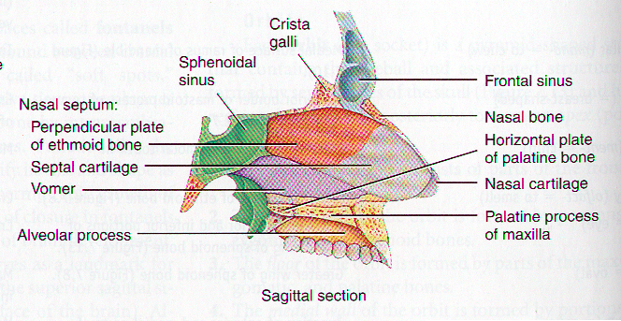
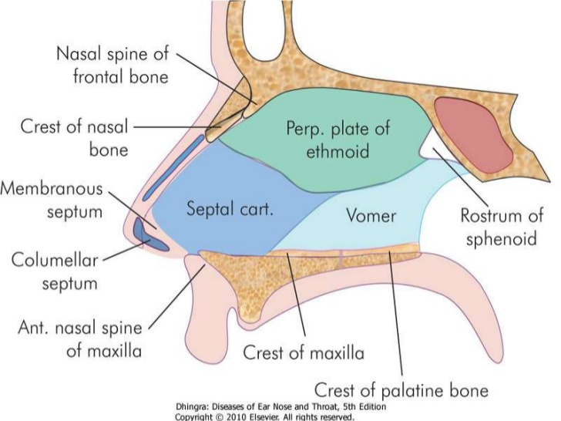
The Nasal Septum
Divides the nasal cavity into right and left

Slide 13
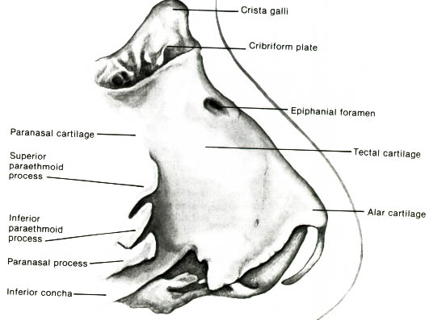
Lateral Nasal Wall
In neonate
  The nasal & orbital floors are located at the same level
  Lateral nasal wall serves as the medial orbital wall
  Maxilla, contributes minimally in fetus & neonate
In adult
  Only the upper half of the lateral nasal wall forms the medial orbital wall
  The nasal floor is at lower level than orbital floor
The medial surface of the maxilla is incomplete (maxillary hiatus)
  The aperture of the hiatus is reduced by presence of palatine and lacrimal bones and the inferior concha

Slide 14
The Lateral Walls of Nasal Cavity
Marked by 3 projections:
  Superior concha
  Middle concha
  Inferior concha
The space below each concha is called a meatus.

Slide 15
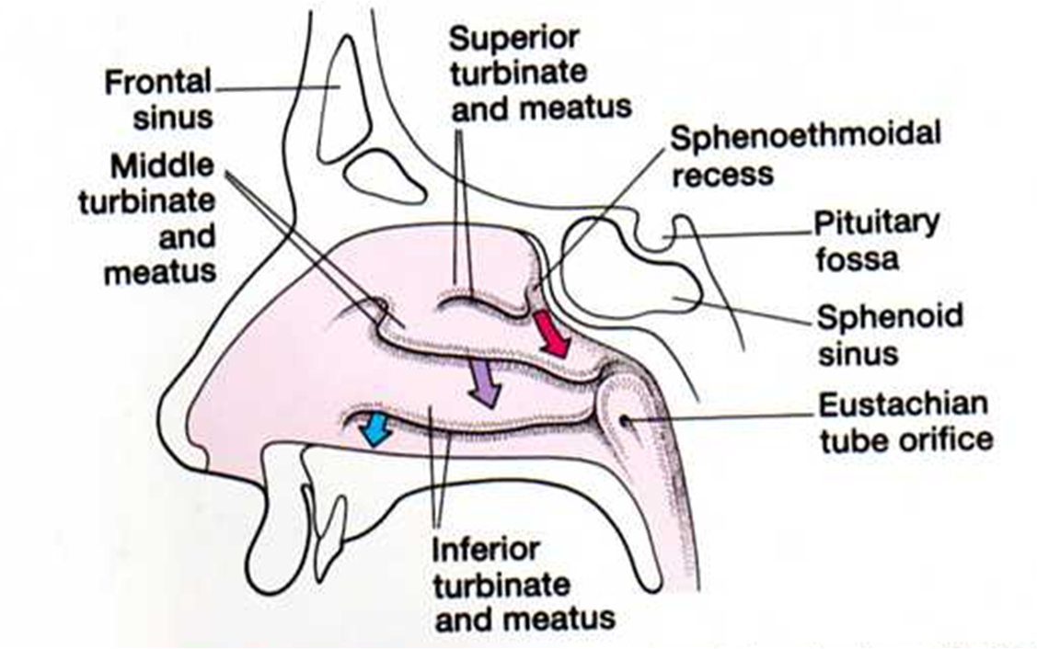
The Lateral Walls of Nasal Cavity
Inferior meatus: nasolacrimal duct
Middle meatus:
  Maxillary sinus
  Frontal sinus
  Anterior ethmoid sinuses
Superior meatus: posterior ethmoid sinuses
Sphenoethmoidal recess: sphenoid sinus

Slide 16
Blood Supply to the Nasal Cavity
From branches of the maxillary artery, one of the terminal branches of the external carotid artery.
The sphenopalatine artery anastomoses with the septal branch of the superior labial branch of the facial artery in the region of the vestibule.
The submucous venous plexus is drained by veins that accompany the arteries.

Slide 17
Nerve Supply of the Nasal Cavity
CN I – Olfactory Nerves (SVA)
Anterior ethmoidal branch of V₁
Posterior nasal branches of V₂
Cut nasopalatine branch of V₂ to septum

Slide 18
Lymph Drainage of the Nasal Cavity
The lymph vessels draining the vestibule end in the submandibular nodes.
The remainder of the nasal cavity is drained by vessels that pass to the upper deep cervical nodes.

Slide 19
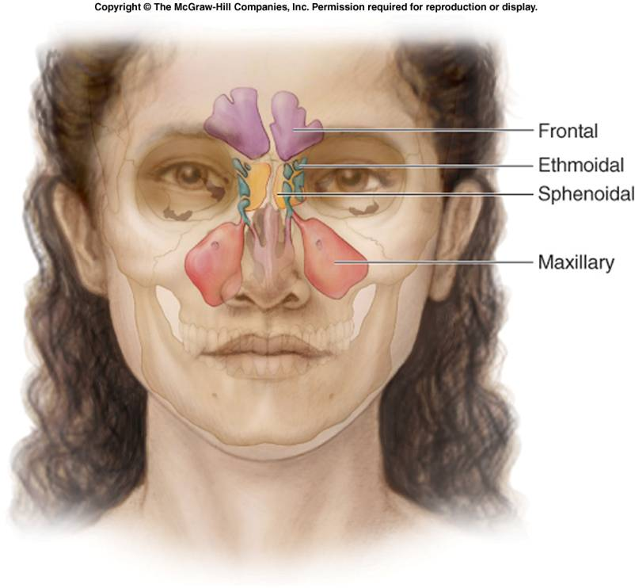
The Paranasal Sinuses

Slide 20
Coronal & Sagital Cut

Slide 21
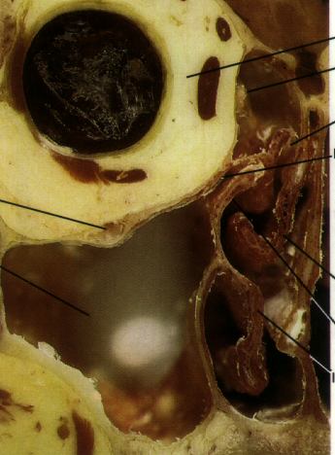
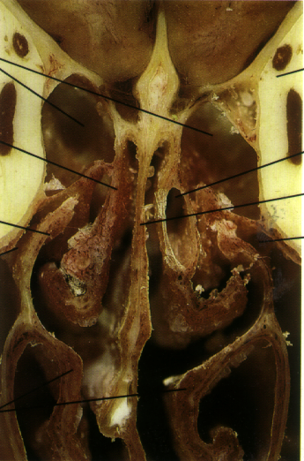
CADAVERIC

Slide 22
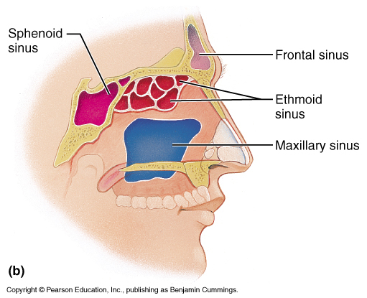
The Paranasal Sinuses
The paranasal sinuses are cavities found in the interior of the maxilla, frontal, sphenoid, and ethmoid bones .
They are lined with mucoperiosteum and filled with air.
They communicate with the nasal cavity through relatively small apertures.

Slide 23
Drainage of Mucus and Function of Paranasal Sinuses
The mucus produced by the mucous membrane is moved into the nose by ciliary action of the columnar cells.
Drainage of the mucus is also achieved by the siphon action created during the blowing of the nose.
Functions:
  Resonators of the voice
  They also reduce the skulls weight
  Help wam and moisten inhaled air
  Act as shock absorbers in trauma

Slide 24
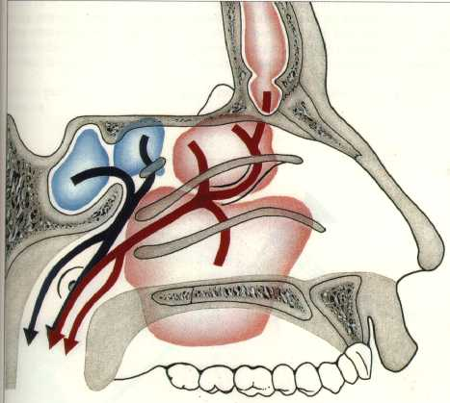
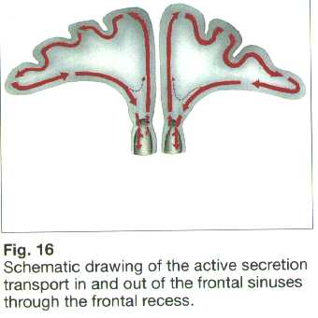
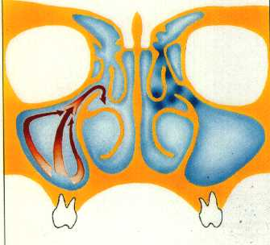
Ciliary Pattern in Sinuses Mucosa

Slide 25
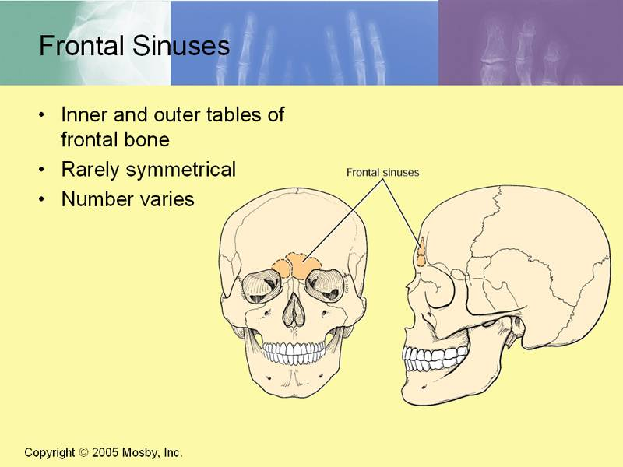
Frontal Sinuses
Rarely symmetrical
Contained within the frontal bone .
Separated from each other by a bony septum.
Each sinus is roughly triangular
Extending upward above the medial end of the eyebrow and backward into the medial part of the roof of the orbit.
Opens into the middle meatus

Slide 26
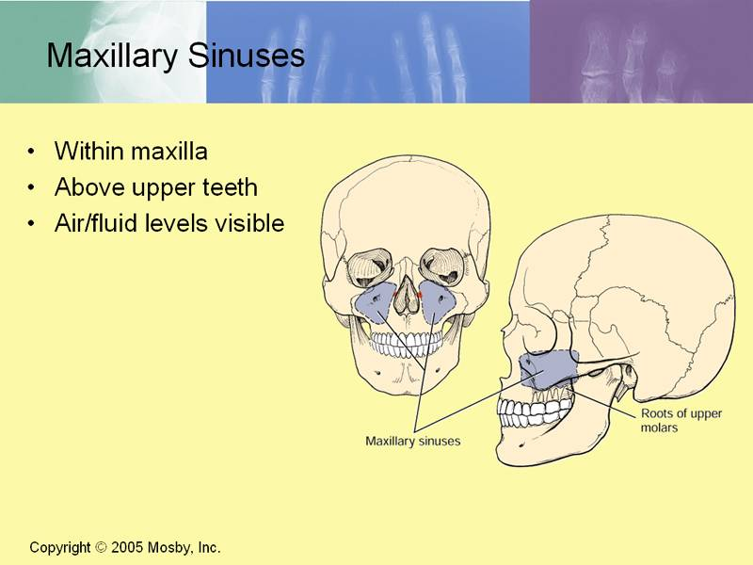
Maxillary Sinus
Pyramidal in shape
Paired & symmetric
Located within the body of the maxilla behind the skin of the cheek.
The roof is formed by the floor of the orbit, and the floor is related to the roots of the 2nd premolars and 1st molar teeth.
The maxillary sinus opens into the middle meatus of the nose

Slide 27
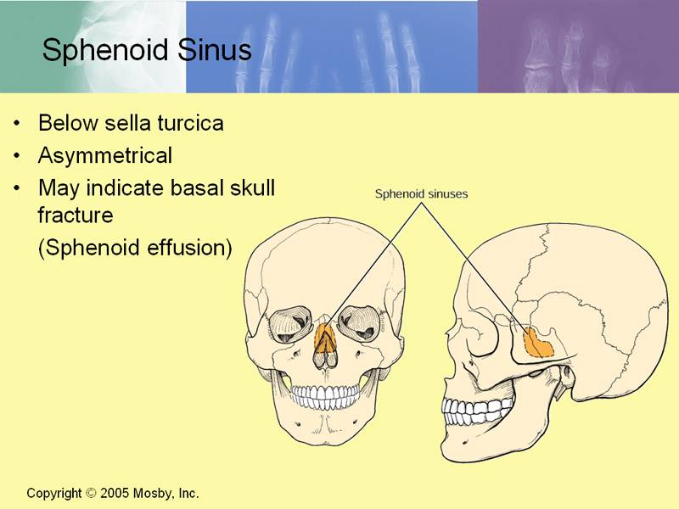
Sphenoidal Sinuses
Lie within the body of the sphenoid bone
Below sella turcica
  Extends between dorsum sellae and post clinoid processes
Opens into the sphenoethmoidal recess above the superior concha

Slide 28
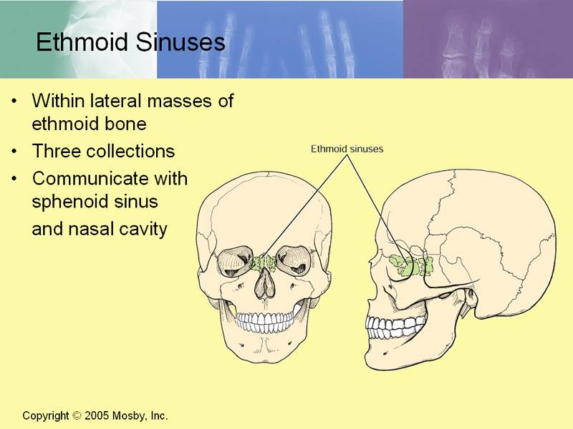
Ethmoid Sinuses
They are anterior, middle, and posterior
They are contained within the ethmoid bone, between the nose and the orbit
Anterior & middle
  Drains into middle nasal meatus
Posterior
  Drain into superior nasal meatus
Separated from the orbit by a thin plate of bone so that infection can readily spread from the sinuses into the orbit

Slide 29
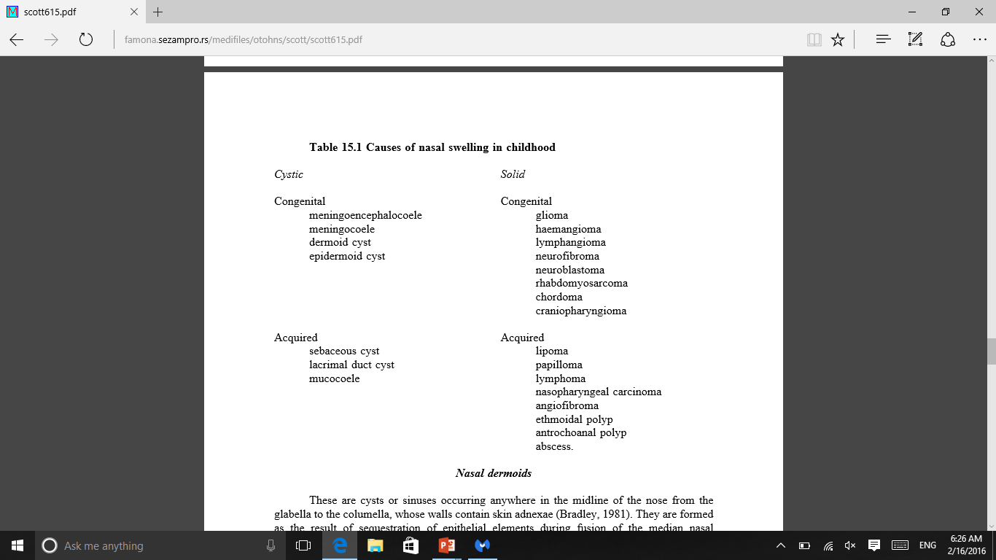
Nasal Swelling in childhood

Slide 30
Normal Function of PNS
Patent Ostia
Normal Ciliary Function
Normal Quality of Mucous
Disturbance of these Function will lead to sinusitis

Slide 31

Physiology of the nose
Three major functions of the nose:
  Olfaction
  Respiration (the most important)
  Defense
Additional minor functions
  Aiding and modifying voice production
  Providing vocal resonance
  Serving as a secondary sex organ

Slide 32
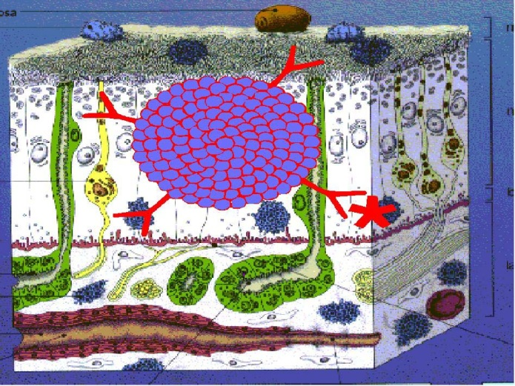
Modification of inspired air
Humidification
  Nose adjust precisely the inspired air to have a humidity of 85 %
    This enhances the gas exchange
  Large portion returned to the nasal mucosa during exhalation.
    This prevents overdrying of the nasal mucosa and thickening of the nasal secretions.
Warms the inspired air
  The rich capillary beds that make up the side wall of the nose, along with their accompanying venous sinusoids

Slide 33
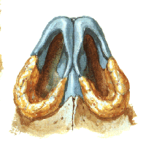
Nasal Valve
The smallest cross-sectional diameter and greatest resistance of the airway
The muscle activity prevents alar collapse during inspiration.
Resistance in this segment is created by the turbinate size, which is altered by the vascular tone and blood volume of the nasal sinusoids.
  Induced by exercise, posture changes, and hyperventilation.
  Chemical irritants, medications, pain, and emotion

Slide 34
Nasal Cycle
Alternating changes in patency of the right & the left nasal cavities
Occur in rhythmic sequence in about 80 % of normal individuals
The total resistance to the nasal airflow remains constant
Controlled through the
  Autonomic adrenergic centers
  Hypothalamic control center
If the cervical ganglion is sectioned, there is abolition of the nasal cycle on the same side

Slide 35
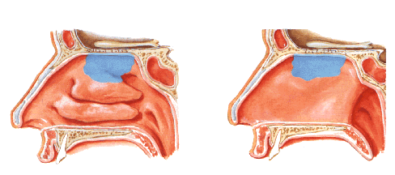
Olfaction
Important in food choices and in social interaction
Warning sign for toxic gases and spoiled foods.
To smell a substance, it must some how reach the olfactory mucosa located in the roof of the nose
The odor-producing substance must have a vapor pressure and must be relatively water- and lipid-soluble in order to be sensed.

Slide 36
Anosmia
Nasal obstruction and nasal infection.
the receptor molecule cannot reach the olfactory mucosa to stimulate a response.
Nasal polyposis and nasal deformities are reversible conditions in adults.
Infections and allergies cause temporary interruption of smell, and olfactory capability returns when the conditions resolve.
smell can trigger an asthmatic attack and can worsen emphysema.
  ? trigeminal reflex, which is induced by a chemical irritant stimulating the nasal mucosa,and leads to reflex bronchial constriction

Slide 37
Immunology
Secretory immunoglobulin A (IgA) is the major immunoglobulin found in nasal secretions
The concentration of IgG (3 per cent) and IgM (l per cent) increases during actual infections,
? transudation of plasma resulting from mucosal injury

Slide 38
Diseases of the Nose
Congenital
  Atresia and Stenosis of anterior nares Caused by non canalozation of an epithelial plug between the median and lateral nasal process.
  Rx: Excision
  Atresia of posterior nares (congenital choanal atresia)
  Types: - Bony most commonly
  - Membranous
  - Mixed

Slide 39
Choanal atresia
Degrees:
  Complete unilateral most commonly.
  Complete bilateral
  Incomplete unilateral
  Incomplete bilateral
  Females are more commonly affected than males

Slide 40
Diseases of the Nose
Clinical Features:
  Unilateral atresia
    Nasal obstruction
    Excessive nasal discharge
  Bilateral atresia
    Asphyxia
    Nasal discharge

Slide 41
Bilateral Choanal atresia
Diagnosis:
  Total absence of nasal air flow
  Plastic catheter cannot be passed through the nose
  Post-rhinoscopy
  Radiographs
Treatment:
  Emergency
  Transnasal perforation
  Trans-palatal excision

Slide 42
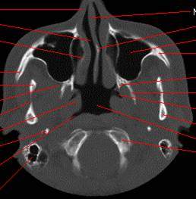
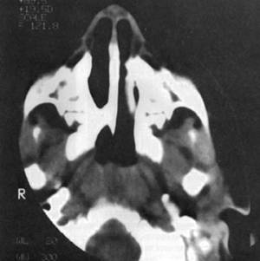
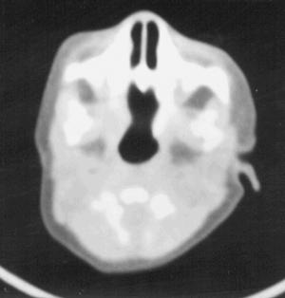
Choanal atresia
Nornal
uinilateral
bilateral

Slide 43
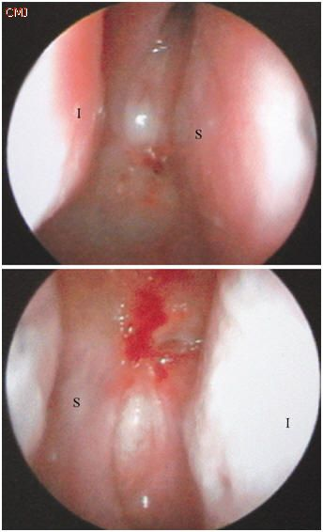
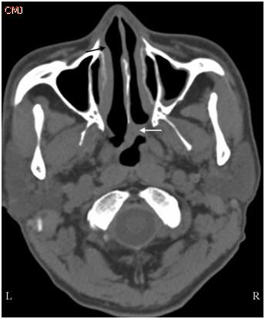
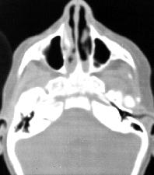
Choanal atresia
uinilateral
bilateral

Slide 44
Developmental errors of the anterior neuropore
Encephalocels
Nasal glioma
Dermoid

Slide 45
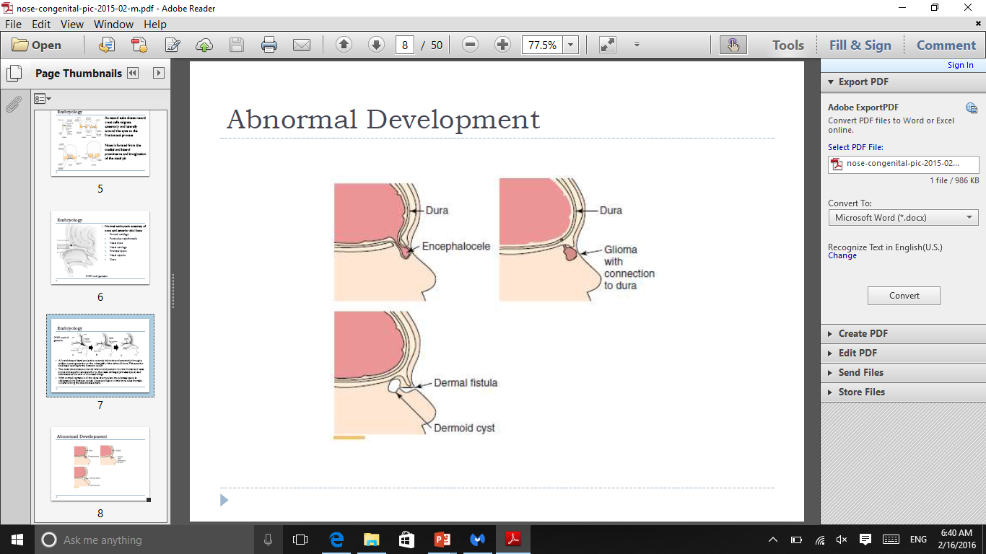
Abnormal Development

Slide 46
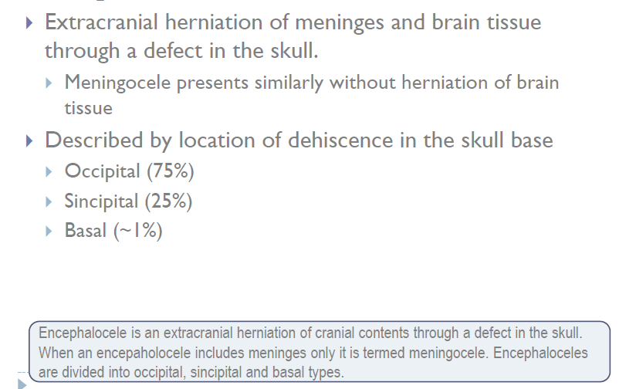
Encephalocele

Slide 47
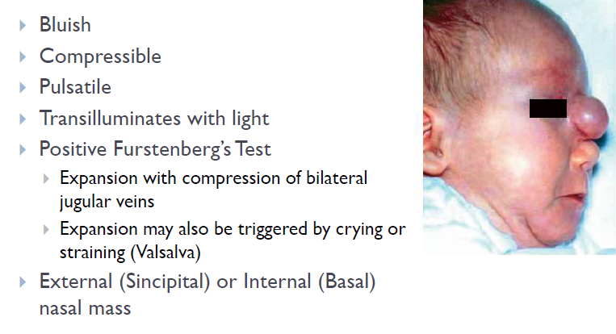
Presentation

Slide 48
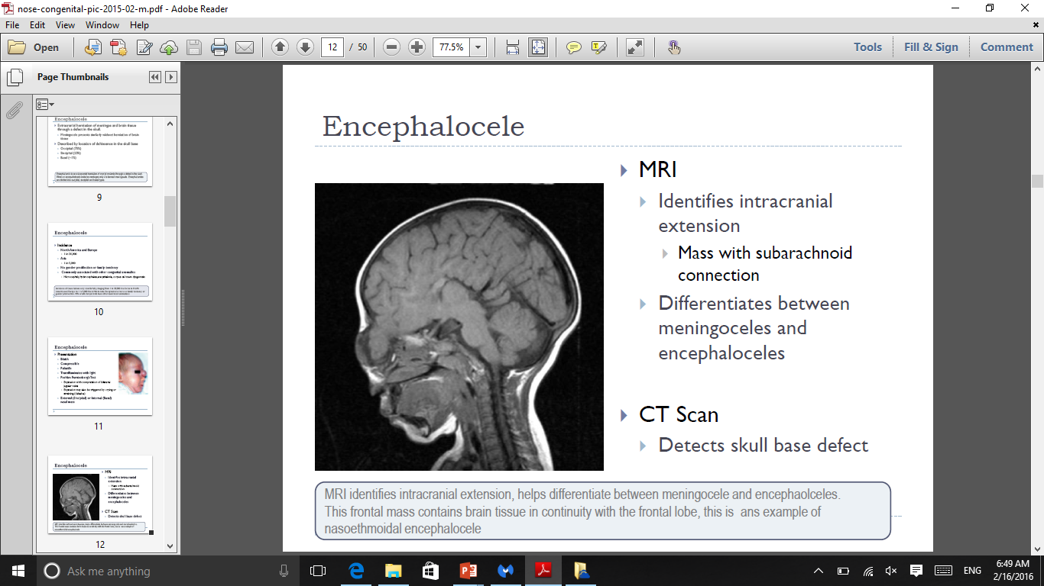
Investigation

Slide 49
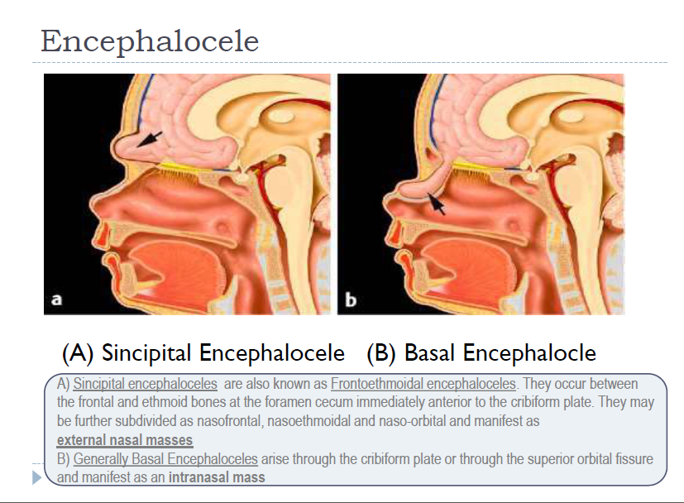

Slide 50
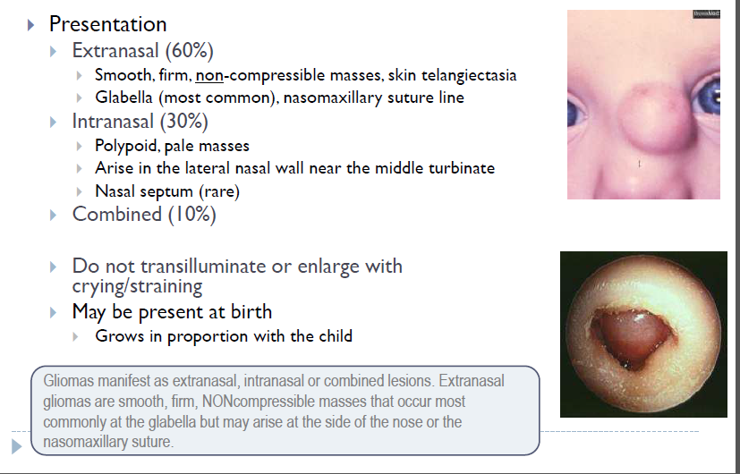
Nasal Glioma

Slide 51
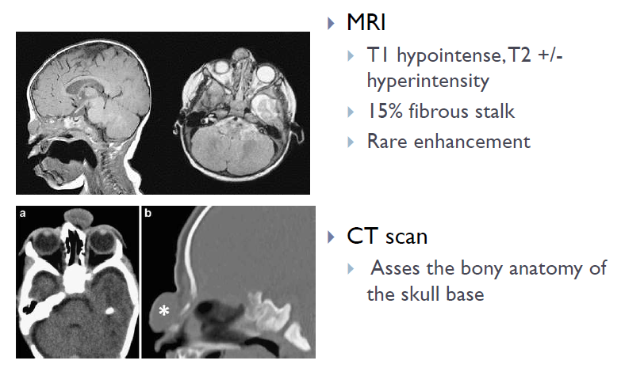

Slide 52
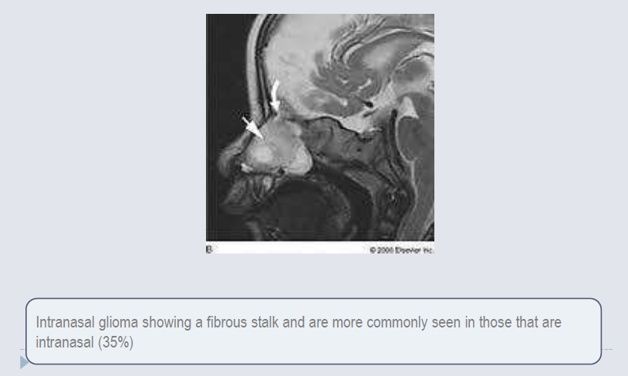
Nasal Glioma

Slide 53
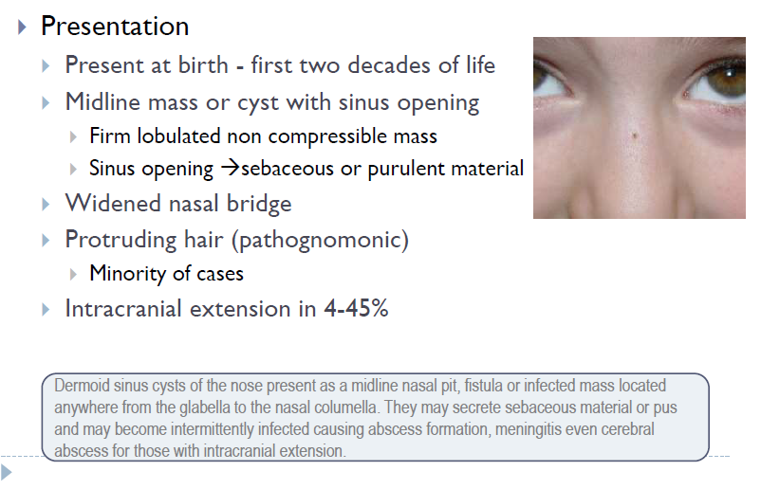
Nasal Dermoids

Slide 54
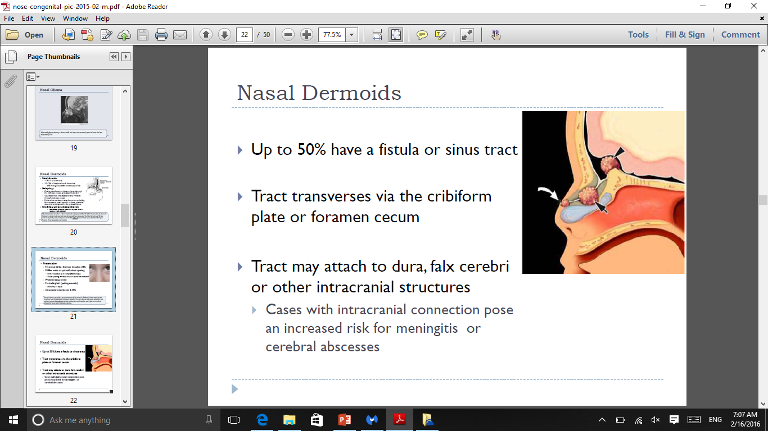

Slide 55
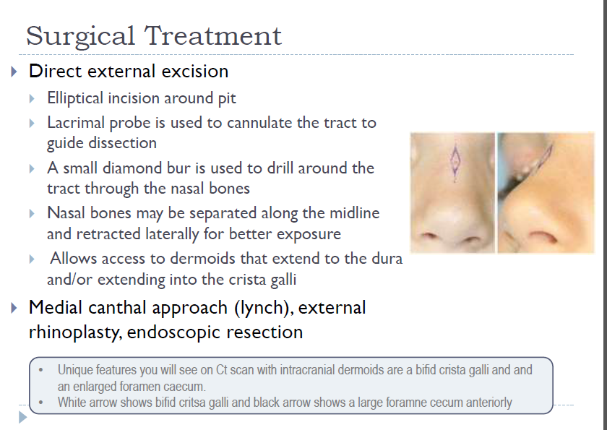

Slide 56
