Slide 1
Rhinitis
Prof. Surayie Al Dousary
Rhinology Research Chair Director
www.rhinologychair.org
www.profseraye.com

Slide 2
Rhinitis
Definition: Inflammation of the mucosa of the nasal fossae.
Types: I. Acute rhinitis
II. Chronic rhinitis

Slide 3
Rhinitis
(1) Infectious rhinitis
(2) Vasomotor rhinitis
(3) Occupational rhinitis
(4) Hormonal rhinitis
(5) Drug-induced rhinitis
(6) Gustatory rhinitis
(7) Nonallergic rhinitis with eosinophilia syndrome (NARES)

Slide 4
Acute Rhinitis:
I. (common cold & inf & Para Inf )
Aetiology:
Virus (Rhinovirus, Coronavirus,Adenovirus,Parainfluenza virus ,Respiratory syncytial virus, Enterovirus)
Bacteria (Strept penumonia, Srtept Pyogen, HF, Maxerella Cataralis)
Conveyed by contact or air borne droplets

Slide 5
Common Cold
Clinical features:
Ischaemic stage
- 1-3 days incubation period - --- - burning sensation in the nasopharynx - sneezing, loss of smell
Hyperaemic stage
- profuse rhinorrhea
- Nasal obstruction - Pyrexia
Stage secondary infection
– discharge becomes yellow or green
Stage resolution
- resolution occurs 5-10 days

Slide 6
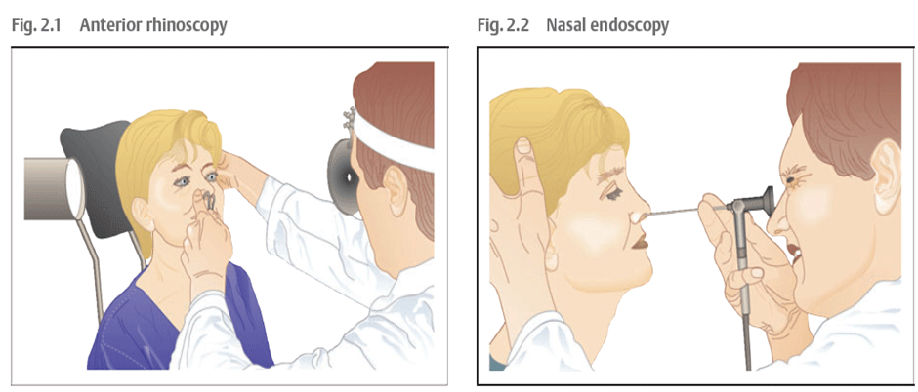
Examination
Anterior Rhinoscopy

Slide 7
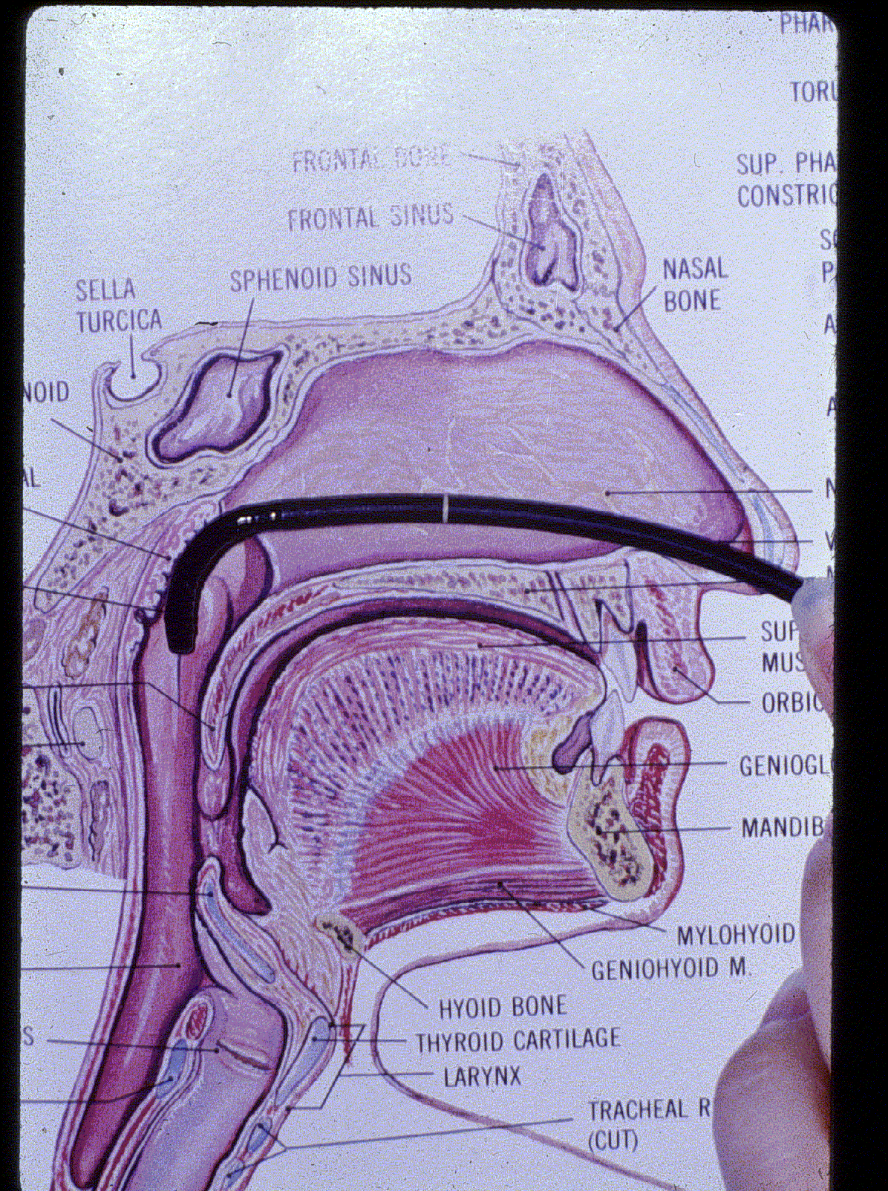
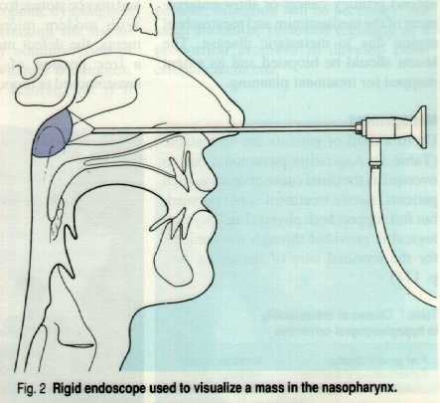
Endoscopic Examinationand Rigid EndoscopyEX

Slide 8
Treatment
Prophylactic
- avoid contact with patient
Therapeutic
-Rest
-Analgesics
-Decongestants
-Antibiotics

Slide 9
Chronic Rhinitis
1) Non-specific
2) Specific

Slide 10
Specific Chronic Rhinitis
Syphilis
Wegner’s granuloma
Medline lethal granuloma
Sarcoidosis
Mycobacteria
Atrophic rhinitis

Slide 11
Non-specific chronic rhinitis
-Simple chronic rhinitis
Aetiology:
- Neighboring infections e.g. chronic tonsillitis
- Adenoids
- Vasomotor rhinitis
- Chronic irritation e.g. dust, smoker
- Swelling of inferior turbinate
Rx:
Correction of any predisposing factors

Slide 12
Non-specific chronic rhinitis
Non-specific chronic rhinitis
-Hypertrophic rhinitis
Etiology: - Permanent hypertrophic changes
due to advanced stage of simple chronic rhinitis
- Rhinitis medicamentosa
Clinical features: Like simple chronic rhinitis
Rx: - Like simple chronic rhinitis
- Reduction of inferior turbinate

Slide 13
Non-specific chronic rhinitis
-Atrophic rhinitis
Definition: Chronic inflammation of nasal mucosa with atrophy of various nasal constituents.
Aetiology: - Not fully known
- Infection
- Endocrine or vitamin disturbances
Types: - Primary
- Secondary

Slide 14
Primary Atrophic Rhinitis
Clinical features:
- Foul stench
- Epistaxis
- Sensation of obstruction
Pathology:
1) Degeneration of epithelium glands
- Thick crust in the nose - infected
- Foul smell
2) Atrophy of the bony turbinates
Rx: - Removal of the crusts
- Glucose 25% in glycerine drops
- Local or systemic antibiotics
- Surgical measures

Slide 15
Secondary Atrophic Rhinitis
Secondary to:
- Severe DNS
- Syphilis
- Lupus
- Excessive operative procedures

Slide 16
Triad of atrophic rhinitis
Triad of atrophic rhinitis, namely
Fetor
Crusting
Atrophy of the nasal structures

Slide 17
Nasal allergy
Allergy is an abnormal reaction of the tissues to certain substances.
Types: 1) Seasonal
2) Non-seasonal (perennial)
WHO
1) Mild
2) Moderate
3) Sever
Clinical features:
- Nasal obstruction
- Rhinorrhea
- Sneezing
- Nasal irritation

Slide 18
classification of rhinitis by WHO
Intermittent
≤ 4 days per week
or ≤ 4 weeks
Persistent
> 4 days per week
and > 4 weeks
Mild
Normal sleep and
No impairment of daily activities, sport, leisure and
Normal work and school and
No troublesome symptoms
Moderate - Severe
One or more items:
Abnormal sleep
Impairment of daily activities, sport, leisure
Abnormal work and school
Troublesome symptoms

Slide 19
ALLERGY
IgE-mediated allergy Non-IgE-mediated allergy
RHINITIS
Allergic rhinitis Non-allergic rhinitis
IgE-mediated rhinitis Non-IgE-mediated allergic rhinitis

Slide 20
Nasal allergy
Diagnosis:
- History
- Eosinophilis
- Skin tests
- Blood tests
Rx:
- Avoidance of precipitating factors
- Antihistamine drugs
- Topical Steroid
- Desensitization
- Surgery

Slide 21
The same uniform classification proposed for:
Rhinitis
Conjunctivitis
Asthma
Eczema/dermatitis
Urticaria
Food hypersensitivity
Drug hypersensitivity
Venom hypersensitivity
Anaphylaxis

Slide 22
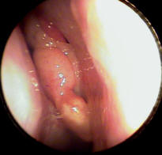
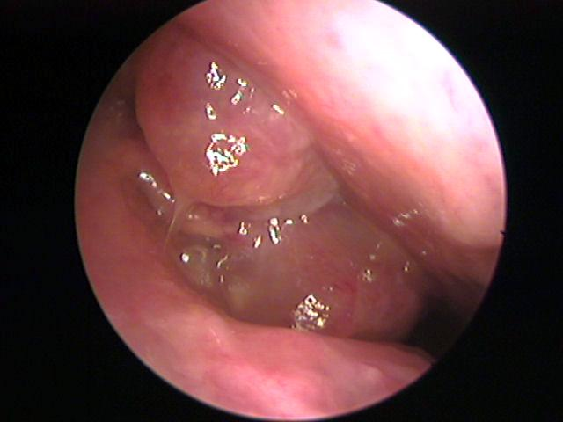
Nasal polypi
Definition: Apendunculated portion of oedematous mucosa of the nose.
Aetiology: ?
- Allergy
- Inflammation
- Neoplastic
Sites of origin:
1) Ethmoidal (commonest sites)
2) Antral (antrochoanal polyps)

Slide 23
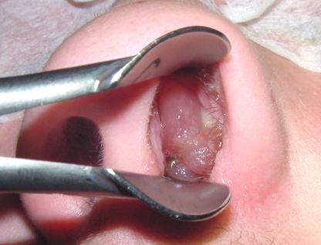
Multiple Polyps
Chronic sinusitis
Allergic rhinitis
Cystic fibrosis (CF)
Allergic fungal sinusitis (AFS)

Slide 24
Individual Polyp
AFS
Antral-choanal polyp
Inverting Papilloma
Encephaloceles, gliomas, hemangiomas, juvenile nasopharyngeal angiofibromas, rhabdomyosarcoma, lymphoma, neuroblastoma, sarcoma, chordoma

Slide 25
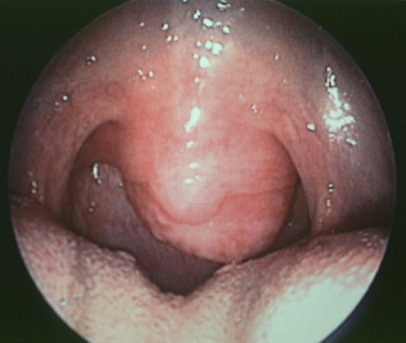
Antrocoanal Polyp
Polyp originating in the maxillary sinus, protruding in the middle nasal meatus
Further posterior extension moves the polyp through the choana into the nasopharynx, and a very large lesion may appear as an oropharyngeal mass

Slide 26
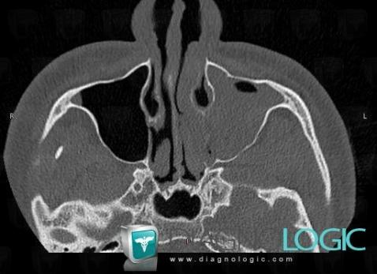
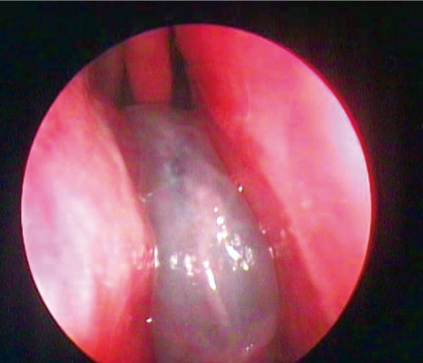
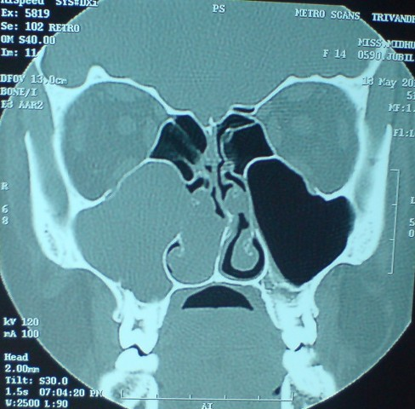
Antro Choanal polyp

Slide 27
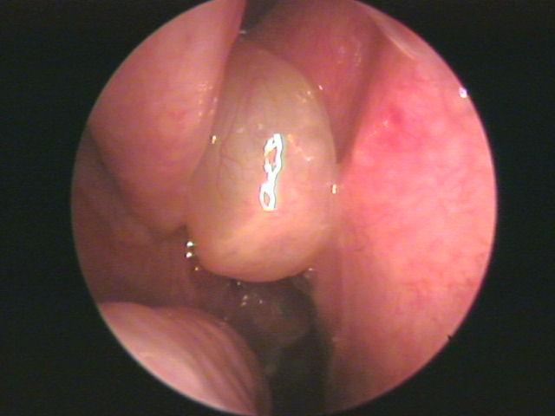
Nasal polypi
Clinical features:
- Nasal obstruction
- Sneezing, clear rhinorrhoea
- Expansion of the nasal bones (frog face)
Rx:
1) Antibiotic
2) Antihistamine
3) Topical and systemic steroid therapy
4) Surgical excision (FESS)

Slide 28
Other names
Atrophic Rhinitis
Dry rhinitis
Rhinitis sicca
Open-nose syndrome
Ozena

Slide 29
Atrophic Rhinitis
mild to severe.
The most mild cases simply involved heavy nasal crusting, and were easily treated with irrigation.
The last category was reserved for ozoena due to syphilis, and was associated with a severe odor and destruction of bone.

Slide 30
Triad of Atrophic Rhinitis
Triad of atrophic rhinitis, namely
Fetor
Crusting
Atrophy of the nasal structures.

Slide 31
Atrophic Rhinitis
Smell of the patient.
Depression at presentation due to the social implications
Nasal crusting.
Removal of these crusts may induce bleeding
The volume of the nasal cavity may appear large
Purulent discharge and septal perforations are not uncommon.

Slide 32
Classification
Primary AR
The causative agent in almost all cases of primary AR is Klebsiella ozenae.
Secondary AR
The most common cause is sinus surgery, followed by radiation, trauma, and granulomatous or infectious diseases.
Sinus surgery alone comprises almost 90% of secondary AR in some studies
Turbinectomies (80%)
Granulomatous diseases which may result in AR include sarcoid, leprosy, and rhinoscleroma. Infectious causes include tuberculosis and syphilis 1-2%

Slide 33
Radiographic findings
Plain films may show lateral bowing of the nasal walls, reduced or absent turbinates, or hypoplastic maxillary sinuses
CT Scan
Mucoperiosteal thickening of the paranasal sinuses
Loss of definition of the osteomeatal complex secondary to resorption of the ethmoid bulla and uncinate process.
Hypoplasia of the maxillary sinus
Enlargement of the nasal cavities with erosion and bowing of the lateral nasal wall.
Bony resorption and mucosal atrophy of the middle and inferior turbinates.
the most consistent finding is actually the bowing of the lateral nasal wall with enlargement of the nasal cavity.
None of these findings are required for diagnosis, however, since the disease remains a clinical entity.

Slide 34
Atrophic Rhinitis
squamous metaplasia, and subsequent loss of cilia
The mucous glands are severely atrophic or absent, which results in the common term “rhinitis sicca”

Slide 35
Medical Therapies
Two main goals:
Restoration of nasal hydration
Minimization of crusting and debris

Slide 36
Nasal Irrigation
Normal saline,
Sodium bicarbonate saline solution
Mixture of sodium carbonate
Sodium biborate
Sodium chloride in plain water.
Eliminate purulent discharge and colonization
Gentamycin 80mg in 1l of normal saline

Slide 37
anti-evaporation compounds
Glycerine,
Mineral oil
Menthol mixed with paraffin
odor masking agents, such as rose oil or menthol

Slide 38
Systemic or oral therapies
Aminoglycoside
Tetracycline
Floroquinolone

Slide 39
Treatment
>80% of patients placed on vitamin A
Iron resulted in improvement in 50% of subjects.

Slide 40
Surgical Therapies
Denervating operations
Volume reduction operations
Nasal closure operations.

Slide 41
Nasal Vestibulitis

Slide 42
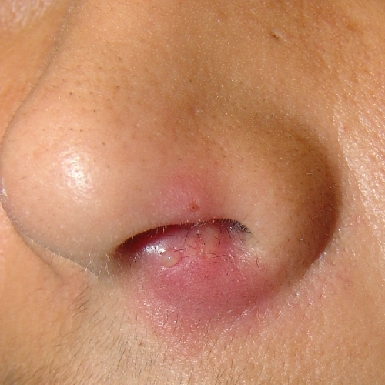

Slide 43
Furunculasis of nasal vestibulae
Acute staphylococcal infection of hair follicle
Clinical feature:
pain– tenderness–indurated swelling in the vestibulae
Treatment:
systemic antibiotics or topical depends if the patient is immune-compromised or extreme of age
Complication:
cavernous sinus thrombosis, cellulitis of upper lip

Slide 44
Denervation Procedures
sympathetic overactivity plays an integral role in the pathogenesis of this disease
cervical sympathectomy,
stellate ganglion block,
sphenopalatine ganglion block
section of greater superficial petrosal nerve.

Slide 45
Nasal closure operations

Slide 46
Volume reduction procedures
autograft bone,
dermofat,
cartilage
xenograft substances such as boplant.
Foreign materials include silicon, silastic, acrylic, teflon, hydroxyapatite, or plastipore

