Slide 1
( Ear I )
Anatomy and Physiology of the ear
Dr. Farid Alzhrani
Assistant professor
Consultant of Otolaryngology, head and neck surgery
King Abdulaziz University Hospital

Slide 2
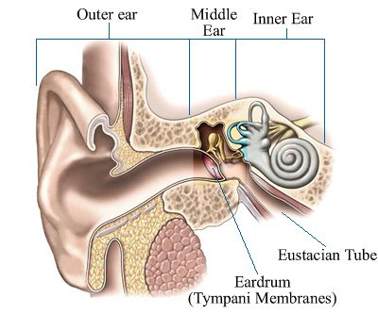
ANATOMY OF THE EAR

Slide 3
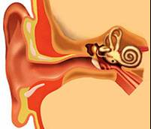
A) External Ear
Auricle
External Canal

Slide 4
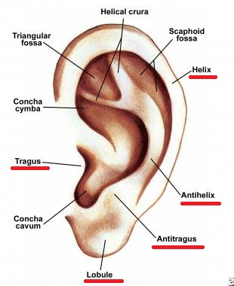
The Auricle:

Slide 5
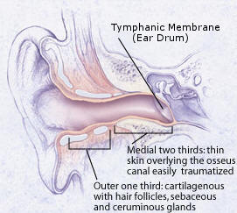
The External Auditory Canal :

Slide 6
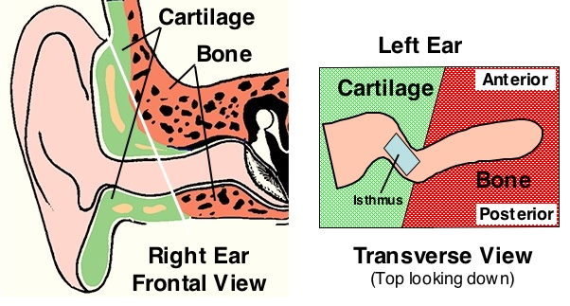
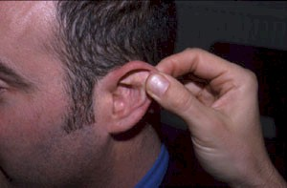
The External Auditory Canal :

Slide 7
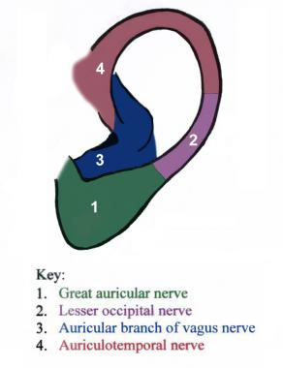
Nerve Supply of External Ear
Cervical II & III ( greater auricular and lesser occipital)
V cranial nerve (auriculotemporal)
X cranial nerve (auricular or Arnold’s)
Fibres from VII cranial nerve

Slide 8
TYMPANIC MEMBRANE
It forms the partition between the external auditory canal and the middle ear.
Parts :
Pars Tensa.
Pars Flaccida.

Slide 9
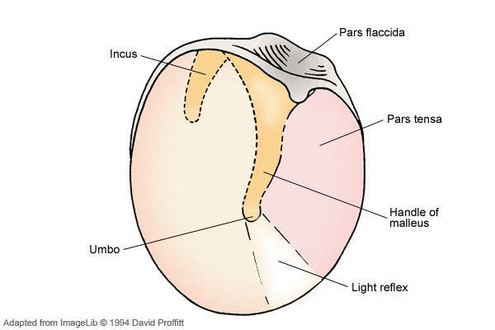
TYMPANIC MEMBRANE

Slide 10
TYMPANIC MEMBRANE
The Tympanic membrane consist of three layers:
Outer layer, of epithelial (ectodermal) origin,
The middle layer or lamina propria, of mesodermal origin,
The inner layer, of endodermal origin, comprising the middle ear mucosa.

Slide 11
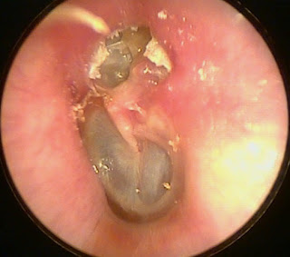
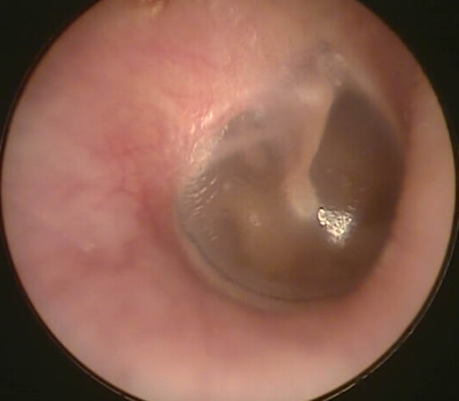
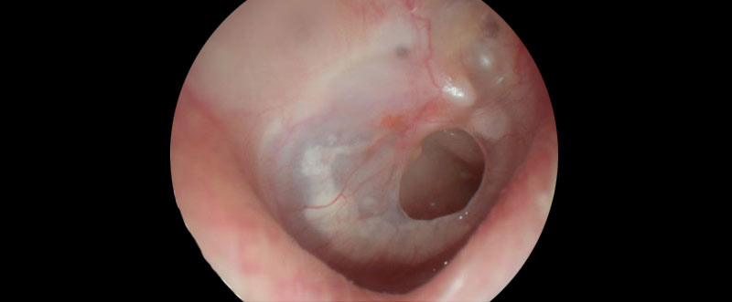
TYMPANIC MEMBRANE

Slide 12
ANATOMY OF THE EAR
External Ear
Middle Ear
Inner Ear

Slide 13
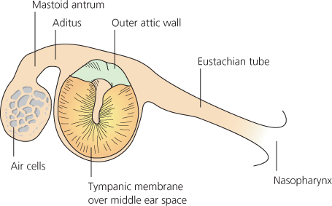
B) Middle Ear
Eustachian (Pharyngo-tympanic) Tube
Tympanum (Middle Ear Cavity)
Mastoid Antrum and Air Cells

Slide 14
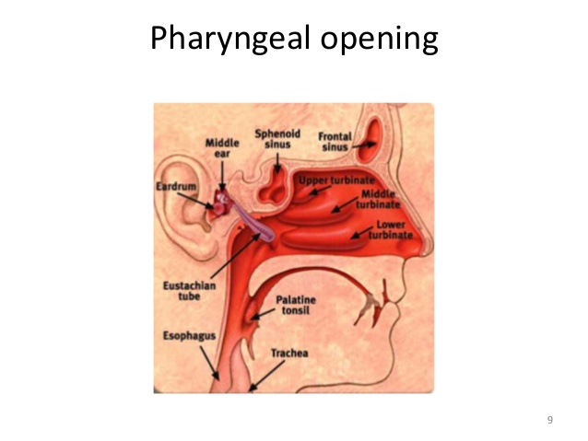
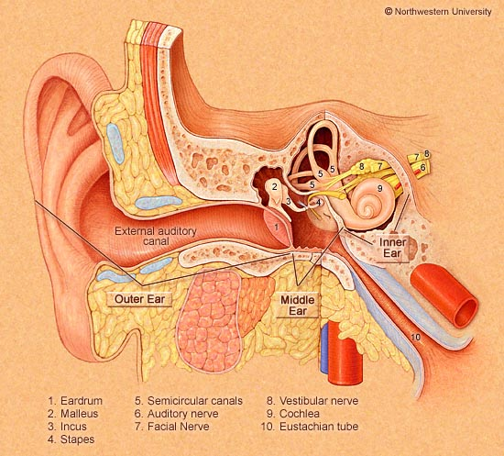
Middle Ear
Eustachian (Pharyngo-Tympanic) Tube
Connect the middle ear cavity with nasopharynx.
Lies adjacent to the ICA

Slide 15
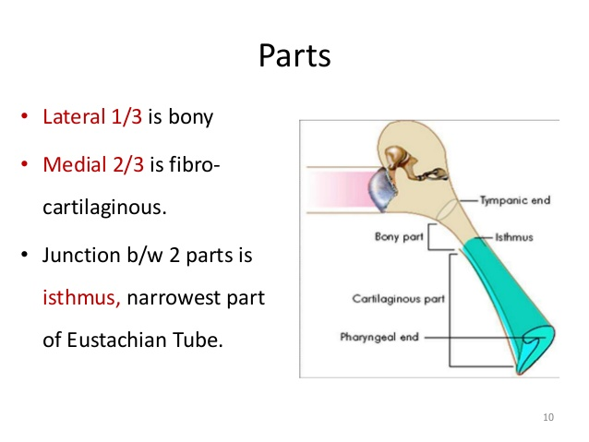
Middle Ear
Eustachian (Pharyngo-Tympanic) Tube

Slide 16
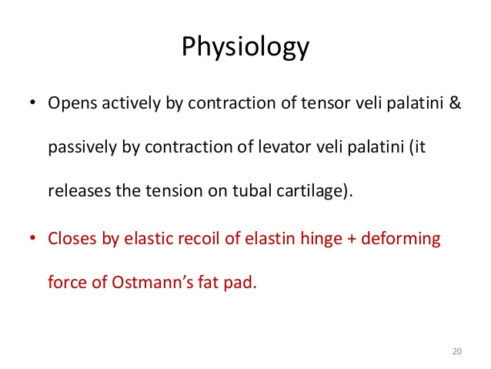
Middle Ear
Eustachian (Pharyngo-Tympanic) Tube

Slide 17
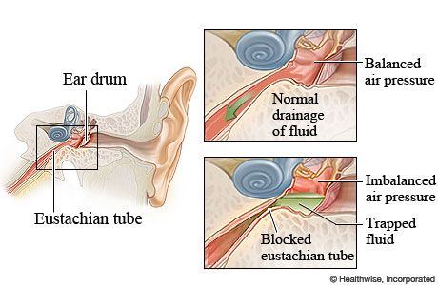
Middle Ear
Eustachian (Pharyngo-Tympanic) Tube

Slide 18
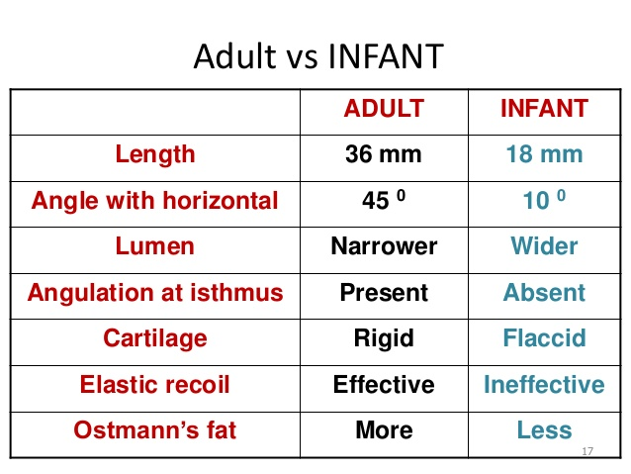
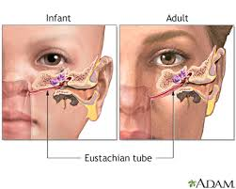
Middle Ear
Eustachian (Pharyngo-Tympanic) Tube

Slide 19
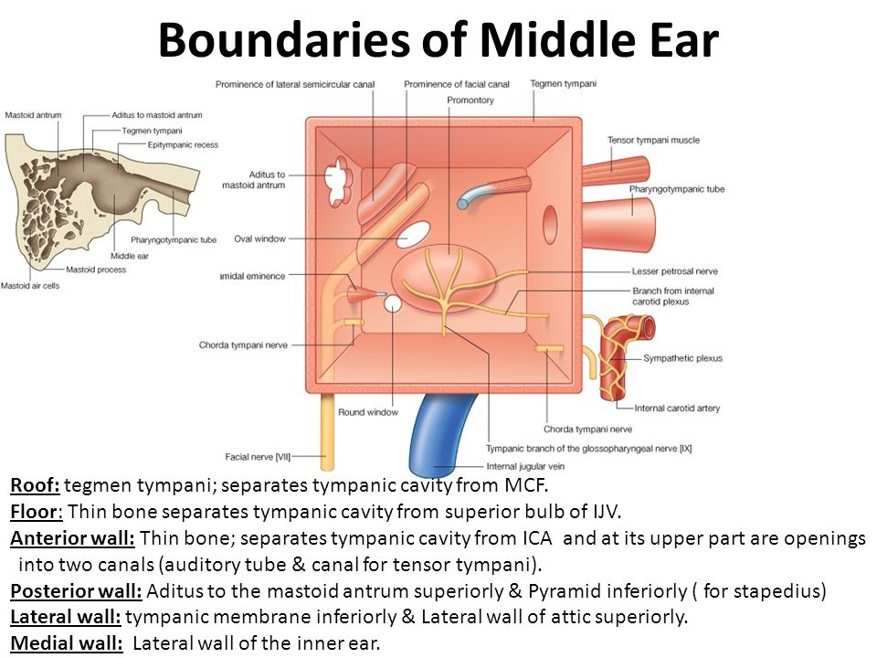
Middle Ear
Tympanic cavity (Middle ear cavity)

Slide 20
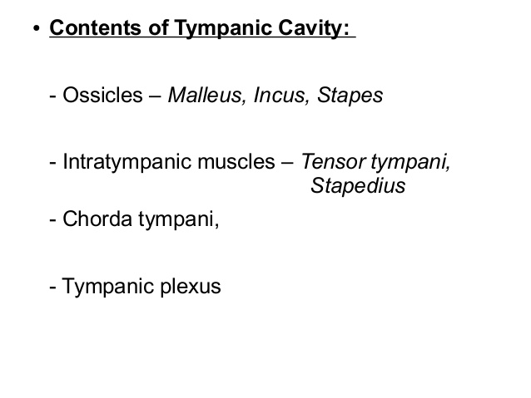
Middle Ear
Tympanic cavity (Middle ear cavity)

Slide 21
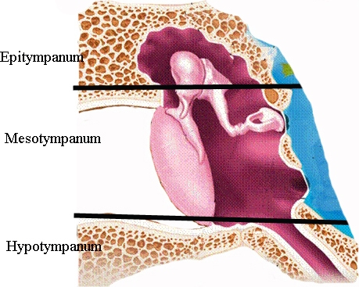
Middle Ear
Tympanic cavity (Middle ear cavity)
Middle ear cavity divided into three parts

Slide 22
Middle Ear
Tympanic cavity (Middle ear cavity)
LINING OF THE MIDDLE EAR :
Mucous membrane of the middle ear space consists of stratified cuboidal epithelium, which changes to pseudostratified ciliated epithelium around the mouth of the eustachian tube.

Slide 23
Middle Ear
Tympanic cavity (Middle ear cavity)
Sensory nerve supply of the middle ear mucosa :
Tympanic branch of the glossopharyngeal nerve.
Auriculotemporal branch of the trigeminal nerve.
Motor nerve supply of the middle ear muscles :
Stapedius muscle supplied by the stapedial branch of the facial nerve.
Tensor tympani muscle supplied by the mandibular division of the trigeminal nerve.

Slide 24
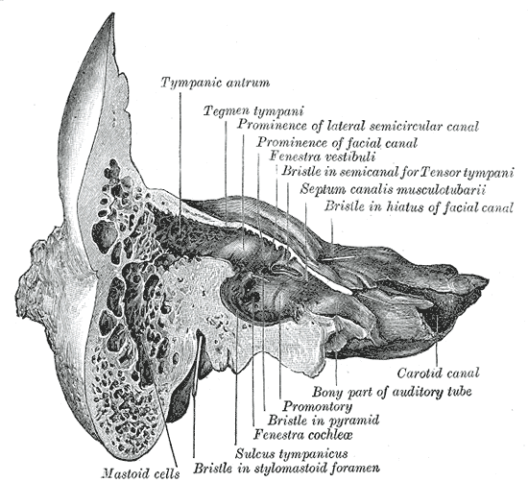
Middle Ear
Mastoid antrum and air cells
Air-containing cells of the mastoid process are continuous with the air in the middle ear.

Slide 25
Middle Ear
Mastoid antrum and air cells
Pneumatization is complete between the sixth and twelfth years of life.
Normal tubal function is a prerequisite for biologically active, healthy middle ear mucosa, and thus for the normal process of pneumatization.

Slide 26
ANATOMY OF THE EAR
External Ear
Middle Ear Cleft
Inner Ear

Slide 27
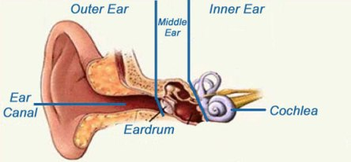
C) Inner Ear
Consists of :
Labyrinth.
Bony Labyrinth
Membranous Labyrinth
2. Internal Auditory Canal.

Slide 28
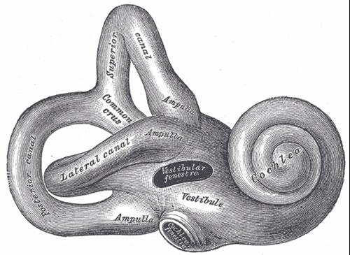
Inner Ear
Bony Labyrinth
  Its parts :
  Bony Cochlea
  Vestibule
  Bony semicircular canals

Slide 29
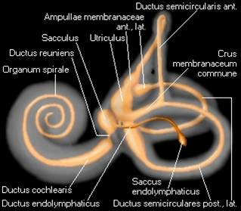
Inner Ear
Bony Labyrinth
Its contents :
Perilymph
Membranous labyrinth

Slide 30
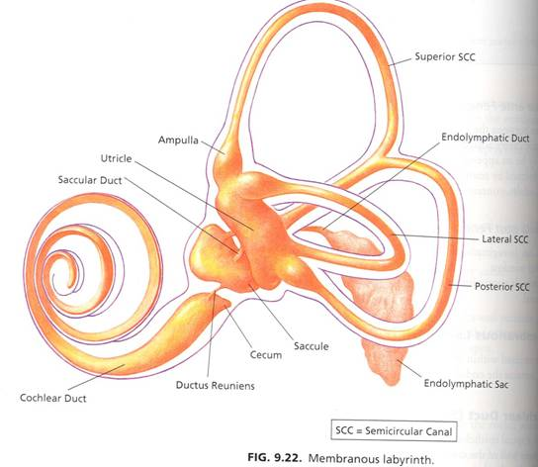
Inner Ear
Membranous Labyrinth
  Its parts :
  Cochlear duct
  Saccule and utricle
  Membranous semicircular ducts

Slide 31
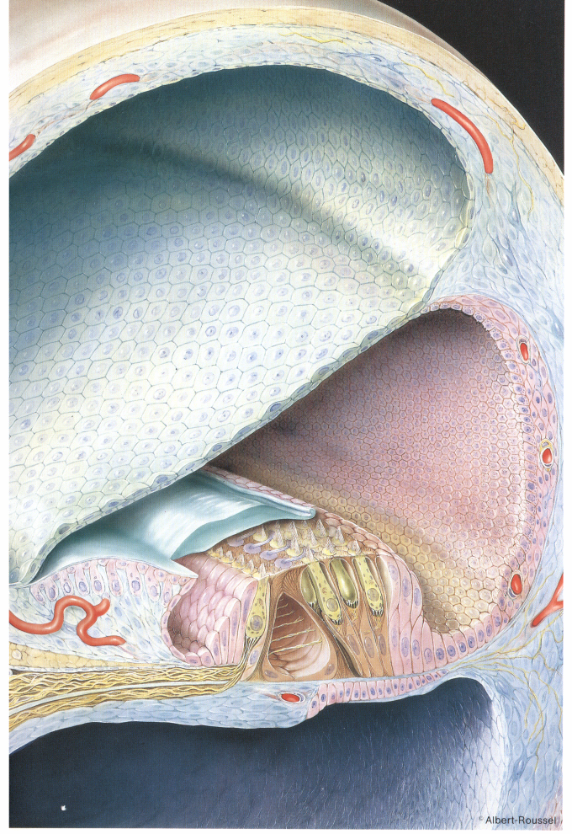
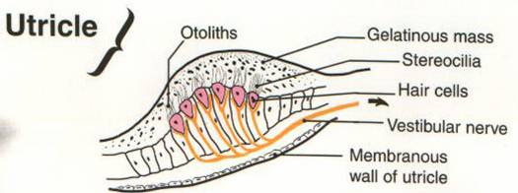
Inner Ear
Membranous Labyrinth
Its contents :
Endolymph
Sensory epithelium
  Cochlea: organ of Corti
  Utricle & saccule: maculae
  Semicircular canals: cristae

Slide 32
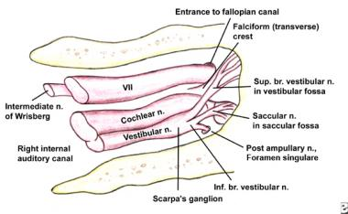
Inner Ear
Internal Auditory Canal
Contains:
Cochleovetibular nerve
Facial nerve

Slide 33
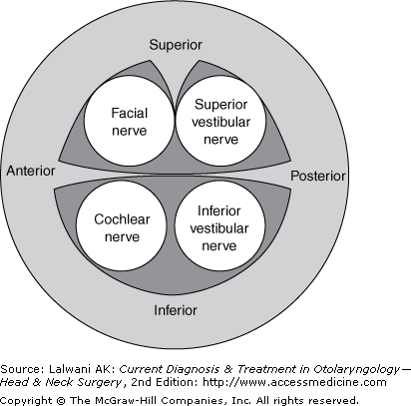
Inner Ear
Internal Auditory Canal

Slide 34
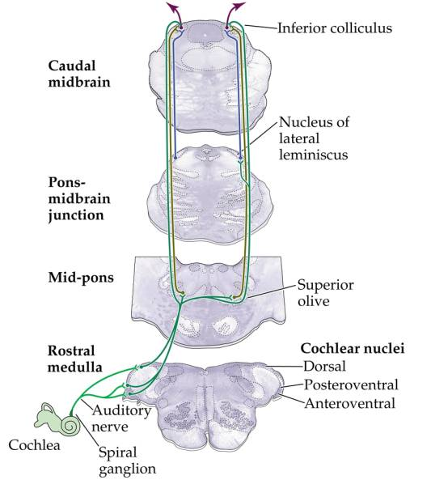
Inner Ear
Internal Auditory Canal
CENTRAL CONNECTIONS OF COCHLEAR NERVE

Slide 35
PHYSIOLOGY OF THE EAR

Slide 36
FUNCIONS OF THE EXTERNAL EAR
Protection of the middle ear
  Curvature
  Cerumen
Auditory functions:
  Sound conduction
  Increase sound pressure by the resonance function

Slide 37
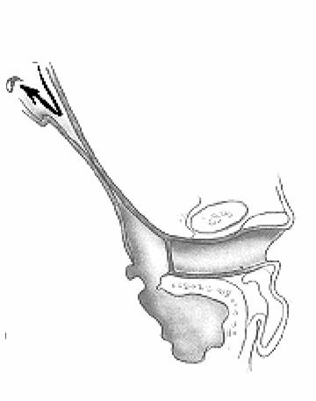
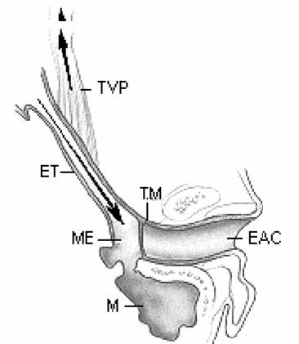
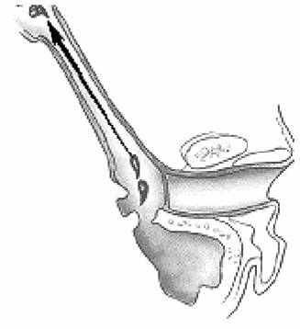
FUNCTIONS OF THE EUSTACHIAN TUBE
Protection
Ventilation
Drainage

Slide 38
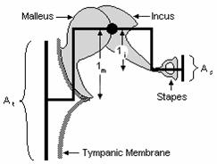
FUNCIONS OF THE MIDDLE EAR
Conduction of sound
Protection to the inner ear
  stapedial reflex

Slide 39
FUNCIONS OF THE INNER EAR
Hearing Function:
  Transduction of sound to action potentials
Vestibular Function:
  Participate in maintaining body balance

Slide 40
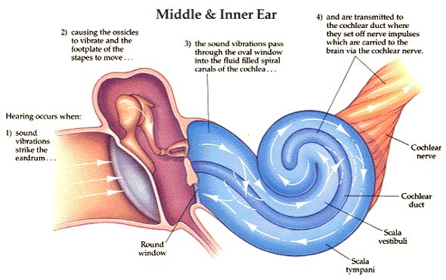
Hearing Function:

Slide 41
Thank you

