Slide 1
Chronic otitis media
Prof. Abdulrahman Alsanosi
Program Director, KSU Fellowship in ORL & Oto-Neurotology
Department of Otolaryngology ,Head and Neck surgery
King Abdulaziz University Hospital
^{King Saud University}

Slide 2
Objectives
Definition and classifications
Otitis media with effusion
Adhesive otitis media
Chronic suppurative otitis media

Slide 3
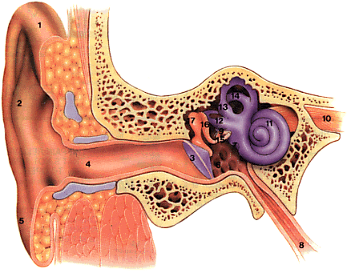
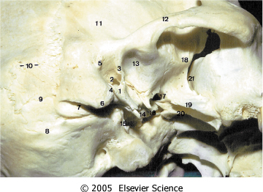
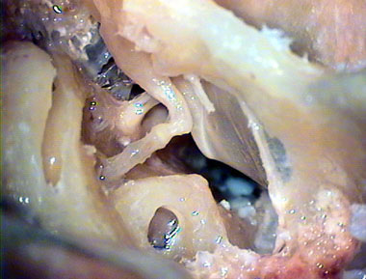
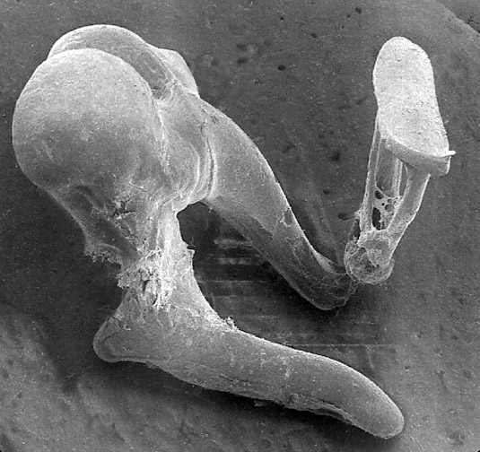
Anatomy
.

Slide 4
Otitis media
Definition:
Inflammation of the middle ear
May also involve inflammation of mastoid

Slide 5
Classifications
Chronic Non Suppurative Otitis Media
– Otitis media with effusion “OME”
– Adhesive otitis media
Chronic Suppurative Otitis Media “CSOM”
– Tubotympanic (Safe)
– Atticoantral (Unsafe)

Slide 6
The pathogenesis of OME
Multifactorial
Eustachian tube dysfunction
Bacterial and virus infectio

Slide 7
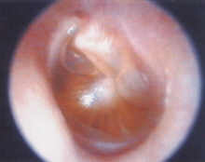
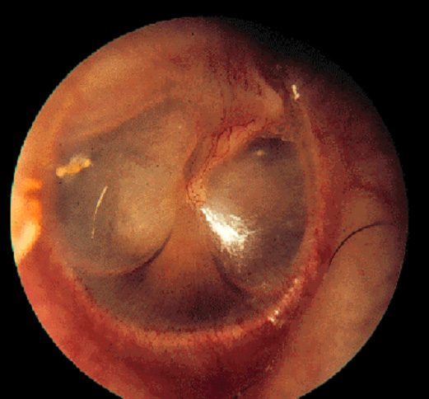
Otitis Media with Effusion
(Chronic non-suppurative Otitis Media)
Middle ear filled with serous or mucoid fluid
No purulence
Often present after acute otitis media is treated appropriately with antibiotics
Most will clear within 3 months

Slide 8
Otitis media with effusion
Previously thought sterile
30-50% grow in culture
over 75% PCR +
Usual organisms

Slide 9
Otitis media with effusion
Etiology :
Bacteria
Strep pnuemonia
Moraxella cat.
Haemophilus influ.
Virus
RSV
Rhinovirus
Parainfluenza virus
Influenza virus

Slide 10
Acute Otitis Media
Resolution
Persistent effusion
Acute Perforation
+
Otitis Media
Resolution
+
Healing
Chronic suppurtive otitis media
Unsafe
Safe

Slide 11
Otitis media with effusion
Estimates of residual effusion:
70% @ 2 wks
40% @ 4 wks
20% @ 8 wks
10% @ 12 wks

Slide 12
Diagnosis
History
Clinical Examination
Tuning fork tests
Audiological assessment

Slide 13
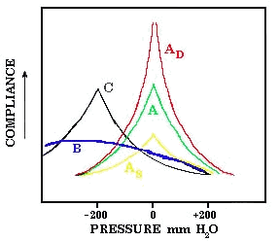
Diagnosis
Tuning fork test ( Weber and Renine test)
Audiological assessment:
1. Tympanmetry

Slide 14
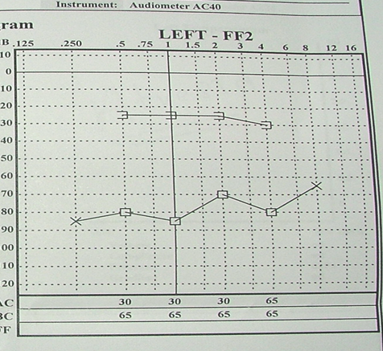
Diagnosis
Audiological assessment:
B-Pure tone audiogram

Slide 15
Management of otitis media with effusion

Slide 16
Medical Treatment of OME
Observation – many European countries wait 6-9 months prior to placement of ear tubes
Antibiotics
  Meta-analysis shows beneficial short-term resolution of OME
Audiogram at 3 months with persistent effusion to determine impact on hearing

Slide 17
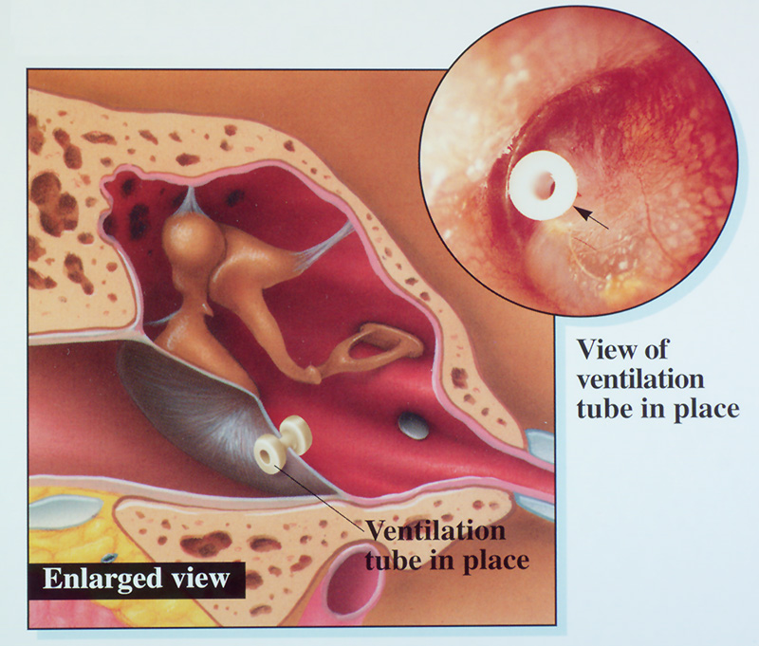
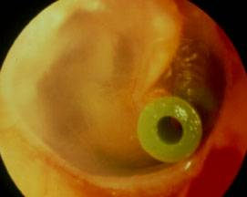
Surgical treatment
Tympanostomy Tubes
chronic OME >3mos with hearing loss and/or speech delay is an indication for tympanostomy tube placement
Bypass Eustachian tube to ventilate middle ear

Slide 18
Adhesive otitis media
Lack of middle ear ventilation results in negative pressure within the tympanic cavity
The ear drum retracts onto structures within the middle ear
The result of long standing Eustachian tube dysfunction
The drum loses structural integrity and becomes flaccid
Contact between the drum and the incus or stapes can cause bone erosion at the IS joint
Can sometimes be treated with tympanostomy tubes

Slide 19
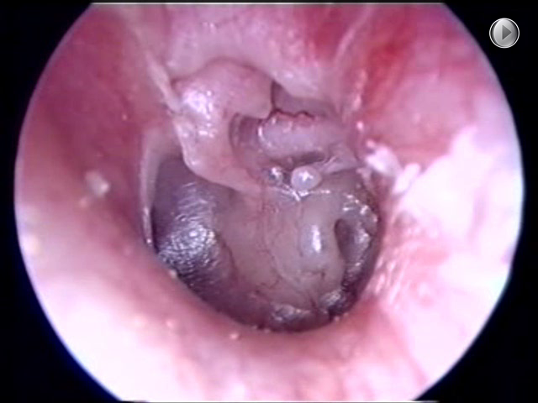
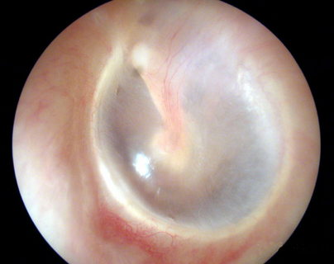
Middle Ear Atelectasis
The result of long standing Eustachian tube dysfunction
The drum loses structural integrity and becomes flaccid
Contact between the drum and the incus or stapes can cause bone erosion at the IS joint
Can sometimes be treated with tympanostomy tubes

Slide 20
Chronic suppurative otitis media with and without cholesteatoma

Slide 21
Chronic suppurative otitis media
3D :
Duration > 3 months despite treatment
Discharge mucopurulent otorrhea
Deafness Perforation /Ossicular chains

Slide 22
Pathogenesis
ET dysfunction
Poor aeration
Mucosal edema and ulceration
Capillary proliferation
Osteitis

Slide 23
Etiology
Pseudomonas aeruginosa
Staphylococcus aureus
Proteus species

Slide 24
Classification
Chronic suppurative otitis media
Tubo-tympanic type (safe)
Attico- antral (un safe)

Slide 25
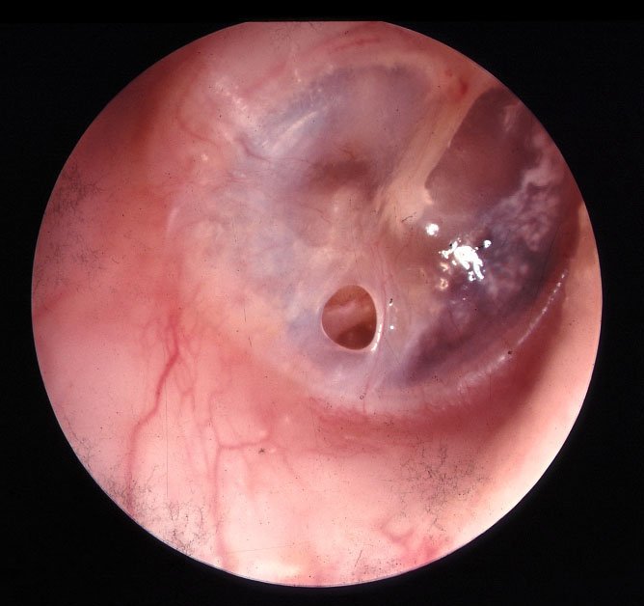
Chronic suppurative otitis media
A-Tubotympanic type (Safe)
Simple perforation
Intermittent non offensive non bloody ear discharge
On examination (central perforation )

Slide 26
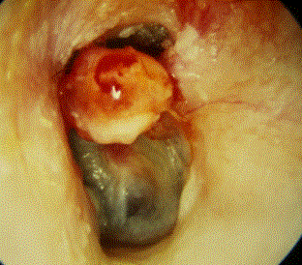
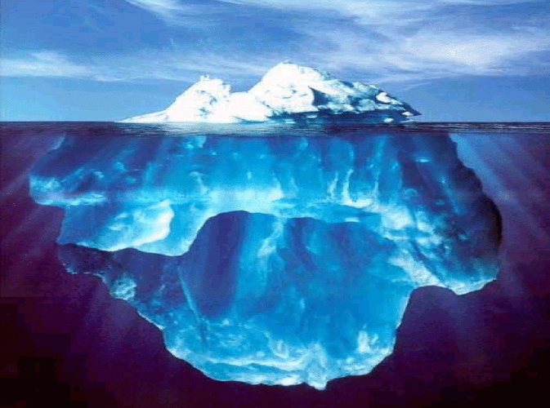
Chronic suppurative otitis media
B-Attico-antral (unsafe)
Chronic ,Scanty, offensive and bloody ear discharge
On examination marginal perforation
You may see cholesteatoma

Slide 27
Cholesteatoma
Cholesteatomas are epidermal inclusion cysts of the middle ear and/or mastoid with a squamous epithelial lining
Contain keratin and desquamated epithelium

Slide 28
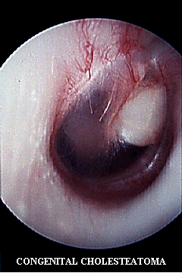
Cholesteatoma
Can be congenital or acquired

Slide 29
Pathogenesis of cholesteatoma
Natural history is progressive growth with erosion of surrounding bone due:
Pressure effects
Osteoclast activation

Slide 30
Diagnosis
History
Examination
Otoscopic
Microscopic
Tuning fork test
Investigation
Audiological assessment
Radiological assessment

Slide 31
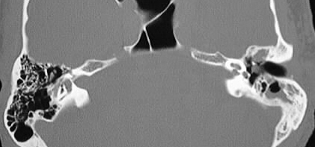
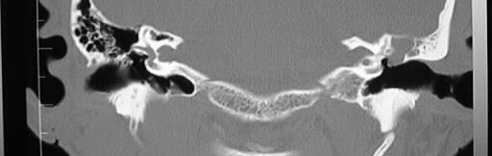
Cholesteatoma Imaging

Slide 32
Treatment

Slide 33
Chronic suppurative otitis media without cholesteatoma ( safe )
A — Ototopical antibiotics
B — Surgical repair of the TM perforation

Slide 34
A— Ototopical Medications
Antibiotic only otic drops
Floxin (ofloxacin)
Antibiotic with steroid otic drops
Ciprodex (ciprofloxin and dexamethasone)
Cipro HC (ciprofloxin and hydrocortisone)

Slide 35
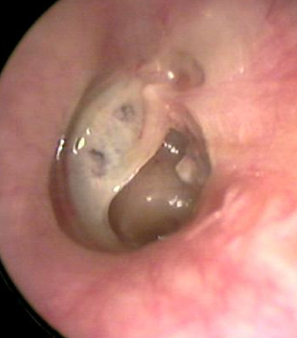
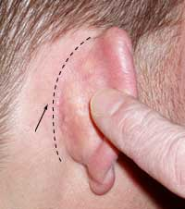
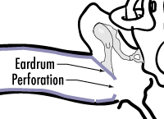
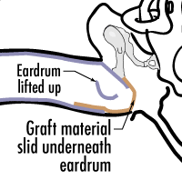
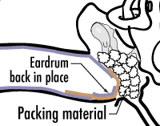
B — Surgical repair of the TM perforation
Myringplasty
Tympanoplasty

Slide 36
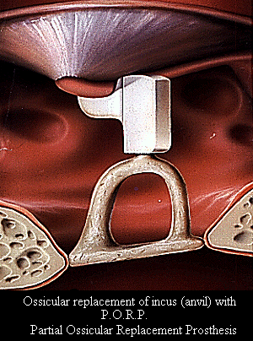
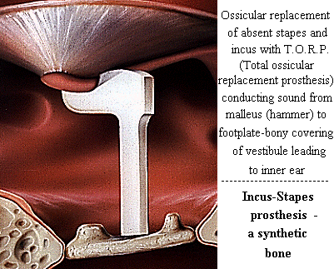
C — Ossicular Chain Reconstruction

Slide 37
Chronic suppurative otitis media with cholesteatoma (Unsafe)
Surgery

Slide 38
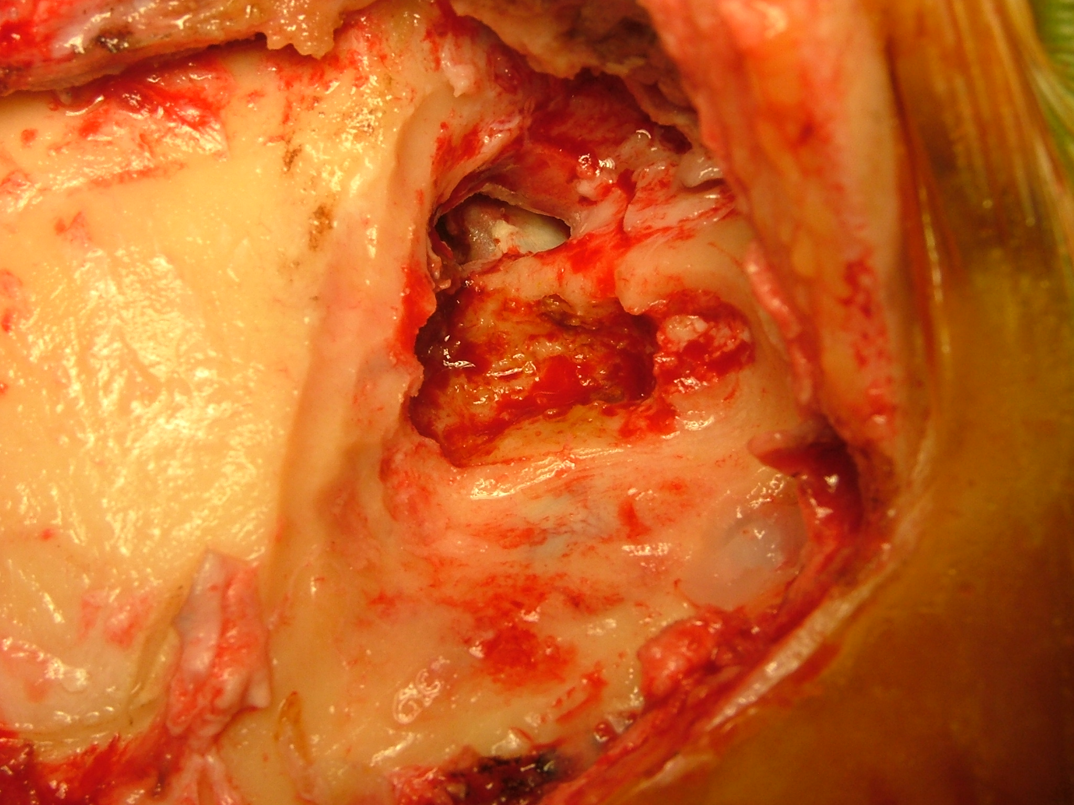
Cholesteatoma Surgery
Mastoidectomy

Slide 39


Slide 40
Thank you

