Slide 1
The complications of acute and chronic otitis media
Prof. Abdulrahman Alsanosi
Program Director, KSU Fellowship in ORL & Oto-Neurotology
Department of Otolaryngology ,Head and Neck surgery
King Abdulaziz University Hospital
^{King Saud University}

Slide 2
Objectives
The predisposing factors for complications
The pathways for spreading the infections beyond the ear?
To know the classifications of complications
To know presentations ,clinical findings ,investigations and management of each complication

Slide 3
Predisposing factors
• Virulent organisms.
Chronicity of disease
•Presence of Cholesteatoma and bone erosion.
• Obstruction of natural drainage e.g. by a polyp.
• Low resistance of the patient

Slide 4
Pathways of infection
• extension of infection is by bone erosion due to a cholesteatoma.
• Vascular extension (retrograde thrombophlebitis).
Congenital dehiscence
fracture lines
Round or oval window membrane to the labyrinth
Dehiscence due to previous surgery

Slide 5
Classification
• Intra-cranial complications
• Intratemporal complications
• Extra-cranial complications

Slide 6
Intra-cranial complications
Extradural Abscess
Subdural Abscess
Meningitis
Venous Sinus Thrombosis
Brain Abscess

Slide 7
What are the natural barriers between brain and temporal bone ?
Bone
Meninges

Slide 8
Extradural Abscess
Collection of pus against the dura
middle or posterior cranial fossa.
Extradural abscess is the commonest
intracranial complication of otitis media

Slide 9
Extradural abscess
Clinical Picture
– Persistent headache on the side of otitis media.
– Pulsating discharge.
– Fever
– Asymptomatic (discovered during surgery)

Slide 10
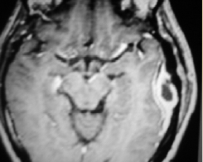
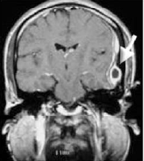
Extradural abscess
Diagnosis
– CT scans reveal the abscess as well as the middle ear pathology.
Treatment:
– Mastoidectomy and drainage of the abscess

Slide 11
Subdural Abscess
Definition
– Collection of pus between the dura and the
arachnoid.
– It’s a rare pathology
Clinical picture:
– Headache without signs of meningeal irritation
– Convulsions
– Focal neurological deficit (paralysis, loss of
sensation, visual field defects)

Slide 12
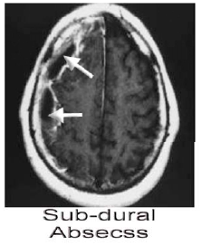
Subdural Abscess
Investigations
– CT scan, MRI
Treatment:
– Drainage (neurosurgeons)
– Systemic antibiotics
– Mastoidectomy

Slide 13
Meningitis
Definition
– Inflammation of meninges (pia & arachinoid)
Pathology:
– Occurs during acute exacerbation of chronic
unsafe middle ear infection.

Slide 14
Meningitis
Clinical picture:
– General symptoms and signs:
• high fever, restlessness, irritability,
• photophobia, and delirium.
– Signs of meningeal irritation?

Slide 15
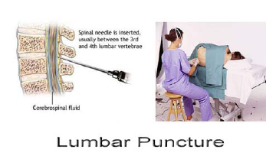
Meningitis
Diagnosis
– Lumbar puncture is diagnostic:
Treatment:
– Treatment of the complication itself and control of ear
infection:
• Specific antibiotics.
• Antipyretics and supportive measures
• Mastoidectomy to control the ear infection.

Slide 16
Venous Sinus Thrombosis
Definition
Thrombophlebitis of the venous sinus.
Etiology:
It usually develops secondary to direct extension

Slide 17
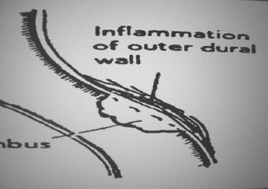
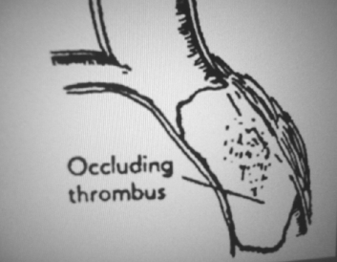
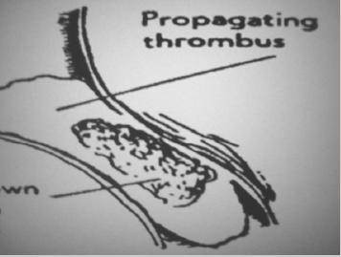
Venous Sinus Thrombosis

Slide 18
Venous Sinus Thrombosis
Clinical picture:
– Signs of blood invasion:
• (spiking) fever with rigors and chills
• persistent fever (septicemia).
– Positive Greissinger’s sign which is edema and tenderness over the area of the mastoid emissary Vein.
headache, vomiting, and papilledema(increase intracranial pressure )

Slide 19
Venous Sinus Thrombosis
Diagnosis
– CT scan with contrast
– MRI, MRA, MRV
– Angiography, venography
– Blood cultures is positive during the febrile
phase.

Slide 20
Venous Sinus Thrombosis
Treatment
– Medical:
• Antibiotics and supportive treatment.
• Anticoagulants
– Surgical:
• Mastoidectomy with exposure of the affected
sinus and the intra-sinus abscess is drained.

Slide 21
Brain Abscess
Definition
– Localized suppuration in the brain substance.
– It is most lethal complication of suppurative otitis media
Incidence:
– 50% is Otogenic brain abscess

Slide 22
Brain Abscess
Pathology
– Site: Temporal lobe or • Less frequently, in the cerebellum. (more dangerous)

Slide 23
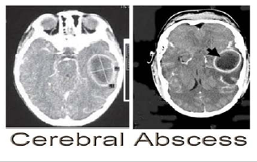
Brain Abscess
Brain Abscess
Diagnosis
– CT scans.
– MRI

Slide 24
Brain Abscess
Brain Abscess
Treatment
Medical:
• Systemic antibiotics.
• Measure to decrease intracranial pressure.
– Surgical:
• Neurosurgical drainage of the abscess .
• mastoidectomy operation after
subsidence of the acute stage.

Slide 25
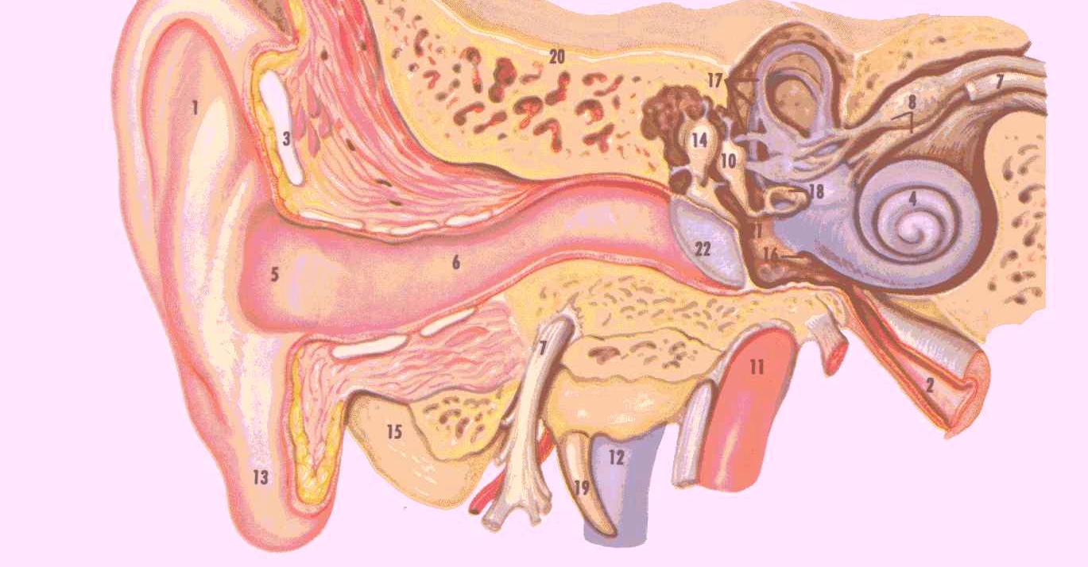
Intratemporal complications

Slide 26
Intratemporal complications
Labybrinthitis
Ossicular fixation or erosions
Labyrithine fistula
Facial nerve paralysis
Mastoiditis /mastoid abscess

Slide 27
Labyrinthine fistula
Labyrinthine fistula
Definition:
communication between middle and inner ear
Atiology :
It is caused by erosion of boney labyrinth due cholesteatoma

Slide 28
Labyrinthine fistula
Clinical picture :
Hearing loss
Attack of vertigo mostly during straining ,sneezing and lifting heavy object
Positive fistula test

Slide 29
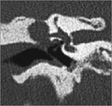
Labyrinthine fistula
Diagnosis:
High index of suspicion
longstanding disease
fistula test
Ct scan of temporal bone
Treatment :
Mastoidectomy

Slide 30
Facial nerve paralysis
Congenital or acquired dehiscence of nerve canal
It is possibly a result of the inflammatory response within the fallopian canal to the acute or chronic otitis media
Tympanic segment is the most commom site to be involved

Slide 31
Facial nerve paralysis
Diagnosis
Clinical
May occur in acute or chronic ottis media
Ct scan

Slide 32
Facial nerve paralysis
Treatment :
-Acute otitis media and acute mastoiditis (cortical mastoidectomy +ventilation tube)
- chronic otitis media with cholestetoma ( mastoidecomy ± facial nerve decompresion )

Slide 33
MASTOIDITIS
Definition:
It is the inflammation of mucosal lining of
antrum and mastoid air cells system.

Slide 34
Acute Mastoiditis
Pathology
• Production of pus under tension
• Hyperaemic decalcification
• Osteoclastic resorption of bony walls

Slide 35
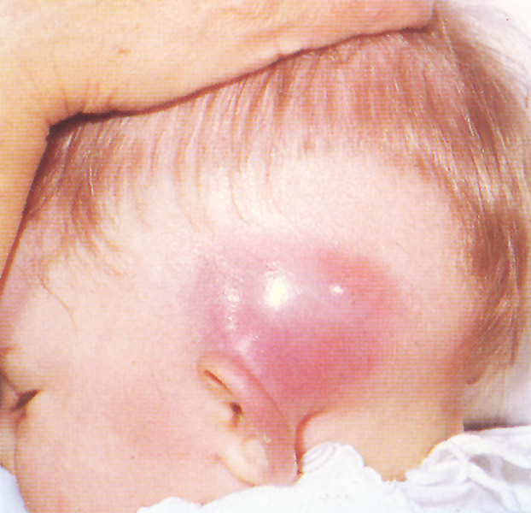
Symptoms:
Earache
Fever
Ear discharge
Signs:
Mastoid tenderness
Sagging of posterosuperior meatal wall
TM perforation
Swelling over mastoid
Hearing loss

Slide 36
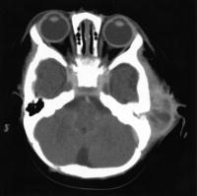
Mastoid abscess
Investigation :
• CT scan temporal bones
• Ear swab for culture and
sensitiveity

Slide 37
TREATMENT
Medical treatment:
− Hospitalize
− Antibiotics
− Analgesics
Surgical treatment:
−Myringotomy
− Cortical mastoidectomy

Slide 38
Extracranial complications
Extension of infection to the neck
Bezold abscess ( extension of infection from mastoid to SCM)

Slide 39
Thanks

