Slide 1
بسم الله الرحمن الرحيم

Slide 2
Objectives
Present the pathology, clinical presentation and management of chronic infection of the middle ear cleft
Outline the indications of the common middle ear surgical procedures

Slide 3
CHRONIC OTITIS MEDIA

Slide 4
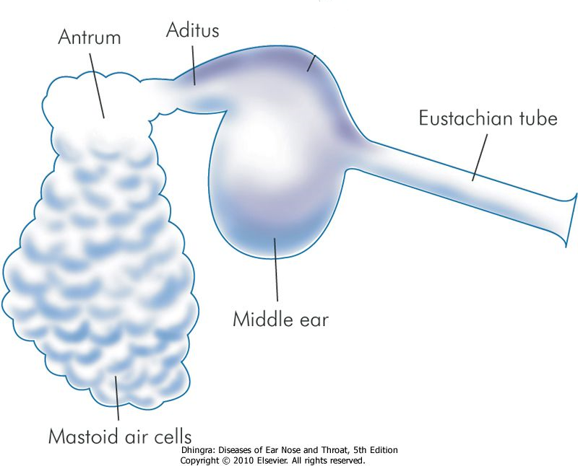
Definition
Chronic inflammation of the middle ear cleft

Slide 5
Classification of Chronic Otitis Media
Chronic Non Suppurative Otitis Media
Otitis media with effusion “OME”
Adhesive otitis media
Chronic Suppurative Otitis Media “CSOM”
Tubo-tympanic (Safe)
Attico-antral (Unsafe)

Slide 6
Chronic Non Suppurative Otitis Media
Otitis media with effusion “OME”
Adhesive otitis media

Slide 7
OTITIS MEDIA WITH EFFUSION (OME)

Slide 8
Definition
Presence of non-purulent fluid within the middle ear cleft

Slide 9
Pathology of OME
Eustachian tube dysfunction
Chronic non suppurative inflammatory changes in the mucosa
Formation of fluid in the middle ear
Transudate
Excudate
Secretion

Slide 10
Synonyms of otitis media with Effusion (OME)
Secretory otitis media
Serous otitis media
Excudative (Catarrhal) otitis media
Sero-mucinous otitis media
Glue ear

Slide 11
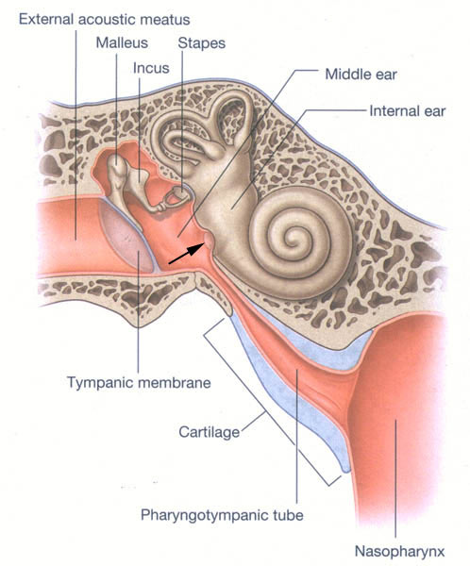
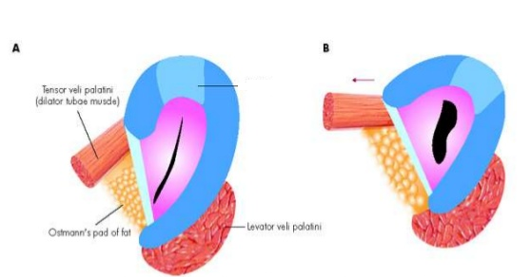
Etiology
Eustachian tube dysfunction
Poor muscular function

Slide 12
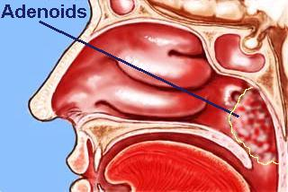
Etiology
Eustachian tube dysfunction
Poor muscular function
Adenoids

Slide 13
Etiology
Eustachian tube dysfunction
Poor muscular function
Adenoids
Barotrauma

Slide 14
Otitic Barotrauma
Due to failure of the ET to equalize the middle ear pressure during descent from high altitudes in aircraft or during diving

Slide 15
ETIOLOGY
Eustachian tube dysfunction
Poor muscular function
Adenoids
Barotrauma
Others (e.g. nasopharyngeal carcinoma)

Slide 16
Important
Nasopharygeal carcinoma should be suspected in adults with OME especially if it is unilateral

Slide 17
Etiology
Eustachian tube dysfunction
Poor muscular function
Adenoids
Barotrauma
Others (e.g. nasopharyngeal carcinoma)
Infections
Unresolved AOM
Adenoiditis and other URTIs

Slide 18
Etiology
Eustachian tube dysfunction
Poor muscular function
Adenoids
Barotrauma
Others (e.g. nasopharyngeal carcinoma)
Infections
Unresolved AOM
Adenoiditis and other URTIs

Slide 19
Prevalence of OME
Between 20% and 50% of children do have OME at some time between 2 and 10 years of age

Slide 20
Risk factors for OME
Age
Season
Cleft palate
Smoking
? Allergy

Slide 21
Symptoms of OME
Hearing impairment
Is usually the only symptom
± Mild Otalgia
Other symptoms (Fluid sensation, tinnitus)

Slide 22
Examination
Otoscopy
Tuning fork tests

Slide 23
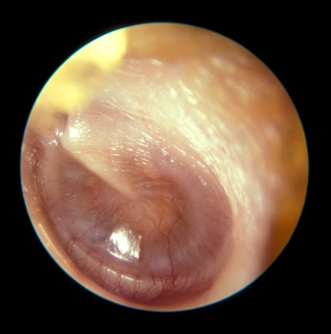
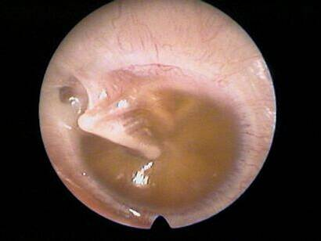
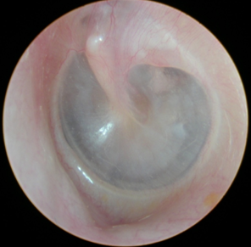
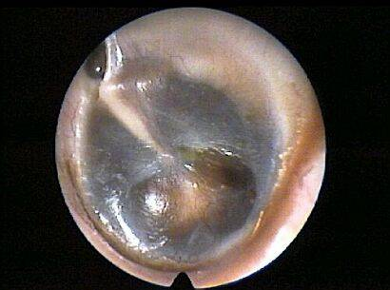
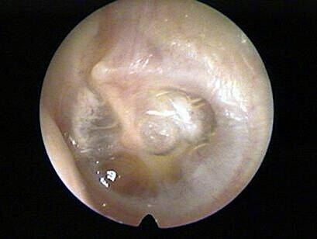
Otoscopy
NORMAL

Slide 24
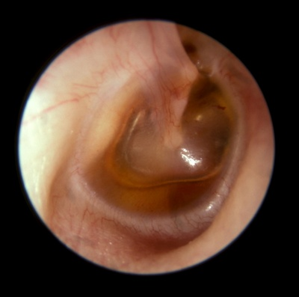

Slide 25
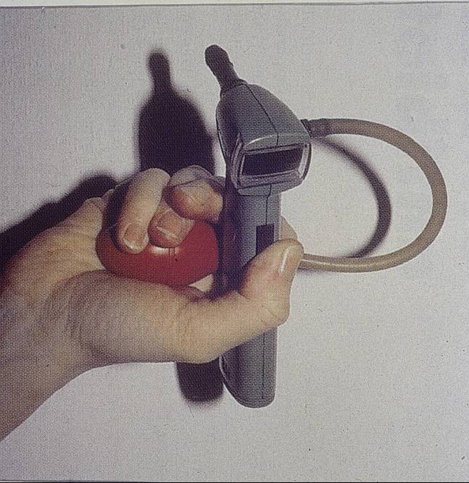
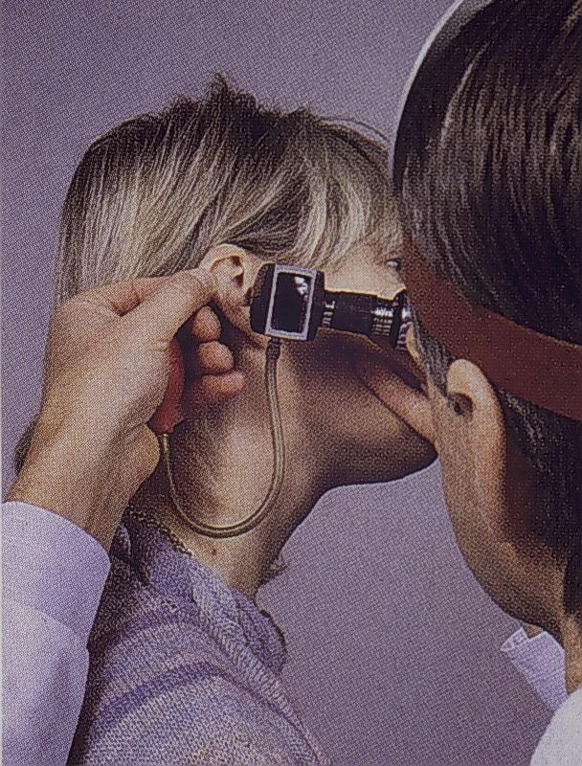
Otoscopy

Slide 26
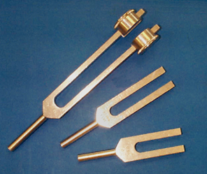
Tuning fork tests
Rinne’s & Weber’s

Slide 27
Investigations
Pure tone audiogram (PTA)
Tympanometry

Slide 28
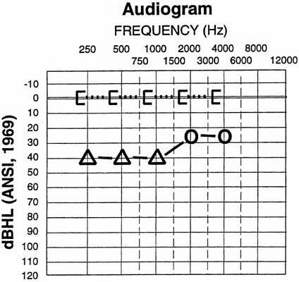
PTA

Slide 29
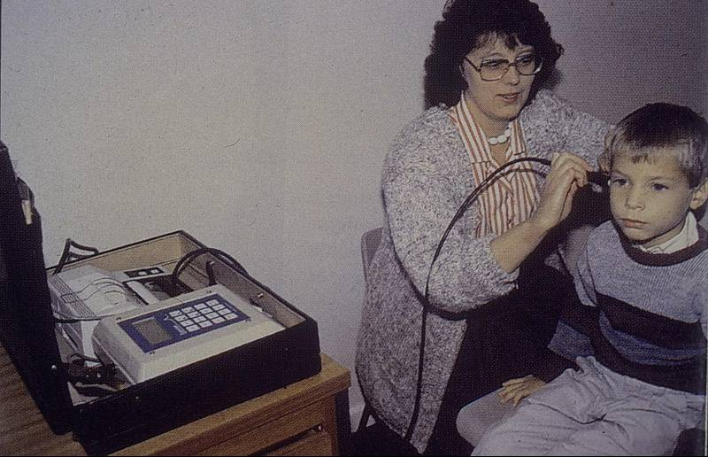
Tympanometry

Slide 30
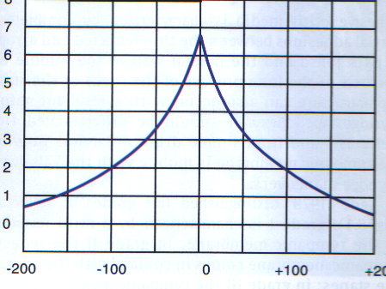
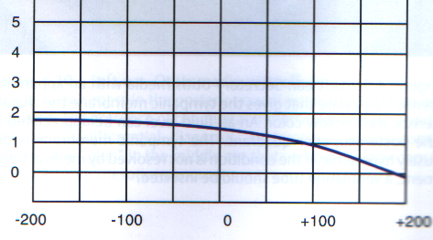
Type A (Normal)
Type B (OME)
Type C (ET dysfunction ?OME)

Slide 31
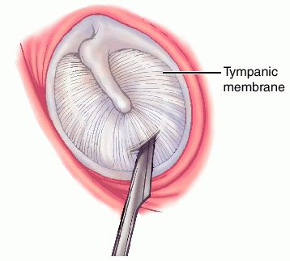
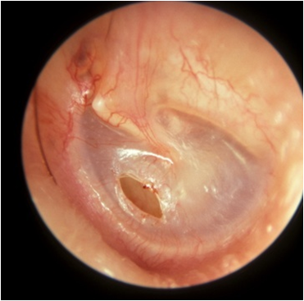
Diagnostic Myringotomy

Slide 32
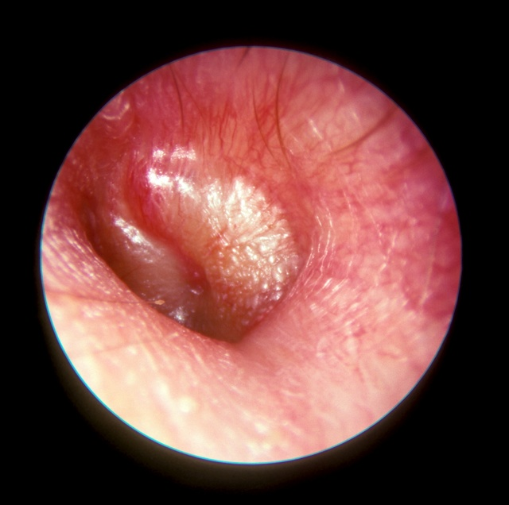
Other indications of myringotomy
AOM with bulging TM
Relieve pain
C & S
To produce a clean cut incision which is more likely to heal spontaneously

Slide 33
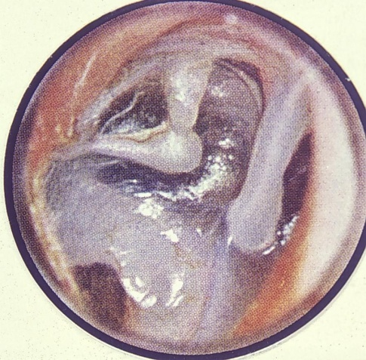
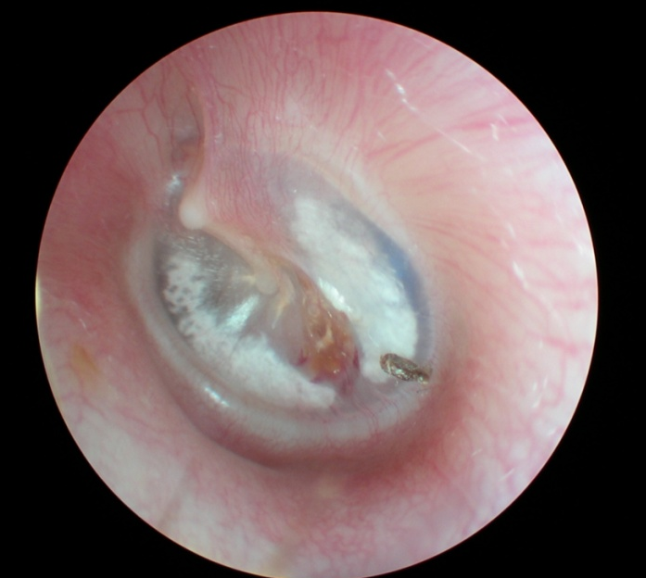
Sequelae of OME
Spontaneous resolution
50% resolve within 3 months. Only 5% persists for more than 12 months
Tympanosclerosis
Scarring
Cholesteatoma

Slide 34
Treatment
Treatment of the cause if feasible
Observation
? Medical treatment
Antibiotics
Decongestants, ?Auto-inflation
Surgical
Ventilation tubes (grommets) insertion

Slide 35
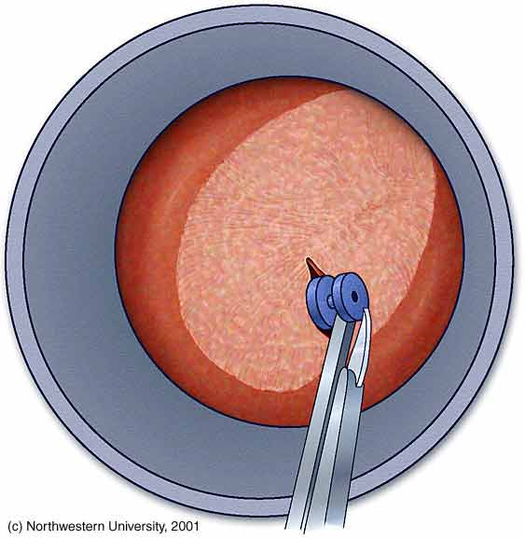
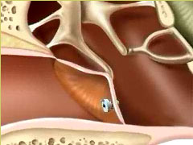
Ventilation tubes insertion

Slide 36
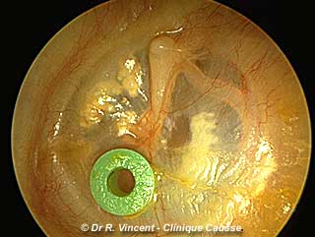
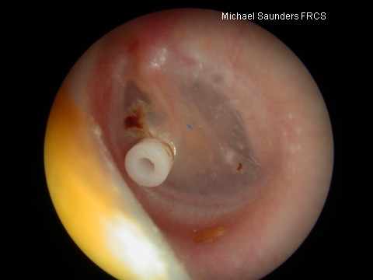

Slide 37
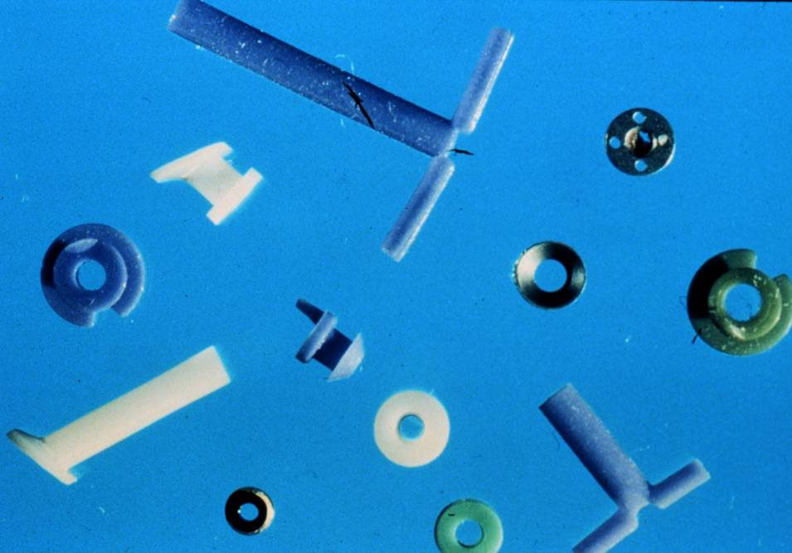

Slide 38
Other indication for VT insertion
Repeated attacks of AOM

Slide 39
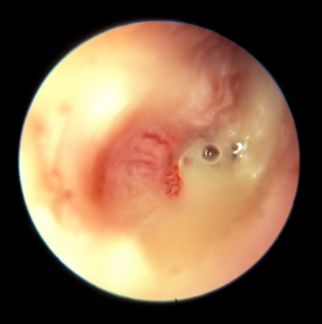
Complications of Ventilation Tubes
Infection

Slide 40
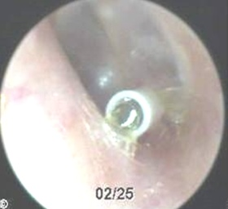
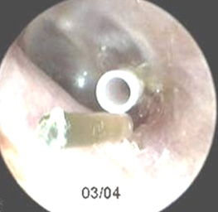
Complications of Ventilation Tubes
Infection
Blockage

Slide 41
Complications of Ventilation Tubes
Infection
Blockage
Early extrusion

Slide 42
Complications of Ventilation Tubes
Infection
Blockage
Early extrusion
Tympanosclerosis

Slide 43
Complications of Ventilation Tubes
Infection
Blockage
Early extrusion
Tympanosclerosis
Persistent perforation

Slide 44
Factors affecting treatment choise
Age
Duration
Unilateral or bilateral
Degree of hearing impairment
Previous treatment
Tympanic membrane changes

Slide 45
Conclusion
OME is very common in children
Etiology is associated with ET dysfunction and or chronic infection
In adults: nasopharyngeal pathology should be considered
Most cases resolve spontaneously
Conservative treatment is of doubtful value
VT insertion restores hearing in the selected cases

Slide 46
Classification of Chronic Otitis Media
Chronic Non Suppurative Otitis Media
Otitis media with effusion “OME”
Adhesive otitis media
Chronic Suppurative Otitis Media “CSOM”
Tubo-tympanic (Safe)
Attico-antral (Unsafe)

Slide 47
Chronic Adhesive Otitis Media
Formation of adhesion in the middle ear following CSOM or OME

Slide 48
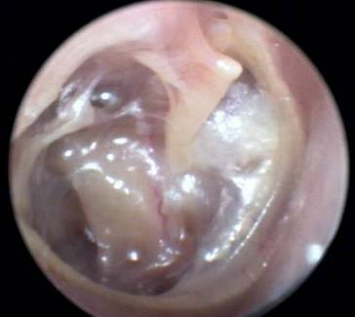
Clinical Features
History of CSOM or OME
Deafness is usually the only symptoms
TM shows various structural changes

Slide 49
Treatment
Observation
Surgical treatment
Hearing aid

Slide 50
Classification of Chronic Otitis Media
Chronic Non Suppurative Otitis Media
Otitis media with effusion “OME”
Adhesive otitis media
Chronic Suppurative Otitis Media “CSOM”
Tubo-tympanic (Safe)
Attico-antral (Unsafe)

Slide 51
CHRONIC SUPPURATIVE OTITIS MEDIA

Slide 52
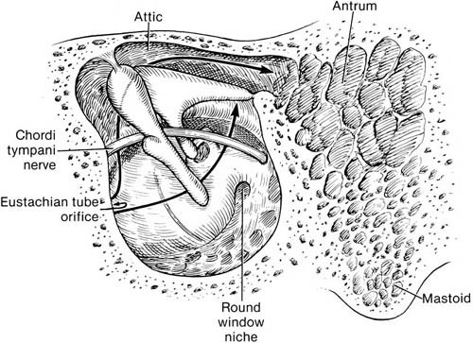
Clinico-pathological types
Tubo-tympanic
(Safe)
Attico-antral
(Unsafe)

Slide 54
Pathology
Purulent or muco purulent discharge
TM perforation
Granulation tissue or polyps
Fibrosis & tympanosclerosis
Cholesteatoma (attico-antral type)

Slide 55
CHOLESTEATOMA

Slide 56
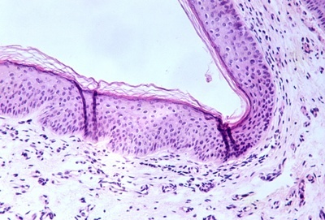
Definition
The presence of a desquamating stratified squamous epithelium (skin) in the middle ear

Slide 57
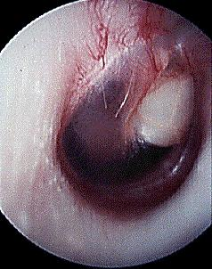
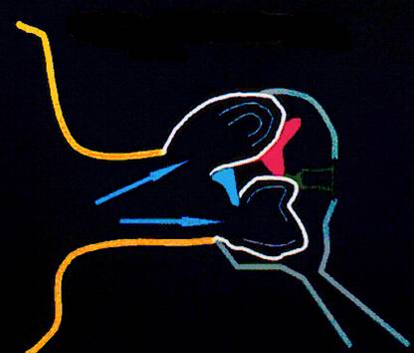
Pathogenesis of cholesteatoma
Implantation (congenital or acquired)
Metaplasia
Epithelial migration

Slide 58
Effects of Cholesteatoma
Persistence of the infection
Bone erosion
Pressure necrosis
Enzymes

Slide 59
Clinical Features of CSOM

Slide 60
Symptoms of CSOM
Otorrhea
Intermittent, profuse & odorless in TT type
Persistent, scanty & malodorous in AA type
Deafness
Tinnitus
N.B. Any other symptom means complication

Slide 61
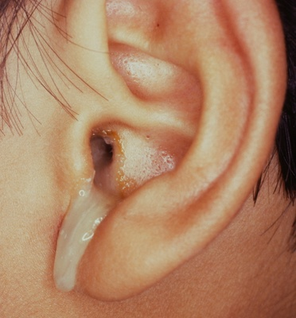
Otoscopic examination
Discharge
Present in TT type if active but may be absent
Usually is present in AA type
Perforation
Central: in TT type
Marginal or attic in AA type with cholesteatoma

Slide 62
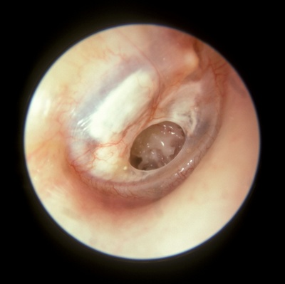
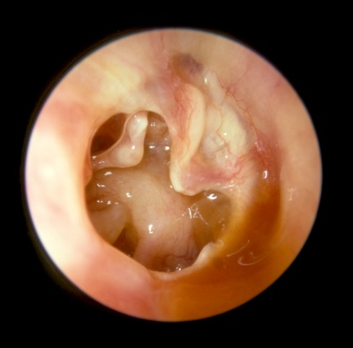
Perforation in TT CSOM

Slide 63
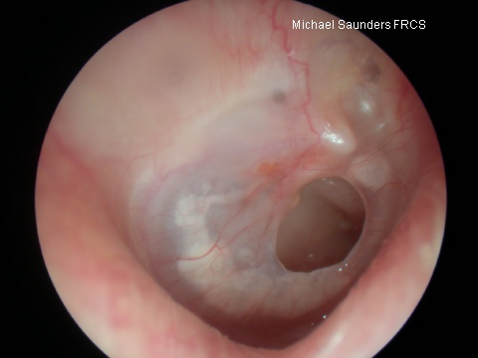
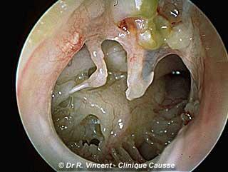

Slide 64
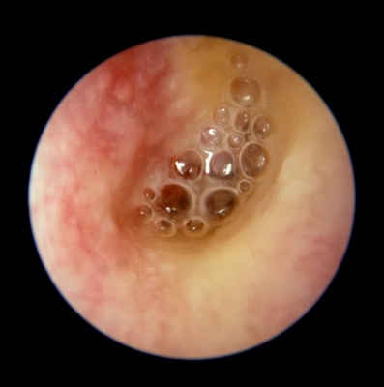
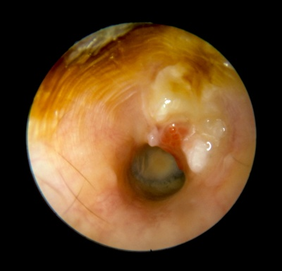

Slide 65
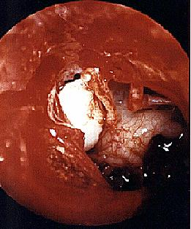
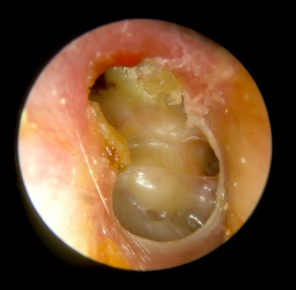
Perforation in AA CSOM

Slide 66
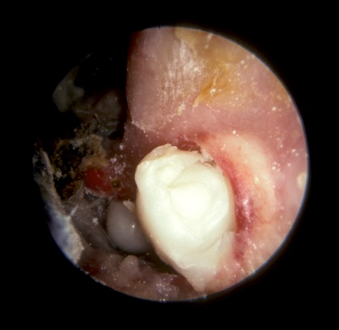
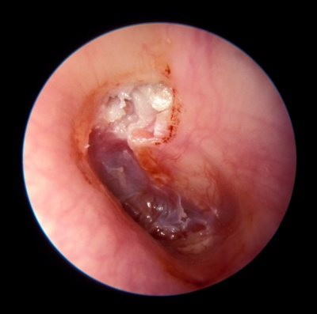

Slide 67
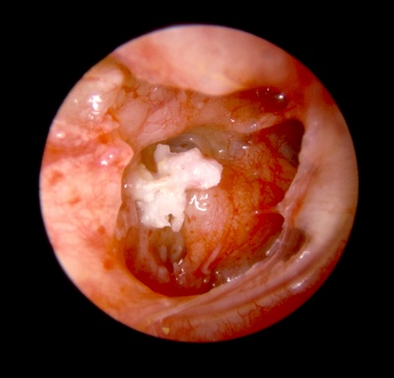
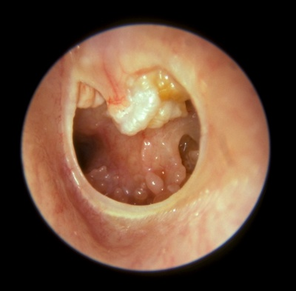

Slide 68
Otoscopic examination
Discharge
Present in TT type if active but may be absent
Usually is present in AA type
Perforation
Central: in TT type
Marginal or attic in AA type with cholesteatoma
Polyps, granulation tissue, tympanosclerosis

Slide 69
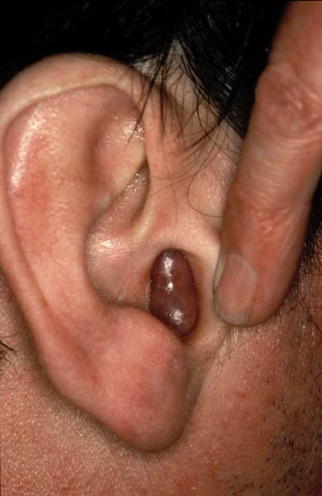
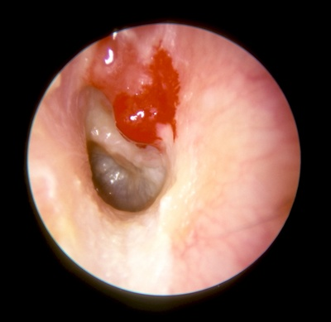

Slide 70
Tympanosclerosis

Slide 71
Investigations
Audiometry
Bacteriology
CT (mainly in the AA type)

Slide 73
Treatment of CSOM

Slide 74
Active TT type
Inactive TT type
Attico-antral type

Slide 75
Conservative treatment
Active TT type
Inactive TT type
Conservative Treatment
Treat any predisposing factor
Ear toilet
Antibiotics
Keep the ear dry
Removal of polyps and granulations
MYRINGOPLASTYOR TYMPANOPLASTY

Slide 76
Myringoplasty
Tympanoplasty
An operation performed to repair the tympanic membrane
An operation performed to repair the tympanic cavity (TM and/or the ossicles)

Slide 77
Aims of Tympanoplasty and Myringoplasty
To prevent re-infection
To improve hearing

Slide 79
Treatment of Attico-antral CSOM
Removal of cholesteatoma by radical or modified radical mastoidectomy

Slide 80
Radical & Modified Radical Mastoidectomy
Radical
An operation in which the mastoid antrum and middle ear and the external canal are converted into common cavity. The tympanic membrane, malleus and incus are removed leaving only the stapes in situ.
Modified Radical
An operation in which the mastoid antrum and middle ear and the external canal are converted into common cavity. The tympanic membrane and ossicles remnants are retained

Slide 84
Aims of radical & modified radical mastoidectomy
Remove cholesteatoma to provide
Safety
Dry ear

Slide 85
Conclusion
In TT type the discharge is usually copious, intermittent and odorless. The perforation is central. Treatment is by elective tympanoplasty to prevent re-infection and improve hearing.
In the AA type the discharge is usually scanty, persistent and of bad odor. The perforation is attic or marginal with cholesteatoma. Treatment is by mastoidectomy to provide safety and dry ear

Slide 87
COMPLICATIONS OF SUPPURATIVE OTITIS MEDIA

Slide 88
Definition
The spread of infection beyond the boundaries of the middle ear cleft

Slide 89
Routes of spread
Direct extension
Usually due to bone erosion by cholesteatoma
Thrombophlebitis
Normal anatomical pathways
e.g. oval window, round window etc

Slide 90
Complications of suppurative otitis media
Extracranial complications
Cranial (intra-temporal) complications
Intracranial complications

Slide 91
Extracranial complications
Otitis externa
Retropharyngeal abscess
Septicemia

Slide 92
Cranial (intratemporal) complications
Acute mastoiditis & mastoid abscess
Petrositis
Facial nerve paralysis
Labyrinthine fistula and labyrinthitis

Slide 93
Acute mastoiditis & mastoid abscess

Slide 94
Pathology of acute mastoiditis
Involvement of the bone of the mastoid air cells by acute suppurative inflammation

Slide 95
NORMAL
ACUTE MASTOIDITIS

Slide 96
Pathology of mastoid abscess
Formation of pus subperiosteally

Slide 97
Diagnosis of acute mastoiditis
General constitutional manifestations
Tympanic membrane changes

Slide 99
Diagnosis of acute mastoiditis
General constitutional manifestations
Tympanic membrane changes
Otorrhea and reservoir sign
Retroauricular tenderness and redness

Slide 101
Diagnosis of mastoid abscess

Slide 103
DIAGNOSIS OF ACUTE MASTOIDITIS & MASTOID ABSCESS
General constitutional manifestations
Tympanic membrane changes
Otorrhea and reservoir sign
Retroauricular tender ness and red ness
Subperiosteal and Bezold’s abscess
Imaging

Slide 104
NORMAL
ACUTE MASTOIDITIS

Slide 105
MASTOID ABSCESS

Slide 106
Treatment of acute mastoiditis
IV antibiotics
Cortical mastoidectomy if medical treatment fails or if there are signs of abscess formation

Slide 107
Cortical mastoidectomy
An operation performed to covert the mastoid antrum and air cells into one cavity, without disturbing the existing middle ear content

Slide 108
Aim
Drainage

Slide 109
Indications of cortical mastoidectomy
Acute mastoiditis not responding to medical treatment
Mastoid abscess

Slide 110
Technique of Cortical Mastoidectomy

Slide 113
Cranial (intratemporal) complications
Acute mastoiditis
Petrositis (apical petrositis)
Facial nerve paralysis
Labyrinthine fistula and labyrinthitis

Slide 114
Petrositis (petrous apicitis)
An extension of infection from the middle ear into a pneumatized petrous apex.

Slide 116
Diagnosis of petrositis
Gradenigo’s syndrome
Otitis media (otorrhea)
Retro-orbital pain
Squint (VI cranial nerve palsy)
Imaging

Slide 118
Treatment of petrositis
Antibiotics and myringotomy
Surgical drainage if medical treatment fails

Slide 119
Cranial (intratemporal) complications
Acute mastoiditis
Petrositis
Facial nerve paralysis
Labyrinthine fistula and labyrinthitis

Slide 120
Facial paralysis in AOM
Mostly due to pressure on a dehiscent nerve by inflammatory products
Usually is partial and sudden in onset
Treatment is by antibiotics and myringotomy

Slide 121
Facial paralysis in CSOM
Usually is due to cholesteatoma
Insidious in onset
May be partial or complete
Treatment is by immediate surgical exploration (mastoidectomy and repair)

Slide 122
Cranial (intratemporal) complications
Acute mastoiditis
Petrositis (apical apicitis)
Facial nerve paralysis
Labyrinthine fistula and labyrinthitis

Slide 123
Pathology of labyrinthitis
Labyrinthine fistula
Erosion of the bony labyrinth usually due to cholesteatoma
Mostly in the lateral SCC
Acute labyrinthitis

Slide 124
Diagnosis of labyrinthine fistula
May be asymptomatic
Vertigo
SNHL
Fistula test
CT scan

Slide 125
Treatment of labyrinthine fistula
Mastoidectomy and surgical repair

Slide 126
Acute Labyrinthitis
Vertigo
SNHL
Nystagmus
Treatment is by antibiotic and myringotomy if due to AOM or by antibiotics and mastoid surgery if due to CSOM

Slide 127
Intracranial complications
Extradural abscess
Lateral sinus thrombophlebitis
Subdural empyema
Meningitis
Brain abscess
Otitic hydrocephalus

Slide 128
Extradural abscess
Accumulation of pus between dura and bone
Causes headache but may be silent
Diagnosis is confirmed by CT or MRI
Treatment is by drainage

Slide 129
Subdural abscess (empyema)
Suppuration of the subdural space
Sever headache, fever, irritative and paralytic focal neurological symptoms
CT and MRI

Slide 131
Subdural abscess (empyema)
Suppuration of the subdural space
May be localized, multiple or diffuse
Sever headache, fever, irritative and paralytic focal neurological symptoms
CT and MRI
Treatment is by neurosurgical drainage

Slide 132
Lateral sinus thrombophlebitis
Pathology

Slide 133
Lateral sinus thrombophlebitis
Diagnosis
Fever, rigor, and sweating
Headache and neck pain
Tenderness and edema in the neck
Blood culture
CT, MRI

Slide 135
Treatment of sinus thrombophlebitis
IV antibiotics and myringotomy if due to AOM
Mastoid surgery if no improvement or if due to CSOM

Slide 136
Intracranial complications
Extradural abscess
Lateral sinus thrombophlebitis
Subdural empyema
Meningitis
Brain abscess
Otitic hydrocephalus

Slide 137
Otogenic meningitis
Infection of the subarachnoid space
The most common intracranial complication
Fever, headache, neck stiffness, phonophobia, restlessness etc
Kernig’s & Brudziniski signs

Slide 139
Otogenic meningitis
Infection of the subarachnoid space
The most common intracranial complication
Fever, headache, neck stiffness, phonophobia, restlessness etc
Kernig’s & Brudziniski signs
Lumber puncture

Slide 140
Treatment
IV antibiotics and myringotomy if due to AOM
Mastoid surgery if secondary to CSOM

Slide 141
Intracranial complications
Extradural abscess
Lateral sinus thrombophlebitis
Subdural empyema
Meningitis
Brain abscess
Otitic hydrocephalus

Slide 142
Otogenic brain abscess
25% of children's and 50% of adult’s brain abscesses are otogenic
Mostly in temporal lobe or cerebellum (2:1)

Slide 143
Otogenic brain abscess
Clinical manifestations
General manifestations: fever, lethargy, headache.
Manifestation of raised IC pressure
Focal manifestations
Temporal: Aphasia, hemianopia, paralysis
Cerebellar: ataxia, vertigo, nystagmus, muscle incoordination

Slide 144
Otogenic brain abscess
Diagnosis
CT
MRI

Slide 145
CT

Slide 147
MRI

Slide 148
Otogenic brain abscess
Treatment
Repeated aspiration or Excision
IV antibiotics and myringotomy if due to AOM
Mastoid surgery if due to CSOM

Slide 149
Intracranial complications
Extradural abscess
Lateral sinus thrombophlebitis
Subdural empyema
Meningitis
Brain abscess
Otitic hydrocephalus

Slide 150
Otitic hydrocephalus
Very rare
Intracranial hypertension associated with ear disease.
Most often it follows lateral sinus thrombophlebitis
Clinically: Manifestations of increased IC pressure
CT

Slide 152
Otitic hydrocephalus
Very rare
Intracranial hypertension associated with ear disease. It most often follows lateral sinus thrombophlebitis
Clinically: Manifestations of increased IC pressure
CT
Treatment: steroids, diuretics, hyperosmolar dehydrating agents, repeated LP

Slide 153
General principles of management of the complications
High index of suspicion
May be multiple
CT and MRI are the mainstay investigations
Treatment is by parental antibiotics & surgery for the complication if applicable
Treatment of the ear lesion
Myringotomy in AOM
Mastoidectomy in CSOM

Slide 154
OFFICE HOURS Prof. YOUSRY EL-SAYED
Flat 407 Building 5 King Abdel-Aziz University Hospital
Mondays from 11 am to 1 pm
Thursdays from 11 am to 1 pm

Slide 155
THANK YOU

