Slide 1
Vertigo
Prof. Abdulrahman Alsanosi
Program Director, KSU Fellowship in ORL & Oto-Neurotology
Department of Otolaryngology ,Head and Neck surgery
King Abdulaziz University Hospital
^{King Saud University}

Slide 2
Objectives
To know anatomy of balance organs
Physiology of balance
Relevant history in dizzy patients
Classification of vertigo
Common peripheral causes of vertigo ,clinical features ,investigation and management
Common central causes of vertigo ,clinical features ,investigation and management

Slide 3
What are the components of balance system ?

Slide 4
Inner ear (3 semicicular canals and otolith organ )
Cerebellum
Vision (VOR)
Proprioceptive

Slide 5
How does balance system work ?

Slide 6
Physiology
Transform of the forces associate with head acceleration and gravity into a biological signals that the brain can use to develop reflexes ?
What are the importance of these reflexes ?

Slide 7
End result from vestibular functions
subjective awareness of head position in space (orientation)
produce motor reflexes that will maintain posture
ocular stability

Slide 8
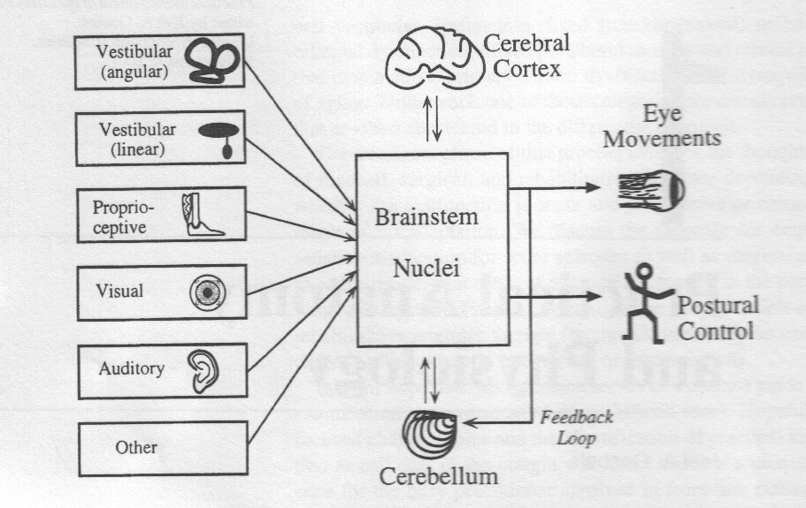

Slide 9
What are the questions to ask in history ?
Frequency:
-Recurrent
- Non -Recurrent
Duration
Seconds
Minutes
Hours to days

Slide 10
Associated auditory symptoms:
-Tinnitus
-Deafness
-Funllness

Slide 11
Aggrevating and relieving factors:
-Rolling over in bed
-Getting up from bed
-Looking up
-Consume salty food

Slide 12
Ear disease or ear surgery
Trauma
Migraine
Ototoxic drug intake

Slide 13
Differential diagnosis
A) peripheral vestibular loss definition ?
B) central vestibular loss

Slide 14
What are the causes of peripheral vestibular loss ?

Slide 15
peripheral vestibular loss
Vestibular neuritis
Benign paroxysmal positional vertigo ( BPPV)
Meneires disease (Endolymphatic hydrop )

Slide 16
Vestibular neuritis
Viral infection of vestibular organ
Affect all ages but rare in childern
Affected patient presents acutely with spontaneous nystagmous ,vertigo and nausea &vomiting
Patient requires only symptomatic treatment
It takes 3 weeks to recover from vestibular neuritis

Slide 17
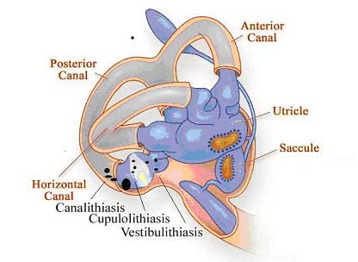
BPPV( benign paroxysmal positional vertigo )

Slide 18
The most common cause of vertigo in patient > 40 years
Repeated attacks of vertigo usually of short duration less than a minute .
Provoked by certain positions (rolling in beds, looking up ,and head rotations)
Not associated with any hearing impairment

Slide 19
Diagnosis:
History
Dix-Halpike maneuver
Management :
Epley maneuver

Slide 20
Endolymphatic hydrop (Meneire’s disease
Pathophysiology :
Unknown etiology
↑ ↓production of fluid within inner compartment

Slide 21
vertigo (minutes to hours )
Low frequency fluctuating SNHL
Tinnitus and fullness in the ear.
In 10 - 20% of cases the disease later involves the opposite ear

Slide 22
Diagnosis
-History
-PTA

Slide 23
Management
low-salt diet
Medical therapy
Others

Slide 24
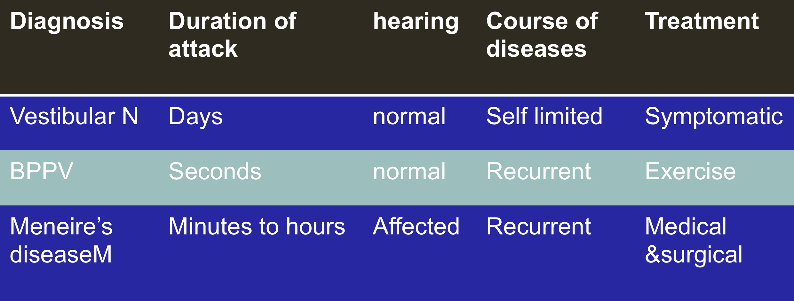
Summary

Slide 25
What are the causes of central ?
CVA (Cerebero vascular accident)
Brain tumor ( acoustic neuroma )
Multiple sclerosis
Migraine

Slide 26
CVA
Elderly patient with chronic disease like (DM ,HTN) with sudden attack of vertigo +neurological symptoms

Slide 27
CPA TUMORS
Benign tumor
Arise from vestibular devision of VIII
Clinical presenatation:
Unilateral tinnitus
Hearing loss
Dizziness

Slide 28
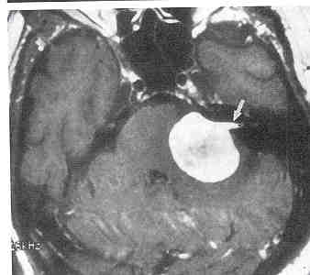
Diagnosis :
History
PTA ( Unilateral SNHL )
Radiology

Slide 29
diagnosis
History is the most important key to diagnosis for a dizzy patient .

Slide 30
Investiagtions
PTA
Vestibular testing
CT SCAN
MRI

Slide 31
Any question

