Slide 1
Evaluation and Management of the Patient with a Neck Mass
Mohammed AlEssa , MBBS FRCSC
Head & Neck surgery Consultant
King Saud University – medical city
National guard health affairs – KAMC

Slide 2
Introduction
Common clinical finding
All age groups
Very complex differential diagnosis
Systematic approach essential

Slide 3
Differential Diagnosis

Slide 4
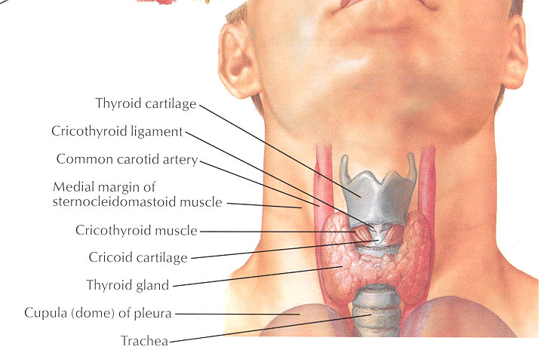
Anatomical Considerations
Prominent landmarks
Triangles of the neck
Lymphatic levels
Carotid bulb

Slide 5
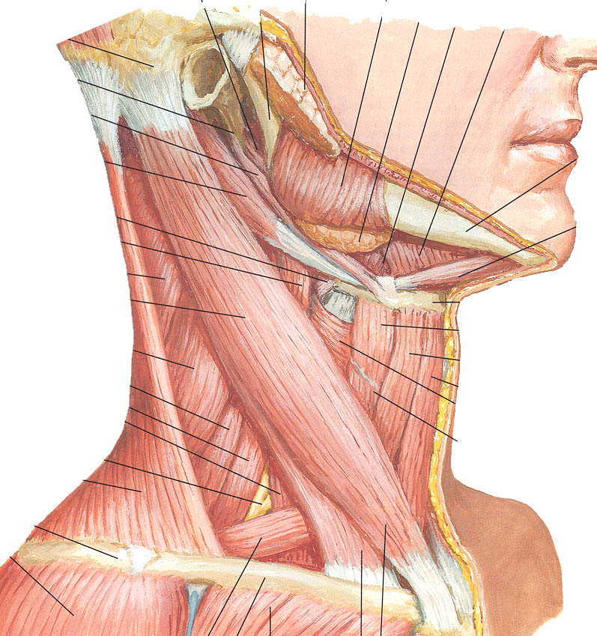
Anatomical Considerations
Prominent landmarks
Triangles of the neck
Lymphatic levels
Carotid bulb

Slide 6
Anatomical Considerations
Prominent landmarks
Triangles of the neck
Lymphatic levels
Carotid bulb
I

Slide 7
Anatomical Considerations
Prominent landmarks
Triangles of the neck
Lymphatic levels
Carotid bulb
I

Slide 8
Anatomical Considerations
Prominent landmarks
Triangles of the neck
Lymphatic levels
Carotid bulb
II
I
III
IV

Slide 9
Anatomical Considerations
Prominent landmarks
Triangles of the neck
Lymphatic levels
Carotid bulb
II
I
III
IV

Slide 10
Anatomical Considerations
Prominent landmarks
Triangles of the neck
Lymphatic levels
Carotid bulb
II
I
III
V
IV

Slide 11
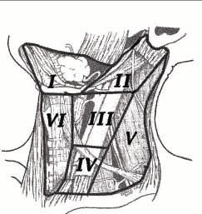
Anatomical Considerations
Prominent landmarks
Triangles of the neck
Lymphatic levels
Carotid bulb

Slide 12
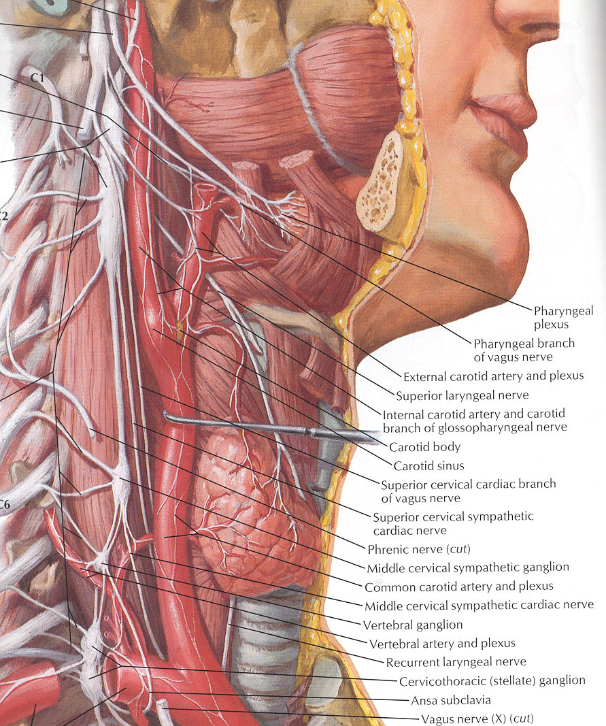
Anatomical Considerations
Prominent landmarks
Triangles of the neck
Lymphatic levels
Carotid bulb

Slide 13
General Considerations
Patient age
Pediatrics (0 – 15 years): mostly benign
Young adults (16 – 40 years): similar to pediatric
old adults (>40 years): High risk of malignancy
Location
Congenital masses: consistent in location
Metastatic masses: key to primary lesion

Slide 14
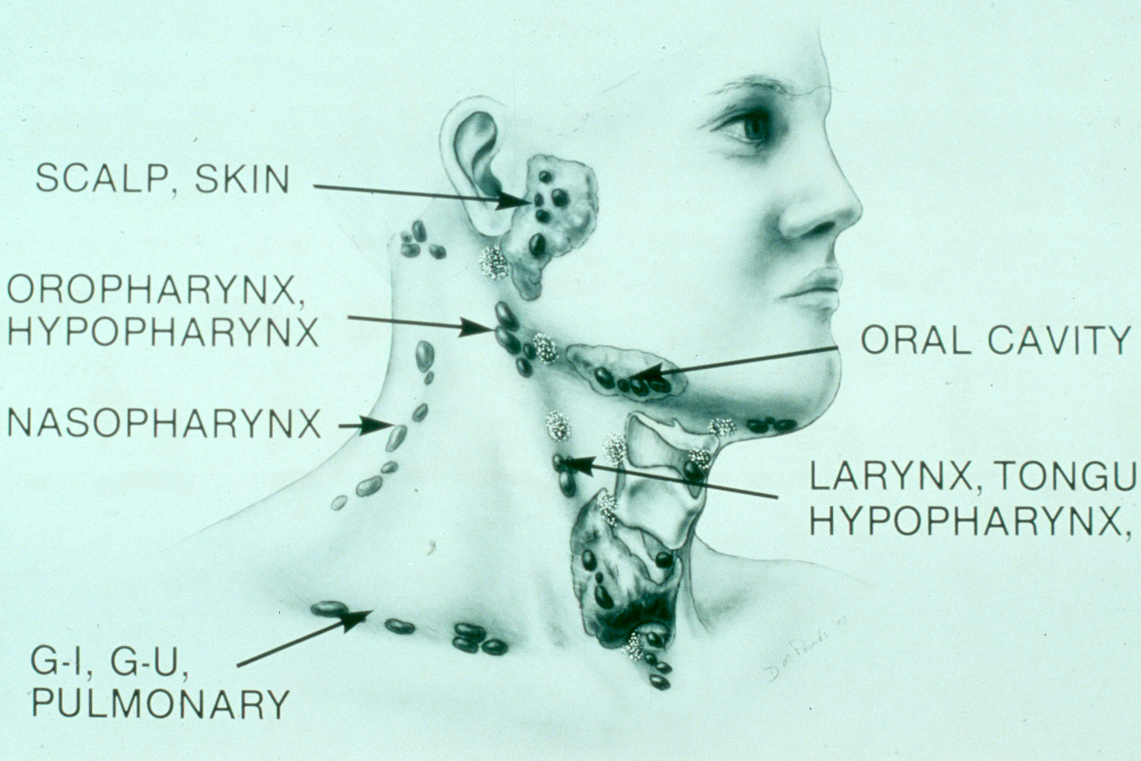
Metastasis Location according to Various Primary Lesions

Slide 15
Diagnostic Steps
History
Developmental time course
Associated symptoms (dysphagia, otalgia, voice)
Personal habits (tobacco, alcohol)
Previous irradiation or surgery
Physical Examination
Complete head and neck exam (visualize & palpate)
Emphasis on location, mobility and consistency

Slide 16
Empirical Antibiotics
Inflammatory mass suspected
Two week trial of antibiotics
Follow-up for further investigation

Slide 17
Diagnostic Tests
Fine needle aspiration biopsy (FNAB)
Computed tomography (CT)
Magnetic resonance imaging (MRI)
Ultrasonography
Radionucleotide scanning

Slide 18
Fine Needle Aspiration Biopsy
Standard of diagnosis
Indications
Any neck mass that is not an obvious abscess
Persistence after a 2 week course of antibiotics
Small gauge needle
Reduces bleeding
Seeding of tumor – not a concern
No contraindications (vascular ?)

Slide 19
Fine Needle Aspiration Biopsy
Proper collection required
Minimum of 4 separate passes
Skilled cytopathologist essential
On-site review best

Slide 20
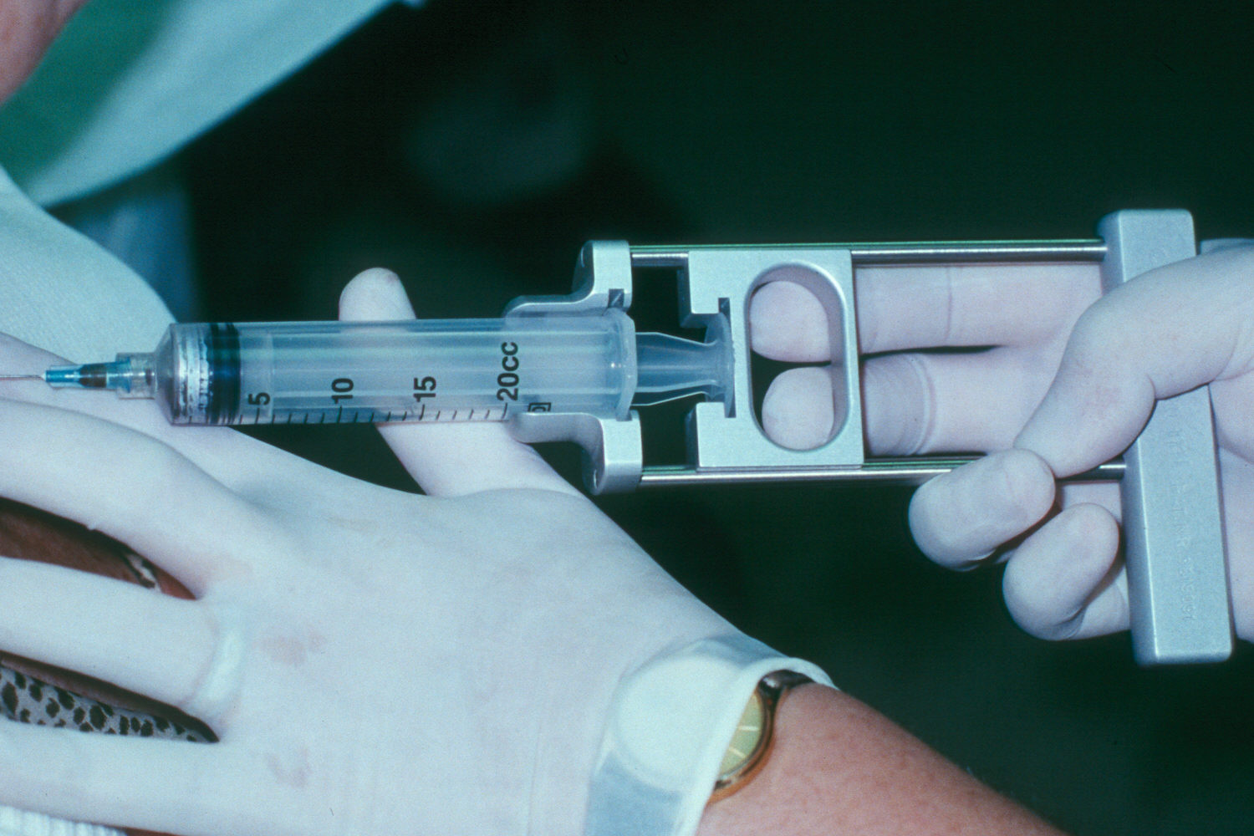
Fine Needle Aspiration Biopsy

Slide 21
Computed Tomography
Distinguish cystic from solid
Extent of lesion
Vascularity (with contrast)
Detection of unknown primary (metastatic)
Pathologic node (lucent, >1.5cm, loss of shape)
Avoid contrast in thyroid lesions

Slide 22
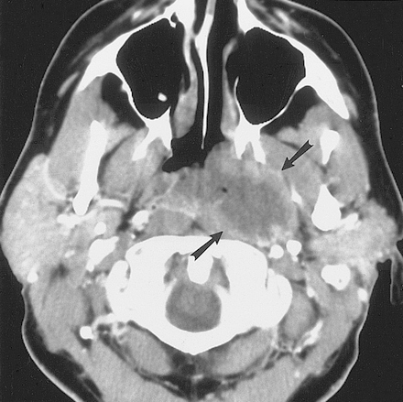
Computed Tomography

Slide 23
Magnetic Resonance Imaging
Similar information as CT
Better for upper neck and skull base
Vascular delineation with infusion

Slide 24
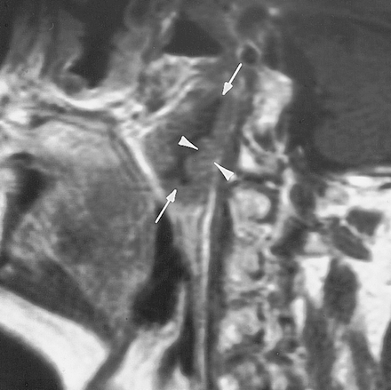
Magnetic Resonance Imaging

Slide 25
Ultrasonography
Less important now with FNAB
Solid versus cystic masses
Congenital cysts from solid nodes/tumors
Noninvasive (pediatric)

Slide 26
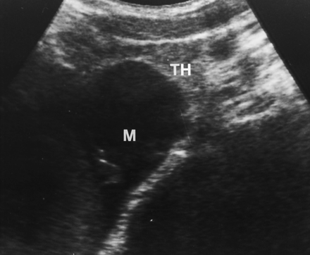
Ultrasonography
YROID
ASS

Slide 27
Radionucleotide Scanning
Salivary and thyroid masses
Location – glandular versus extra-glandular
Functional information
FNAB now preferred for for thyroid nodules
Solitary nodules
Multinodular goiter with new increasing nodule
Hashimoto’s with new nodule

Slide 28
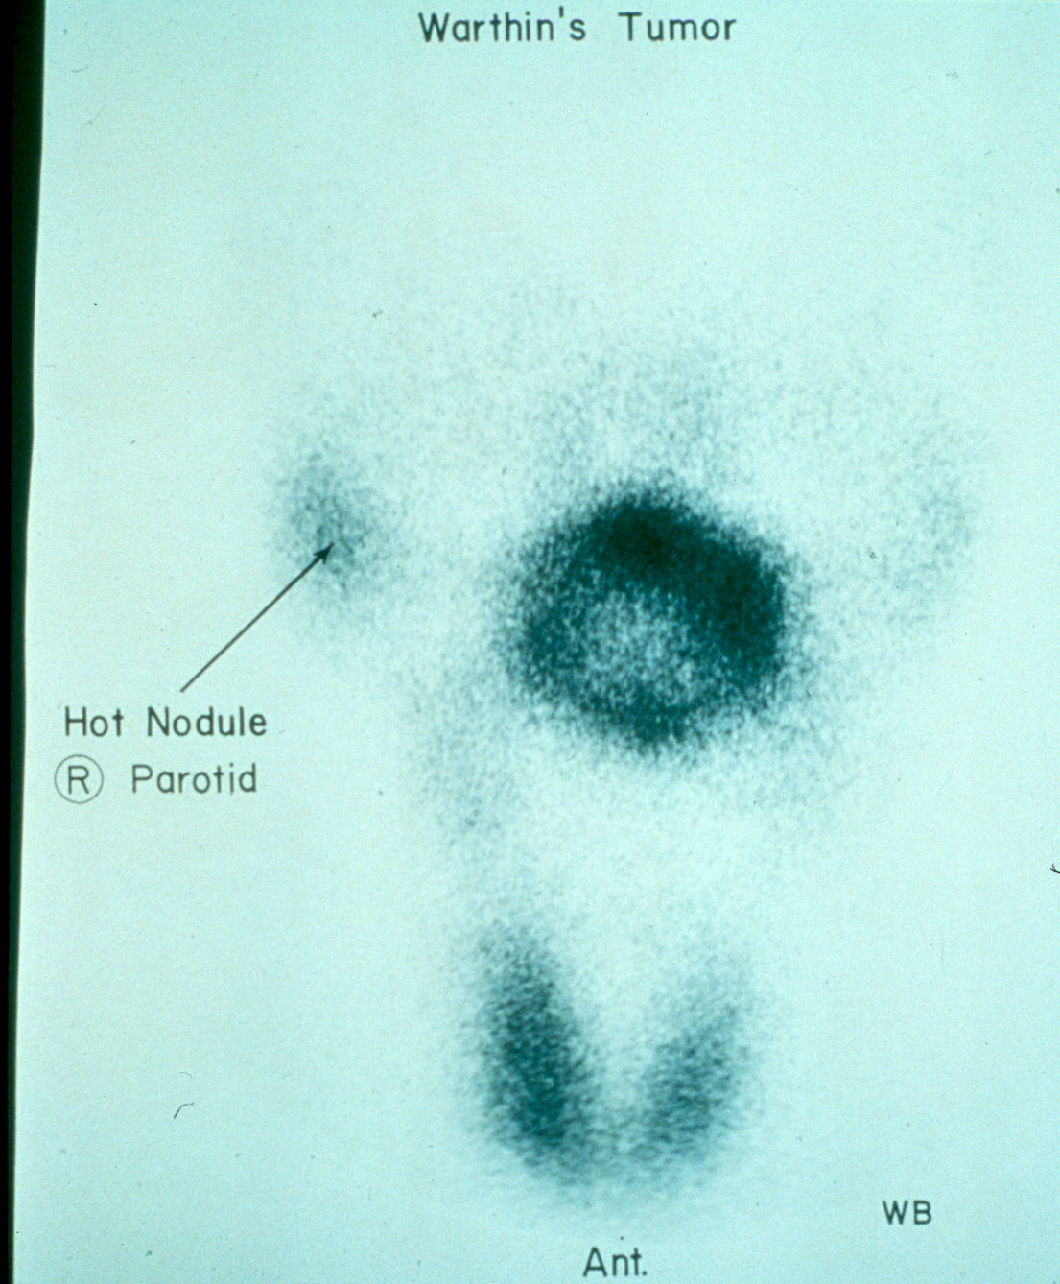
Radionucleotide Scanning

Slide 29
Nodal Mass Workup in the Adult
Any solid asymmetric mass MUST be considered a metastatic neoplastic lesion until proven otherwise
Asymptomatic cervical mass – 12% of cancer
~ 80% of these are SCCa

Slide 30
Nodal Mass Workup in the Adult
Ipsilateral otalgia with normal otoscopy – direct attention to tonsil, tongue base, supraglottis and hypopharynx
Unilateral serous otitis – direct examination of nasopharynx

Slide 31
Nodal Mass Workup in the Adult
Panendoscopy
FNAB positive with no primary on repeat exam
FNAB equivocal/negative in high risk patient
Directed Biopsy
All suspicious mucosal lesions
Areas of concern on CT/MRI
None observed – nasopharynx, tonsil (ipsilateral tonsillectomy for jugulodigastric nodes), base of tongue and piriforms
Synchronous primaries (10 to 20%)

Slide 32
Nodal Mass Workup in the Adult
Unknown primary
University of Florida (August, 2001)
Detected primary in 40%
Without suggestive findings on CT or panendoscopy yield dropped to 20%
Tonsillar fossa in 80%

Slide 33
Nodal Mass Workup in the Adult
Open excisional biopsy
Only if complete workup negative
Occurs in ~5% of patients
Be prepared for a complete neck dissection
Frozen section results (complete node excision)
Inflammatory or granulomatous – culture
Lymphoma or adenocarcinoma – close wound

Slide 34
Primary Tumors
Thyroid mass
Lymphoma
Salivary tumors
Lipoma
Carotid body and glomus tumors
Neurogenic tumors

Slide 35
Thyroid Masses
Leading cause of anterior neck masses
Children
Most common neoplastic condition
Male predominance
Higher incidence of malignancy
Adults
Female predominance
Mostly benign

Slide 36
Thyroid Masses
Lymph node metastasis
Initial symptom in 15% of papillary carcinomas
40% with malignant nodules
Histologically (microscopic) in >90%
FNAB has replaced US and radionucleotide scanning
Decreases # of patients with surgery
Increased # of malignant tumors found at surgery
Doubled the # of cases followed up
Unsatisfactory aspirate – repeat in 1 month

Slide 37
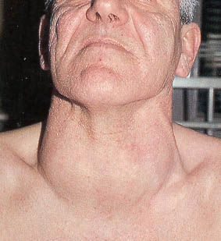
Thyroid Masses

Slide 38
Lymphoma
More common in children and young adults
Up to 80% of children with Hodgkin’s have a neck mass
Signs and symptoms
Lateral neck mass only (discrete, rubbery, nontender)
Fever
Hepatosplenomegaly
Diffuse adenopathy

Slide 39
Lymphoma
FNAB – first line diagnostic test
If suggestive of lymphoma – open biopsy
Full workup – CT scans of chest, abdomen, head and neck; bone marrow biopsy

Slide 40
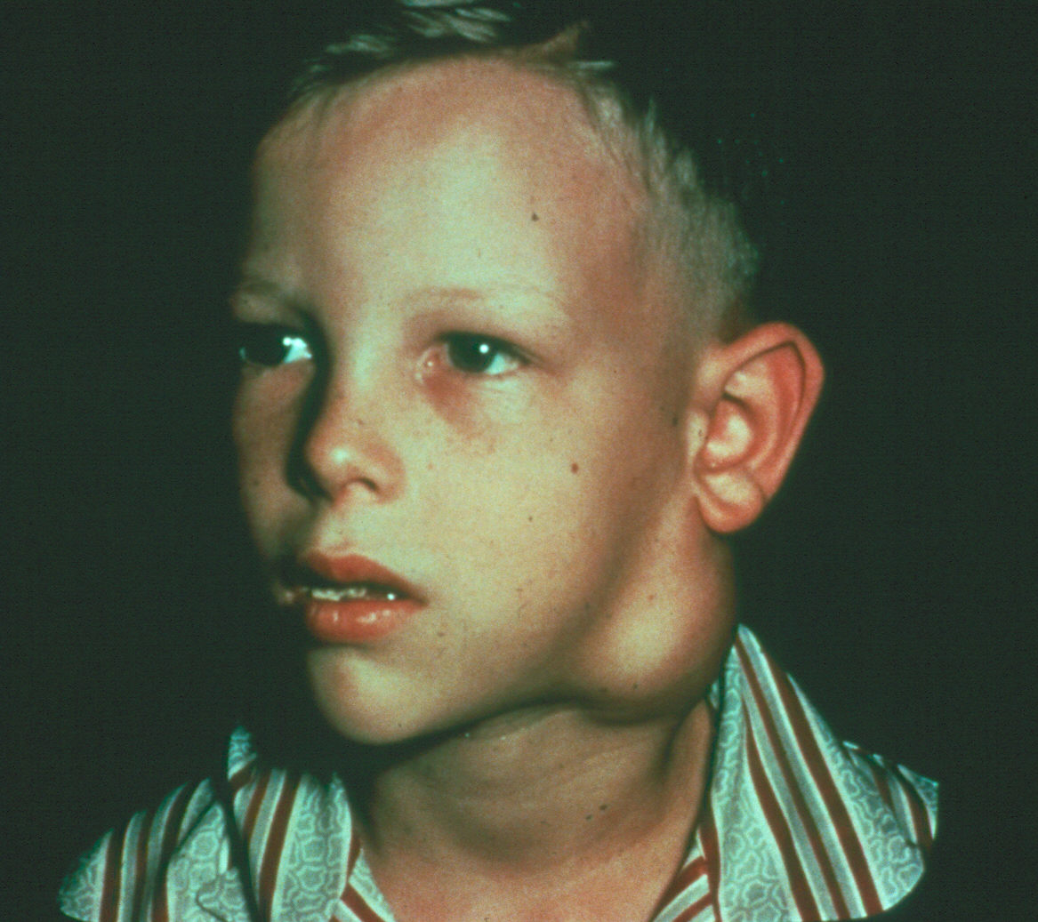
Lymphoma

Slide 41
Salivary Gland Tumors
Enlarging mass anterior/inferior to ear or at the mandible angle is suspect
Benign
Asymptomatic except for mass
Malignant
Rapid growth, skin fixation, cranial nerve palsies, pain

Slide 42
Salivary Gland Tumors
Diagnostic tests
Open excisional biopsy (submandibulectomy or parotidectomy) preferred
FNAB
Shown to reduce surgery by 1/3 in some studies
Delineates intra-glandular lymph node, localized sialadenitis or benign lymphoepithelial cysts
May facilitate surgical planning and patient counseling
Accuracy >90% (sensitivity: ~90%; specificity: ~80%)
CT/MRI – deep lobe tumors, intra vs. extra-parotid
Be prepared for total parotidectomy with possible facial nerve sacrifice

Slide 43
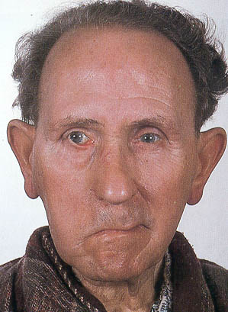
Salivary Gland Tumors

Slide 44
Carotid Body Tumor
Rare in children
Pulsatile, compressible mass
Mobile medial/lateral not superior/inferior
Clinical diagnosis, confirmed by angiogram or CT
Treatment
Irradiation or close observation in the elderly
Surgical resection for small tumors in young patients
Hypotensive anesthesia
Preoperative measurement of catecholamines

Slide 45
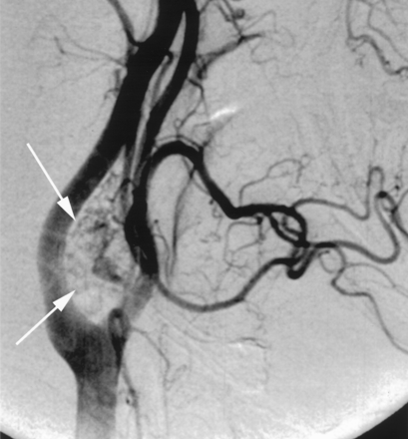
Carotid Body Tumor

Slide 46
Lipoma
Soft, ill-defined mass
Usually >35 years of age
Asymptomatic
Clinical diagnosis – confirmed by excision

Slide 47
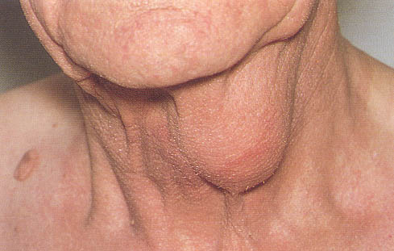
Lipoma

Slide 48
Neurogenic Tumors
Arise from neural crest derivatives
Include schwannoma, neurofibroma, and malignant peripheral nerve sheath tumor
Increased incidence in NF syndromes
Schwannoma most common in head & neck

Slide 49
Schwannoma
Sporadic cases mostly
25 to 45% in neck when extracranial
Most commonly between 20 and 50 years
Usually mid-neck in poststyloid compartment
Signs and symptoms
Medial tonsillar displacement
Hoarseness (vagus nerve)
Horner’s syndrome (sympathetic chain)

Slide 50
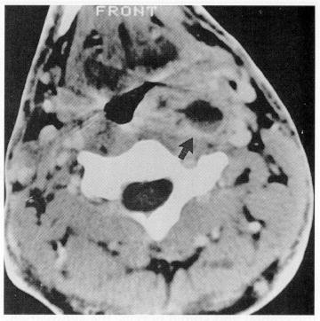
Schwannoma

Slide 51
Congenital and Developmental Mass
Epidermal and sebaceous cysts
Branchial cleft cysts
Thyroglossal duct cyst
Vascular tumors

Slide 52
Epidermal and Sebaceous Cysts
Most common congenital/developmental mass
Older age groups
Clinical diagnosis
Elevation and movement of overlying skin
Skin dimple or pore
Excisional biopsy confirms

Slide 53
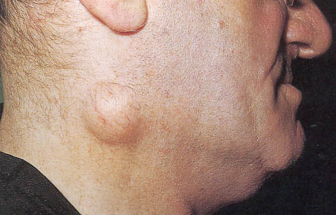
Epidermal and Sebaceous Cysts

Slide 54
Branchial Cleft Cysts
Branchial cleft anomalies
2nd cleft most common (95%) – tract medial to XII nerve between internal and external carotids
1st cleft less common – close association with facial nerve possible
3rd and 4th clefts rarely reported
Present in older children or young adults often following URI

Slide 55
Branchial Cleft Cysts
Most common as smooth, fluctuant mass underlying the SCM
Skin erythema and tenderness if infected
Treatment
Initial control of infection
Surgical excision, including tract
May necessitate a total parotidectomy (1st cleft)

Slide 56
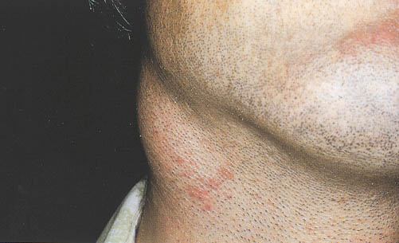
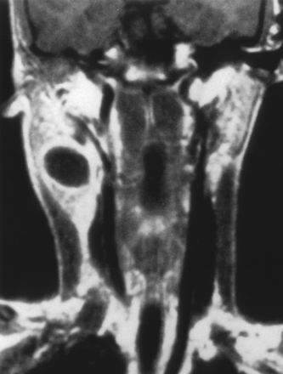
Branchial Cleft Cysts

Slide 57
Thyroglossal Duct Cyst
Most common congenital neck mass (70%)
50% present before age 20
Midline (75%) or near midline (25%)
Usually just inferior to hyoid bone (65%)
Elevates on swallowing/protrusion of tongue
Treatment is surgical removal (Sis trunk) after resolution of any infection

Slide 58
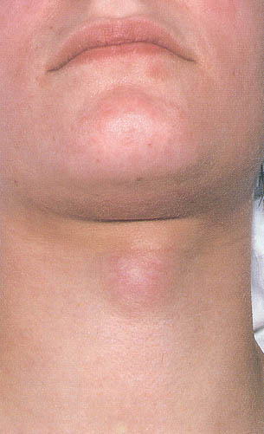
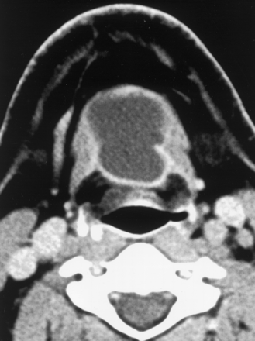
Thyroglossal Duct Cyst

Slide 59
Vascular Tumors
Lymphangiomas and hemangiomas
Usually within 1st year of life
Hemangiomas often resolve spontaneously, while lymphangiomas remain unchanged
CT/MRI may help define extent of disease

Slide 60
Vascular Tumors
Treatment
Lymphangioma – surgical excision for easily accessible or lesions affecting vital functions; recurrence is common
Hemangiomas – surgical excision reserved for those with rapid growth involving vital structures or associated thrombocytopenia that fails medical therapy (steroids, interferon)

Slide 61
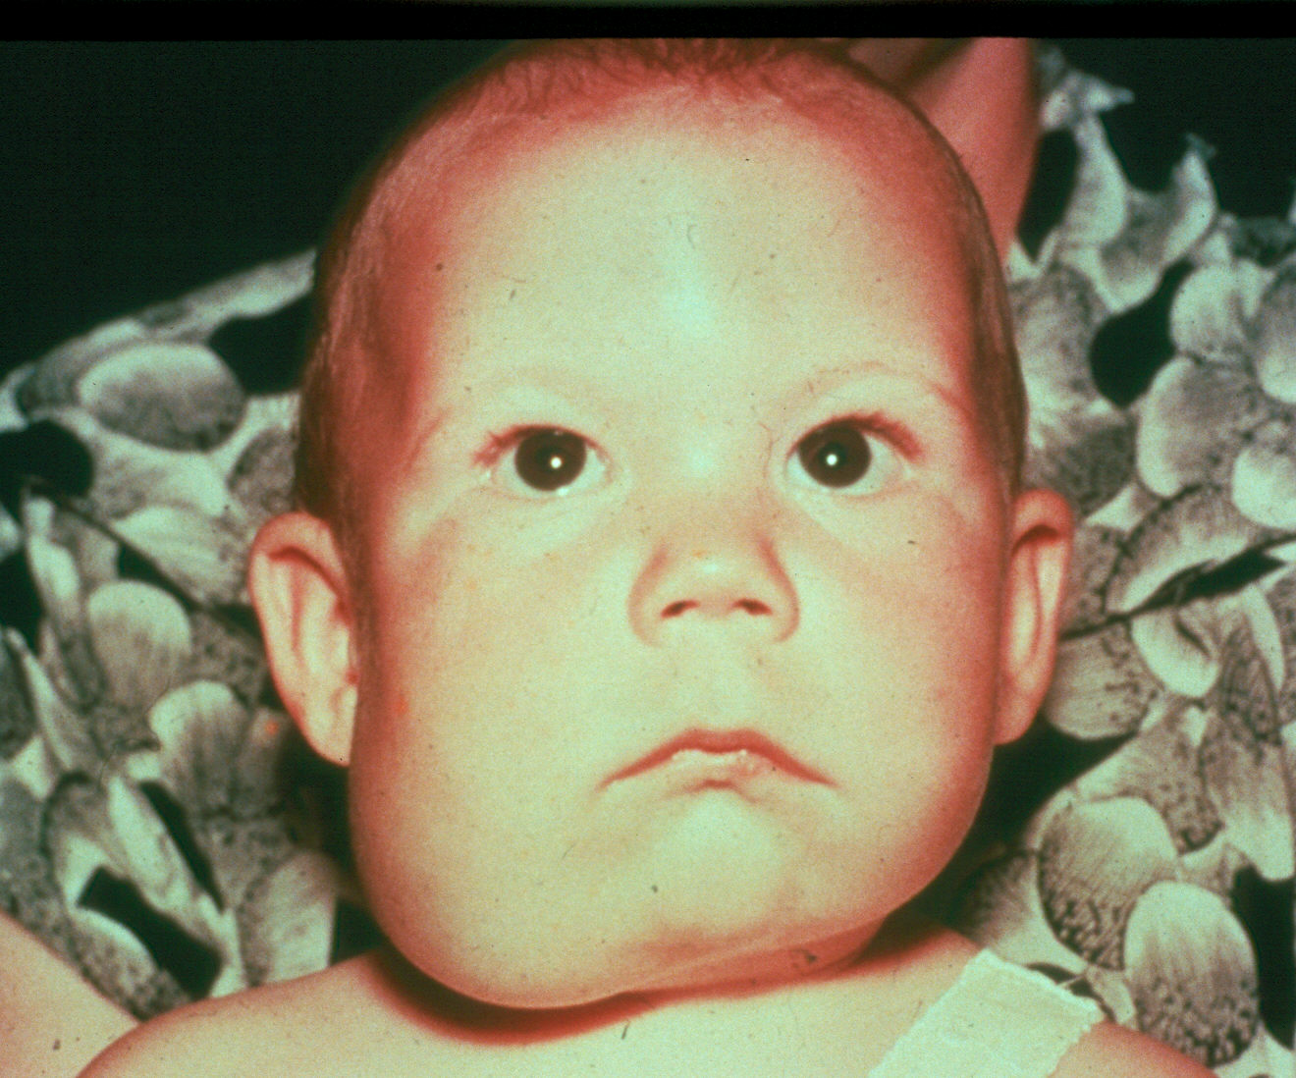
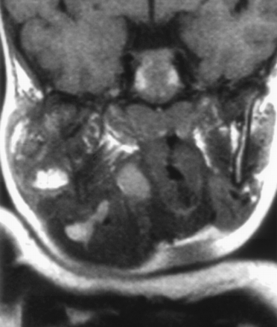
Vascular Tumors (lymphangioma)

Slide 62
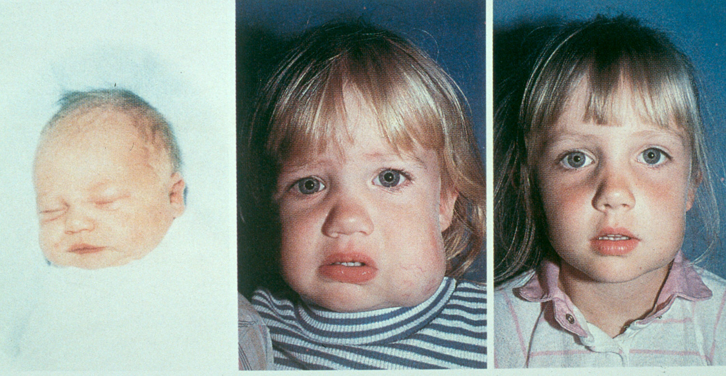
Vascular Tumors (hemangioma)

Slide 63
Inflammatory Disorders
Lymphadenitis
Granulomatous lymphadenitis

Slide 64
Lymphadenitis
Very common, especially within 1st decade
Tender node with signs of systemic infection
Directed antibiotic therapy with follow-up
FNAB indications (pediatric)
Actively infectious condition with no response
Progressively enlarging
Solitary and asymmetric nodal mass
Supraclavicular mass (60% malignancy)
Persistent nodal mass without active infection

Slide 65
Lymphadenopathy
Equivocal or suspicious FNAB in the pediatric nodal mass requires open excisional biopsy to rule out malignant or granulomatous disease

Slide 66
Granulomatous lymphadenitis
Infection develops over weeks to months
Minimal systemic complaints or findings
Common etiologies
TB, atypical TB, cat-scratch fever, actinomycosis, sarcoidosis
Firm, relatively fixed node with injection of skin

Slide 67
Granulomatous lymphadenitis
Typical M. tuberculosis
more common in adults
Posterior triangle nodes
Usually responds to anti-TB medications
May require excisional biopsy for further workup

Slide 68
Granulomatous lymphadenitis
Atypical M. tuberculosis
Pediatric age groups
Anterior triangle nodes
Brawny skin, induration and pain
Usually responds to complete surgical excision or curettage

Slide 69
Granulomatous lymphadenitis
Cat-scratch fever (Bartonella)
Pediatric group
Preauricular and submandibular nodes
Spontaneous resolution with or without antibiotics

Slide 70
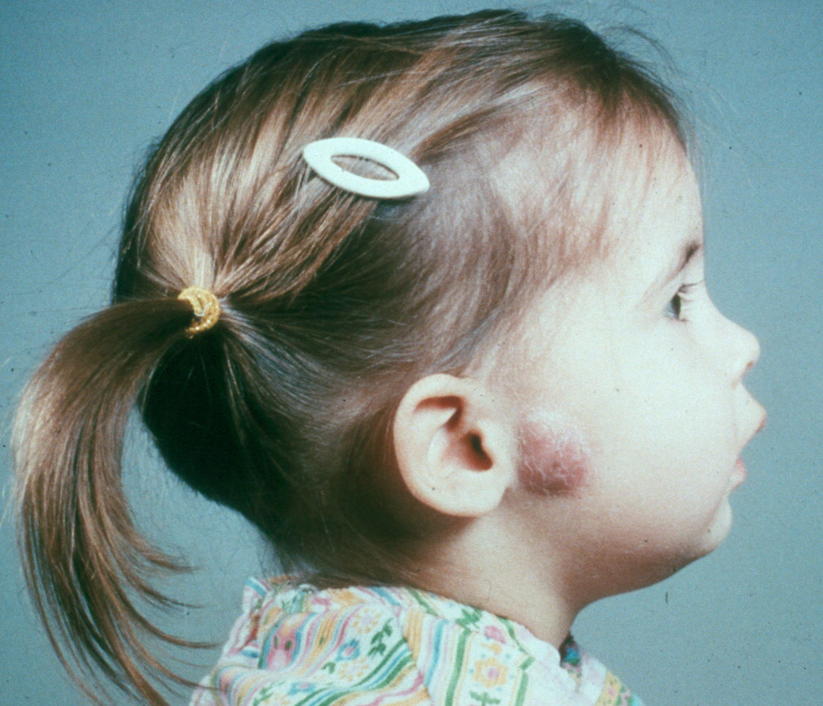
Granulomatous lymphadenitis

Slide 71
Summary
Extensive differential diagnosis
Age of patient is important
Accurate history and complete exam essential
FNAB – invaluable diagnostic tool
Possibility for malignancy in any age group
Close follow-up and aggressive approach is best for favorable outcomes

Slide 72
Thank you

