Slide 1
Deafness
Dr. Farid Alzhrani Assistant professor
Consultant of Otolaryngology, head and neck surgery
King Abdulaziz University Hospital

Slide 2
Objectives
Definition
Prevelance of deafness
Impact of deafness
Who is at risk of deafness
Classification of deafness
Atiologies of conductive deafness

Slide 3
Objectives
Atiologies of sensorineural deafness
Exmination of patient with deafness
Investigation of patient with deafness
Management of deafness

Slide 4
Questions you should be able to answer at the end of lecture
What is deafness ?
How common is the problem ?
What is the impact of deafness on the patient ?
Who is at risk for developing deafness ?

Slide 5
Questions you should be able to answer at the end of lecture
What is the definition of deafness on pure tone audiogram ?
What are the classifications of deafness?
What are the causes of conductive hearing loss ?
What are the causes of sensorineural hearing loss ?

Slide 6
Questions you should be able to answer at the end of lecture
What are the findings in the clinical examination you may see in patient with deafness ?
How would you confirm hearing loss clinically ?
What are the tests you request to confirm deafness ?
How would you manage patient with deafness ?

Slide 7
Definition
Hearing impairment refers to complete or partial loss of the ability to hear from one or both ears.

Slide 8
Prevalence of deafness
Overall about 1 in 10
1 in 3 adults 65 - 75
1 in 2 older than 75
1-2% school age children
4% children under 5 (SA 18 % <15Y)
Common and Important

Slide 9
Facts About Deafness
50% of deafness is avoidable through prevention, early diagnosis, and management.

Slide 10
Signs of Hearing Loss
Talking louder than necessary
Turning up volume on the TV or radio
Complaints that other people “mumble”
Confusion of similar sounding wordsنحلة/ نخلة
Inappropriate responses in conversation

Slide 11
Signs of Hearing Loss
Ringing or buzzing in the ears
Lip Reading
Watching a speaker’s face intently
Difficulty “hearing” someone behind
Having difficulty on the telephone

Slide 12
The impact of hearing impairment
Speech,
Language,
Education
Social

Slide 13
High Risk Criteria For Hearing Loss in Infants
Family history of hereditary childhood sensorineural hearing loss
Hyperbilirubinemia
Ototoxic medications
Bacterial meningitis
In utero infections (cytomegalovirus, rubella, syphilis, herpes, and toxoplasmosis)

Slide 14
High Risk Criteria For Hearing Loss in Infants
Birth weight less than 1500 grams
Craniofacial anomalies (including pinna and ear canal)
Birth asphexia
Mechanical ventilation lasting 5 days or longer
Stigmata or other findings associated with a syndrome known to include a sensorineural and/or conductive hearing loss

Slide 15
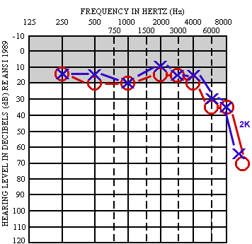
Definitions
Impairment of sound perception more than 20 decibel on pure tone audiogram.

Slide 16
Types of Hearing loss
Conductive hearing loss
Sensorineural hearing loss
Mixed hearing loss

Slide 17
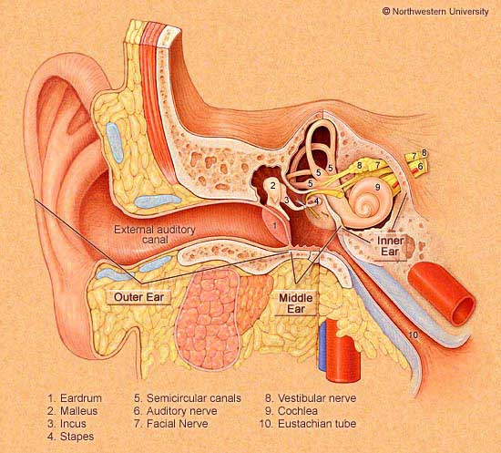
Conductive hearing loss
Concha
Ear Canal
Drum
Ossicular Chain
Eustachian Tube

Slide 18
Conductive hearing loss
External canal pathology
Artesia

Slide 19
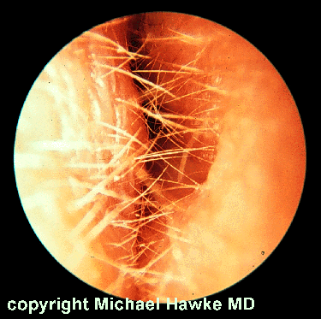
Conductive hearing loss
External canal pathology
Acute otitis externa

Slide 20
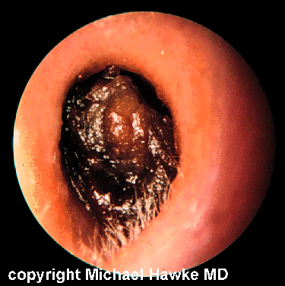
Conductive hearing loss
External canal pathology
Wax

Slide 21
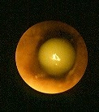
Conductive hearing loss
External canal pathology
Foreign body

Slide 22
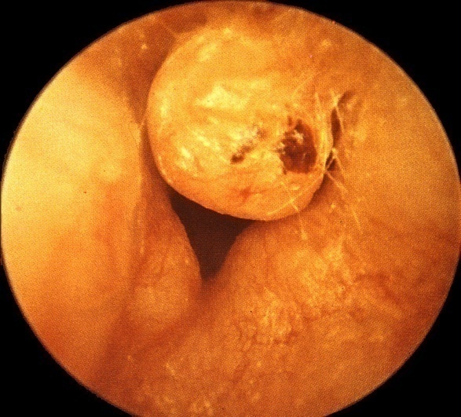
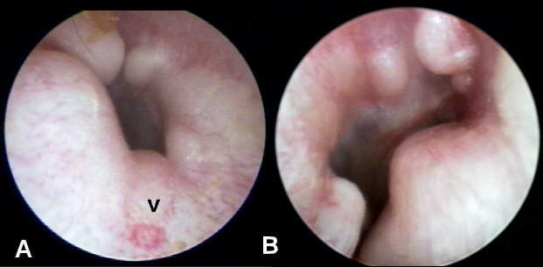
Conductive hearing loss
External canal pathology
Tumors:
Osteoma
exostosis

Slide 23
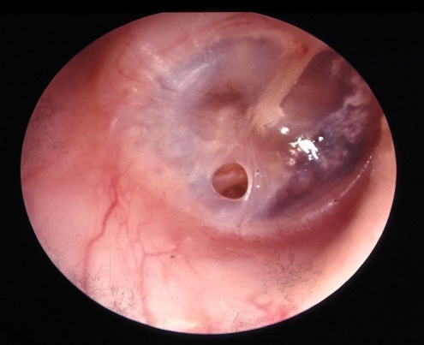
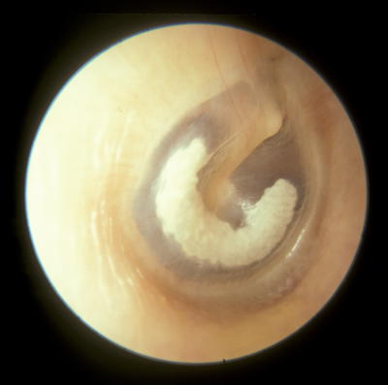
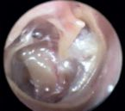
Conductive hearing loss
Tympanic membrane
Perforated
Tympansclerosis
SOM

Slide 24
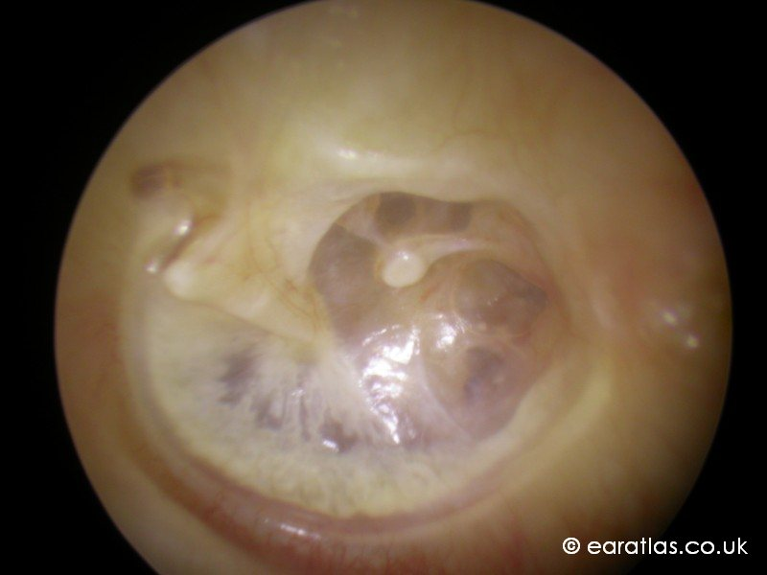
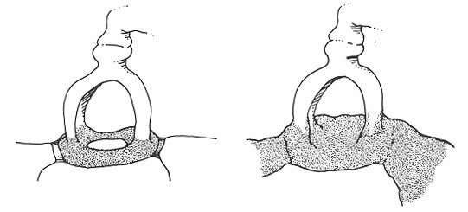
Conductive hearing loss
Ossicular chains
Absent & erosion
Fixation(otosclerosis)
Disrupted(trauma)

Slide 25
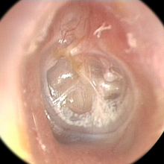
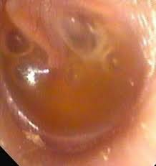
Conductive hearing loss
Eustachian Tube dysfunction:
Retraction
Effusion

Slide 26
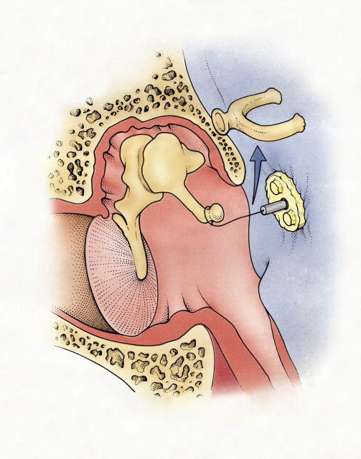
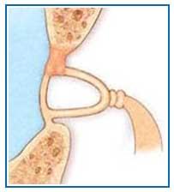
Otosclerosis
10% otosclerotic lesions (10% symptomatic)
Females: Male 2: 1
Middle-age
Worse during pregnancy
Stapedectomy

Slide 27
Sensorineural hearing loss
Two types:
Sensory (the pathology is within hair cells in cochlea)
Neural (the pathology is within the auditory nerve and it’s connection

Slide 28
Sensorineural hearing loss
Etiologies :
1. Congenital:
Inherited
Syndromic (less common)
Non- syndromic (common)
Congenital infection (TORCH)

Slide 29
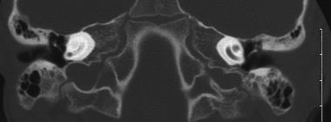
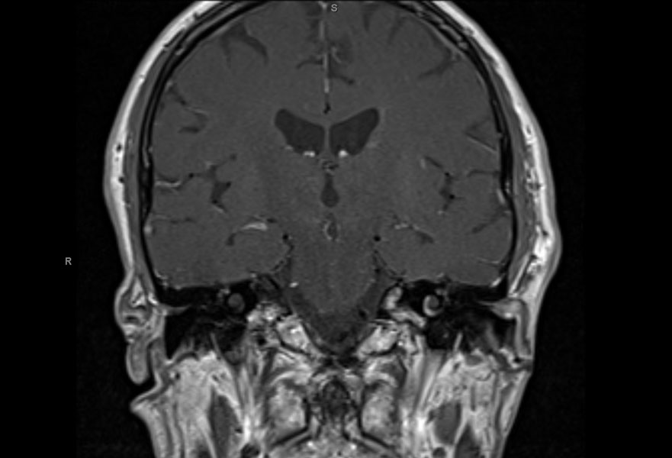
Sensorineural hearing loss
2. Acquired :
Inflammatory
Labyrinthitis
Meningitis

Slide 30
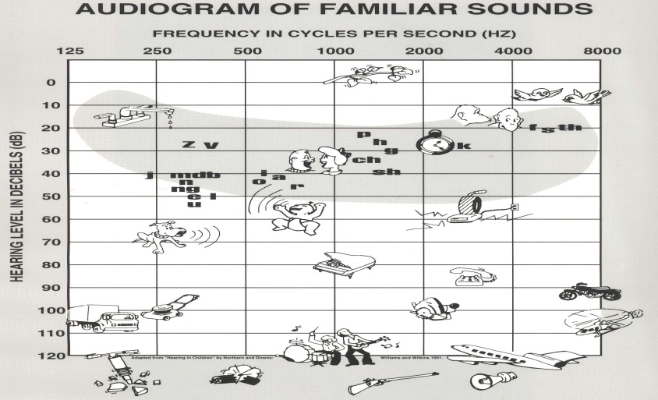
Noise exposure
Sensorineural hearing loss

Slide 31
Sensorineural hearing loss
Autoimmune
Cogan syndrome
Ototoxic drugs
-Aminoglycosides groups ,diruitics,….

Slide 32
Sensorineural hearing loss
Presbycusis
Acoustic neuroma
Trauma

Slide 33
1.What are the types of temporal bone fractures? 2. How does patient present clinically ?

Slide 34
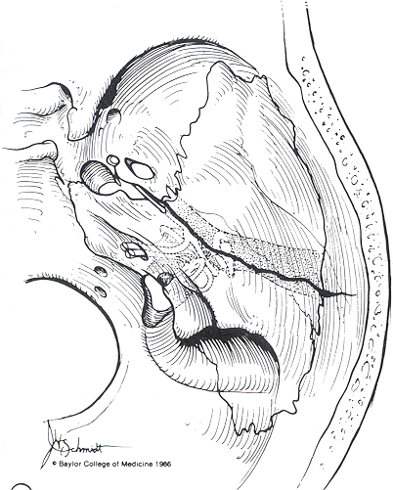
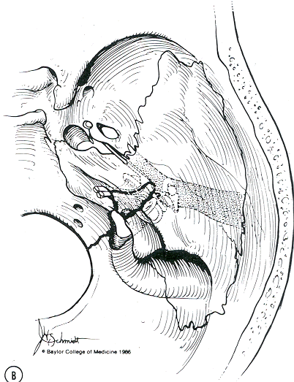
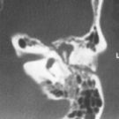
Sensorineural hearing loss
Trauma
Temporal bone fracture
1.Longitudinal fracture
2.Transeverse fracture

Slide 35
Sensorineural hearing loss
Longitudinal fracture :
Bleeding from ear
Conductive hearing loss
Uncommon facial nerve paralysis
CSF

Slide 36
Sensorineural hearing loss
Transverse fracture
SNHL
Facial nerve paralysis common
CSF

Slide 37
Examination
General look ( syndromic )
Complete head and neck exam
Otoscopic / microscopic ear exam of both ears
Tuning fork test

Slide 38
What is tunning fork test ? How to conduct the test ?
Examination

Slide 39
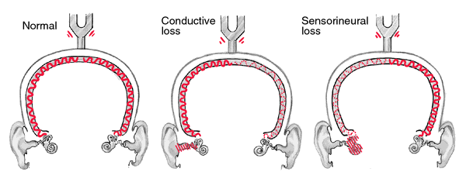
The Weber Test

Slide 40
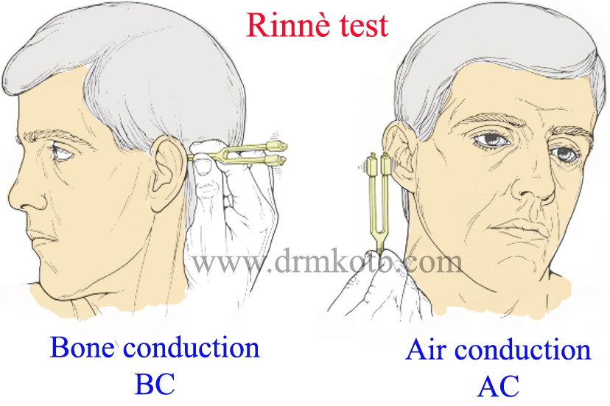
The Rinne Test
AC > BC (Positive)
AC < BC (Negative)

Slide 41
What tests you want to request in patient with hearing loss and why?
Investigation

Slide 42
Clinical testing of hearing
Pure tone audiogram
Tympanogram

Slide 43
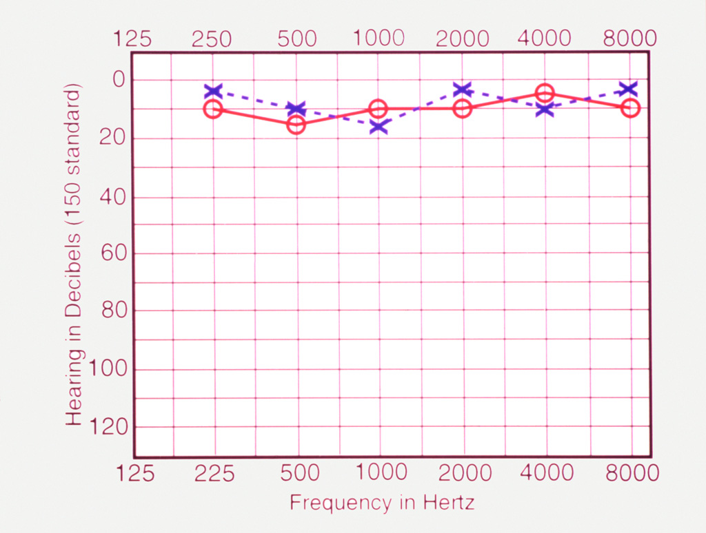
Pure Tone Audiogram
Normal hearing

Slide 44
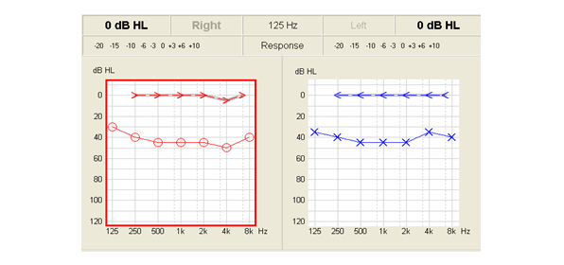
Conductive hearing loss
Pure Tone Audiogram

Slide 45
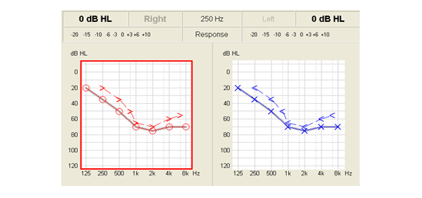
Pure Tone Audiogram
Sensorineural hearing loss

Slide 46
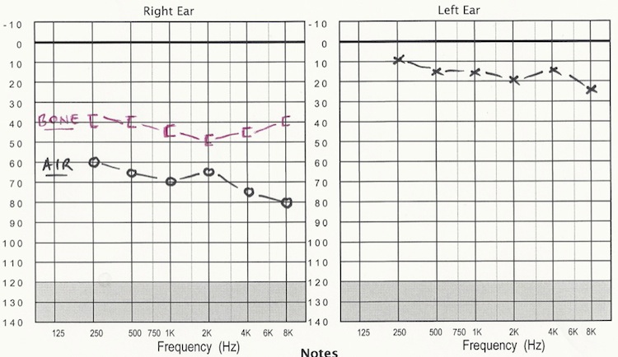
Pure Tone Audiogram
Mixed hearing loss

Slide 47
How would you classify the degree of hearing loss?

Slide 48
Degree of hearing impairment

Slide 49
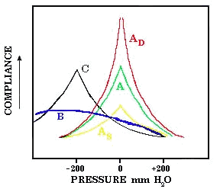
Tympanogram

Slide 50
Managment of deafness
Medical management
Hearing aids

Slide 51
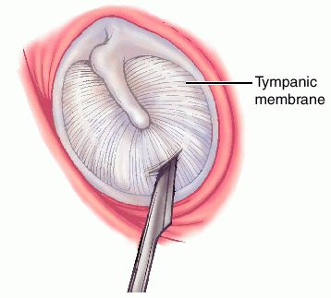
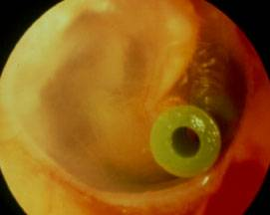
Managment of deafness
Surgery
Myringotomy and ventilation tube Otitis media with effusion

Slide 52
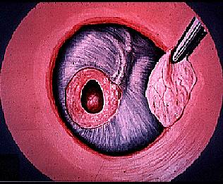
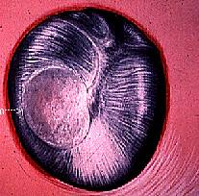
Managment of deafness
Myringplasty & tympanoplasty in case of CSOM

Slide 53
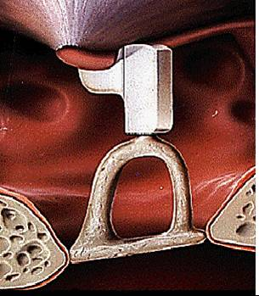
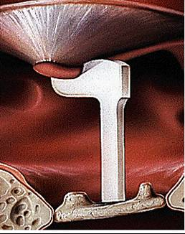
Managment of deafness
Ossiculoplasty

Slide 54
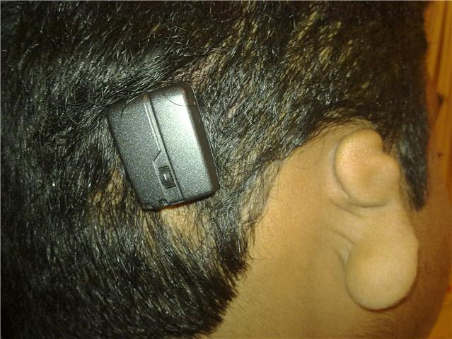
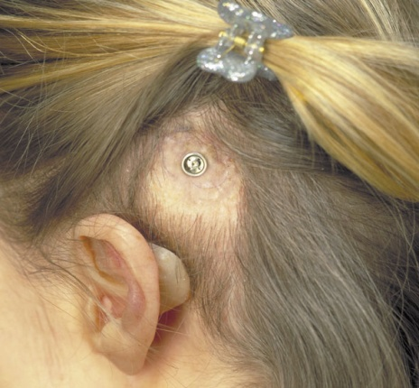
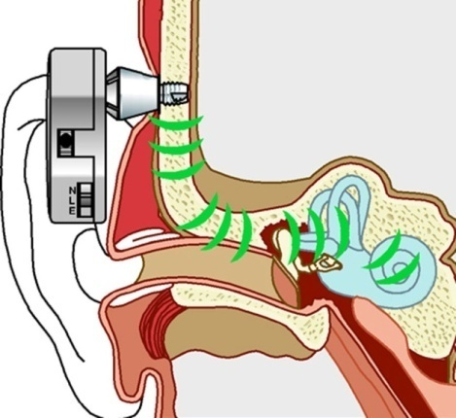
Managment of deafness
Implantable devices :
BAHA (Bone anchored hearing aid)
Atersia of external canal
Chronic drainage ear not responding to surgery

Slide 55
Managment of deafness
Cochlear implant
prelingual children and postlingual adult
it pass by the external ,middle and inner ear to stimulate auditory nerve directly

Slide 56
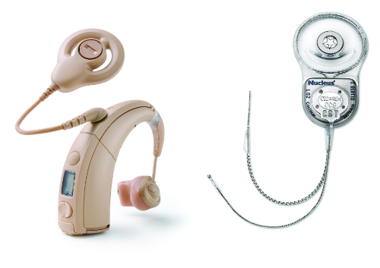

Slide 57
