Slide 1
Vertigo
Dr. Farid Alzhrani Assistant professor
Consultant of Otolaryngology, head and neck surgery
King Abdulaziz University Hospital

Slide 2
Objectives
To know anatomy of balance organs
Physiology of balance
Relevant history in dizzy patients
Classification of vertigo
Common peripheral causes of vertigo ,clinical features ,investigation and management
Common central causes of vertigo ,clinical features ,investigation and management

Slide 3
What are the components of balance system ?

Slide 4
components of balance system
Inner ear (3 semicicular canals and otolith organ )
Cerebellum
Vision (VOR)
Proprioceptive

Slide 5
How does balance system work ?

Slide 6
Physiology
Transform of the forces associate with head acceleration and gravity into a biological signals that the brain can use to develop reflexes ?
What are the importance of these reflexes ?

Slide 7
End result from vestibular functions
subjective awareness of head position in space (orientation)
produce motor reflexes that will maintain posture
ocular stability

Slide 8
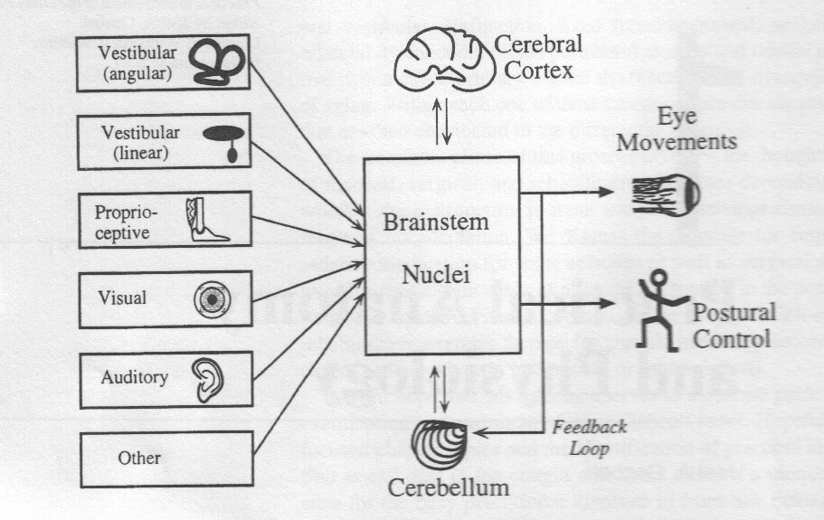

Slide 9
What is Dizziness?
Illusion of movement of self or environment
Exact description important: Not accept “dizziness” - too vague
True spinning? -comparator
Lightheadedness?
Unsteadiness?
Fainting, passing out

Slide 10
What are the questions to ask in history ?
Frequency:
Recurrent
Non -Recurrent
Duration :
Seconds
Minutes
Hours to days

Slide 11
What are the questions to ask in history ?
Associated auditory symptoms:
Tinnitus
Deafness
Funllness

Slide 12
What are the questions to ask in history ?
Aggravating and relieving factors:
Rolling over in bed
Getting up from bed
Looking up
Consume salty food

Slide 13
What are the questions to ask in history ?
Others:
Ear disease or ear surgery
Trauma
Migraine
Ototoxic drug intake

Slide 14
Worrisome Features
Diplopia, Dysarthria, Dysphagia, Difficulty moving one side/limb, paraesthesia one side/limb.
Bowel or bladder disturbance.
True loss of consciousness.
Prominent arrhythmia.

Slide 15
Differential diagnosis
A) peripheral vestibular loss
B) central vestibular loss

Slide 16
What are the causes of peripheral vestibular loss ?

Slide 17
Peripheral Vestibular Loss
Vestibular neuritis
Benign paroxysmal positional vertigo ( BPPV)
Meneires disease (Endolymphatic hydrop )

Slide 18
Vestibular neuritis
Viral infection of vestibular organ
50% Infectious illness precede VN
Affect all ages but rare in children

Slide 19
Vestibular neuritis
Affected patient presents acutely with spontaneous nystagmous ,vertigo and nausea & vomiting
Patient requires only symptomatic treatment
It takes 3 weeks to recover from vestibular neuritis

Slide 20
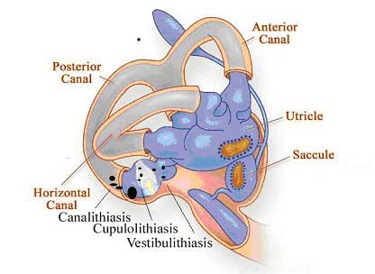
Benign Paroxysmal Positional Vertigo

Slide 21
Benign Paroxysmal Positional Vertigo
The most common cause of vertigo in patient > 40 years
Repeated attacks of vertigo usually of short duration less than a minute .
Provoked by certain positions (rolling in beds, looking up ,and head rotations)
Not associated with any hearing impairment

Slide 22
Benign Paroxysmal Positional Vertigo
Etiology
not identifiable.
closed head injury followed `(surgery )
infections (15% vestibular neuronitis)
prolonged bed rest.
Ménière's disease
recurrent vestibulopathy
migraine

Slide 23
Benign Paroxysmal Positional Vertigo
Diagnosis:
History (Only type of vertigo)
Multiple times per day
brief episodes
Unaccompanied by auditory complaints
Dix-Halpike maneuver

Slide 25
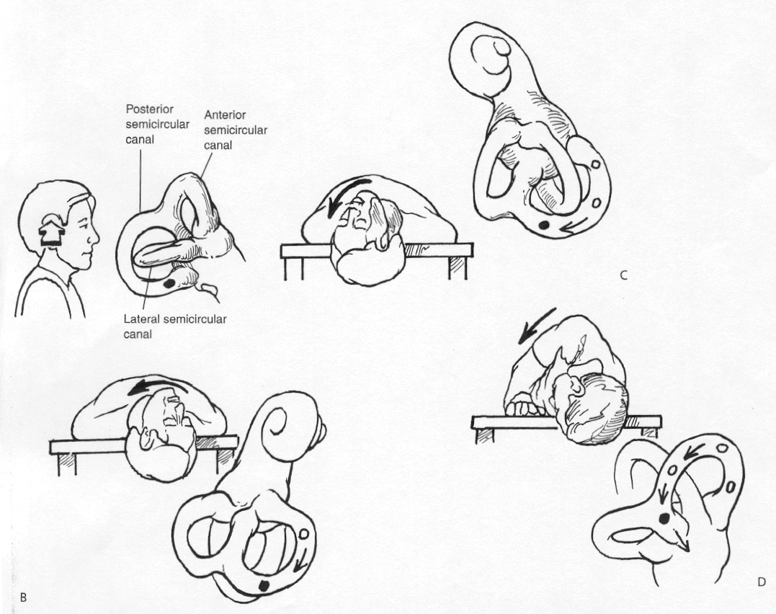
Benign Paroxysmal Positional Vertigo
Management :
Epley maneuver

Slide 27
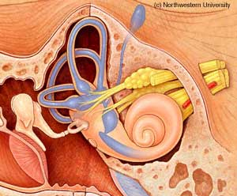
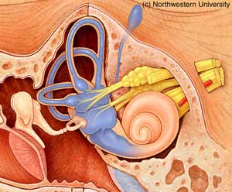
Endolymphatic hydrop (Meneire’s disease)
Pathophysiology :
Unknown etiology
↑ production / ↓ reabsorption of fluid within inner compartment

Slide 28
Endolymphatic hydrop (Meneire’s disease)
Recurrent vertigo (minutes to hours )
Low frequency fluctuating SNHL
Tinnitus
Ear Fullness
In 10 - 20% of cases the disease later involves the opposite ear

Slide 29
Endolymphatic hydrop (Meneire’s disease)
Pathology:
↑ production / ↓ reabsorption of endolymphatic fluid
Progressive hydrops
membranous ruptures
Spillage of large amounts of neurotoxic endolymph into the perilymphatic compartment
healing of the membranes
Distortion and atrophy of sensory and neural structures

Slide 30
Endolymphatic hydrop (Meneire’s disease)
Diagnosis
History
PTA : LF-SNHL
R/O other DD

Slide 31
Endolymphatic hydrop (Meneire’s disease)
Management:
low-salt diet
Medical therapy
Others

Slide 32
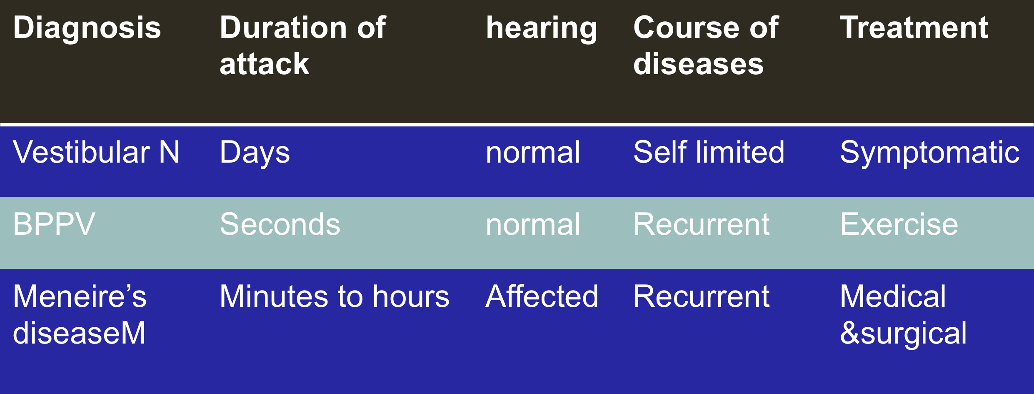
Summary

Slide 33
What are the causes of central ?
CVA (Cerebero vascular accident)
Brain tumor ( acoustic neuroma )
Multiple sclerosis
Migraine

Slide 34
CVA
Elderly patient with chronic disease like (DM ,HTN) with :
Sudden attack of vertigo
+ Neurological symptoms

Slide 35
CPA TUMORS
Benign tumor
Arise from vestibular devision of VIII CN
Clinical presenatation
Unilateral tinnitus
Hearing loss
Dizziness

Slide 36
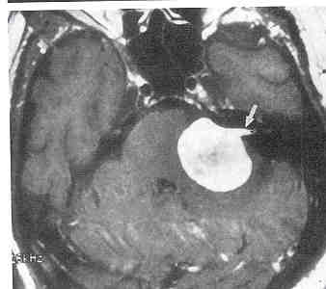
CPA TUMORS
Diagnosis :
History
PTA ( Unilateral SNHL )
Radiology

Slide 37
Investigations
Audiology
PTA
ENG
Posturography
Rotation chair
Radiology
CT Scan
MRI
Blood Test
CBC, TFT, FT-Abs

Slide 38
Take Home message
History is the most important key to diagnosis for a dizzy patient.

