Slide 1
ORL 432
Otorhinolaryngology course for undergraduates
Presentation available : http://fac.ksu.edu.sa/maalessa/course/124627

Slide 2
Course : ORL 432
Hours : 4 credit hours
1 hour (Theoretical or Lectures)
3 hours (Clinical or Practical Aspect)
Chairman
Dr.Sami Alharethy
Director ( undergraduate unit ) :
Dr.Mohammed AlEssa
maalessa@ksu.edu.sa
Undergraduate co-ordinators
Ms. Antonieta Adiova
Ms. Shatha AlOtibi
Avenue / office :
King Abdulaziz University Hospital
Building no.1
4 floor
011/4786100 , extension : 1429
** new avenue will be announced later

Slide 3
ORL 432 Objectives
TEACHING
STUDENTS
THEORITICAL
SKILLS
CLINICAL
SKILLS
Notes:
No need for operative skills , add

Slide 4
COURSE Objectives
Summary of the main learning outcomes for students enrolled in the course.
To know the basic ENT anatomy and physiology.
To recognize assessment and management of common ENT diseases, include ability to obtain patients’ history, perform comprehensive physical and mental status assessment, interprets findings
To know how to handle common ENT emergencies.
To handle simple ENT diagnostic instruments.
To be aware of common ENT operations.
To create an interest for further post-graduate study in ENT.
Enable to acquire and practice the code of medical ethics and demonstrates good and ideal attitude towards patients and their families, with the colleagues and other Staff and Sectors
To learn not only the theoretical and clinical aspects of the course but to mold as an ideal instruments in the line of medical profession includes communication and inter-relationship with colleagues and other Staff

Slide 5
Theoretical and Practical Activities in ORL COURSE 432
Notes:
Stress on clinical more

Slide 6
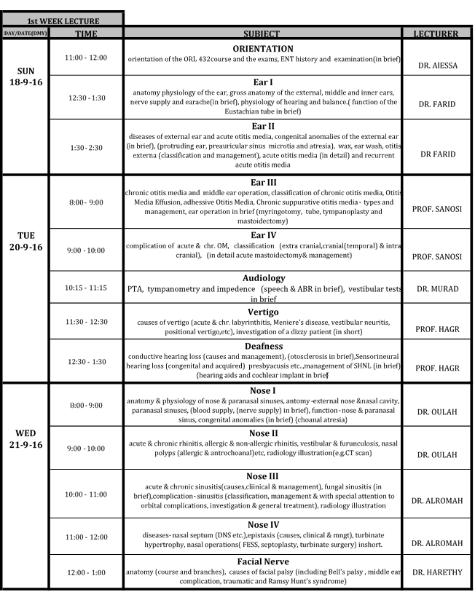
Lectures

Slide 7
Lectures
Notes:
Change it to new one

Slide 8
COURSE STRUCTURE
1 st Cycle Male
Division I 5 Weeks
Division II 5 Weeks
2 nd Cycle Female
Division I 5 Weeks
Division II 5 Weeks
3 rd Cycle Male
Division I 5 Weeks
Division II 5 Weeks
Note that at its 11th week of each Cycle will be the examination days –Written (MCQ, SAQ) and
Oral (OSCE)
Failures : Summer Course 4 weeks
Notes:
Why 11 week

Slide 9
STUDENT’S GROUPING
GROUP 1 ENT – FIVE WEEKS 5 DAYS / WEEK | GROUP 2 OPHTHA - FIVE WEEKS 5 DAYS / WEEK
Subgroups 6: A, B, C, D, E, F. | Subgroups 6: A, B, C, D, E, F.

Slide 10
ACTIVITIES
ACADEMIC ACTIVITIES
Lectures
First TWO WEEKS
CLINICAL ACTIVITIES
Clinics
Rounds (Pre & Post Operation)
Operative session
Communication Disorders
Audiology

Slide 11
ACTIVITIES
ACADAEMIC ACTIVITIES
Lectures:
Theoretical aspects
Building 4 ( level 2 /3)
Building 2 ( main auditorium)
First two weeks
From 8 AM – 4 PM
The WHOLE Group

Slide 12
CLINICAL ACTIVITIES
How to Examine ear, nose, throat, head & neck
Common ENT symptoms & signs

Slide 13
CLINICAL ACTIVITIES
I. CLINICS
II. ROUNDS (Pre and Post-Op)
III. OPERATIVE SESSION
IV. AUDIOLOGY
V. COMMUNICATION DISORDERS
(SPEECH)

Slide 14
CLINICAL ACTIVITIES
I. CLINICS
History taking
Examination
Building 3 –Level 3
Clinic 4: Building 5 - primary care 3rd floor.

Slide 15
CLINICAL ACTIVITIES
II. ROUNDS
Building 1 : 5th & 7TH floor
Pre-operative rounds
Discussion of diseases, complications, outcome
Notes:
Change ward to 7A &B

Slide 16
CLINICAL ACTIVITIES
III. OPERATIVE SESSIONS
To see common surgical procedures
Building 1 , 2nd floor

Slide 17
CLINICAL ACTIVITIES
IV. AUDIOLOGY
Audiology & Vestibular tests
Audiometry reading
Building 5- Ground floor , (New avenue will be announced later).

Slide 18
CLINICAL ACTIVITIES
IV. COMMUNICATION DISORDERS (SPEECH DISORDERS)
Observe voice disorders
Building 5- second floor ( new avenue will be announced later)

Slide 20
ATTENDANCE
Lectures (40%)
26 lectures
e.g. 1
26 X 40 = 1.54% per lecture
Clinical Session (60%)
14 sessions (7days : am & pm
e.g. 1
14 X 60 = 4.29% per session
Notes:
What does that mean ????? When not allow t write exam

Slide 21
ATTENDANCE
20 % WARNING
- 1 full day lecture (5 lectures)
- 1 & 1/2 days clinical activities
25 % - No EXAMINATION
-1 & 1/2 full day lecture; (8 lectures)
- 1 &1/2 days clinical activities

Slide 22
EXAMINATION 11th Week of each Cycle
10 Marks - Clinical assessment
(on the practical/clinical session/course)
30 Marks – multiple choice question (MCQ)
40 Marks - Short answer questions (SAQ)
20 Marks - OSCE – Oral , instrument , equipment

Slide 23
Multiple choice question
Case scenario
Lead in question ?
Answers
A 40-year-old male presented to the emergency room complaining of fever, dysphagia, drooling of saliva and submandibular swelling for 3 days. He had a tooth extraction one week earlier. Examination showed bilateral indurated diffuse swelling involving the submandibular and the sublingual regions with elevation of the floor of the mouth
What is the most likely diagnosis?
A.Calculus sialadenitis
B.Cervical lymphadenitis
C.Ludwig’s angina
D.Vincent angina

Slide 24
Short answers question ( SAQ)
A 34-year-old patient who is complaining of hoarseness for 6 months.
A) What is the diagnosis?
B) What are the two main lines of management?

Slide 25
OSCE
What is the name of this equipment ?
Rigid endoscopy
Mention one area examined by this equipment ?
Nasopharynx

Slide 26
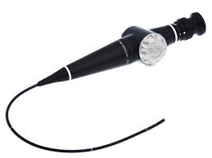
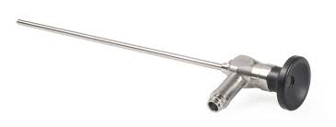

Slide 27
Complaints From Students
Complaints concerning lectures, clinical activities, attendance & examination should be put in writing and forwarded to the Undergraduate Director.

Slide 28
Thank you

