Slide 1
Fetal assessment
Dr. Saleh AlAsiri, MD, FRCSC, FACOG, FACS, FICS
Assistant Professor, Consultant
Reproductive Endocrinology & infertility
Department of Obstetrics & Gynecology

Slide 2
Fetal assessment
to identify fetuses at risk of neurologic injury or death in order to prevent it
It can be divided into:
A-Early pregnancy fetal assessment
B-Late pregnancy fetal assessment
OR
A- Assessment of low risk pregnancy
B -Assessment of high risk pregnancy

Slide 3
Rational
→ fetal oxygenation challenged:
- blood flow directed to brain, heart & adrenal & blood flow away from the kidney decrease fetal urine production ↓ AF volume.
- CNS hypoxia ↓ Fetal movement
-chemoreceptor's vegally-mediated reflex
Fetal heart rate abnormality late deceleration.

Slide 4
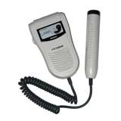
Early pregnancy assessment
Fetal heart activity
fetal auscultation (fetal doppler device )
~12weeks

Slide 5
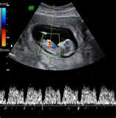
fetal heart activity seen by USS
Can be seen from 6 weeks

Slide 6
Early pregnancy assessment
Fetal movement
Fetal movement are usually first perceptible to mother ~17w-20w (quickening)
50% of isolated limb movements are perceived
80% of trunk and limb movements
Fetal growth
Symphysis fundal height (SFH)
USS

Slide 7
2- Late pregnancy assessment
Fetal movement counting (kick chart)
Contraction stress test (CST)
Non stress test (NST)
Doppler Velocimetry (UAV)
amniotic fluid index (AFI)

Slide 8
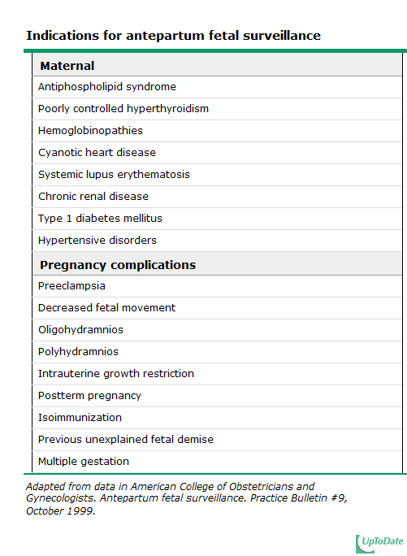

Slide 9
fetal movement counting
It should be started ~28w in normal pregnancy
&~24w in high risk pregnancy
It can reduce avoidable stillbirth
CARDIFF TECHNIQUE
-10 movement in 12 hours
-If abnormal → further assessment
SADOVSKY TECHNIQUE
-4 movement /hour if not felt another hour
If not → further assessment

Slide 10
Contraction stress test (CST)
Causing uterine contraction over 20 minutes
At least 2 uterine contractions
Uterine contraction restrict O2 delivery to the fetus
Normal fetus will tolerate contraction
Hypoxic fetus will have late deceleration

Slide 11
Non stress test (NST)
Main advantage over CST is no need for contraction
False +ve & false –ve higher than CST

Slide 12
Non stress test
The base line 120-160 beats/minute
Different criteria in fetuses <32w
A- Reactive:
At least 2 accelerations from base line of 15 bpm for at least 15 sec within 20 minutes
B- Non reactive:
No acceleration after 20 minutes → another 20 minutes

Slide 13
Non stress test (NST)
If non- reactive in 40 minutes →contraction stress test or Biophysical Profile (BPP)

Slide 14
Amniotic fluid volume ~AFI
Amniotic Fluid Index (AFI)
-the sum of the maximum vertical fluid pocket diameter in four quarters
-the normal value 5-25cm
-<5 : oligohydraminous
->25 : polyhydraminous

Slide 15
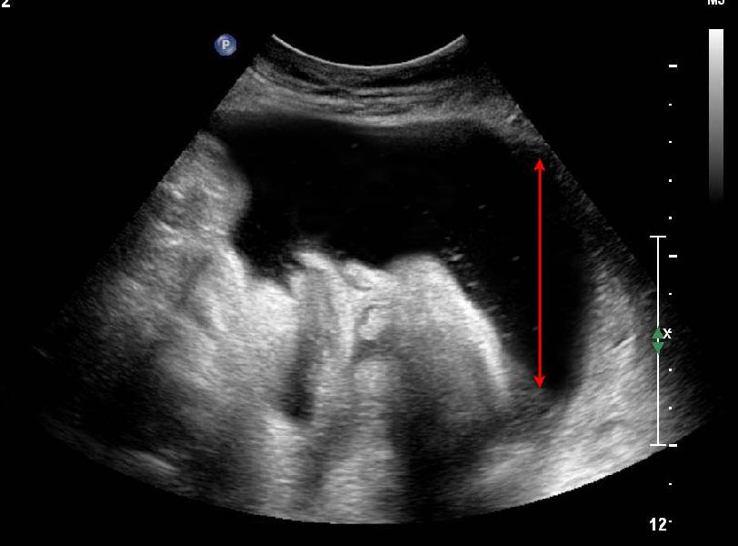
Amniotic Fluid Index (AFI)

Slide 16
Biophysical profile (BPP)
Combines NST , AFV, fetal breathing, body movement & tone.
it is a scoring system ( out of 10 points)
it is done over 30 min
It measure acute hypoxia (NST, body mov. &breathing) & chronic hypoxia (AFI)

Slide 17
Fetal Biophysical profile/NST+
Abnormal (score= 0) | Normal (score=2) | Biophysical Variable
Absent FBM or no episode >30 s in 30 min | 1 episode FBM of at least 30 s duration in 30 min | Fetal breathing movements
2 or fewer body/limb movements in 30 min | 3 discrete body/limb movements in 30 min | Fetal movements
Either slow extension with return to partial flexion or movement of limb in full extension Absent fetal movement | 1 episode of active extension with return to flexion of fetal limb(s) or trunk. Opening and closing of the hand considered normal tone | Fetal tone
Either no AF pockets or a pocket<2 cm in 2 perpendicular planes | 1 pocket of AF that measures at least 2 cm in 2 perpendicular planes | Amniotic fluid volume

Slide 18
BPP
The risk of fetal death within 1 week if BPP is normal~ 1/1300

Slide 19
Doppler velocimetry
Measurement of blood flow velocities in maternal & fetal vessels
Reflect feto-placental circulation
Doppler indices from Uterine Artery, Uterine A & Middle cerebral artery
In IUGR absent or reversed EDF (end diastolic flow) associated with fetal hypoxia

Slide 20
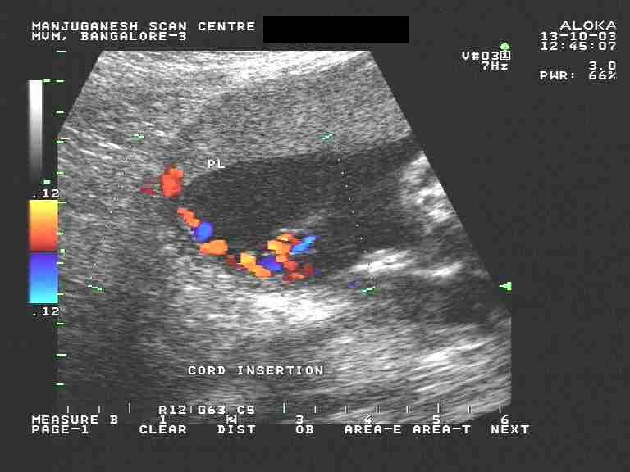
umbilical artery waveform

Slide 21
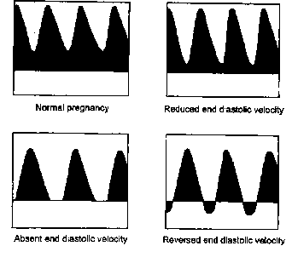
Umbilical Artery Doppler

Slide 22
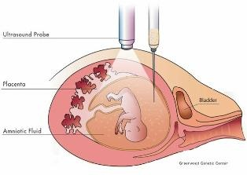
Invasive fetal assessment
Amniocentesis

Slide 23
Amniocentesis
Obtaining a sample of amniotic fluid during pregnancy.
Usullay done after 15w (can be done after 11w)
Indications:
-Genitic (karyotype)
-Billirubine level (RH-isoimunisation)
-Fetal lung maturity : (L / S) ratio
-Therputic : in polyhydranios
Risks: ROM ~1%, abortion 0.5%, infection 1/1000

Slide 24
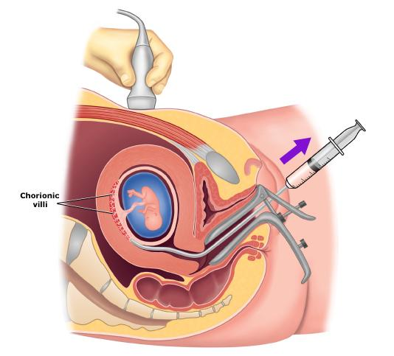
CVS chorionic villus sampling

Slide 25
chorionic villus sampling (CVS):
Usually done after 10w
It is the procedure of choice for first trimester prenatal diagnosis of genetic disorders
Complication: fetal loss (0.7 percent within 14 days of a TA CVS procedure and 1.3 percent within 30 days), Procedure-induced limb defects
Second trimester amniocentesis is associated with the lowest risk of pregnancy loss; chorionic villus samplings safer than early (ie, before 15 weeks) amniocentesis.
.

Slide 26
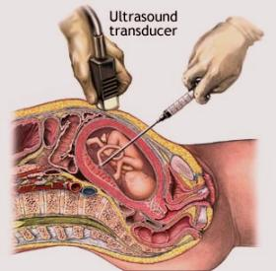
cordocentesis

Slide 27
cordocentesis
Indication: - Rapid karyotyping
-Diagnosis of inherited disorders
-Fetal HB assessment
-Fetal platelets level
-Fetal blood transfusion
Complication: bleeding, bradycardia, infection….

