Slide 1
Introduction to Ophthalmic Genetics
Khaled K. Abu-Amero, Ph.D., FRCPath
Professor, Department of Ophthalmology, College of Medicine, King Saud University, Riyadh , SA
Associate Professor, Department of Ophthalmology, College of Medicine, Jacksonville, FL, USA

Slide 2
Why Ophthalmologists need to know about Genetics
Almost 50% of paediatric blindness is due to a genetic aetiology.
The eye is second only to the brain as an individual organ in its frequency of involvement in genetic disorders.
The ophthalmologist plays important roles not only in clinical diagnosis and management but may also be asked by patients and their families to provide genetic counselling and referrals to appropriate subspecialty services.
An understanding of clinical genetic concepts and accurate diagnosis are prerequisites for effective genetic counselling. Examination of other family members might be required.

Slide 3
How to Recognize a Disease with a Genetic Basis?
Family History
Previous studies had linked the disease to a gene(s)
Chromosomal abnormalities are largely sporadic –No family History
Trauma with no family history – may be NO GENETICS BASIS
Gene-Environment Interaction

Slide 4
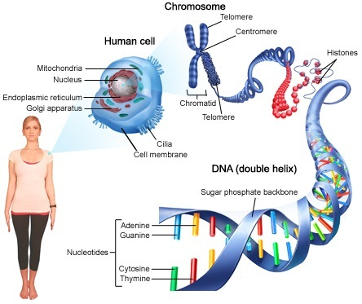
Notes:
The nuclous contains most of the DNA – white blood cells. Only nucleated cells have DNA. RBC – No DNA
3 BILLION BASES
16600 BASES IN mitochondria genome – which is even less than 0.00053% of the nuclear genome.
Rough endoplasmic reticula synthesize proteins, while smooth endoplasmic reticula synthesize lipids and steroids, metabolize carbohydrates and steroids (but not lipids), and regulate calcium concentration, drug metabolism, and attachment of receptors on cell membrane proteins. Sarcoplasmic reticula solely regulate calcium levels.
Mitochondria – source of cell energy
The Golgi apparatus (also Golgi body or the Golgi complex) is an organelle found in most eukaryotic cells.^{[1]} It was identified in 1897 by the Italian physician Camillo Golgi, after whom the Golgi apparatus is named.^{[2]}
It processes and packages macromolecules, such as proteins and lipids, after their synthesis and before they make their way to their destination; it is particularly important in the processing of proteins for secretion. The Golgi apparatus forms a part of the cellular endomembrane system.
WE WILL see more details about chromosomes in future slide

Slide 5
Inheritance patterns
Mendelian disorders are caused by mutations in single genes and follow the principles of inheritance initially described by Gregor Mendel in 1866.
5 types of mode of inheritance follow Mednel
One type (mitochondrial inheritance does not follow Mendel).

Slide 6
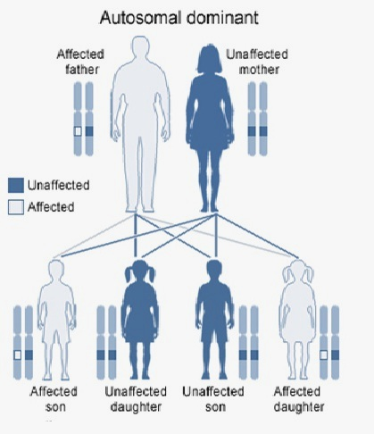
Autosomal Dominant
An affected person usually has at least one affected parent
Affects either sex
A child of affected X unaffected mating has 50% chance of being affected
Retinoblastoma, Retinitis pigmentosa

Slide 7
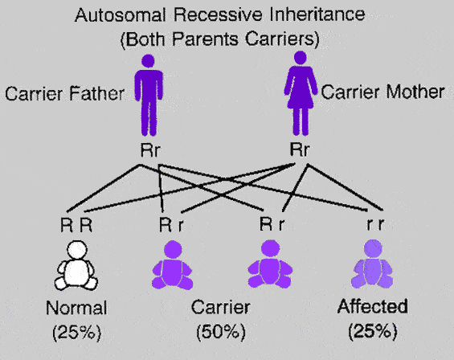
Autosomal Recessive
Males & females affected in equal proportions
Individuals affected in single sibship in one generation (horizontal transmission)
Consanguinity provides further support of AR inheritance
Cystic fibrosis
Sickle cell disease
Thalassaemia
Haemochromatosis

Slide 8
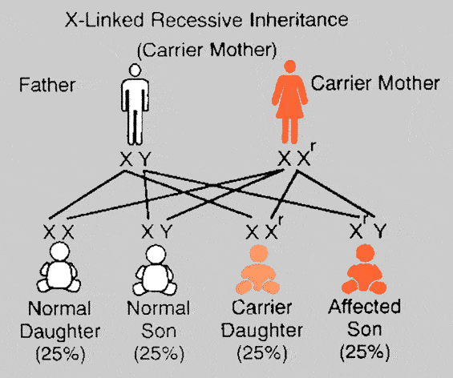
X-Linked Recessive
Males affected almost exclusively
Transmitted through carrier females to sons (knight’s move pattern)
Affected males cannot transmit disorder to sons
Duchenne & Becker muscular dystrophy
Haemophilia
Fragile X Syndrome

Slide 9
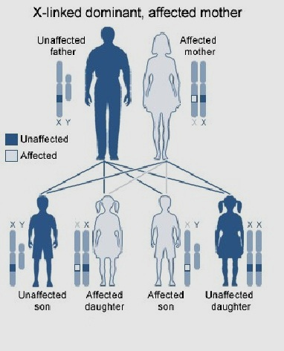
X-linked dominant
Affect either sex
The child of an affected female has a 50% chance of being affected
For an affected male, all his daughters will be affected and none of his sons will be affected.
Rett syndrome, incontinentia pigmenti

Slide 10
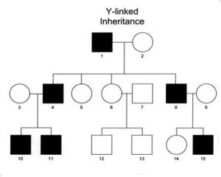
Y-linked Inheritance
Because males inherit a Y chromosome from their fathers, every son of an affected father will be affected.
Because females inherit an X chromosome from their fathers, female offspring of affected fathers are never affected.

Slide 11
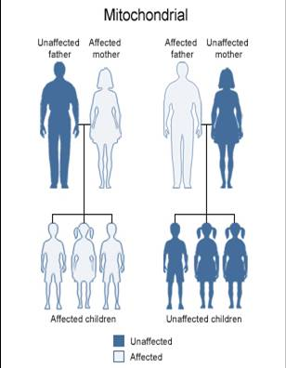
Mitochondrial Inheritance
Transmit only from the mother
Males and Females of an affected mother have equal chances of getting the disease (each 50%).
Mitochondrial diseases are usually multi- systemic.
LHON, MELAS, Chronic Progressive External Ophthalmoplegia (CPEO)

Slide 12
Sequence Changes and Diseases
Causative
Disease
AA
Change
Mutation
+ Environmental
factors
Non-Causative
Risk Factor
Sequence Change
No AA change
Polymorphism

Slide 13
Retinitis Pigmentosa (RP)
Parameter | Description
Clinical features | Affects Retina, loss of night vision (peripheral vision)
Age of onset | Childhood
Genetic cause | Mutations in various genes (Causative)
Mode of Inheritance | Autosomal dominant, Autosomal recessive, X-linked
# of Genes | > 60 genes
Frequency in population | 1 in 3,500 to 1 in 4,000 people (USA and Europe)
Secondary Causes | Syndromic RP - usher syndrome (combination of vision loss and hearing loss)- Bardet-Biedl syndrome; Refsum disease; and neuropathy, ataxia, and retinitis pigmentosa (NARP)
Genetic testing | Available commercially

Slide 14
Primary Angle Closure Glaucoma (PACG)
Parameter | Description
Clinical features | Narrow iridocorneal angle resulting in a blockage of the aqueous outflow structures. Sight loss if not treated
Age of onset | Mean 52.9 ± 18.8
Genetic cause | SNPs and mutations (risk factors)
Mode of Inheritance | Not determined but mainly AD in cases where mode of inheritance can be determined
# of Genes | rs11024102 in PLEKHA7 rs3753841 in COL11A1 rs1015213 (PCMTD1 and ST18 on chromosome 8q)
Frequency in population | 1 of 1000 whites / about 1 in 100 Asians / 2-4 of 100 Eskimos / Saudi Arabia, 40% of glaucoma are PACG
Genetic testing | Research based only

Slide 15
Primary Open Angle Glaucoma (POAG)
Parameter | Description
Clinical features | Open anterior chamber angles, visual field abnormalities, High IOP and optic nerve damage with a loss of optic nerve fibers
Age of onset | Adulthood
Genetic cause | Mutations (OPTN, MYOC in <5% of patients) – Genetic risk factors(multiple SNPs)
Mode of Inheritance | Complex – Mendelian forms are autosomal dominant. A positive family history is a strong risk factor for this disease up to 50% of patients with POAG have family history of this disorder
# of Genes | MYOC, OPTN, and SNPs risk factors CAV1/CAV2, TMCO1, CDKN2B-AS1, CDC7-TGFBR3, SIX1/SIX6, GAS7 and ATOH7
Frequency in population | Affects around 2% of adult population
Genetic testing | Available commercially

Slide 16
Keratoconus
Parameter | Description
Clinical features | Degenerative disorder of the eye in which structural changes within the cornea cause it to thin and change to a more conical shape than the more normal gradual curve.
Age of onset | The mean age of onset 39.3 years
Genetic cause | VSX1 gene (< 5% of cases had mutation)
Mode of Inheritance | Mainly Sporadic, can be familial (some cases are Autosomal recessive)
# of Genes | 20 genes – 8-10 SNPs (genetic risk factors)
Frequency in population | Prevalence range from 1 in 500 to 1 in 2000 people - in the Middle East (including the Arabs and non-Arabs) the incidence is between 20/100,000 and 24.9/100,000
Genetic testing | Commercially available

Slide 17
Primary Congenital Glaucoma (PCG)
Parameter | Description
Clinical features | Epiphora, photophobia and blepharospasm are the three most common manifestations. Untreated PCG is a major cause of childhood blindness
Age of onset | Children from birth to age 3
Genetic cause | CYP1B1 (Causative)
Mode of Inheritance | Mainly autosomal recessive – Sporadic cases has been reported
# of Genes | One gene CYP1B1
Frequency in population | It affects about one in every 10,000 infants. Higher is societies were consanguinities are prevalent
Genetic testing | Commercially available

Slide 18
Optic Neuritis
Parameter | Description
Clinical features | Inflammation and deterioration of optic disk - loss of vision in one eye that may occur within several hours of onset. The severity ranging from slight visual deficiency to complete loss of light perception. reduction in color perception. – associated with MS
Age of onset | female between the ages of 18 and 45 you’ve been diagnosed with multiple sclerosis (MS)
Genetic cause | Not Known – some mtDNA mutation been reported in some cases of ON
Secondary Causes | Mumps, measles, tuberculosis, Lyme disease
# of Genes | 0
Frequency in population | Overall in North America, the incidence of optic neuritis is about 3 per 100,000 people per year
Genetic testing | n/a

Slide 19
Retinoblastoma
Parameter | Description
Clinical features | The most common presentations are leukocoria and strabismus.. Tumors may spread towards the vitreous cavity (endophytic spread) or towards the outer layers of the eye and subretinal space (exophytic tumor).
Age of onset | Mean age of onset for bilateral cases is 15 months and for unilateral cases 24 months.
Genetic cause | Retinoblastoma (RB1) gene (causative)
Mode of Inheritance | Autosomal dominant.
# of Genes | One gene
Frequency in population | Incidence of 4:1,000,000 or about 1:23,000 live births.
Genetic testing | Commercially available

Slide 20
Ocular Motility
Congenital Fibrosis of Extarocular Muscles (CFEM)
Neurological Involvement
Congenital Cranial Dysinnervation Disorders(CFEM)
Duane Retraction Syndrome

Slide 21
Genetics of DRS
DRS syndrome | Gene(s) | Characteristics
DURS1 | Cytogenetic abnormalities on Chr. 8q13 | Contiguous gene deletion syndrome
DURS2 | CHN1, important in CN6 and CN3 axon path finding | Often bilateral with vertical motility abnormalities
DRRS, Duane Radial Ray Syndrome | SALL4, important in patterning of embryonic CN6, limbs, and heart | Variable hand and upper extremity anomalies; variable cardiac, renal, auditory, and vertebral abnormalities

Slide 22
Thank You

