Slide 1
Common Foot and ankle Disorders
DR. MARWAN ZAMZAMI
Associate Professor & Consultant Orthopedic Surgeon
College of Medicine, King Saud University and King Khalid University Hospital

Slide 2
Objectives of this Lecture
To understand the importance of bony and soft tissues structure of Foot and Ankle.
To get a concise idea on common Foot and Ankle disorders.
To differentiate from simple disorders and serious ones.
To learn about initial management and prognosis.

Slide 3
Importance of Foot and Ankle
They are the structures which are subject to most weight bearing (Loading) of the body.
Have very important proprioception function.
Their sensory role is very important.
Their appearance or deformity is easily noticeable.
Faulty or improper shoe wear can cause symptoms.
With advancing age; deformity becomes more common.

Slide 4
Foot Skeleton: Medial Aspect

Slide 5
X-ray standing

Slide 6
Foot skeleton: Lateral aspect

Slide 7
Foot skeleton: Dorsal View

Slide 8
Common Disorders
Flat Foot.
Hallux Valgus.
Heel Pain (Plantar Fasciitis).
Ankle Sprains and Ankle Instability.
Osteochondral lesions of Talus.
Diabetic Foot.
Charcot Foot.

Slide 9
Flat Foot
Means reduced longitudinal arches of the foot.
Most cases are developmental: i.e. arches do not develop normally.
Usually is painless.
Rarely acute flat foot can be encountered.
Rigid flat foot can be the result of tarsal coalition( fibrous or bony cross union between bones of the foot )

Slide 10
Arches of The Foot

Slide 11
X-ray standing

Slide 12
Flat foot :Lat. Weight bearing X-rays

Slide 13
Flat Foot: rigid or flexible
Rigid flat foot can be suspected by simple test: when patient is inspected from behind and asked to stand on tip-toes; the heel normally moves inward.
In cases of rigid flat foot heel does not move inward.
Also; on examination table: when ankle is held still and heel is moved sideways; it does not move in stiff heel as normally

Slide 14
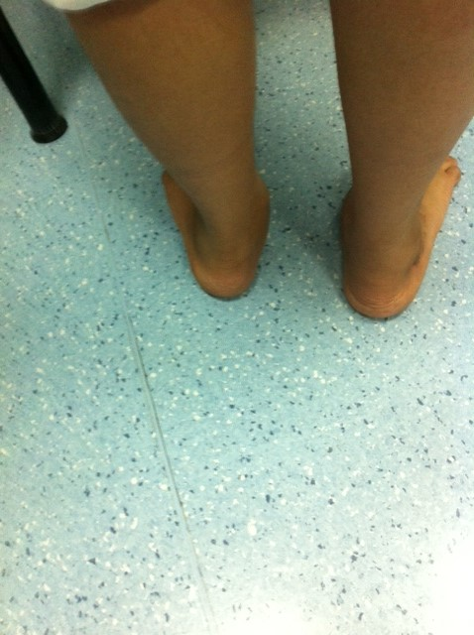
Inspection of heels from behind
Normally the heel is straight or minimally in valgus.
This patient has normal appearance Right heel and excessive valgus Left heel.

Slide 15
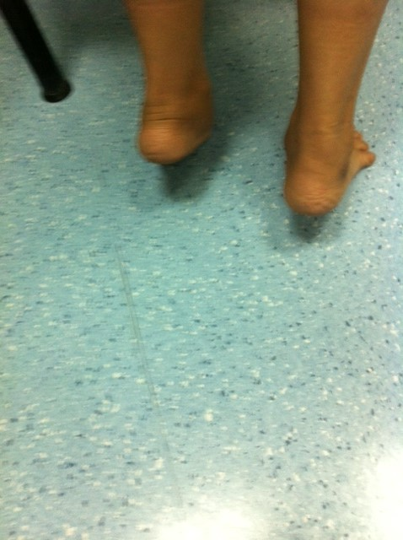
Standing on tip-toes
Both heels correct their valgus and point medially in some varus:
This is NOT rigid flat foot and there is no tarsal coalition or bony bar connecting tarsal bones.

Slide 16
Flat Foot management
Usually NO action is needed.
Foot exercises is prescribed ; but its value is not confirmed.
Orthotics and insoles are sometimes prescribed ; As a treatment of flexible flat feet.
However choosing correct and good type of shoes can be of benefit on the long run.
Rigid flat foot may require surgical management.

Slide 17
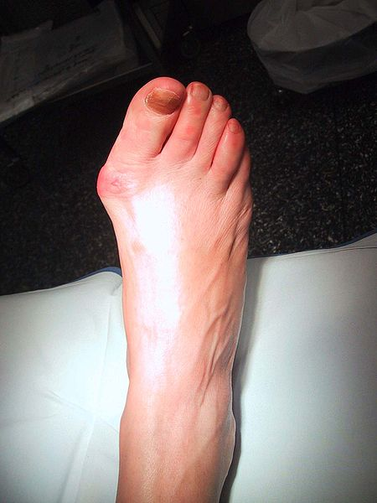
Developmental Foot deformity: Hallux Valgus

Slide 18
Hallux Valgus
Means lateral deviation of big toe.
Usually at the metatarsophalangeal joint.
Often is associated with a bunion (swelling and protrusion at the medial aspect of big toe).
Common at middle age and elderly, mainly females.
Most cases are painless.
When severe it interferes with shoe wear and may cause symptoms.

Slide 19
Hallux Valgus measurements (Normal foot)

Slide 20
Hallux Valgus Measurements
Hallux Valgus Angel: angle between line extending along 1st metatarsal and a line extending along proximal phalanx.
Normal angles: <15
Mild HV: 16-25
Moderate HV: 26-35
Severe HV: > 35

Slide 21
Hallux Valgus Measurements
1st intermetatarsal angle:
Angle between 1st metatarsal long axis and 2nd metatarsal
N < 10
Hallux interphalangeus angle:
Angle between long axis of proximal and distal phalanges
N < 8

Slide 22
Hallux Valgus Management
Correct and suitable shoe wear.
Avoidance of tight shoes.
Protection to the bunions.
Surgery is reserved for symptomatic and disturbing cases.
Following surgery; patient has to continue proper shoe wear.

Slide 23
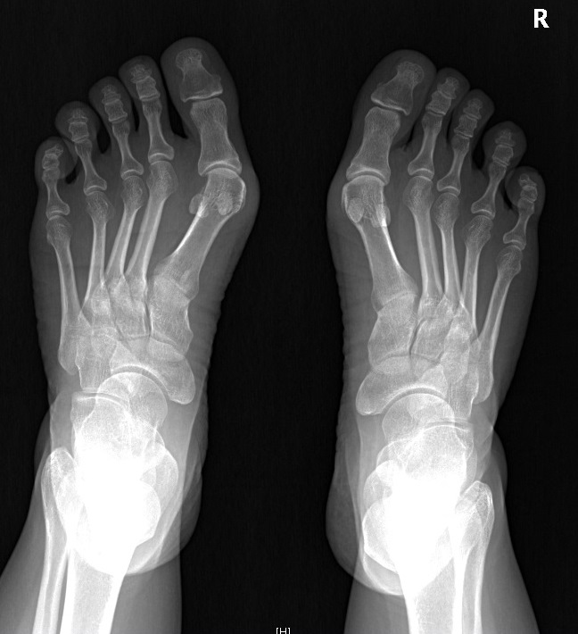
Hallux Valgus Pre Op

Slide 24
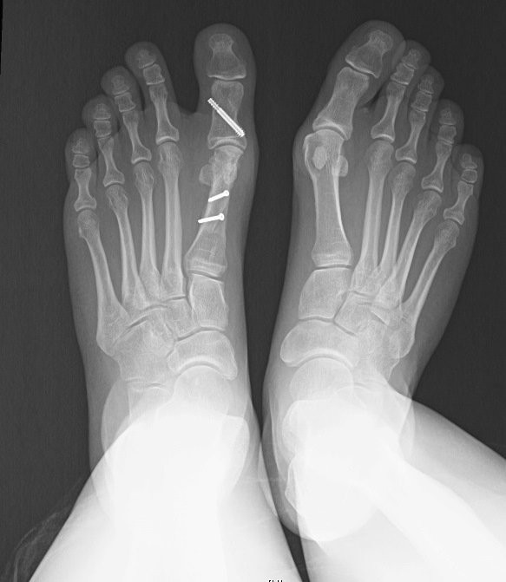
Hallux Valgus Post Op

Slide 25
Heel Pain: Plantar Fasciitis
Common disorder at middle age and elderly.
Insidious in onset; unilateral or bilateral.
Vague pain at heel region.
Localised tenderness to insertion of plantar fascia into calcaneum.
Plain lateral X-ray of heel frequently shows calcaneal spur (prominence or ossification at the site of anterior calcaneum at plantar fascia insertion site)

Slide 26
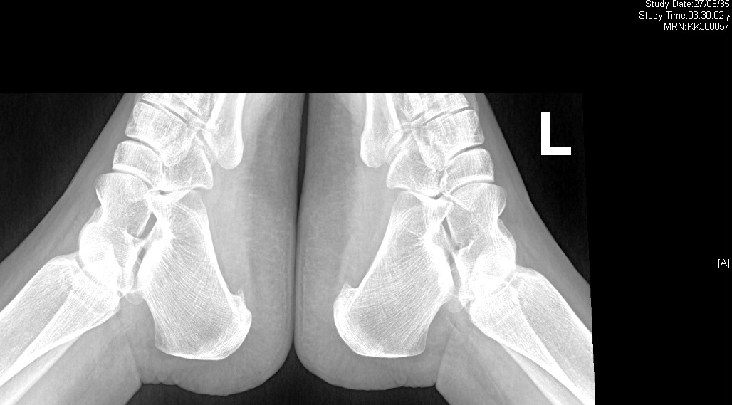
X-ray: Bilateral calcaneal spur (Early)

Slide 27
Plantar fasciitis
Commonly associated with flat feet.
No visible heel swelling, no skin changes and no increase in local temperature.
Inflammatory process is at site of pain; i.e. at plantar fascia insertion into calcaneum.
Heel pain like stabbing pain when patient puts foot to the ground first thing in the morning; and gets less after some walking.

Slide 28
X-ray: Calcaneal Spur (Advanced)

Slide 29
Plantar Fasciitis management
At present NO easy or simple management is available.
Mainly conservative.
Includes stretching exercises to plantar fascia: active and passive.
Use of soft heel insoles orthotics is helpful.
Shock wave therapy (SWT) may be effective.
Local steroid injections are helpful sometimes.

Slide 30
Ankle Sprains
One of most common injuries.
Usually occurs during sports activities.
But may occur at home or at street.
Is the result of twisting injury.
There is pain, swelling and local bruising.
X-rays do not show fracture.
The injury is partial or complete ligament rupture.

Slide 31
Ankle Ligaments (Lateral)

Slide 32
Ankle Sprain
Most commonly injured ligament is the Anterior Talo-Fibular Ligament.
Ankle anterior drawer test is used to detect its rupture.
Other ligaments are Posterior Talo-Fibular Ligament and Calcaneo-Fibular ligament.

Slide 33
Clinical picture of Ankle Sprains
Always there is a history of twisting injury.
Pain, swelling and bruising at and around ankle.
No tenderness of lateral malleolus; but tenderness anterior, posterior or inferior to it i.e. over ligaments.
Dorsi-flection and plantar flexion possible; but inversion and eversion very painful.
X-Rays : NO fracture.

Slide 34
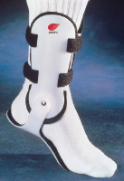
Management of Ankle Sprain
RICE: Rest, Ice, compressors, Elevation.
Used to apply Back-slab splints for few days.
Rest should only be for few days.
PRICES: recent view = Protection, relative Rest, Ice, Compression, Elevation and support.

Slide 35
Osteochondral Defects of talus (OCD)
Very localised areas of joint damage; due to lack of blood supply.
Lack of blood supply is often post traumatic, but occasionally No cause can be found.
A local cartilage and varying depth of underneath bone are involved and may separate of main talus inside the ankle joint.
Usually postero-medial part of dome of talus.
Localised pain on weight bearing and even at rest may present.

Slide 36
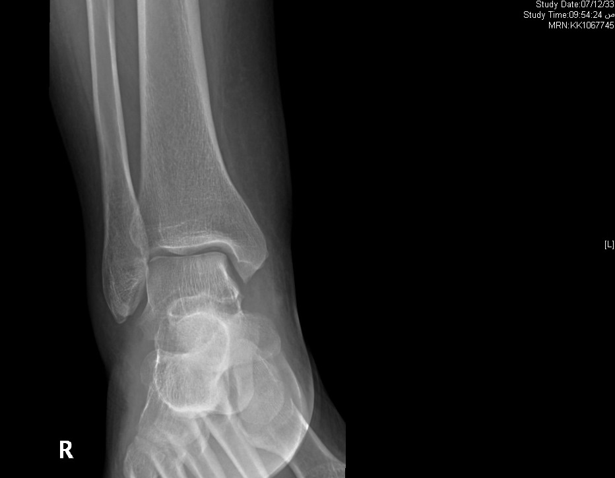
Plain AP X-ray : lesion is suspected

Slide 37
CT Coronal view; lesion highly suspected

Slide 38
MRI: lesion is confirmed

Slide 39
Management of OCD
Depends on how much symptoms and disturbance the patient suffers.
Also when the OCD is large and Loose or almost loose.
Arthroscopic debridement of the lesion and drilling of its crater (base).
Rarely Fixation of a large defect which has significant bony part, by absorbable screws.

Slide 40
Diabetic Foot
Long term diabetes or failure to control diabetes adequately may result in Neuropathy.
Neuropathy: is nerve damage.
It can result in numbness, tingling and reduced sensation of the feet.
Decreased circulation associated with neuropathy can result in small cuts on feet being overlooked and becoming infected.
Infection in diabetic foot may result in Gangrene.

Slide 41
Care of Feet in Diabetes
Very important as well as blood sugar control.
Daily self inspection of feet is mandatory.
If patient is unable to do self inspection (due to poor sight or hips and knees stiffness); a member of the family or assistant should do it.
Regular inspections by healthcare personnel should be arranged
A visit to a doctor should take place immediately whenever any complication occurs.

Slide 42
Surgery in Diabetic Foot
Skilled care of wounds and ulcers in diabetic foot is required.
Wound debridement, antibiotics and repeated dressing should be done.
Amputations may become necessary when there is Gangrene.
Toe amputation or ray amputation, forefoot amputation, below or above knee amputation.

Slide 43
Charcot Foot
Occurs in people who have significant nerve damage to the foot.
The bones of the foot become weak and the joints inflamed, swollen and lax.
walking on the foot leads to disintegration and collapse of the joints and Deformity: such as Rocker- bottom deformity.

Slide 44
Charcot Foot Causes
Any disorder which lead to Neuropathy.
There is decreased sensation and decreased ability to feel temperature, pain and trauma.

Slide 45
Charcot Foot Clinically
Warms of an area of foot or whole foot.
May become red or dusky in colour.
Swelling in the area.
Pain or soreness.
X-rays changes are important to detect and interpret, as early there is NO changes.
Later: haziness, osteopenia, irregular joint destruction, subluxation or even dislocation.

Slide 46
Charcot Foot & Ankle

Slide 47
Diabetic foot 04/03/1428

Slide 48
(R)Diabetic foot : Early Charcot 1431

Slide 49
(R) Charcot Ankle 1431

Slide 50
(L) Side Early Charcot 1433

Slide 51
Advanced Case of Charcot

Slide 52
Diagnosis of Charcot Foot
Good history and clinical examination.
Awareness.
Exclusion of other causes which may give similar picture: like infection or tumour.
MRI, bone scans, aspiration biopsies can help.

Slide 53
Non Surgical Management of Charcot Foot
Immobilisation:
Custom Shoes and Bracing:
Activity modification

Slide 54
Surgery in Charcot Foot
May be indicated in certain cases

Slide 55
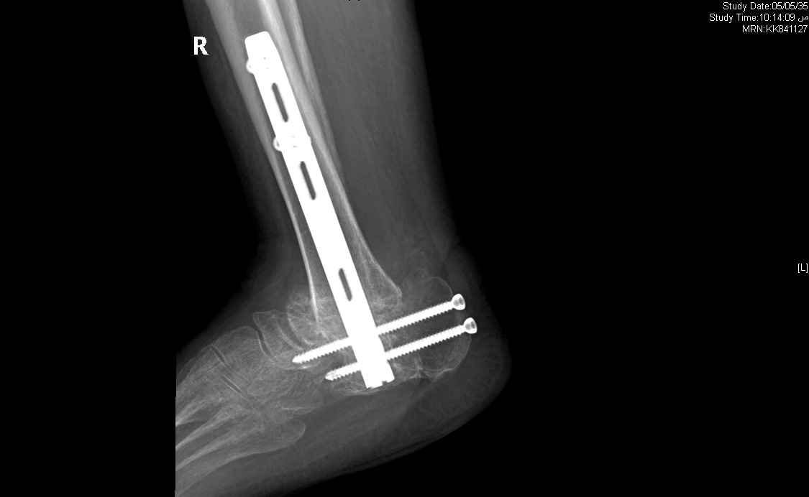
Post Op right Ankle 1435

Slide 56
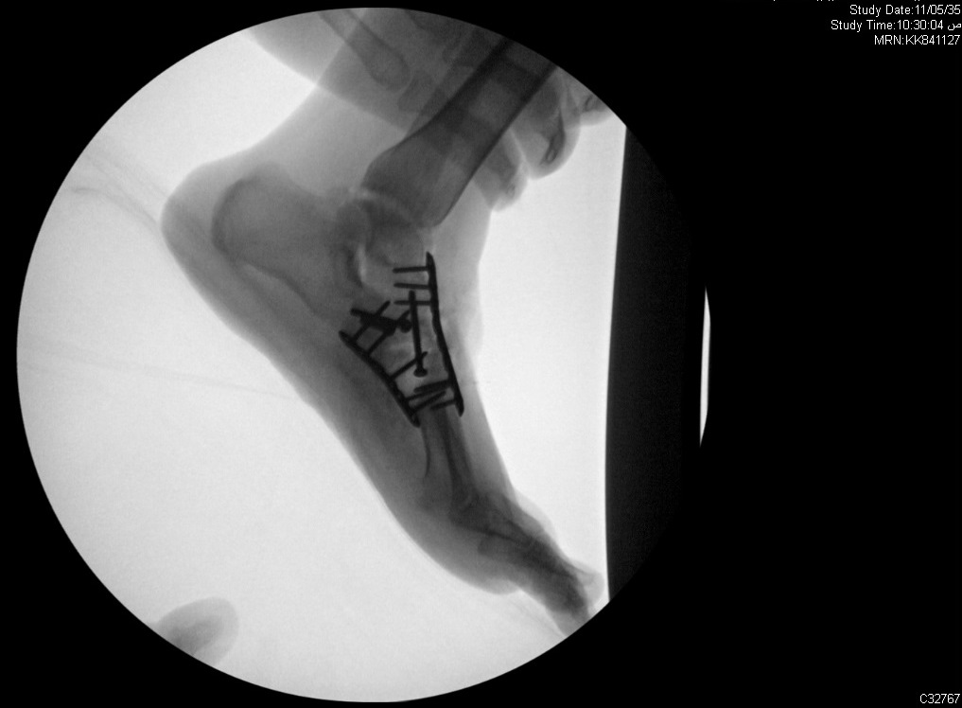
Post Op Left foot 1435

Slide 57
Amputation in Charcot foot
May be indicated as a last option.
Mainly when there is severe instability which cannot be controlled by surgery or orthosis.
Also when surgery fails to achieve stability.
Presence of refractory infection increase the possibility of amputation.

Slide 58
Significance of high shoes wear for females

Slide 59
What can affect body joints with this shoe wear

Slide 60
Spread of pressure during walking

Slide 61
How to reduce pressure during walking

Slide 62
Foot pressure during weight bearing

