Slide 1
Common Pediatric Hip Problem
Dr. Abdulmonem Alsiddiky, MD, SSCO
Associate professor & consultant
Pediatric Orthopedic & Spinal Deformities

Slide 2
Common Pediatric Hip problems:
  DDH developmental dysplasia of the hip
  SCFE slipped capital femoral epiphysis
  Perthes

Slide 3
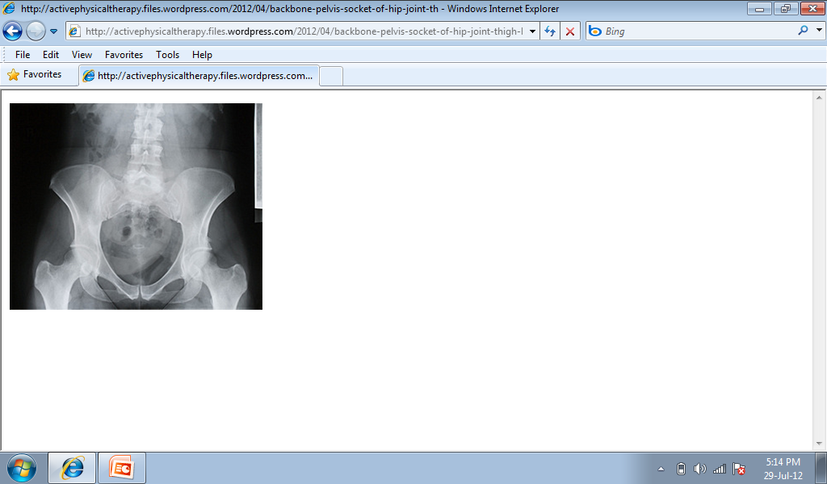
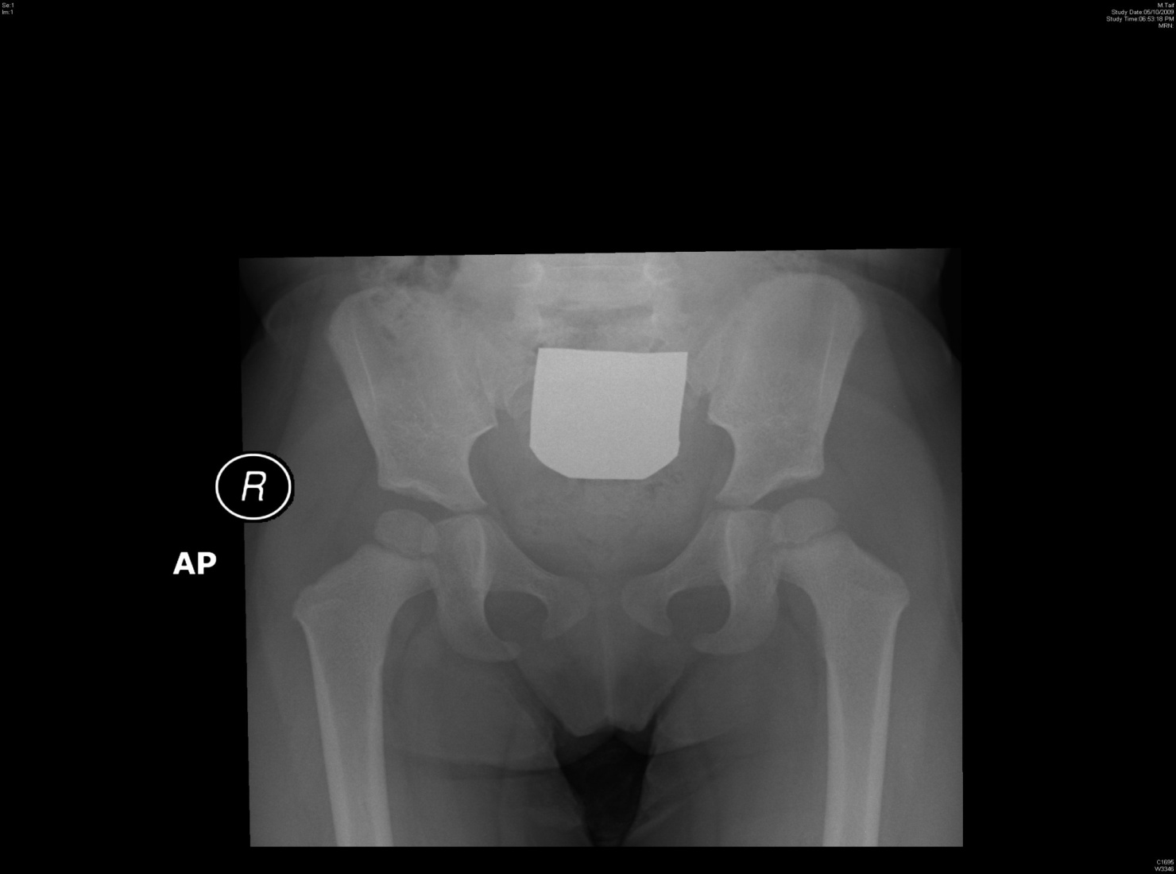
Normal pelvis
adult
child
CHILD
ADULT

Slide 4
Normal pelvis
adult
child

Slide 5
Normal pelvis
adult
child

Slide 6
Normal pelvis
adult
child

Slide 7
DDH or CDH
Nomenclature
CDH : Congenital Dislocation of the Hip
DDH : Developmental Dysplasia of the Hip

Slide 8
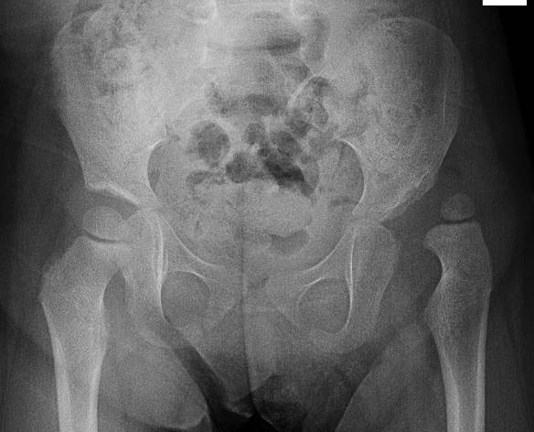
DDH
Normal hip Dislocated hip

Slide 9
DDH
Normal hip Dislocated hip

Slide 10
Patterns of disease
Dislocated
Dislocatable
Sublaxated
Acetabular dysplasia

Slide 11
Radiology
After 6 months: reliable

Slide 13
Causes (multi factorial)
Unknown
Hormonal
  Relaxin, oxytocin
Familial
  Lig.laxity diseases
Genetics
  Female 4 X male --- twins 40%
Mechanical
  Pre natal
  Post natal

Slide 14
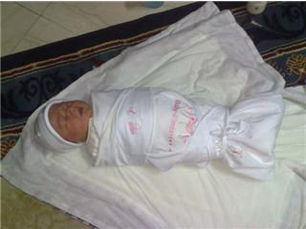
Mechanical causes
Pre natal
  Breach , oligohydrominus , primigravida , twins
    (torticollis , metatarsus adductus )
Post natal
  Swaddling , strapping

Slide 15
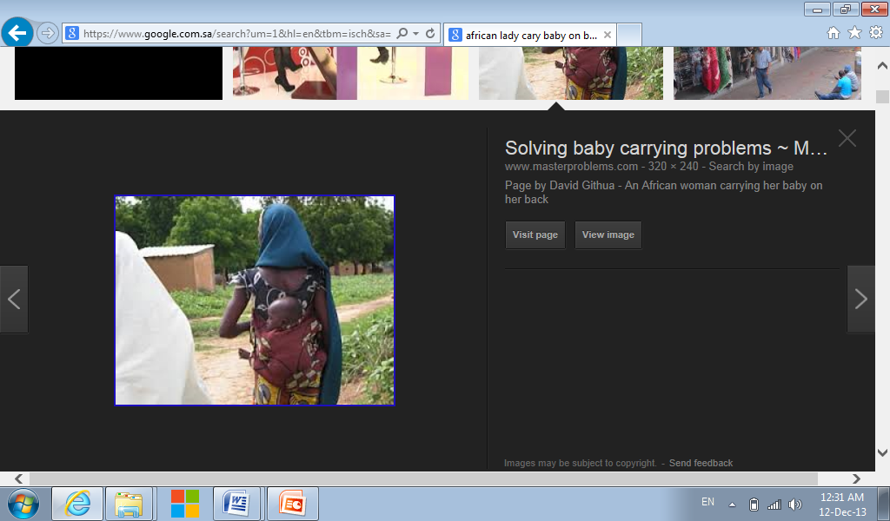

Slide 16
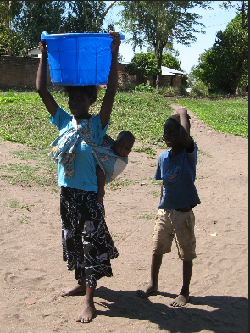

Slide 17
Infants at risk who?
Positive family history: 10X
A baby girl: 4-6 X
Breach presentation: 5-10 X
Torticollis: CDH in 10-20% of cases
Foot deformities:
  Calcaneo-valgus and metatarsus adductus
Knee deformities:
  hyperextension and dislocation

Slide 18
Infants at risk
When risk factors are present
The infant should be reviewed
  Clinically
  radiologically

Slide 19
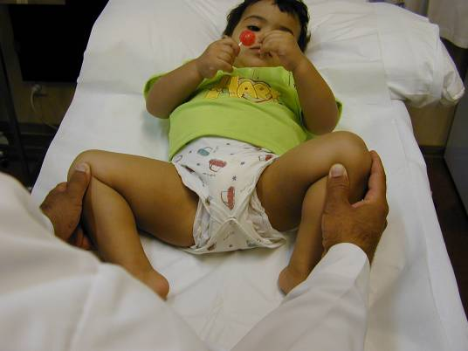
Clinical examination
The infant should be
  quiet
  comfortable

Slide 20
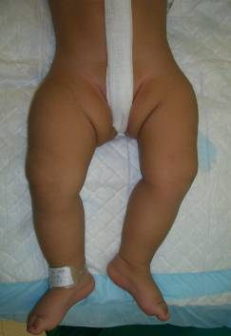
Look:
  External rotation
  Lateralized contour
  Shortening
  Asymmetrical skin folds
    Anterior – posterior

Slide 21
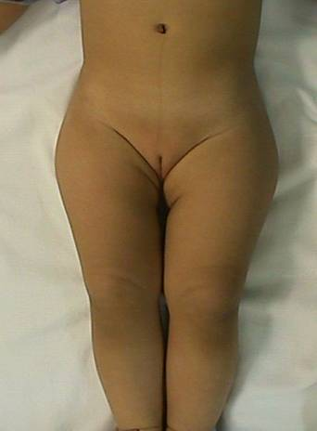
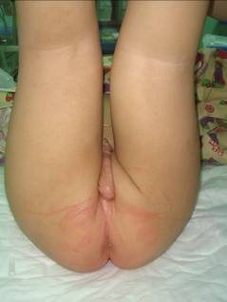
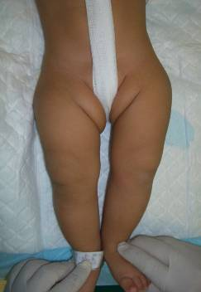

Slide 22
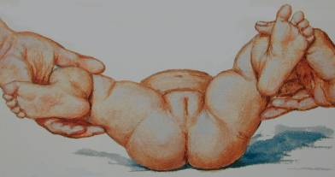
Move
  Limited abduction

Slide 23
Special test
  Galiazzi
  Ortolani , Barlow test
  Trendelenburgh sign
  Limping ( waddling gait if bilateral)

Slide 24
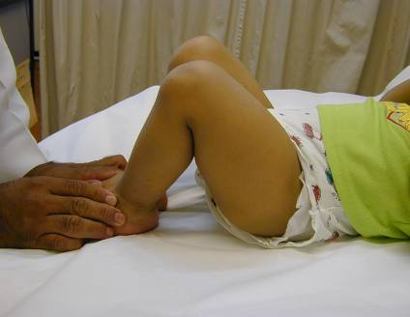
Special test
Galiazzi test

Slide 25
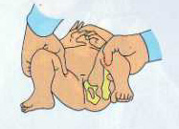
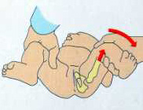
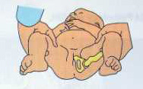
Special test
Ortolani test

Slide 26
Special test
Barlow test

Slide 27
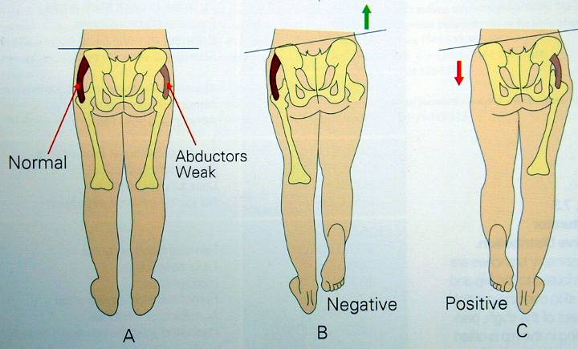
Special test
Trendelenburgh sign

Slide 28
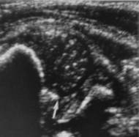
Investigations
0-3 months U/S
> 3months X-ray pelvis
AP + abduction

Slide 29
Radiology
After 6 months: reliable

Slide 30
Radiology
After 6 months: reliable

Slide 31
Radiology
After 6 months: reliable

Slide 32
Treatment - Aims
Obtain concentric reduction REDUCE
Maintain concentric reduction STABELIZE
In a non-traumatic fashion SAFELY
Without disrupting the blood supply to femoral head
Way:
Refer to pediatric orthopedic clinic

Slide 33
Treatment
Method depends on age
The earlier started, the easier and better the results
Should be detected EARLY
Could be surgical or non surgical
If not treated : OA. Stiffness. Pain. Limping. Spine problems . Difficult life

Slide 34
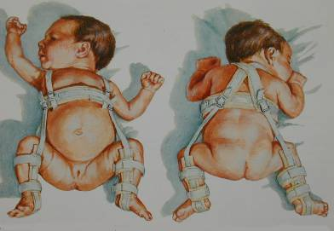
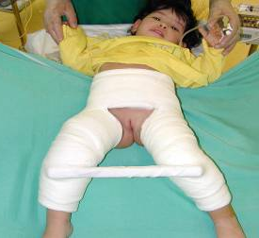
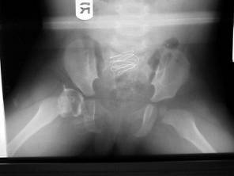
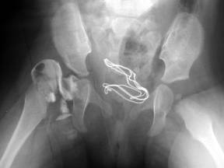
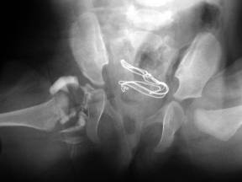

Slide 35
Treatment
Birth – 6m
  Reduce + maintain with Pavlik harness or hip spica (H.S)
6-12 m:
  GA + Closed reduction + maintain with hip spica ?? Open ??
12 - 18 m:
  GA + Open reduction + maintain with hip spica
18 – 24 m:
  GA + Open reduction + Acetabuloplasty + maintain with hip spica
2-8 years:
  GA + Open reduction + Acetabuloplasty + femoral shortening + H.S
Above 8 years:
  GA +Open reduction + Acetabuloplasty (advanced) + femoral shortening + H.S

Slide 36
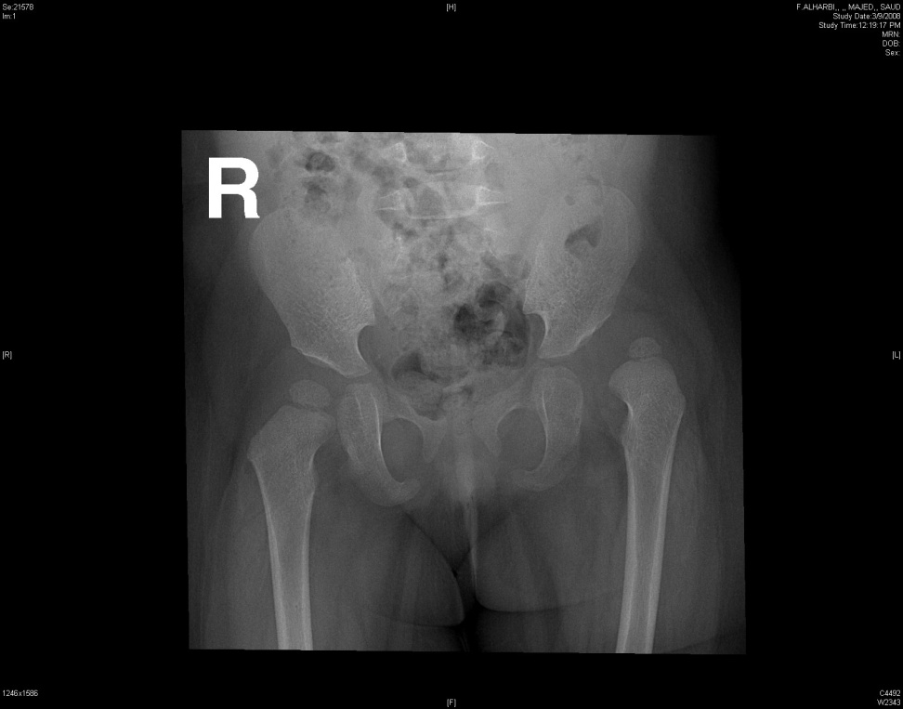

Slide 37
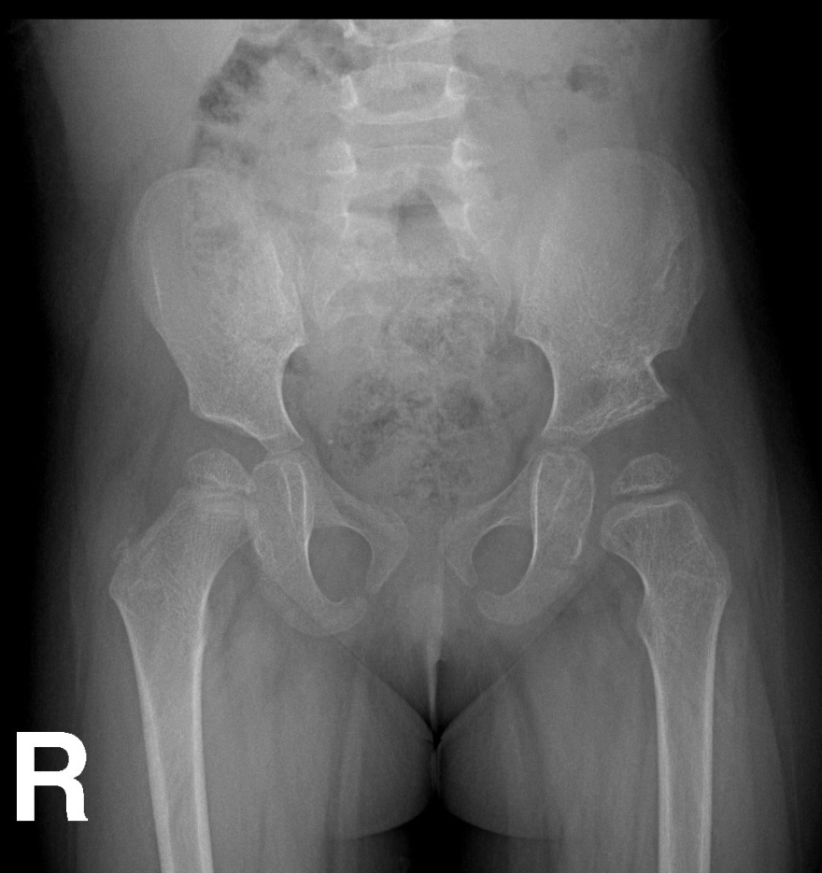

Slide 38
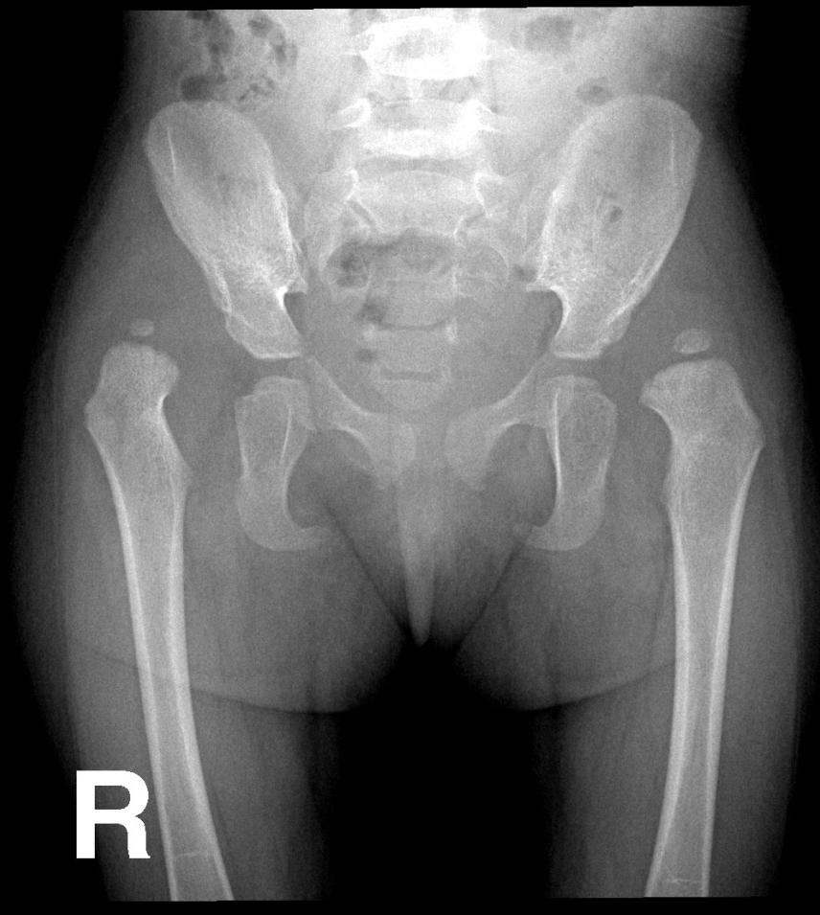
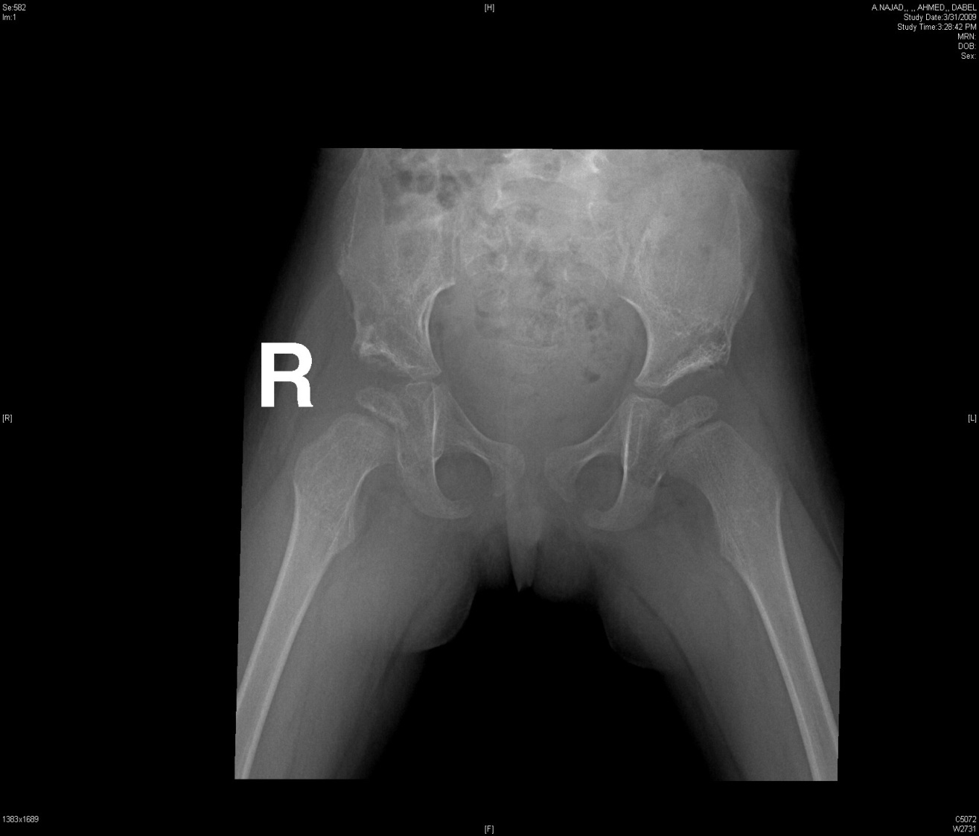

Slide 39
Late complications if not treated:
  Severe pain
  Early arthritis
  LLD leg length discrepancy
  Pelvic inequality
  Early Lumbar spine degeneration

Slide 41

SCFE slipped capital femoral epiphysis

Slide 42
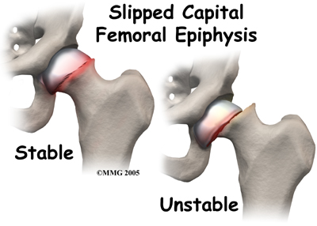

Slide 43
SCFE:
Slipped Capital Femoral Epiphysis
Where → at level of growth plate
Why → ? Hormonal
? Metabolic
? Mechanical, obesity
? Trauma
? Unknown

Slide 44
SCFE:
Typical :
> 8-12
> ↑ in males
> ↑ in obese
> ↑ in black
> ↑ if other side affected
History:
> Hip pain / ? knee pain (only)
> Minor trauma
> no trauma
> Limping (painful)

Slide 45
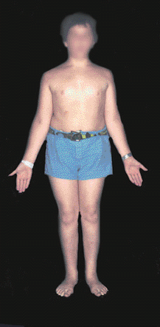
On Examination:
Hip in ER (external rotation)
↓ IR (internal rotation)
↓ Abduction
Usually painful ROM
Limping (painful)

Slide 46
Ix:
X-ray
. Pelvis – slippage positive or
↑ ↑ growth plate space
[pre slip phase]
. Knee
If not clear but still doubtful MRI can help

Slide 47
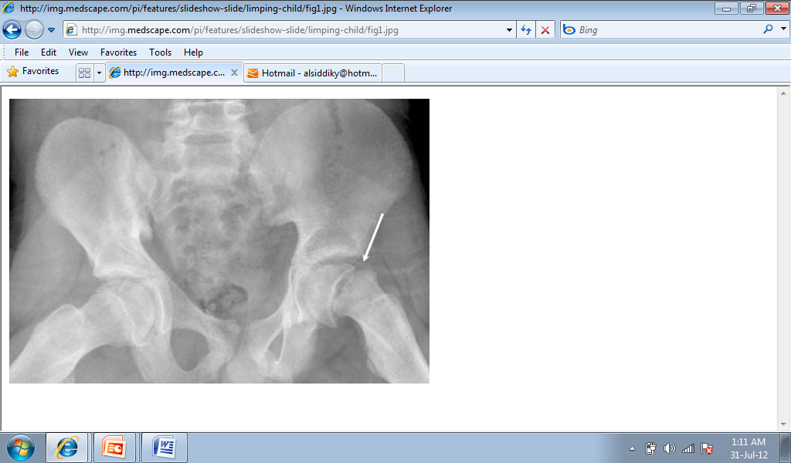
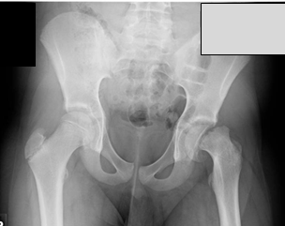

Slide 48
Treatment:
Refer to orthopedic as emergency case
What they will do?
  In situ pinning – to prevent further damage to the vascularity
  Protected weight bearing for 3-4 weeks then full weight bearing
  No sport for 6 months

Slide 49
Late complications :
  FAI ( femoral Acetabular Impingement)
  Early arthritis
  LLD leg length discrepancy
  Pelvic inequality
  Early Lumbar spine degeneration

Slide 50
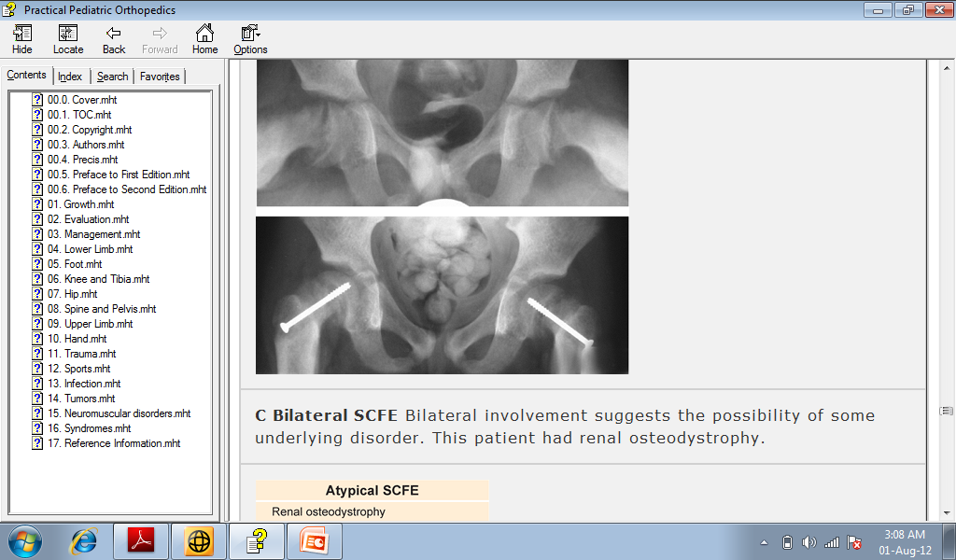

Slide 52
Perthes Disease:
Legg-Calvé-Perthes Disease

Slide 53
Perthes Disease:
Where: at the level of head of femur
Why: ↓ vascularity of head of femur
(avascular necrosis)
Cause → unknown
Typical :
4-8 years
↑ in males
↑ in obese

Slide 54
Severity of the disease depends on :
the amount of femoral head involvement

Slide 55
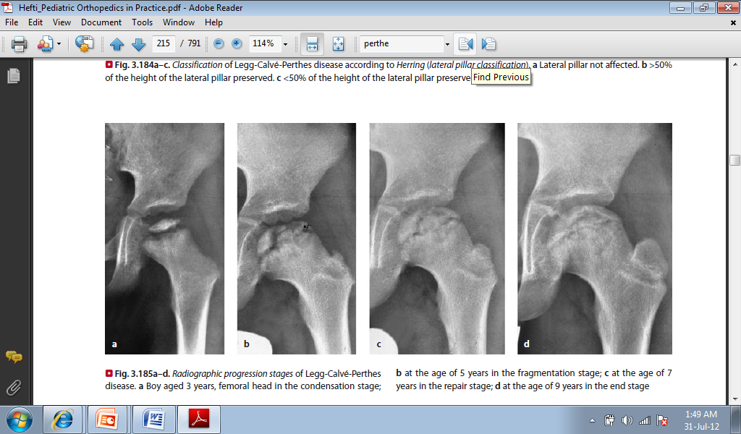

Slide 56
History:
Hip pain or knee pain
Minor trauma or no trauma
Painful limping

Slide 57
On Examination:
↓ Abduction
↓ IR (internal rotation)
Usually painful range of motion ↓ ↓ ↓
Limping (painful)

Slide 58
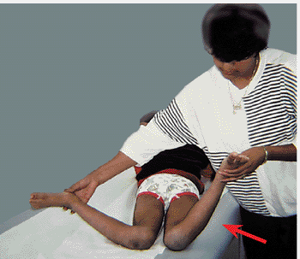
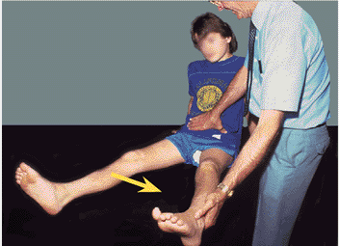

Slide 59
Ix:
X-ray: - knee
- Pelvis → ↓ head size
(irregular shape)
If early:
    X-ray might not show anything
    MRI can help

Slide 60
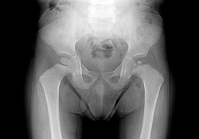

Slide 61
Treatment:
Very controversy
Refer to pediatric orthopedics as an urgent case
Guidelines of treatment:
> Control pain
> Maintain ROM
> Hip containment

Slide 62
Late complications :
  Early arthritis
  LLD leg length discrepancy
  Pelvic inequality
  Early Lumbar spine degeneration

Slide 63
thanks

