Slide 1
Common Pediatric Fractures & Trauma
Prof. Zamzam
Dr.Kholoud Al-Zain
Ass. Professor and Consultant Pediatric Orthopedic Surgeon
F1 Dec 2016

Slide 2
Objectives
Introduction to Ped. # & trauma
Difference between Ped. & adult
Fractures of the physis → Salter-Harris classification
Indications of operative treatment
Methods of treatment of Ped # & trauma
Common Ped #:
U.L → clavicle, s.c, distal radius
L.L → femur shaft

Slide 3
Pediatric Fractures

Slide 4
Introduction
Fractures account for ~15% of all injuries in children
Different from adult fractures
Vary in various age groups (infants, children, adolescents )

Slide 5
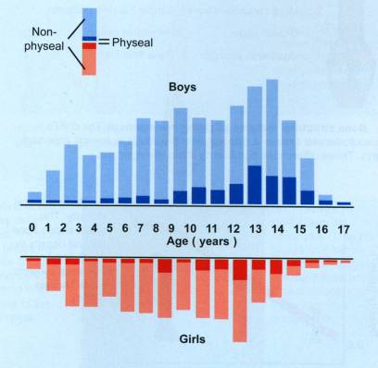
Statistics
Boys > girls
Rate increases with age
Mizulta, 1987

Slide 6
Difference Between A Child & Adult’s Fractures & Trauma

Slide 7
Why are Children’s Fractures Different ?
Children have different physiology and anatomy
Growth plate
Bone
Cartilage
Periosteum
Ligaments
Physiology → age
Anatomy → blood supply

Slide 8
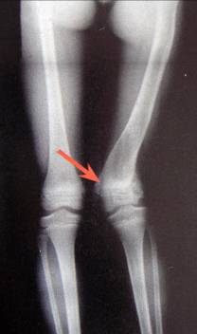
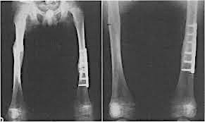
Why are Children’s Fractures Different ?
Growth plate:
Provides perfect remodeling power
Injury of growth plate causes deformity
A fracture might lead to overgrowth

Slide 9
Why are Children’s Fractures Different ?
Bone:
⬆ (collagen : bone) ratio
Less brittle
deformation

Slide 10
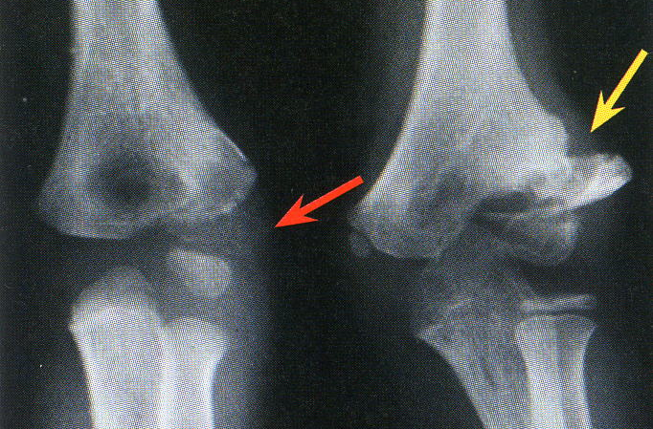
Why are Children’s Fractures Different ?
Cartilage:
Difficult X-ray evaluation
Size of articular fragment often under-estimated

Slide 11
Why are Children’s Fractures Different ?
Periosteum:
Metabolically active
More callus
Rapid union
Increased remodeling
Thickness and strength
Intact periosteal hinge affects fracture pattern
May aid reduction

Slide 12
Why are Children’s Fractures Different ?
Ligaments:
Are functionally stronger than bone.
Therefore, a higher proportion of injuries that produce sprains in adults result in fractures in children.

Slide 13
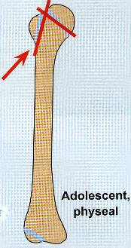
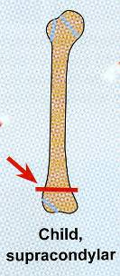
Why are Children’s Fractures Different ?
Age related fracture pattern:
Infants → diaphyseal fractures
Children → metaphyseal fractures
Adolescents → epiphyseal injuries

Slide 14
Why are Children’s Fractures Different ?
Physiology
Better blood supply
⬇⬇⬇ incidence → delayed and non-union

Slide 15
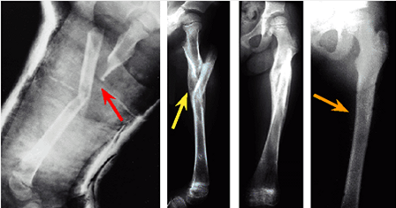
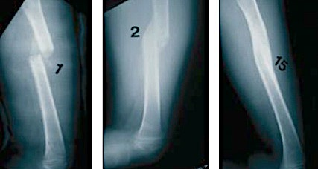

Slide 16
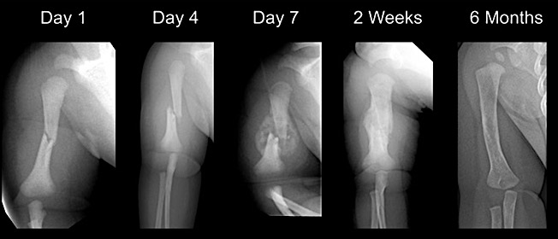

Slide 17
Physis Fractures

Slide 18
Physis Injuries
Account for ~25% of all children’s #
More in boys
More in upper limb
Most heal well, rapidly, with good remodeling
Growth may be affected

Slide 19
Physis Injuries- Classifications
Salter-Harris Classification

Slide 20
Salter-Harris Classification

Slide 21
Salter-Harris Classification

Slide 22
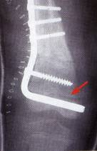
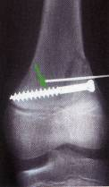
Physis Injuries- Complications
Less than 1% cause physeal bridging → affecting growth (varus, valgus, or even L.L.I)
Keep in mind:
Small bridges (<10%) → may lyse spontaneously
Central bridges → more likely to lyse
Peripheral bridges → more likely to cause deformity
Take care with:
Avoid injury to physis during fixation
Monitor growth over a long period
Image suspected physeal bar (MRI, CT)

Slide 23
Indications of Operative Treatment

Slide 24
General Management
Indications for surgery
Open fractures
Severe soft-tissue injury
Fractures with vascular injury
? Compartment syndrome
Multiple injuries/#
Displaced intra articular fractures (Salter-Harris III-IV )
Failure of conservative means (irreducible or unstable #’s)
Malunion and delayed union
Adolescence
Head injury
Neurological disorder

Slide 25
Methods of Treatment of Pediatric Fractures & Trauma (7)

Slide 26
1) Casting → still the commonest

Slide 27
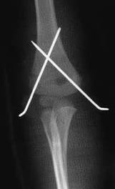
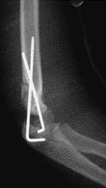
2) K-wires
Most commonly used internal fixation (I.F)
Usually used in → metaphyseal fractures

Slide 28
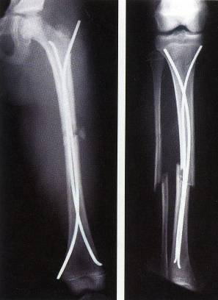
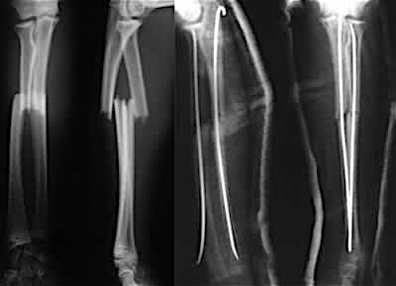
3) Intramedullary wires (Elastic nails)

Slide 29
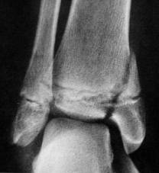
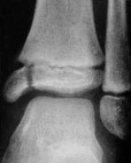
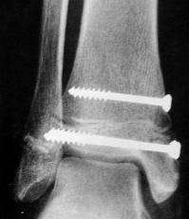
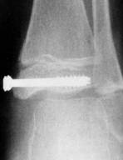
4) Screws

Slide 30
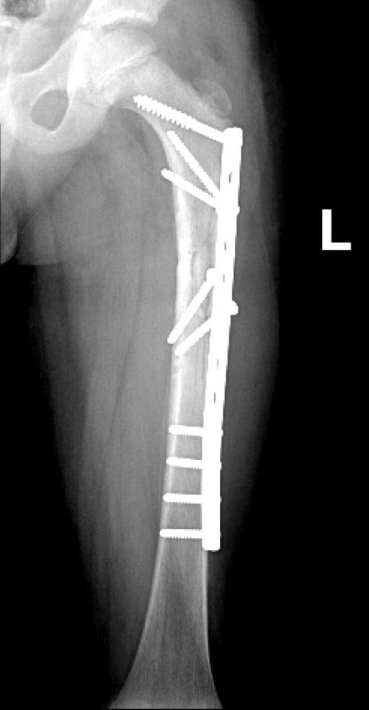
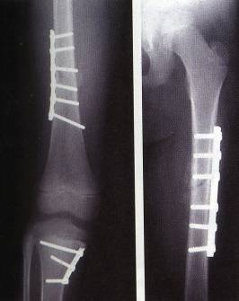
5) Plates → specially in multiple trauma

Slide 31
6) I.M.N → only in adolescents (>12y)

Slide 32
7) Ex-fix → usually in open #

Slide 33
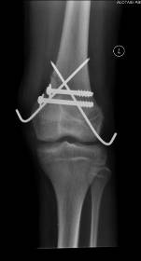
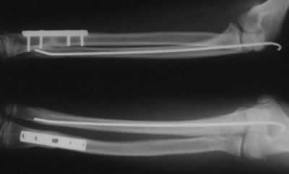
Methods of Fixation
Combination

Slide 34
Common Pediatric Fractures

Slide 35
Common Pediatric Fractures
Upper limb:
Clavicle
Humeral supracondylar
Distal Radius
Lower Limbs:
Femur shaft (diaphysis)

Slide 36
Clavicle Fractures

Slide 37
Clavicle # - Incidents
8-15% → of all pediatric #
0.5% → of normal SVD
1.6% → of breech deliveries
80% → of clavicle # occur in the shaft
The periosteal sleeve always remains in the anatomic position → therefore, remodeling is ensured

Slide 38
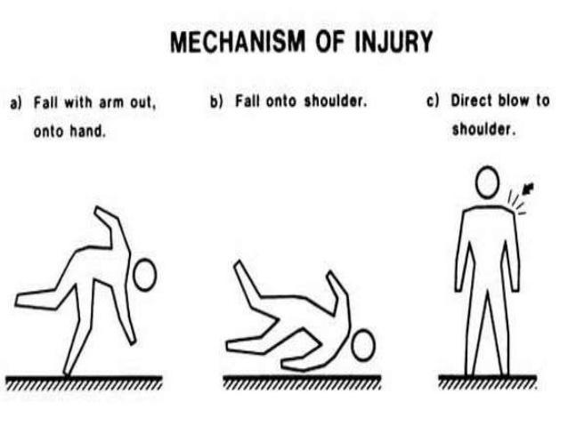
Clavicle # - Mechanism Injury
Indirect → fall onto an outstretched hand
Direct:
The most common mechanism
Has highest incidence of injury to the underlying:
N.V &,
Pulmonary structures
Birth injury

Slide 39
Clavicle # - Examination
Look → Ecchymosis
Feel:
Tender # site
As a palpable mass along the clavicle (as in displaced #)
Crepitus (when lung is compromised)
Special tests → Must assesse for any:
N.V injury
Pulmonary injury

Slide 40
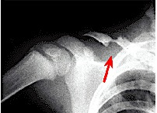
Clavicle # - Radiographic (AP X-ray)

Slide 41
Clavicle # - Reading XR
Location:
(medial, middle, lateral) ⅓ → commonest middle ⅓
Or junction of ⅓’s → commonest middle/lateral ⅓
Open or closed → see air on XR
Displacement → %
Fracture type:
Segmental
Comminuted
Greenstick

Slide 42
Clavicle #
5%
80%
15%

Slide 43
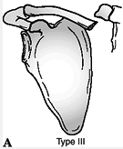
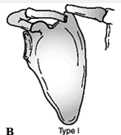
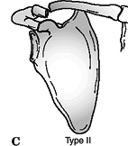
Clavicle # - Allman Classification
Type II → Medial third
Type I → Middle third (most common)
Type III → Lateral third

Slide 44
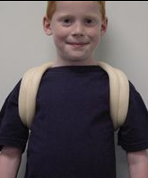
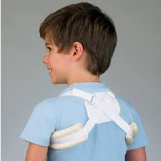
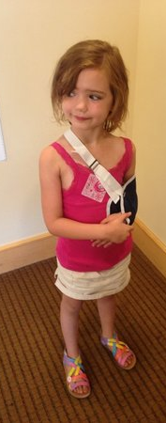
Clavicle # - Treatment
Newborn (< 28 days):
No orthotics
Unite in 1w
1m – 2y:
Figure-of-eight
For 2w
2 – 12y:
Figure-of-eight or sling
For 2-4 weeks

Slide 45
Clavicle # - Remodeling

Slide 46
Clavicle # - Remodeling

Slide 47
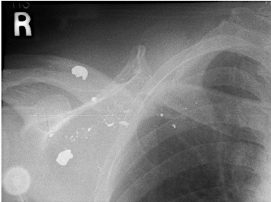
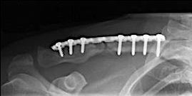
Clavicle # - Treatment
Indications of operative treatment:
Open #’s, or
Neurovascular compromise

Slide 48
Clavicle # - Complications (rare)
From the #:
Malunion
Nonunion
Secondary from healing:
Neurovascular compromise
Pulmonary injury
In the wound:
Bad healed scar
Dehiscence
Infection

Slide 49
Humeral Supracondylar Fractures

Slide 50
Supracondylar #- Incidences
55-75% → of all elbow #
M:F 3:2
Age → 5 - 8 years
Left (non-dominant) side → most frequently #

Slide 51
Supracondylar #- Mechanism of Injury
Indirect:
Extension type
>95%
Direct:
Flexion type
< 3%
Notes:
Need pic’s

Slide 52
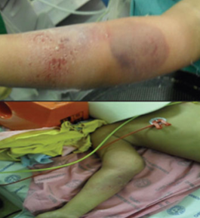
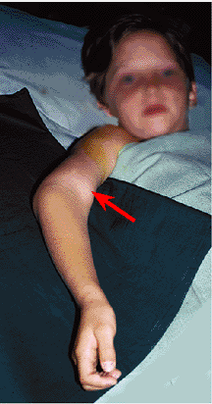
Supracondylar #- Clinical Evaluation
Look:
Swollen
S-shaped angulation
Pucker sign (dimpling of the skin anteriorly)
May have burses
Feel:
Tender elbow
Move:
Painful & can’t really move it
Neurovascular examination

Slide 53
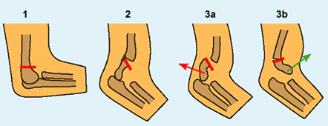
Supracondylar #- Gartland Classification
Type III Complete displacement (extension type) may be:
Posteromedial (75%), or
Posterolateral (25%)

Slide 54
Supracondylar #- Gartland Classification
Type III Complete displacement (extension type) may be:
Posteromedial (75%), or
Posterolateral (25%)

Slide 55
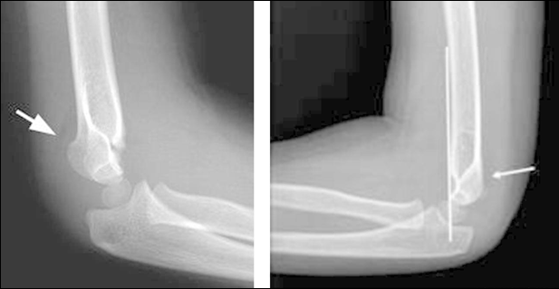
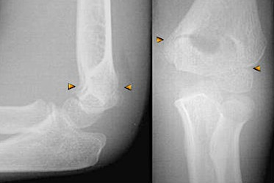
Type 1
Anterior Humeral Line
Hour-glass appearance

Slide 56
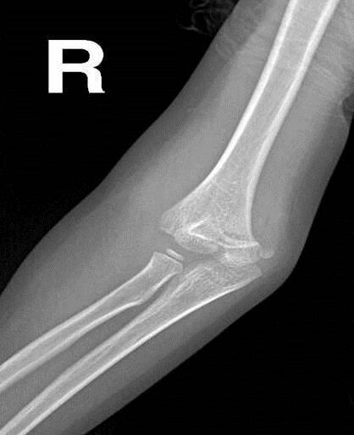
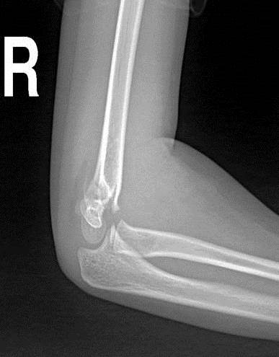
Type 2

Slide 57
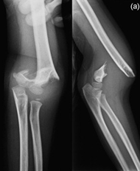
Type 3

Slide 58
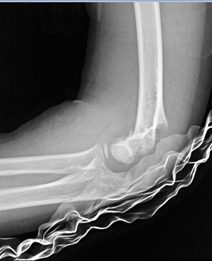
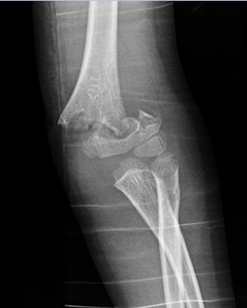
Type 3
Extension type
Flexion type

Slide 59
Supracondylar #- Treatment
Type I:
Immobilization in a long arm (cast, or splint),
At (60° – 90°) of flexion,
For 2-3 weeks
Type II:
Closed reduction, followed by casting, or
Percutaneous pinning (if: unstable or sever swelling), then splinting

Slide 60
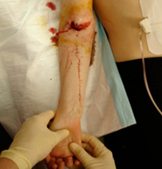
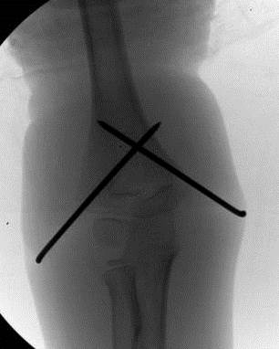
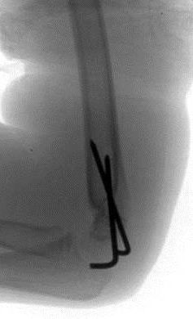
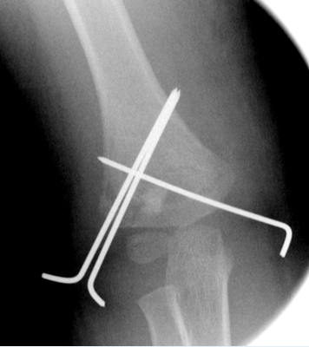
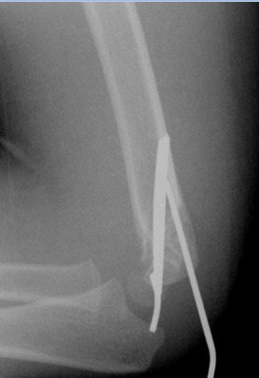
Supracondylar #- Treatment
Type III:
Attempt closed reduction and pinning
If fails then open reduction and internal fixation by pinning
May be necessary → unstable #, open #, or # with N.V injury

Slide 61
Supracondylar #-Treatment of Flexion Type
Type I:
Immobilization in a long arm cast,
In near extension,
For 2 to 3 weeks
Type II:
Closed reduction, percutaneous pinning, then splinting
Type III:
Reduction is often difficult,
Most require open reduction and internal fixation with pinning

Slide 62
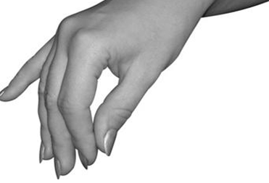
Supracondylar #- Complications
Neurologic injury (7% to 10%):
Median and anterior interosseous nerves (most common)
Most are neurapraxias
Requiring no treatment
Ulnar nerve → iatrogenic
Vascular injury (0.5%):
Direct injury to the brachial artery, or
Secondary to swelling

Slide 63
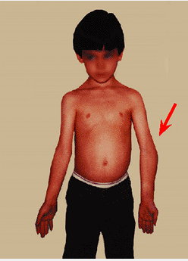
Supracondylar #- Complications
Loss of motion (stiffness)
Myositis ossificans
Angular deformity (cubitus varus)
Compartment syndrome

Slide 64
Distal Radial Fractures a) Physeal Injuries

Slide 65
Distal Radial Physeal #- “S.H” Type I

Slide 66
Distal Radial Physeal #- “S.H” Type II

Slide 67
Distal Radial Physeal #- “S.H” Type III

Slide 68
Distal Radial Physeal #- Treatment Types I & II
Closed reduction,
Followed by long arm cast, with the forearm pronated
We can accept deformity:
50% apposition,
With no → angulation or rotation

Slide 69
Distal Radial Physeal #- Treatment Types I & II
Growth arrest can occur in 25% → with repeated manipulations
Open reduction is indicated
Irreducible #
Open #

Slide 70
Distal Radial Physeal #- Treatment Types I & II

Slide 71
Distal Radial Physeal #- Treatment Types III
Anatomic reduction is necessary
ORIF with smooth pins or screws

Slide 72
Distal Radial Physeal #- Treatment Types IV & V
Rare injuries
Need ORIF

Slide 73
Distal Radial Physeal #- Complications
Physeal arrest
Shortening
Angular deformity
Ulnar styloid nonunion
Carpal tunnel syndrome

Slide 74
Distal Radial Fractures b) Metaphyseal Injuries

Slide 75
Classification
Depending on the biomechanical pattern:
Torus (only one cortex is involved)
Incomplete (greenstick)
Complete
We need to also describe:
Direction of displacement, &
Involvement of the ulna

Slide 76
Distal Radius Metaphyseal Injuries
Torus fracture
Stable
Immobilized for pain relief
Bicortical injuries should be treated in a long arm cast

Slide 77
Distal Radius Metaphyseal Injuries
Incomplete (greenstick)
Greater ability to remodel in the sagittal plane
Closed reduction and above elbow cast with supinated forearm to relax the brachioradialis muscle

Slide 78
Distal Radius Metaphyseal Injuries
Complete fracture
Closed reduction
Well molded long arm cast for 3-4 weeks

Slide 79
Distal Radius Metaphyseal Injuries
Complete fracture
Indications for percutaneous pinning without open reduction
loss of reduction
Excessive swelling
Multiple manipulations
Associated with floating elbow

Slide 80
Distal Radius Metaphyseal Injuries
Complete fracture
Indications for ORIF:
Irreducible fracture
Open fracture
Compartment syndrome

Slide 81
Distal Radius Meta. Injuries- Complications
Malunion
Residual angulation may result in loss of forearm rotation
Nonunion
Rare
Refracture
With early return to activity (before 6 w)
Growth disturbance
Overgrowth or undergrowth
Neurovascular injuries
With extreme positions of immobilization

Slide 82
Femoral Shaft Fractures

Slide 83
Femoral Shaft #
1.6% → of all pediatric #
M > F
Age:
(2 – 4) years years old
Mid-adolescence
Adolescence → >90% due to RTA

Slide 84
Femoral Shaft #
In children younger than walking age:
80% of these injuries are caused by child abuse
This decreases to 30% in toddlers

Slide 85
Femoral Shaft #- Mechanism of Injury
Direct trauma:
RTA,
Fall, or
Child abuse
Indirect trauma:
Rotational injury
Pathologic #:
Osteogenesis imperfecta,
Nonossifying fibroma,
Bone cysts, and
Tumors

Slide 86
Femoral Shaft #- Clinical Evaluation
Look:
Pain,
Swelling of the thigh,
Inability to ambulate, and
Variable gross deformity
Careful O/E of the overlying soft tissues to rule out the possibility of an open fracture (puncture wound)
Feel:
Tender # site
Careful neurovascular examination is essential

Slide 87
Femoral Shaft #- Radiology
AP and lateral views
Must include hip, knee joints

Slide 88
Femoral Shaft #- Classification
Descriptive
Open or closed
Level of fracture:
(proximal, middle, distal) ⅓
Fracture pattern:
transverse, oblique, spiral, butterfly fragment, comminution
Displacement
Angulation
Anatomic
Neck
Subtrochanteric
Shaft
Supracondylar

Slide 89
Femoral Shaft #- Treatment
Less than 6m:
Pavlik Harness,
Traction then hip spica casting

Slide 90
Femoral Shaft #- Treatment
6m – 6y:
C.R and immediate hip spica casting (>95%)
Traction followed by hip spica casting (if there is difficulty to maintain length and acceptable alignment)

Slide 91
Femoral Shaft #- Treatment
6 – 12y:
Flexible I.M.N
Bridge Plating
External Fixation

Slide 92
Femoral Shaft #- Treatment
6 – 12y:
Flexible IMN
Bridge Plating
External Fixation

Slide 93
Femoral Shaft #- Treatment
6 – 12y:
Flexible IMN
Bridge Plating
External Fixation:
Multiple injuries
Open fracture
Comminuted #
Unstable patient

Slide 94
Femoral Shaft #- Treatment
12y to skeletal maturity:
Intramedullary fixation with either:
Flexible nails, or
Interlocked I.M nail

Slide 95
Femoral Shaft #- Complications
Malunion
Remodeling will not correct rotational deformities
Nonunion (Rare)
Muscle weakness
Leg length discrepancy
Secondary to shortening or overgrowth
Overgrowth of 1.5 to 2.0 cm is common in 2-10 year of age
Osteonecrosis with antegrade IMN <16 year

Slide 96
Remember …

Slide 97
Remember
Difference between adult and pediatric fractures
Growth plate fractures
Methods of treatment of pediatric fractures and there indications
The importance of growth plates and periosteum in remodeling
Growth plat fractures classifications, treatments, and complications
Know the common pediatric fracture’s: mechanism of injury, evaluations, treatments, and complications
Pediatric fractures have great remodeling potentials
A good number of cases can be treated conservatively
Operative fixations aids in avoiding complications

