Slide 1
INTRODUCTION TO COURSE 452
Dr.KHOLOUD AL-ZAIN
Assistant Professor of Orthopedic Surgery
Pediatric Orthopedic Consultant
Course Organizer (Course 452)
F2, Jan 2017

Slide 2
WILL COVER
Course objectives
What is expected of you
Deference between Ortho. & other subjects
Explain the tables
Reading sources
Exams

Slide 3
ORTHOPEDICS
Orthopedic = study of musclo.skeletal system
(bone diseases & trauma)

Slide 4
OBJECTIVES
Knowledge:
Ortho → important & common problems, especially those related to our community
Trauma → emphasize on basic aspects in trauma & how to deal with them

Slide 5
OBJECTIVES
To acquire the skills:
Good H/O taking of trauma and elective cases
Perform O/E of limbs & joints
The ability to read radiological images
Perform simple basic Orthopedic tasks

Slide 6
Expected From You

Slide 7
IT IS EXPECTED FROM YOU
4 week course
Study & prepare from the beginning

Slide 8
IT IS EXPECTED FROM YOU
Be on time for lectures & clinical sessions
Do not sign attendance for someone else
Notes:
You should never enter the class if you arrived ≥ 15 min.

Slide 9
IT IS EXPECTED FROM YOU
Each student must attend at least 75% of each: lecture, clinical, skill, O/E, and CBL
If this is not achieved ➔ not be allowed to attend the FINAL EXAM
Leaders → to submit them daily to Mrs.Hajer

Slide 10
Difference Between Orthopedics & Other Specialties

Slide 11
HISTORY
will be given in a separate lecture

Slide 12
CLINICAL EXAMINATION
Patient’s position (in bed / walk in OPD)
Limb’s attitude

Slide 13
CLINICAL EXAMINATION
The system we are going to use is:
Inspection = Look
Palpation = Feel
Movement = Move (active / passive)
Do:
Special tests
Measurements
Gait
Neurovascular assessment
Always compare

Slide 14
SKILLS
3 types of skills:
Knee aspiration
Casting
Management of open fractures

Slide 15
Your Group

Slide 16
YOUR GROUP
You are 66 Dr.’s, with 1 leader
3 gp (22, 22, 22)
Each gp (A & B)
Each with a leader, & a deputy
“What’s App” gp → ask/relay everything there

Slide 17
The Tables

Slide 18
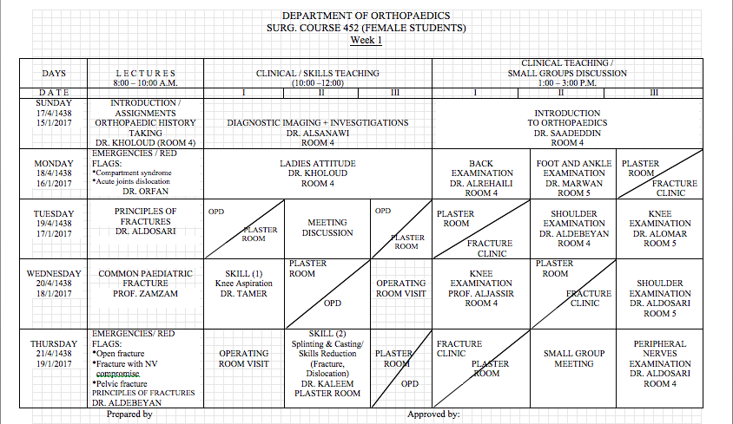
THE TABLES

Slide 19
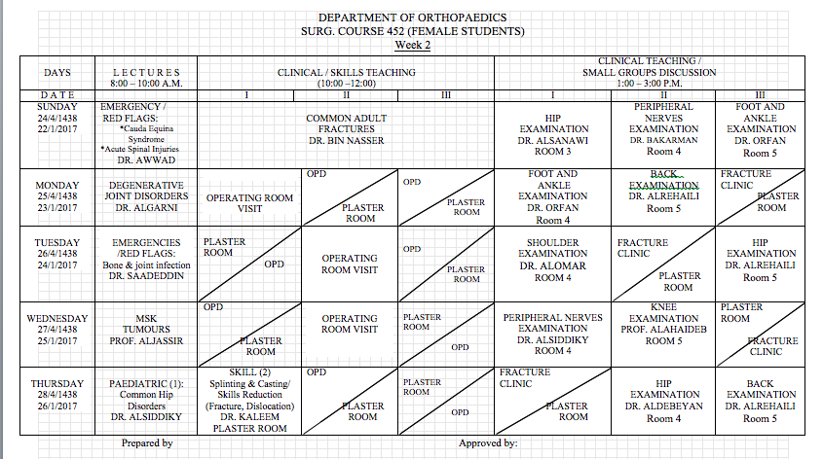
THE TABLES

Slide 20
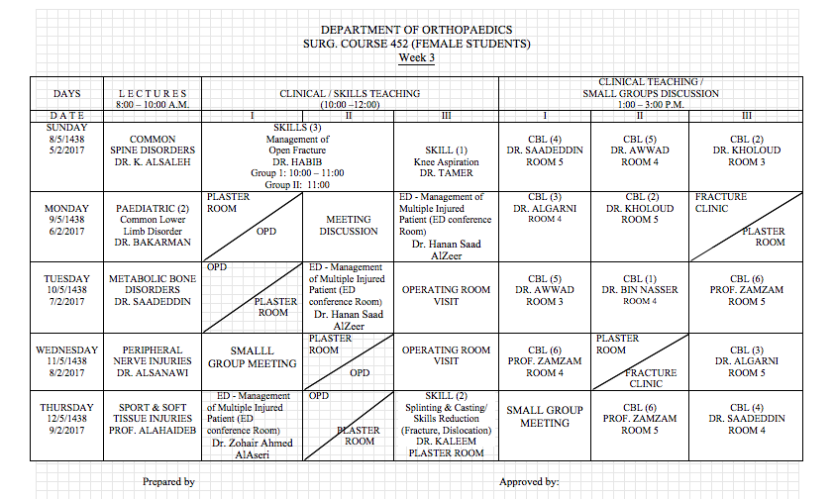
THE TABLES

Slide 21
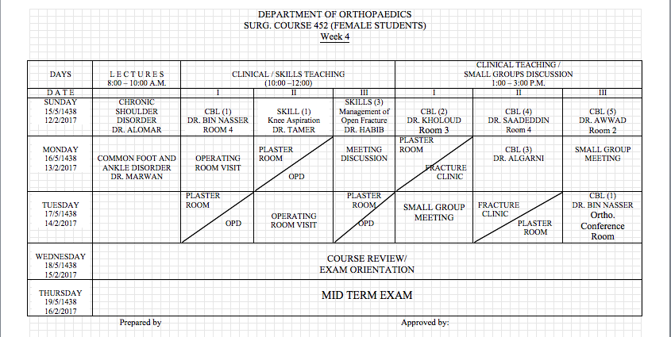
THE TABLES

Slide 22
CBL & Books

Slide 23
CBL Distribution
You have 6 CBL sessions (as PBL)
In each gp divide into 6 sub-gp (4,4,4,4,3,3)
Each sub-gp from all 3 gp’s → to meet tutor, together
Contact your tutor from w1
Different Dr’s approach CBL differently…

Slide 24
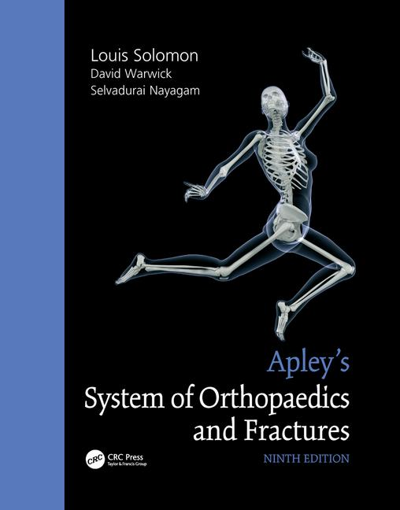
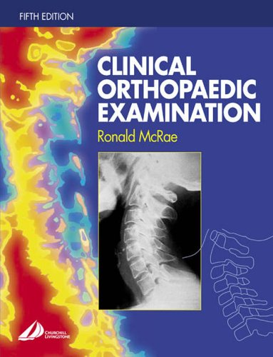
BOOKS
“Apley’s System of Orthopedics and Fractures”, 9th edition
“Clinical Orthopedic Examination” by Roland McRae, 6th edition
“Students Guide”

Slide 25
Exams

Slide 26
Exam Marking
Marks:
Continuous assessment → 20 marks
CBL (10) → presenters & who interact
OPD/OR/ER (5)
Skills (5)
Written → 40 marks
MCQ → 60 questions → 30 marks
SAQ → 5 questions → 10 marks
OSCE → 40 marks
6 stations
O/E, H/O, Skill

Slide 27
KEEP IN MINDE
If:
Any session 15 min’s no one → contact me
O/E & skill sessions → S.P & teaching materials
A lecture not given → tell me the same day
(please only by leaders, care on Sun. & Tues.)

Slide 28
KEEP IN MINDE
Dr.’s office hours
Locations of:
Secretary office
Department’s meeting room
OPD / Cast room
OR → rooms 8, 9, 10, 11
My office

Slide 29
Any Question ? Dr.Kholoud Al-Zain P-0073

