Slide 1
X-ray Interpretation Skills
Dr. Hisham Alsanawi
Orthopaedic Consultant and Assistant Professor

Slide 2
Medical Decision Making is a Triad
History – from patients/records
Physical Examination
Confirming Studies – Imaging, Labs, etc.

Slide 3
Imaging
X-ray
Ultrasound
CT Scan
MRI
Nuclear Medicine

Slide 4
X-RAY
Radiation Source
Patient Exposed
Capture Image
Interpret Image

Slide 5
X-RAY
Ionizing Radiation
Radiation damages cells

Slide 6
X-RAY
Patient Blocks Transmission of Radiation
Soft tissues Less
Bones More

Slide 7
X-RAY
Capture Image
Films
Digital

Slide 8
X-RAY
Interpret Image
Radiologist
Orthopaedist

Slide 9
X-RAY
Best for:
Hard tissue
Bones
Often combined with other imaging

Slide 10
OBJECTIVES
Review a systematic approach to interpreting orthopedic x-rays
Review the language of fracture description

Slide 11
ABCs APPROACH
Pre ABC: identify pt, read provided info
A
Adequacy
Alignment
B
Bones
C
Cartilage
S
Soft Tissues
Apply ABCs approach to every orthopedic film you evaluate

Slide 12
ADEQUACY
All x-rays should have an adequate number of views.
Minimum of 2 views—AP and lateral
3 views preferred
Joint above and joint below
All x-rays should have adequate penetration

Slide 13
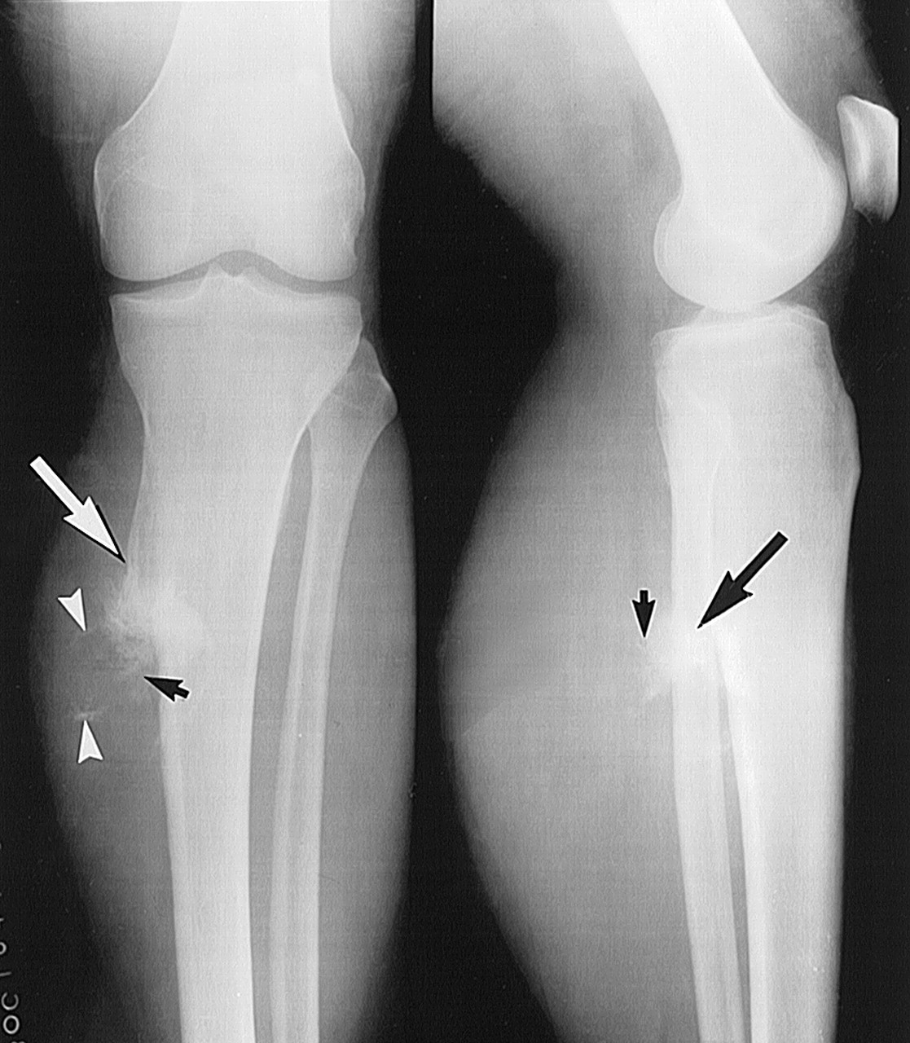

Slide 14
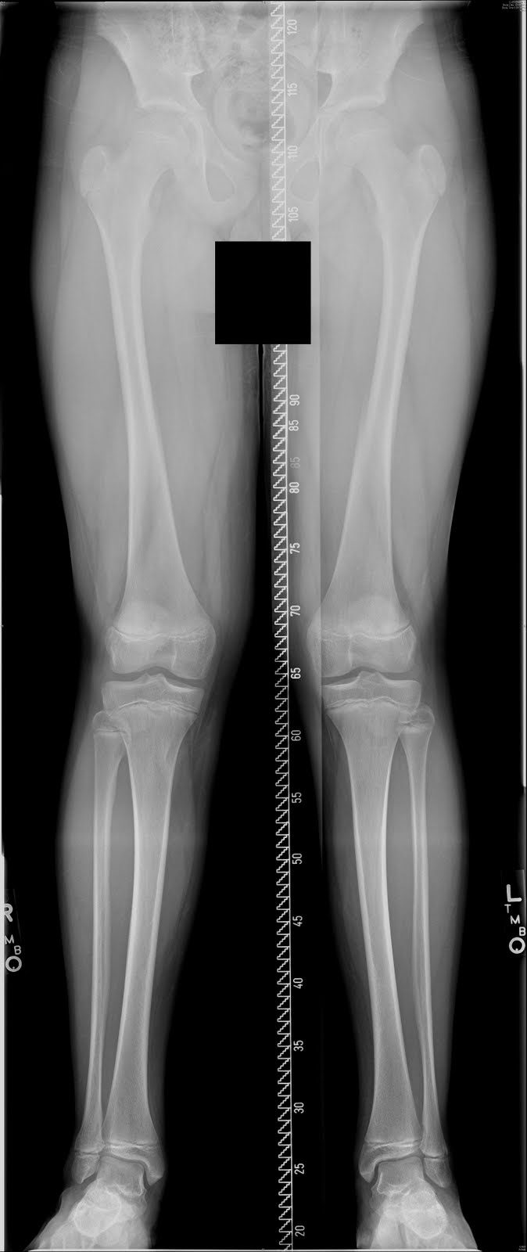
ALIGNMENT
Alignment: Anatomic relationship between bones on x-ray
Bone alignment vs other side
Bone alignment relative to proximal and distal bones
Normal x-rays should have normal alignment
Fractures and dislocations may affect the alignment on the x-ray

Slide 15
BONES
Identify bone
Examine the whole bone for
Discontinuity → fractures
Change in bone shadow consistency → change in density
Describe bone abnormality
Location
Shape

Slide 17
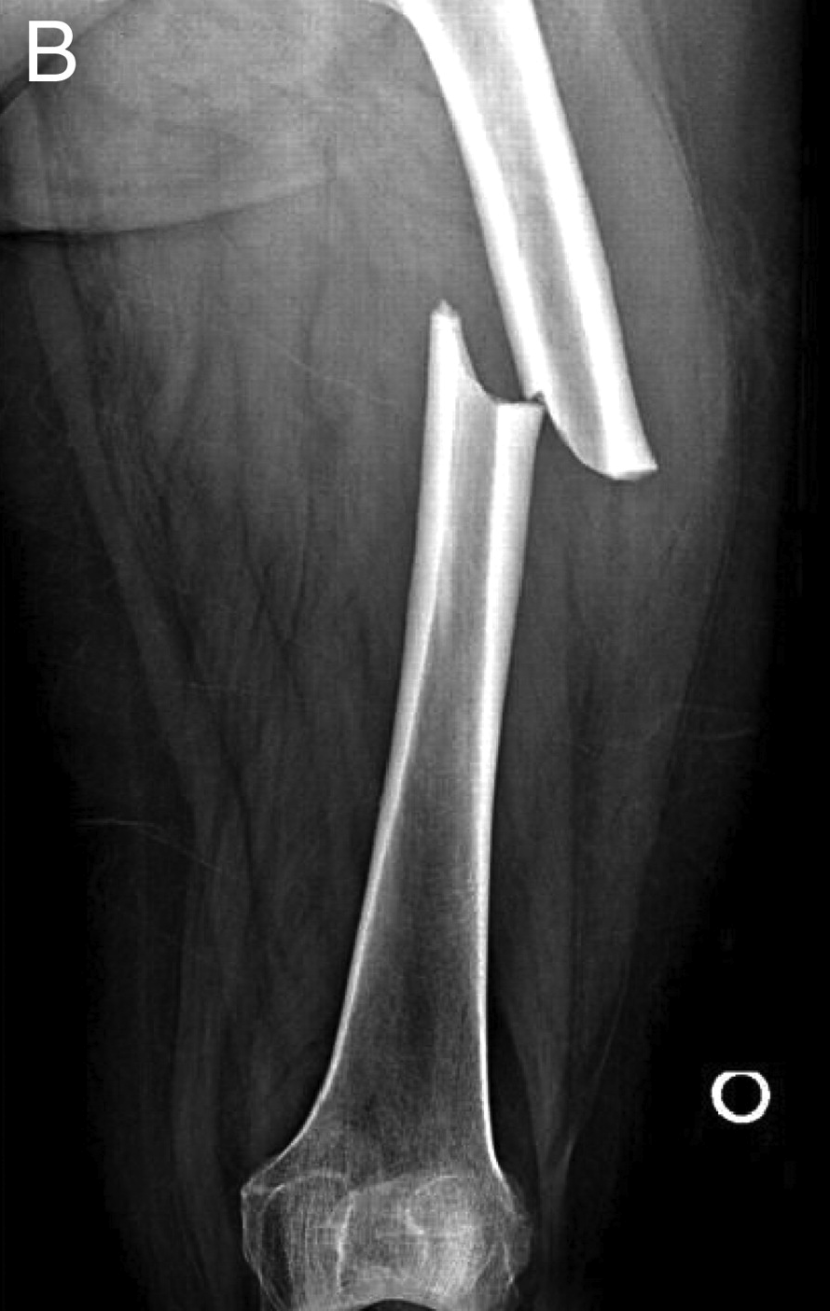

Slide 18
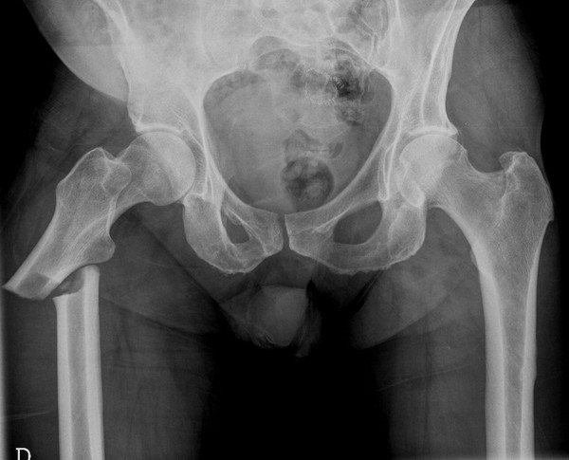

Slide 19
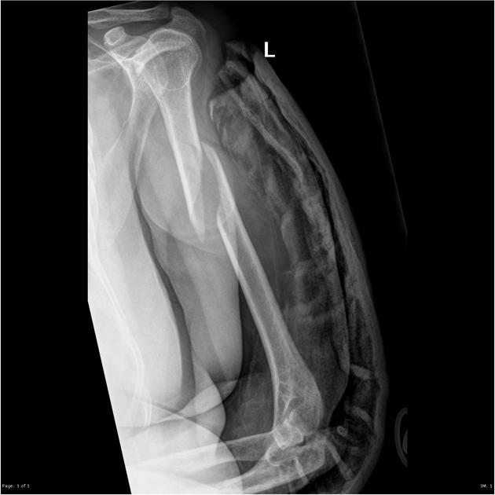

Slide 20
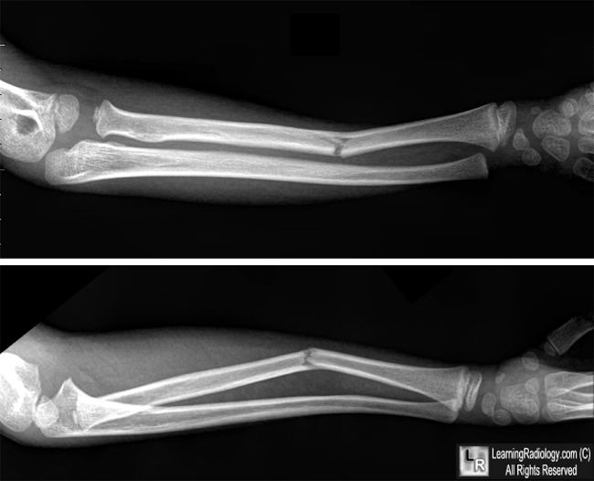

Slide 21
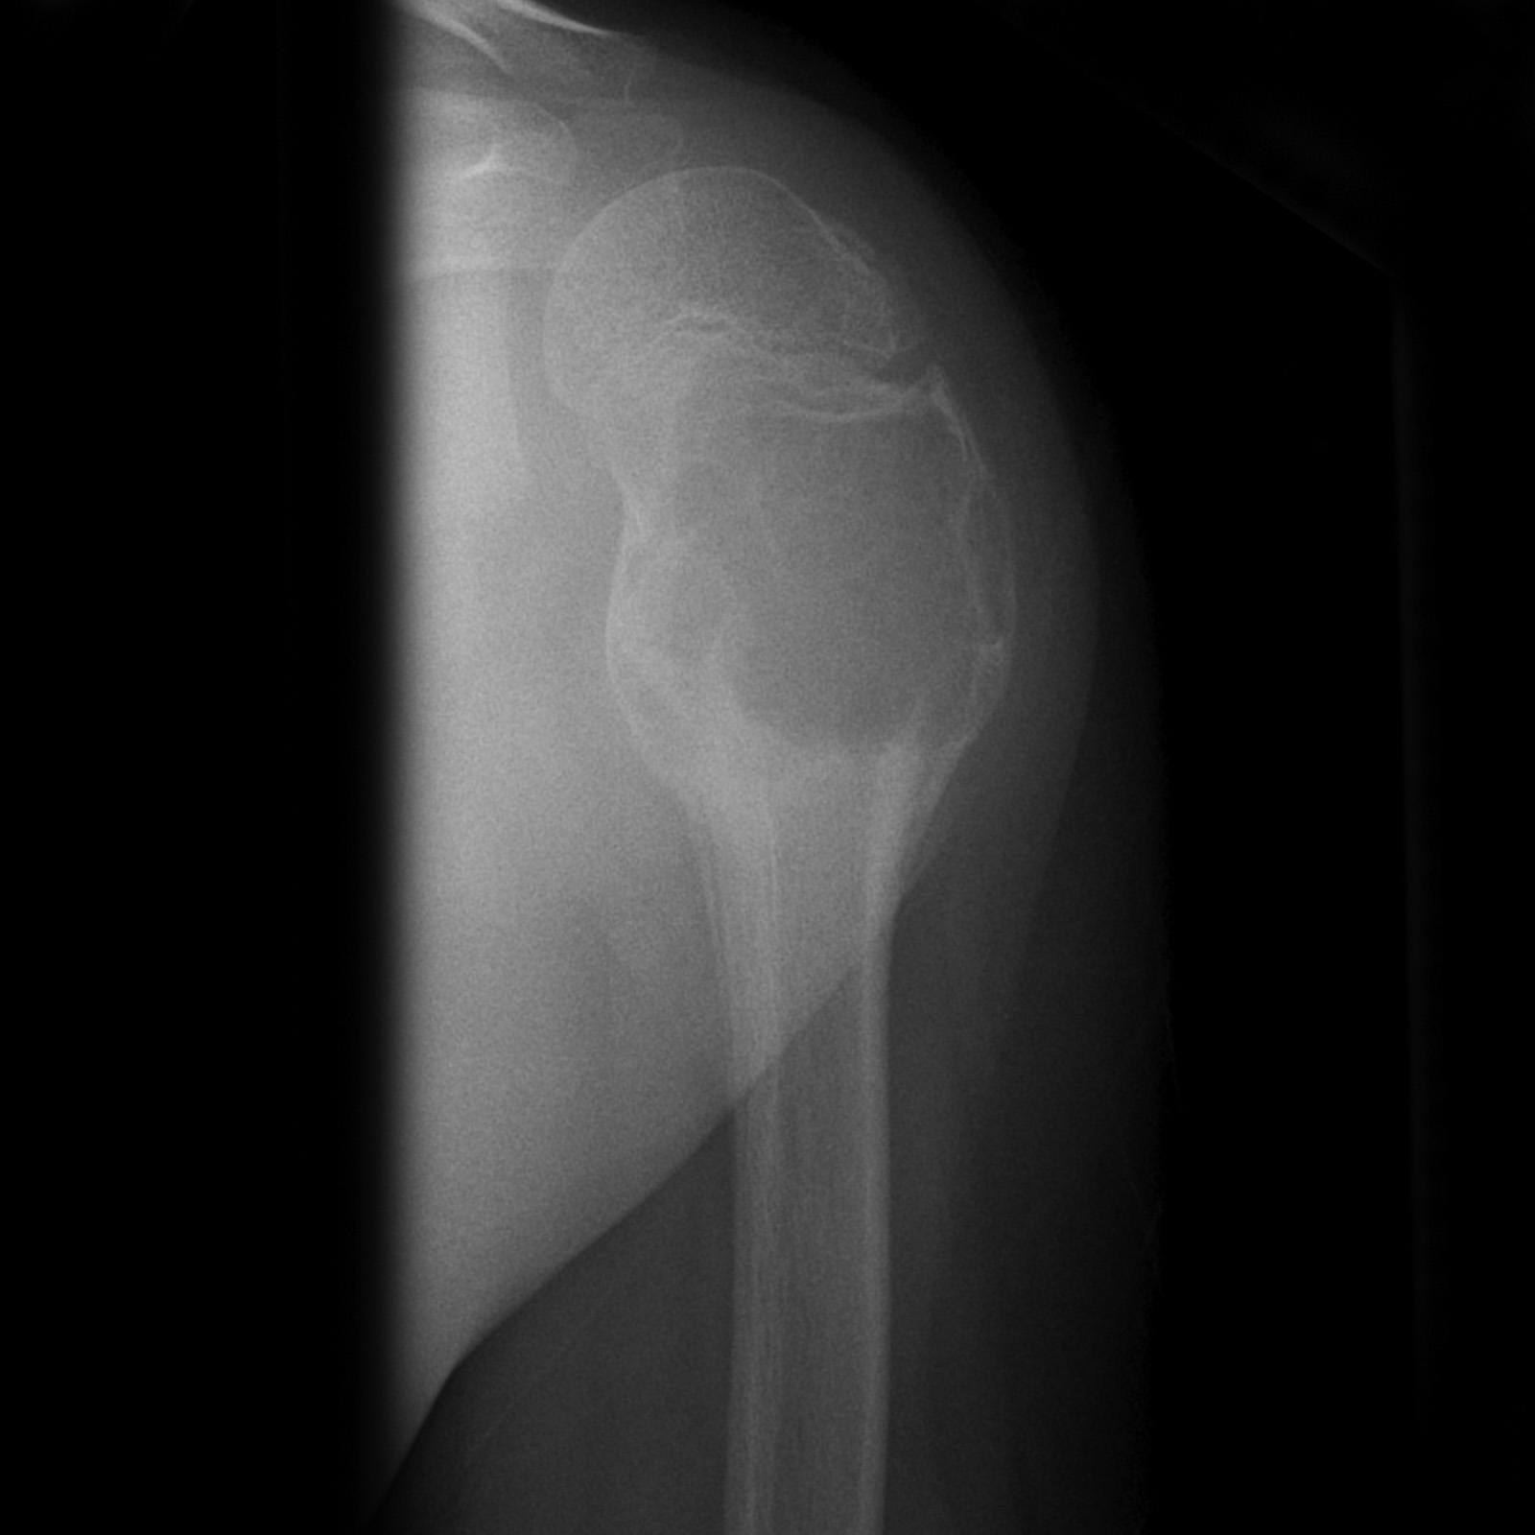

Slide 22
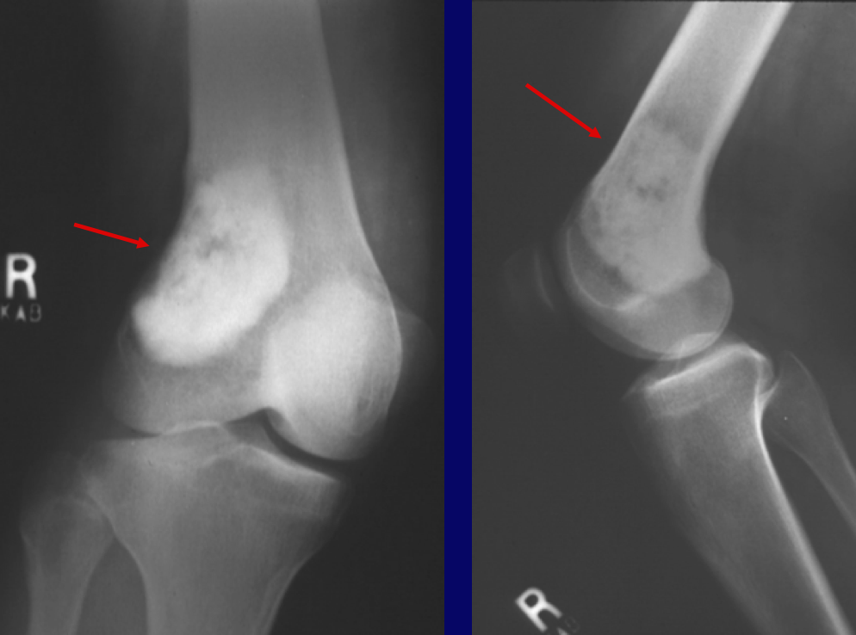

Slide 23
CARTILAGE
Cartilage
joint spaces on x-rays
you cannot actually see cartilage on x-rays
Widening of joint spaces → signifies ligamentous injury and/or fractures
Narrowing of joint spaces → arthritis

Slide 24
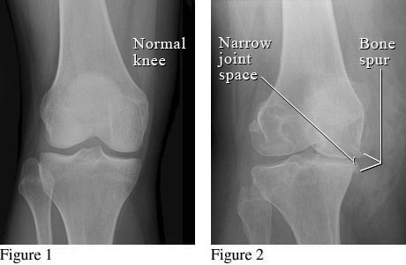

Slide 25
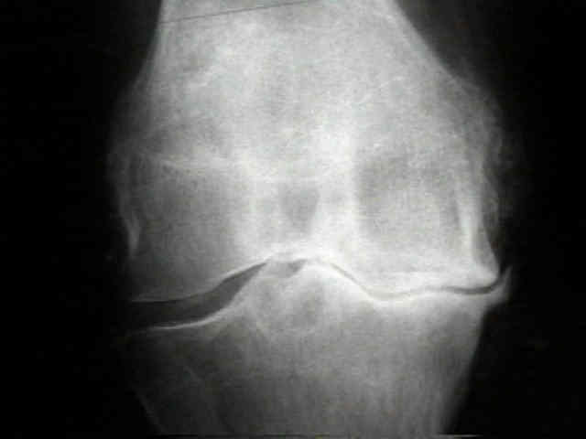

Slide 26
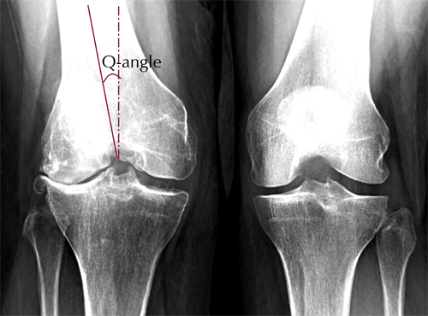

Slide 28
SOFT TISSUES
Soft tissues implies to look for soft tissue swelling and joint effusions
These can be signs of
Trauma
occult fractures
Infection
Tumors

Slide 29
REVIEW: ABCs
A
Assess adequacy of x-ray which includes proper number of views and penetration
Assess alignment of x-rays
B
Examine bones throughout their entire length for fracture lines and/or distortions
C
Examine cartilages (joint spaces) for widening
S
Assess soft tissues for swelling/effusions

Slide 30
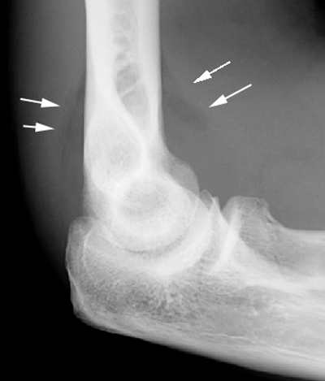
EXAMPLE # 1

Slide 31
EXAMPLE # 1…
This x-ray demonstrates a lateral elbow x-ray.
There is swelling anteriorly which is displaced known as a pathologic anterior fat pad sign
There is swelling posteriorly known as a posterior fat pad sign
Both of these are signs of an occult fracture although none are visualized on this x-ray
Remember, soft tissue swelling can be a sign of occult fracture!

Slide 32
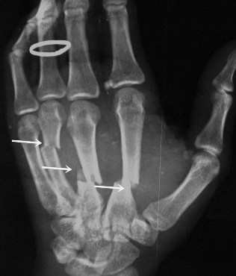
EXAMPLE # 2…WHERE ARE THE FRACTURES?

Slide 33
EXAMPLE # 2…
If you follow ABCs, you will notice there is are problems with alignment on this x-ray (A)
(B)…You will notice there are fracture lines through the 2nd, 3rd, and 4th metacarpals
These are 2nd, 3rd, and 4th, midshaft metacarpal fractures.
A teaching point: Notice the ring on this film. Always remove rings of patients with fractured extremities because swelling may preclude removal later.

Slide 34
LANGUAGE OF FRACTURES
Important for use to describe x-rays in medical terminology.
Improves communication with orthopedic consultants

Slide 35
LANGUAGE OF FRACTURES
Things you must describe (clinical and x-ray):
Open vs Closed fracture
Anatomic location of fracture
Fracture line
Relationship of fracture fragments
Neurovascular status

Slide 36
OPEN VS CLOSED
Must describe to a consultant if fracture is open or closed
Closed fracture
Simple fracture
No open wounds of skin near fracture
Open fracture
Compound fracture
Cutaneous (open wounds) of skin near fracture site. Bone may protrude from skin
Open fractures are open complete displaced and/or comminuted

Slide 37
OPEN FRACTURES
Orthopedic emergency
Requires emergency orthopedic consultation
Bleeding must be controlled
Management
IV antibiotics
Tetanus prophylaxis
Pain control
Surgery for washout and reduction

Slide 38
ANATOMIC LOCATION
Describe the precise anatomic location of the fracture
Include if it is left or right sided bone
Include name of bone
Include location:
Proximal…Mid…Distal
To aid in this, divide bone into 1/3rds

Slide 39
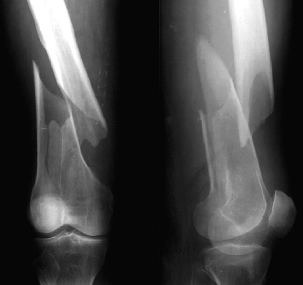
FOR EXAMPLE....WHERE IS THIS LOCATED?

Slide 40
EXAMPLE…
This is a closed L distal femur fracture.
The main thing I want you to take from this example is the description of location

Slide 41
ANATOMIC LOCATION
Besides location, it is helpful to describe if the location of the fracture involves the joint space—intra-articular

Slide 42
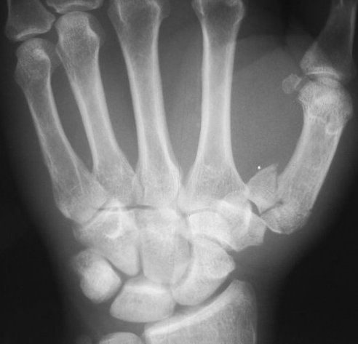
INTRA-ARTICULAR FRACTURE OF BASE 1ST METACARPAL

Slide 43
FRACTURE LINES
Next, it is imperative to describe the type of fracture line
There are several types of fracture lines

Slide 44
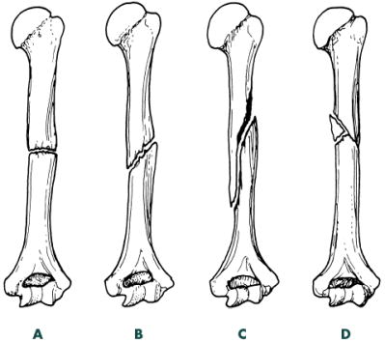
FRACTURE LINES

Slide 45
FRACTURE LINES
A is a transverse fracture
B is an oblique fracture
C is a spiral fracture
D is a comminuted fracture
There is also an impacted fracture where fracture ends are compressed together

Slide 46
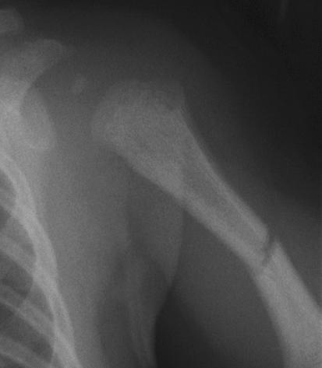
WHAT TYPE OF FRACTURE LINE IS THIS???

Slide 47
ANS: TRANSVERSE FRACTURE
Transverse fractures occur perpendicular to the long axis of the bone.
To fully describe the fracture, this is a closed midshaft transverse humerus fracture.

Slide 48
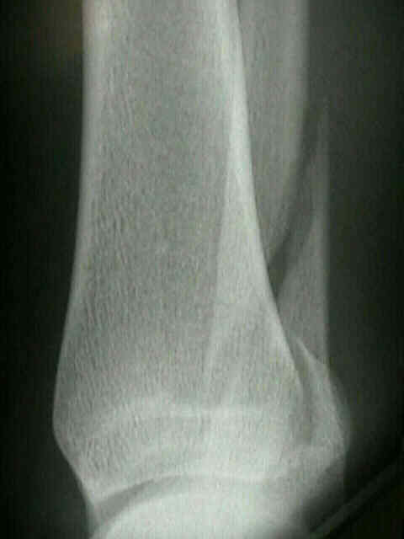
ANOTHER EXAMPLE OF FRACTURE LINE…

Slide 49
ANS: SPIRAL FRACTURE
Spiral fractures occur in a spiral fashion along the long axis of the bone
They are usually caused by a rotational force
To fully describe the fracture, this is a closed distal spiral fracture of the fibula

Slide 50
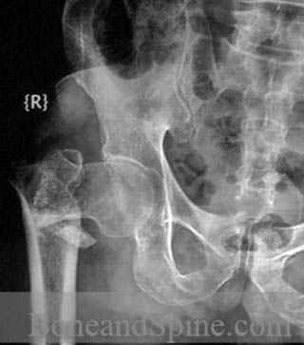
ONE MORE EXAMPLE…

Slide 51
ANS: COMMINUTED FRACTURE
Comminuted fractures are those with 2 or more bone fragments are present
Sometimes difficult to appreciate on x-ray but will clearly show on CT scan
To fully describe the fracture, this is a closed R comminuted intertrochanteric fracture

Slide 52
FRACTURE FRAGMENTS
Terms to be familiar with when describing the relationship of fracture fragments
Alignment
Angulation
Apposition
Displacement
Bayonette apposition
Distraction
Dislocation

Slide 53
ALIGNMENT/ANGULATION
Alignment is the relationship in the longitudinal axis of one bone to another
Angulation is any deviation from normal alignment
Angulation is described in degrees of angulation of the distal fragment in relation to the proximal fragment—to measure angle draw lines through normal axis of bone and fracture fragment

Slide 54
20 DEGREES OF ANGULATION

Slide 55
OTHER TERMS
Apposition: amount of end to end contact of the fracture fragments
Displacement: use interchangeably with apposition
Bayonette apposition: overlap of fracture fragments
Distraction: displacement in the longitudinal axis of the bones
Dislocation: disruption of normal relationship of articular surfaces

Slide 56
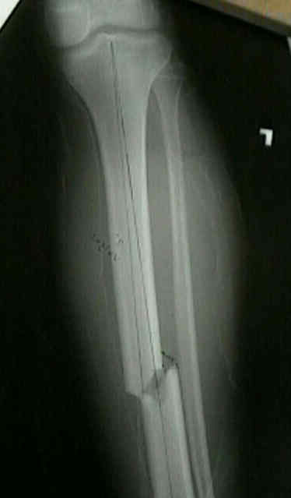
DESCRIBE FRACTURE FRAGMENTS

Slide 57
ANSWER
This is a closed midshaft tibial fracture….But how do we describe the fragments?
This is an example of partial apposition; note part of the fracture fragments are touching each other
Alternatively you can describe this as displaced 1/3 the thickness of the bone
Remember aposition and displacement are interchangeable—we tend to describe displacement
Final answer: Closed midshaft tibial fracture with moderate (33%) displacement

Slide 58
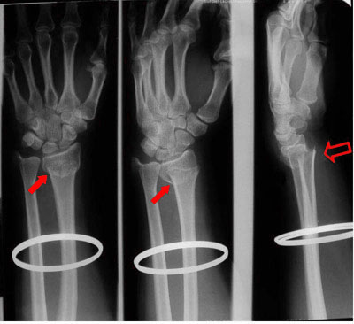
ANOTHER ONE…

Slide 59
ANSWER
There are 2 fractures on this film
Closed distal radius fracture with complete displacement. Also there is an ulnar styloid fracture which is also displaced
The displacement is especially prominent on the lateral view highlighting the importance of multiple views.
There may be intra-articular involvement as joint space is close by
Remember, remove all jewelry from extremity fractures

Slide 60
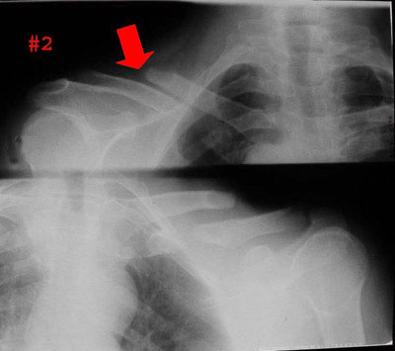
BAYONETTE APPOSITION

Slide 61
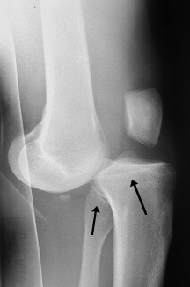
DISLOCATION

Slide 62
DISLOCATION
Note the dislocation on the previous slide; the articular surfaces of the knee no longer maintain their normal relationship
Dislocations are named by the positioin of the distal segemnt
This is an Anterior knee dislocation

Slide 63
NEUROVASCULAR STATUS
Finally when communicating a fracture, you will want to describe if the patient has any neurovascular deficits
This is determined clinically

Slide 64
LANGUAUGE OF FRACTURES
To review, when seeing a patient with a fracture and the x-ray, describe the following:
Open vs closed fracture
Anatomic location of fracture (distal, mid, proximal) and if fracture is intra-articular
Fracture line (transverse, oblique, spiral, comminuted)
Relationship of fracture fragments (angulation, displacement, dislocation, etc)
Neurovascular status

Slide 65
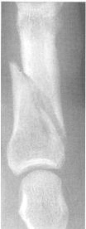
DESCRIBE THIS R MIDDLE PHALANX FRACTURE

Slide 66
ANSWER
Oblique fracture of midshaft of R 4th middle phalanx with minimal displacement and no angulation
Remember to comment if open vs closed & neurovascular status

Slide 67
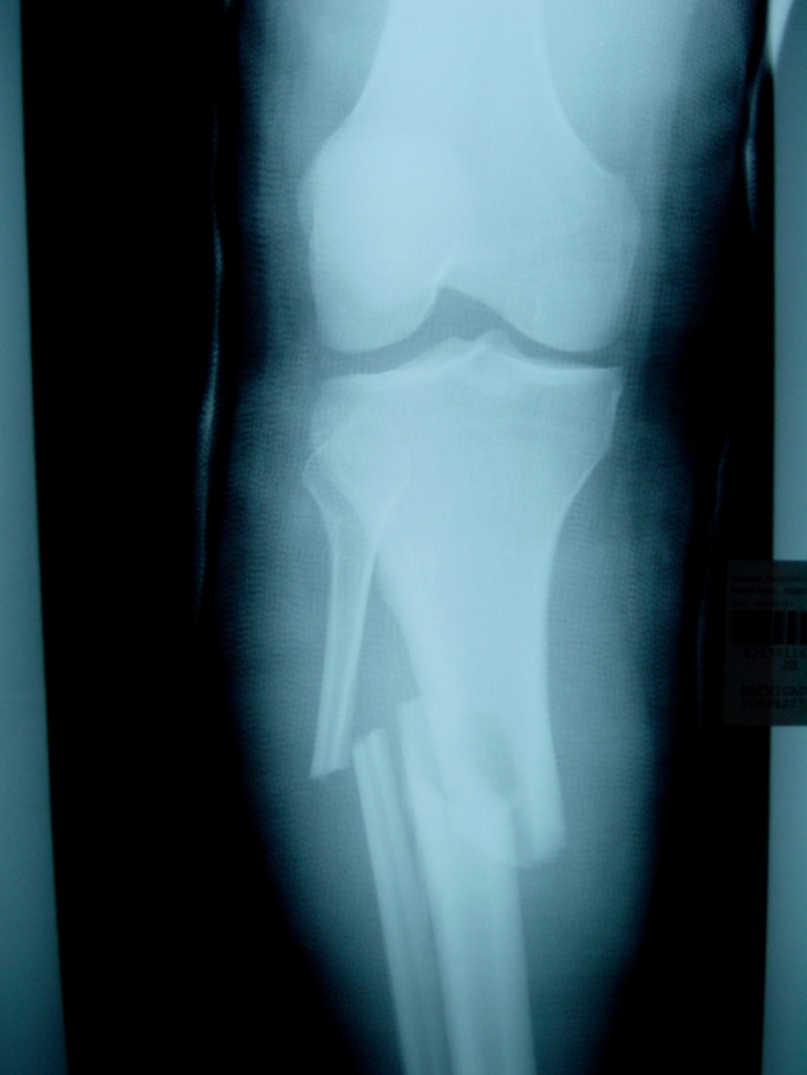
DESCRIBE TO ORTHO ATTENDING…

Slide 68
ANSWER
This one is a bit more challenging!
R midshaft tibia fracture displaced ½ the thickness of the bone without angulation; also there is bayonette appositioning of the fracture fragments
R midshaft fibular fracture with complete displacement and
Also comment if the fracture is open vs closed & neurovascular status

