Slide 1
Pelvic Injuries and Open Fracture
Dr Abdulaziz Alrabiah, MD
Emergency Medicine, Trauma & EMS

Slide 2
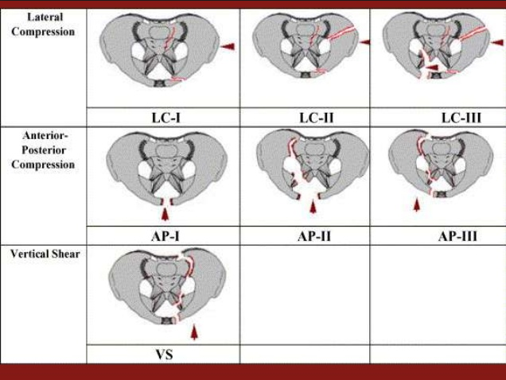
Pelvic Fracture
Young Classification

Slide 3
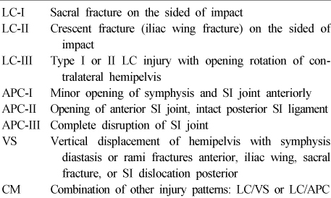
Young Classification

Slide 4
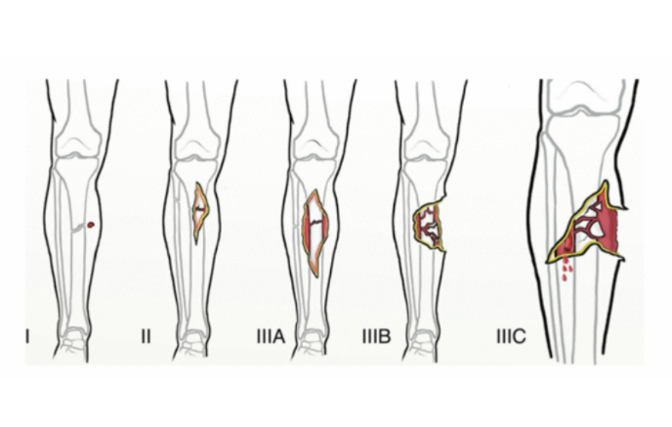
Open Fractures

Slide 5
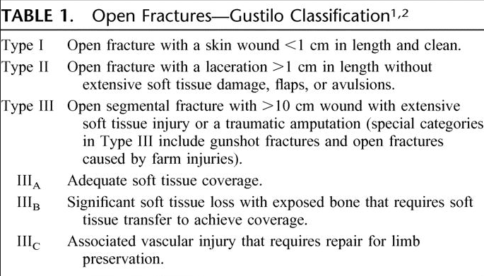
Open Fracture

