Slide 1
Dr. Hussein Saad, MRCP (UK)
Assistant Professor and Consultant
College of Medicine, King Saud University
Introduction to ECG
K
Notes:
Any question

Slide 2
We hope to cover:
Heart rate, How to calculate
Axis deviation
Arrhythmia ( Tachycardia, AF, Flutter, Vent. T)
First degree heart block
Right Bundle Branch Block (RBBB)
Premature Ventricular Contraction (PVC)
Premature Atrial Contraction (PAC)
Left Ventricular Hypertrophy (LVH)
Right Ventricular Hypertrophy (RVH)
Ischaemia (MI)

Slide 3
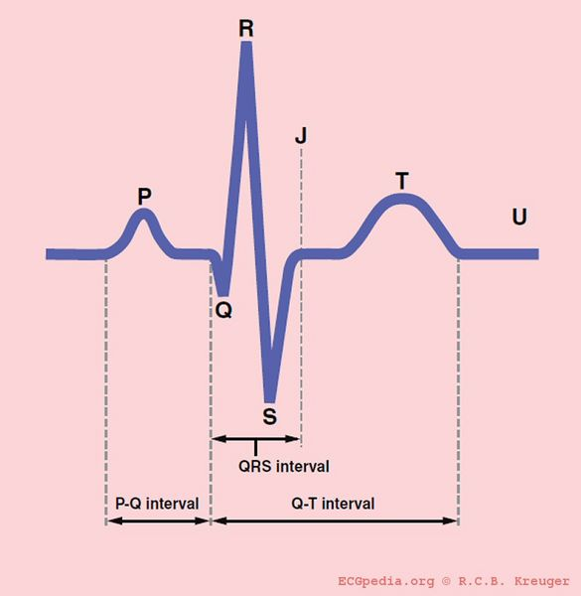

Slide 5
Normal P Wave
Height and Width: 2 – 2.5 mm (0.08 to 0.10 sec)
PR Interval: 3 - 5 mm (0.12 – 0.20 sec)
Best seen: Leads I, II and aVF
Normal QRS
Duration: 1 – 2.5 mm (0.04 – 0.10 sec)
Wide QRS
Bundle Branch Block
Premature Ventricular Contractions
Ventricular Tachycardia

Slide 6
Requested by:
Dr. HUSSAIN
What is the heart rate?
300 / number of large boxes (choose R on the bald line and count)
What is the approximate heart rate?
50 bpm
70 bpm
90 bpm
110 bpm
B

Slide 7
The heart rate is
Fast and regular
Fast and irrigular
Normal and regular
Normal and irrigular
A

Slide 8
3 sec
3 sec
3 sec
What is the abnormal finding?
Atrial Fibrillation
What is the approximate heart rate?
60 – 70 bpm
(Count number of R waves in 6 seconds or 30 large squares)

Slide 9
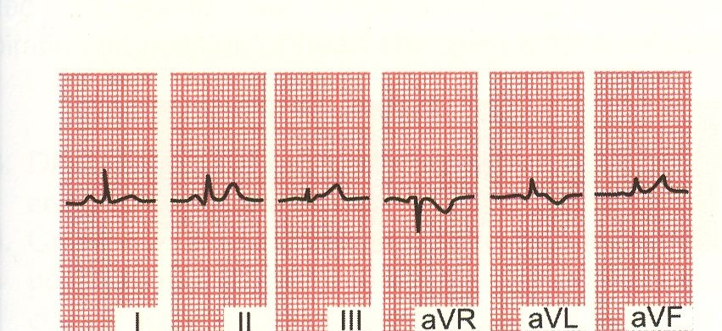
A
B
C
What is the electrical axis of the strips A, B and C?
Normal axis deviation
Left axis deviation
Right axis deviation

Slide 10
(- aVL)

Slide 11
LAD
Which type of axis deviation?

Slide 12
What is the main finding in this strip?
Prolonged PR interval (> 5 mm [>0.2 second])
First degree heart block

Slide 13
What is your diagnosis?
First degree heart block

Slide 14
Sinus Bradycardia (Rate is less than 60 bpm), T wave changes

Slide 15
Sinus Tachycardia (Rate is above 100 bpm)

Slide 16
Supraventricular tachycardia (Rate is > 200 bpm), NO P waves

Slide 17
A 33 year-old man with sensation of chest tightness last night, where he
could not sleep.
(Sinus bradycardia)

Slide 18
What is the diagnosis?
Atrial Fibrillation (Irregular R waves)

Slide 19
What is the abnormality in this strip?
Atrial flutter (Saw tooth appearance of P waves)

Slide 20
Spontaneous conversion of atrial flutter to Sinus rhythm

Slide 21
What is the diagnosis?
(PVCs) Ventricular bigeminy
(The ectopic:Wide QRS, No P wave, with a pause, appear after each normal beat)

Slide 22
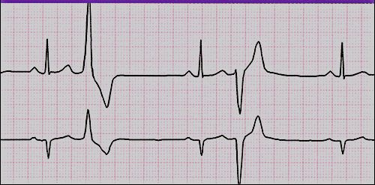
Multifocal PVCs have different sites of origin, Multiformed PVCs (different shapes)
Are common in digitalis intoxication and could be normally found.

Slide 23
Ventricular Premature Complexes

Slide 24
He
What is your diagnosis?
Atrial premature beats (Atrial Bigeminy) The ectopic has P wave different in shape from normal one. Normal QRS and with a pause.

Slide 25
A 71-year-old man is routinely followed for hypertension.
Interpret this ECG.
What is your diagnosis?
Atrial fibrillation (Irregular irregularity of R waves)

Slide 26
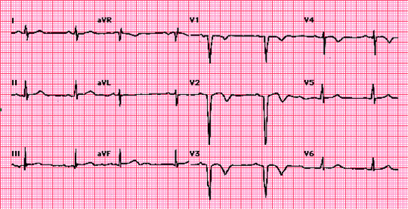
A 58-year-old man had severe substernal chest pain three days ago.
What abnormality is shown on the electrocardiogram?
Old anterior MI (Q waves in V1 – 3)

Slide 27
What is your Diagnosis?
Atrial Fibrillation

Slide 28
What is your diagnosis?
Atrial Flutter
Regular atrial activity with a "clean" saw-tooth appearance

Slide 29
Dominant R wave in Lead V1:
Right bundle branch block (RBBB)
Right ventricular hypertrophy (RVH)

Slide 30
Requested by:
Dr. HUSSAIN

Slide 31
A 42 year old man presents with 2 months H/O non specific chest pain.
What is your diagnosis?
(Predominant R in V1 and also M shape) RBBB

Slide 32
What is your diagnosis?
RBBB (Predominant R in V1 and also M shape)

Slide 33
A 85 year-old man with weakness and fatigue
Sinus bradycardia, LAD, RBBB and Atrial premature beats

Slide 34
A 24 year-old man with systolic murmur.
Right ventricular hypertrophy : ■ RAD
■ Dominant R wave in V1
■ RV Strain /Ischaemia ( T wave inversion in right
chest leads (V1, V2 and V3)

Slide 35
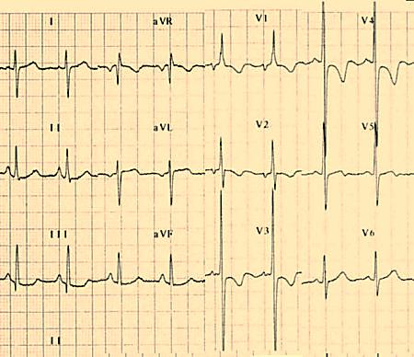
Interpret this ECG
RVH Supported by (RAD, Dominant R in V1, Right Vent. Strain / Ischaemia (inverted T waves in V1 – V4)

Slide 36
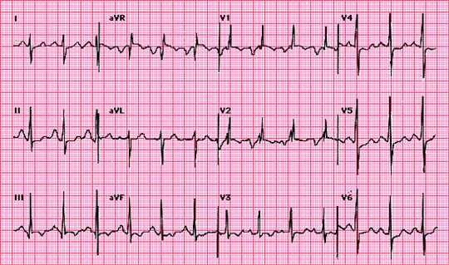
A patient with cardiac murmur, what are the abnormal findings?
Right ventricular hypertrophy and marked left atrial abnormality
Tall R in V1, RAD, negative p wave in V1 (LA enlargement), P pulmonale in lead II
RBBB (rsR) Mitral Stenosis

Slide 37
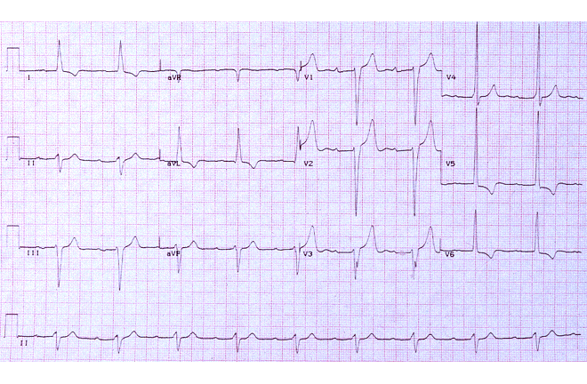
A 54 year-old man for routine follow up of hypertension
LAD, First degree heart block, LVH and left ventricular strain /ischaemia

Slide 38
A 54-year-old man is booked recently for control of hypertension.
Interpret this ECG.
LAD, LVH and anterolateral ischaemic changes (T waves inverted in I, aVL, V4-V6)
Is this patient in need for further assessment.

Slide 39
Wide QRS, No P waves
Ventricular Tachycardia

Slide 40
What is the most likely occluded coronary artery?
Right Coronary Artery (Acute Inferior MI) ST elevation in II, III and aVF

Slide 41
What is the most likely occluded coronary artery?
Left Coronary Artery (Acute Anterior MI) ST elevation in V1 to V6

Slide 42
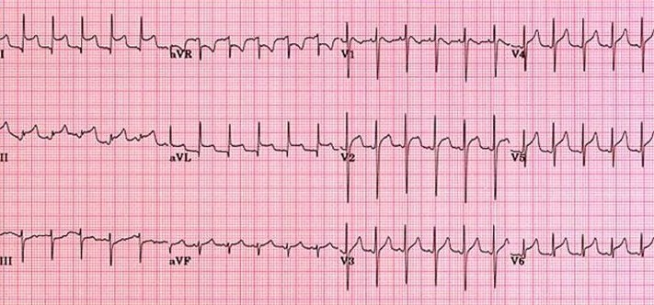
This 29 year old male presents in the ER complaining of severe pleuritic chest pain over the left precordium. Physical examination reveals a friction rub over the left precordium. An ECG is performed:
What is your diagnosis?
Acute pericarditis (Generalised ST elevation with concavity) look to age and scenario

Slide 43
Acute anterior MI

Slide 44
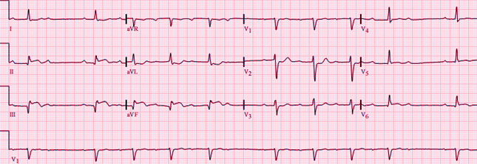
A 56-year-old man presents with 2 hours H/O epigastric pain.
What is your diagnosis?
Acute inferior MI (ST elevation in II, III and aVF)
AF (Irregular irregularity of heart beats in lead aV1)

Slide 45
What is your diagnosis?
Old inferior MI (significant Q waves in II, III and aVF)

Slide 46
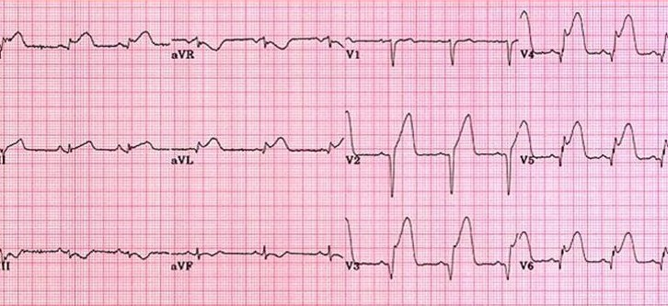
A 74 year old man presents to emergency room with chest pain of 2 hours duration.
What is your diagnosis?
Acute anterior MI B. Acute inferior MI
C. Acute pericarditis D. Acute posterior MI

Slide 47
A 33 year-old man with sensation of chest tightness last night, where he could not sleep.
What are the findings?
Sinus Bradycardia

Slide 48
Fast Atrial Fibrillation (1)

Slide 49
AF (same patient after start of B Blocker) Rate 60 / min (2)

Slide 50
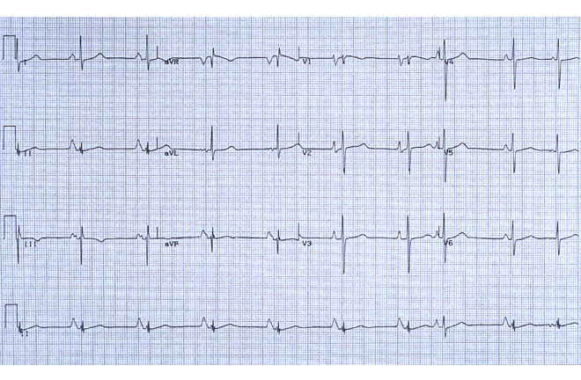
Mention three findings in this ECG.
1- P pulmonale (RAH, of lead II) 2- P mitrale (LAH, lead III and V1))
3- Sinus Bradycardia

Slide 51
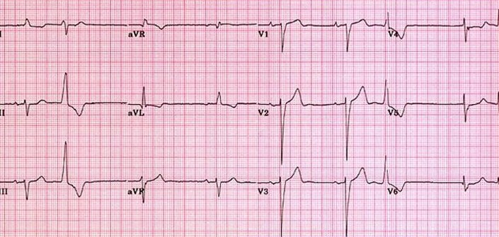
A 37 year old lady feels that her heart is bounding.
An ECG, was done which reveals that this lady has:
First degree heart block B. Premature atrial contractions
C. Premature ventricular contractions D. Right bundle branch block
C

Slide 52
What is your diagnosis?
Premature ventricular contraction (Ventricular Bigeminy)

Slide 53
Normal ECG

Slide 54
RBBB, in need for Echocardiography to R/O cong. HD like ASD

Slide 55
What is your diagnosis?
Premature ventricular contraction (Ventricular Bigeminy)

Slide 56
Acute inferior MI

Slide 57
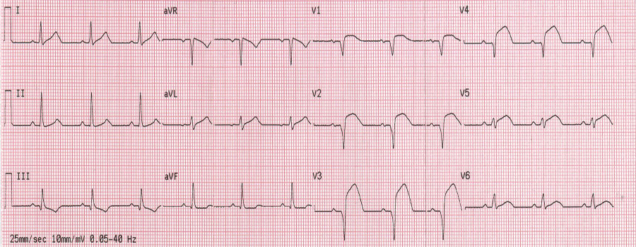
A 61 year old man with acute chest pain.
What is your diagnosis?
Anterior MI

Slide 58
ECG 156
A Ventricular Tachycardia in a patient with demand pacemaker.

