Slide 1
Domestic Violence
Dr Mohammed Batais
Assistant Professor & Consultant , Family Medicine, Diabetes and Chronic Disease Management
King Saud University

Slide 2
Objectives
Differentiate violence against women (VAW) from domestic violence (DV)/family violence
Identify different types of violence
Identify different victims of domestic violence
Recognize sign and symptoms of violence
Identify risk factors in domestic violence
List bio-psycho-social consequences of domestic violence
Outline resources of victim support in Saudi Arabia

Slide 3
Definition of domestic violence
Types of violence
Types of victims
Risk factors
Sign and symptoms
Impact of violence
supportive resources in Saudi Arabia

Slide 4
واحد متجوز وقاعد في البيت وبيبص كتير في عقد الزواج، مراته قالت له: "بتبص في عقد الزواج ليه يا حبيبي؟" قالها: "بأبحث عن تاريخ إنتهاء العقد.

Slide 5
يقولون لك
فيه سورية ولبنانية وسعـــــــــــــودية
أتفقوا إنهم يقولون لأزواجهم إنهم ماراح يشتغلون بالبيت!:
وبعد أسبوع إلتقـوا
قالت السورية: أنا أول يوم وثاني يوم ماشفت شي وثالث يوم غسل ملابسـه بنفسه:
قالت اللبنـانيه:
أنا أول يوم وثاني يوم ماشفت شي وثالث يوم " غـداني برا”
قالت السعودية
انا أول يوم وثاني يوم ماشفت شي وثالث يوم بديت أشوف شوي بعيني اليسار

Slide 6
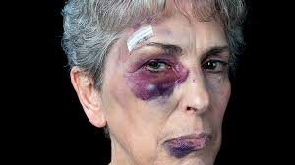
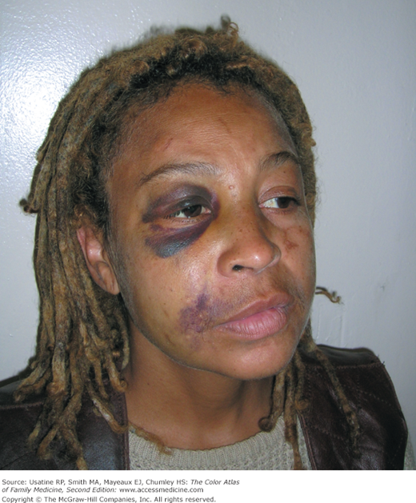
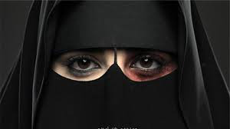
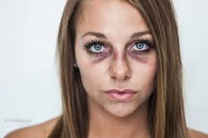

Slide 7
Definition of Domestic Violence

Slide 8
Violence Against Women
“Any act of gender based violence that result in, or likely to result in, physical, sexual or psychological harm or suffering to women, including threats of such acts, whether occurring in public or private life”
Domestic Violence
All behaviors/actions within the family result in mental or physical injury (or death) to another member of the family
(WHO: putting women first. P7. 2001).
Prevalence (10-69%).

Slide 9
The annual incidence
47 assaults per 1000 women
32 assaults per 1000 men.
Annual 1.3 million women & 800,000 men who are physically abused in the United States
28% of female homicide victims were killed by their current or former male partners
only 3% of men were murdered by current or former female partners.

Slide 10
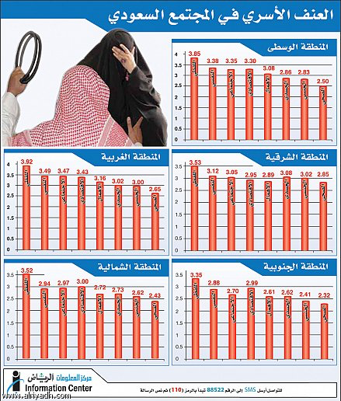
السبت6 محرم 1430هـ - 3 يناير2009م – جريدة الرياض العدد 14803

Slide 11
Types of violence
Types of victims

Slide 12
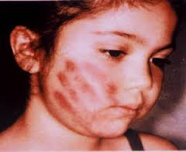
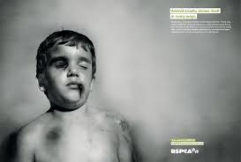
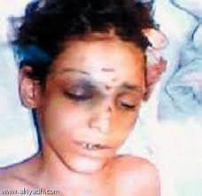
CHILD MALTREATMENT

Slide 13
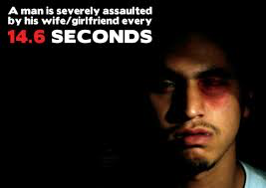
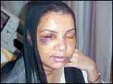
INTIMATE PARTNER VIOLENCE

Slide 14
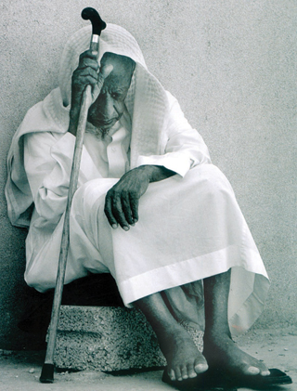
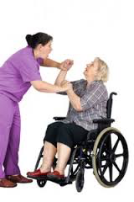
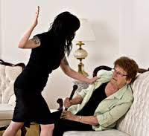
ELDER MISTREATMENT

Slide 15
Physical violence,
“Intentional use of physical force with the potential for causing death, disability, injury, or harm." (CDC)
Pushing
Punching
Burning
Biting
Shaking
Slapping
Throwing
Homicide

Slide 16
Emotional/psychological abuse
Includes humiliation, controlling behavior, repeated verbal assaults (name-calling), isolation (rejection, withholding attention and affection), threats, and public harassment, all of which can produce psychological trauma that reduces a person's self-worth, value, and sense of efficacy.
Emotional/psychological violence often coexists with chronic physical or sexual violence, but can also stand alone.

Slide 17
Financial abuse
Is when a person withholds resources such as money or transportation, or limits freedom of movement or association (eg, domination, isolation) of another person—a tactic often found in abusive relationships.
Financial abuse most often involves the inappropriate transfer or use of an elder's funds for the caregiver's purposes.

Slide 18
Neglect
Is the chronic failure of a person who is responsible for the physical and emotional needs of another person to provide for those needs.
Usually >>> directed at children, elders, or disabled family members.
Child and adult day care, schools, group homes, nursing facilities, and hospitals, may be involved in neglect of a dependent person.

Slide 19
Sexual violence
Is any sexual act or attempt to obtain a sexual act by violence or threat, unwanted sexual comments or advances, acts to traffic a person or acts directed against a person's sexuality, regardless of the relationship to the victim.

Slide 20
What is the most common form of elder abuse?

Slide 21
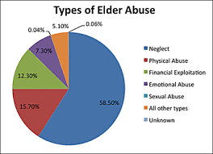
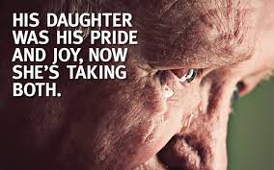
The most common form of elder abuse is neglect,
followed by physical abuse, financial exploitation,
emotional abuse, and sexual abuse.

Slide 22
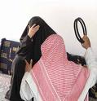
جريدة الرياض : غصون صورة ومرآة لباطن مجتمع!
25 كانون الثاني (يناير) 2008 ... فهل الأنظمة الحالية كافية لإنصاف كثير من قضايا العنف الأسري وحماية ضحاياها؟ .... بلطجة عائلية ! عندما يكون الجو مشحون بالتوتر والقلق، تتحول ...
الدعوه للتوعيه المجتمعيه بحقوق المراه والطفل ونبذ اشكال العنف
البعيده المدى ومنها الكابه المزمنه واهمال الذات وخصت في ورقتها العنف ضد الزوجه. وتعرضت د. سهام الصويغ عميده كليه التربيه في ورقتها عن تاثيرات العنف العائلي على الام والطفل الى العلاقه بين العنف ضد المراه
التاريخ : 2005/12/20
العنف ضد المراه... حالات اجرام فرديه مشينه مسيئه للمجتمع
العنف ضد المراه... حالات اجرام فرديه مشينه مسيئه للمجتمع
التاريخ : 2007/01/11
جريدة الرياض : العنف ضد المرأة.. يولد الاكتئاب والشعور بالدونية!!
11 شباط (فبراير) 2005 ... أما موضوع الانتحار أو التفكير بالانتحار فإن النسبة بلغت بين السيدات اللاتي تعرضن للعنف العائلي والايذاء حوالي 40,5٪ مقارنة بحوالي 4,6٪ من ...

Slide 23
Risk factors

Slide 24
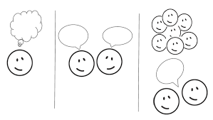
What are the risk factors that make individual be victimized?

Slide 25
Gender
Studies show that women are much more likely than men to be the victims of IPV.
Education
Education more predictor than employment status.
Income
Income was found to be a relatively strong predictor of IPV
More women needed medical treatment for injury.

Slide 26
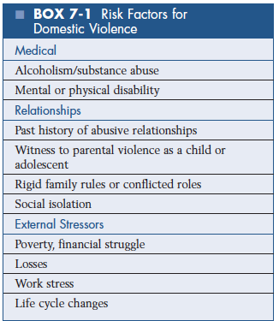

Slide 27
Sign and symptoms

Slide 28
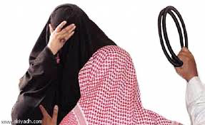
Women may present to the clinic
24 years old Saudi female is frequent attender to KKUH clinic with back-pain
18 years old Saudi female who presented to KKUH clinic with abdominal pain
Physical exam showed extensive post burn scar over the chest and abdomen

Slide 30
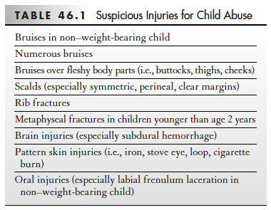

Slide 31
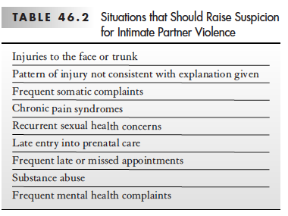
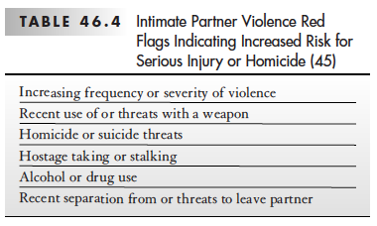

Slide 32
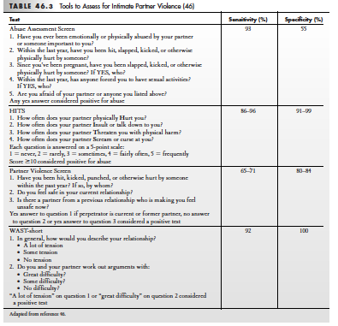

Slide 33
Impact of violence

Slide 34
Why a woman may not wish to report abuse or leave a relationship
Fear of reprisal or counter charges being laid by their partner
Too worn down to seek help
Living in fear of severe violence
Fear their children will be taken away
Unable or to recognise the cycle of abuse
Social isolation
Financial dependence
Emotional dependence and fear
Poor self-esteem
Cultural or religious issues

Slide 35
Consequences of domestic violenc
Family violence has a significant negative impact on health and wellbeing
Patients present to general practice with varying physical and psychological issues.

Slide 36
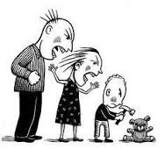

Slide 37
supportive resources in Saudi Arabia

Slide 38
The Nine steps to intervention – the 9 Rs Health practitioners need to understand their:
• Role with patients who are experiencing abuse and violence
• Readiness to be open to
• Recognize symptoms of abuse and violence, ask directly and sensitively and
• Respond to disclosures of violence with empathic listening and explore
• Risk and safety issues
• Review the patient for follow-up and support
• Refer appropriately and also
• Reflect on their own attitudes and management of abuse and violence
• Respect for patients, colleagues and themselves is an overarching principle of this sensitive work
The Royal Australian College of General Practitioners from: Abuse and violence: Working with our patients in general practice, 4th edn. Melbourne: RACGP, 2014

Slide 39
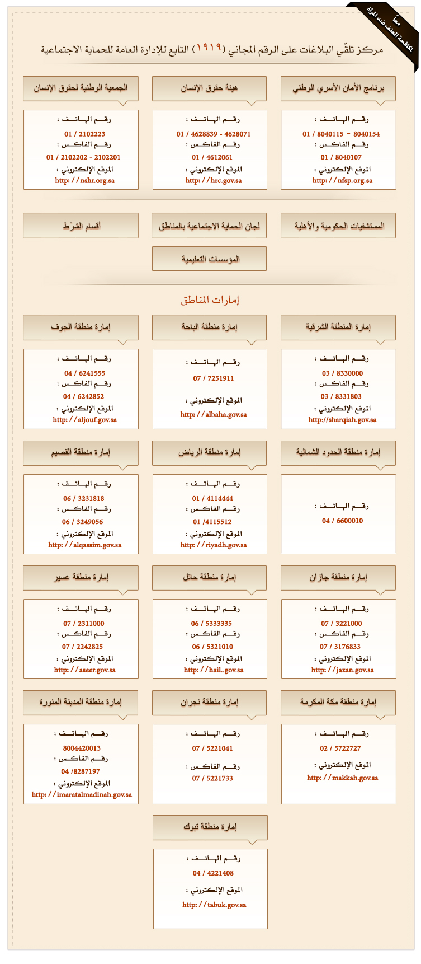
أرقام هواتف وفاكسات لجان الحماية الاجتماعية بالمناطق السعودية

Slide 40
Take-home messages:
Family violence refers to any abuse within a family and includes physical violence, emotional, sexual, economic and social abuse.
Prevalence of the domestic violence is increasing due to increase reporting
Risk factors (gender, health status, education and economy)
Family violence have a significant negative impact on health and are very common in clinical practice.
FPs are in a unique position to recognize, ask and appropriately respond to families who are experiencing violence.
Different women shelters are available for support in the Kingdom of Saudi Arabia

