Slide 1
Changes in bowel movements (IBS)
Sattam alsulami
Nasser AlQahtani
Amer Almutairi

Slide 2
True or False
People suffering from irritable bowel syndrome for more than 10 years develop cancer.
Truth
False

Slide 3
True or False
People with irritable bowel syndrome may suffer from either constipation only or diarrhea only
Truth
False

Slide 4
True or False
Rectal bleeding is a common presentation of irritable bowel syndrome
Truth
False

Slide 5
MCQ
Once other disease condition have been ruled out, a person can be considered for the diagnosis of irritable bowel syndrome if the symptoms were present for the last
One week
One fortnight
One month
Three months

Slide 6
MCQ
The following are typical symptoms of IBS except:
Abdominal pain improves with defecation.
Onset of abdominal discomfort is associated with changes in normal stool.
Progressive abdominal pain.
Change in frequency of stool.

Slide 7
Normal bowel movements
Normal bowel movement is between three times a day to three times a week.
Problems arises when bowel movements frequency decreases or increases.
Control loss of bowel sphincters.

Slide 8
bowel movement Disorders
Diarrhea
Passage of loose or watery stools, typically at least three times in a 24-hour period
Constipation
Stool frequency of less than three per week
Irritable Bowel Syndrome

Slide 9
DIARRHEA
Diarrhea is defined by the World Health Organization as having three or more loose or liquid stools per day, or as having more stools than is normal for that person
Acute diarrhea is defined as an abnormally frequent discharge of semisolid or fluid fecal matter from the bowel, lasting less than 14 days, by World Gastroenterology Organization.

Slide 10
Causes of diarrhea
Infection: Diarrhoea is a symptom of infections caused by a host of bacterial, viral and parasitic organisms, most of which are spread by faeces-contaminated water
.
Malabsorption
inflammatory bowel disease
Irritable bowel syndrome

Slide 11
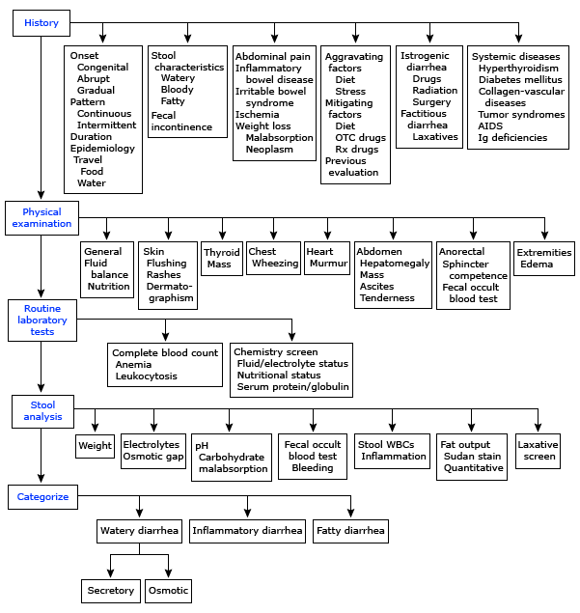
Algorithm For Chronic Diarrhea

Slide 12
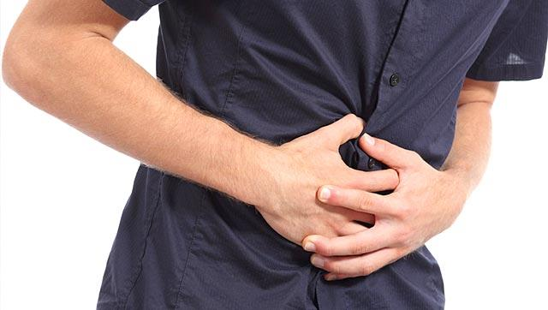
Constipation
Constipation is a symptom, not a disease.
Different patients have different perceptions of symptoms. Some patients regard constipation as straining, while for others, it means hard, pellet-like stools or an inability to defecate when desired, or infrequent defecation.

Slide 13
Rome criteria for constipation
There is constipation if patients who do not take laxatives report at least two of the following in any 12-week period during the previous 12 months :
Fewer than three bowel movements (BMs) per week.
Hard stool in more than 25% of BMs.
A sense of incomplete evacuation in more than 25% of BMs.
Excessive straining in more than 25% of BMs.
A need for digital manipulation to facilitate evacuation.

Slide 14
Causes of Constipation
Mechanical causes:
Colorectal tumors
Strictures
Neurological causes:
Autonomic neuropathy
Multiple sclerosis
Gastrointestinal causes:
IBS
Metabolic causes:
Diabetes mellitus
Electrolytes imbalance
Diet:
Low fiber intake
Fluid depletion
Medications:
Antidepressants, calcium-channel blockers.. etc.

Slide 15
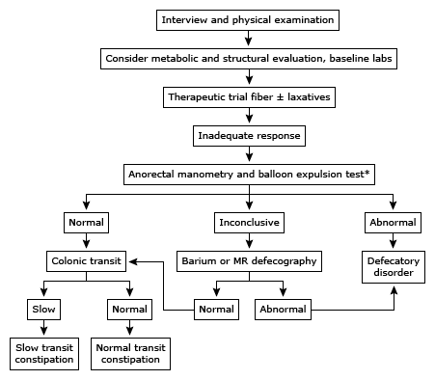
Algorithm For Chronic Constipation

Slide 16
Irritable bowel syndrome
Irritable bowel syndrome (IBS) is defined as a chronic functional disorder of the gastrointestinal tract in the absence of an organic disease
characterized by recurrent abdominal pain or discomfort at least three days per month in the last three months with two or more of the following: improvement with defecation, onet associated with a change in frequency of stool, or onset associated with a change in form (appearance) of stool.
Present in 10-20% of the population
Twice as common in women compared to men
Most commonly affects people between 20-30 years
1

Slide 17
Inflammation
Genetics
Motility
Postinfecious
Microflora Alterations
Sensitivity
Psychosocial
Etiology

Slide 18
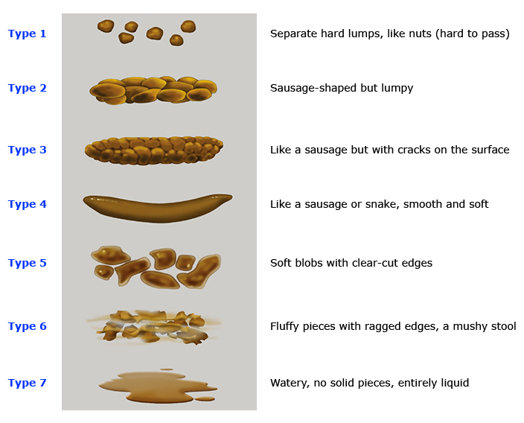
Bristol stool form scale

Slide 19
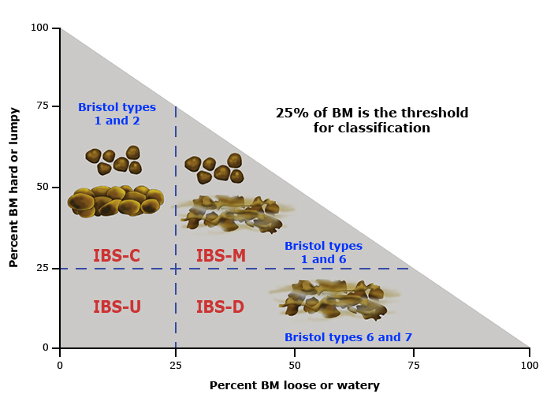
Classification of IBS

Slide 20
Diagnosis
It is Difficult.
It Needs to balance between few and many investigations.
Red flag symptoms should be ruled out.
The Diseases that causing similar symptoms should ruled out.

Slide 21
Rome IV ibs Criteria
According to the Rome IV criteria, IBS is defined as recurrent abdominal pain, on average, at least one day per week in the last three months, associated with two or more of the following criteria:
Related to defecation
Associated with a change in stool frequency
Associated with a change in stool form (appearance)

Slide 22
Diagnosis (NICE Guidelines)
Irritable bowel syndrome should be considered if an adult presents with abdominal pain or discomfort, bloating or a change in bowel habit for at least 6 months.
A diagnosis should be considered only if the person has abdominal pain or discomfort that is either relieved by defecation or is associated with altered bowel frequency or stool form. This should be accompanied by at least 2 of the following 5 symptoms:
altered stool passage (straining, urgency, incomplete evacuation)
abdominal bloating (more common in women than men), distension, tension or hardness
symptoms made worse by eating
passage of mucus.
Lethargy, nausea, backache and bladder symptoms are also common in people with irritable bowel syndrome, and may be used to support the diagnosis.

Slide 23
Alarming Symptoms !!!
Unintentional and unexplained weight loss.
Rectal bleeding.
A family history of bowel or ovarian cancer.
In people aged over 60, a change in bowel habit lasting more than 6 weeks with looser and/or more frequent stool.
Anemia.
Abdominal masses.
Rectal masses.

Slide 24
Physical Examination
anaemia
abdominal masses
rectal masses

Slide 25
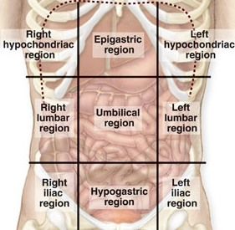
Abdominal examination
Inspection
Bloatness
Palpitation
Organmegaly
masses
Rectal
Percussion
Auscultation
Bowel movements

Slide 26
investigations
inflammatory markers for inflammatory bowel disease.
In addition, women with symptoms that suggest ovarian cancer should have their serum CA125 measured.
When the above have been excluded, the following tests should be done to exclude other diagnoses:
full blood count
erythrocyte sedimentation rate (ESR) or plasma viscosity
C reactive protein (CRP)
antibodies for coeliac disease (endomysial antibodies [EMA] or tissue transglutaminase [TTG]).

Slide 27
investigations
The following tests are not necessary to confirm diagnosis in people who meet the diagnostic criteria for irritable bowel syndrome:
ultrasound
rigid/flexible sigmoidoscopy
colonoscopy, barium enema
thyroid function test
faecal ova and parasite test
faecal occult blood
hydrogen breath test (for lactose intolerance and bacterial overgrowth).

Slide 28
Management
Patients need “Basic” and “Beyond Basic” education regarding IBS
Help seeking behavior need to be modified to decrease costs spent on acute attacks.
Education
Dealing with symptoms
What are the worrying symptoms?
When to seek help?

Slide 29
Management
Life style:
Diet:
- Reduce stress, increase leisure and relaxation time
- Increase physical activity
Regular meals
Decrease caffeine
Increase fiber?
Probiotics
If persistent → specific food avoidance

Slide 30
Management
Pharmacological:
Psychological: Mainly in refractory IBS
Antispasmodics (otilonium, hyoscine)
Constipation→ laxatives (osmotic, linaclotide)
Diarrhea → antimotility (loperamide)
TCAs (amitriptyline) or SSRIs
Cognitive behavioral therapy (CBT)
Hypnotherapy
Psychotherapy

Slide 31
Management
In general:
Does not affect quality of life → Diet and life style changes only
Effects quality of life → Diet, life style changes and pharmacological therapy

Slide 32
Follow up
Agreed between physician and patient.
Depends on response of the person’s symptoms to intervention.
‘Red flag’ symptoms should prompt further investigation and/or referral to secondary care.

Slide 33
When to Refer to a specialist?
Refer when there is:
More than minimal rectal bleeding
Weight loss
Unexplained iron deficiency anemia
Nocturnal symptoms
Family history of Colorectal cancer IBD Celiac disease

Slide 34
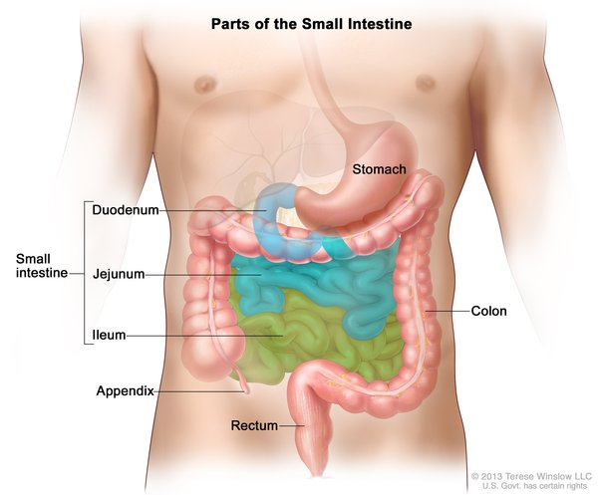
Lactose intolerance
People with lactose intolerance are unable to fully digest the sugar (lactose) in milk. As a result, they have diarrhea, gas and bloating after eating or drinking dairy products.
A deficiency of lactase — an enzyme produced in your small intestine — is usually responsible for lactose intolerance

Slide 35
Symptoms
Tests
Diarrhea
Abdominal cramps
Bloating
Gas
Lactose tolerance test.
Hydrogen breath test.
Stool acidity test.

Slide 36
Risk factors
age. (usually appears in adulthood. It’s uncommon in babies and young children)
Ethnicity. (common in people of African, Asian, Hispanic and American Indian descent)
Premature birth.
Diseases affecting the small intestine. (bacterial overgrowth, celiac disease and Crohn's disease)
Certain cancer treatments.

Slide 37
Treatments and drugs
There's currently no way to boost your body's production of lactase, but you can usually avoid the discomfort of lactose intolerance by:
Avoiding large servings of milk and other dairy products
Including small servings of dairy products in your regular meals
Eating and drinking lactose-reduced ice cream and milk
Drinking regular milk after you add a liquid or powder to it to break down the lactose
Maintain good nutrition

Slide 38
True or False
People suffering from irritable bowel syndrome for more than 10 years develop cancer.
Truth
False

Slide 39
True or False
People suffering from irritable bowel syndrome for more than 10 years develop cancer.
Truth
False

Slide 40
True or False
People with irritable bowel syndrome may suffer from either constipation only or diarrhea only
Truth
False

Slide 41
True or False
People with irritable bowel syndrome may suffer from either constipation only or diarrhea only
Truth
False

Slide 42
True or False
Rectal bleeding is a common presentation of irritable bowel syndrome
Truth
False

Slide 43
True or False
Rectal bleeding is a common presentation of irritable bowel syndrome
Truth
False

Slide 44
MCQ
Once other disease condition have been ruled out, a person can be considered for the diagnosis of irritable bowel syndrome if the symptoms were present for the last
One week
One fortnight
One month
Three months

Slide 45
MCQ
Once other disease condition have been ruled out, a person can be considered for the diagnosis of irritable bowel syndrome if the symptoms were present for the last
One week
One fortnight
One month
Three months

Slide 46
MCQ
The following are typical symptoms of IBS except:
Abdominal pain improves with defecation.
Onset of abdominal discomfort is associated with changes in normal stool.
Progressive abdominal pain.
Change in frequency of stool.

Slide 47
MCQ
The following are typical symptoms of IBS except:
Abdominal pain improves with defecation.
Onset of abdominal discomfort is associated with changes in normal stool.
Progressive abdominal pain.
Change in frequency of stool.

Slide 48
Refrences
UpToDate https://www.uptodate.com
NICE Guidelines https://www.nice.org.uk/
Healthy Bowel Guide http://www.cnwl.nhs.uk/wp-content/uploads/Healthy_Bowel-_Patient_Information_leaflet.pdf
Lecture of Prof. A Aljebreen, titled “abdominal pain and IBS” department of medicine, KSU/KKUH

Slide 49
Thank You
For Your Attention
Notes:
https://pixabay.com/en/typewriter-book-notebook-paper-801921/

