Slide 1
Maternal & Child Health
Student Led Seminar
FMED 421
Done by :
Saleh Alfulayyih
Suliman Alsuliman
Rakan Alhamoud
Supervised by :
Prof. Mohammad Al-Rukban

Slide 2
Objectives
Health behaviors and health systems indicators that affect the health, wellness, and quality of life of women, children, and families.
Factors can affect pregnancy and childbirth, including: Preconception health status, Age, Access to appropriate preconception and interconception health care, Poverty
Health risks may include: Hypertension and heart disease, Diabetes, Depression, Genetic conditions, Sexually transmitted diseases (STDs), Tobacco use and alcohol Abuse, Inadequate nutrition, Unhealthy weight
Social and Physical Determinants of Maternal Health
Social and Physical Determinants of Infant and Child Health
How to improve the health and well-being of women, infants, children, and families.

Slide 3
Quiz 1
Which of the following is a maternal health indicator recommended by WHO?
Sexually transmitted infections (STIs) incidence rate
Cervical cancer screening
Exclusive breastfeeding for six months (0–5 months)

Slide 4
Quiz 2
A 30 year old women delivered a baby with a cleft palate, which one of the following is the most likely causative agent ingested by the mother ?
Alcohol
Pencillin
proplonalol
tobacco smoking

Slide 5
Quiz 3
Which one of the following is a complication of drinking alcohol during pregnancy?
abnormal facial features
Cleft lip
eye infection
pneumonia
ectopic pregnancy

Slide 6
Quiz 4
Which one of the following is the major cause of maternal mortality in Saudi Arabia ?
infection
hemorrhage
high blood pressure
unsafe abortion

Slide 7
Quiz 5
Which one of the following vaccines is given to the mother before pregnancy ?
Measles
DTaP vaccine
Hepatitis B
TB

Slide 8
What is Maternal health
Maternal health refers to the health of women during pregnancy childbirth and the postpartum period.
The major direct causes of maternal morbidity and mortality include infection, hemorrhage, high blood pressure, unsafe abortion, and obstructed labour

Slide 10
Cont.
The MMR in developing countries in 2015 is 239 per 100 000 live births
Vs 12 per 100 000 live births in developed countries

Slide 12
Maternal Mortality Ratio
All maternal deaths occurring within a reference period
(usually 1 year) x100,000 ______________________________________________________ Total number of live births occurring within the reference period

Slide 13
Maternal Health Indicators
Maternal mortality ratio
Under-five child mortality, with the proportion of newborn deaths
Children under five who are stunted
Proportion of demand for family planning satisfied
Antenatal care coverage (at least four times during pregnancy)
Antiretroviral (ARV) prophylaxis among HIVpositive pregnant women to prevent HIV transmission and antiretroviral therapy for [pregnant] women who are treatment-eligible

Slide 14
Maternal Health Indicators
Skilled attendant at birth
Postnatal care for mothers and babies within two days of birth
Exclusive breastfeeding for six months (0–5 months)
Three doses of combined diphtheria-tetanuspertussis (DTP3) immunization coverage (12–23 months)
Antibiotic treatment for suspected pneumonia

Slide 15
Preconception Health Care

Slide 16
Preconception Health Care (Case)
Sarah is a 30-year old women with a known history of type II DM for 5 years. she smokes 10 cigarettes a day. She came to the Primary Care Clinic at KKUH for consultation about getting pregnant for the first time. On examination : Her BP was 160/90mmhg and Her BMI was 32.
# Which medical issues can complicate her pregnancy?
# What is the role of family physician here and how would you manage this patient?

Slide 17
Preconception Health Care
Preconception health care :
is the medical care a woman or man receives from the doctor or other health professionals that aimed to increase the chance of having a healthy baby.
- Should ideally take place 3-6 months before conception.
# Is it only for woman ?
# What are the items that covered by Preconception Health Care ?

Slide 18
Minimizing occupational risks.
Prescribing folic acid
Control and treat underlying medical conditions
Maximizing chronic illness care
Improving health habits
Review current medications and assess safety
Vaccinations
Genetic screening

Slide 19
Carrier Screening
sickle cell disease in blacks
current recommendations state that all women should be offered carrier screening for cystic fibrosis.

Slide 20
Prenatal care

Slide 21
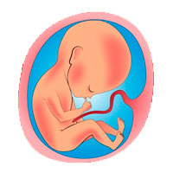
Prenatal care
Is the care a woman gets during pregnancy.
During the First Visit
probably sometime after the eighth week of pregnancy.
Most health care providers won’t schedule a visit any earlier unless you have a medical condition,

Slide 22
Urine sample for infection and to confirm your pregnancy.
Blood pressure, weight, and height.
Prenatal blood tests
Gonorrhea and chlamydia cultures, and Pap test to screen for cervical cancer.
Ultrasound test.
Complete physical exam, including a pelvic exam.

Slide 23
Factors Affecting Pregnancy
Existing Health Conditions
Age
Lifestyle Factors
Conditions of Pregnancy

Slide 24
High risk Factor in maternal and child health
HTN
Heart Disease
GDM
Tobacco &alcohol use
STDs
Nutrition
Unhealthy weight
Genetic factor
Post partum depression

Slide 25
Hypertension
most common medical problem encountered during pregnancy,
complicating 2-3% of pregnancies
complication:
preeclampsia : BP and signs of damage to another organ system (proteinuria) , usually after 20 weeks of pregnancy
Failure to thrive, seizures, , lack of energy, and difficulty in breathing can be associated with hypertension in neonates
Why is high blood pressure a problem during pregnancy?
Decreased blood flow to the placenta
Premature delivery
Placental abruption
Future cardiovascular disease

Slide 26
Heart disease
Leading Cause of death of maternal death worldwide
Myocardial inarction
cardiomyopathy
Rheumatic heart disease

Slide 27
Gestational Diabetes mellitus
is when a woman without diabetes, develops high blood sugar levels during pregnancy
Approximately 7% of all pregnancies are complicated by GDM more than 200,000 annually.
in gestational diabetes, blood sugar usually returns to normal soon after delivery. But you're at risk for type 2 diabetes.
Risk factors?
Age greater than 25
Excess weight (30 or higher BMI)
Family or personal health history.

Slide 28
complication
mother
baby
Future DM
preeclampsia
birth weight
Preterm birth with respiratory distress syndrome
Blood sugars

Slide 29
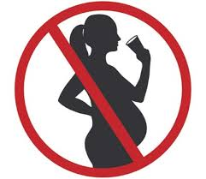
Alcohol use
Can pregnant women drink small amount of alcohol or beer? Why?
There is No known safe amount of alcohol use during pregnancy.
Why Alcohol is Dangerous?
Alcohol in the mother's blood passes to the baby through the umbilical cord
Complication of drinking alcohol during:
miscarriage, stillbirth
abnormal facial features
Growth and central nervous system problems

Slide 30
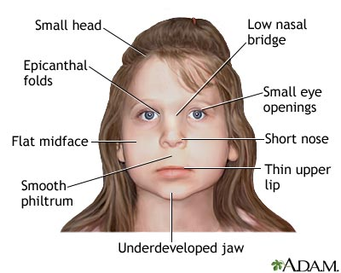
Fetal alcohol spectrum disorders
FASD is a group of disorders caused by prenatal exposure to alcohol.

Slide 31
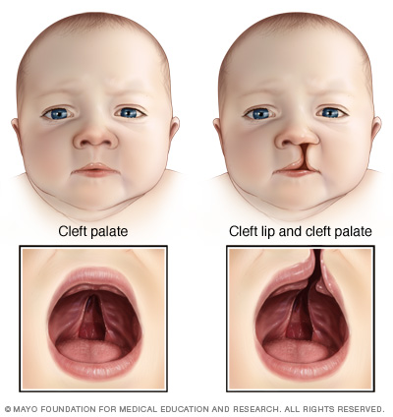
Smoking
Smoking effect:
harder for a woman to get pregnant.
placenta can separate
Sudden Infant Death Syndrome
Cleft lip or cleft palate
Second smoke effect:
baby who weighs less.
Ear infections AND asthma attacks
cleft lip and cleft palate

Slide 32
STDs . 1-Perinatal HIV/AIDS
It recommends that all women who are pregnant or planning to get pregnant should get tested for HIV as early as possible.
If a woman is treated for HIV early in her pregnancy, the risk of transmitting HIV to her baby can be 1% or less.
How to lower the risk of transmitting HIV from the mother to their babies?
HIV medicines
No breastfeeding
Cesarean delivery
No pre-chewing her baby’s food.

Slide 33
STDs
2- Chlamydia :
Most women have NO symptoms and it is Easy to cure
Chlamydia lesions on genitals are highly contagious and infect the baby during labor
The risk in pregnancy : early delivery, eye infection or ectopic pregnancy.
3-Gonorrhea
The risk in pregnancy :miscarriage, preterm birth
The risk before and after pregnancy if untreated : cause pelvic inflammatory disease
Gonorrhea in newborns most commonly affects the eyes

Slide 34
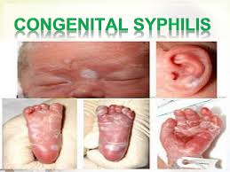
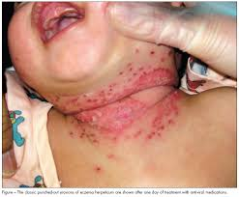
4-Syphilis:
Typically occurs during second half of pregnancy
May be transmitted to baby by infected mother.
It be linked to premature birth, stillbirth.
death in some cases
5-Herpes simplex virus:
Herpes is safe in pregnant women until she get ready to deliver.
Herpes lesions on genitals are highly contagious and infect the baby during labor

Slide 35
Case
Norah is 28years old pregnant women complain with abdominal pain ,nausea and fever 2 days ago . She notice her urine was dark.
And she had +ve blood donation weeks ago.
What is the hypothesis of this case ?
Hepatitis B,C
HIV
On physical examination :yellowish of the skin
We do HIV test and the result was –ve and HBsAG was +ve and anti HcV was -ve
What is the deferential diagnoses ?
Hepatitis B
Can Hepatitis B be spread to babies?
What we can do to reduce the chance of Transmission of
Hepatitis B to the baby?

Slide 36
Hepatitis b | Hepatitis C
Mostly: during delivery ,nursing ,breast feeding | RNA levels in her blood, and HIV positive
CDC recommends that babies get the HBIG shot and the first dose of Hepatitis B vaccine within 12 hours of being born. | There is no preventive treatment can influence the transmission.

Slide 37
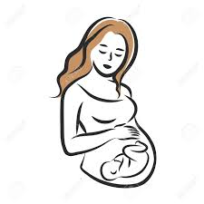
Poor nutrition
mother
baby
malnutrition
fail to gain weight in pregnancy
low-birth weight
Mother die while pregnant
restricted fetal growth
Iron : Preterm birth
and anemia (risk of death from bleeding during childbirth)
Calcium: prevent baby from draw calcium from his mother bone.
Folate : neural tube defect
Micro nutrition
Calcium:? poor skeletal development
Iron: low birth weight

Slide 38
Unhealthy weight
A women weight before and during pregnancy are important indicators of health for both mother and child.
Recent CDC studies showed overweight or obese before pregnancy associated with a higher pregnancy complication.
Genetic conditions
more than 50 per cent of miscarriages in the early stages of pregnancy are due to abnormalities of the chromosomes.

Slide 39
Social and Physical Determinants of Maternal and child Health
Race and ethnicity
pre-pregnancy health
income level
socioeconomic factors
age
medical insurance coverage

Slide 40
Facts
Healthy children need healthy mothers.
5.9 million children under age five died in 2015, 16000 every day.
A woman dies from complications in childbirth every minute.
With quality health care, many of these deaths could be prevented.

Slide 41
Cont.
Studies have shown that many lives can be saved by the prober interventions.
Most maternal and infant deaths occur in the first month after birth: about 50 % within 24 hours and 66% during the first week.
The majority of maternal deaths take place in developing countries (99%) where access to health care is low.

Slide 42
Home Birth
A 30 year old Women came to you asking if she could deliver her child safely at home with trained midwife, what is your recommendation?
A planned home birth isn't right for everyone. (depend🤔 )
Caution in these situation?
diabetes
Previously had a C-section
Risk of home birth :
Double to triple the risk of infant death than are planned hospital births.

Slide 43
Postnatal Care

Slide 44
Postnatal Care Highlights
Provide postnatal care in first 24 hours for every birth:
Delay facility discharge for at least 24 hours.
Visit women with home births within the first 24 hours.
Provide every mother and baby four postnatal visits on : First day (24 hours), Day 3 (48–72 hours) , Between days 7–14 and the Sixth week.

Slide 45
How to improve maternal health
First 24 hours : assessment of vaginal bleeding, uterine contraction, temperature and heart rate should be done routinely during the first 24 hours
Breastfeeding should be assessed
women should be asked about their emotional wellbeing, what family and social support they have
Iron and folic acid supplementation should be provided for at least 3 months after delivery.
After 10–14 days, all women should be asked about postpartum depression

Slide 46
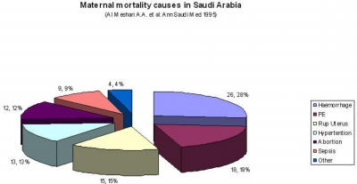

Slide 47
Postpartum depression
1 in 9 women experience depression before, during, or after pregnancy
Symptoms :
Causes:
Crying more often than usual.
Feelings of anger.
Insomnia
Difficulty bonding with their baby
Physical changes.
Emotional issues.
Risk Factor:
Stress.
Low social support
Preterm (before 37 weeks) labor and delivery.
Having a baby with a birth defect or disability.

Slide 48
Developmental Milestones

Slide 50
How to improve infancy health
promote early and exclusive breastfeeding (EBF):
Evidence shows EBF reduces the risks of mortality and morbidity and improves post-neonatal outcomes
Preterm and low-birth-weight babies should be identified as soon as possible and should be provided special care.
A full clinical examination should be done 1 hour after birth. This includes giving vitamin K prophylaxis and hepatitis B vaccination (within 24 hours).

Slide 52
Vaccinations
Pregnancy:
Infant:
hepatitis B
TB
Chickenpox
Before
During
Measles
rubella
DTaP vaccine to protect
against whooping cough
Flu shot could be taken during or before pregnancy

Slide 55
Millennium Development Goal 5
MDG 5: was set at 2000 by the WHO, With two main goals :
Target 5. A: reduce maternal mortality by three quarters between 1990 and 2015.
Target 5. B: to achieve universal access to reproductive health by 2015.
Between 1990 and 2015, maternal mortality worldwide dropped by about 45%.

Slide 56
Video
https://www.youtube.com/watch?v=74cUQepOnbQ&t=4s

Slide 57
Quiz 1
Which of the following is a maternal health indicator recommended by WHO?
Sexually transmitted infections (STIs) incidence rate
Cervical cancer screening
Exclusive breastfeeding for six months (0–5 months)

Slide 58
Quiz 2
A 30 year old women delivered a baby with a cleft palate, which one of the following is the most likely causative agent ingested by the mother ?
Alcohol
Pencillin
proplonalol
tobacco smoking

Slide 59
Quiz 3
Which one of the following is a complication of drinking alcohol during pregnancy?
abnormal facial features
Cleft lip
eye infection
pneumonia
ectopic pregnancy

Slide 60
Quiz 4
Which one of the following is the major cause of maternal mortality in Saudi Arabia ?
infection
hemorrhage
high blood pressure
unsafe abortion

Slide 61
Quiz 5
Which one of the following vaccines is given to the mother before pregnancy ?
Measles
DTaP vaccine
Hepatitis B
TB

Slide 62
http://www.who.int/topics/maternal_health/en/
http://www.who.int/woman_child_accountability/progress_information/recommendation2/en/
http://www.who.int/gho/countries/sau/country_profiles/en/
http://www.who.int/gho/child_health/en/
https://www.cdc.gov/ncbddd/fasd/alcohol-use.html
http://www.who.int/maternal_child_adolescent/publications/WHO-MCA-PNC-2014-Briefer_A4.pdf?ua=1
http://www.who.int/mediacentre/factsheets/fs178/en/
http://www.who.int/mediacentre/factsheets/fs348/en/
http://www.who.int/mediacentre/factsheets/fs290/en/
http://www.who.int/topics/millennium_development_goals/maternal_health/en/
http://www.cdc.gov/preconception/planning.html
https://www.nichd.nih.gov/health/topics/preconceptioncare/conditioninfo/pages/prenatal-visits.aspx
https://www.healthypeople.gov/2020/leading-health-indicators/2020-lhi-topics/Maternal-Infant-and-Child-Health/determinants
https://www.cdc.gov/reproductivehealth/maternalinfanthealth/tobaccousepregnancy/
http://blogs.ubc.ca/middlechildhoodintervention2/category/2-1-children-with-nervous-system-disorders-fatal-alcohol-spectrum-disorder-fasd/
http://ispub.com/IJH/3/2/6236
http://www.mayoclinic.org/diseases-conditions/postpartum-depression/basics/causes/con-20029130
https://www.cdc.gov/std/pregnancy/stdfact-pregnancy.htm\

