Slide 1
Smoking and substance abuse
Mojahed Otayf
Abdullah alrsheed
Khalid alnasser
Muhannad alwabel
PROF. Jamal jarallah

Slide 2
Objectives:
Epidemiology of smoking in Saudi Arabia
Risks of smoking (Morbidity and Mortality)
Effect of passive smoking on pregnancy, children, ….
How are you going to help the smoker to quit and how to overcome withdrawal symptoms
Role of PHC physician “smoking cessation clinic’
Update in pharmacological management, smoking cessation medication
Nicotine preparations, Varniciline, Bupropion.
Factors lead to substance abuse
Highlight on types of substance abuse
How to approach subjects with substance abuse

Slide 3
Q1: What is the most common diseases developed secondary to smoking?
Cancer
Cardiovascular diseases
Respiratory diseases
GI diseases

Slide 4
Q2: What is the medication that is used for alcohol abuse?
Naloxone
Benzodiazepine
Naltrexone
Physostigmine

Slide 5
Q3: When it is contraindicated to use Bupropion?
Heart disease
Seizure
Kidney stones
Peptic ulcer

Slide 6
Q4: What is the most effective way for smokers to quit?
A. Sudden withdrawal
B. Following Doctor advices
C. Family support
D. Following peer advices

Slide 7
Tobacco use is one of the main risk factors for a number of chronic diseases, including cancer, lung diseases, and cardiovascular diseases.

Slide 8
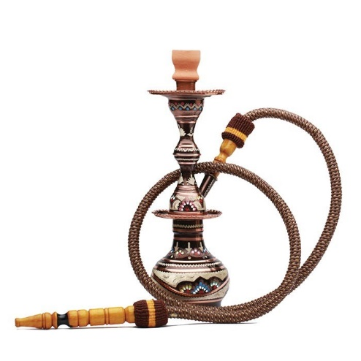
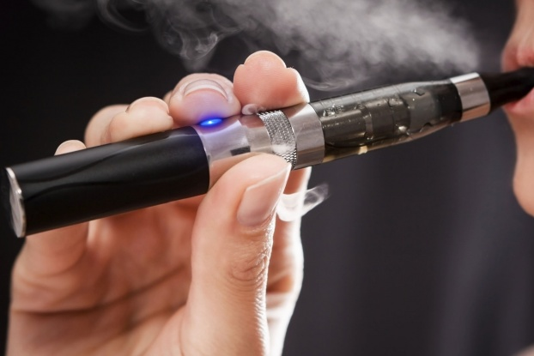
Types of Tobacco
Cigarettes
Shisha
E-Cigarettes

Slide 9
Epidemiology

Slide 11
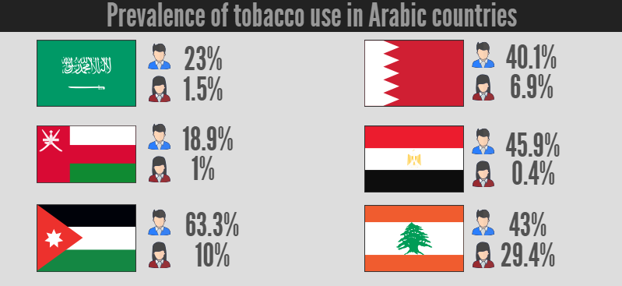

Slide 12
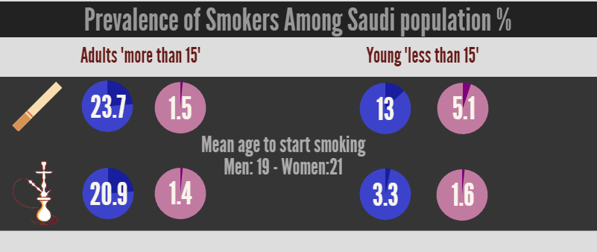

Slide 13
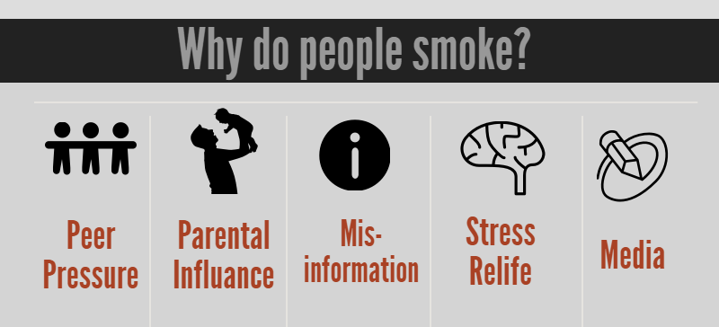

Slide 14
Risks of smoking

Slide 15
Notes:
Cardiovascular Disease:
stroke
coronary heart disease
Respiratory diseases:
COPD, which includes emphysema and chronic bronchitis.
lung cancer
Triggers asthma attack
Smoking can cause cancer almost anywhere in your body

Slide 16
Health Effects of Secondhand Smoke

Slide 18
Role of PHC “smoking cessation clinics” and “Approaching smokers to quit”

Slide 19
PHC “smoking cessation clinics” role
It deals with smokers who are not thinking of quitting yet, and others thinking of quitting, and some ready to quit and already quitters.
It includes also pharmacological preparations and long–short term follow-ups.

Slide 20
Getting ready to quit “ self approachment ”
Start your stop smoking plan with "START "
S = Set a quit date.
T = Tell family, friends, and co-workers that you plan to quit.
A = Anticipate and plan for the challenges you'll face while quitting.
R = Remove cigarettes and other tobacco products from your home, car, and work.
T = Talk to your doctor about getting help to quit.

Slide 21
Dealing with smokers whom are not considering about quitting:
Objective:
To help the patient reflect on his/her smoking.
Ask about and discuss the impact of smoking on the patient’s life.
Link every smoking-related illness in the patient to his/her smoking.
Provide a strong personalized message.
Encourage patient to make his/her house and car smoke free.
Provide relevant educational materials.

Slide 22
Dealing with smokers whom are considering about quitting:
Objective:
To increase patient’s motivation to quit.
Offer to help your patient.
Ask about your patient’s concerns about quitting and discuss ways of dealing with them
Provide patient materials
Suggest a follow-up visit.

Slide 23
Dealing with smokers whom are ready to quit:
Objective:
To help the patient find the right treatment. Note: A special, longer appointment may be necessary.
Assess nicotine dependence, past quitting history and comorbidity
Ask about other smokers in the patient’s home and workplace.

Slide 24
Dealing with already quitted smokers:
Objective:
Support Strategies
Congratulate the patient on his/her efforts.
Encourage the patient to establish a self reward system and use positive self-talk.
Behavioral Strategies
Discuss coping strategies for withdrawal symptoms, urges and triggers.
Discuss strategies for dealing with slips and relapses
Tools
Review use of stop-smoking medications, if relevant.
Follow-up
Develop a specific follow-up plan that includes several visits or numerous phone contacts.

Slide 25
Generally, these are some advices that could help in quitting:
spend as much free time as you can in public places where smoking is not allowed.
Don’t drink alcohol, coffee, or any other drinks you link with smoking for at least a couple of months.
If you miss the feeling of having a cigarette in your hand, hold something else ( a pencil, a coin ) .

Slide 26
If you miss the feeling of having something in your mouth, try (toothpicks, cinnamon sticks, السواك)
Call a friend, family member, or a telephone stop-smoking help-line when you need extra help or support.
Work out to relieve stress
Attend group behavior therapy involves scheduled meetings where people who smoke receive information, advice and encouragement and some form of behavioral intervention

Slide 27
Withdrawal and Pharmacological tools ( Nicotine prep, Bupropion, Varenicline )

Slide 28
Withdrawal
Characterized by symptoms that include headache, anxiety, nausea and a craving for more tobacco.
Nicotine creates a chemical dependency, so that the body develops a need for a certain level of nicotine at all times.
Other Symptoms of withdrawal include feeling:
Irritated.
Angry.
Restless.
Hungrier than usual.

Slide 29
People going through withdrawal may find it hard to:
- Concentrate.
- Sleep.
- Cope with cravings.
- Deal with stress.
How to over come it?
Nicotine Replacement Products or Quitting Medication.
Do exercise you enjoy.
Get involved in new or favorite hobbies.
Focus on relaxation

Slide 30
Pharmacological tools:
There are many different stop-smoking medications available.
Nicotine replacement therapy: “Range of quitting 19% - 26%.”
nicotine patch
nicotine gum
nicotine nasal spray
nicotine inhaler
Bupropion . “Range of quitting about 24%”
Varenicline. “Range of quitting about 33%”

Slide 31
Different pharmacological tools:
Before choosing a pharmacologic tool physician should consider “Advantages of each, Disadvantages, Contraindications

Slide 32
NRT
Nicotine skin patch: “Habitrol, Nicoderm, Nicotrol”
How to use?
For a light smoker (≤ 20 cigarettes per day), start 14 or 7 mg.
For a heavy smoker (> 20 cigarettes per day) start 21 mg
For how long?
8-12 weeks or longer if necessary.

Slide 33
Possible side effects?
local skin reaction, disturbed sleep, nightmares.
Contraindications?
pregnant and breastfeeding, have had unstable heart condition in the past 2 weeks
Advantages:
needs only to be applied once a day, can control craving for 24 hours, delays weight gain while using it.

Slide 34
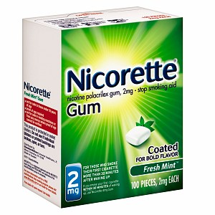
NRT
Nicotine gum (Nicorette):
How to use?
piece of gum every 1-2 hours. 2 mg for a light smoker (≤ 20 cigarettes per day).
4 mg for a heavy smoker (> 20 cigarettes per day). stop smoking before starting.
For how long?
several weeks to several months or longer if necessary.

Slide 35
Possible side effects?
burning in throat, hiccups if chewed too quickly, dental problems.
Contraindications?
pregnant and breast feeding. have had unstable heart condition in the past 2 weeks.
Advantages?
you can control when to take nicotine and how much. Satisfies oral cravings. Delays weight gain while using it.

Slide 36
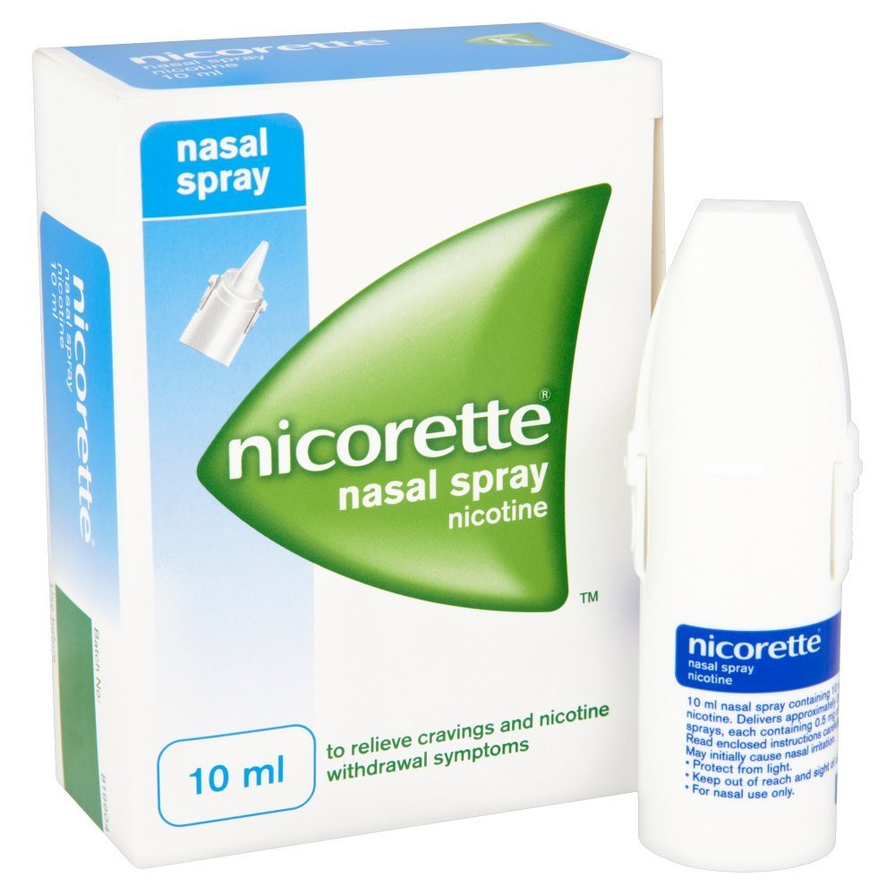
NRT
Nicotine nasal spray:
Nicotine here is absorbed faster. And also its available for prescription use only.
Possible side effects?
hot, peppery feeling in the back of the nose or throat
runny nose
throat irritation
watering eyes
sneezing
coughing

Slide 37
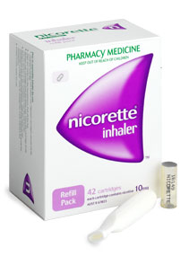
NRT
Nicotine inhalator :
The inhalator releases nicotine into your mouth when you inhale.
The nicotine is then absorbed through the lining of your mouth and enters the bloodstream. The nicotine is sufficient to relieve unpleasant withdrawal symptoms and to decrease the cravings for smoking.
Possible side effects:
Local irritation reactions, Coughing and rhinitis.
it is contraindicated in case of bronchospastic disease.

Slide 38
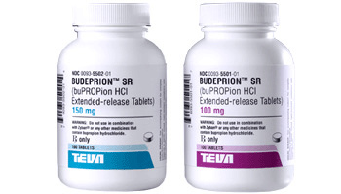
Bupropion
How to use it?
150 mg once a day (in the morning) for 3 days.
Then twice a day.
Start 7-14 days before quit date.
For how long?
7-12 weeks or longer if necessary.

Slide 39
Possible side effects?
Dry mouth & insomnia. Minimal weight gain while you use it.
Contraindications?
pregnant or breastfeeding. History of seizures. Eating disorders. Taking monoamine oxidase inhibitors.
Advantages?
Inexpensive. improves depression.

Slide 40
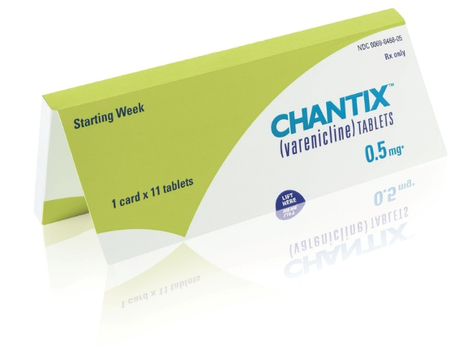
Varenicline
Possible side effects?
Neuropsychiatric effects including depression and suicidal thoughts
Abnormal dreams and Nightmares
Cardiovascular effects
Headache
Nausea
Insomnia
Visual disturbances

Slide 41
Physical Benefits
Two hours after you quit, the amount of nicotine in your bloodstream will drop by half.
Eight hours after quitting, there will be more oxygen in your body and your blood pressure will begin to lower.
Your risk of developing cancer, heart disease, stroke and ulcers will go down.
You will be protecting your family from the dangers of second-hand smoke.

Slide 42
If you are pregnant, you will help prevent complications such as miscarriage and premature delivery, and your baby will more likely have a normal birth weight.
Food will taste better and your sense of smell will improve.
Your teeth will be less stained.
You will have more energy.
Physical activities will be easier and more enjoyable.

Slide 43
In Summary
Quitting starts with self approaching and cooperation with the physician’s advices including pharmacological tools then follow-ups as advised by the physician.

Slide 44
Case based discussion

Slide 45
27 year-old male visits the PHC clinic. He is willing and ready to quit from smoking.
How to approach this patient?
1- Taking history of smoking (type, numbers per day, comorbidities, for how long, If tried to quit before?, other smokers at home/work place?)
2- Assess the patient willing (START?)

Slide 46
From the history we found that this patient smokes 10 cigarette per day for the last 5 years and he has a history of multiple seizures attacks and he is on medications.
We start the management with advices (mention?)
Start pharmacotherapy (What should we give him?)
AVOID bupropion (WHY?)
Follow-up

Slide 47
Substance Abuse

Slide 48
OVERVIEW — Substance use disorders (SUD) are easy to recognize in the patient who has just been arrested for a motor vehicle violation or who presents with a request to discontinue using drugs.
Patient denial is a significant barrier to identifying patients needing help for SUD

Slide 49
●Risky use —
characterized by consumption amounts that increase the likelihood of health consequences.
●Physical dependence —
A state of adaptation that is manifested by a withdrawal syndrome that can be produced by abrupt cessation of a substance or by tolerance to the substance.

Slide 50
●Addiction — A primary, chronic, neurobiologic disease, with psychosocial, and environmental factors influencing its development and manifestations. Addiction is characterized by behaviors that include impaired control over substance use, compulsive use, continued use despite harm, and craving [5].
●Unhealthy alcohol or other drug use — Unhealthy use refers to the spectrum of use that can result in health consequences.

Slide 51
Factors lead to SUD
Financial problems
Problems at school or at work
Parents who have the same problem
Traumatic accidents
Smoking and caffeine
Friends (F→M)
Health care worker
Other gender friend who have SUD

Slide 52
Types of substance abuse
Alcohol :
FEATURES
a strong need to drink - Loss of control - Physical dependence (withdrawal symptoms) - the need to drink more alcohol to feel the same effect
Treatment:
Behavioral Treatments – Medications(Naltrexone) - Mutual-Support Groups

Slide 53
Opioid:
FEATURES
pin point pupil – coma – respiratory depression
treatment :
Naloxone
Sympathomimetic:
FEATURES
dilation of the pupil – tachycardia – sweating
Treatment:
supportive care – benzodiazepine.

Slide 54
As A Friend
1955

Slide 55
As A Doctor
detoxification (the process by which the body rids itself of a drug)
behavioral counseling
medication
evaluation and treatment for co-occurring mental health issues such as depression and anxiety
long-term follow-up to prevent relapse

Slide 56
Q1: What is the most common diseases developed secondary to smoking?
Cancer
Cardiovascular diseases
Respiratory diseases
GI diseases

Slide 57
Q2: What is the medication that is used for alcohol abuse?
Naloxone
Benzodiazepine
Naltrexone
Physostigmine

Slide 58
Q3: When it is contraindicated to use Bupropion?
Heart disease
Seizure
Kidney stones
Peptic ulcer

Slide 59
Q4: what is the most effective way for smokers to quit?
A. Sudden withdrawal
B. Following Doctor advices
C. Family support
D. Following peer advices

Slide 60
References
http://www.who.int/tobacco/surveillance/policy/country_profile/sau.pdf
https://www.cdc.gov/tobacco/data_statistics/fact_sheets/health_effects/effects_cig_smoking/
https://www.cdc.gov/tobacco/data_statistics/fact_sheets/secondhand_smoke/health_effects/
Silagy C, Ketteridge S. Physician advice for smoking cessation. The Cochrane Library 1998.
National Health Service Executive. Smoking cessation guidelines for health professionals. Thorax 1998; (54 Suppl): S1-S19
Goldberg DN et al. Physician delivery of smoking-cessation advice based on the stages-of-change model. Am J Prev Med 1994; 10:267-74
Substance use disorder: Principles for recognition and assessment in general medical care
https://medlineplus.gov/alcoholismandalcoholabuse.html
National Institute on Alcohol Abuse and Alcoholism
3rd year toxicology
http://www.quit.org.au/staying-quit/managing-nicotine-withdrawal
http://www.cancer.org/healthy/stayawayfromtobacco/quitting-smoking-help-for-cravings-and-tough-situations
https://www.nice.org.uk/guidance/ph10/chapter/4-Recommendations#pharmocotherapies-and-other-treatments

