Slide 1
Sore throate
Otitis media
Sinusitis

Slide 2
MCQs

Slide 3
MCQs
A 4 year old child presented to the ER with dysphagia, respiratory difficulty and drooling for 12 hours. the ER doctor refuses to examine the child and he called the doctor. what is the best action that the doctor should do ?
A-Performing endoscopic examination to the larynx.
B-Take a throat swab.
C-Take the child to the OR
D-Request an X-ray for the neck.
A patient presented with snoring and obstructive sleep apnea. throat examination show kissing tonsils. what is the most appropriate treatment for the patient ?
A-Adenotonsillectomy
B-Amoxicillin
C-Observation
D-Non of the above
A 2 years old child presented with his family to the primary care clinic complaining of severe pain and some sort of hearing loss in the right ear for 3 days , a diagnosis of acute otitis media was made. How would you manage this patient ?
A-Give Amoxicillin for 7-10 days.
B-Reassure the patient and tell the family it’s a self-limiting infection.
C-Observe for 3 days and check for improvement.
D-Prescribe analgesia and tell the patient to take it as needed.

Slide 4
A 5 years old boy came to the primary clinic because of sudden onset of deafness in left ear, history revealed presence of fever and otalgia for the last week, which are no more present. While examining the patient by otoscopy, what is expected to be seen ?
A-Swelled and reddened tympanic membrane.
B-Bulging of tympanic membrane.
C-Retraction of tympanic membrane.
D-Ruptured tympanic membrane.
A 30 Y/O male came to the clinic with complain of headache ,nasal discharge, fever and loss of smell. he is normal otherwise. He mentioned that he recently recovered from URTI.
What is the most likely diagnosis ?
A-Tonsillitis.
B-Pre-septal cellulitis.
C-Sinusitis.
D-Allergic rhinitis.
ALL of the below are considered to be good management choices to treat allergic rhinitis except :
A-Oral antihistamines.
B-Decongestants.
C-Avoiding exposure to allergic substances.
D-Antibiotics.

Slide 5
Sore throate

Slide 6
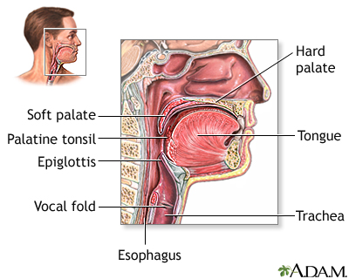

Slide 7
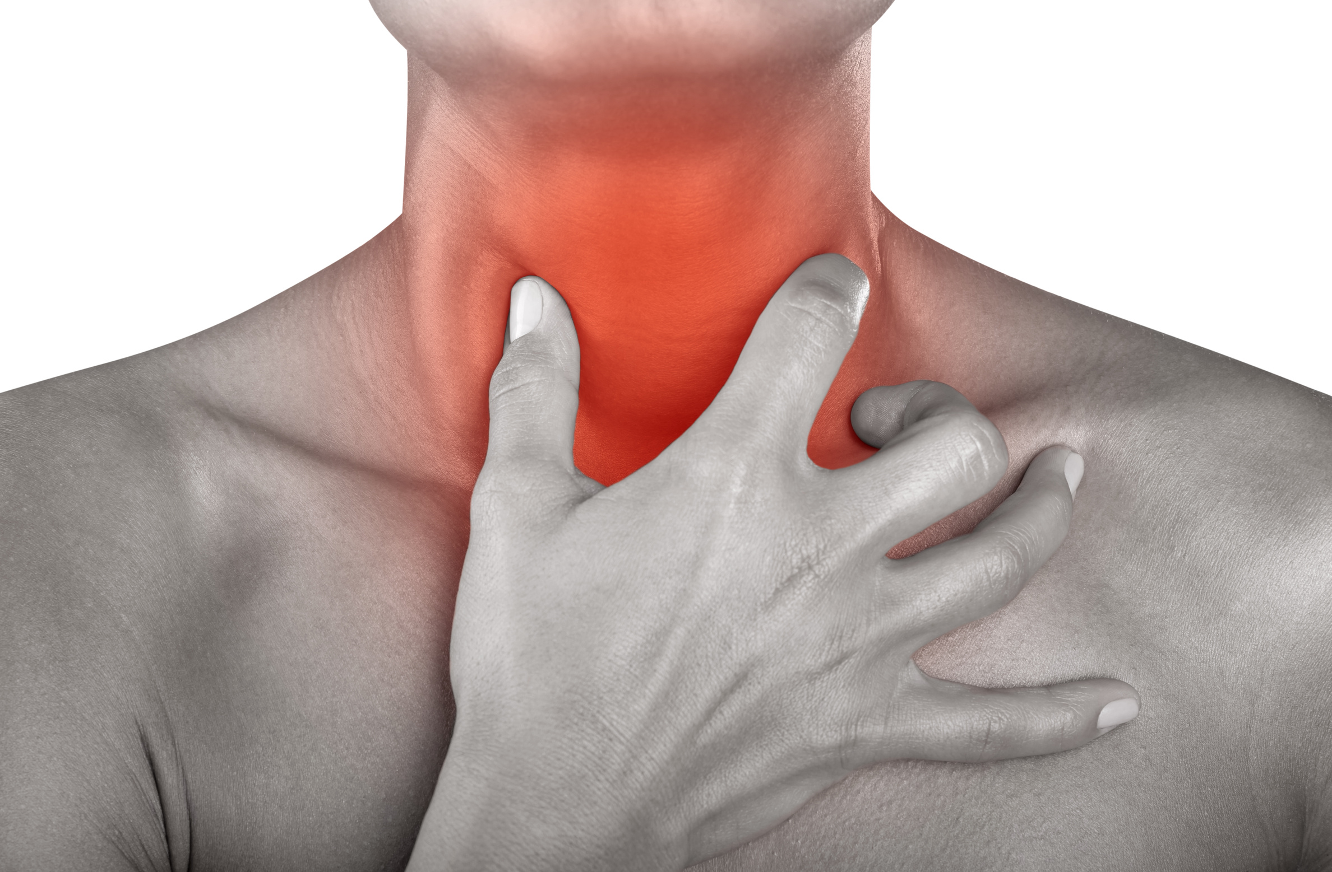
Sore throat
A sore throat refers to pain, itchiness, or irritation of the throat. You may have difficulty swallowing food and liquids, and the pain may get worse when you try to swallow.
Symptoms:
A dry throat.
Swollen glands in the neck.
White patches on the tonsils.
Hoarseness.
Fever.
Chills.

Slide 8
Sore throat
What are the causes?
There are several causes of a sore throat.
The majority of sore throats are triggered by a viral infection such as Rhinovirus, coronavirus and parainfluenza virus.
Other viral causes are: Influenza virus, adenovirus, herpes simplex virus type 1, EBV (causes infectious mononucleosis).

Slide 9
Sore throat
Causes:
Bacterial:
The most important and most common cause of bacterial pharyngitis is group A beta haemolytic streptococcus (GABHS) (5-20% in adults, 15- 30% in children).
There are other rare causes e.g. haemophilus influenzae, Neisseria gonorrhoeae and others.
It can be because of GERD or allergens.

Slide 10
Who can give examples of diseases that cause sore throat ?

Slide 11
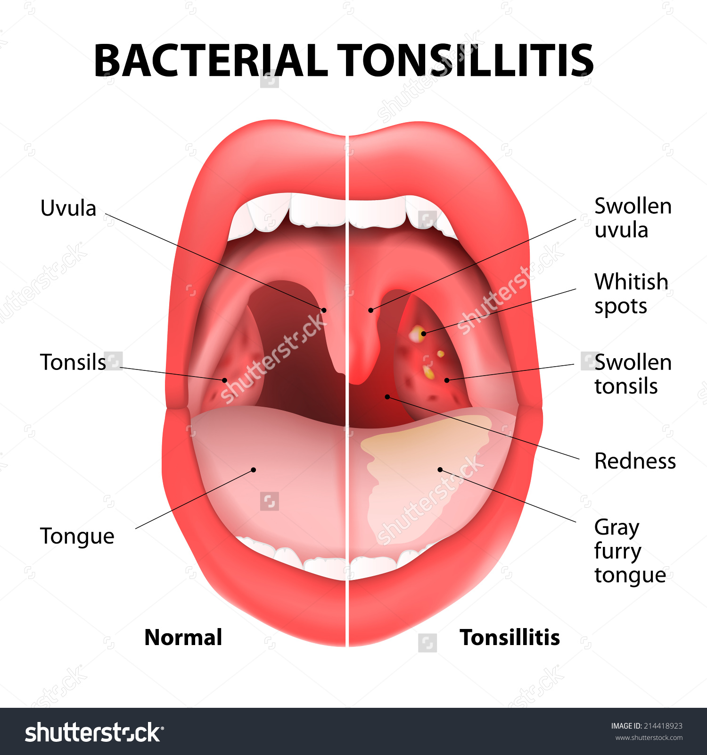
1-Tonsillitis
Inflammation of the tonsils.
The most important and most common cause of it is group A beta haemolytic streptococcus (GABHS).
The main symptom is Throat Pain, dysphagia, fever and enlarged lymph nodes.

Slide 12
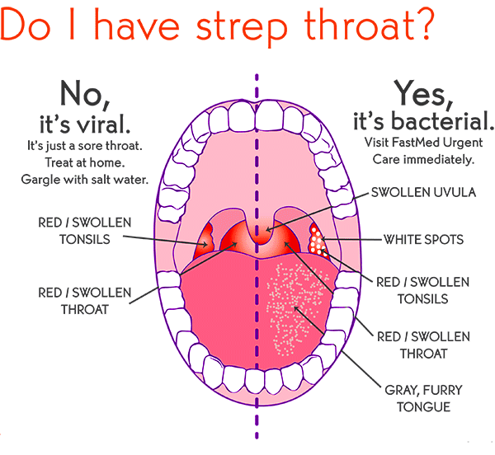
2-pharyngitis
Inflammation of the pharynx.
Commonly caused by viral infections such as: common cold, influenza virus and mononucleosis.
The main symptom is Throat Pain, dysphagia, fever and enlarged lymph nodes.

Slide 13
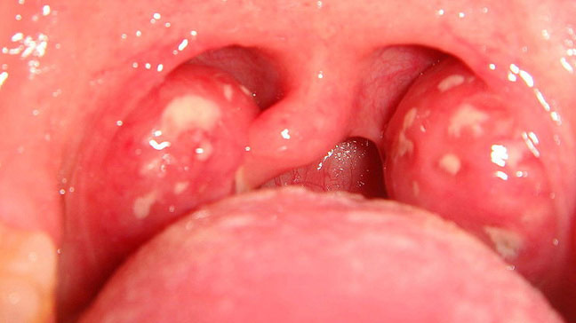
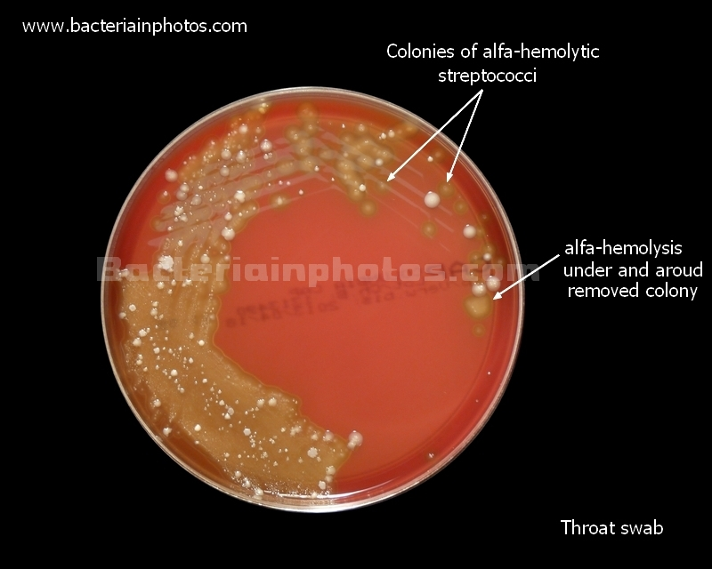
Diagnosis and investigations
First :
History.
Physical examination.
Second :
Exclude bacterial causes.
Throat examination. (Inflammation or white patches).
Throat swab and culture.

Slide 14
List of other diseases that can cause sore throat
Epiglottitis
Retropharyngeal abscess
Peritonsillar abscess.
Diphtheria

Slide 15
Complications
Middle ear infection (Otitis Media).
Sinusitis.
Retreopharyngeal abscess.
Peritonsillar abscess.
Toxic shock syndrome

Slide 16
Prevention
Avoid contact with sick people.
Wash your hands.
Identify and avoid irritants .
Don’t smoke and avoid exposure to secondhand smoke.

Slide 17
Treatment
Q-when do we have to use Antibiotics?
Viral infections:
Usually it’s self limited and doesn’t required medications.
For the fever and pain , use acetaminophen.
Do not give aspirin for pain or fever to children younger than 12 year (Reyes syndrome)
Bacterial infection:
First line of treatment is penicillin.
Drink plenty of cool or warm fluids, and avoid very hot drinks.
Eat cool, soft foods.
Avoid smoking and smoky place.

Slide 18
Sinusitis

Slide 19
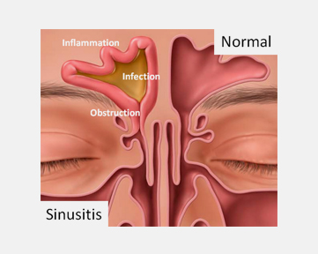
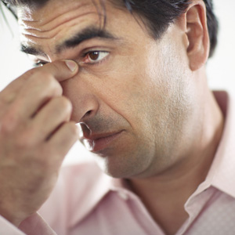
Sinusitis
Sinusitis and Rhinosinusitis refer to inflammation in the nasal cavity and paranasal sinuses.

Slide 20
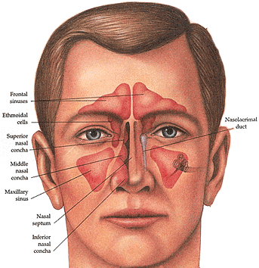
sinuses
normal sinuses are filled with air.
lined by respiratory epithelium (ciliated pseudostratified columnar epithelium).
The mucus produced by the sinuses usually drains into the nose.
When they get inflamed they get blocked and get filled by mucus and become a good media for microorganism.

Slide 21
Classification of Sinusitis
Acute Sinusitis
Chronic sinusitis
Recurrent acute sinusitis
Between 4 weeks and 12 weeks.
More than 12 weeks.
Diagnosed when infection occurs 2-4 times per year.
Less than 4 Weeks.
Subacute Sinusitis

Slide 22
Etiology
Infectious:
Viral
(Rhinovirus, Influenza virus).
Bacterial
(Streptococcus pneumoniae, Haemophilus influenzae).
Fungal
(Aspergillus , Curvularia).
CT of Fungal sinusitis

Slide 23
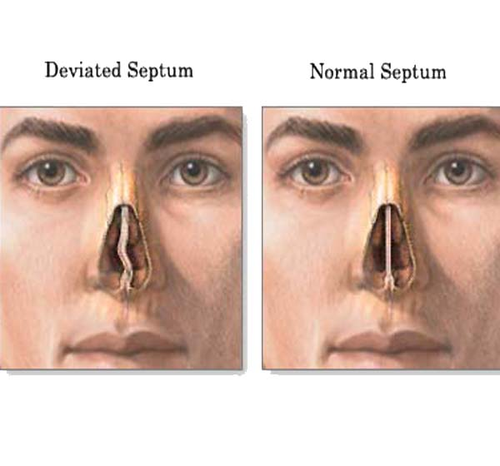
Etiology
Non-Infectious:
Nasal obstruction by
nasal polyps, Tumors, mucous plug, septal deviation.
Primary ciliary dyskinesia.
Patients with immune deficiency or hyper inflammatory disease such as Wegner's disease.
Cystic fibrosis .

Slide 24
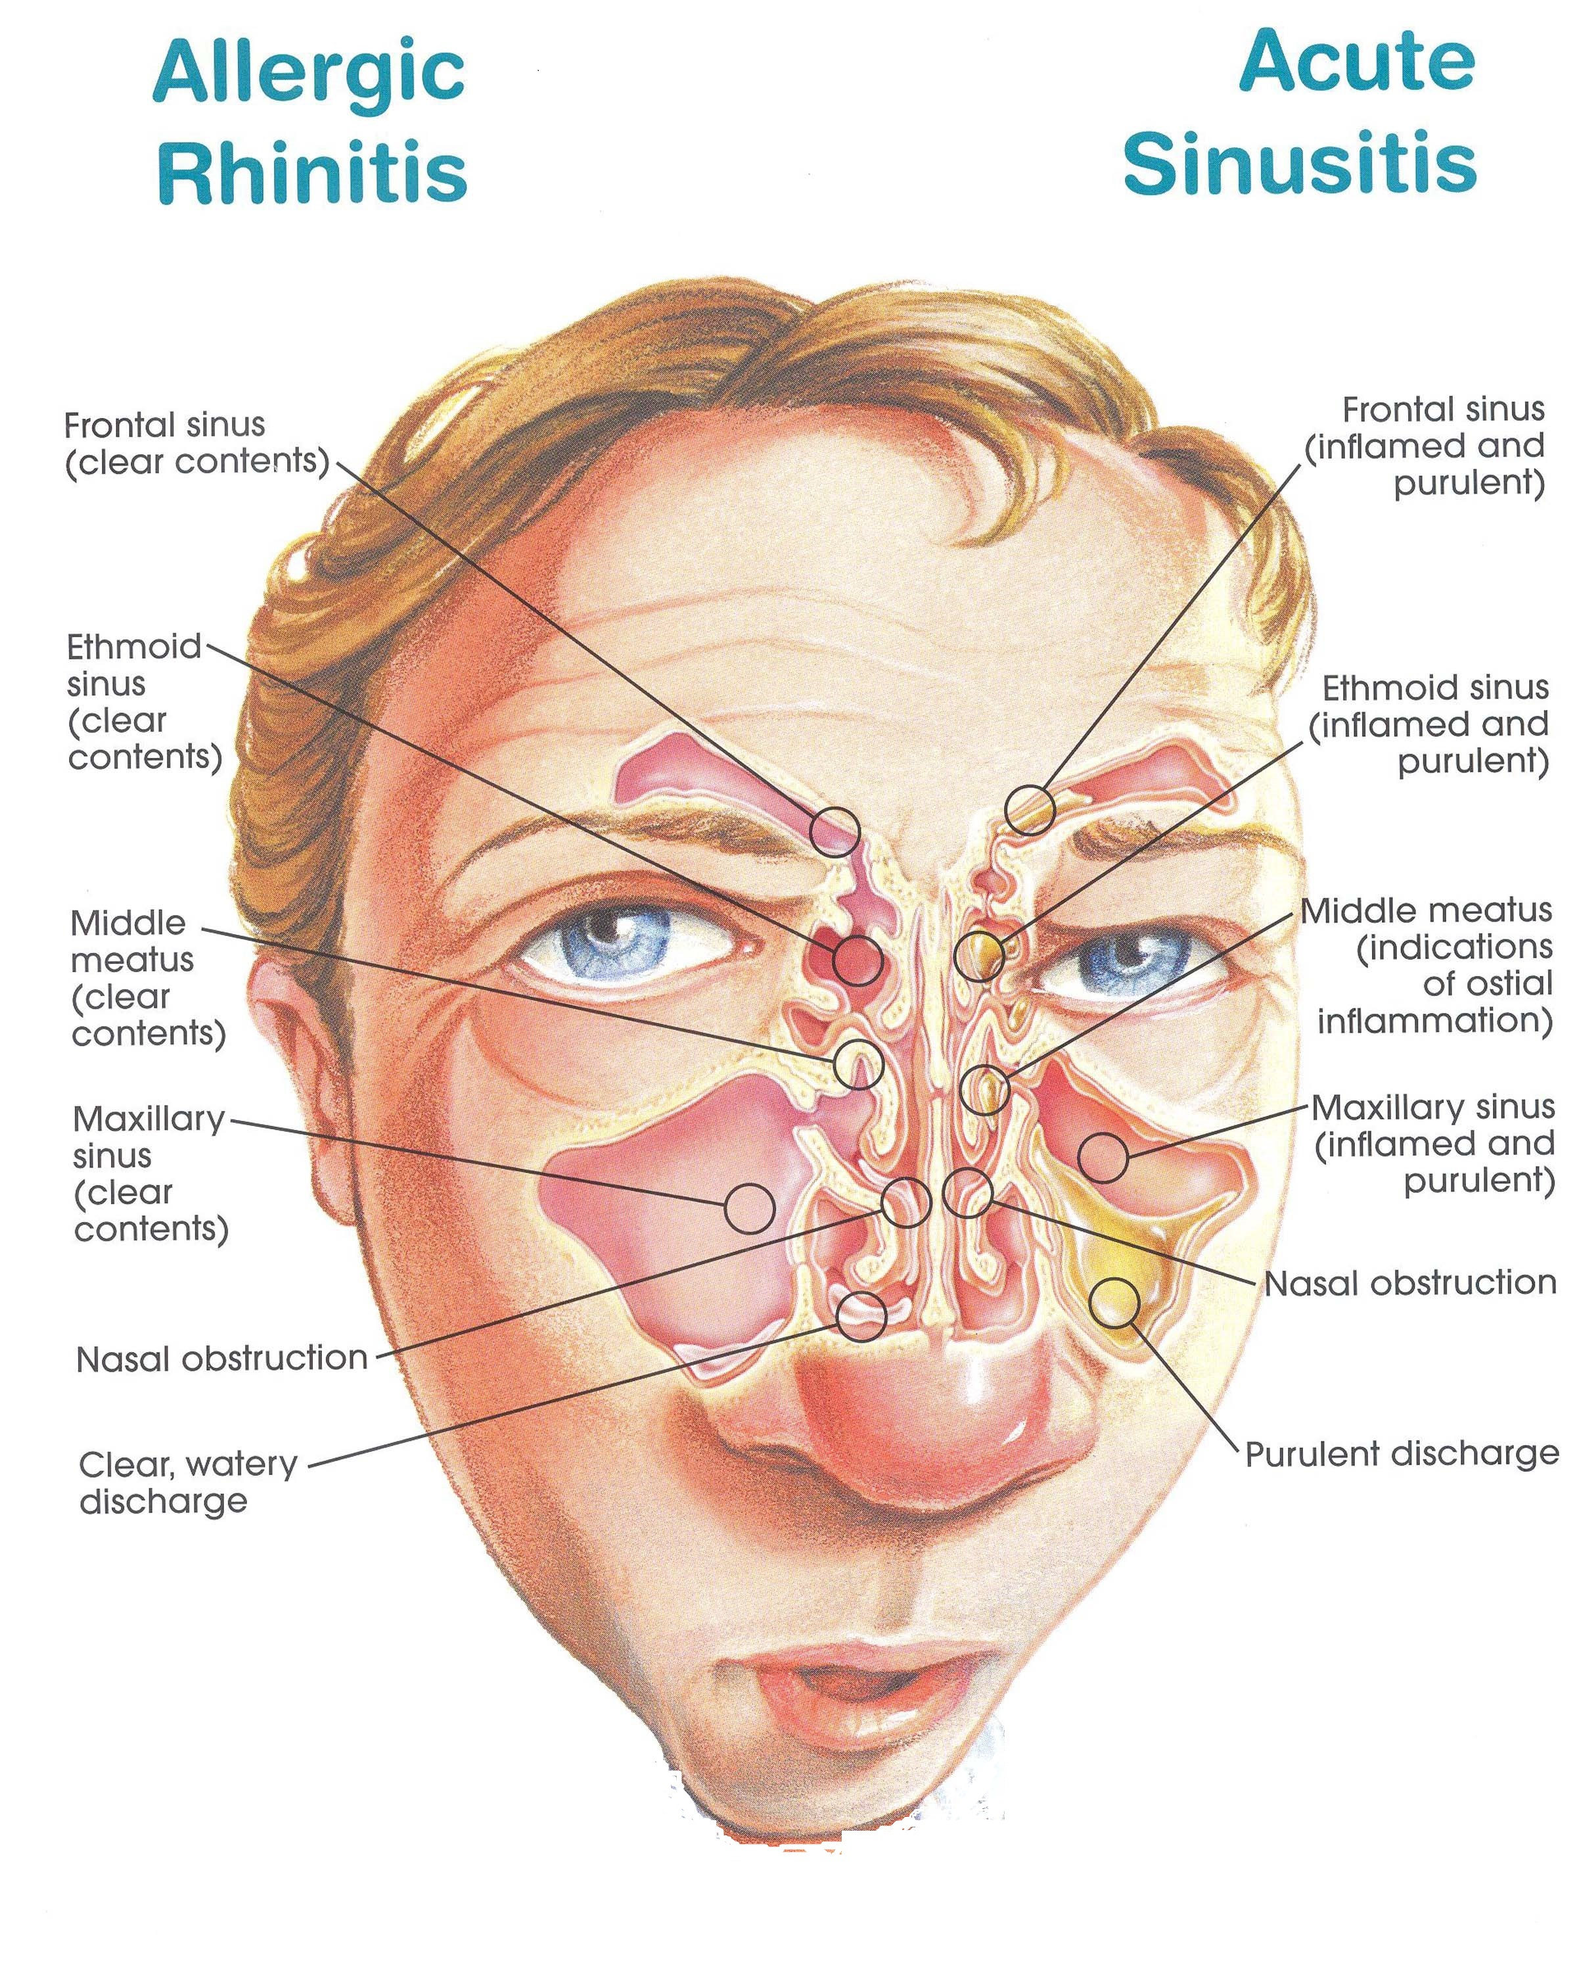
Clinical features:
Headache.
Pain.
Obstruction.
Discharge.
Loss of smell.
(PODS)
Fever.
Fatigue.
Earache.
Dental issues.

Slide 25
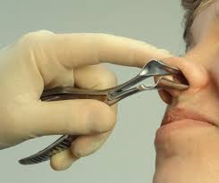
How to diagnose?
History
(PODS)
Pain: Ask about the site to know which sinuses are affected.
Obstruction: unilateral or bilateral.
Discharge: thickness, consistency, color, amount, frequency
Deceased in smell sensation.
Fever, fatigue, headache, earache.
Physical examination:
Tenderness overlying sinuses.
Altered speech (indicating nasal obstruction).
Purulent nasal secretions.
Facial erythema.
Mucosal erythema.
Oral cavity examination.

Slide 26
How to diagnose?
Labs:
Acute sinusitis is a clinical diagnosis but you can ask for other tests to confirm.
It depends on how bad the disease is, sometimes no investigations are required at all.
If the patient is really sick, do:
CBC, ESR, IgE.
Culture.
CT scan: when you suspect something serious.
MRI : look for complications.
Other tests such as:
Tests for Immunodeficiency.
Sweat Chloride Test.

Slide 27
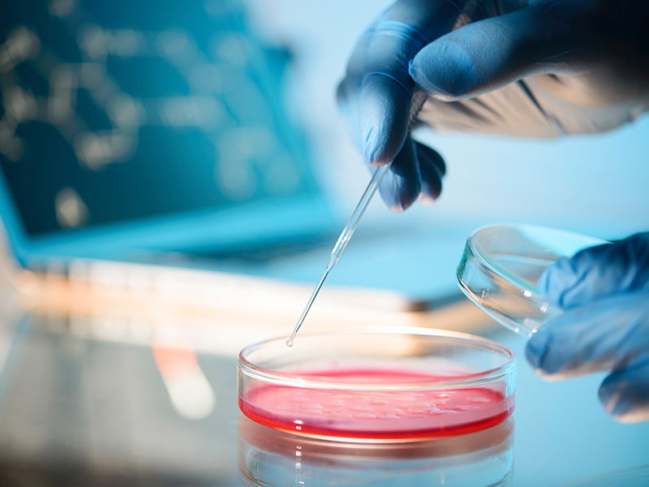
How to diagnose?
Cultures of Nasal Secretions:
Cultures are not routinely done to evaluate acute sinusitis but should be obtained in the following cases:
Patients in ICU or that are immunocompromised.
Children not responding to appropriate medical management.
Patients with complications of sinusitis.

Slide 28
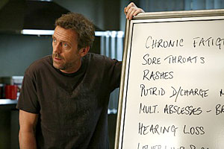
Differential Diagnosis?
Common cold
“Generally do not have facial pain”.
Allergic Rhinitis
“Common causes of rhinorrhea and nasal congestion”.
Any cause of Facial Pain or Headache.
Nasal Foreign body.
Tonsillitis.

Slide 29
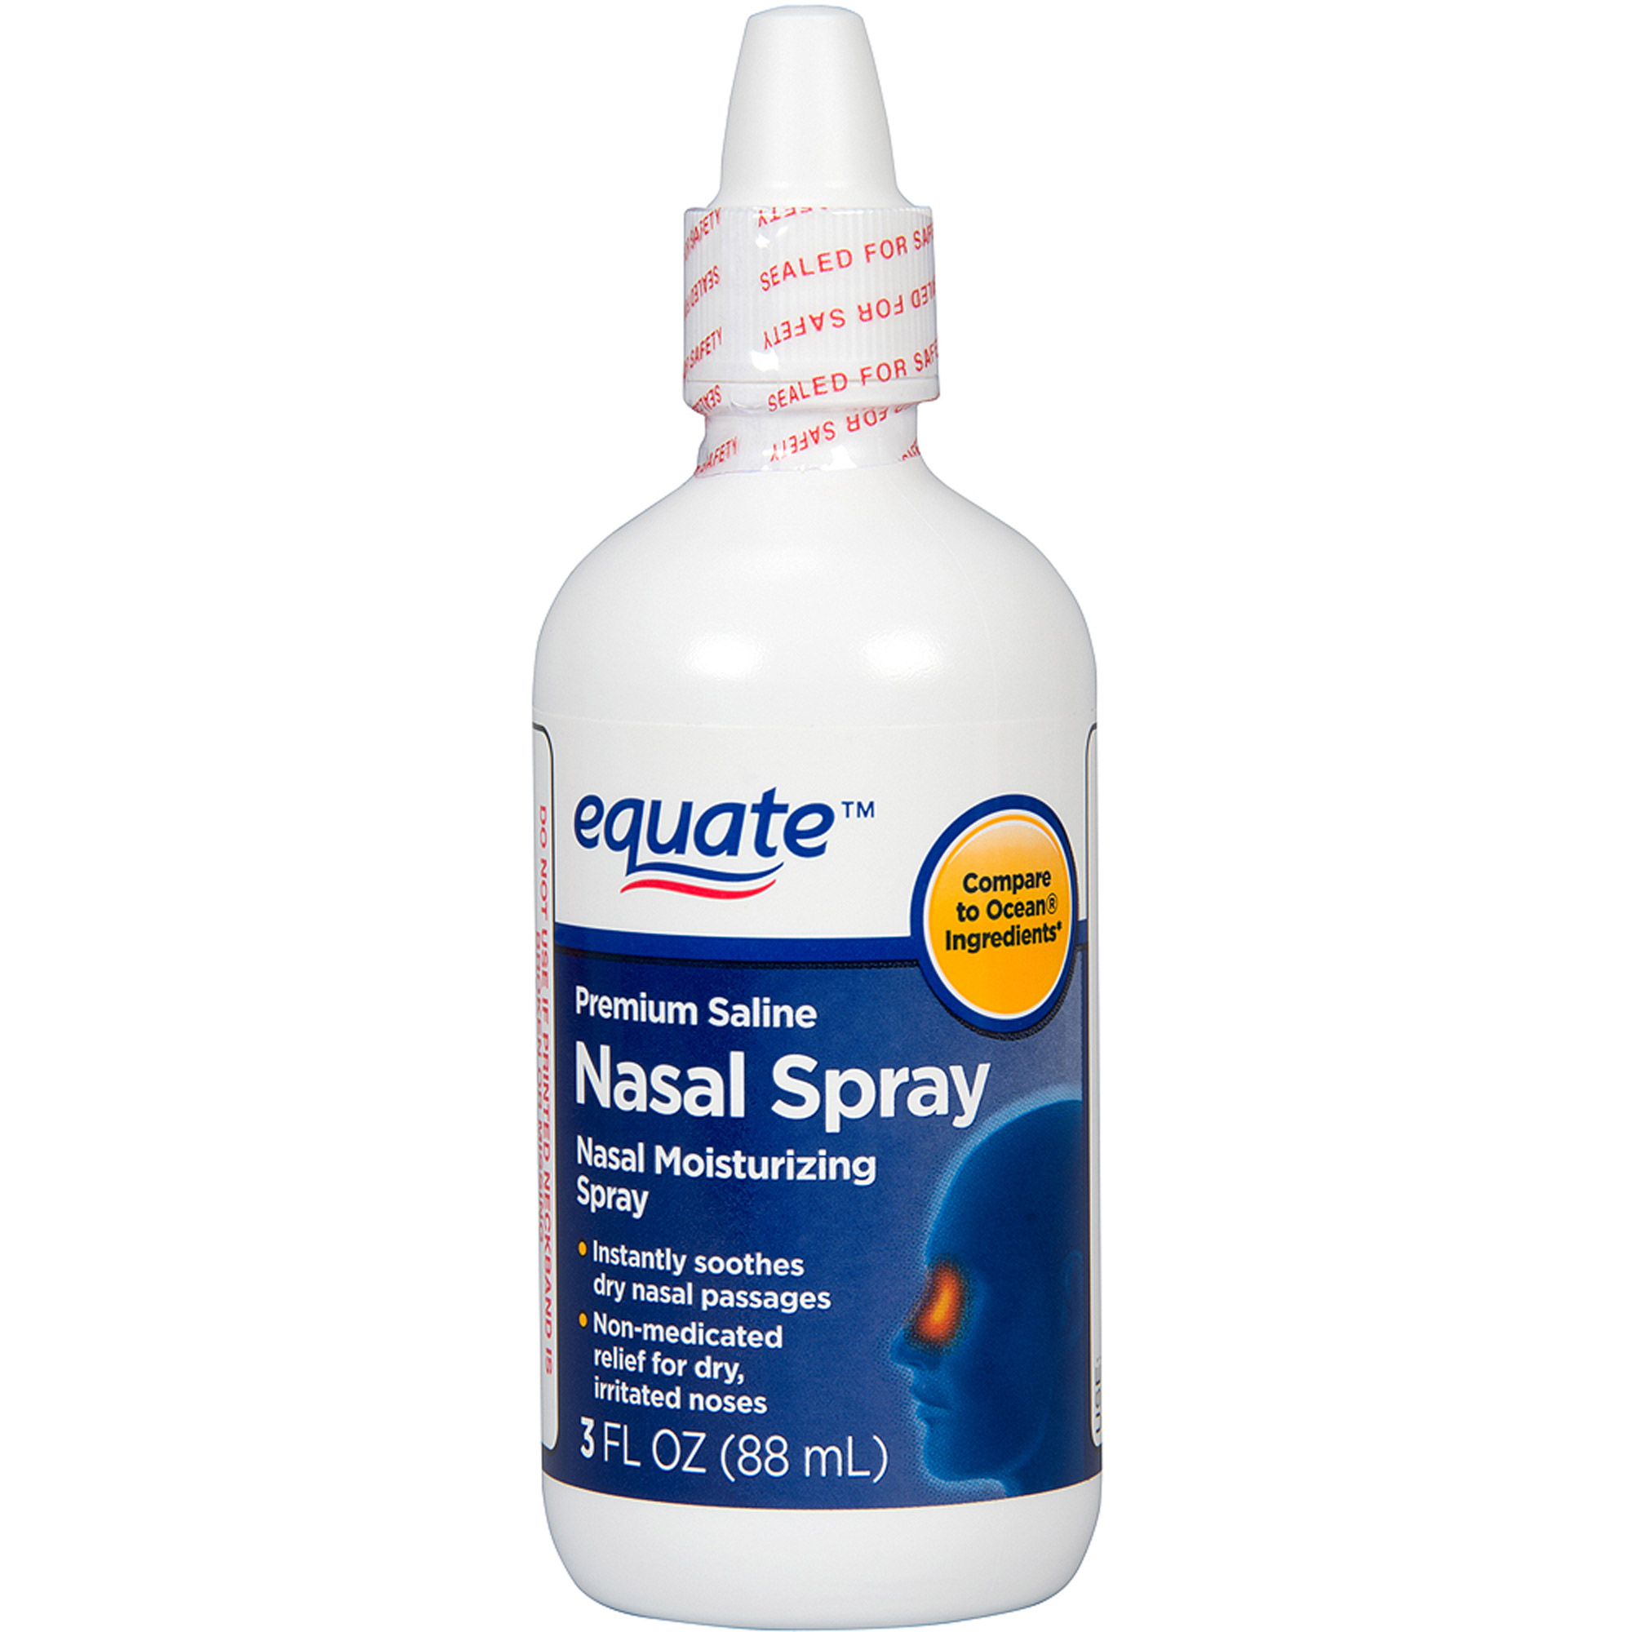
Prevention?
Maintain good general and sinus hygiene by drinking plenty of fluids to keep nasal secretions thin.
Saline nasal sprays help keep the nasal passages moist, helping remove infectious agents.
Don’t smoke, and avoid to be too near people who are smoking.
Try to stay away from things you know you’re allergic to.

Slide 30
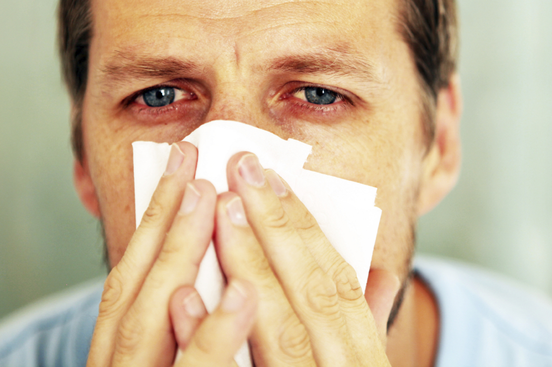
Allergic sinusitis
which occurs most commonly as allergic rhinitis, is an inflammation of the nasal membranes.

Slide 31
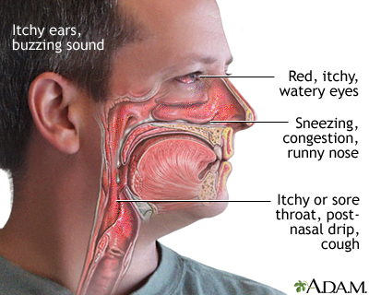
Clinical features
Sneezing.
Itching: Nose, eyes, ears, palate.
Rhinorrhea.
Postnasal drip.
Red eyes.
Congestion.
Headache.
Tearing.
Fatigue.
Drowsiness.
Malaise.

Slide 32
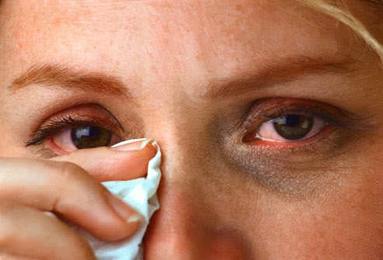
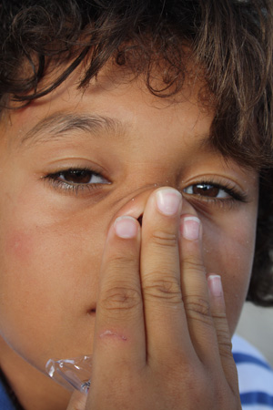
How to diagnose?
Physical Examination:
Allergic Shiners: dark circles around the eyes and are related to vasodilation or nasal congestion.
Nasal crease: A transverse crease across the lower half of the bridge of the nose; caused by repeated rubbing and pushing the tip of the nose up with the hand. (Allergic Salute)
Thin, watery nasal secretions.
Deviation or perforation of the nasal septum.

Slide 33
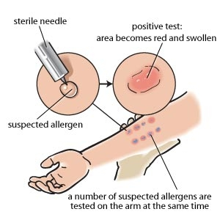
How to diagnose?
Labs:
Total Serum IgE and Total Blood Eosinophil Count
Both are Neither sensitive nor specific for allergic rhinitis, but the results can be helpful in some cases when combined with other factors.
Allergy Skin Tests
Radioallergosorbent Test (RAST).
Immunoassays test to detect allergen-specific IgE antibodies in the serum have limited utility in the diagnosis of allergic rhinitis.

Slide 34
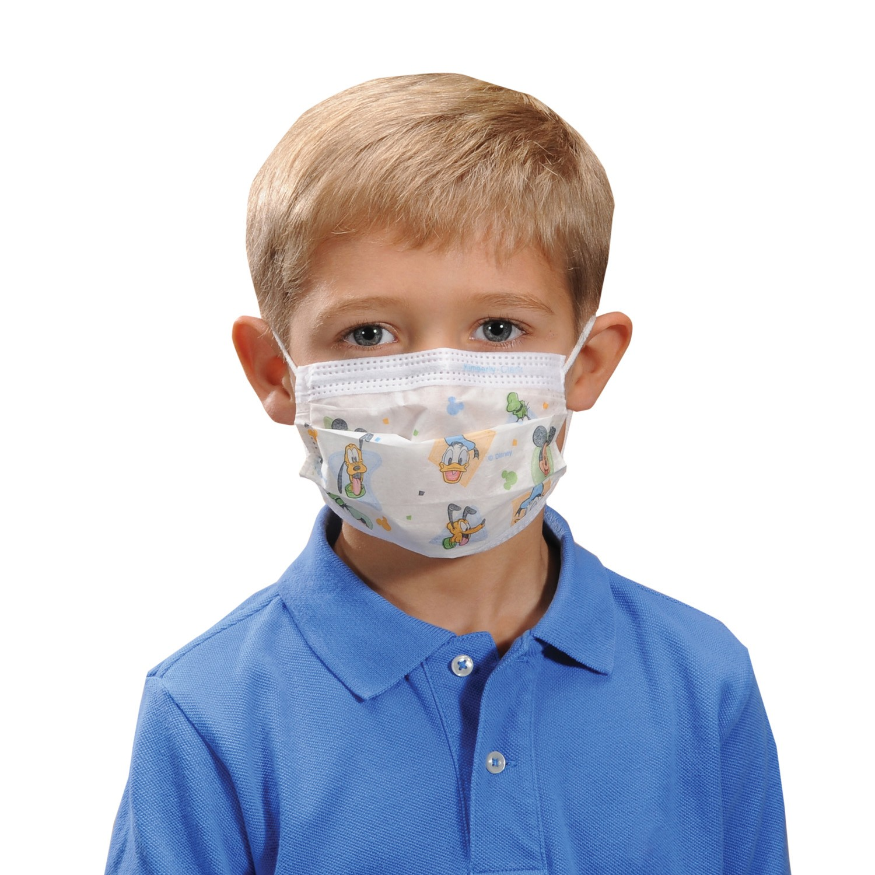
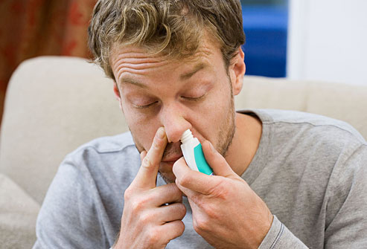
MANAGEMENT
Environmental control measures and allergen avoidance.
Pharmacologic management: Patients are often successfully treated with oral antihistamines, decongestants, or both.
Immunotherapy: This treatment may be considered more strongly with severe disease or poor response to other management options.

Slide 35
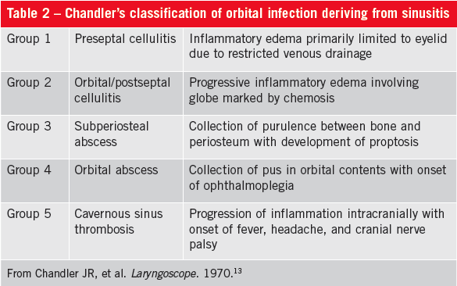
COMPLICATIONS
Acute or chronic sinusitis.
Otitis media.
Sleep disturbance or apnea.
Dental problems : Caused by excessive breathing through the mouth.
Palatal abnormalities.

Slide 36
Otitis Media

Slide 37
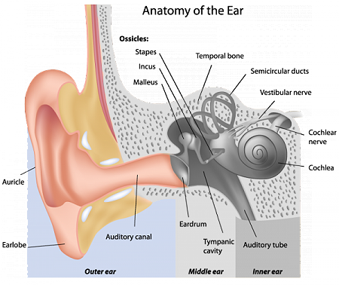

Slide 38
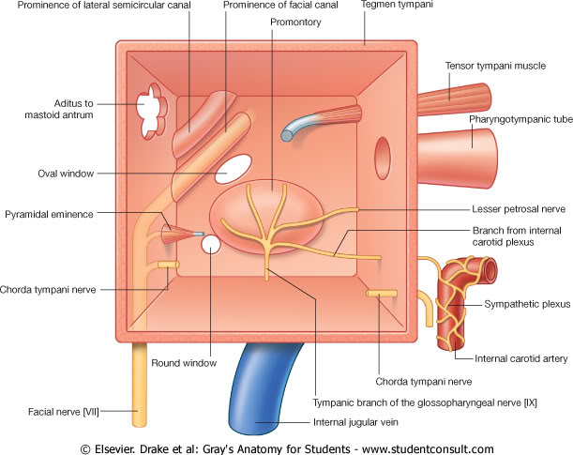

Slide 39
Otitis Media
Definition
is any inflammation of the middle ear, It is mainly a disease of childhood.
Types
Otitis Media
Chronic >3mo
Tubotympanic
COME
Acute <3mo
Supparative
Non-Supparative
Atticoantral
Adhesive

Slide 40
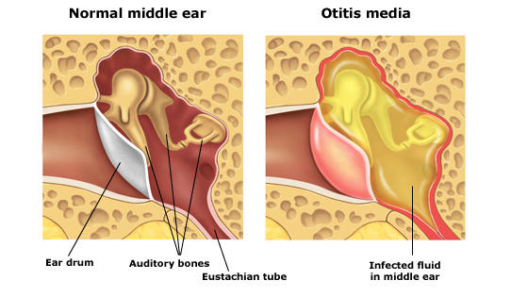
Acute Otitis Media
AOM implies rapid onset of disease associated with one or more of the following symptoms
Otalgia
Otorrhea
Deafness
Fever
Headache
Irritability
Loss of appetite
Vomiting
Most common route of infection is Eustachian Tube

Slide 41
Acute Otitis Media
Pathophysiology
Congestion of nasopharynx mucosa
Obstruction of Eustachian tube (dysfunction)
Negative pressure in middle ear cavity
Suction of mucosal secretion; a good environment of microorganisms
Infection starts and fluid is accumulated in middle ear cavity

Slide 42
Acute Otitis Media
Streptococcus Pneumoniae
Haemophilus Influenzae
Branhamella Catarrhalis
Predisposing Factors
Age (More common in children)
Males
Crowded living conditions
Associated conditions
- cleft palate
- immunodeficiency
- ciliary dyskinesia
- cystic fibrosis

Slide 43
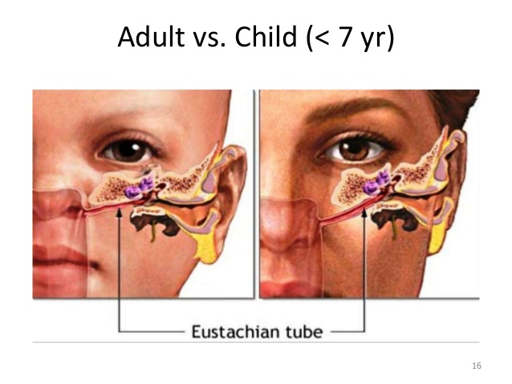

Slide 44
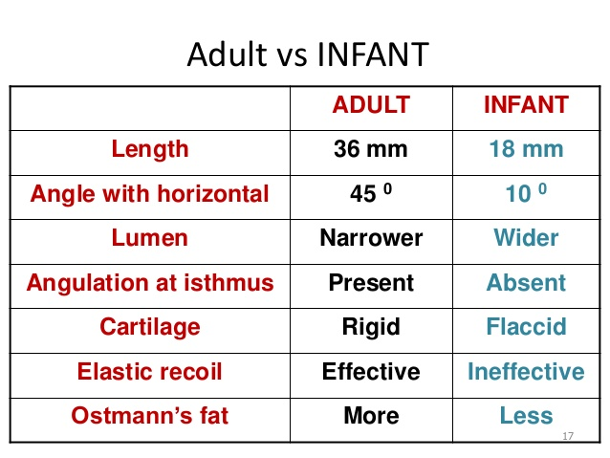

Slide 45
Acute Otitis Media
Stages
Pathophysiology | Stage
ET dysfunction Retracted Tympanic membrane ± Loss of light reflex Discomfort / Earache | Tubal occlusion
Presence of pus in middle ear Bulging of tympanic membrane Fever | Suppuration
Resolve of pain and fever Otorrhea Deafness | Rupture
Either self heal or persist (COME) | Resolution

Slide 46
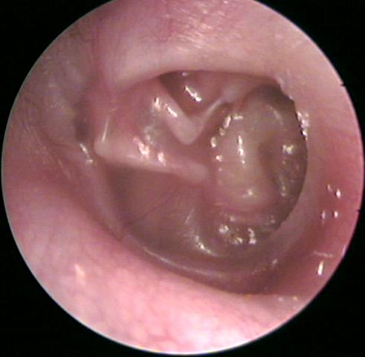
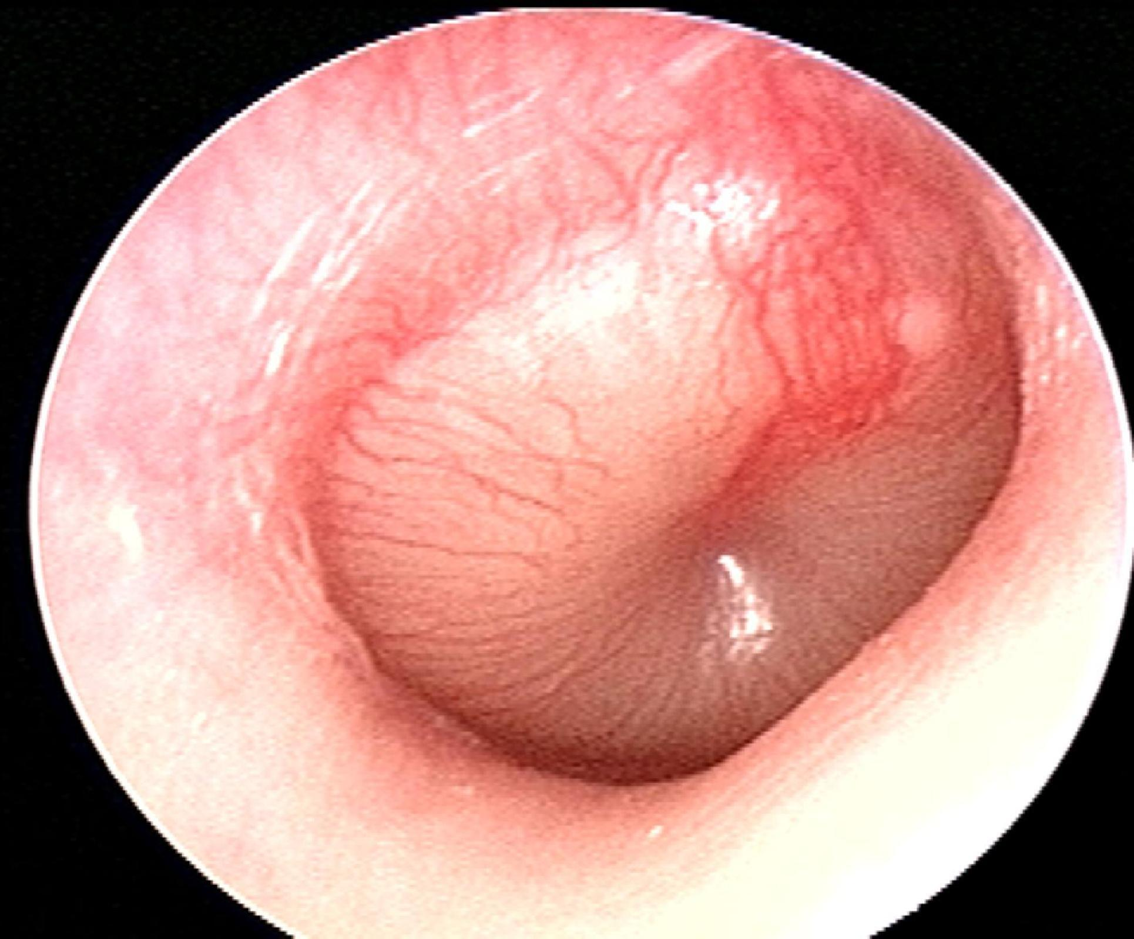
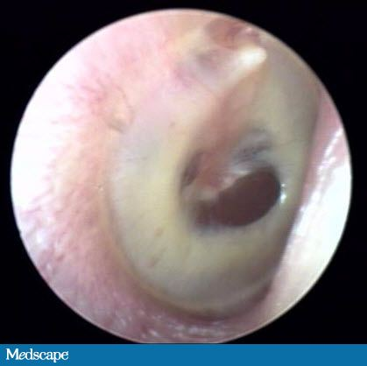
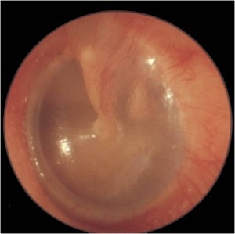
Notes:
Acute Otitis Media

Slide 47
Acute Otitis Media
Diagnosis “Uptodate”
The clinical diagnosis of acute otitis media (AOM) requires bulging of the tympanic membrane or other signs of acute inflammation and middle ear effusion.
Otoscopy (What are the signs of AOM ?)
Tympanocentesis (aspiration of the middle ear fluid) for culture is required for etiologic diagnosis
“However, etiologic diagnosis is not important in AOM”

Slide 48
Acute Otitis Media
Management “Uptodate”
Otitis media is the most common diagnosis for which children receive antibiotics
1/Symptomatic therapy (Indicated to relieve pain)
- Oral : Ibuprofen or Acetaminophen.
- Topical : Benzocaine or Lidocaine (Alternative), only used in children > 2 years old “Risk of methemoglobinemia if < 2 YO”
We recommend not using decongestants and or antihistamines in the symptomatic management of AOM in children “American Academy of pediatrics”

Slide 49
Acute Otitis Media
Management “Uptodate”
2/Antimicrobial therapy (Definite management)
Age
Less than 6 MO
More than 6 MO
Give Abx immediately
Bilateral
Unilateral
Observe for 2-3 days, if fail to improve, give Abx
- First line : Amoxicillin
- Penicillin Allergic : Cephalosporin/Macrolides
- Pneumococcal resistant : TMP-SMX
Most clinical trials and standard pediatric practice provide a 10-day course of an oral antimicrobial agent for the treatment of AOM

Slide 50
Chronic Non-supparative Otitis Media
1/Chronic Otitis Media with Effusion (COME)
Usually a result of improperly treated AOM.
Usually self-limiting (within 3 months).
Doesn’t benefit from antimicrobial therapy.
Hearing evaluation is critical (Pure tone audiometry).
“Hearing loss indicate intervention”
Most patients only require watchful waiting.
Some may require Tympanostomy (Ventilation) tube
Children at risk of speech or learning problems.
Hearing loss ≥ 40 db.
Structural damage of tympanic membrane.
2/Adhesive chronic Otitis Media
Formation of adhesion in the middle ear after reactivation and subsequent healing of either CSOM or OME. Usually requires Tympanostomy tube.

Slide 51
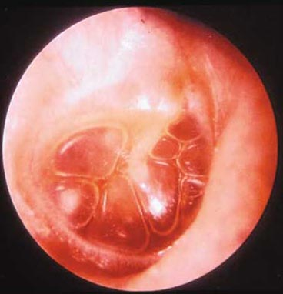
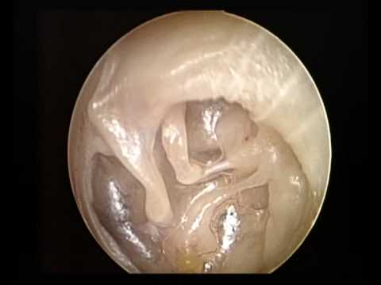

Slide 52
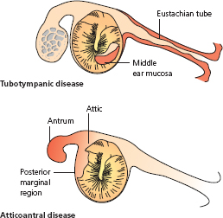
Chronic Supparative Otitis Media
Otorrhea / tympanic membrane perforation is a must in CSOM
Atticoantral (Unsafe) | Tubotympanic (Safe)
Large perforation and offensive discharge | Simple perforation and Discharge
Marginal perforation | Central perforation
Persistent | Intermittent
High risk of complications (Cholesteatoma) | Low risk of complications
Requires Mastoidectomy | Doesn’t require Mastoidectomy

Slide 53
Complications of Otitis Media
Periauricular abscess
Facial nerve paresis
Labyrinthitis
Labyrinthine fistula
Mastoiditis
Temporal abscess
Intracranial abscess
Meningitis
Sigmoid sinus thrombosis
Cerebrospinal fluid (CSF) leak

Slide 54
MCQs
A 4 year old child presented to the ER with dysphagia, respiratory difficulty and drooling for 12 hours. the ER doctor refuses to examine the child and he called the doctor. what is the best action that the doctor should do ?
A-performing endoscopic examination to the larynx.
B-take a throat swab.
C-take the child to the OR
D-request an X-ray for the neck.
A patient presented with snoring and sleep obstructive apnea. throat examination show kissing tonsils. what is the most appropriate treatment for the patient ?
A-adenotensillectomy
B-amoxicillin
C-observation
D-non of the above
A 2 years old child presented with his family to the primary care clinic complaining of sever pain and some sort of hearing loss in the right ear for 3 days , a diagnosis of acute otitis media was made. How would you manage this patient ?
A-Give Amoxicillin for 7-10 days.
B-Reassure the patient and tell the family it’s a self-limiting infection.
C-Observe for 3 days and check for improvement.
D-Prescribe analgesia and tell the patient to take it as needed.

Slide 55
A 5 years old boy came to the primary clinic because of sudden onset of deafness in left ear, history revealed presence of fever and otalgia for the last week, which are no more present. While examining the patient by otoscopy, what is expected to be seen ?
A-Swelled and reddened tympanic membrane.
B-Bulging of tympanic membrane.
C-Retraction of tympanic membrane.
D-Ruptured tympanic membrane.
A 30 Y/O male came to the clinic with complain of headache ,nasal discharge, fever and loss of smell. he is normal otherwise. He mentioned that he recently recovered from URTI.
What is the most likely diagnosis ?
A-Tonsillitis.
B-Pre-septal cellulitis.
C-Sinusitis.
D-Allergic rhinitis.
ALL of the below are considered to be good management choices to treat allergic rhinitis except :
A-oral antihistamines.
B-Decongestants.
C-Avoiding exposure to allergic substances.
D-Antibiotics.

Slide 56
References
https://www.american-rhinologic.org/
http://rhinologychair.org/
http://www.radiologyinfo.org
https://www.ncbi.nlm.nih.gov/pubmed/19346944
http://www.american-rhinologic.org
http://www.entnet.org/content/allergic-rhinitis-sinusitis-and-rhinosinusitis
http://care.american-rhinologic.org/fungal_sinusitis
https://www.ncbi.nlm.nih.gov/pmc/articles/PMC4318521/
http://pennstatehershey.adam.com/content.aspx?productId=28&pid=28&gid=000041
https://www.ncbi.nlm.nih.gov/pmc/articles/PMC3157813/
https://www.uvm.edu/medicine/surgery/documents/Rhinosinusitis4.pdf
http://www.jorl.net/otolaryngology/orbital-complications-of-sinusitis-a-review.pdf
http://www.uptodate.com/contents/acute-otitis-media-in-children-treatment
http://emedicine.medscape.com/article/994656-overview

Slide 57
Thank You

