Slide 1
WOMEN HEALTH

Slide 2
Definition
Women's health refers to the branch of medicine that focuses on screening , diagnosis and management of diseases and conditions that affect a woman's physical and emotional well-being.
It is important to :
Preservation of wellness
Prevention of illness

Slide 3
Who provides woman health
The women's health services team includes doctors and health care providers from a variety of different specialties. include:
Obstetrician/gynecologist
General surgeons specializing in breast care
Perinatologist
Primary care doctor

Slide 4
CVD in Women
Cardiovascular disease (CVD) is the leading cause of death in women.
The incidence of myocardial infarction (MI) in women, although lower than in men, increases dramatically following menopause.

Slide 5
CVD in Women
Risk factors in common with men:
Age
Family history.
Hypertension.
Lipids and lipoproteins.
Diabetes mellitus.
Lifestyle factors.

Slide 6
CVD in Women
Risk factors unique to women:
Menarche: Early menarche appears to be associated with future CVD risk.
Menopause: Postmenopausal state as a risk factor for CVD
Hysterectomy.
Premenstrual syndrome: Variety of physical and emotional symptoms and typically occurs in the days prior to the onset of menses
Oral contraceptives

Slide 7
CVD in Women
Pregnancy complications:
Hypertension and diabetes that develop during pregnancy.
Spontaneous pregnancy loss.
Preterm birth.

Slide 8
Incidence of myocardial infarction in men and women

Slide 9
CVD in Women
Use of Aspirin in prevention of CVD:
In women age 55-79 years old, 75 mg of Aspirin per day for at least 10 years for primary prevention decreases the risk of myocardial infarction (MI) and possibly all-cause mortality.

Slide 10
Screening
Dyslipidemia:
Patients aged 17 to 21 years suggested to undergo one-time screening for hyperlipidemia:
High risk patients: screening starts at age 25 for men and 35 for women
Not at high risk: screening starts at age age 35 for men and 45 for women..

Slide 11
When a decision is made to screen lipids we suggest measuring:
Total Cholesterol.
High Density Lipoprotein Cholesterol

Slide 12
Screening
Diabetes Mellitus:
Screening tests include Hg-A1C level, fasting plasma glucose level, and two-hour 75-g oral glucose tolerance test.

Slide 13
Screening criteria of DM
All adults beginning at 45 years of age.
Adults with BMI ≥ 25 plus one of the following risk factors:
Physical inactivity .
1st degree relative with DMT2.
Hypertension.
HDL < 35 mg/dL or TAG > 150 mg/dL.
Polycystic ovarian syndrome

Slide 14
Screening
Hypertension:
Screen for elevated blood pressure (greater than 140/90 mm Hg) in all adults 18 years and older.

Slide 15
Health issues unique to women

Slide 16
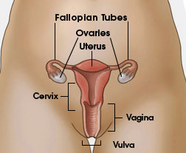
Cervical Cancer
Cervical cancer used to be the leading cause of cancer death.
Cervical cancer is the third most common cancer in the world.
Cervical cancer is highly preventable because screening tests and a vaccine to prevent human papillomavirus (HPV) infections are available.
Notes:
In women in developing countries, cervical cancer was the second most common type of cancer

Slide 17
Risk Factors for Cervical Cancer
Almost all cervical cancers are caused by human papillomavirus (HPV).
Other things can increase your risk of cervical cancer—
- Smoking.
- Having given birth to three or more children.
- Having several sexual partners.

Slide 18
Cervical Cancer: Diagnosis and Treatment
Early detection: Pap test.
Tests to confirm a diagnosis of cervical cancer include:
- A colposcopy and cervical biopsy.
- An endocervical biopsy (or curettage).
Treatment
Surgery
Chemotherapy
Radiation

Slide 19
Breast cancer
Breast cancer is a group of diseases that affects breast tissue. Both women and men can get breast cancer, though it is much more common in women.
Breast cancer is the most common cancer among women in the United States.
Breast cancer is the second leading cause of cancer deaths among women in the United States.
Getting mammograms regularly can lower the risk of dying from breast cancer.

Slide 20
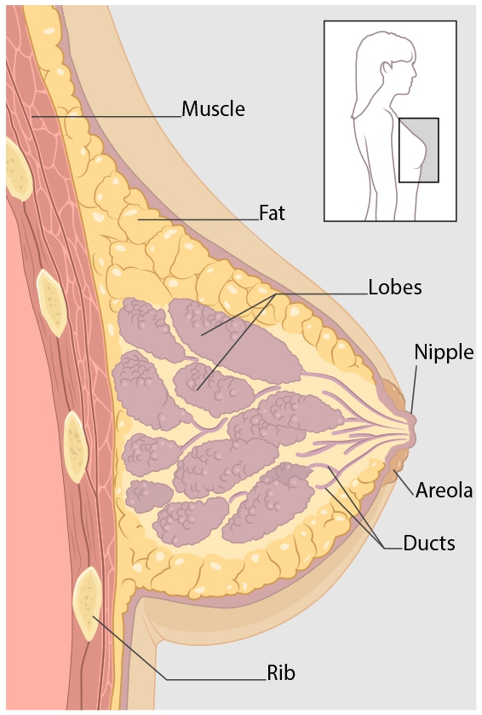
Kinds of Breast Cancer
The most common kinds of breast cancer are :-
- Invasive ductal carcinoma.
- Invasive lobular carcinoma.
There are several other less common kinds of breast cancer, such as Paget’s disease, medullary, mucinous, and inflammatory breast cancer.

Slide 21
Symptoms of Breast Cancer
New lump in the breast or underarm (armpit).
Thickening or swelling of part of the breast.
Irritation or dimpling of breast skin.
Redness or flaky skin in the nipple area or the breast.
Pulling in of the nipple or pain in the nipple area.
Nipple discharge other than breast milk, including blood.
Any change in the size or the shape of the breast.
Pain in any area of the breast.
Notes:
‪nipples was slightly retracting‬
lump

Slide 22
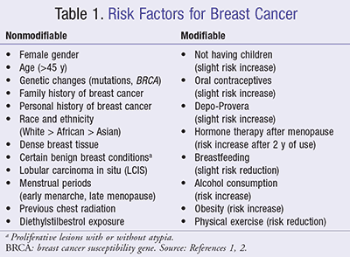
Risk Factors for Breast Cancer
Notes:
depo provera : birth control shot

Slide 23
Diagnosis of Breast Cancer
Breast ultrasound.
Diagnostic mammogram.
Magnetic resonance imaging (MRI)
Biopsy.
Notes:
core biopsy

Slide 24
Treatment of Breast Cancer
Surgery.
Chemotherapy.
Hormonal therapy.
Radiation therapy.

Slide 25
Planning for pregnancy
Make a Plan and Take Action
See Her Doctor
Medical Conditions
Lifestyle and Behaviors
Medications
Vaccinations

Slide 26
Take 400 Micrograms of Folic Acid Every Day
Stop Drinking Alcohol, Smoking, and Using Street Drugs
Avoid Toxic Substances and Environmental Contaminants
Reach and Maintain a Healthy Weight
Get Mentally Healthy

Slide 27
contraceptive
Do you want to be pregnant in the future?
If yes, when do you want to be pregnant?
Women who desire pregnancy within one year
we provide information about reversible contraceptives
Women who do not desire pregnancy within one year
For women who desire long-term contraception, we provide information on reversible and permanent contraceptive options

Slide 29
STIs among women
The effect of STIs on women can be more serious than men.
Untreated STIs can cause infertility, pelvic inflammatory diseases, pre-term delivery, and fetal/neonatal pathologies, ectopic pregnancy, increased risk of HIV transmission or worst cervical cancer.

Slide 30
Sexually transmitted infection
High risk group:
Sexually active adults, with multiple partners
who have an STI or have had one within the past year
Causative organisms: chlamydia, gonorrhea, syphilis, HIV

Slide 31
Criteria of screening
All sexually active women 24 years and younger should be screened annually for chlamydia.
High-risk women should be screened at least annually for chlamydia, gonorrhea, and syphilis.
All adolescents should be screened and adults through 65 years of age for HIV

Slide 32
HOW CAN STIs AFFECT THE MOTHER AND HER FETUS ?
She may pass the infection to her baby before, during, or after the baby’s birth.
She could go into labor too early. This makes it more likely that her baby will be born weighing less than 5 pounds, which is less than a healthy newborn baby should weigh.

Slide 33
A doctor might decide to do a cesarean delivery (“C-section”) to protect her baby from infection.
The infection may cause serious health problems in her baby.

Slide 34
Osteoporosis
Screening for osteoporosis involves fracture risk assessment and measurement of bone mineral density We recommend assessing risk factors for fracture in all adults, especially postmenopausal women.

Slide 35
Test of screening :
Dual-energy x-ray absorptiometry
— DXA is the most widely used method for measuring BMD
Criteria of screening:
in all women 65 years of age and older
in postmenopausal women less than 65 years if one or more risk factors are present . ( next slide )
We suggest not performing routine BMD measurements in premenopausal women.
Postmenopausal women with fracture

Slide 36
Risk factors Validated risk factors that are independent of BMD include the following:
Advanced age
Previous fracture
Long-term glucocorticoid therapy
Low body weight (less than 58 kg [127 lb])
Family history of hip fracture
Cigarette smoking
Excess alcohol intake

Slide 37
Site of screening:
DXA of hip and spine.
Repeat of screening:
- In women 65 years of age and older with normal or slightly low bone mass with no risk factor (follow-up DXA in 10 to 15 years).
- In women 65 years of age and older with low bone mass at any site, and with no risk ( follow-up DXA in three to five years )

Slide 38
immunization
maternal immunization protects both the mother and fetus from the morbidity of certain infections
Ideally, women should be vaccinated against preventable diseases in their environment prior to conception according to the recommended adult immunization schedule

Slide 39
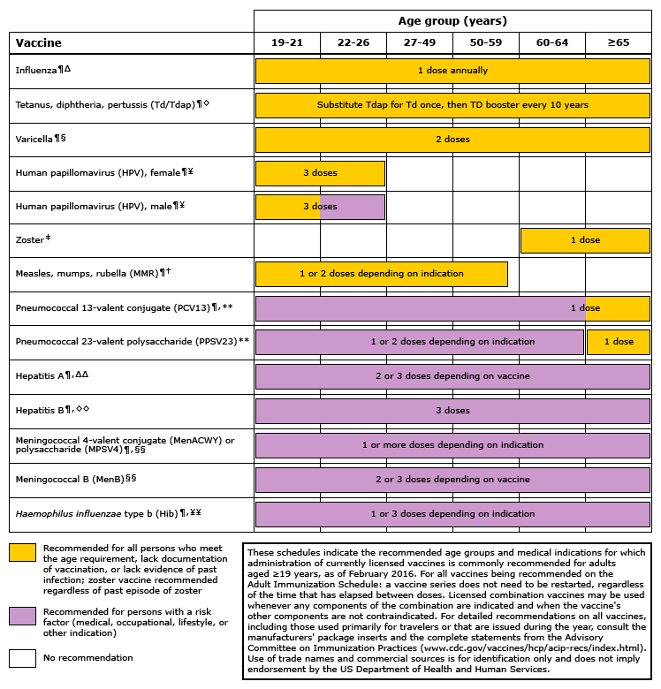

Slide 40
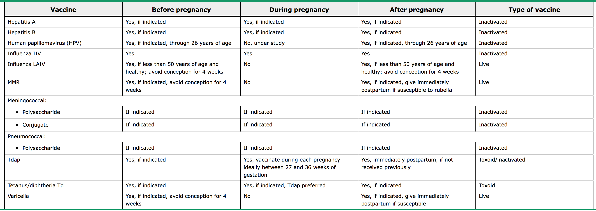
Immunizations that may be administered before, during, and after pregnancy

Slide 41
general guidelines for immunization of pregnant women:
● immunizations routinely recommended for all pregnant women: tetanus, diphtheria, pertussis, and influenza.
● Following delivery, postpartum women should receive all recommended vaccines that could not be or were not administered during pregnancy (eg, measles, mumps, and rubella; varicella; tetanus toxoid, diphtheria, and acellular pertussis ).
● Providers should be aware of and follow contraindications and precautions for immunization of pregnant women (eg, avoid administration of live attenuated virus vaccines).

Slide 42
Two types of vaccines
Routine Vaccines :
Hepatitis A, Hepatitis B ,Human Papillomavirus (HPV), Influenza (inactivated) , Influenza (LAIV), Measles, Mumps, Rubella (MMR), Meningococcal, Meningococcal (MenB),Pneumococcal Conjugate (PCV13), Pneumococcal Polysaccharide (PPSV23) ,Polio (IPV) , Tetanus, Diphtheria, and Pertussis (Tdap); & Tetanus and Diphtheria (Td) ,Varicella , Zoster
Travel and Other:
Anthrax , BCG , Japanese Encephalitis , Rabies , Typhoid , Vaccinia (Smallpox) , Yellow Fever

Slide 43
Which of the following factors increases the risk of breast cancer among women?
a. Obesity and nulliparity*
b. Age at menarche
c. Multiple pregnancies
d. Low-fiber diet
Notes:
A-A

Slide 44
Which one of the following is Criteria of screening Osteoporosis?
A-Women younger than 65 year old with one or more risk factor of osteoporosis*
B-All women below 65 year old
C-Postmenopausal women without fracture

Slide 45
reference
https://www.cdc.gov/std/herpes/the-facts/default.htm
https://www.cdc.gov/std/chlamydia/the-facts/default.htm
https://www.cdc.gov/std/syphilis/the-facts/default.htm
https://www.cdc.gov/std/pregnancy/the-facts/default.htm
https://www.cdc.gov/preconception/planning.html
https://www.cdc.gov/ncbddd/fasd/alcohol-use.html
https://www.cdc.gov/features/pregnantdontsmoke/index.html
https://www.uptodate.com/contents/screening-for-osteoporosis?source=search_result&search=screening%20osteoporosis%20in%20women&selectedTitle=1~150#H20
https://www.uptodate.com/contents/immunizations-during-pregnancy?source=search_result&search=Recommended%20immunizations%20for%20women.&selectedTitle=1~150

Slide 46
Thank You
Done by:
Mohammad AlGhofili
Ibrahim AlRabiah
Mohammad AlBaz

