Slide 1
Adolescent Health
Abdulrahman Bahkley 433100432
Mohammed Almanie 433102961
Saad Alsaeed 430105055

Slide 2
Q1. Adolescence age is between:
7-18
10-15
10-19
4-20

Slide 3
Q2. What is the adolescence population in Saudi Arabia?
10%
25%
30%
50%

Slide 4
Q3. What age group has the lowest mortality rate among these?
0-4 years
10-19 years
20-24 years
25-59 years

Slide 5
Q4. What is the leading cause of death in adolescents?
HIV
Injuries
Cancer
Suicide

Slide 6
Q5. What is the most common mental health problem in adolescence?
Anxiety
Schizophrenia
Depression
Bipolar

Slide 7
Adolescence
Adolescence (from Latin adolescere, meaning "to grow up")
“
It takes courage to grow up and become who you really are.
E. E. Cummings

Slide 8
Definition of adolescence age
WHO identifies adolescence as the period in human growth and development that occurs after childhood and before adulthood, from ages 10 to 19.
Biological processes drive many aspects of this growth and development with the onset of puberty , marking the passage from childhood to adolescence.

Slide 9
Physiological changes in adolescence

Slide 10
Skeletal changes
1-Height grow peak in boys are at the age of 13 and they grow average of 26 cm and height growth peak in girls are at the age of 11 and they grow average of 23 cm.
2-Weight gain in boys mostly because of muscle growth and for girls are because of fat that develop in breast and hips.

Slide 11
Hormonal changes in puberty
● Hypothalamus releases GNRH to anterior pituitary to stimulate it
● Anterior pituitary then releases LH & FSH to testis and ovaries
● Sex steroid synthesis
● Sexual maturation

Slide 12
Behavioral changes in adolescence
Social changes:
● Searching for identity: young people are busy working out who they are and where they fit in the world, and this can be influenced by gender, peer group, cultural background, and family expectations.
● Seeking more independence: this is likely to influence the decisions your child makes and the relationship with his family and friends.
● Seeking more responsibility at home & school.

Slide 13
● Looking for new experiences and engaging in more risk taking behavior; they get into more fights and they might carry weapons.
● Thinking more about ‘right’ & ‘wrong’ your child will start developing a stronger individual set of values and morals.
● Influenced more by friends, especially when it comes to behavioral and sense of self-esteem they can use tobacco just because there close friends are smokers.
● Communicating in different ways: the internet, mobile phones, and social media can significantly influence them and learn about the world.

Slide 14
Emotional changes :
● Show strong feelings and intense emotions at different times, moods might seem unpredictable
● Your child will be more sensitive to your emotions
● Becoming more self conscious especially about physical appearance
● Goes through ‘bulletproof’ stage of thinking as if nothing bad can happen and still learning about consequences of their actions

Slide 15
Dietary changes:
● Weight problems ‘obesity’ from eating a lot of junk food and physical inactivity
● Anorexia nervosa and bulimia from not eating because of appearance

Slide 16
Importance of adolescence health
Adolescence health is not just a question of individual well being as the size of adolescence population grows especially in developing countries the health of young people will be a major determent of economic, social development and progress. Investing in research, polices and programs to improve adolescence health is a key strategy to preserve gains in childhood health and ensure the boys and girls grow into healthy and productive men and women.

Slide 17
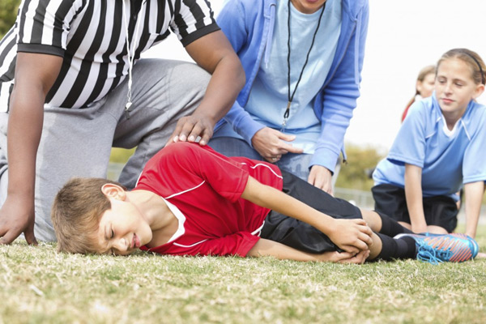
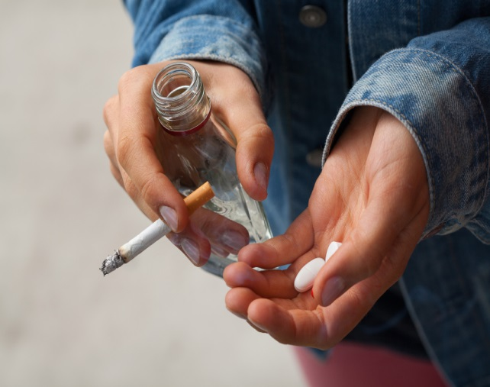
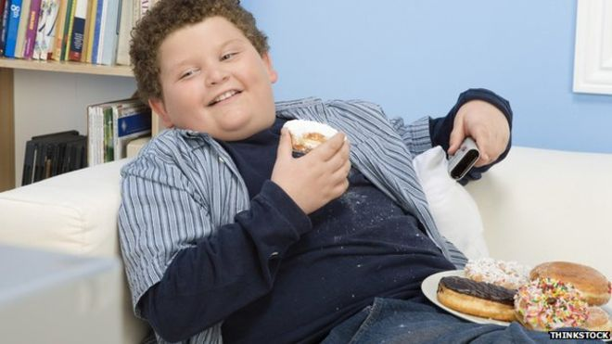
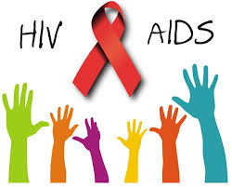
Adolescent Health Problems
What are they?

Slide 18
Mortality rate

Slide 19
Causes of mortality in adolescents

Slide 20
Injuries
Unintentional injuries are a leading cause of death and disability among adolescents. Transportation is the largest source of these injuries. Other major causes involve drowning, poisonings, fires, sports and work related injuries.
In 2012:
120,000 adolescents died as a result of road traffic accidents
60 000, two-thirds of them boys, died drowning

Slide 21
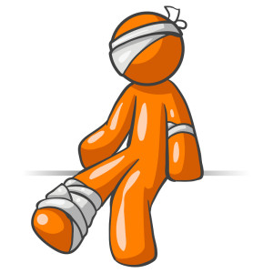
Injuries
Consequences of injuries:
1-physical
2- psychological

Slide 22
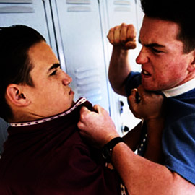
Violence
Around 1 of every 3 deaths among adolescent males of the low- and middle-income countries in the WHO Americas Region is due to violence. Globally, some 30% of girls aged 15 to 19 experience violence by a partner.

Slide 23
Violence
Risk factors that contribute to violent behavior:
1-Being a victim of physical and/or sexual abuse
2-Exposure to violence in the home and/or community
3-Gentic factors
4-Use of Drugs or Alcohol
5-Exposure to violence in media (TV, Movies, Video Games)
6-Victim of Bullying

Slide 24
HIV and other STDs
HIV: More than 2 million adolescents are living with HIV. Although the overall number of HIV-related deaths is down 30% since the peak in 2006 estimates suggest that HIV deaths among adolescents are rising.
STD: CDC estimates that 20 million new sexually transmitted infections occur in the United States each year, half of which are between people aged 15-24.

Slide 25
Early pregnancy and childbirth
Complications linked to pregnancy and childbirth are the second cause of death for 15-19-year-old girls globally. Some 11% of all births worldwide are to girls aged 15 to 19 years, and the vast majority are in low- and middle-income countries.
It puts a risk on both mother and child.

Slide 27
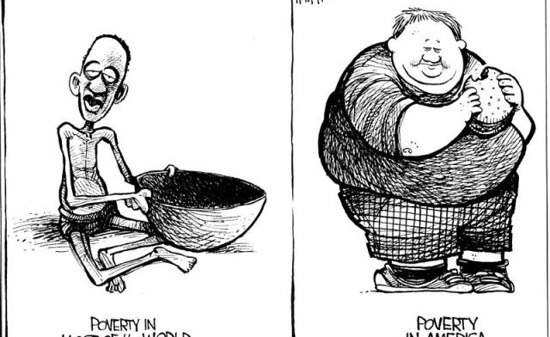
Malnutrition and Obesity
Many boys and girls in developing countries enter adolescence undernourished, making them more vulnerable to disease and early death. The number of adolescents who are overweight or obese is increasing in both low- and high-income countries.

Slide 28
Substance abuse
Many teens try tobacco, alcohol, and drugs for various reasons. They might do it to fit in with certain people, they like how it makes them feel, or they believe it makes them more grown up.
The vast majority of people using tobacco today began doing so when they were adolescents

Slide 30
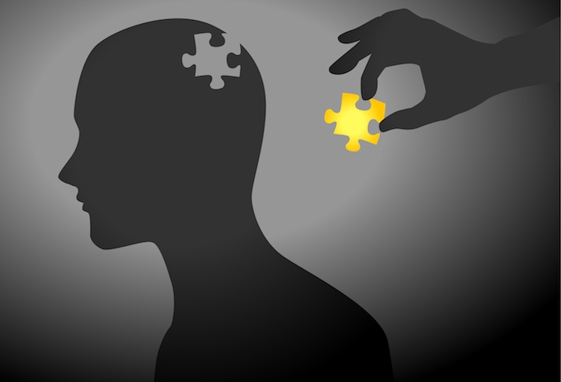
Mental Health
Depression is the top cause of illness and disability among adolescents and suicide is the third cause of death. Violence, poverty, humiliation and feeling devalued can increase the risk of developing mental health problems.
Most mental disorders follow a developmental course that typically starts early in life.

Slide 31
Warning signs that indicates a call for help:
1-Feeling angry or worried
2-Unable to enjoy pleasurable activities
3-Low or no energy
4-Isolate themselves
5-Substance abuse
6-Suicidal thoughts
7-Can’t sleep or eat
8-Hurt her/himself or others
9-Hears voices

Slide 32
Adolescent health problems in Saudi Arabia
25% of Saudi population are Adolescents
What are the problems we face?

Slide 33
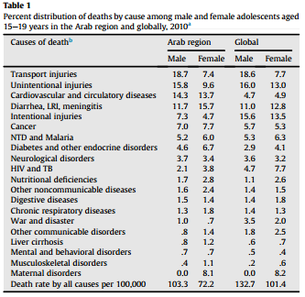
Comparison between Arab and Global
The proportion of deaths due to cardiovascular and circulatory diseases is nearly three times higher among Arab adolescents (both male and female) than the global average.

Slide 34
Injuries
A study to determine the incidence and pattern of injuries among children and adolescents <18 years old in Riyadh city was done in 2011. The study included 1650 children and adolescents. Of them, 22.2% reported having had injuries in the previous 12 months. The most common injuries were falls (40.4%), Road Traffic Accidents (RTA) (15%), food intoxication (8.8%). Males were more affected by injuries than females (26% vs. 18%)
The epidemiology of traumatic head injury in children and adolescents in Saudi Arabia has been studied in 2013.

Slide 35
HIV
A descriptive analytic study in 2005 described the pattern and characteristics of HIV/AIDS cases in Saudi Arabia.
As of 2003, 1743 Saudi nationals and 6064 non-Saudi HIV cases were reported. Among Saudis, 872 were AIDS cases. Males accounted for 1329 HIV infections (77%) with a male-to-female ratio of about 3:1. Adults 15-49 years constituted 78% of cases, including 46% of cases infected through sexual activity, while 33% of reported HIV seropositive cases had already died. Most cases (67%) were registered in Jeddah, Riyadh and Dammam. Infection through blood transfusion declined with no reported cases since 2001

Slide 36
Malnutrition and Obesity
A study was carried out with the aim of identifying the health risk behaviors and health status of adolescents in Saudi Arabia, in 2015. It was a cross-sectional, school-based study was in all 13 regions of Saudi Arabia with a total of 12,575 adolescents participated.
28% of adolescents reported having a chronic health condition
14.3% reported having symptoms suggestive of depression
30.0% were overweight/obese
95.6% were vitamin D deficient
Almost half of all adolescents did not engage in any physical exercise. Females reported complete absence of exercise much more than males
42% spent at least 2 hours/day watching television.

Slide 37
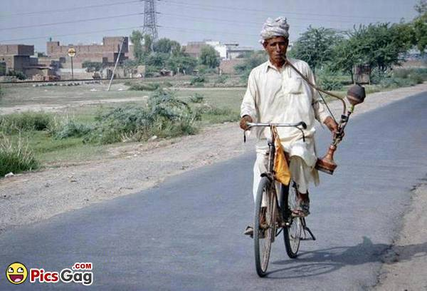
Substance Abuse
Tobacco use in Arab countries includes both cigarettes and shisha. Due to the restriction of religion and law on alcohol and drug use, knowledge is relatively less in Arab countries compared with other regions and most evidence is patchy and outdated.
Tobacco Surveys found that 11%-42% of boys aged 13-15 years in 20 Arab countries reported using tobacco in the past 30 days. Arab girls were noted to less tobacco use

Slide 39
Mental Health
A study conducted on 1723 Saudi school students in Abha in 2007 to see the prevalence of depression, anxiety, and stress among them.
A study carried out in Tiaf Governorate, Saudi Arabia

Slide 40
Approach to dealing with adolescents
Primary care physicians are well situated to deal with adolescents and discuss risks and offer interventions.
but some physicians are missing this key opportunities because:
1. lack of data indicating what makes up an effective physician-
adolescent conversation.
2. physician and adolescent discomfort with addressing sensitive topics

Slide 41
Physicians can establish a productive relationship with adolescents through the following steps:
Assess the individual adolescent's ability to understand the consequences of risky behavior
Assess the role of the parent
Meet privately and raise sensitive topics
Use the physician-patient relationship to personalize risk-reduction messages.
Physicians should use empathic, personal messages to communicate with adolescents about these issues

Slide 42
Approach to common adolescent health problems
smokin,substance abuse
Prohibiting the sale of tobacco products to minors
increasing the price of tobacco products through higher taxes,
banning smoking advertising
ensuring smoke-free environments
counseling and explain the dangers of using illegal drug.(role of family,school and community)

Slide 43
Mental health
Building life skills in children and adolescents and providing them with psychosocial support can help promote good mental health and reduce violence
we should take care about Environmental factors, including family, peer group, school, neighborhood, and societal cues,because they can either support or refute young people’s health.
Early pregnancy and childbirth
Better access to contraceptive information and services can reduce the numbers
Girls who do become pregnant need access to quality antenatal care

Slide 44
obesity and physical inactivity:
providing access to healthy foods and opportunities to engage in physical activity
Developing healthy eating and exercise habits at adolescents are foundations for good health in adulthood
Injuries:
Young drivers need advice on driving safely
forbidding adolescents aged less than 18 years from driving

Slide 45
Role of family
Adolescents who have good communication and are bonded with an adult are less likely to engage in risky behaviors.
Parents supervision and involved with their adolescents' activities are promoting a safe environment.
The children of families living in poverty are more likely to have health conditions and poorer health status, as well as less access to and utilization of health care.

Slide 46
Role of school
School environment and behavior of teachers play a major role in character building and personality development of adolescents.
School health clinics for health education & counseling has important role.
Proficient academic skills are associated with lower rates of risky behaviors and higher rates of healthy behaviors.
The school social environment affects students' attendance, academic achievement, and behavior.
A safe and healthy school environment protects against risky behaviors and dropping out.

Slide 47
Role of community
Antismoking program should be established, including prohibition of the sale and use of cigarettes in public places.
application of firm traffic laws forbidding adolescents aged less than 18 years from driving
raising awareness of health issues for young people among the general public and special groups
Supervision over media content because, adolescents who are exposed to media portrayals of violence, sexual content, smoking, and drinking are at risk for adopting these behaviors
production of evidence-based guidelines to support health services and other sectors

Slide 48
Take home message
Adolescence is a very critical stage in one’s life. It’s where biological, physiological, and psychological maturation happens. Taking risks at this age without thinking of the consequences is common. Which may lead to serious illnesses, disabilities, and death.
Unintentional injuries are the leading cause of death among adolescence, and in most cases they’re preventable.
The health problems in adolescents globally are to some extent similar to those in Saudi Arabia. Such as the widespread of smoking, obesity, injuries, mental problems, physical inactivity..
The efforts to prevent these problems from happening in the first place and the right approach to deal with them should be studied extensively.

Slide 49
Q1. Adolescence age is between:
7-18
10-15
10-19
4-20

Slide 50
Q2. What is the adolescence population in Saudi Arabia?
10%
25%
30%
50%

Slide 51
Q3. What age group has the lowest mortality rate among these?
0-4 years
10-19 years
20-24 years
25-59 years

Slide 52
Q4. What is the leading cause of death in adolescents?
HIV
Injuries
Cancer
Suicide

Slide 53
Q5. What is the most common mental health problem in adolescence?
Anxiety
Schizophrenia
Depression
Bipolar

Slide 54
References
1- WHO/http://www.who.int/mediacentre/factsheets/fs345/en/
2-Review of unintentional injuries in adolescents/https://www.ncbi.nlm.nih.gov/pubmed/20235851
3-WHO/http://www.who.int/topics/adolescent_health/en/
3- Al-Gelban, K. S. "Depression, Anxiety And Stress Among Saudi Adolescent School Boys". The Journal of the Royal Society for the Promotion of Health 127.1 (2007): 33-37. Web.
4- Alhabdan S, et al. "Epidemiology Of Traumatic Head Injury In Children And Adolescents In A Major Trauma Center In Saudi Arabia: Implications For Injury Prevention. - Pubmed - NCBI". N.p., 2013. Print.
5- Gad, A. et al. "Pattern Of Injuries Among Children And Adolescents In Riyadh, Saudi Arabia: A Household Survey". Journal of Tropical Pediatrics 57.3 (2010): 179-184. Web. 2 Oct. 2016.
6- Alzahrani, Saeed G et al. "Patterns Of Clustering Of Six Health-Compromising Behaviours In Saudi Adolescents". BMC Public Health 14.1 (2014): n. pag. Web.
7- "Medical And Behavioral Problems Among Saudi Adolescents". International Journal of Health Sciences 7.2 (2013): V. Web. 2 Oct. 2016.
8- Stigma towards People Living with HIV/AIDS (PLWAs) among Adolescents of Riyadh, Kingdom of Saudi Arabia | Journal of AIDS & Clinical Research

Slide 55
Questions

Slide 56
Thank you

