Slide 1
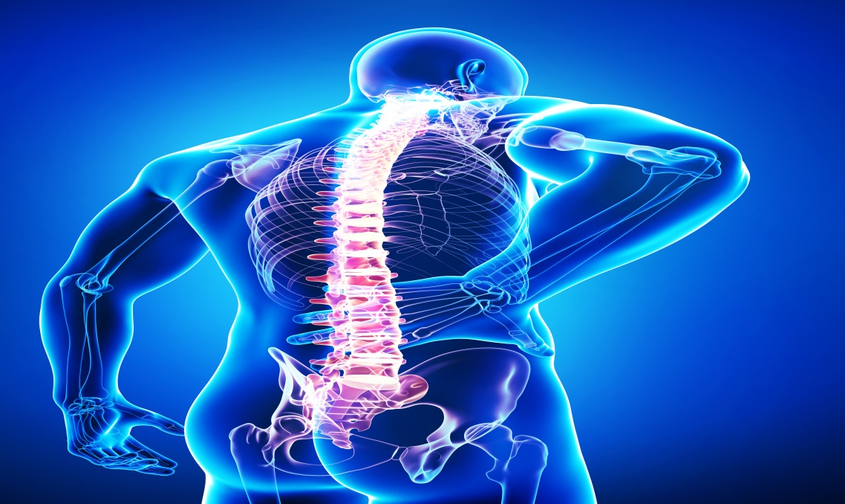
Back pain
Done by:
Matar Aldawsari
Ziyad Altasan
Youssef Alnamshan
Tutor:
Prof. Sulaiman Al-Shammari

Slide 2
Objectives
Common causes of back pain.
Diagnosis including History, Red Flags & Examination.
Brief comments on Mechanical, Inflammatory, Root nerve compression and Malignancy.
Role of primary health care in management.
When to refer to specialist.
Prevention and Education.

Slide 3
Quiz
Q1: Which of the following is considered as a red flag in patients with back pain:
A) History of DM
B) Family history of back pain
C) Focal neurologic deficit
D) Young age

Slide 4
Quiz
Q2: Most of spinal column tumors are primary tumors:
A) true
B) False

Slide 5
Quiz
Q3: Which of the following is the duration of chronic back pain:
A) 3-6 weeks
B) 6-12 weeks
C) More than 12 weeks

Slide 6
Introduction
Low back pain is one of the most common reasons for visits to physicians in the ambulatory care setting.
The prevalence of low back pain in KSA is ranging from 53.2% to 79.17%.
In nations like the United States, its prevalence is between 8% and 57%.
The global point prevalence of [low back pain] is 9.4%.
Prevalence is higher in men compared with women and it increases with age.

Slide 7
Introduction
It is the second most common reason for physician visits after respiratory tract infection.
The total cost related to back pain is estimated to be more than 100 billion dollar per year in the United States. High cost due to investigations & treatment which not always necessary.

Slide 8
Causes

Slide 9
Brief comments on:
Mechanical back pain
Inflammatory back pain
Root nerve compression
Malignancy

Slide 10
Mechanical back pain
Diffuse and unilateral.
Deep and dull.
Moderate intensity.
Relived by Rest.
Increased by activity and at end of the day.

Slide 11
Causes of mechanical back pain
Trauma
Improper posture
Poorly designed chairs
Obesity/ pregnancy
Lifting heavy weight

Slide 12
Inflammatory back pain
Chronic pain.
Gradual onset.
Increased by Rest.
Relived by activity.
Worst at morning and the end of the day.
Associated with morning stiffness.

Slide 13
Nerve root compression
It may be secondary to:
Disc herniation
Osteoarthritis
Facet joint hypertrophy
Ligamentous hypertrophy
Neoplastic disease
Scoliosis

Slide 14
Malignancy
Most spinal column tumors are metastatic and majority of them coming from tumors in the breast, prostate, kidney, lung or thyroid.
These malignant tumors usually produce back pain that does not diminish with rest, and the nighttime pain may be worse than daytime pain.

Slide 15
Malignancy
The metastatic tumors are usually associated with other symptoms such as loss of appetite, unplanned weight loss, nausea and vomiting, or fever/chills/shakes. This type of tumor is more common among older adults.
Often, the patient already has a known primary tumor in another part of the body.

Slide 16
Malignancy
Primary tumors of the spinal column are very rare. They are more common in younger adults.
If the primary tumor causes a fracture in the spine or leads to neurological problems, surgery is usually needed to stabilize the spine.
If the tumor causes back pain only, and is sensitive to radiation, radiation therapy can often diminish the pain without spine surgery.

Slide 17
Risk factors
Modifiable:
1- Obesity
2- Smoking
3- Occupational hazards
4- Deformity
5- Previous injury
Non-modifiable:
1- Genetics
2- Aging

Slide 18
Classification

Slide 19
Classification
Back pain is classified as Acute and Chronic:
Acute back pain is usually the result of an injury or a sudden jolt and can last from a few days to a few weeks; it is generally resolved within 6 to 12 weeks.
Back pain becomes chronic when it persist for 3 to 6 months beyond the expected healing time.
About 15% of low back pain cases progress from acute to chronic.

Slide 20
Diagnosis:
History
Red flags
Physical examination

Slide 21
History
The following points should be included during taking history of back pain:
• The course of pain
• Any evidence of a systemic disease
• Any evidence of neurologic problems
• Occupational history
• Red flags

Slide 22
Red flags of back pain:
Age > 50 y
Progression of symptoms
Immunosuppression
Unintentional weight loss
History of trauma
History of cancer
Osteoporosis
Focal neurologic deficit
IV drug use
Steroid use

Slide 23
Physical examination

Slide 24
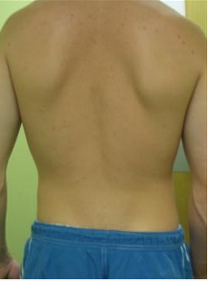
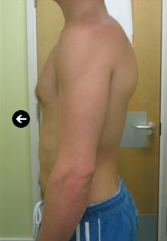
Examination of back including lower limp
The patient should be standing.
Start by examining the patient from behind, looking for any obvious abnormalities such as scars. Also note the muscle bulk and any wasting , symmetry of each side and look for any scoliosis.
Look from the side to check for the normal curvatures of the spine.
Notes:
This slide lets the audience know that everyone is at “some stage” of retirement planning.

Slide 25
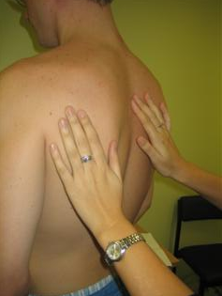
Now feel the areas around the spine. Feel along the entire length of the spine, palpating each spinous process and checking with the patient for any tenderness.
Then palpate the sacroiliac joints and finally the paraspinal muscles.
As it is difficult to observe the patient’s face for signs of discomfort, you should regularly ask them if what you are doing is painful.
Notes:
This slide lets the audience know that everyone is at “some stage” of retirement planning.

Slide 26
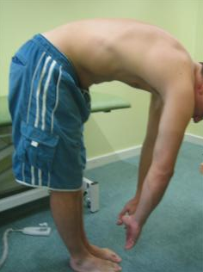
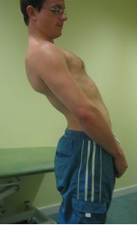
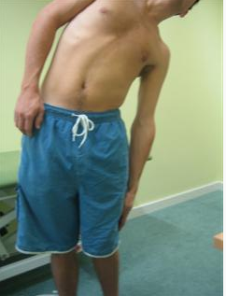
Movements of the spine are all performed actively.
The first movements which are examined are lumbar flexion, extension and lateral flexion.
Flexion and extension are checked by asking the patient to try and touch their toes (flexion) and then lean backwards (extension).
Lateral flexion is examined by asking the patient to run their hand down the outside of their leg.
Notes:
This slide lets the audience know that everyone is at “some stage” of retirement planning.

Slide 27
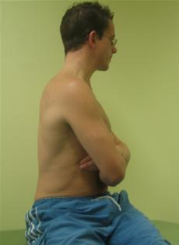
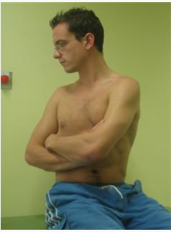
The last movement to assess is thoracic rotation. For this the patient should be sat on the edge of the bed to fix the pelvis then ask the patient to turn to each side.
Notes:
This slide lets the audience know that everyone is at “some stage” of retirement planning.

Slide 28
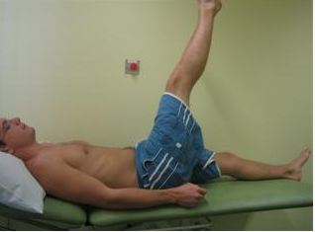
Now ask the patient to lie flat on the bed.
Perform a straight leg raise which assesses for nerve entrapment such as sciatica.
An extension to this examination could be to perform an upper limb neurological examination or lower limb neurological examination if your findings suggest nerve entrapment from the cervical or lumbar spine
Notes:
This slide lets the audience know that everyone is at “some stage” of retirement planning.

Slide 29
Role of PHC in back pain management

Slide 30
Role of PHC
PHC provides non invasive treatment.
Give the patients specific instructions or recommendations depend on the patient need.

Slide 31
Role of PHC
Bed rest is recommended for a few patients with severe back pain and muscle spasms.
Physical activity is recommended in other cases to promote rapid recovery from back pain.

Slide 32
Role of PHC
Ice and heat application: it is helpful to relax the muscles and decrease muscle inflammation.
Prescribe medications.

Slide 33
When to refer patients with back pain to specialist?

Slide 34
When to refer?
Cauda Equina Syndrome - EMERGENCY referral to ER.
Severe unremitting worsening of pain (at night and pain when laying down), consider infection/tumor – URGENT referral to ER for pain control – will need prompt investigation.
Significant trauma – consider fractures – check for instability and refer URGENTLY to spinal surgery.
Weight loss, fever, history of cancer/HIV – consider infection/tumor – refer URGENTLY for MRI Scan and to spinal surgery.

Slide 35
When to refer?
Use of IV drugs or steroids – consider infection /compression fracture – URGENT referral to spinal surgery.
Patient over 50 (if first ever episode of serious back pain) – refer SOON for prompt investigation/spinal surgery.
Widespread neurological signs – consider infection/tumor/neurological disease – refer SOON to neurology/spinal surgery/investigate further.

Slide 36
Prevention and education How can we prevent back pain?

Slide 37
Prevention and education
Keeping your back strong and supple is the best way to avoid getting back pain. Regular exercise, maintaining good posture and lifting correctly will all help.
1- Lose weight – too much upper body weight can strain the lower back; you can use the healthy weight calculator to find out whether you need to lose weight or not.
2- Wear flat shoes with cushioned soles as they can
help reduce the pressure on your back.

Slide 38
Prevention and education
3- Avoid sudden movements which can cause muscle strain.
4- Try to reduce any stress, anxiety and tension, which can all cause or worsen back pain.
5- Read more about recognizing and managing stress,
stay active with regular exercise, such as walking and swimming, is an excellent way of preventing back pain.

Slide 39
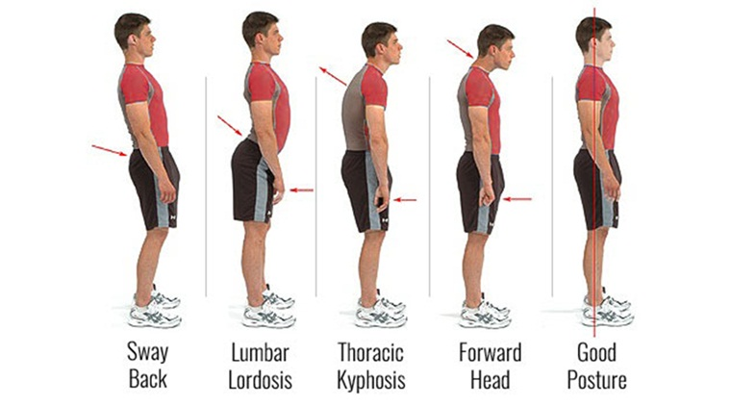
Prevention and education
6- Posture:
How you sit, stand and lie down can have an important effect on your back. The following tips should help you maintain a good posture.
7- Standing:
Stand upright, with your head facing forward and your back straight. Balance your weight evenly on both feet and keep your legs straight.

Slide 40
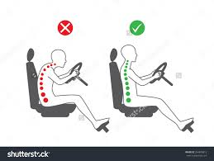
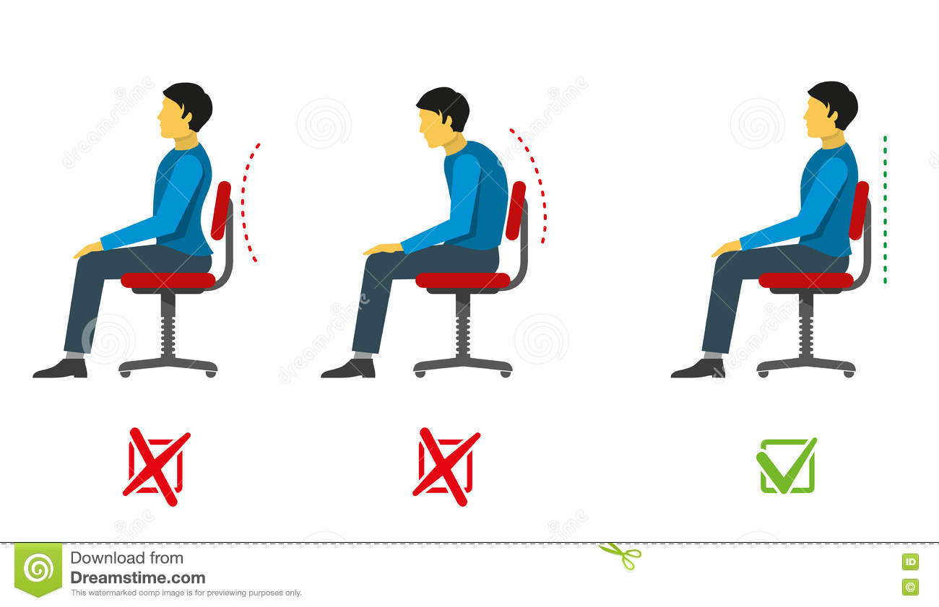
Prevention and education
8- Sitting and driving:
Make sure you sit upright with support in the small of your back. Your knees and hips should be level and your feet should be flat on the floor.

Slide 41
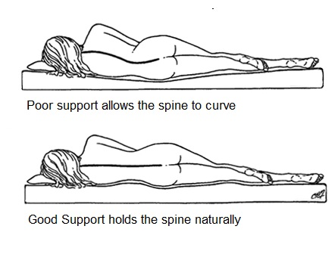
Prevention and education
9- Sleeping:
Your mattress should be firm enough to support your body while supporting the weight of your shoulders and buttocks, keeping your spine straight.

Slide 42
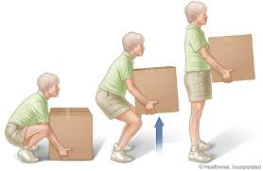
Prevention and education
10- Lifting and carrying:
One of the biggest causes of back injury, particularly at work, is lifting or handling objects incorrectly.
Think before you lift:
can you manage the lift?
Push rather than pull – if you
have to move a heavy object across
the floor, it is better to push it
rather than pull it.
Distribute the weight evenly – if you are carrying shopping bags or luggage, try to distribute the weight evenly on both sides of your body.

Slide 43
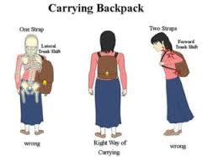
Child’s backpack

Slide 44
Prevention and education
11- Exercise:
Exercise is both an excellent way of preventing back pain and of reducing it, but should seek medical advice before starting an exercise programs if you've had back pain for six weeks or more.
Exercises such as walking or swimming strengthen the muscles that support your back without putting any strain on it or subjecting it to a sudden jolt.

Slide 45
Quiz

Slide 46
Quiz
Q1: Which of the following is considered as a red flag in patients with back pain:
A) History of DM
B) Family history of back pain
C) Focal neurologic deficit
D) Young age

Slide 47
Quiz
Q1: Which of the following is considered as a red flag in patients with back pain:
A) History of DM
B) Family history of back pain
C) Focal neurologic deficit
D) Young age

Slide 48
Quiz
Q2: Most of spinal column tumors are primary tumors:
A) True
B) False

Slide 49
Quiz
Q2: Most of spinal column tumors are primary tumors:
A) True
B) False

Slide 50
Quiz
Q3: Which of the following is the duration of chronic back pain:
A) 3-6 weeks
B) 6-12 weeks
C) More than 12 weeks

Slide 51
Quiz
Q3: Which of the following is the duration of chronic back pain:
A) 3-6 weeks
B) 6-12 weeks
C) More than 12 weeks

Slide 52
References
https://www.nice.org.uk/guidance/cg88/chapter/1-Guidance#referral-for-surgery
http://www.nhs.uk/Conditions/Back-pain/Pages/Prevention.aspx
http://www.afhsr.med.sa/!web/images/he/prosh/LBP_Awaji.pdf
http://www.medpagetoday.com/painmanagement/backpain/44931

Slide 53
Thank you..

