Slide 1
Common Psychiatric Problems in Primary Care
PHC 2016
(Student Led Seminar)
Abdullah Abdlatif Alghaiheb
Abdulaziz Mohammed Alsudairi
Mohammed Fahad Binaskar

Slide 2
Objectives:
Highlight the prevalence of anxiety, depression , and somatic symptom disorder in Saudi Arabia
Highlight the aetiology of anxiety, depression and somatic symptom disorder
Highlight on use of Tricyclic antidepressants and Selective Serotonin Reuptake Inhibitors “SSRI”
Discuss the clinical features and management of anxiety in family medicine setting
Discuss the clinical features and management of depression in family medicine setting
Discuss the clinical features and management of psycho-somatic illness in family medicine setting
Brief discussion about the role of counseling and psychotherapy in the management of common psychiatric problems in family medicine
When to refer to Psychiatrist

Slide 3
Quiz

Slide 4
Q1. Which one of the following symptom must be present to diagnose Depression?
A) Weight loss
B) Sleep disturbance
C) Anhedonia
D) Loss of appetite

Slide 5
Q2. Which of the following is the overall best anti depressant ?
A) TCAs
B) NSAIDs
C) SSRI
D) MAOIs

Slide 6
Q3. A 32-year-old man presented with intense worries when he becomes in the middle of a row in the mosque as escape seems difficult. The most likely diagnosis is ?
Panic disorder.
Specific phobia.
Agoraphobia.
Social phobia.

Slide 7
Q4. A 20-year-old college student presented with repeated bouts of palpitation, sweating, and excessive worries when he uses public transport. The most likely diagnosis is ?
Generalized anxiety disorder.
Post traumatic disorder.
Agoraphobia with panic attacks.
Social phobia.

Slide 8
Q5. What is the Difference Between Somatization and Somatic Symptom Disorder?

Slide 9
Q6. What Can you Tell us about somatic symptom disorder?

Slide 10
Case scenario:
Ms. Amal is a 27-year-old single woman works as a teacher. She has a five-week history of low mood, chest tightness, poor appetite, disturbed sleep, excessive guilt feelings, and loss of interest in her social activities. Her father has a history of mood disorder.

Slide 12
Depression
Is a mood disorder that causes a persistent feeling of sadness and loss of interest. it affects how you feel, think and behave and can lead to a variety of emotional and physical problems.

Slide 13
Prevalence of Depression
Females are more prone to have depression compared to males 2:1.
Depression is more common in younger adults.
Depression is estimated to affect 350 million people worldwide (WHO 2012).
In a study done on 822 male patients that attended Primary Health Care Centers, Eastern Saudi Arabia: The overall prevalence of depression was 32.8% with mild depression accounting for 22.9%.

Slide 14
Cross-sectional study was conducted in three large primary care centers in Riyadh .They used Arabic version of PHQ-2 and PHQ-9. Patients included in the survey analysis were 477. The study found the point-prevalence of screened depression (showing signs of depression) to be 49.9% among the adult visitors to primary healthcare.
Need further exploration of these symptoms .

Slide 15
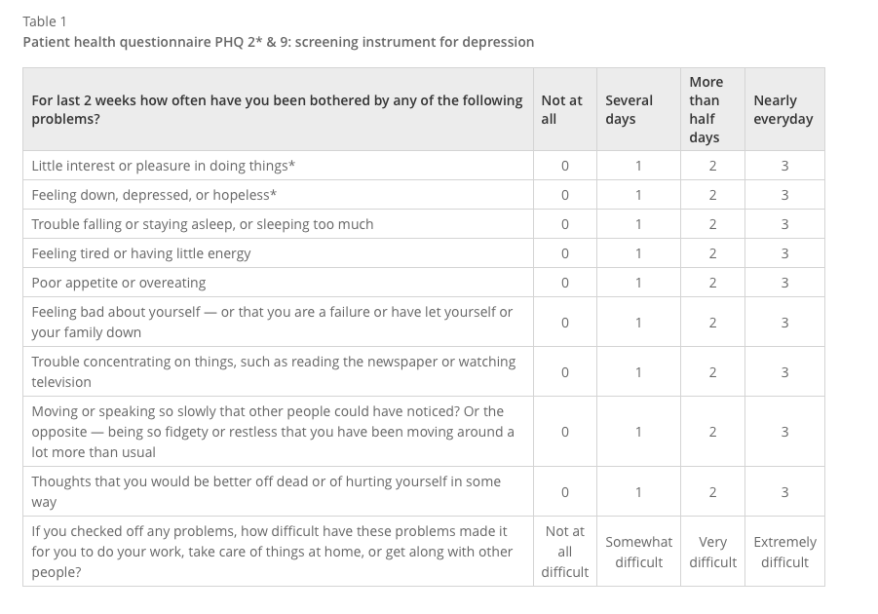

Slide 17
Causes of Depression
Genetics
Biological
Psychological

Slide 18
It is a Multifactorial disorder
Previous Abuse.
Certain medications (isotretinoin , interferon-alpha, and corticosteroids).
Death or a loss of loved one.
Major events.
Social isolation due to other mental illnesses.
Sometimes depression co-exists with a major illness or may be triggered by another medical condition.
Substance Abuse, nearly 30% of people with substance abuse problems also have major or clinical depression.

Slide 19
Clinical features ?
1. Low mood.
2. Loss of interest in pleasurable activities (anhedonia).
3. Appetite or body weight change (increased or decreased). 4.Insomnia or hypersomnia.
5. Psychomotor agitation or retardation. 6. Fatigue or loss of energy.
7. Feelings of worthlessness or excessive guilt.
8. Diminished concentration.
9. Recurrent thoughts of death or suicide.

Slide 20
Major Depressive Disorder
≥ 5 of the previous symptoms have been present during the same 2-week period and represent a change from previous functioning; at least one of the symptoms is either no.1 or no.2:
Significant distress or impairment in functioning.
The symptoms do not meet criteria for a mixed episode.
Not due to substance abuse , a medication or a medical condition(e.g., hypothyroidism)

Slide 22
Dysthymic Disorder (Persistent depressive disorder)
Dysthymic disorder is a chronic depressed mood that lasts most of the day and presents on most days.
≥ 2 years history of chronic low mood.
No remission periods more than two months.

Slide 23
Post-partum Depression
About 10 - 15 % recently delivered women develop disabling depression within 6 weeks of childbirth .
Which if not treated may continue for six months or more and cause considerable family disruption.
It is associated with increasing age, mixed feelings about the baby, physical problems in the pregnancy and prenatal period, family distress and past psychiatric history.

Slide 24
Depressed mood may be associated with irritability, self-blame and doubt of being a good mother, excessive anxiety about the baby’s health and death wishes.
Counseling, additional help with child-care may be needed. Antidepressants or ECT are indicated if there are biological features of depression.

Slide 25
Management

Slide 26
Anti Depressants
Selective-Serotonin- Reuptake Inhibitors (SSRIs):
E.g. paroxetine (seroxat), fluoxetine (prozac), citalopram (cipram)
Selective serotonin reuptake inhibitors (SSRIs) are considered to have the most favourable balance of benefit to harm.
Side effects:
Sexual dysfunction
Gastrointestinal side effects

Slide 27
Seretonin and noradrenaline reuptake inhibitors (SNRIs):
E.g. Venlafaxine (Effexor-Efexor), desvenlafaxine (Pristiq), duloxetine (Cymbalta).
Higher rates of remission in depressed patients than the SSRIs.
More side effects compared to SSRI

Slide 28
Old Anti depressant (second-line treatment)
Tricyclic Antidepressants (TCAs):
E.g. Amitriptyline, imipramine, clomipramine.
They are of proven effectiveness and commonly used though they have many side effects. They are generally less expensive than other antidepressants.
Side Effects :
constipation, urinary retention, dry mouth , impaired visual accommodation, worsening of glaucoma central anticholinergic toxicity(delirium) ,Postural hypotension, delayed ejaculation ,sweating, weight gain, arrhythmia, tremor, precipitation of mania in susceptible patients.
Tricyclics are dangerous in overdose and should be avoided with suicidal patients (cardiac toxicity).

Slide 29
Old Anti depressant (second-line treatment)
Monoamine Oxidase Inhibitors (MAOIs):
Because of their serious interactions with tyramine – containing foodstuffs and other drugs, they are almost obsolete nowadays.
Side effects:
Dry mouth/urinary retention/constipation.
Postural hypotension.
Sexual dysfunction.
Weight gain
Hepatotoxicity.
Hypertensive crisis.

Slide 30
When to refer to a specialist ?
Substantial suicide risk.
Severe depression.
Psychotically depressed (with delusions or hallucinations).
Failure of response to routine antidepressant therapy.
Depression in the elderly where diagnosis includes dementia
Children with major depression.
Uncertainty about diagnosis.
Inpatient care obviously necessary.

Slide 31
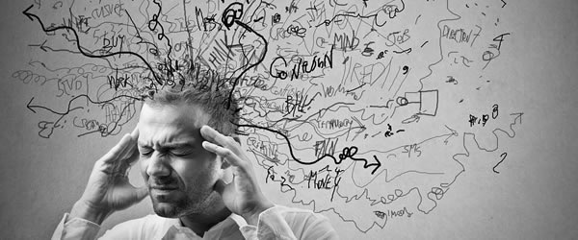
Anxiety

Slide 32
Anxiety
Subjective feeling of worry, fear, and apprehension accompanied by autonomic symptoms (such as palpitation, sweating), caused by anticipation of threat/danger.

Slide 33
Prevalence :-
In a study done on 822 male patients that attended Primary Health Care Centers, Eastern Saudi Arabia: The overall prevalence of anxiety was 22.3% with 17.0% of the attendees having mild degree of anxiety.

Slide 34
Case scenario :-
Mr. Muhannad is a 23-year-old married man seen by his Family doctor for a 7-month history of persistent disabling anxiety, irritability, muscle tension, and disturbed sleep.

Slide 35
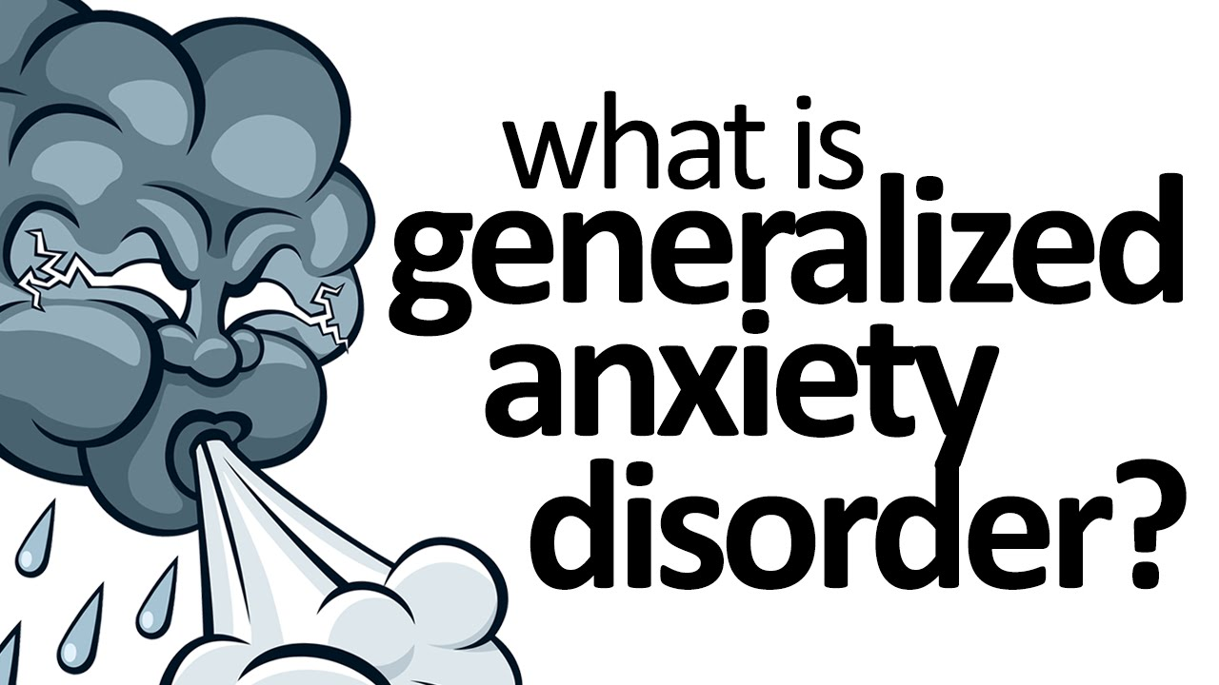

Slide 36
Generalized Anxiety Disorder ( GAD) :-
Is an anxiety disorder characterized by excessive, uncontrollable and often irrational worry, that is, apprehensive expectation about events or activities.

Slide 37
Epidemiology :-
Women > men (2:1).
One year prevalence rate: 3 %. Life time prevalence rate: 5 %.
Age at onset: Often begins in early adult life, but may occur for the first time in middle age.

Slide 38
Diagnostic Criteria :-
A- ≥ 6 months history of excessive anxiety occurring most of the days.
B-The person finds it difficult to control the worry.
C-The anxiety and worry are associated with ≥ 3of 6:-
1- Restlessness. 2- Irritability.
3- Easily Fatigued. 4- Muscle Tension.
5- Difficulty In Concentrating. 6- Sleep Disturbance.
D- The focus of the anxiety is not confined.
E- It causes significant distress or functional impairment.
F- The disturbance is not due to the direct physiological effects (drugs, medical co,..)

Slide 39
Etiology :-
Combination of genetic and environmental influences in childhood.
Many study show that the Anxiety has a familial association.

Slide 40
Treatment :-
A- Rule out medical causes.
B- Cognitive – behavior therapy (CBT):
Anxiety management training: relaxation with cognitive therapy to control worrying thoughts.
C. Medications:
1. Antidepressants :-SSRIs (e.g. paroxetine) or SNRIs( e.g. Venlafaxine).
2. Buspirone :- it is effective in reducing the cognitive symptoms of GAD.
3. Benzodiazepines :- for a limited period (to avoid the risk of dependence)

Slide 41
Case scenario :-
Mr. Abdulaziz is a 23-year-old came to Primary Health Care Clinic complaining of 3- month history of recurrent sudden attacks of severe fear of death, palpitation, shortness of breath, excessive sweating, and impaired concentration. The attack lasts for about 20 minutes then disappears completely. Between, the attacks, although he is free from physical symptoms, he is anticipating the next attack.

Slide 42
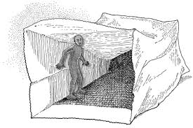
Panic attack :-
Sudden self-limited attack of intense anxiety, with feeling of imminent doom or death and an urge to escape. Panic attacks are symptoms
Panic Disorder :-
Recurrent sudden attacks of severe fear.

Slide 43
Epidemiology :-
Women > men.
Lifetime prevalence is 1 – 3 % throughout the world .
Age at onset: bimodal distribution, with one peak in
late adolescence and a second smaller peak in the mid 30s.

Slide 44
Diagnostic Criteria :-
Recurrent sudden unexpected panic attacks.
At least one of the attacks has been followed by ≥ 1 month of ≥ one of the following:
- Persistent concern about having additional attacks. - Worry about the implications / consequences of the attacks (e.g. going mad or death).
- A significant change in behavior related to the attacks.
3. Not due to medical disease, substance abuse or psychiatric disorder.

Slide 45
Etiology :-
Poorly regulated autonomic responses to stressors when a person becomes afraid of the consequences of symptoms of autonomic arousal.
Pathological hyperactivity in Locus Ceruleus.
Genetic basis (panic disorder occurs more often among relatives).
The biochemical hypothesis (induced by chemical agents like sodium lactate).
Mitral Valve Prolapse (MVP) is more common in patients with panic disorder.

Slide 46
Treatment :-
Cognitive Behavior therapy (CBT): detection and correction of wrong thoughts and thinking process (negative cognition) about the origin, meaning, and consequence of symptoms & relaxation training.
Medications: Choose one of SSRIs (selective serotonin reuptake inhibitors). All are effective for panic disorder although the most widely used is paroxetine. Also tricyclic antidepressants can be a good alternative. For rapid onset of action add a benzodiazepine (lorazepam ).

Slide 47
Case scenario :-
Mr. Mouaiad is a 23-year-old man seen at outpatient clinic because of several weeks' history of excessive fear of fainting when in crowds or in situations that she cannot leave easily.

Slide 48
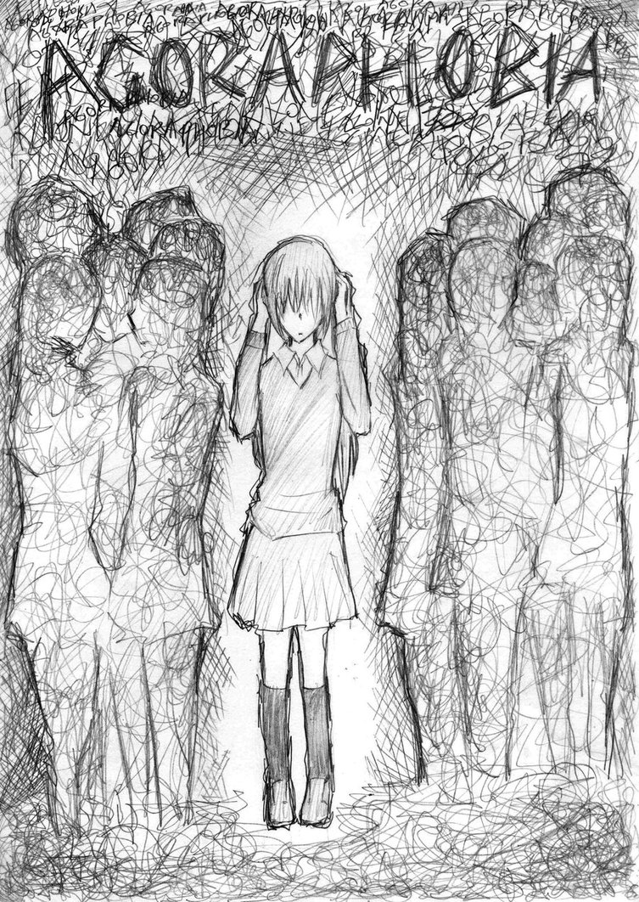
Agoraphobia :-
It means fear and avoidance of market places and open spaces.

Slide 49
Epidemiology :-
Women: men = 2:1.
Lifetime prevalence: 6 – 10 % throughout the world .
Onset : most cases begin in the early or middle twenties.

Slide 50
Diagnostic Criteria :-
Anxiety about being in places or situations from which escape might be difficult.
The situations are either avoided, endured with severe distress.
Symptoms cannot be better explained by another mental disorder.
Functional impairment.

Slide 51
Etiology :-
Predisposing Factors :-
- Separation anxiety in childhood.
- Parental overprotection.
- Dependent personality traits.
- Defective normal inhibitory mechanisms.
Precipitating Factors :-
- A Panic attack in a public place where escape was difficult. - Conditioning (public places trigger fear of having subsequent attacks).
Maintaining Factors :-
- Avoidance reduces fear and ensures self-safety.

Slide 52
Treatment :-
Cognitive Behavior therapy (CBT): detection and correction of wrong thoughts and thinking process (negative cognition) about the origin, meaning, and consequence of symptoms & relaxation training.
Medications: Choose one of SSRIs (selective serotonin reuptake inhibitors) as for panic disorder (SSRIs +/- anxiolytics as per need).

Slide 53
When To Refer?
If the diagnosis is DOUBTFUL
If drug and alcohol dependence or withdrawal complicate the management
If depression or a psychosis appears to be involved
Failure of response to basic treatment

Slide 54
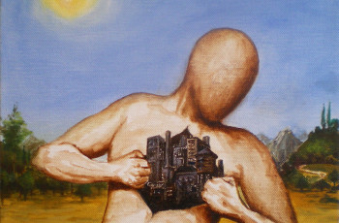
Somatic Symptom Disorder

Slide 55
Case scenario:
A 48-year-old man presented to the clinic complaining of headache , back pain , cough and burning micturition. Symptoms worsen during the week and are relived in the weekends. He also mentioned that he visited 5 Different Doctors over the past Year.
What do you think the Dr. Should do ?

Slide 56
Can You Link the Following ??
Diarrhea
Fecal Incontinence
Burning micturition
Vomiting
Low Mood
Stress
Anxiety
Social Phobia

Slide 57
There is a unity of mind and body.

Slide 58
https://www.youtube.com/watch?v=h5eHWYJTlsE

Slide 59
What is the somatic symptom disorder ?
It is the tendency to experience and communicate mental states and distress as physical symptoms or altered bodily function. It is associated with excessive illness, worry and abnormal illness behavior.
Somatic symptom disorder can be conscious or unconscious and may be influenced by a desire for the sick role or for personal gain.

Slide 60
What is the Epidemiology of somatic symptom disorder ?
Women > men (5 – 10 : 1).
The lifetime prevalence in the general population is about 2%
More common in patients who bottle up their emotions and are less assertive

Slide 61
What is the Prevalence of somatic symptom disorder ?
In Saudi Arabia :-
A study done in Aseer, Saudi Arabia in 2008 out of a sample size of 224 about half of the sample had one or more psychological disorders. The prevalence of Somatic Symptom Disorders was 16%.
A study done on Patients attending the Primary Health care Clinics in 2002, Saudi Arabia. Out of a sample size of 431 the prevalence of somatic symptom disorder was 19.1%.

Slide 62
What is the Prevalence of Somatic Symptom Disorders ?
Netherlands :-
Out of a sample size of 1046 (aged 25–80 years). The prevalence of Somatic Symptom Disorders was 16.1%

Slide 63
What is the Prevalence of somatic symptom disorder ?
Primary care Setting :-
10% to 15% of primary care patients have multiple unexplained symptoms that are present for >2 years

Slide 64
What is the Prevalence of somatic symptom disorder ?
Worldwide :-
The prevalence of Somatic Symptom Disorders is not known but may be around 5% to 7%.

Slide 65
How do you Prevent somatic symptom disorder ?
Primary Prevention:-
There are no demonstrated primary prevention measures.
Preventing child abuse and developmental trauma would eliminate a key known environmental risk factor for somatic symptom disorder .
Facilitating emotional processing skills during childhood may prevent somatic symptom disorder in response to awareness of physical symptoms.

Slide 66
How do you Prevent somatic symptom disorder ?
Secondary Prevention:-
Limiting tests and procedures
Encouraging graded physical exercise
Encouraging a gradual increased participation in general activities of daily living (work, home, school)

Slide 67
How dose Someone with somatic symptom disorder Present ?
Unconventional behavior during history
Emotional processing problems
Recent/ Remote life stressors
Multiple illness behaviors
Unusual neurological deficits
Inconsistent examination findings
False sensory findings
Distractible symptoms
Inconsistent paralysis
Generalized seizure-like motor movements without loss of awareness
Bizarre movements
Gait disorders

Slide 68
How To Diagnose somatic symptom disorder ?
According to the Diagnostic and Statistical Manual of Mental Disorders, 5th Edition (DSM5)
A. The patient has one or more somatic symptoms that are distressing or result in significant disruption of daily life.

Slide 69
How To Diagnose somatic symptom disorder ?
B. Excessive thoughts, feelings, or behaviors related to the somatic symptoms or associated health concerns as manifested by at least one of the following:
Disproportionate and persistent thoughts about the seriousness of one's symptoms
Persistently high levels of anxiety about health or symptoms
Excessive time and energy devoted to these symptoms or health concerns.

Slide 70
How To Diagnose somatic symptom disorder ?
C. Although any one somatic symptom may not be continuously present, the state of being symptomatic is persistent (typically more than 6 months).

Slide 71
Management
The number of medical staff involved is better limited.
Arrange brief regularly scheduled appointments
Repeat physical examination.
Avoid additional diagnostic procedures
Shift the patient’s awareness to psychological factors, and support her/him.
Minimize the use of psychotropic drugs
Encourage graded return to normal activities
Antidepressants are useful when secondary depression develops.

Slide 72
When To Refer ?
The patient has a psychiatric disorder, on psychotropic medications, or has a past history of such.
Patient with disturbing, demanding, manipulative behavior
The Patient has suicidal thoughts.
Suspicion of a psychiatric problem behind the physical symptoms.
The patient has asked to see a psychiatrist.

Slide 73
Counseling and Psychotherapy

Slide 74
Counseling

Slide 75
Definition
An interactive learning process contracted between counselor and client, which approaches in a holistic way, social, cultural, economic and emotional issues.

Slide 77
Goals
Usually the goals of counseling revolve around obtaining information from clients , educating the client, and common understanding between all parties of the counseling session.

Slide 78
Indication
It’s indicated for any presenting difficulty.
Techniques
Listening.
Discussion.
Problem solving.
Enable decision-making.
Enable Learning.

Slide 79
Psychotherapy

Slide 80
Definition
An interpersonal treatment based on psychological principles. It is individualized to the patient, seeking to help him or her with a psychiatric disorder, problem, or adverse circumstance.

Slide 81
Indication
Treatment of a psychiatric disorder, with the goal of reducing or ameliorating symptoms and improving functioning.
Changing maladaptive thoughts, behaviors, or relationships.
Providing support when a crisis, a difficult period, or a chronic problem impairs functioning.
Enhancing a patient’s capacity to make behavioral changes, e.g. losing weight, quitting smoking, or increasing adherence to medical treatment.

Slide 82
Types
Interpersonal psychotherapy/counselling, ideal for primary care and the treatment of depression, is therapy for interpersonal problems.
Mindfulness based on intervention therapy.
Behaviour therapy (BT) is where the patient is directed to do something.
Cognitive therapy (CT) is based on the identification of automatic thoughts that are invariably negative. Cognitions are thoughts, beliefs and perceptions.
Cognitive behaviour therapy (CBT), which combines BT and CT.

Slide 83
Mindfulness
It is based on meditation, is the process about raising awareness and a special way of paying attention to help the person cope with the daily events in their life.

Slide 84
Cognitive behavior therapy (CBT)
CBT is a form of non-pharmacologic treatment emphasizing self-help and aiming to change perceptions and behavior that may perpetuate symptoms and disability.
It can be applied in any area of medical practice as a form of psychotherapy and is suitable in general practice for the treatment of depression, insomnia, eating disorders, delusions and hallucinations in psychotic disorders and anxiety in all forms, especially social anxiety disorder and phobias

Slide 85
Quiz

Slide 86
Q1. Which one of the following symptom must be present to diagnose Depression?
A) Weight loss
B) Sleep disturbance
C) Anhedonia
D) Loss of appetite

Slide 87
Q2. Which of the following is the overall best anti depressant ?
A) TCAs
B) NSAIDS
C) SSRI
D) MAOIs

Slide 88
Q3. A 32-year-old man presented with intense worries when he becomes in the middle of a row in the mosque as escape seems difficult. The most likely diagnosis is ?
Panic disorder.
Specific phobia.
Agoraphobia.
Social phobia.

Slide 89
Q4. A 20-year-old college student presented with repeated bouts of palpitation, sweating, and excessive worries when he uses public transport. The most likely diagnosis is ?
Generalized anxiety disorder.
Post traumatic disorder.
Agoraphobia with panic attacks.
Social phobia.

Slide 90
Q5. What Can you Tell us about somatic symptom disorder?

Slide 91
References :-
John Murtagh's General Practice - 6th Edition (2015
http://www.lifesciencesite.com/lsj/life0903/017_9353life0903_128_133.pdf
https://www.ncbi.nlm.nih.gov/pmc/articles/PMC4744283/
Manual of psychiatry
http://ijp.sagepub.com/lookup/pmid?view=long&pmid=12489702
https://www.ncbi.nlm.nih.gov/pmc/articles/PMC3377053/
http://www.who.int/mental_health/management/depression/who_paper_depression_wfmh_2012.pdf
http://bmcpsychiatry.biomedcentral.com/articles/10.1186/1471-244X-14-190
DSM 5

Slide 92
Thank You!

