Slide 1
Prevention and Screening
Done by : Faris alharbi
Fares Aljohani
Talal alawaji

Slide 2
Objectives
To Define screening / prevention and its uses in family practice
To understand the Criteria for screening tests
To identify Screening types and targeted people for each type with examples.
To identify appropriate approaches for prevention and screening of common problems in primary care .
To explain pros and cons of screening .
To justify the rational for selection of a screening test with practical case /condition, examples like for CA. breast, Ca. colon, Ca. prostate, …….

Slide 4
What is Prevention?
the action of stopping something from happening or arising.
Prevention includes a wide range of activities — known as “interventions” — aimed at reducing risks or threats to health.

Slide 5
PREVENTION TYPES ?
Researchers and health experts talk about three categories of prevention:
Primary .
Secondary .
Tertiary.
(What's the difference?)

Slide 6
Primary prevention
Primary prevention aims to prevent disease or injury before it ever occurs.
This is done by preventing exposures to hazards that cause disease or injury,
altering unhealthy or unsafe behaviors that can lead to disease or injury, and
increasing resistance to disease or injury WHENEVER exposure occur.

Slide 7
Examples of Primary Prevention
Legislation and enforcement to ban or control the use of hazardous products (e.g. asbestos)
Education about healthy and safe habits (e.g. eating well, exercising regularly, not smoking)
Immunization against infectious diseases
Removing the causal agents ; like sanitation measures of nineteenth century.

Slide 8
Secondary prevention
Occurs at the early stages od the pathogenesis
To reduce the impact of a disease or injury that has already occurred.
This is done by detecting and treating disease or injury as soon as possible to halt or slow its progress
Implementing programs to return people to their original health and function to prevent long-term problems.

Slide 9
Prevention VS screening

Slide 10
Screening
The presumptive identification of unrecognized disease or defect by the application of tests, examinations, or other procedures which can be applied rapidly
an early disease detection OR secondary prevention
A screening is not intended to be diagnostic

Slide 11
Screening
The EARLY DETECTION of
Disease
Risk factors
Susceptibility to disease in individuals who do not show any signs of disease

Slide 12
TYPES OF SCREENING
1. Mass screening
2. High risk or selective or targeted screening.
3. Multiphasic screening.
4. Multipurpose screening.
5. Opportunistic and case finding screening.
Notes:
Mass screening : Mass screening means, the screening of a whole population or a subgroup. It is offered to all, irrespective of the risk status of the individual.
Multiphasic screening involves the use of several screening tests on the same occasion (e.g., an annual health check-up)
Selective screening ( targeted screening) of groups with specific exposures is often used in environmental and occupational health (e.g., battery workers)
Proactive or systematic screening: population registers are used to invite members of the population at risk for screening at appropriate intervals
Case-finding (or opportunistic screening) is a form of screening restricted to patients who consult a health practitioner for some other purpose (the GP may take your blood pressure when you come for your 'flu shot)

Slide 13
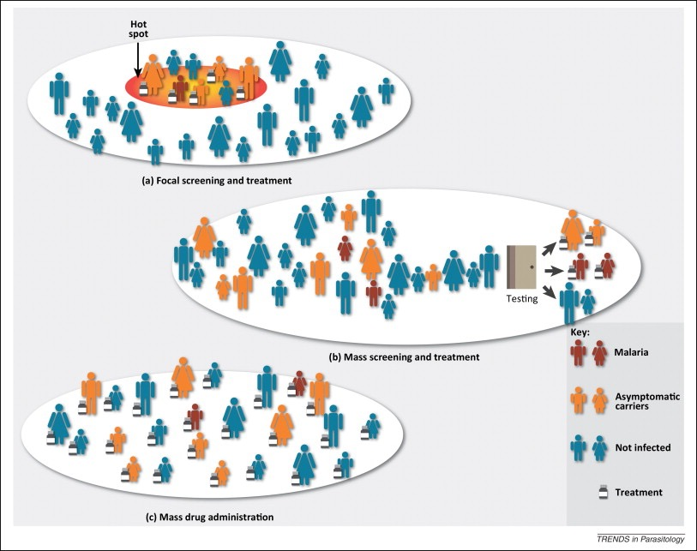
Mass screening and treatment

Slide 14
Examples for mass screening:
Visual defects in school children.
Mammography in women aged 40 years.
New born screening program.
TB screening
Cervical cancer screening

Slide 15
Mass screening for T.B

Slide 16
TESTING VISUAL DEFECTS IN CHILDREN

Slide 17
HIGH-RISK OR SELECTIVE SCREENING
It is applied selectively to high risk groups, the groups defined on the basis of epidemiological research.
Examples:
a. Screening foetus for Down’s syndrome in a mother who already has a baby with Down’s syndrome.
b. Screening for familiar cancers, HTN and DM.
c. Screening for cancer cervix in low social groups.
d. Screening for HIV in risk groups.

Slide 18
HIGH-RISK OR SELECTIVE SCREENING

Slide 19
MULTIPHASIC SCREENING
It has been defined as the application of two or more screening tests in combination to a large number of people at one time than to carry out screening tests for single diseases.
The procedure may also include health questionnaire, clinical examination and a range of measurements and investigations.
E.g.
1) Chemical and hematological tests on blood and urine specimens.
2) Lung function assessment, audiometry and measurement of visual acuity.

Slide 20
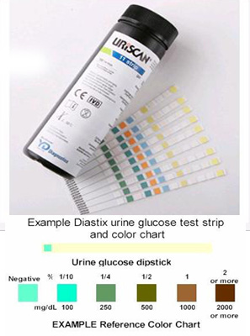
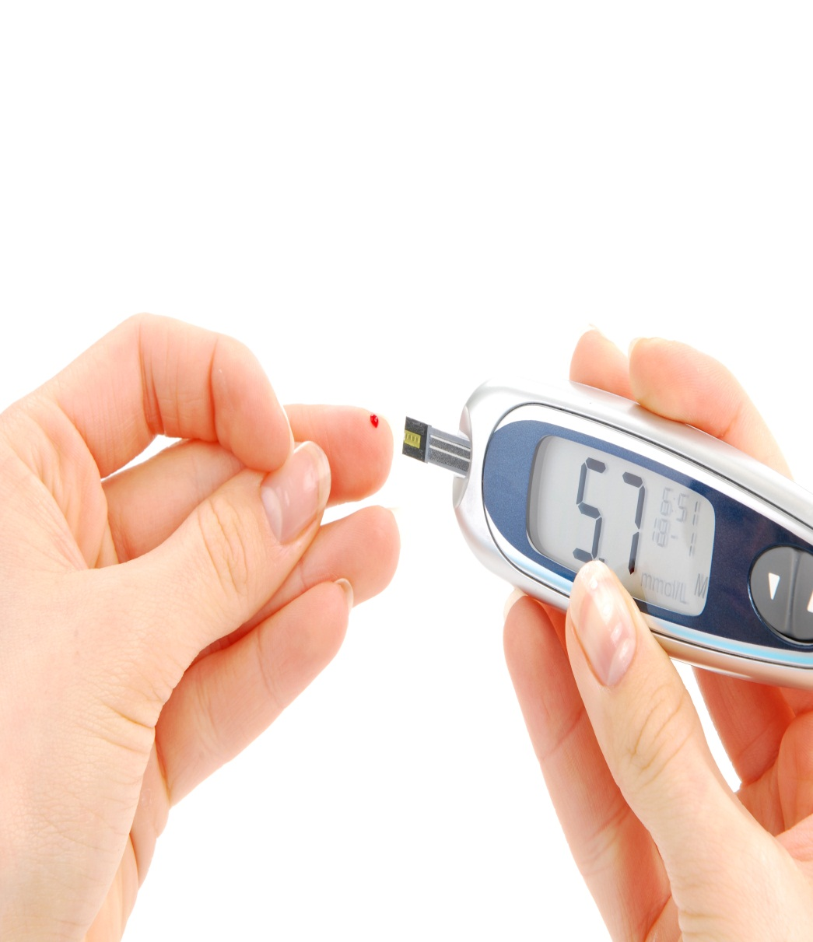
Multiphasic Screening for Diabetes

Slide 21
MULTI PURPOSE SCREENING
The screening of a population by more than one test done simultaneously to detect more than one disease.
Example:
Screening of a pregnant women for VDRL, HIV, HBV by serological tests.

Slide 22
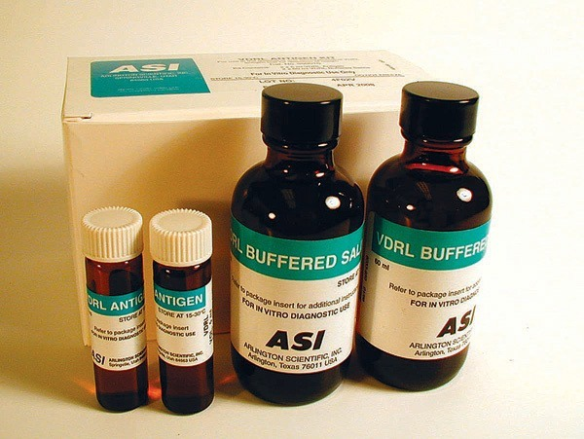
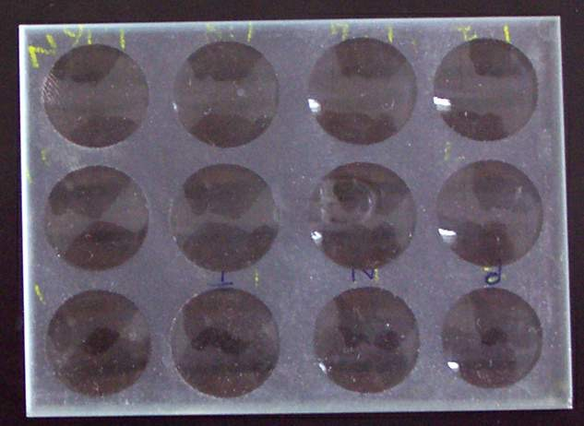
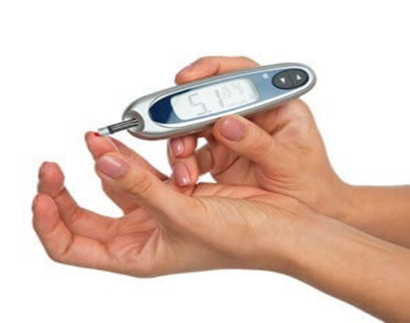
VDRL test antigen VDRL slide Hypertension Diabetes screening

Slide 24
Examples of Secondary prevention
regular exams and screening tests to detect disease in its earliest stages (e.g. mammograms to detect breast cancer)
daily, low-dose aspirins and/or diet and exercise programs to prevent further heart attacks or strokes
Identifying the pre-symptomatic diseases (or risk factors)before significant damage is done e.g screening for hypertension.

Slide 25
Tertiary prevention
To soften the impact of an ongoing illness or injury that has lasting effects.
This is done by helping people manage long-term, often-complex health problems and injuries (e.g. chronic diseases, permanent impairments) .
This helps to improve as much as possible their ability to function, their quality of life and their life expectancy.

Slide 26
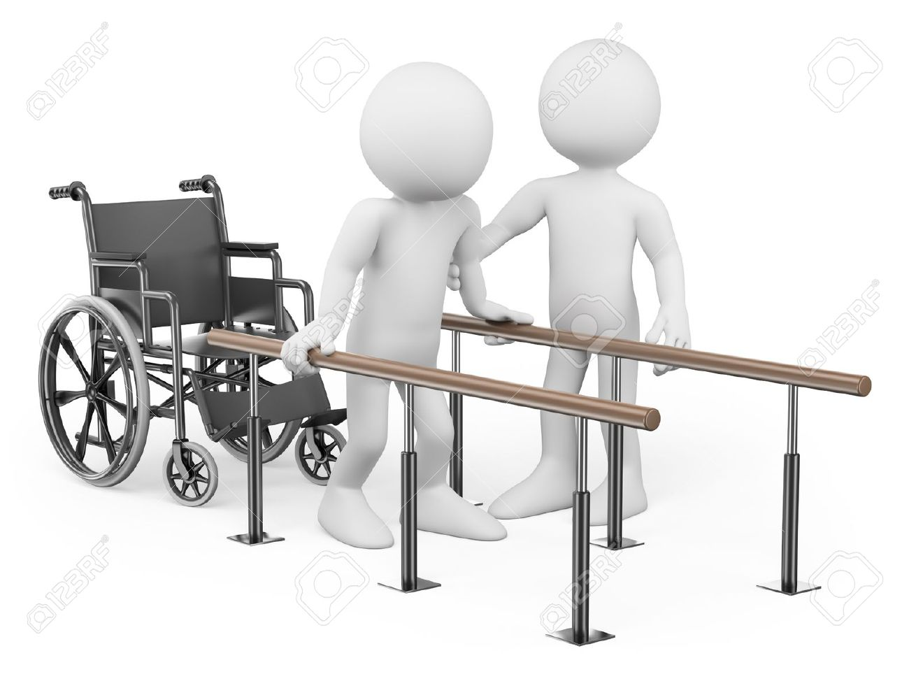

Slide 27
Examples of Tertiary prevention
cardiac or stroke rehabilitation programs.
Limiting complications /disability in patients with established disease by regular surveillance , e.g. : trying to prevent Diabetic problems by good control , regular funduscopic , foot care .
chronic disease management programs (e.g. for diabetes, arthritis, depression, etc.)

Slide 28
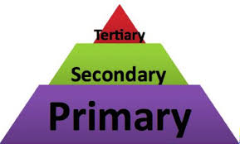

Slide 29
What is Family Physicians Role in Screening ?
A family physicians is the one who provides an anticipatory care approach for precluding problems .
This specialty puts all efforts to offer all appropriate forms of prevention within the consultation and the organizational framework of primary care .

Slide 30
Common Screening Conditions
Hypertension Screening.
Cervical Cytology
Developmental surveillance.
Well woman & man clinic.
Visiting elderly people at home.
Mammography.
Serum lipid estimation.
Screening psychiatric illness.
Prostate Cancer screening

Slide 31
Screening by Age Groups:

Slide 32
Screening in :-
New borns
Children:
Hemoglobinopathies
Hearing loss
Hypothyrodism
Phenylketonuria
Visual acuity
Obesity

Slide 33
Screening in Adults:
Hypertension
Cholesterol abnormalities 35+
Cholesterol abnormalities 35-
Colorectal cancer 50-75
Depression
Diabetes 40-70
Lung cancer
Annually, 55-80 with 30 pack-years or quit in last 15y
Obesity
Tuberculosis (?)
Tobacco use counseling
Hepatitis B
HBsAg

Slide 34
Screening in Adult females:
Osteoporosis 65+
BRCA risk assessment with FH
Breast cancer 40+
Mammography every 1 or 2 years
Cervical cancer 21-65
Pap smear every 3 years / HPV testing every 5

Slide 35
Screening in Pregnant females:
Bacteriuria
12 to 16 weeks' gestation
Gestational diabetes
24 weeks gestation
Hepatitis B
HIV
Rh incompatibility
Folic acid supplements

Slide 36
Periodic Health Examination
In Saudi Arabia

Slide 37
Periodic Health Exam under 6 years
Dental health
Sun Exposure and Vitamin D
5–30 minutes of sun exposure between 10 AM and 3 PM at least twice a week to the face, arms, legs, or back
Recommended Dietary Allowance (RDAs) for Vitamin D :
0 - 12 months 400 IU (10 mcg)
1 - 13 years 600 IU(15 mcg)

Slide 39
Periodic Health Exam under 6 years
The Red Reflex
The Corneal Light Reflex
The Cover-Uncover Eye Test
https://www.youtube.com/watch?v=iLw9iYCAy88
Evaluate Gross Hearing by observing an infant response to sound
Sickling and G6PD
Phenyl ketoneuria
Vitamin K injection: A single dose (1.0 mg) of intramuscular vitamin K after birth is effective in the prevention of classic Haemolytic disease of the newborn (HDN). Either intramuscular or oral (1.0 mg) vitamin K prophylaxis improves biochemical indices of coagulation status at 1 - 7 days.

Slide 40
Periodic Health Examination (6 - 17 years)

Slide 42
Sun Exposure and Vitamin D
Depression Screening: Ask 2 simple questions about: Mood and loss of interest in the past 2 weeks from 12 years of age.
Oral Hygiene
BMI Plotting Charts: Annually
Overweight = age and gender specific BMI at ≥85th to 94th percentile.
Obesity = age and genderspecific BMI at ≥95th percentile.
Sexually Transmitted Infections.

Slide 43
Periodic Health Examination (8 - 59 years)

Slide 45
Periodic Health Exam (18 - 59 years )
Oral Hygiene
Depression Screening
Check BMI & Waist Circumference
Blood Pressure :
reading every 2 years if BP ≤120 /80 mmHg and annually if BP 120 - 139/ 80 - 89 mmHg.
Check Fasting Blood Sugar or Hb A1c or RBS
starting at the age of 45 years every 3 years.
Screen all adults who are overweight ( BMI ≥ 25 kg/ m2) and have additional risk factors
Fasting Lipid Screening
every 5 years starting at age (F≥45 years (if they are at increased risk for CHD) - M≥35 years)

Slide 46
Periodic Health Exam (18 - 59 years )
STI Screening
Colon Cancer
Screening:start ≥ 50y
Fecal occult blood done annually OR
Flexible Sigmoidoscopy every 5y OR
Colonoscopy every 10y

Slide 47
Periodic Health Exam (18 - 59 years ) Females
Pap smear:
Within three years of sexual activity PAP smear should be done once per year for three years then every three years after three consecutive normal sample.
Mammogram:
Women aged 40 - 49 years routine screening should be individualized and should take into account women context, and values regarding specific benefits and harms screening mammography.((locally The Saudi Expert Panel suggests screening with mammography in women aged 40–49 years every 1 to 2 years).
DEXA Scan :For women at risk for what?? every1 - 2 years
In younger women (50 - 64) years whose fracture risk is equal to or greater than that of 65 years old white women who has no additional risk factors.
Aspirin 81mg daily (Male:45/ Female:55) when potential benefit of a reduction in MI (in male) and stroke (in female) outweigh the harm of gastrointestinal hemorrhage
All women planning or capable of pregnancy
Folic Acid:

Slide 48
Periodic Health Examination (60 above)

Slide 50
Periodic Health Exam (60 years and above)
Fall Assessment and Prevention:
Risk Assessment:
History of falls.
Mobility problems.
Poor performance on the timed Get-Up-and-Go test also identifies persons at increased risk for falling.
Depression Screening: Ask 2 simple questions about Mood and loss of interest in the past 2 weeks.

Slide 51
Screening vs periodic health exam
Capable of wide application
Relatively inexpensive
Requires less physician - time

Slide 52
Benifits Of Screening:
Improved prognosis for some cases detected by screening.
Less radical treatment for some early cases.
Reassurance for those with negative test results.
Increased information on natural history of disease and benefits of treatment at early stage.
economic saving on future treatment.

Slide 53
Disadvantages Of Screening:
Longer morbidity in cases where prognosis is unaltered.
False reassurance for those with false-negative results.
Anxiety, Unnecessary intervention and sometimes morbidity for those with false-positive results.

Slide 54
The Wilson–Jungner criteria:
All screening tests should meet the following criteria before they are introduced to the target population:
• The condition being screened for is an important health problem
• Natural history of the condition is well understood
• There is a detectable early stage
• Treatment at early stage is of more benefit than at late stage
• There is a suitable test to detect early stage disease

Slide 55
• The test is acceptable to the target population
• Intervals for repeating the test have been determined
• Risks, both physical and psychological, are < benefits
• Costs are worthwhile in relation to benefits gained

Slide 56
Good Screening Program
Disease
Disease
Test
Suitable
Acceptable
Important Detectable at early stage
Adequately understood
Treatment
Accepted
Available
Cost-Efficient

Slide 57
What are common conditions or diseases
Where we can apply screening & Preventive?

Slide 58
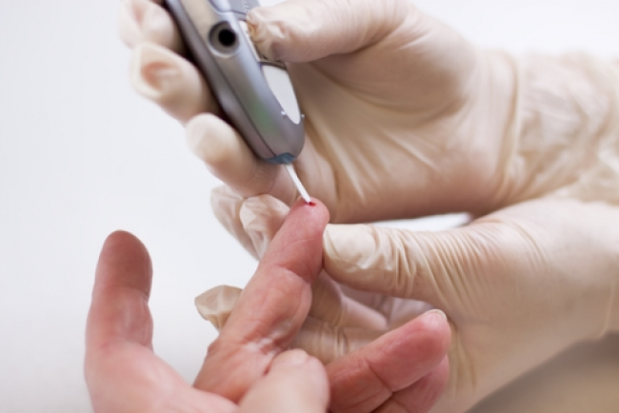

Slide 59
Developmental surveillance
Hypertension
Diabetes Mellitus
Colon cancer
Breast cancer
Prostate Cancer
Cervical cancer
CVD risk assessment

Slide 60
Colorectal Cancer

Slide 61
Most common cancer in Saudi males and 3rd in Saudi females.
25-30% of patients present with distant metastasis
Low survival rates due to late diagnosis
It’s an important health problem, where early diagnosis is critical.
fecal occult blood tests (FOBT):
Simple Acceptable Cheap
Beneficial Cost-Effective
Safe

Slide 62
Breast Cancer

Slide 63
The major form of Cancer among women
Among 20% of female cancer deaths , it is the most common cause of death in women aged 35-54.
It’s an important health problem, where early diagnosis is critical.
Mammography:
Simple Acceptable Cheap
Beneficial Cost-Effective

Slide 64
Hypertension

Slide 65
Common
Usually asymptomatic.
Dangerous itself, but also a risk factor for CVD
Usually found during routine BP screening or incidentally.

Slide 66
Conclusion

Slide 67
Questions ?

Slide 68
References
http://www.med.uottawa.ca/sim/data/Screening_e.htm
https://www.betterhealth.vic.gov.au/health/conditionsandtreatments/cancer-screening
http://www.interesjournals.org/full-articles/colorectal-cancer-in-saudi-arabia-moving-collectively-forward-to-reduce-the-risks.pdf?view=inline
Oxford Hand Book Of General Practice 4TH Edition
https://www.cancer.gov/types/colorectal/screening-fact-sheet
http://www.colorectal-cancer.ca/en/screening/fobt-and-fit/
http://phprimer.afmc.ca/Part1-TheoryThinkingAboutHealth/Chapter4BasicConceptsInPreventionSurveillanceAndHealthPromotion/Thestagesofprevention

