Slide 1
Sexually Transmitted disease
Done by:
- Abdullah Aldurihm.
- Abdulaziz Almsoud.
- Muhannad Alsharidah.

Slide 2
At the end of the session the student should be able to:
1­ List common sexual transmitted infections.
2­ Discus how to obtain sexual history and risk factors.
3­ Discus the differential diagnosis of:
▪ Vaginal and urethral discharge.
▪ Ulcerative and non­ulcerative genitalia.
▪ Pelvic pain and dysuria.
4- List the possible sexual transmitted infections among heterosexual and homosexual person.
5­ - Discus the investigation, diagnosis and management of sexual transmitted infections.
6­ - Discus the methods of prevention.
7­ - Discus the complications of sexual transmitted disease.
8­- Dermatological pictures of different sexual transmitted infection.

Slide 3
Question 1
Most common STIs in KSA ?
HIV
Chlamydia
Gonorrhea
Syphilis

Slide 4
Question 2
A patient went 3 days ago to one of the gulf countries. He complains of urethral discharge. What do you expect :
HIV
Chlamydia
Gonorrhea
Syphilis

Slide 5
Question 3
Patient comes to you complaining of urinary frequency. When you examined her you found Frothy yellowish vaginal discharge and strawberry cervix:
What is the most likely diagnosis?
HIV
Trichomoniasis
Gonorrhea
Syphilis

Slide 6
Question 4
Which of the following is required to diagnose a patient with AIDS?
A CD4 count of less than 200 cells/mm3
A CD4 count of less than 1000 cells/mm3
A CD4 count of less than 2000 cells/mm3
A CD4 count of less than 100 cells/mm3

Slide 7
Question 5
Which of the following is the drug of choice in the treatment of Trichomoniasis :
Azithromycin
Doxycycline
Ceftriaxone
Metronidazole

Slide 8
Why Sexual History is Important?
Diagnosis & treatment
Detection of asymptomatic disease
Prevent serious complication (i.e. infertility, PID…)
Promote behavior changes to prevent future infections

Slide 9
Taking Sexual History
Reassurance.
Play the helper rule, not the judge rule.
History must cover the 5Ps:
Past STIs .
Partners .
Practices .
Prevention of STIs and HIV.
Pregnancy history and plans .

Slide 10
Method of Taking History
Use open ended questions.
Relieve pressure of patients.
Avoid medical terminologies .
Don’t make assumptions .
Specific sexual practices: ask about anal, oral, or vaginal sex.

Slide 11
Definition of STIs
“Sexually transmitted infections (STIs) are infections that are spread primarily through person-to-person sexual contact. There are more than 30 different sexually transmissible bacteria, viruses and parasites.”
World Health Organization (WHO)

Slide 12
PARASITIC
VIRAL
BACTERIAL
MOST COMMON SEXUAL TRANSMITTED INFECTIONS

Slide 13
Most Common Sexual transmitted Infections:
Bacterial infections :
Chlamydia trachomatis (causes chlamydial infections)
Neisseria gonorrhoeae (causes gonorrhoea or gonococcal infection)
Treponema pallidum (causes syphilis)
Haemophilus ducreyi (causes chancroid)
Klebsiella granulomatis (causes granuloma inguinale or donovanosis).

Slide 14
Most Common Sexual Infections
Viral infections:
Human papillomavirus (causes genital warts and certain subtypes lead to cervical cancer in women).
Herpes simplex virus type 1 and type 2 (causes genital herpes)
Human Immunodeficiency Virus (causes HIV infection)
Hepatitis B virus (causes hepatitis and chronic cases may lead to cancer of the liver)
Parasitic infections:
Trichomonas vaginalis (causes trichomoniasis)

Slide 15
Common STIs

Slide 16
PARASITIC
VIRAL
BACTERIAL
MOST COMMON SEXUAL TRANSMITTED INFECTIONS

Slide 17
Chlamydia Trachomatis
Bacterial Infection

Slide 18
Chlamydia Trachomatis
It is the most common bacterial STI in the world.
It is the most common STI in KSA
Etiology:
It is caused by the bacterium Chlamydia trachomatis.
It has an incubation period of 1–3 weeks.
Mode of transmission:
Sexual contact

Slide 19
Clinical Presentation of Chlamydial Infection
Males (asymptotic in 50%) | Female (asymptotic in 70%)
Painful urination
Burning Sensation on the genitalia
Cloudy or clear discharge from the penis | Abnormal vaginal discharge
Painful and swollen testicles | Pain during intercourse
 | Abdominal pain with fever
 | Intermenstrual bleeding

Slide 20
Diagnosis
Diagnosis: Using the following methods after a urine sample (specimen of choice) or swab is obtained:
Nucleic acid amplification test (NAAT) .
Direct fluorescent antibody test.
Enzyme immunoassays (EIAs) .

Slide 21
Treatment
Tetracyclines or Macrolides antibiotics such as Azithromycin or Doxycycline
In pregnancy, Erythromycin is the drug of choice.

Slide 22
Complications
Women
Pelvic inflammatory disease (PID)
Cervicitis
Salpingitis (causing ectopic pregnancy)
Men
Urethritis
Epididymitis
Reactive arthritis

Slide 23
Gonorrhea
Bacterial Infection

Slide 24
Gonorrhea
Etiology:
Neisseria gonorrhea (Gram -ve intracellular diplococcus).
Incubation period is 2-14 days.
Modes of transmission:
Sexual contact (most symptoms present between 2-5 days)
Mother to child transmission

Slide 25
Gonorrhea Presentation
 | Men | Women
Asymptomatic | 10% | 50%
Signs and symptoms | Dysuria Urethral discharge In MSM rectal infection may produce proctitis. | Dysuria Pelvic pain vaginal discharge Intermenstrual bleeding Conjunctival infection: seen in neonates born to infected mothers.
Notes:
MSM = men who have sex with men

Slide 26
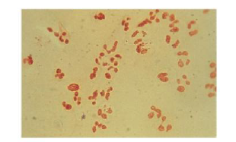
Diagnosis of Gonorrhea
Gram-negative intracellular diplococcic may be seen on microscopy of smears from infected sites (see the Figure).
The diagnosis must be confirmed by culture or nucleic acid amplification test (NAAT)
Figure This is gram stain urethral smear for men with gonococcal urethritis.
Notes:
disseminated GC = Gonococcal infection , The diagnosis must be confirmed by culture or nucleic acid amplification test (NAAT) such as polymerase chain reaction (PCR).

Slide 27
Treatment of Gonorrhea :
Ceftriaxone
Azithromycin or Doxycycline to cover Chlamydia.

Slide 28
Complications of Gonorrhea
Women
Bartholin’s abscess
Pelvic inflammatory disease
Infertility
Men
Epididymitis
Prostatitis

Slide 29
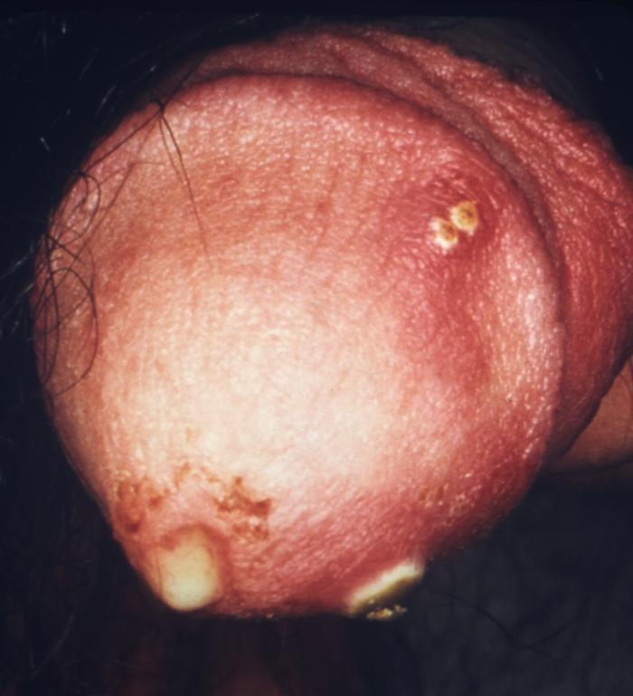
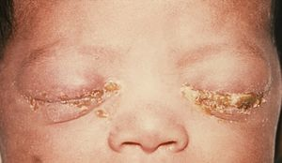
purulent penile discharge due to gonorrhea with an overlying penile pyodermal lesion.
Gonococcal ophthalmia neonatorum

Slide 30
Syphilis
Bacterial Infection

Slide 31
Syphilis
Etiologic agent: Treponema pallidum
Disease progresses in stages,(Primary , Secondry , latent , Tertiary).
Modes of Transmission :
Sexual and vertical
Most contagious to sex partners during the primary and secondary stages

Slide 32
Primary Syphilis
The first stage present with chancre (a firm, painless, non-itchy skin ulceration) form at the site of infection about 2-3 weeks after you are first infected.

Slide 33
Secondary Syphilis
Occurs about 2-8 weeks after the first sores form.
About 33% of those who do not have their primary syphilis treated will develop this second stage.
These symptoms (diffuse rash which frequently involves the palms of the hands and soles of the feet).

Slide 34
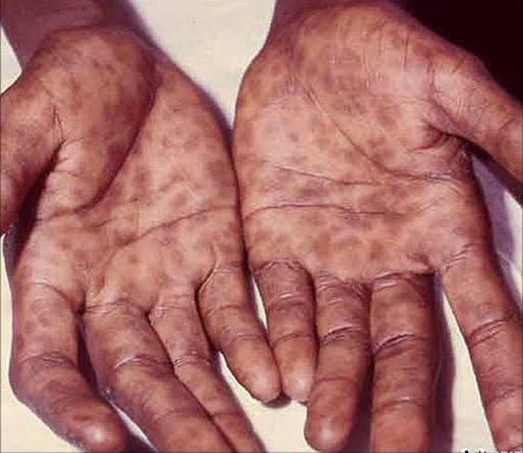
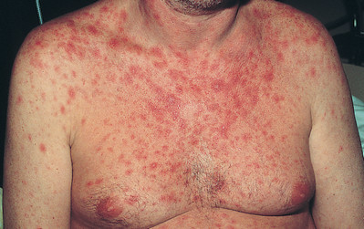
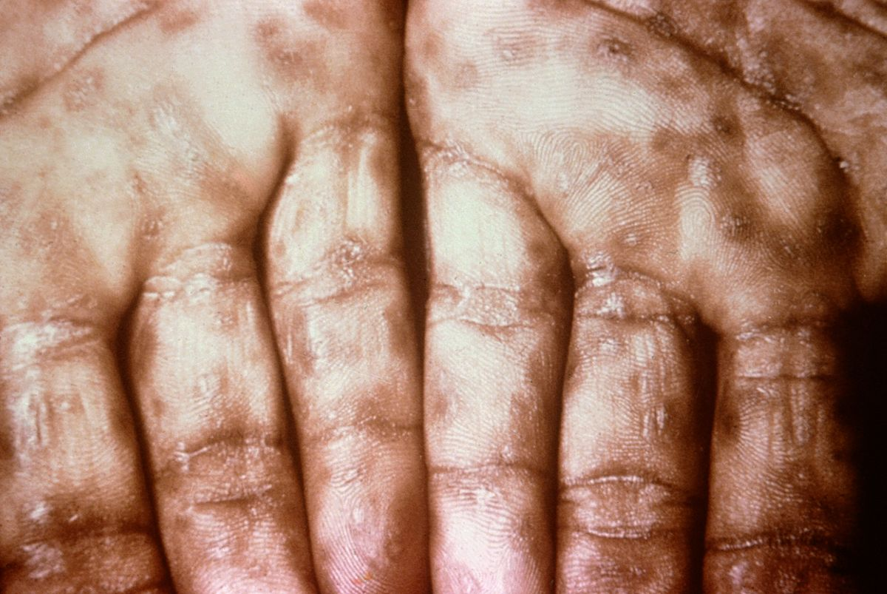
Secondary syphilis

Slide 35
Latent syphilis
Latent syphilis is defined as having serologic proof of infection without symptoms of disease
It can be:
Early:
less than 2 years after secondary syphilis.
Late:
more than 2 years after secondary syphilis.
Late latent syphilis is asymptomatic.
not as contagious as early latent syphilis.

Slide 36
Tertiary Syphilis
Final stage of syphilis.
The infection generally involves the skin and bones but can also spreads to the brain, nervous system, heart.
Appearance of Gumma (charactaristic granulomatous lesions) commonly found on skull and legs.

Slide 37
Tertiary Syphilis

Slide 38
Diagnosis of Syphilis
a- Dark field microscopy of smear
from primary or secondary lesions. May be negative.
b- Serologic tests: (commonly used) VDRL and TPHA
i-Nontreponemal tests
ii-Treponemal tests
iii- IgM

Slide 39
Treatment of syphilis
Antibiotics: effective early
Benzathine penicillin (1 dose, IM), if allergic: doxycycline (2 weeks)
If latent/tertiary: Benzathine penicillin (3 doses, IM)

Slide 40
PARASITIC
VIRAL
BACTERIAL
MOST COMMON SEXUAL TRANSMITTED INFECTIONS

Slide 41
Trichomoniasis
Parasitic Infection

Slide 42
Trichomoniasis
Etiology:
Trichomonas Vaginalis (Flagellated protozoa).
Mode of transmission:
Sexual contact.
Perinatally, from mother to child.

Slide 43
Signs and symptoms
Men:
usually present asymptomtic
They may complain of urethral discharge,
urinary frequency.
Women:
The major complaint are vaginal discharge
Local irritation.
Examination often reveals a frothy yellowish vaginal discharge
The cervix may have multiple small hemorrhagic areas which lead to the description ‘strawberry cervix’.

Slide 44
Strawberry cervix

Slide 45
Diagnosis and Treatment
Diagnosis:
Dark-ground microscopy:
Positive in 40-80% of women.
Positive in 30% of men.
Culture techniques are good and confirm the diagnosis.

Slide 46
Treatment
Metronidazole is the treatment of choice.

Slide 47
Complications
Genital inflammation
During pregnancy
Preterm delivery
Low birth weight

Slide 48
PARASITIC
VIRAL
BACTERIAL
MOST COMMON SEXUAL TRANSMITTED INFECTIONS

Slide 49
Human immunodeficiency virus (HIV)
Viral Infection
Notes:
Sub-Saharan Africa remains most severely affected

Slide 50
HIV
Etiology:
Retrovirus, either HIV-1 or HIV-2
HIV-2 is almost entirely confined to West Africa
Modes of Transmission:
Sexual intercourse (Vaginal or Anal)
Mother-to-child (transplacental, perinatal, breastfeeding).
Contaminated blood, blood products and organ transplantation
Contaminated needles
Notes:
Worldwide, the predominant virus is HIV-1, So when we generally say HIV, we are referring to HIV-1. The relatively uncommon HIV-2 type is concentrated in West Africa and is rarely found elsewhere
There are two types of HIV: HIV-1 and HIV-2. Both types are transmitted by sexual contact, through blood, and from mother to child, and they appear to cause clinically indistinguishable AIDS. However, it seems that HIV-2 is less easily transmitted, and the period between initial infection and illness is longer in the case of HIV-2. less pathogenic
HIV-1 and HIV-2 have many similarities including their intracellular replication pathways, transmission modes and clinical effects leading to acquired immune deficiency syndrome (AIDS). However, HIV-2 is less likely to progress into AIDS because of its lower transmissibility. Thus, individuals infected by HIV-2 mostly remain non-progressors for a long period of time, while patients infected by HIV-1 progress faster and contract AIDS.

Slide 51
Risk factors and stages of HIV infection
Risk factors:
STIs (due to open sores)
Unprotected sexual intercourse
Multiple sexual partners
Uncircumcised males
Notes:
Stages of HIV infection
Acute HIV infection
Chronic HIV infection
AIDS

Slide 53
Diagnosis of HIV
ELISA
Screening
High sensitivity
PCR
Measure the viral load.
Western Blot
Confirmatory test

Slide 54
CD4 counts
Number of CD4 cells in blood provides a measure of immune system damage
CD4 count :
500 -1200 | Nomral
200-500 | Biginning of HIV illines
<200 | AIDS
Notes:
CD4 count reflecte

Slide 55
When to use ELISA
This test is the initial test to detect infection with HIV (Antibodies)
2 weeks after infection and lasted 3-5 months
If antibodies to HIV are present (positive), if not (negative) the test is usually repeated to confirm the diagnosis.

Slide 56
When to use Western blot
It is done to confirm the results of two positive ELISA tests.

Slide 57
When to use PCR
This test may be done in the days or weeks after exposure to the virus, before development of the antibodies.
This test is done to confirm the presence of virus RNA and viral Load.

Slide 58
Treatment of HIV
Antiviral Therapy
Triple therapy HAART:
Nucleoside reverse transcriptase inhibitors
Zidovudine, Nevirapine
Protease inhibitor
Saquinavir, Indiniavir
Opportunistic infection prophylaxis
TB
PCP
Toxoplasmosis

Slide 59
Treatments to prevent mother-to-baby transmission :
UK guidelines recommend that you start taking AZT (zidovudine) in the final three months (third trimester) of your pregnancy.
You will also need to take an intravenous injection of AZT during delivery and have a caesarean .

Slide 60
Genital Herpes
Viral Infection

Slide 61
Genital Herpes
Etiology
Genital Herpes caused by Herpes Simplex Virus type 2 (HSV-2)
Oral Herpes caused by HSV-1
HSV-1 can cause genital lesions
Mode of transmission
Contact with person who is infected (either sexual contact of regular physical contact)
Vertical transmission (very rare)
Through the birth canal

Slide 62
Signs and symptoms of Genital Herpes
It is a lifelong infection with exacerbations and remissions
Primary Herpes Infection:
Painful shallow ulcers (Around the mouth or on genitalia)
In Immunocompromised patients, symptoms are more severe with increased instances of shedding .
Notes:
Painless
Lympho-granuloma venereum
Granuloma inguinale
Primary Syphilis

Slide 63
Diagnosis and Complications of Genital Herpes
Diagnosis:
Clinical presentation and history
Swab is taken from the base of the lesions
PCR
Complications:
Rectal infection may lead to proctitis
Aseptic meningitis
Involvement of sacral autonomic plexus leading to urine retention

Slide 64
Transmission of Genital Herpes from mother to baby
If a woman with genital herpes has virus present in the birth canal during delivery, herpes simplex virus (HSV) can be spread to an infant, causing neonatal herpes, a serious and sometimes fatal condition.
Neonatal herpes can cause an overwhelming infection resulting in lasting damage to the central nervous system, mental retardation, or death. Medication, if given early, may help prevent the infection .

Slide 65
Delivery in a mother with genital herpes
If you have an active outbreak at the time of delivery, the safest course is a Cesarean section to prevent the baby from coming into contact with virus in the birth canal. If you do not have an active outbreak, you can have a vaginal delivery.

Slide 66
Treatment and management of Genital Herpes
Primary
Acyclovir for 5 days when new lesions are still forming
Recurrence
Caring for patients mental health
Long term suppressive therapy (Acyclovir 6-12 months) therapy should be discontinued after 12 months

Slide 67
Consultation
Sexual intercourse must be avoided during times of exacerbations
Condoms may not be effective (Lesions may be present outside the covered area)
Partners must be tested
Mothers who are expecting are encouraged to give birth via Caesarean section

Slide 68
Genital Herpes

Slide 69
Oral Herpes

Slide 70
Comparison between homosexual and heterosexual for HIV infection
Notes:
in 2010, MSM accounted for 78% of new HIV infections among males and 63% of all new infections.

Slide 71
Prevention Of STDs
Sexual Behavior
Vaccination
Screening
Notes:
Sexual behavior :
Abstinence.
Mutual monogamy.
Consistent use of latex condom.
Using condoms are highly effective in reducing STIs transmission, but they do not guarantee 100% prevention. (e.g. Herpes, HPV)
Reduce number of sex partners.
Vaccination:
Vaccines are a recommended way to prevent hepatitis B, and HPV
Screening :
First identify population at risk : Young age (15-35)
Recent travel history
Sexual practices:
New partner
Multiple partners
Partner with multiple partners
Symptoms need to check :
Sores or bumps anywhere on the body
Recurrent genital sores
Generalized skin rash
Pain during intercourse
Scrotal pain, redness and swelling
Pelvic pain

Slide 72
Case
Khalid a 25 year old came to the hospital complaining of an ulcer in his genital area for the past 5 days
It Is associated with:
Pain
Itching
Burning
fever
Khalid gave history of frequent travelling and unprotected sexual relations

Slide 73
Differential diagnosis
Infectious
Herpes Simplex virus
Syphilis
Chancriod
Candida
Non-infectious
Sexual trauma
Fixed drug eruptions
Wegner’s granulomatosis

Slide 74
Examination & investigation
Physical examination
the patient had 4 round ulcers around the penis and the scrotum and palpable lymph nodes in the inguinal area.
Investigation
Lab test confirmed the diagnosis of Herpes
What further information from the history would support your diagnosis?
Multiple Ulcers
Painful ulcers
Palpable lymph nodes

Slide 75
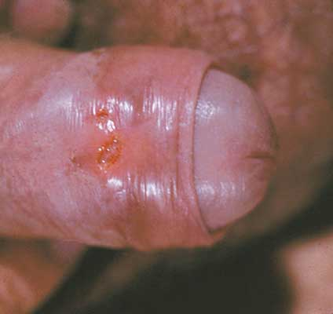
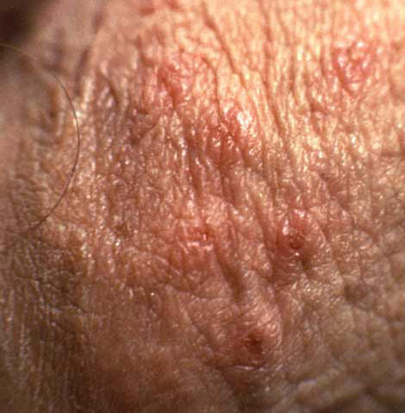
Example

Slide 76
Summary

Slide 77
Questions

Slide 78
Question 1
Most common STIs in KSA ?
HIV
Chlamydia
Gonorrhea
Syphilis

Slide 79
Question 2
A patient went 3 days ago to one of the gulf countries. He complains of urethral discharge. What do you expect:
HIV
Chlamydia
Gonorrhea
Syphilis

Slide 80
Question 3
Patient comes to you complaining of urinary frequency. When you examined her, you found Frothy yellowish vaginal discharge and strawberry cervix:
What is the most likely diagnosis?
HIV
Trichomoniasis
Gonorrhea
Syphilis

Slide 81
Question 4
Which of the following is required to diagnose a patient with AIDS?
A CD4 count of less than 200 cells/mm3
A CD4 count of less than 1000 cells/mm3
A CD4 count of less than 2000 cells/mm3
A CD4 count of less than 100 cells/mm3

Slide 82
Question 5
Which of the following is the drug of choice in the treatment of Trichomoniasis :
Azithromycin
Doxycycline
Ceftriaxone
Metronidazole

Slide 83
Take home massage
The physician must Maintain non judgmental attitude.
Chlamydia is the most common STI in KSA , it is asymptomatic disease, and has IP of 1-3 weeks.
Trichomoniasis has frothy yellowish vaginal discharge and causes Strawberry cervix.
Gonorrhea has shorter IP than chlamydia and characterized by dysuria and discharge.

Slide 84
References
Chlamydia trachomatis UK Testing Guidelines
British Association of Sexual Health and HIV (BASHH)
Kumar and Clark's Clinical Medicine (9th Ed)
CDC website
AVERT.org
World Health Organization
AVERT. STD Pictures. from AVERT: http://www.avert.org/std-pictures.htm
American Academy of Family Physicians
http://www.webmd.com/hiv-aids/human-immunodeficiency-virus-hiv-test
http://www.aidsmap.com/Mother-to-baby-transmission/page/1044918/

Slide 85
Thank you
Any questions ?

