Slide 1
UPPER RESPIRATORY TRACT INFECTIONS
Sore Throat, Sinusitis, Otitis Media
Fahad Al-Qahtani
Abdulaziz Islam
Mouaiad Ghabban
Ahmed Al-Jadeed

Slide 2
Objectives
Sore Throat (clinical features, differential diagnosis, complications, management)
Sinusitis including Allergic Rhinitis (Clinical features and management)
Otitis Media in children (AOM and Secretory OM, Features, management)
How can we differentiate between Viral and Bacterial Infections?
Update in management and role of Antibiotics
How can we modify help seeking behavior of patients with flu illness?

Slide 3
Quiz
Q.1: One of the differences between bacterial and viral pharyngitis is that in Bacterial pharyngitis there is usually:
A. No fever
B. Coughing and Wheezing
C. Conjunctivitis
D. Whitish spots on the tonsils

Slide 4
Quiz
Q.2: The duration of symptoms in subacute sinusitis is ?
A. Less than 4 weeks.
B. Between 3 and 4 weeks.
C. Between 4 weeks and 3 months.
D. Between 5 weeks and 5 months.

Slide 5
Quiz
Q.3: An irritable 3 year old patient came with ear pain, difficulty in hearing , and fever. What is the diagnosis?
A. Pharyngitis
B. Otitis Media
C. Mastoiditis
D. Sinusitis

Slide 6
Quiz
Q.4: Which of the following patients who present with a sore throat should you start on immediate antibiotics therapy:
A. 37.5c fever, conjunctivitis, runny nose, and a very bad headache.
B. An 80 year old man with history of congestive heart failure.
C. No fever. Congested nose and very painful to swallow solids and liquids.
D. No fever, clear discharge from the nose, coughing and shortness of breath.

Slide 7
Sore throat

Slide 8
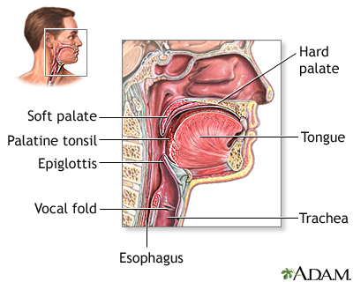
What is sore throat?
A sore throat is pain, scratchiness or irritation of the throat that often worsens when you swallow.

Slide 9
Clinical features
Pain or a scratchy sensation in the throat.
Pain that worsens with swallowing or talking.
Difficulty swallowing.
Sore, swollen glands in your neck or jaw.
Swollen, red tonsils.
White patches or pus on your tonsils.
Hoarse or muffled voice.

Slide 10
causes
Infectious:
Pharyngitis.
Tonsillitis.
Non Infectious:
GERD, allergiens.
1- Viral:
Flu.
Mononucleosis(kissing disease), caused by EBV.
Measles.
chickenpox.
2- Bacterial:
The most common is Streptococcus pyogenes, or group A streptococcus.

Slide 11
Differential diagnosis
1- Viral infections:
Herpes simplex virus (HSV)1 and 2
Influenza A and B
Epstein-Barr virus (EBV)
Cytomegalovirus (CMV)
Human herpesvirus (HHV) 6
HIV
2- Bacterial infections:
GABHS
Group C beta-hemolytic streptococci
Neisseria gonorrhoeae
Corynebacterium diphtheriae
Mycoplasma pneumoniae

Slide 12
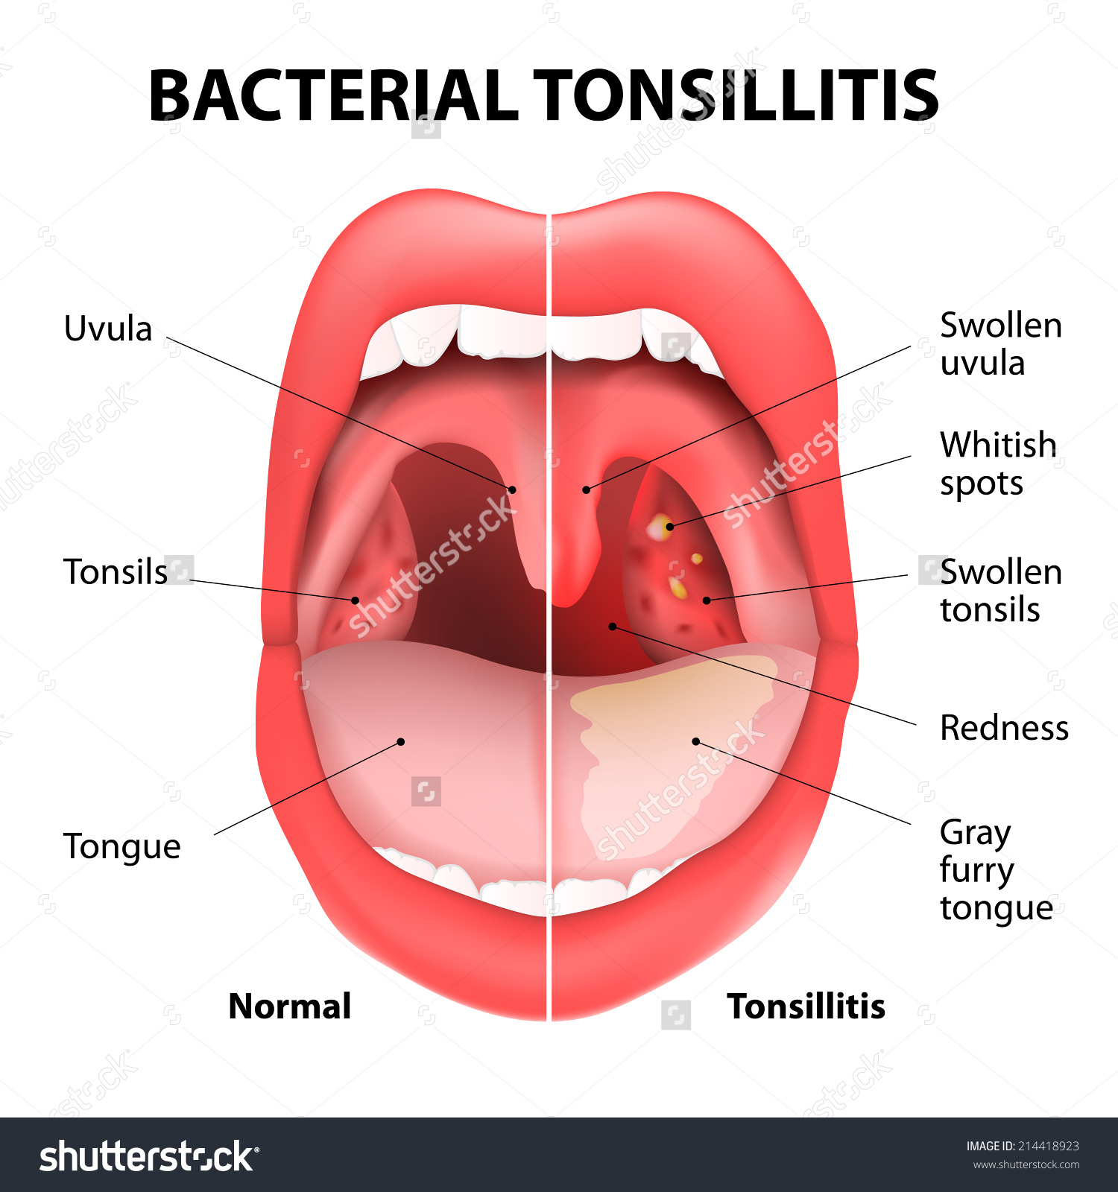
Tonsillitis
Inflammation of tonsils.
Commonly caused by: Streptococcus Infection.
Could be caused by viral infections, such as: influenza virus, ebv.
The main symptom is Throat Pain.

Slide 13
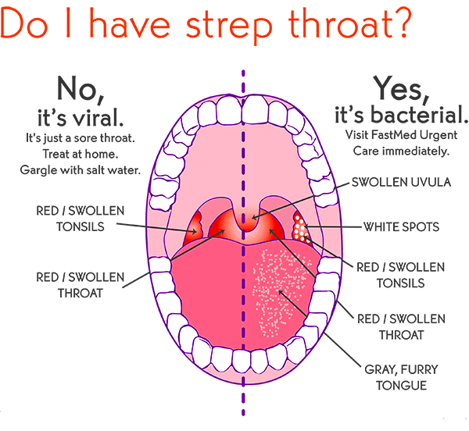
Pharyngitis
Pharyngitis is inflammation of the pharynx.
Sudden and usually self limiting.
Commonly caused by viral infections such as: common cold, influenza virus and mononucleosis.
Less commonly caused by bacterial infection, such as: Group A streptococcus.

Slide 14
When to see your doctor???
Difficulty Breathing.
Joint Pain.
Difficulty Swallowing.
A Rash.
A Fever Over 101˚F.
Bloody Mucus.
A Lump In The Throat.
Hoarseness That Lasts Longer Than Two Week.

Slide 15
Complications
Related to strep infection:
Middle ear infection (Otitis Media).
Sinusitis.
Rare complications:
Retreopharyngeal abscess.
Peritonsillar abscess.
Toxiv shock syndrome.

Slide 16
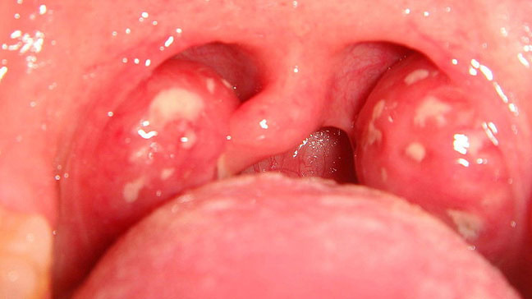
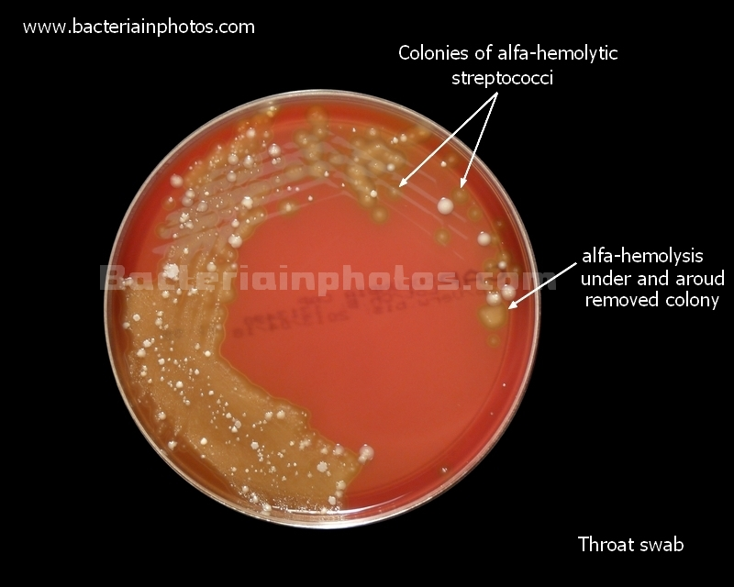
Diagnosis and investigations
Exclude bacterial causes.
Throat examination. (Inflammation or white patches).
Throat swab and culture.

Slide 17
Treatment
Viral infections:
Usually its self limited and don’t required medications.
For the fever and pain , use acetaminophen.
Do not give aspirin for pain or fever to children younger than 12 year (reyes syndrome)
Bacterial infection:
First line tx is penicillin.
Drink plenty of cool or warm fluids, and avoid very hot drinks.
Eat cool, soft foods.
Avoid smoking and smoky place.
Q-when do u have to use Antibiotics?

Slide 18
Prevention
Avoid contact with sick people.
Wash your hands.
Identify and avoid irritants .
Don’t smoke and avoid exposure to secondhand smoke.

Slide 19
Sinusitis

Slide 20
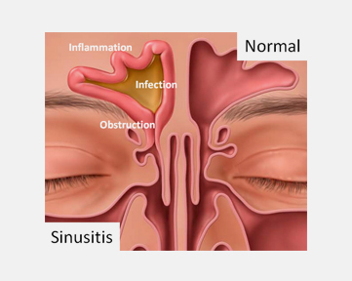
Sinusitis
Sinusitis and Rhinosinusitis refer to inflammation in the nasal cavity and paranasal sinuses.

Slide 21
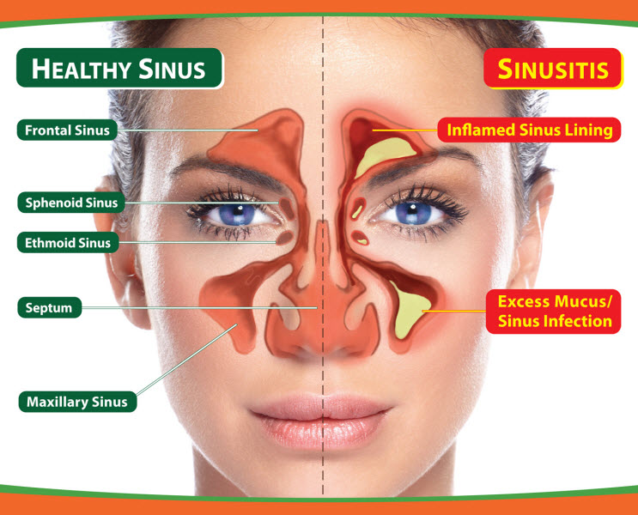
sinuses
Healthy sinuses are filled with air.
The mucus produced by the sinuses usually drains into the nose through small channels.
When the sinus linings become inflamed, these channels become blocked.
After they become blocked and filled with fluid, germs can grow and cause an infection.

Slide 22
Classification of Sinusitis
Acute Sinusitis
Chronic sinusitis
Recurrent acute sinusitis
Between 4 weeks and 12 weeks.
More than 12 weeks.
Diagnosed when infection occurs 2-4 times per year.
Less than 4 Weeks.
Subacute Sinusitis
Sinusitis
Usually starts with cold like symptoms such as a runny, stuffy nose and facial pain.

Slide 23
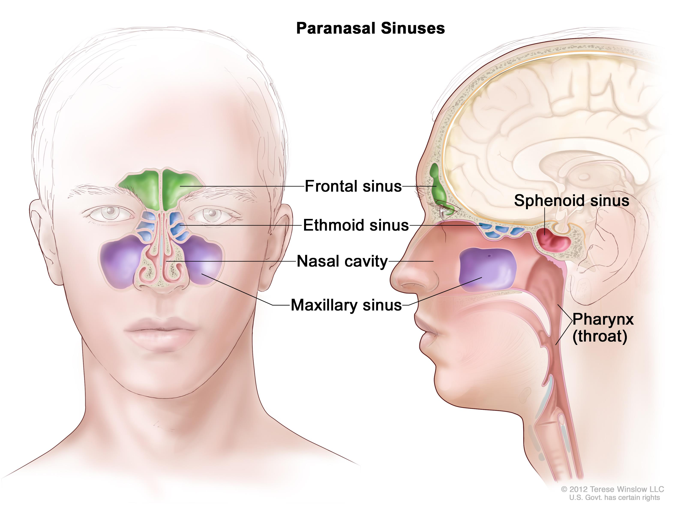
The Maxillary sinuses are the most common site (85%), followed by Ethmoidal (65%), Sphenoidal (39%), and Frontal (32%) involvement.

Slide 24
Etiology
Infectious:
Viral (Rhinovirus, Influenza virus).
Begins with viral inoculation via direct contact with the conjunctiva or nasal mucosa.
Bacterial (Streptococcus pneumoniae, Haemophilus influenzae).
Nosocomial bacterial sinusitis may develop in patients in the intensive care unit, particularly in those with prolonged intubation.
Fungal (Aspergillus).

Slide 25
Etiology
Non-Infectious:
Blocking of the sinuses opening due to increased secretion of mucus in response to colds or allergies.
Nasal septum Deviation or nasal polyps blocking the opening of the sinuses.
Problems within the sinuses due to a Medical condition.

Slide 26
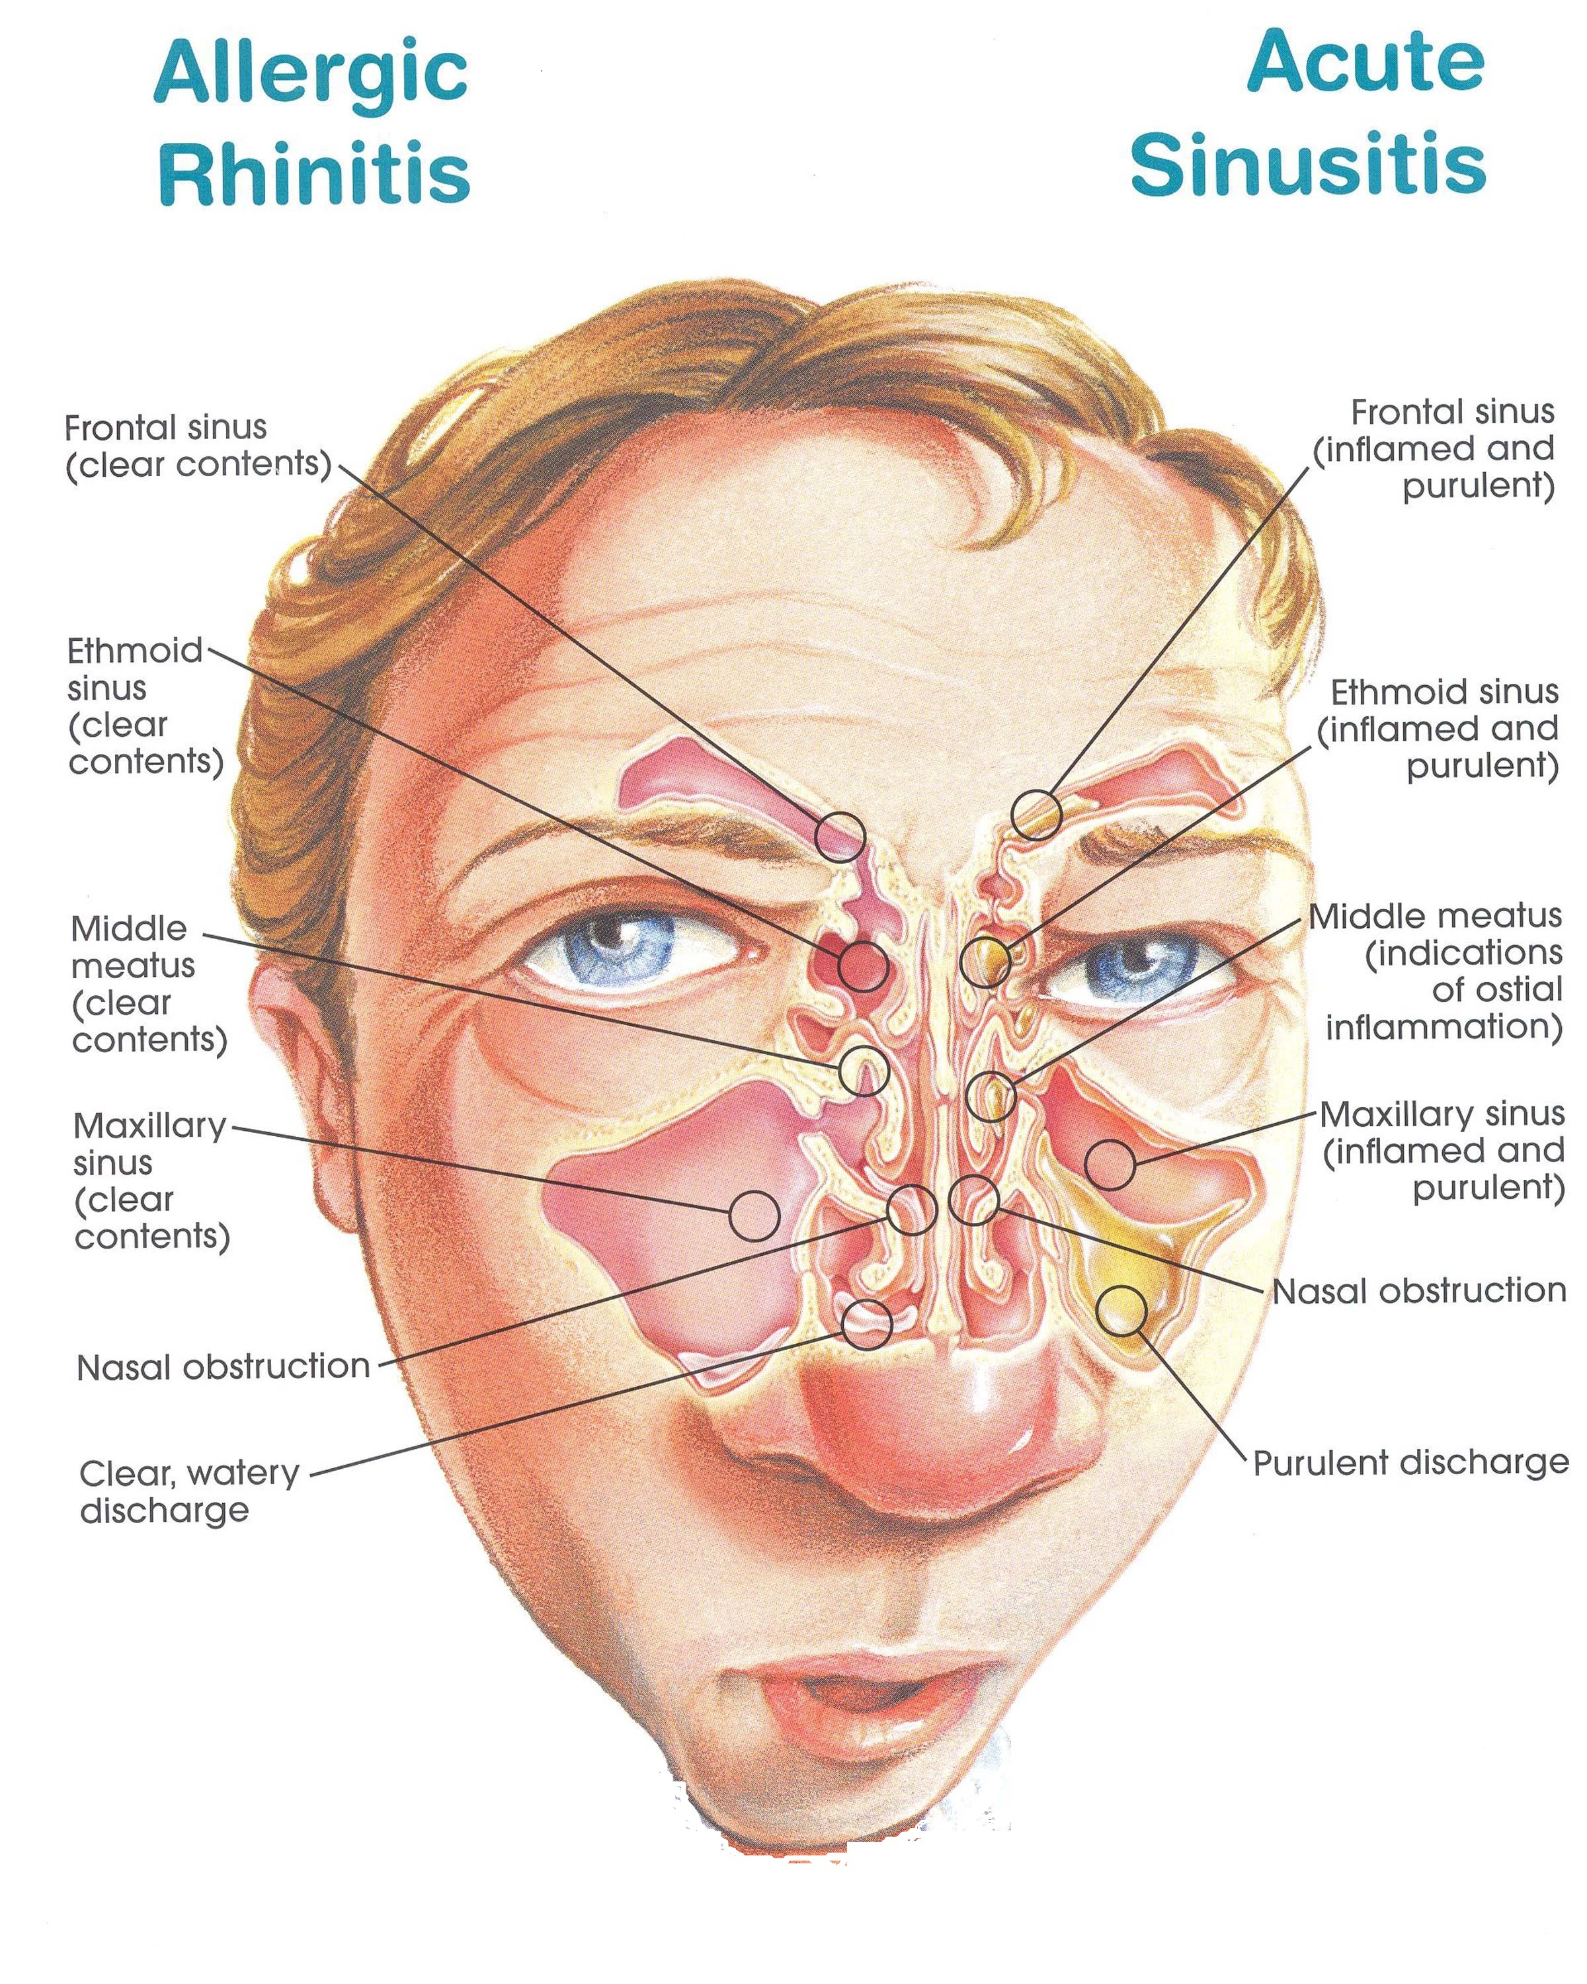
Clinical Features
Symptoms of sinusitis
Pain and Tenderness Around Your Cheeks, Eyes or Forehead
Nasal Congestion
Nasal Discharge
A Reduced Sense of Smell
Fever
Postnasal Drip
Cough
Fatigue
Bad Breath (Halitosis)
A Sinus Headache
Toothache

Slide 27
Diagnoses
Physical examination:
Altered speech (indicating nasal obstruction)
Purulent nasal secretions.
Facial erythema.
Tenderness overlying sinuses.
Mucosal erythema.

Slide 28
Diagnoses
Labs (Acute sinusitis is a clinical diagnoses):
Tests for Immunodeficiency
Indicated if history findings indicate recurrent infection.
Sweat Chloride Test
Should be performed if cystic fibrosis is suggested.
Nasal cytology

Slide 29
Diagnoses
Cultures of Nasal Secretions:
Cultures are not routinely done to evaluate acute sinusitis but should be obtained in the following cases:
Patients in ICU or that are immunocompromised.
Children not responding to appropriate medical management.
Patients with complications of sinusitis.

Slide 30
Differential Diagnoses
Common cold “Generally do not have facial pain”.
Allergic Rhinitis “Common causes of rhinorrhea and nasal congestion”.
Any cause of Facial Pain or Headache.
Nasal Foreign body.
Tonsillitis.
Tumors of the Nasal cavity/Sinuses (Sinonasal tumor).

Slide 31
Prevention
Maintain good sinus hygiene by drinking plenty of fluids to keep nasal secretions thin.
Saline nasal sprays help keep the nasal passages moist, helping remove infectious agents.
Don’t smoke, and avoid to be too near people who are smoking.
Try to stay away from things you know you’re allergic to.

Slide 32
Allergic Rhinitis

Slide 33
Allergic Rhinitis
Rhinitis, which occurs most commonly as allergic rhinitis, is an inflammation of the nasal membranes.

Slide 34
Clinical Features
Sneezing.
Itching: Nose, eyes, ears, palate.
Rhinorrhea.
Postnasal drip.
Red eyes.
Congestion.
Headache.
Tearing.
Fatigue.
Drowsiness.
Malaise.

Slide 35
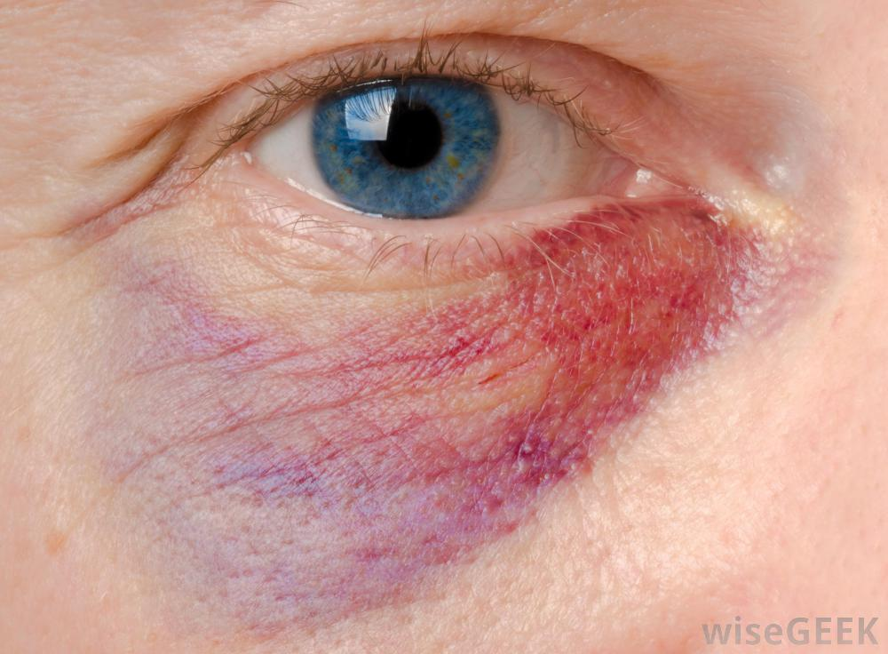
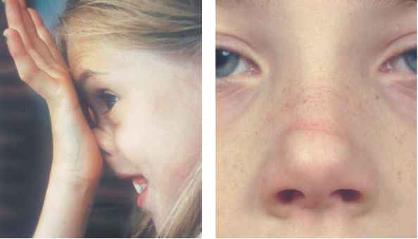
Diagnoses
Physical Examination:
Allergic Shiners: dark circles around the eyes and are related to vasodilation or nasal congestion.
Nasal crease: A transverse crease across the lower half of the bridge of the nose; caused by repeated rubbing and pushing the tip of the nose up with the hand. (Allergic Salute)
Thin, watery nasal secretions.
Deviation or perforation of the nasal septum.

Slide 36
Diagnoses
Labs:
Total Serum IgE and Total Blood Eosinophil Count
Both are Neither sensitive nor specific for allergic rhinitis, but the results can be helpful in some cases when combined with other factors.
Allergy Skin Tests
Radioallergosorbent Test (RAST).
Immunoassays test to detect allergen-specific IgE antibodies in the serum have limited utility in the diagnosis of allergic rhinitis.

Slide 37
Management
Environmental control measures and allergen avoidance.
Pharmacologic management: Patients are often successfully treated with oral antihistamines, decongestants, or both.
Immunotherapy: This treatment may be considered more strongly with severe disease or poor response to other management options.

Slide 38
Complications
Acute or chronic sinusitis.
Otitis media.
Sleep disturbance or apnea.
Dental problems : Caused by excessive breathing through the mouth.
Palatal abnormalities.

Slide 39
Otitis Media

Slide 40
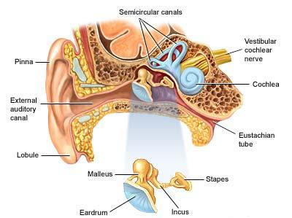
Anatomy Of The Middle Ear
Largely formed by the tympanic membrane laterally.
Consist of: auditory ossicles : malleus, incus, and stapes.
They transmit sound waves from tympanic membrane to the perilymph of the internal ear.
Eustachian tube runs through the middle ear originally from the nose to ventilate the middle ear space, ensuring that its pressure remains at near normal environmental air pressure.

Slide 41
Otitis Media
Definition: Otitis media is an infection of the middle ear that causes inflammation (redness and swelling) and a build-up of fluid behind the eardrum.

Slide 42
Classification of Otitis Media
Acute Otitis Media (AOM).
Otitis Media With Effusion.
Chronic Otitis Media.

Slide 43
Etiology
Bacteria:
Streptococcus Pneumoniae.
Non-typable Haemophilus Influenzae.
Group A Beta-hemolytic Streptococcus.
Staphylococcus Aureus.
Moraxella Catarrhalis.
Viruses:
Respiratory Syncytial Virus.
Influenza Viruses.
Rhinoviruses.
Uncommon Causes Of AOM Include:
Chlamydia Trachomatis.
Diphtheritic Otitis.
Tuberculous Otitis.
Otogenous Tetanu.

Slide 44
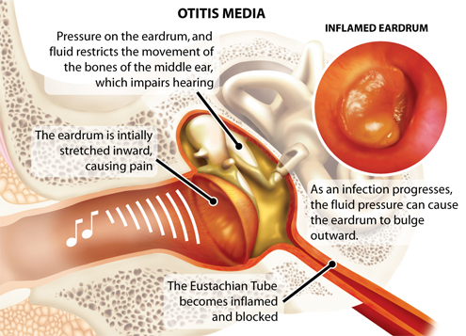
Pathophysiology
Under normal conditions the the mucociliary action of eustachian tube is to drain any accumulated secretions, infection, or debris from the middle ear spacer.
Upper respiratory viruses can infect the middle ear and can impair this process.
Virus can cause an inflammation of the nasal passages and eustachian tube, which disrupts the normal mucociliary clearance .
A middle ear effusion develops, and nasopharyngeal bacteria contaminate the effusion.
Effusion is followed by inflammatory response , suppuration and subsequent pressure against the tympanic membrane lead to pain and fever.

Slide 45
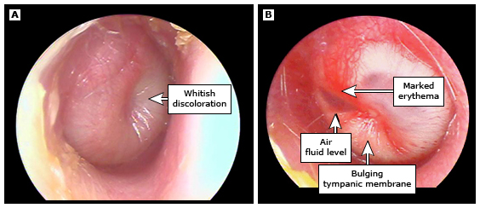
Acute otitis media (AOM)
Acute otitis media (AOM) is marked by the presence of middle ear purulent fluid and inflammation of the mucosa that lines the middle ear space .
The infection is often caused by obstruction of the Eustachian tube, which results in fluid retention and bulging of eardrum usually accompanied by pain.
Signs and symptoms:
Otalgia (ear pain)
Headache
Fever
Irritability
Loss of appetite
Vomiting
Diarrhea

Slide 46
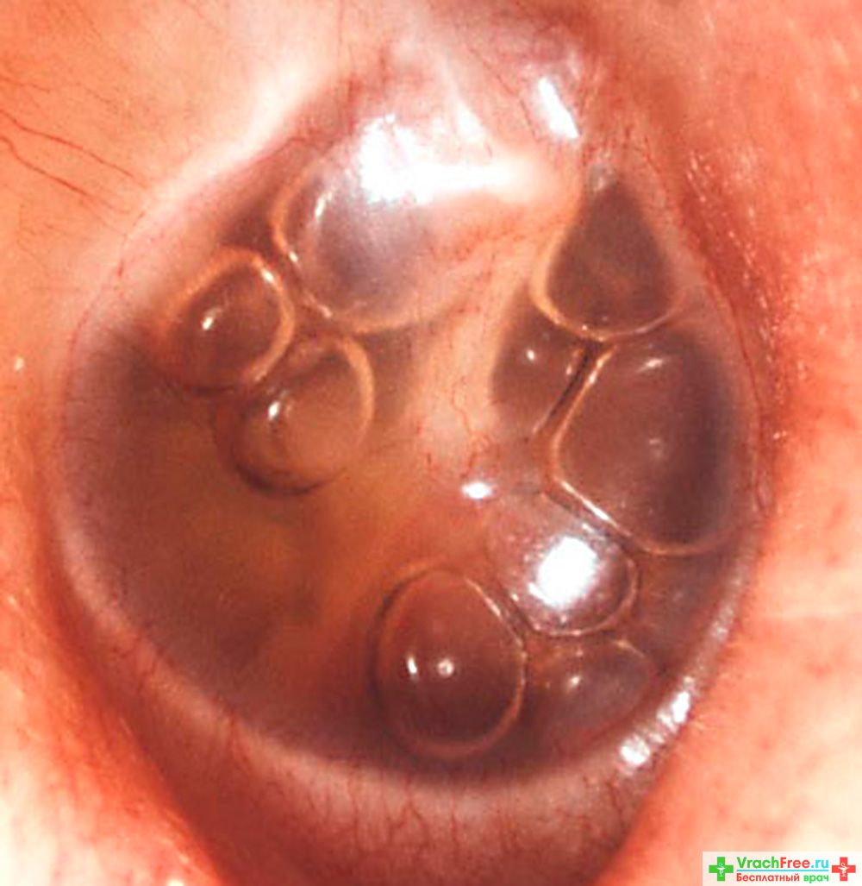
Otitis Media With Effusion (OME)
Otitis media with effusion (OME), also called glue ear, is characterized by a collection of serous and mucoid fluid in the middle-ear cleft.
There is chronic inflammation but without signs of acute inflammation.
OME is the most common cause of hearing impairment.
Normal eardrum.
Symptoms that may be indicative of OME include the following:
Hearing loss
Tinnitus (buzzing in the ears).
Vertigo.
Otalgia.
Otorrhea (ear discharge).

Slide 47
Examination
Pneumatic otoscopy remains the standard examination technique for patients with suspected OM.
Every examination should include an evaluation and description of the following four Tympanic Membrane characteristics:
Color – A normal TM is a translucent pale gray; an opaque yellow or blue TM is consistent with middle ear effusion (MEE).
Position – In AOM, the TM is usually bulging; in OME, the TM is typically retracted or in the neutral position.
Mobility – Impaired mobility of TM is the most consistent finding in patients with OME .
Perforation – Single perforations are most common.

Slide 48
Complications
Intratemporal:
TM perforation (acute and chronic).
Mastoiditis : one underneath the ear (the mastoids).
Hearing loss.
Cholesteatoma: abnormal collection of skin cells inside the ear.
Labyrinthitis: spread into the inner ear.
Facial paralysis.
Intracranial:
Meningitis.
Subdural empyema.
Brain abscess.
Extradural abscess.
Lateral sinus thrombosis.
Otitic hydrocephalus.

Slide 49
Management
Most cases of AOM improve spontaneously. Cases that require treatment may be managed with antibiotics and analgesics or with observation alone.
Amoxicillin is the first drug of choice .
Patients who report penicillin allergy :
Cefuroxime
Ceftriaxone
Erythromycin
Tympanocentesis is the trans-tympanic needle aspiration of ME contents. Aspiration of fluid reduces ME pressure and is very effective in relieving pain. (Surgical option).

Slide 50
Viral vs bacterial
Generally in Bacterial infections:
Fever
Infection spreads to nearby organs
Pus or whitish covering of mucous membranes
Recurrent infections are common
In viral infections:
Low grade fever or no fever
Mostly contained and self limiting
No pus, only clear discharge, if any at all
Generalized malaise and fatigue

Slide 51
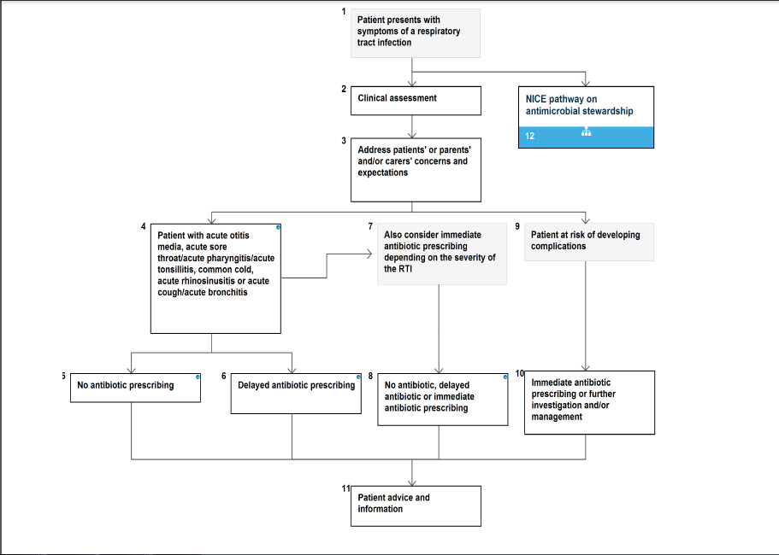

Slide 52
Nice Guidance to URTI
Patients should be given advice about the usual natural history of the illness, including the average total length of the illness :
Acute otitis media: 4 days.
Acute sore throat/acute pharyngitis/acute tonsillitis: 1 week.
Common cold: 1½ weeks.
Acute rhinosinusitis: 2½ weeks.
Acute cough/acute bronchitis: 3 weeks.

Slide 53
Nice Guidance to URTI
A no antibiotic prescribing strategy or a delayed antibiotic prescribing strategy should be agreed for patients with the following conditions:
Acute otitis media.
Acute sore throat/acute pharyngitis/acute tonsillitis.
Common cold.
Acute rhinosinusitis.
Acute cough/acute bronchitis.
Depending on clinical assessment of severity, patients in the following subgroups can also be considered for an immediate antibiotic prescribing strategy:
Bilateral acute otitis media in children younger than 2 years.
Acute otitis media in children with otorrhoea.
Acute sore throat/acute pharyngitis/acute tonsillitis when three or more centor criteria are present.

Slide 54
Nice Guidance to URTI
An immediate antibiotic prescription should only be offered to patients in the following situations:
If the patient is systemically very unwell
If the patient has symptoms and signs suggestive of serious illness and/or complications
If the patient is at high risk of serious complications because of pre-existing comorbidity.
If the patient is older than 65 years with acute cough and two or more of the following criteria, or older than 80 years with acute cough and one or more of the following criteria:
Hospitalization in previous year.
Type 1 or type 2 diabetes.
History of congestive heart failure.
Current use of oral glucocorticoids.

Slide 55
Nice Guidance to URTI
When the delayed antibiotic prescribing strategy is adopted, patients should be offered:
Reassurance that antibiotics are not needed immediately because they are likely to make little difference to symptoms and may have side effects, for example, diarrhoea, vomiting and rash
Advice about using the delayed prescription if symptoms are not starting to settle in accordance with the expected course of the illness or if a significant worsening of symptoms occurs
Advice about re-consulting if there is a significant worsening of symptoms despite using the delayed prescription.
A delayed prescription with instructions can either be given to the patient or left at an agreed location to be collected at a later date.

Slide 56
How to modify help seeking behavior of patients with flu illness ?

Slide 57
How to modify patient help seeking behavior
Raise awareness of the seriousness of seasonal flu in high risk patients.
Increase the will to seek help in affected patients.
Increase awareness of the ways to protect infection within the household and work environment.
Increase the public attitude toward vaccination and encourage high risk people to get vaccinated early.

Slide 58
How to modify patient help seeking behavior
Provide incentive to businesses to take care of flu ridden workers, with paid leaves or forced sick leaves.
Make flu vaccines available in more health care centers, and provide them for less cost.
Raise awareness on personal hygiene and ways to avoid infecting other people or avoiding getting sick from contact with other people.
Advise flu patients to stay away from work and public for a day after their symptoms are alleviated.

Slide 59
Quiz
Q.1: One of the differences between bacterial and viral pharyngitis is that in Bacterial pharyngitis there is usually:
A. No fever
B. Coughing and Wheezing
C. Conjunctivitis
D. Whitish spots on the tonsils

Slide 60
Quiz
Q.1: One of the differences between bacterial and viral pharyngitis is that in Bacterial pharyngitis there is usually:
A. No fever
B. Coughing and Wheezing
C. Conjunctivitis
D. Whitish spots on the tonsils

Slide 61
Quiz
Q.2: The duration of symptoms in subacute sinusitis is ?
A. Less than 4 weeks.
B. Between 3 and 4 weeks.
C. Between 4 weeks and 3 months.
D. Between 5 weeks and 5 months.

Slide 62
Quiz
Q.2: The duration of symptoms in subacute sinusitis is ?
A. Less than 4 weeks.
B. Between 3 and 4 weeks.
C. Between 4 weeks and 3 months.
D. Between 5 weeks and 5 months.

Slide 63
Quiz
Q.3: An irritable 3 year old patient came with ear pain, difficulty in hearing , and fever. What is the diagnosis?
A. Pharyngitis
B. Otitis Media
C. Mastoiditis
D. Sinusitis

Slide 64
Quiz
Q.3: An irritable 3 year old patient came with ear pain, difficulty in hearing , and fever. What is the diagnosis?
A. Pharyngitis
B. Otitis Media
C. Mastoiditis
D. Sinusitis

Slide 65
Quiz
Q.4: Which of the following patients who present with a sore throat should you start on immediate antibiotics therapy:
A. 37.5c fever, conjunctivitis, runny nose, and a very bad headache.
B. An 80 year old man with history of congestive heart failure.
C. No fever. Congested nose and very painful to swallow solids and liquids.
D. No fever, clear discharge from the nose, coughing and shortness of breath.

Slide 66
Quiz
Q.4: Which of the following patients who present with a sore throat should you start on immediate antibiotics therapy:
A. 37.5c fever, conjunctivitis, runny nose, and a very bad headache.
B. An 80 year old man with history of congestive heart failure.
C. No fever. Congested nose and very painful to swallow solids and liquids.
D. No fever, clear discharge from the nose, coughing and shortness of breath.

Slide 67
References
http://accessmedicine.mhmedical.com/content.aspx?bookid=1088&sectionid=61700530
http://www.mayoclinic.org/diseases-conditions/mononucleosis/symptoms-causes/dxc-20165844
http://www.healthline.com/health/pharyngitis#Overview1.
http://cks.nice.org.uk/sore-throat-acute
http://www.webmd.com/oral-health/tc/strep-throat-complications-topic-overview.
http://www.mayoclinic.org/diseases-conditions/sore-throat/diagnosis-treatment/treatment/txc-20201997
http://www.nps.org.au/conditions/ear-nose-mouth-and-throat-disorders/ear-nose-and-throat-infections/sore-throat/for-individuals/medicines-and-treatments
http://emedicine.medscape.com/article/232670-overview
http://cks.nice.org.uk/sinusitis
https://www.uptodate.com/contents/acute-sinusitis-and-rhinosinusitis-in-adults-clinical-manifestations-and diagnosis?source=search_result&search=sinusitis&selectedTitle=2~150
http://www.medicinenet.com/eustachian_tube_problems/article.htm
http://emedicine.medscape.com/article/994656-overview#showall
http://www.nhs.uk/conditions/Otitis-media/Pages/Introduction.aspx
http://cks.nice.org.uk/otitis-media-acute
http://www.uptodate.com/contents/acute-otitis-media-in-adults- suppurative-and-serous
http://bestpractice.bmj.com/best-practice/monograph/39/basics/pathophysiology.html
http://patient.info/doctor/otitis-media-with-effusion
http://bestpractice.bmj.com/best-practice/monograph/14/treatment/guidelines.html

Slide 68
THANK YOU...

