Slide 1
Smoking And Substance Abuse
Done By :
Faroq Abdulfattah and Abdulellah Al-thwini

Slide 2
Objectives
Epidemiology of smoking in Saudi Arabia
Risks of smoking (Morbidity and Mortality)
Effect of passive smoking in pregnancy and children.
How are you going to help the smoker to quit
And How to overcome withdrawal symptoms
Role of PHC physician “smoking cessation clinic’
Update in pharmacological management, smoking cessation medication Nicotine preparations, Varniciline, Bupropion
Factors lead to substance abuse
Highlight on types of substance abuse
How to approach subjects with substance abuse

Slide 3
Questions …

Slide 4
Q1
What is the main cause of death due to smoking?
A- CVD
B- COPD
C- Lung Cancer
D- Bladder cancer

Slide 5
Q2
Smoking can increase risk of having coronary heart disease (CHD) than non-smoking by?
A- 0 times
B- 0-1 times
C-1-2 times
D- 2-4 times

Slide 6
Q3
intentional inhalation of smoke using the methods of smoking such as: cigarettes and cigars is :
A- Active smoking
B- Passive smoking
C- environmental tobacco smoke
D- Secondhand smoke

Slide 7
Q4
Which one of the following kills more people every
:year
A- smoking
B- alcoholism
C- Cannabis
D – stamiulant

Slide 8
Q5
Which of the following antismoking drugs are the most effictive one:
A- Nicotine gum
B- Bupropion SR
C- Varenicline
D- Nicotine skin patch

Slide 9
Definition
Smoking is the exposure to a substance, most commonly tobacco, that is burned and the smoke either tasted or inhaled.
Notes:
Smoking is the inhalation of the smoke of burning tobacco that is used mostly in three forms: cigarettes, pipes, and cigars. Read more: http://www.healthofchildren.com/S/Smoking.html#ixzz3l8Snm0rw

Slide 10
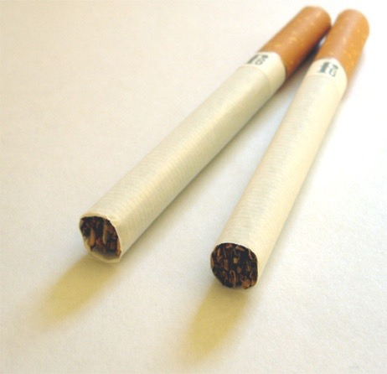
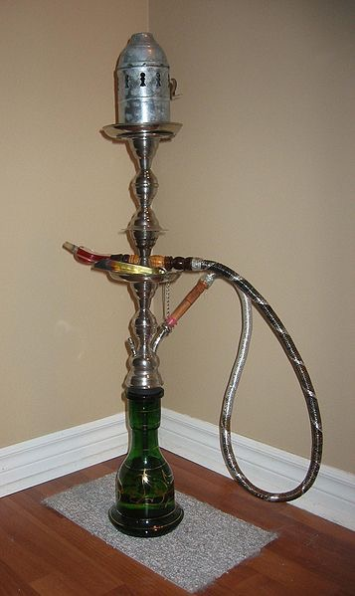
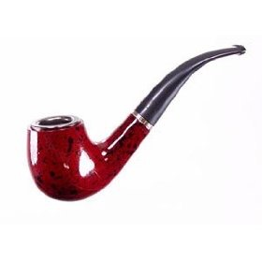
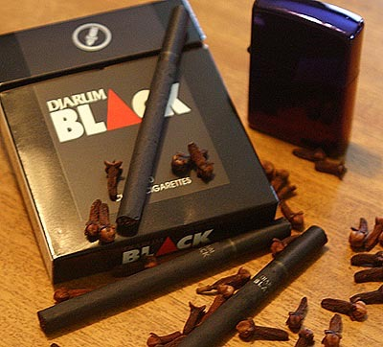
Types of tobacco product
Cigars Cigarettes hookah(shesha)
Kretek Pipe smoking
Notes:
A single large cigar can contain more than a 1/2 ounce of tobacco -- as much tobacco as an entire pack of cigarettes. One cigar also contains 100 to 200 milligrams of nicotine, while a cigarette averages only about 8 milligrams. That extra nicotine may be why smoking just a few cigars a week is enough to trigger nicotine cravings
Cigars: They are generally not inhaled because the high alkalinity of the smoke, which can quickly become irritating to the trachea and lungs.
Cigarettes: are a product consumed through smoking, often combined with other additives.
Different in seveerity b\c of amount of tobaco differ
No filter like in cigrate to filtre some of toxin at least
More smoke than cigrate
The charcoal used to heat tobacco in the hookah increases the health risks by producing smoke that contains high levels of carbon monoxide, metals, and cancer-causing chemicals.
A typical 1-hour-long hookah smoking session involves 200 puffs, while an average cigarette is 20 puffs. The volume of smoke inhaled during a typical hookah session is about 90,000 milliliters, compared with 500 to 600 milliliters inhaled when smoking a cigarette.
Using a hookah to smoke tobacco poses a serious potential health hazard to smokers and others exposed to the emitted smoke.

Slide 11
objectives
Epidemiology of smoking in Saudi Arabia
Risks of smoking (Morbidity and Mortality)
Effect of passive smoking in pregnancy and children.
How are you going to help the smoker to quit
And How to overcome withdrawal symptoms
Role of PHC physician “smoking cessation clinic’
Update in pharmacological management, smoking cessation medication Nicotine preparations, Varniciline, Bupropion
Factors lead to substance abuse
Highlight on types of substance abuse
How to approach subjects with substance abuse

Slide 12
Epidemiology of smoking in Saudi Arabia
A study was conducted on 10735 individuals aged 15 years or older (5253 men and 5482 women) which was performed between April and June 2013 to assess the status of tobacco consumption in the Kingdom of Saudi Arabia (KSA).
Overall prevalence of current smoking was 12.2 % and males were more likely to smoke than females (21.5 % vs. 1.1 %).
Mean age of smoking initiation was 19.1 years (±6.5 years) with 8.9 % of ever smokers starting before the age of 15 years.

Slide 13
Epidemiology of smoking in Saudi Arabia
A study was conducted in September 2005 to asses the prevalence of smoking habits among male medical students at the College of Medicine, King Saud University and it shows that
13% of male medical students were currently active smokers.
5.3% were ex-smokers, and 38.2% were passive smokers.
The common reason given for the smoking behavior was the influence of friends (35.6%). The study shows that 57.1% of current smokers were motivated to stop smoking.

Slide 14
objectives
Epidemiology of smoking in Saudi Arabia
Risks of smoking (Morbidity and Mortality)
Effect of passive smoking in pregnancy and children.
How are you going to help the smoker to quit
And How to overcome withdrawal symptoms
Role of PHC physician “smoking cessation clinic’
Update in pharmacological management, smoking cessation medication Nicotine preparations, Varniciline, Bupropion
Factors lead to substance abuse
Highlight on types of substance abuse
How to approach subjects with substance abuse

Slide 15
Risks of smoking
Smoking causes more deaths each year than the following causes combined:
Human immunodeficiency virus (HIV)
Illegal drug use
Alcohol use
Motor vehicle injuries
Firearm-related incidents
Every 6.5 seconds someone dies from tobacco use!

Slide 16
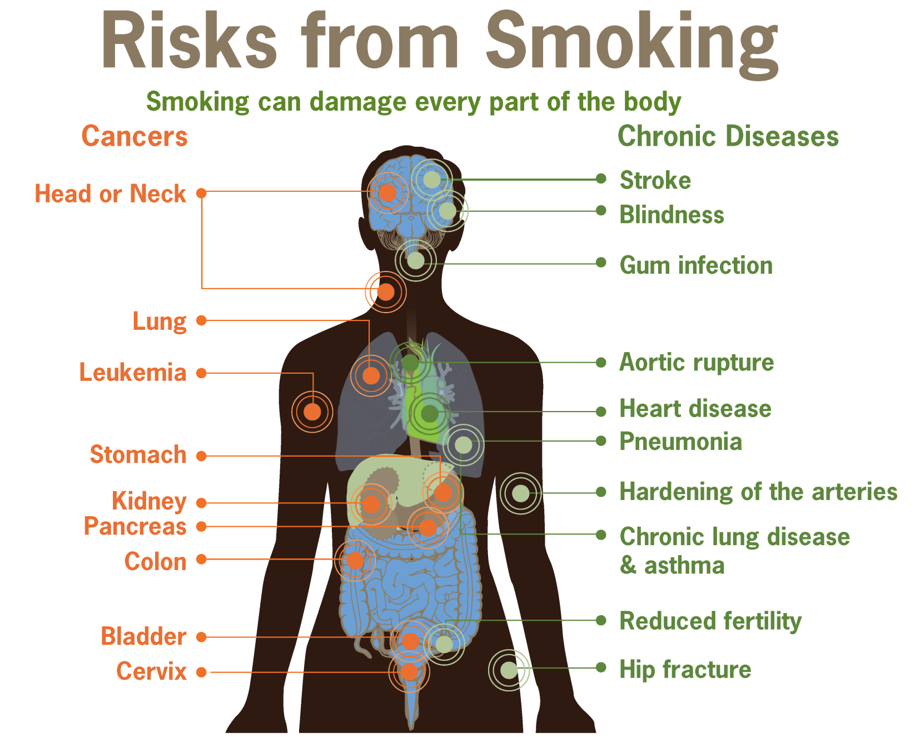

Slide 17
Risks of smoking
Smoking can cause cancer almost anywhere in your body:
Trachea, bronchus, and lung
Bladder
Esophagus
Larynx
Oropharynx (includes parts of the throat, tongue, soft palate, and the tonsils)

Slide 18
Risks of smoking
Cardiovascular diseases is the main cause of death due to smoking.
Cigarette smokers are two to four times more likely to develop coronary heart disease (CHD), than non-smokers.
Notes:
Some smoking effects:
Increases in blood pressure and heart rate
Reduces cardiac output and coronary blood flow
Reduces the amount of oxygen that reaches the body's tissues.
Coronary Artery diseases.
Stroke.
Aneurysm.
When the blood supply to the heart is interrupted, it sometimes causes the chest pain known as angina. When the blood supply is cut off completely, a myocardial infarction or heart attack occurs, which may cause permanent damage to the heart muscle.

Slide 19
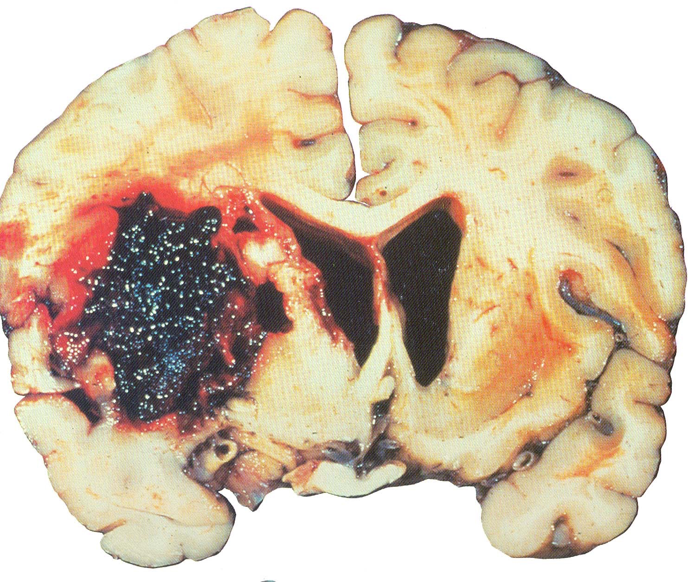
Risks of smoking
It is currently the second most common cause of death world-wide after heart disease.
Smokers are more likely to have a stroke than non-smokers.
Heavy smokers (consuming 20 or more cigarettes a day) have 2-4 times greater risk of stroke than non-smokers.
Notes:
occurs when blood flow to the brain is interrupted causing brain cells to become damaged or die.

Slide 20
Risks of smoking
About 80% of all deaths from chronic obstructive pulmonary disease (COPD) are caused by smoking.
impaired lung growth during childhood and adolescence.
increased susceptibility to pneumonia

Slide 21
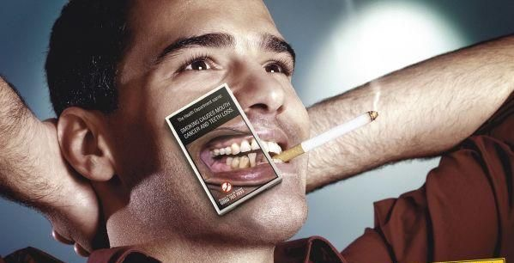
Risks of smoking
Stained teeth.
Gum inflammation.
Black hairy tongue.
Oral cancer.
Delayed healing of the gums.
Notes:
http://www.cdc.gov/tobacco/data_statistics/fact_sheets/health_effects/effects_cig_smoking/#estimates

Slide 22
Risks of smoking
Smokers are 60% more likely to be infertile than non smokers .

Slide 23
Case scenario:
John, a 68 year-old male, has been feeling unwell for the last 5 days, and feels ‘out of breath’ and wheezing more. He could not walk further than 5m, from his chair to the toilet. He has a worsening productive cough and has been producing yellow/green sputum.
He is Heavy smoker smoking 20 cigarettes/day since 14 years old.
What the most likely diagnosis?
What the most common reason of his disease?

Slide 24
objectives
Epidemiology of smoking in Saudi Arabia
Risks of smoking (Morbidity and Mortality)
Effect of passive smoking in pregnancy and children.
How are you going to help the smoker to quit
And How to overcome withdrawal symptoms
Role of PHC physician “smoking cessation clinic’
Update in pharmacological management, smoking cessation medication Nicotine preparations, Varniciline, Bupropion
Factors lead to substance abuse
Highlight on types of substance abuse
How to approach subjects with substance abuse

Slide 25
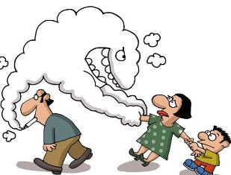
Types of smoking
1- Active smoking:
is the intentional inhalation of smoke using the methods of smoking such as: cigarettes and cigars.
2-Passive smoking(second-hand smoking):
is the inhalation of smoke by persons other than the intended 'active' smoker.

Slide 26
Effect of passive smoking
Secondhand smoke (environmental tobacco smoke)
is the combination of smoke from a burning cigarette and smoke exhaled by a smoker.

Slide 27
Effect of passive smoking
Pooled evidence has indicated a relationship between secondhand smoke and both lung cancer and CHD.
Nonsmokers exposed to secondhand smoke at home or at work have about :
25% to 30% increased risk of heart disease
20% to 30% increased risk of lung cancer.

Slide 28
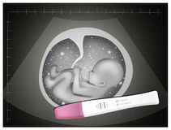
Continue..
Pregnant women
Miscarriage
Premature birth
Lower birth weight than expected
Sudden infant death syndrome
congenital anomalies
Learning problems and attention-deficit/hyperactivity disorder

Slide 29
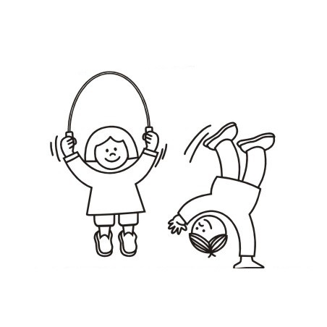
Continue..
Kids bodies are still growing and they breathe at a faster rate than adults.
Conditions have been linked to secondhand smoke exposure in children:
- Ear infections
- Coughs and colds
- Respiratory problems
- Tooth decay

Slide 30
objectives
Epidemiology of smoking in Saudi Arabia
Risks of smoking (Morbidity and Mortality)
Effect of passive smoking in pregnancy and children.
How are you going to help the smoker to quit
And How to overcome withdrawal symptoms
Role of PHC physician “smoking cessation clinic’
Update in pharmacological management, smoking cessation medication Nicotine preparations, Varniciline, Bupropion
Factors lead to substance abuse
Highlight on types of substance abuse
How to approach subjects with substance abuse

Slide 31
Getting Ready To Quit
Start your stop smoking plan with START
S = Set a quit date.
T = Tell family, friends, and co-workers that you plan to quit.
A = Anticipate and plan for the challenges you'll face while quitting.
R = Remove cigarettes and other tobacco products from your home, car, and work.
T = Talk to your doctor about getting help to quit.

Slide 32
Withdrawal Symptoms
The symptoms of nicotine withdrawal can begin within 30 minutes of your last use of tobacco.
Symptoms :
Cigarette cravings
Irritability, frustration, or anger
Anxiety or nervousness
Difficulty concentrating
Restlessness
Increased appetite
Headaches
Insomnia
Tremors
Increased coughing
Fatigue
Constipation or upset stomach
Depression
Decreased heart rate

Slide 33
Continue..
Your Quit Date:
You could quit smoking today, but that wouldn’t give you time to prepare. Research shows that proper preparation will improve your chances of staying quit. Most people need at least a week to make all of their preparations, so select a quit date within the next two weeks.

Slide 34
Continue..
Change Your Environment:
Here are some things you can do to create a smoke-free environment
Physical change The first step is to search your
home, office, and car for cigarettes, and throw out every one you find.
Social changes . Many social situations trigger an urge to smoke.

Slide 35
Continue..
Remind yourself why you quit.
Focus on your reasons for quitting, including the health benefits, improved appearance, money you're saving, and enhanced self-esteem.
Reward yourself.
Reinforce your victories. Whenever you triumph over a craving, give yourself a reward to keep yourself motivated.

Slide 36
Quitting
Get Support and Encouragement
Help From Your Doctor
Help From Family and Friends
Counseling and Quitting Programs or support group

Slide 37
Real Stories
https://www.youtube.com/watch?v=dZ66pcdvq1s

Slide 38
Epidemiology of smoking in Saudi Arabia
Risks of smoking (Morbidity and Mortality)
Effect of passive smoking in pregnancy and children.
How are you going to help the smoker to quit
And How to overcome withdrawal symptoms
Role of PHC physician “smoking cessation clinic’
Update in pharmacological management, smoking cessation medication Nicotine preparations, Varniciline, Bupropion
Factors lead to substance abuse
Highlight on types of substance abuse
How to approach subjects with substance abuse

Slide 39
Role of PHC
Smoking Cessation Clinic:
1- education and Counseling the smokers by a Physician to cut down the number of cigarettes gradually.
2- Prescribe pharmacological treatments for the smokers.
3- Follow up with the Quit smokers to avoid any relapses.

Slide 40
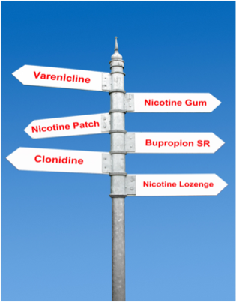
Pharmacological Management
All smokers trying to quit should be offered medication

Slide 41
Pharmacological Management
Recommended Medications:
1- Nicotine Replacement Therapy:
- nicotine gum
- nicotine inhaler
- nicotine lozenge
- nicotine nasal spray
- nicotine patch
2-bupropion SR
3-varenicline

Slide 42
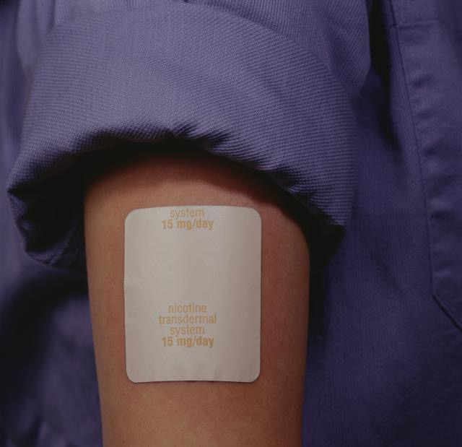
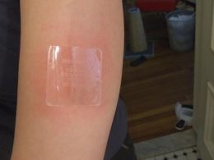
Nicotine Replacement Therapy
Quit rate range from 19% to 26%
1- Nicotine skin patch:
Nicotine patches are the preferred method of NRT because of the ease
of use and highconcentrations of nicotine delivered
Side effects : Skin reactions, insomnia

Slide 43
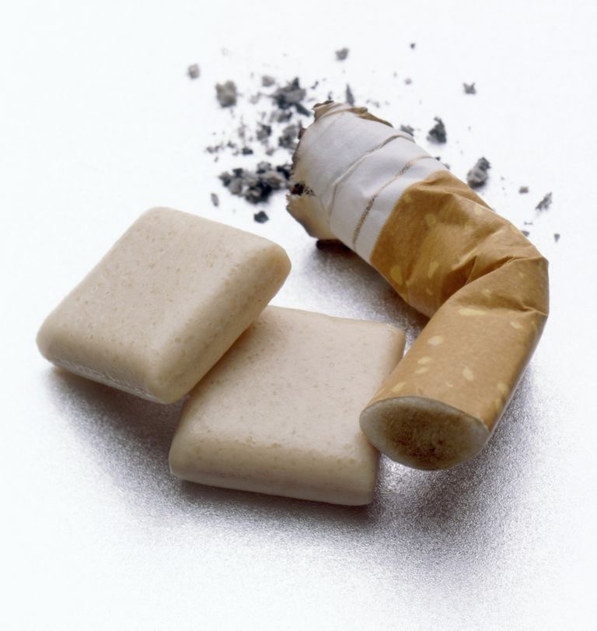
Cont…
2- Nicotine gum:
The taste can be unpleasant at first but most people get used to it in a week or so.
Side effects:
mouth soreness, hiccups, dyspepsia, jaw ache, mouth irritation and
excessive salivation

Slide 44
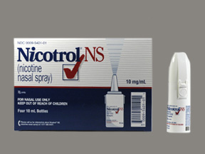
Nicotine Replacement Therapy
Nicotine nasal spray:
Nicotine is absorbed faster, and it’s available for for prescription use only.
Side Effects :
- Nasal/airway reactions.
- Dependency.
- Rhinitis and tearing.

Slide 45
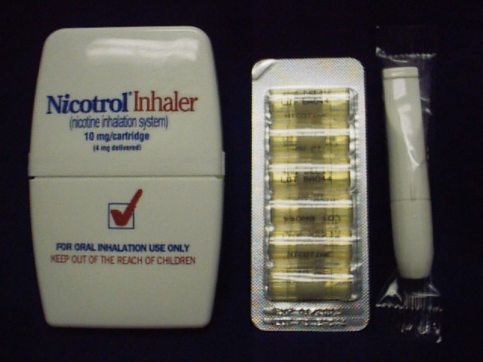
Nicotine Replacement Therapy
Nicotine Inhalator :
it’s available for prescription use only, Despite its name,
the nicotine does not reach the lungs but stops in the mouth and throat.
Side effects:
Local irritation reactions, Coughing and rhinitis it is contraindicated with
bronchospastic disease.

Slide 46
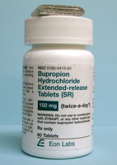
Bupropion
About 24% of smokers who use Bupropion successfully quit.
Side Effects:
The most common reported side effects were insomnia (35–40%)
and dry mouth
Contraindications
is contraindicated in individuals who have a history of seizures

Slide 47
Varenicline
About 33% of smokers who use Varenicline successfully quit.
Side effects:
- Neuropsychiatric effects
- Abnormal dreams
- Cardiovascular effects
- headache
- nausea
- insomnia
- visual disturbances

Slide 48
Epidemiology of smoking in Saudi Arabia
Risks of smoking (Morbidity and Mortality)
Effect of passive smoking in pregnancy and children.
How are you going to help the smoker to quit
And How to overcome withdrawal symptoms
Role of PHC physician “smoking cessation clinic’
Update in pharmacological management, smoking cessation medication Nicotine preparations, Varniciline, Bupropion
Factors lead to substance abuse
Highlight on types of substance abuse
How to approach subjects with substance abuse

Slide 49
Factors lead to substance abuse
Factors within a family that influence a child's early development have been shown to be related to increased risk of drug abuse.
Chaotic home environment
Genetic risks (drug or alcohol abuse sometimes can run in families)

Slide 50
Lack of nurturing and parental attachment
Factors related to a child’s socialization outside the family may also increase risk of drug abuse.
Inappropriately aggressive or shy behavior in the classroom

Slide 51
Poor social coping skills
Poor school performance
Association with a deviant peer group
Perception of approval of drug use behavior

Slide 52
Types of substance abuse
Alcohol Use Disorder (AUD)
Excessive alcohol use can increase a person’s risk of developing serious health problems in addition to those issues associated with intoxication behaviors and alcohol withdrawal symptoms. According to the Centers for Disease Control and Prevention (CDC), excessive alcohol use causes 88,000 deaths a year.

Slide 53
Tobacco Use Disorder
According to the CDC, more than 480,000 deaths each year are caused by cigarette smoking. Tobacco use and smoking do damage to nearly every organ in the human body, often leading to lung cancer, respiratory disorders, heart disease, stroke, and other illnesses

Slide 54
Cannabis Use Disorder
Stimulant Use Disorder
Hallucinogen Use Disorder
Opioid Use Disorder

Slide 55
Questions …

Slide 56
Q1
What is the main cause of death due to smoking?
A- CVD
B- COPD
C- Lung Cancer
D- Bladder cancer

Slide 57
Q2
Smoking can increase risk of having coronary heart disease (CHD) than non-smoking by?
A- 0 times
B- 0-1 times
C-1-2 times
D- 2-4 times

Slide 58
Q3
Intentional inhalation of smoke using the methods of smoking such as: cigarettes and cigars is :
A- Active smoking
B- Passive smoking
C- environmental tobacco smoke
D- Secondhand smoke

Slide 59
Q4
Which one of the following kills more people every
:year
A- Smoking
B- Alcoholism
C- Cannabis
D – Stamiulant

Slide 60
Q5
Which of the following antismoking drugs are the most effictive one:
A- Nicotine gum
B- Bupropion SR
C- Varenicline
D- Nicotine skin patch

Slide 61
Refrences
http://www.webmd.com/mental-health/addiction/substance-abuse?page=2#1
http://www.aafp.org/afp/2013/0715/p113.html
https://www.nice.org.uk/guidance/health-protection/drug-misuse
http://www.drugs.ie/resourcesfiles/research/2010/RiskYoungPeopleSchool.pdf
https://pathways.nice.org.uk/pathways/drug-misuse
http://www.webmd.com/smoking-cessation/news/20160422/no-link-between-anti-smoking-drugs-mental-health--issues-study

Slide 62
Refrences
https://www.ncbi.nlm.nih.gov/pmc/articles/PMC4491232/
http://www.cdc.gov/tobacco/data_statistics/fact_sheets/health_effects/effects_cig_smoking/
http://www.uptodate.com/contents/cigarette-smoking-and-pregnancy?source=search_result&search=smoking&selectedTitle=6~150
http://www.helpguide.org/articles/addiction/how-to-quit-smoking.htm
https://www.healthychildren.org/English/health-issues/conditions/tobacco/Pages/Dangers-of-Secondhand-Smoke.aspx
http://www.cdc.gov/tobacco/campaign/tips/resources/videos/brian-heart-videos.html

Slide 63
Thank You .

