Slide 1
Changes in bowel movements (IBS)
Hassan Almalak
Hussain Alsalman
Abdulaziz Almutayliq

Slide 2
True or False
People suffering from irritable bowel syndrome for more than 10 years develop cancer.
Truth
False

Slide 3
True or False
People with irritable bowel syndrome may suffer from either constipation only or diarrhea only
Truth
False

Slide 4
True or False
People with irritable bowel syndrome may suffer from either constipation only or diarrhea only
Truth
False

Slide 5
True or False
Rectal bleeding is a common presentation of irritable bowel syndrome
Truth
False

Slide 6
MCQ
Once other disease condition have been ruled out, a person can be considered for the diagnosis of irritable bowel syndrome if the symptoms were present for the last
One week
One fortnight
One month
Three months

Slide 7
MCQ
The following are typical symptoms of IBS except:
Abdominal pain improves with defecation.
Onset of abdominal discomfort is associated with changes in normal stool.
Progressive abdominal pain.
Change in frequency of stool.

Slide 8
Normal bowel movements
It is normal to open your bowels from between three times a day to three times a week.
Problems arises when bowel movements frequency decreases or increases.
Control loss of bowel sphincters.

Slide 9
bowel movement Disorders
Diarrhea
Passage of loose or watery stools, typically at least three times in a 24-hour period
Constipation
Stool frequency of less than three per week???
Rome IV (Morphology, Behaviour, Frequency…)
Irritable Bowel Syndrome

Slide 10
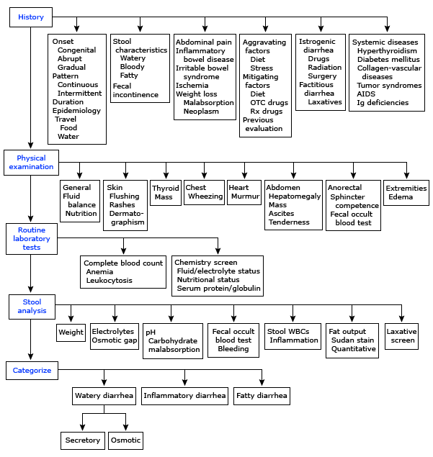
Algorithm For Chronic Diarrhea

Slide 11
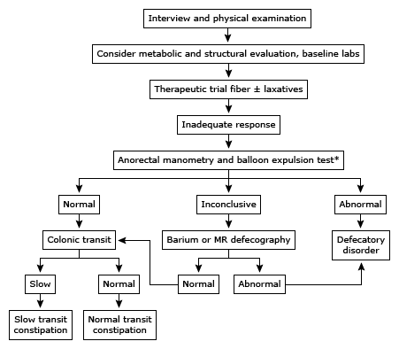
Algorithm For Chronic Constipation

Slide 12
Irritable bowel syndrome
Irritable bowel syndrome (IBS) is defined as a chronic functional disorder of the gastrointestinal tract in the absence of an organic disease characterized by recurrent abdominal pain or discomfort at least three days per month in the last three months with two or more of the following: improvement with defecation, onset associated with a change in frequency of stool, or onset associated with a change in form (appearance) of stool.
Present in 10-20% of the population
Twice as common in women compared to men
Most commonly affects people between 20-30 years

Slide 13
Etiology
Inflammation
Genetics
Motility
Postinfecious
Microflora Alterations
Sensitivity
Psychosocial

Slide 14
Rome IV ibs Criteria
According to the Rome IV criteria, IBS is defined as recurrent abdominal pain, on average, at least one day per week in the last three months, associated with two or more of the following criteria:
Related to defecation
Associated with a change in stool frequency
Associated with a change in stool form (appearance)

Slide 15
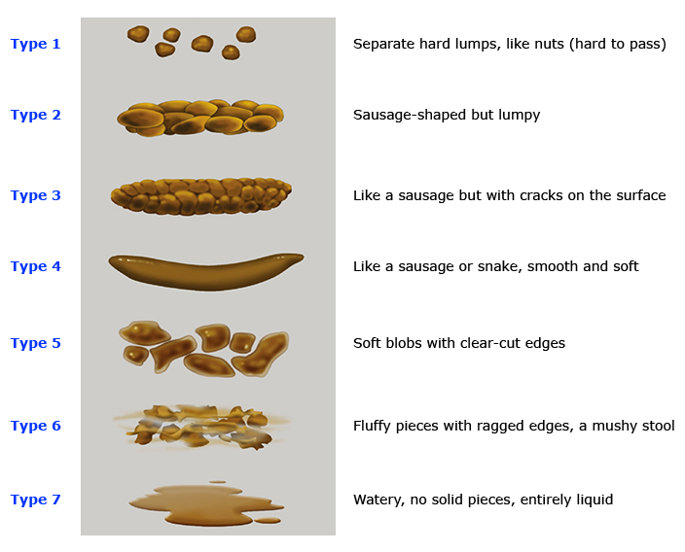
Bristol stool form scale

Slide 16
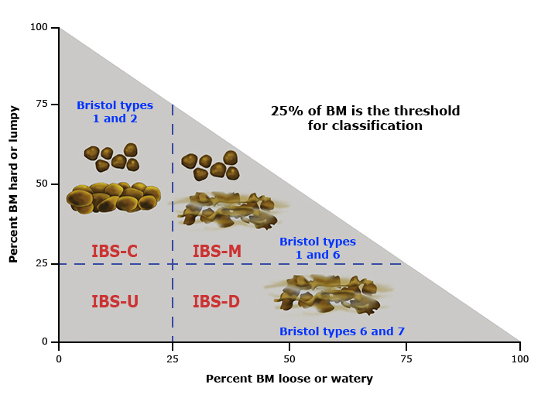
Classification of IBS

Slide 17
Diagnosis
It is Difficult.
It Needs to balance between few and many investigations.
Red flag symptoms should be ruled out.
The Diseases that causing similar symptoms should ruled out.

Slide 18
Diagnosis (NICE Guidelines)
Irritable bowel syndrome should be considered if an adult presents with abdominal pain or discomfort, bloating or a change in bowel habit for at least 6 months. A diagnosis should be considered only if the person has abdominal pain or discomfort that is either relieved by defaecation or is associated with altered bowel frequency or stool form. This should be accompanied by at least 2 of the following 4 symptoms:
altered stool passage (straining, urgency, incomplete evacuation)
abdominal bloating (more common in women than men), distension, tension or hardness
symptoms made worse by eating
passage of mucus.
Lethargy, nausea, backache and bladder symptoms are also common in people with irritable bowel syndrome, and may be used to support the diagnosis.

Slide 19
Alarming Symptoms !!!
Unintentional and unexplained weight loss.
Rectal bleeding.
A family history of bowel or ovarian cancer.
In people aged over 60, a change in bowel habit lasting more than 6 weeks with looser and/or more frequent stool.
Anemia.
Abdominal masses.
Rectal masses.
Inflammatory markers for inflammatory bowel disease such as:.
Positive Fecal calprotectin testing

Slide 20
Physical Examination
anaemia
abdominal masses
rectal masses

Slide 21
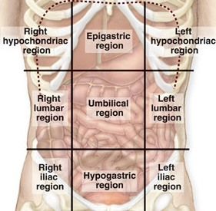
Abdominal examination

Slide 22
Abdominal examination
Inspection
Bloatness
Palpitation
Organmegaly
masses
Rectal
Percussion
Auscultation
Bowel movements

Slide 23
investigations
inflammatory markers for inflammatory bowel disease.
In addition, women with symptoms that suggest ovarian cancer should have their serum CA125 measured.
When the above have been excluded, the following tests should be done to exclude other diagnoses:
full blood count
erythrocyte sedimentation rate (ESR) or plasma viscosity
C reactive protein (CRP)
antibodies for coeliac disease (endomysial antibodies [EMA] or tissue transglutaminase [TTG]).

Slide 24
investigations
The following tests are not necessary to confirm diagnosis in people who meet the diagnostic criteria for irritable bowel syndrome:
ultrasound
rigid/flexible sigmoidoscopy
colonoscopy, barium enema
thyroid function test
faecal ova and parasite test
faecal occult blood
hydrogen breath test (for lactose intolerance and bacterial overgrowth).

Slide 25
Management
Education
Patients need “Basic” and “Beyond Basic” education regarding IBS
Help seeking behavior need to be modified to decrease costs spent on acute attacks.
Dealing with symptoms
What are the worrying symptoms?
When to seek help?
Education Resources
https://www.uptodate.com/contents/irritable-bowel-syndrome-the-basics?source=see_link
https://www.uptodate.com/contents/irritable-bowel-syndrome-beyond-the-basics?source=see_link

Slide 26
Management
Life style:
Reduce stress, increase leisure and relaxation time
Increase physical activity
Diet:
Regular meals
Decrease caffeine
Increase fiber?
Probiotics
If persistent → specific food avoidance

Slide 27
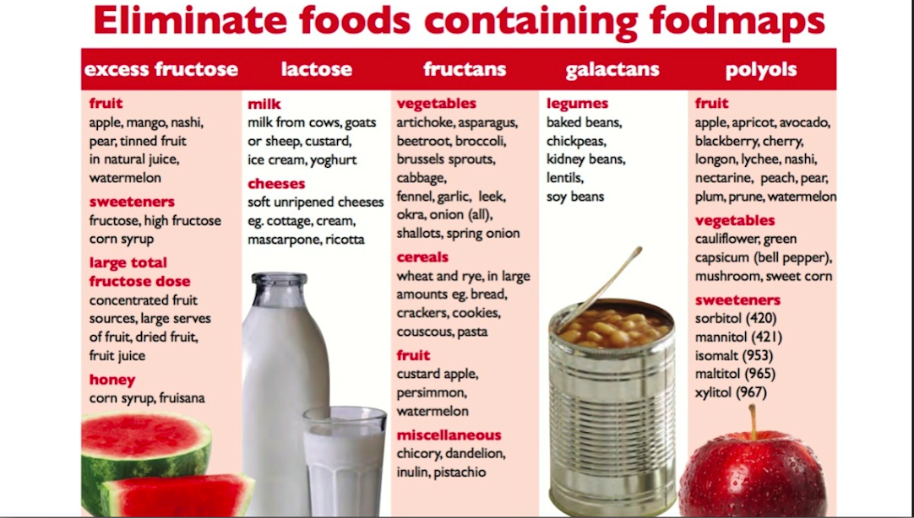

Slide 28
Management
Pharmacological:
Antispasmodics (otilonium, hyoscine)
Constipation→ laxatives (osmotic, linaclotide)
Diarrhea → antimotility (loperamide)
TCAs (amitriptyline) or SSRIs
Psychological: Mainly in refractory IBS
CBT
Hypnotherapy
Psychotherapy

Slide 29
Courtesy of: Prof. A Aljebreen, department of medicine, KSU/KKUH

Slide 30
Management
In general:
Does not affect quality of life → Diet and life style changes only
Effects quality of life → Diet, life style changes and pharmacological therapy

Slide 31
Follow up
Agreed between physician and patient.
Depends on response of the person’s symptoms to intervention.
‘Red flag’ symptoms should prompt further investigation and/or referral to secondary care.

Slide 32
When to Refer to a specialist?
Refer when there is:
More than minimal rectal bleeding
Weight loss
Unexplained iron defiency aneamia
Nocturnal symptoms
Family history
Colorectal cancer
IBD
Celiac disease

Slide 33
Role Play

Slide 34
True or False
People suffering from irritable bowel syndrome for more than 10 years develop cancer.
Truth
False

Slide 35
True or False
People suffering from irritable bowel syndrome for more than 10 years develop cancer.
Truth
False

Slide 36
True or False
People with irritable bowel syndrome may suffer from either constipation only or diarrhea only
Truth
False

Slide 37
True or False
People with irritable bowel syndrome may suffer from either constipation only or diarrhea only
Truth
False

Slide 38
True or False
Rectal bleeding is a common presentation of irritable bowel syndrome
Truth
False

Slide 39
True or False
Rectal bleeding is a common presentation of irritable bowel syndrome
Truth
False

Slide 40
MCQ
Once other disease conditions have been ruled out, a person can be considered for the diagnosis of irritable bowel syndrome if the symptoms were present for the last
One week
One fortnight
One month
Three months

Slide 41
MCQ
Once other disease conditions have been ruled out, a person can be considered for the diagnosis of irritable bowel syndrome if the symptoms were present for the last
One week
One fortnight
One month
Three months

Slide 42
Refrences
UpToDate https://www.uptodate.com
NICE Guidelines https://www.nice.org.uk/
Healthy Bowel Guide http://www.cnwl.nhs.uk/wp-content/uploads/Healthy_Bowel-_Patient_Information_leaflet.pdf
Lecture of Prof. A Aljebreen, titled “abdominal pain and IBS” department of medicine, KSU/KKUH

