Slide 1
Women health

Slide 2
Objectives
Women health risk factors
Gender related diseases
Health promotion for women

Slide 3
Which one of the following is Criteria of screening Osteoporosis?
A-Women younger than 65 year old with one or more risk factor of osteoporosis
B-All women below 65 year old
C-Postmenopausal women without fracture
D-Duxa scan above -1

Slide 4
What is the most common cancer in females?
Colon cancer
Breast cancer
Thyroid cancer
Lung cancer

Slide 5
Which one of the following is women related issue ?
Diabetes
Osteoporosis
Dysmenorrhea
stroke

Slide 6
Definition
Women's health refers to the branch of medicine that focuses on screening , diagnosis and management of diseases and conditions that affect a woman's physical and emotional well-being.
It is important to :
Preservation of wellness
Prevention of illness

Slide 7
Maternal health
Maternal health refers to the health of women during pregnancy, childbirth and the postpartum period. While motherhood is often a positive and fulfilling experience, for too many women it is associated with suffering, ill-health and even death.
the major direct causes of maternal morbidity and mortality :
hemorrhage
infection
high blood pressure
unsafe abortion
obstructed labor
Notes:
http://www.who.int/topics/maternal_health/en/

Slide 8
Who provides woman health
The women's health services team includes doctors and health care providers from a variety of different specialties. The team may include:
Obstetrician/gynecologist
General surgeons specializing in breast care
Perinatologist
Radiologist
Primary care doctor
Nurses

Slide 9
Women’s Reproductive Health
A woman’s reproductive system is a delicate and complex system in the body. It is important to take steps to protect it from infections and injury, and prevent problems—including some long-term health problems.
The WHO assessed in 2008 that "Reproductive and sexual ill-health accounts for 20% of the global burden of ill-health for women.

Slide 10
Contraception (birth control)
There are several safe and highly effective methods of birth control available to prevent unintended pregnancy.
These include :
1-intra uterine devices
2-hormonal ex: pills, patches and injections
3- sterilization “tubal ligation”

Slide 11
Women at risk of
There are some health issues that are common to both men and women affect women differently.
Hypertension:
Hypertension at younger ages was higher in men than in women but among older people (>60 years) it was higher in women.
Risk factors:
Genetic predisposition
Lifestyle
Dietary factors, such as high salt , alcohol intake and obesity.
Low carbs diat ??

Slide 12
Women at risk of
Diabetes:
Risk factors:
Sedentary lifestyle
Family history
Age over 45
Obese (BMI >30)
History of GDM
Family history (first relative) of D.M

Slide 13
Women health risk factor
Heart disease:
Women are more likely to die following a heart attack than men, because they are more likely to experience delays in emergency care and to have treatment to control their cholesterol levels. It show up about 10 years later in women compared to men because of the estrogen.
-
Note: Low-Carbohydrate Diet Better Than Low-Fat Diet to Reduce Cardiovascular Risk Factors and Cause Weight Loss.
Notes:
Although total cholesterol levels did not markedly change in either group, high-density lipoprotein levels increased significantly more in the low-carbohydrate group, and triglyceride levels decreased significantly more in that group, as well. Blood pressure, glucose levels, and insulin levels were not different between the groups.Low fat vs low carbohydrate.

Slide 14
Women at a risk of
1. Stroke:
It is the third leading cause of death for women. Some risk factors are unique to women include:
Taking birth control pills
Being pregnant (Pregnancy is hyper-coagulable state)
Using hormone replacement therapy, a combined hormone therapy of progestin and estrogen designed to relieve menopausal symptoms
Having frequent migraine headaches
Having a thick waist (larger than 35.2 inches), particularly if post- menopausal, and high triglyceride levels

Slide 15
Women health risk factor
Mental health:
Women are more likely to report having recently suffered from depression and anxiety disorders.
Osteoporosis:
Women are at greatest risk for osteoporosis after menopause.
Osteoarthritis:
After age 45, the condition is more common in women. The severity of osteoarthritis is usually significantly worse in women than in men.

Slide 16
Health issues unique to women
Breast cancer
Cervical cancer
Amenorrhea
Dysmenorrhea

Slide 17
Breast cancer
Breast cancer is a group of diseases that affects breast tissue. Both women and men can get breast cancer, though it is much more common in women.
Breast cancer is the most common cancer among women in the United States.
Breast cancer is the second leading cause of cancer deaths among women in the United States.
Getting mammograms regularly can lower the risk of dying from breast cancer.

Slide 18
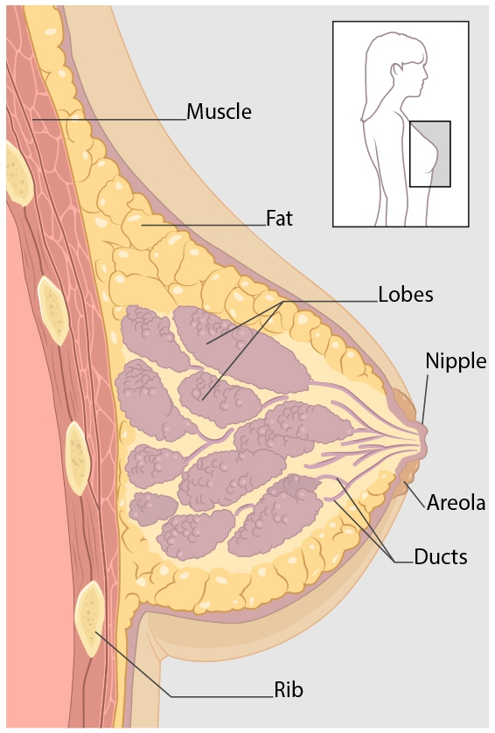
Kinds of Breast Cancer
The most common kinds of breast cancer are :-
- Invasive ductal carcinoma.
- Invasive lobular carcinoma.
There are several other less common kinds of breast cancer, such as Paget’s disease, medullary, mucinous, and inflammatory breast cancer.

Slide 19
Symptoms of Breast Cancer
New lump in the breast or underarm (armpit).
Thickening or swelling of part of the breast.
Irritation or dimpling of breast skin.
Redness or flaky skin in the nipple area or the breast.
Pulling in of the nipple or pain in the nipple area.
Nipple discharge other than breast milk, including blood.
Any change in the size or the shape of the breast.
Pain in any area of the breast.

Slide 20
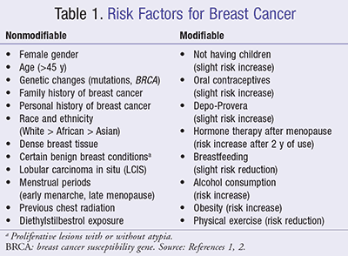
Risk Factors for Breast Cancer

Slide 21
Diagnosis of Breast Cancer
Breast ultrasound.
Diagnostic mammogram.
Magnetic resonance imaging (MRI)
Biopsy.

Slide 22
Treatment of Breast Cancer
Surgery.
Chemotherapy.
Hormonal therapy.
Radiation therapy.

Slide 23
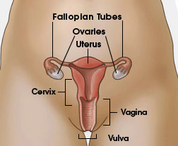
Cervical Cancer
Cervical cancer used to be the leading cause of cancer death for women in the United States.
Cervical cancer is the third most common cancer in the world, with 2.3 million prevalent cases
Annually, 288,000 women die of cervical cancer, and 80% of those deaths occur in developing countries .
Cervical cancer is highly preventable in most Western countries because screening tests and a vaccine to prevent human papillomavirus (HPV) infections are available.

Slide 24
Risk Factors for Cervical Cancer
Almost all cervical cancers are caused by human papillomavirus (HPV).
Other things can increase your risk of cervical cancer—
- Smoking.
- Having given birth to three or more children.
- Having several sexual partners.

Slide 25
Cervical Cancer: Diagnosis and Treatment
Early detection: Pap test.
Tests to confirm a diagnosis of cervical cancer include:
- A colposcopy and cervical biopsy.
- An endocervical biopsy (or curettage).
Treatment
Surgery
Chemotherapy
Radiation

Slide 26
Amenorrhea
Primary amenorrhea: failure to reach menarche.
Secondary amenorrhea: cessation of previously regular menses for three months or previously irregular menses for six months.
Normal menstrual cycle typically occurs every 21 to 35 days.
Major Causes of Amenorrhea
- Outflow tract, Primary ovarian insufficiency, Pituitary, Hypothalamic, Other endocrine gland disorders, Physiologic

Slide 27
Primary Dysmenorrhea
It is a cramping pain in the lower abdomen occurring just before or during menstruation in the absence of any identifiable pelvic disease. Prevalence rates are as high as 90%.
Clinical presentation and diagnosis:
• Sharp, intermittent spasms of pain, Pain may radiate to the back of the legs or the lower back. Systemic symptoms of NVD , fatigue, fever, headache.

Slide 28
Primary Dysmenorrhea
Treatment of Primary Dysmenorrhea:
› NSAIDs
› Oral contraceptives (OCP):
• The pain associated with PMS is generally related to breast tenderness and abdominal bloating، rather than a lower abdominal cramping pain.
• PMS symptoms begin before the menstrual cycle usually 2 wks and resolve shortly after menstrual flow begins.

Slide 29
Secondary Dysmenorrhea
Late onset of dysmenorrhea
No response to therapy with NSAIDs, OCPs, or both.
Possible causes of secondary dysmenorrhea:-
-Endometriosis
-Uterine fibroids.
-Adenomyosis.
-Pelvic inflammatory disease (PID).
-Cervical stenosis.
The treatment of secondary dysmenorrhea depend on the cause.

Slide 30
Health promotion
Youtube: https://www.youtube.com/watch?v=y9THQTEqMaU

Slide 31
Health promotion is the process of enabling people to increase control over, and to improve, their health. It moves beyond a focus on individual behaviour towards a wide range of social and environmental interventions.
Educated women more likely than uneducated women to take advantage of modern medicine and comply with recommended treatments.

Slide 32
key elements of health promotion
1. Good governance for health
Health promotion requires policy makers across all government departments to make health a central line of government policy. This means they must factor health implications into all the decisions they take, and prioritize policies that prevent people from becoming ill and protect them from injuries.
2. Health literacy
People need to acquire the knowledge, skills and information to make healthy choices, for example about the food they eat and healthcare services that they need. They need to have opportunities to make those choices. And they need to be assured of an environment in which people can demand further policy actions to further improve their health.
3. Healthy cities
Cities have a key role to play in promoting good health. Strong leadership and commitment at the municipal level is essential to healthy urban planning and to build up preventive measures in communities and primary health care facilities.

Slide 33
Health promotion for women
Family planning:
For patients who want to conceive:
-Age, medical history, family history, weight, nutrition, medications, immunization status, environmental exposures, STI risk, and substance use should be reviewed and appropriate counseling provided. Physicians may choose to counsel women on expectations of perimenopause and menopause, when relevant
-For patients who want contraception:
Premenopausal women should be asked about their reproductive plans. If the patient does not currently want to get pregnant, options for contraception should be reviewed

Slide 34
Physical Activity
All women should be assessed regarding muscle strength and aerobic physical activity and be offered recommendations appropriate to their physical abilities. For substantial health benefits, adults should do at least 150 minutes (2 hours and 30 minutes) a week.
Nutrient Intake
All women capable of becoming pregnant should be counseled to choose foods that supply heme iron, which is more readily absorbed by the body, additional iron sources, and enhancers of iron absorption such as vitamin C-rich foods; and consume 400 micrograms (mcg) per day of synthetic folic acid (from fortified foods and/or supplements) in addition to food forms of folate from a varied diet.

Slide 35
Weight Status
Reaching a healthy weight before pregnancy reduces the risks of neural tube defects, preterm delivery, diabetes, cesarean section, and hypertensive and thromboembolic disease that are associated with obesity.
Substance Use
Healthcare providers should identify smokers and offer them cessation advice, all women should be advised of the risks to the embryo or fetus of alcohol exposure during pregnancy.
.

Slide 36
screening
screening
Breast Cancer
Cervical Cancer
STD
Osteoporosis
Premarital Screening

Slide 37
Premarital Screening:
It is defined as conducting examination for soon-to-be married in order to identify if there is any injury with genetic blood diseases such as sickle-cell anemia (SCA) and Thalassemia, and some infectious diseases such as hepatitis B, C and HIV "Aids".
Osteoporosis:
Test used: DEXA scan
Criteria of screening: (every 2 years)
- All women above 65 year old
- Women younger than 65 year old with one or more risk factor of osteoporosis
- Postmenopausal women with fracture

Slide 38
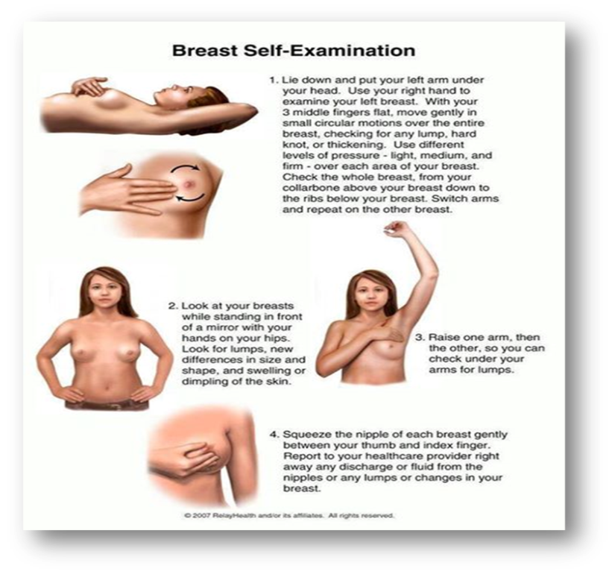
Breast Cancer:
-In Saudi Arabia, a total of 6,922 female breast cancer cases were recorded in the Saudi Cancer Registry from 2001 to 2008. The highest overall percentages (38.6% and 31.2%) of female breast cancer
-screening methods
Breast Self Exam (BSE) *
as a family physician you have to fully educate your patients how to examine her breasts regularly every month, after period ideally, and emphasize about any breast changes she noticed , she must report it as early as possible to her family physician .
Mammogram
-can help in identifying cysts, calcifications, and tumors within the breast.
-Mammograms are the most efficient screening
method to detect early breast cancer, the earlier detecting the more curable is the tumor .

Slide 39
Cervical Cancer
- Cervical cancer is the third most common cancer in the world, with 2.3 million prevalent cases
Annually, 288,000 women die of cervical cancer, and 80% of those deaths occur in developing countries .
The incidence rate in Saudi Arabia is one of the lowest in the world at 1.9 cases per 100,000 women

Slide 40
Sexually Transmitted Infections (STIs):
High risk group: Sexually active adults, those with multiple partners, those who have an STI or have had one within the past year.
Health care providers regularly and routinely should assess STI risks, provide counseling to prevent acquisition of STIs, and provide indicated STI testing and treatment for all women of childbearing age.

Slide 41
Which one of the following is Criteria of screening Osteoporosis?
A-Women younger than 65 year old with one or more risk factor of osteoporosis*
B-All women below 65 year old
C-Postmenopausal women without fracture
D-Duxa scan above -1

Slide 42
What is the most common cancer in females?
Colon cancer
Breast cancer*
Thyroid cancer
Lung cancer

Slide 43
Which one of the following is women related issue ?
Diabetes
Osteoporosis
Dysmenorrhea*
stroke

Slide 44
Referencese
http://www.cdc.gov/cancer/breast/
http://www.cdc.gov/cancer/cervical/index.htm
http://www.cdc.gov/dhdsp/data_statistics/fact_sheets/fs_women_heart.htm
http://www.mayoclinic.org/diseases-conditions/menstrual-cramps/basics/definition/con-20025447
http://www.mayoclinic.org/diseases-conditions/amenorrhea/basics/definition/con-20031561
http://www.webmd.com/cancer/cervical-cancer/cervical-cancer-exams-and-tests
https://www.stoptheclot.org/learn_more/womens_health_faq.htm
www.uptodate.com
https://medlineplus.gov/ency/article/007458.htm

Slide 45
That’s it !
Thanks for your Attention
Done by:
Mishari Alshasha
Hamad Aldossari
Abdulrhaman Alharbi
Abdullah Alobaisi

