Slide 1
Maternal & Child Health
Student Led Seminar
FMED 421
By:
Feras AL-Fawaz
Ali ALElayan
Musab ALMasry

Slide 2
Objectives
Health behaviors and health systems indicators that affect the health, wellness, and quality of life of women, children, and families.
Factors can affect pregnancy and childbirth, including: Preconception health status, Age, Access to appropriate preconception and interconception health care, Poverty
Health risks may include: Hypertension and heart disease, Diabetes, Depression, Genetic conditions, Sexually transmitted diseases (STDs), Tobacco use and alcohol Abuse, Inadequate nutrition, Unhealthy weight
Social and Physical Determinants of Maternal Health
Social and Physical Determinants of Infant and Child Health
How to improve the health and well-being of women, infants, children, and families.

Slide 3
What is Maternal health
Maternal health refers to the health of women during pregnancy childbirth and the postpartum period.
for too many women it is associated with suffering, ill-health and even death

Slide 4
830 women die from preventable causes related to pregnancy and childbirth
Every day !!!
Maternal mortality is higher in women living in rural areas and among poorer communities.
Young adolescents face a higher risk of complications and death as a result of pregnancy than other women.
Skilled care before, during and after childbirth can save the lives of women and newborn babies.
99% of all maternal deaths occur in developing countries.

Slide 5
Maternal Mortality Ratio
Maternal death is the death of a woman while pregnant or within 42 days of termination of pregnancy.
All maternal deaths occurring within a reference period (usually 1 year) x100,000 ______________________________________________________ Total # of live births occurring within the reference period

Slide 6
Preconception Health Care
Preconception health care :
is the medical care a woman or man receives from the doctor or other health professionals that aimed to increase the chance of having a healthy baby.
- Should ideally take place 3-6 months before cnception.
# Is it only for woman ?
# What are the items that coverd by Preconception Health Care ?

Slide 7
Items coverd by Preconception Health Care
Minimizing occupational risks.
Prescribing folic acid
Control and treat underlying medical conditions
Maximizing chronic illness care
Improving health habits
Review current medications and assess safety
Vaccinations
Genetic screening

Slide 8
Carrier Screening
- Examples include sickle cell disease in blacks and
Tay-Sachs disease in Ashkenazi Jews and Eastern Europeans called carrier screening.
- current recommendations state that all women should be offered carrier screening for cystic fibrosis.

Slide 9
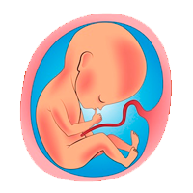
Prenatal care
Is the care a woman gets during pregnancy.
:During the First Visit
probably sometime after the eighth week of pregnancy.
Most health care providers won’t schedule a visit any earlier unless you have a medical condition,

Slide 10
: Routine Prenatal Tests
Urine sample for infection and to confirm your pregnancy.
Blood pressure, weight, and height.
Prenatal blood tests
Gonorrhea and chlamydia cultures, and Pap test to screen for cervical cancer.
Ultrasound test.
Complete physical exam, including a pelvic exam.

Slide 11
Factors Affecting Pregnancy
Existing Health Conditions
Age
Lifestyle Factors
Conditions of Pregnancy

Slide 12
High risk Factor in maternal and child health
HTN
Heart Disease
GDM
Tobacco &alcohol use
STDs
Nutrition
Unhealthy weight
Genetic factor
Post partum depression

Slide 13
Hypertension
most common medical problem encountered during pregnancy, complicating 2-3% of pregnancies
complication:
preeclampsia : BP and signs of damage to another organ system (proteinuria) , usually after 20 weeks of pregnancy
Failure to thrive, seizures, , lack of energy, and difficulty in breathing can be associated with hypertension in neonates
Why is high blood pressure a problem during pregnancy?
Decreased blood flow to the placenta
Premature delivery
Placental abruption
Future cardiovascular disease
Notes:
http://www.mayoclinic.org/healthy-lifestyle/pregnancy-week-by-week/in-depth/pregnancy/art-20046098
http://emedicine.medscape.com/article/261435-overview

Slide 14
Heart disease
Leading to Cause death of maternal heath worldwide
Myocardial inarction
cardiomyopathy
Rheumatic heart disease

Slide 15
Gestational Diabetes mellitus
is when a woman without diabetes, develops high blood sugar levels during pregnancy
Approximately 7% of all pregnancies are complicated by GDM more than 200,000 annually.
in gestational diabetes, blood sugar usually returns to normal soon after delivery. But you're at risk for type 2 diabetes.
Risk factors?
Age greater than 25
Family or personal health history.
Excess weight (30 or higher BMI)
Notes:
http://care.diabetesjournals.org/content/26/suppl_1/s103
https://en.wikipedia.org/wiki/Gestational_diabetes

Slide 16
complication
mother
baby
Future DM
preeclampsia
birth weight
Preterm birth with respiratory distress syndrome
Blood sugars
Notes:
http://www.mayoclinic.org/diseases-conditions/gestational-diabetes/basics/complications/con-20014854

Slide 17
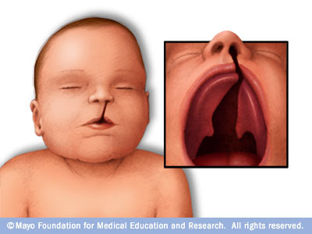
Tobacco use
Approximately 10% of women reported smoking during the last 3 months of pregnancy.
Tobacco effect:
hard to get pregnant
Miscarriage
problems with the placenta
Risk for Sudden Infant Death Syndrome (SIDS)
cleft lip or cleft palate
Notes:
http://www.cdc.gov/reproductivehealth/maternalinfanthealth/tobaccousepregnancy/

Slide 18
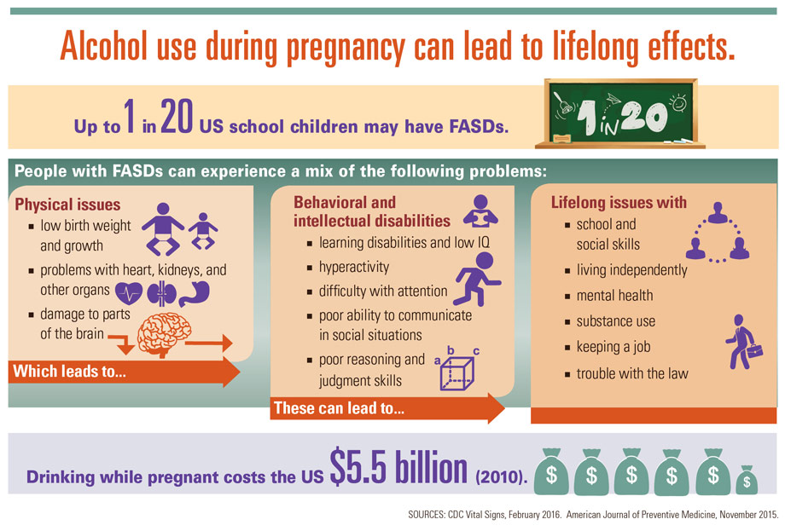
Alcohol use
There is no known safe amount of alcohol use during pregnancy.
Notes:
http://www.cdc.gov/ncbddd/fasd/alcohol-use.html

Slide 19
STDs 1-HIV/AIDS
It recommends that all women who are pregnant or planning to get pregnant should get tested for HIV as early as possible.
If a woman is treated for HIV early in her pregnancy, the risk of transmitting HIV to her baby can be 1% or less.
How to lower their risk of transmitting HIV to their babies?
Take HIV medicines
After delivery, ensure their infants take HIV medicines
Avoid pre-chewing food for an infant, toddler, or anyone else.
Avoid breastfeeding
Notes:
http://www.cdc.gov/hiv/group/gender/pregnantwomen/index.html

Slide 20
2-Herpes
Herpes is safe in pregnant women until she get ready to deliver.
Herpes lesions on genitals are highly contagious and infect the baby during labor
3-syphilis
May be transmitted to baby by infected mother.
It be linked to premature birth, stillbirth ,death in some cases
4-Gonorrhea
The risk in pregnancy :miscarriage, preterm birth
The risk before and after pregnancy if untreated : cause pelvic inflammatory disease
Gonorrhea in newborns most commonly affects the eyes
Notes:
http://www.babycenter.com/0_gonorrhea-during-pregnancy_1427382.bc

Slide 21
Hepatitis
can be spread to a baby during childbirth
The risk of a pregnant woman passing the to her unborn child has been related RNA levels in her blood, and HIV positive.
In highly endemic areas, hepatitis B is most commonly spread from mother to child at birth perinatal transmission
When babies become infected they have a 90% chance of developing a lifelong, cause liver damage, liver disease, and liver cancer.
Transmission of the virus to the fetus HCV RNA titer greater than 1 million copies/mL
Mother without HCV RNA , no Transmission
CDC recommends that babies get the
HBIG shot and the first dose of Hepatitis B
vaccine within 12 hours of being born.
There is no preventive treatment can influence the transmission.
Notes:
http://www.hepatitiscentral.com/hcv/hepatitis/pregnancy/
https://www.cdc.gov/hepatitis/hbv/pdfs/hepbperinatal-protectwhenpregnant.pdf

Slide 22
Poor nutrition
mother
baby
malnutrition
fail to gain weight in pregnancy
low-birth weight
Mother die while pregnant
restricted foetal growth
type 2 diabetes
Iron : Preterm birth
Neurological dysfuction
risk of death from bleeding
during childbirth
Folate : neutral tube defect
Micro nutrition
Calcium : poor skeletal development
Iron: low birth weight
Vit A: night blindness
Notes:
http://www.myvmc.com/pregnancy/under-nutrition-before-and-during-pregnancy/

Slide 23
Unhealthy weight
A women weight before and during pregnancy are important indicators of health for both mother and child.
Recent CDC studies showed overweight or obese before pregnancy associated with a higher pregnancy complication.
Genitic conditions
more than 50 per cent of miscarriages in the early stages of pregnancy are due to abnormalities of the chromosomes.
Down's syndrome: have two number of 21 chromosome , low IQ
Sickle cell, G6PD, heamophilia
Notes:
http://www.cdc.gov/reproductivehealth/maternalinfanthealth/pregcomplications.htm
http://www.netdoctor.co.uk/conditions/pregnancy-and-family/a9096/chromosome-abnormalities-in-pregnancy/

Slide 24
Postpartum depression
1 in 9 women experience depression before, during, or after pregnancy
Symptoms :
Crying more often than usual.
Feelings of anger.
Withdrawing from loved ones.
Risk Factor:
Stress.
Low social support
Preterm (before 37 weeks) labor and delivery.
Having a baby with a birth defect or disability.
Notes:
http://www.cdc.gov/features/maternal-depression/index.html

Slide 25
Social and Physical Determinants of Maternal and child Health
range of biological, social, environmental, and physical factors have been linked to maternal, infant, and child health outcomes.
These include:
race and ethnicity, age, and socioeconomic factors, such as income level, educational attainment, medical insurance coverage, access to medical care, pre-pregnancy health, and general health status.

Slide 26
How to improve maternal and child health
approximately 830 women die every day from causes related to pregnancy and childbirth.
5.9 million children under age five died in 2015, 16000 every day.
With quality health care, many of these deaths could be prevented.

Slide 27
Postnatal Care Highlights
Provide postnatal care in first 24 hours for every birth:
Delay facility discharge for at least 24 hours.
Visit women with home births within the first 24 hours.
Provide every mother and baby four postnatal visits on : First day (24 hours), Day 3 (48–72 hours) , Between days 7–14 and the Sixth week.

Slide 28
How to improve Maternal health
First 24 hours : assessment of vaginal bleeding, uterine contraction, temperature and heart rate should be done routinely during the first 24 hours
Breastfeeding should be assessed
women should be asked about their emotional wellbeing, what family and social support they have
After 10–14 days, all women should be asked about postpartum depression

Slide 29
How to improve Maternal health
All women should be asked about sexual intercourse and possible dyspareunia as part of an assessment of overall well-being 2–6 weeks after birth
Iron and folic acid supplementation should be provided for at least 3 months after delivery.

Slide 30
How to improve infancy health
promote early and exclusive breastfeeding (EBF):
Evidence shows EBF reduces the risks of mortality and morbidity and improves post-neonatal outcomes
Preterm and low-birth-weight babies should be identified as soon as possible and should be provided special care.
A full clinical examination should be done 1 hour after birth. This includes giving vitamin K prophylaxis and hepatitis B vaccination (within 24 hours).

Slide 31
How to improve maternal and child health
Vaccinations :
● Before pregnancy: measles, rubella
● During pregnancy: tdap vaccine to protect against whooping cough
● To the infant: hepatitis B, TB, Chickenpox
● -- Flu shot could be taken during or before pregnancy.

Slide 32
Vaccinations
pregnancy
infant
During
Before
hepatitis B
TB
Chickenpox
tdap vaccine to protect
against whooping cough
Measles
rubella
Flu shot could be taken during or before pregnancy

Slide 33
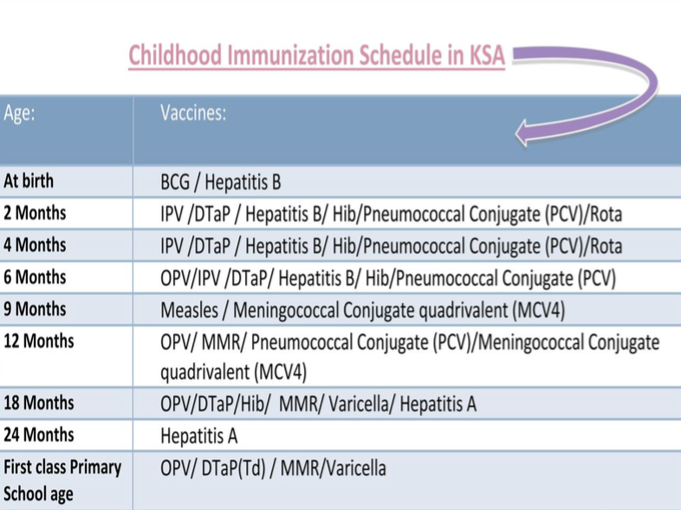

Slide 34
How to improve maternal and child health
Avoid stress
Nutrition support
Sanitation
Lifestyle modification: smoking, drinking alcohol

Slide 35
Answers
What is the newborn normal weight ?
A- 2.5 kg
B- 1.5 kg
C- 6 kg

Slide 36
Answers
Which one of the following vaccines should be given immediately after birth ?
A- Hepatitis B
B- Varicella
C- Hepatitis A

Slide 37
Answers
Which of the following is a maternal health indicator recommended by WHO?
A- Sexually transmitted infections (STIs) incidence rate
B- Cervical cancer screening
C- Skilled attendant at birth

Slide 38
Answers
What’s the Maternal mortality ratio in Saudi Arabia in 2015?
A- 12 Per 100,000 live births
B- 24 Per 100,000 live births
C- 48 Per 100,000 live births

Slide 39
Answers
What is the most common medical problem encountered during pregnancy?
A- Hypertension .
B- DM.
C- UTI.

Slide 40
http://apps.who.int/gho/data/view.sdg.3-2-data-ctry?lang=en
http://www.who.int/topics/maternal_health/en/
http://www.who.int/woman_child_accountability/progress_information/recommendation2/en/
http://www.who.int/gho/countries/sau/country_profiles/en/
http://www.who.int/gho/child_health/en/
http://www.who.int/maternal_child_adolescent/publications/WHO-MCA-PNC-2014-Briefer_A4.pdf?ua=1
http://www.who.int/mediacentre/factsheets/fs178/en/
http://www.who.int/mediacentre/factsheets/fs348/en/
http://www.who.int/mediacentre/factsheets/fs290/en/
http://www.who.int/topics/millennium_development_goals/maternal_health/en/
http://www.cdc.gov/preconception/planning.html
https://www.nichd.nih.gov/health/topics/preconceptioncare/conditioninfo/pages/prenatal-visits.aspx
https://www.healthypeople.gov/2020/leading-health-indicators/2020-lhi-topics/Maternal-Infant-and-Child-Health/determinants

