Slide 2
Objectives :
Definition of Oteoporosis and Osteomalacia / Rickets
Highlight on Vitamin D deficiency
Prevalence in world / Saudi Arabia
Factors lead to Osteoporosis and Vitamin D deficiency
How patients could be presented
Common fractures with osteoporosis
Vitamin D and Comorbidities
Diagnosis, through
X- Ray
Role of DXA and how interpret (Normal, Osteopenia [Grades] and Osteoporosis)
Biochemistry
Management: (Osteopenia and Osteoporosis)
Prevention and advice
Role of Vitamin D and Calcium
Vitamin deficiency in pregnancy
Role of medications for osteoporosis like Alendronate, …

Slide 4
Osteoporosis is :
A- A disease of children caused by vitamin D deficiency.
B- A condition in which the bones become brittle and fragile from loss of tissue.
C-A condition in which the bones become soft due to decreased in mineralization.
D-All of the above.

Slide 5
prevalence of post-menopausal osteoporosis in Saudi Arabia is:
A- 10% to 20%
B- 20%to30%
C- 30% to 40%
D- 40%to50%

Slide 6
Which of the following are considered signs of Osteoporosis in X- ray:
A- Increased Radiolucency.
B- Cortical Thinning.
C- Cortical thickening.
D- A and B.

Slide 7
Osteoporosis and Vitamin D deficiency
Osteoporosis :
characterized by low bone mass(osteopenia), microarchitectural disruption, and increased skeletal fragility resulting in an increased risk of fracture mostly due to hormonal or calcium or vitamin D deficiency. despite the normal mineralization.
Rickets :
deficient mineralization of bone and cartilage and occurs before the closure of the growth plates (in childhood) resulting in bow legs
Oseomalacia :
deficient mineralization of bone and occurs after the closure of the growth plates (in adulthood).

Slide 8
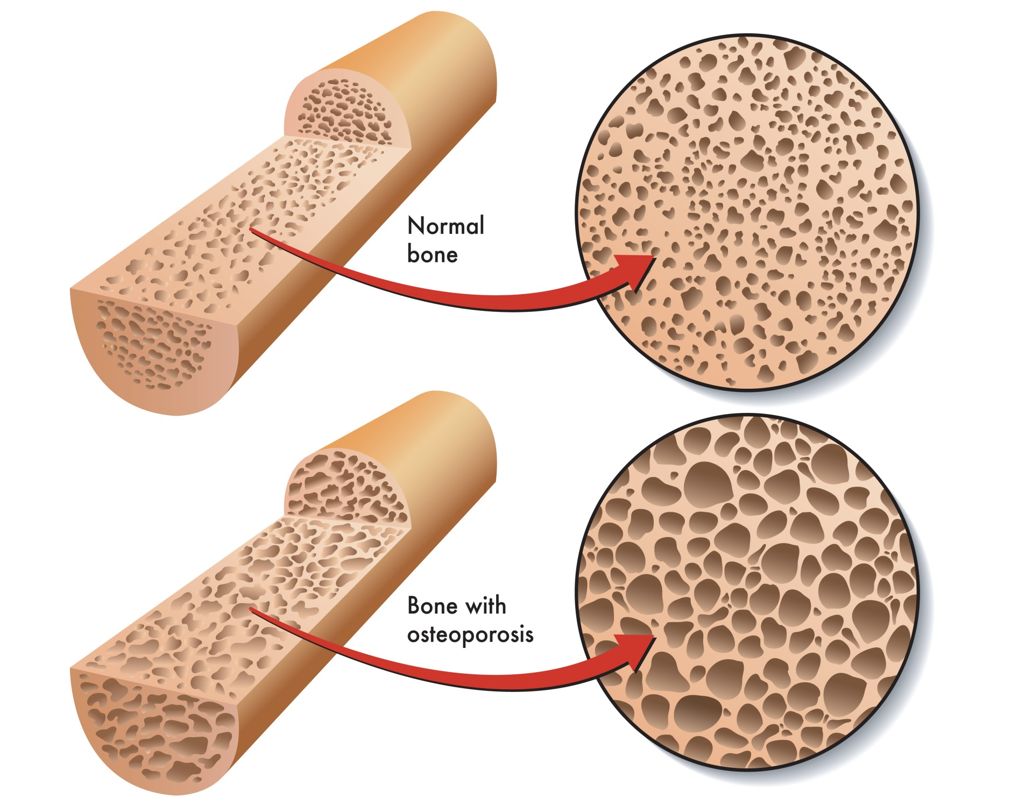

Slide 9
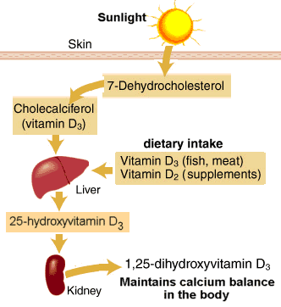
Highlights on Vitamin D deficiency

Slide 10
Highlights on Vitamin D deficiency
Source: Skin and diet
Stored as : 25 OH Vitamin D3
Active Form : 1.25 dihydroxyvitamn D3
Function :
Regulate calcium homeostasis

Slide 11
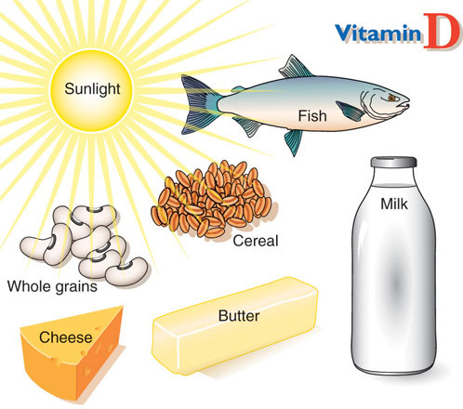
Sources of Vitamin D

Slide 14
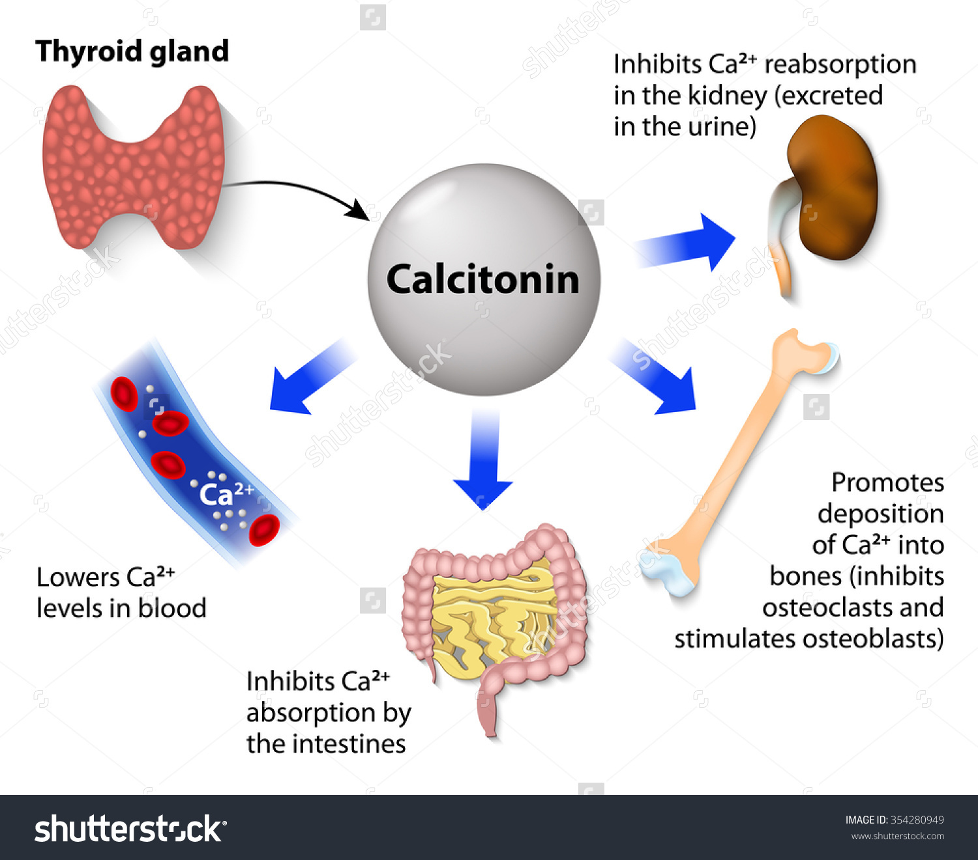

Slide 15
Importance of osteoporosis
The most common nutritional deficiency worldwide.
Affect quality of life .
Long time pain and disability.
Common prevalence worldwide and increasing in number.

Slide 16
Prevalence in world / Saudi Arabia
The prevalence of vitamin D deficiency depends upon the definition used (<20 or <30 ng/mL [50 or 75 nmol/L]).
The prevalence of low vitamin D levels may be increasing globally In a review of vitamin D levels in different regions of the world, vitamin D levels below 30ng/mL (75 nmol/L) were prevalent in every region studied, and low vitamin D levels (<10 ng/mL [25 nmol/L]) were more common in South Asia and the Middle East than in other regions .

Slide 17
Prevalence in world / Saudi Arabia
In Saudi Arabia, osteoporosis is already a serious issue a report in the eastern region of Saudi Arabia indicates an incidence of postmenopausal osteoporosis (PMO) of 30 percent to 40 percent, with over 60 percent of postmenopausal women already having some degree of osteopenia.
Saudi Med J. 2004 Oct;25(10):1423-7.

Slide 18
Risk Factor Of Osteoporosis

Slide 20
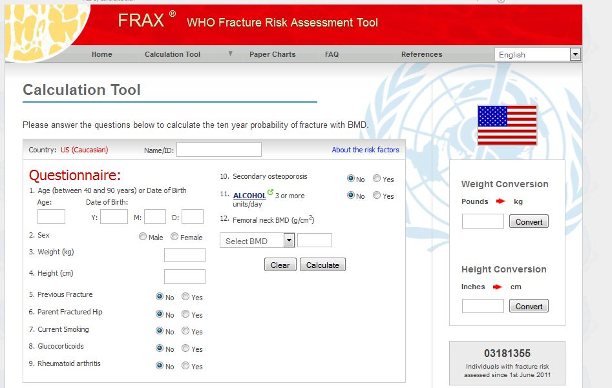
To predict the likelihood of having a fracture in the next 10 years

Slide 21
Smoking :
Cigarette smoking was first identified as a risk factor for osteoporosis more than 20 years ago.
Recent studies have shown a direct relationship between tobacco use and decreased bone density.

Slide 22
How does smoking affect bone health?
Cigarette smoke generates huge amounts of free radical and disturb balance of hormones (like estrogen) that bones need to stay strong.
Increased levels of the hormone cortisol, which leads to bone breakdown.
Smoking also damages blood vessels, so there is poor blood supply.

Slide 23
Physical inactivity :
People who spend a lot of time sitting have a higher risk of osteoporosis than do those who are more active.
Physical activity prevent osteoporosis is based on evidence that it can regulate bone maintenance and stimulate bone formation and this reducing the overall risk of falls and fractures.
Most experts recommend exercising for at least 30 minutes three times per week.

Slide 24
Medical diseases :
Premature menopause
Malabsorption
Chronic liver disease
IBD

Slide 25
Medication :
Steroids induced Osteoporosis
L-Thyroxine(hight ammount)
Phenytoin and Barbiturates
Aromatase Inhibitors and methotrexate
Thiazolidinediones
Chronic Lithium use

Slide 27
Vitamin D deficiency :

Slide 28
How does the patient should present ?
There are no symptoms in the early stages of bone loss. But once bones have been weakened by osteoporosis, you may have signs and symptoms that include:
Back pain, caused by a fractured or collapsed vertebra
Loss of height over time
A stooped posture
A bone fracture that occurs much more easily than expected

Slide 29
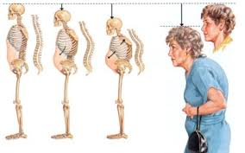
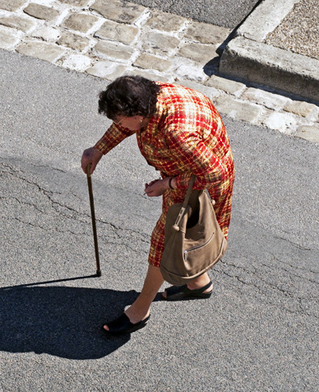

Slide 30
Common fracture with osteoporosis :

Slide 31
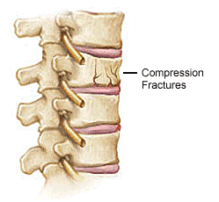
Spine :
The most common type of spinal fracture (also known as a ‘vertebral fracture’) in people with osteoporosis is called a wedge or compression fracture.
severe osteoporosis : a spinal fracture
may be caused by simple movements such
as lifting a light object, sneezing, or even just bending forward.
moderate osteoporosis : more force may be required, for example, a fall or lifting a heavy object.

Slide 32
Hip and pelvis
the most mobile type of joint in the body.
The two most common types of hip fractures:
femoral neck fractures : occurring in the narrow section of bone between the main shaft of the femur and the ball
intertrochanteric hip fractures : where the shaft of the femur breaks just below the femoral neck.

Slide 33
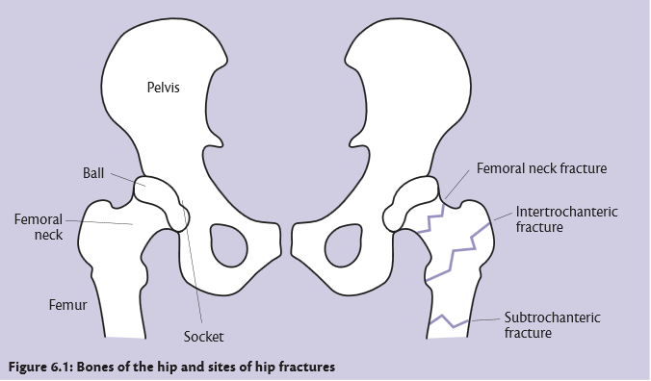

Slide 34
Wrist and forearm :
Falls are the most common cause of fractures of the wrist and forearm.
The two most common types of wrist fracture are:
Colles’ fracture—this is a fracture to the lower end of the radius, and very common in people with osteoporosis.
Scaphoid fracture —the scaphoid is a wedge-shaped bone located on the thumb side of the wrist, just where it meets the radius. These fractures are less commonly related to osteoporosis.

Slide 35
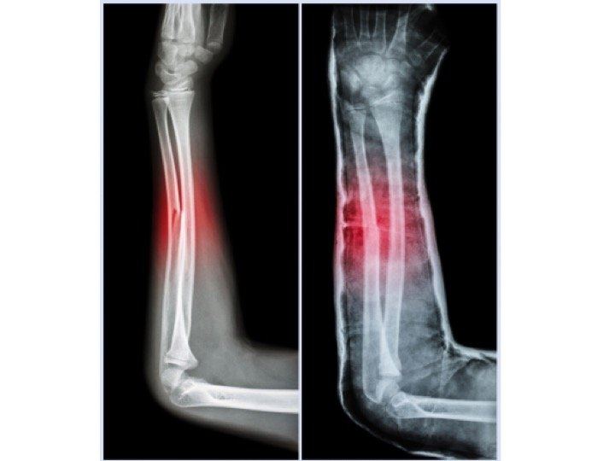

Slide 36
Effect Of Vitamin D Defiency
Hypocalcemia
Hypophosphatemia
Rickets/osteomalacia
Leading to increase risks of repeated falls , fractures and difficult mobility

Slide 37
Comorbidities and Vitamin D

Slide 38
CVS
Hypertension
Obesity
Diabetes

Slide 39
CVS
In the National Health and Nutrition Examination Study (NHANES) 2001 to 2004, the prevalence of coronary heart disease (angina, myocardial infarction) ,heart failure and peripheral arterial diseases was more common in adults with 25-hydroxyvitamin D levels <20 ng/mL compared with ≥30 ng/mL

Slide 40
CVS
. observational studies show an association between low vitamin D status and risk of hypertension and cardiovascular events. But, most randomized trials have not shown a cardiovascular benefit of vitamin D supplementation

Slide 41
CVS
In one of the larger trials included in the meta-analyses, there was no beneficial effect on cardiovascular or metabolic risks after increasing baseline 25-hydroxyvitamin D levels from 23 to well above 40 ng/mL (58 to 100 nmol/L).

Slide 42
Hypertension
Observational studies are consistent with these preclinical data. In normotensive and hypertensive individuals, there is an association between 25-hydroxyvitamin D (25[OH]D) concentration and blood pressure .
A 2015 meta-analyses of 46 intervention trials did not show a benefit of vitamin D supplementation on systolic or diastolic blood pressure .

Slide 43
Obesity
The prevalence of VDD was considered high in obese adolescents and their relationship with the obesity and related diseases was found in adolescents

Slide 44
DM2
In several cross-sectional and prospective cohort studies, type 2 diabetes and conditions known to be part of the metabolic syndrome were associated with a poor vitamin D status . As an example, a meta-analysis of 21 prospective studies showed a relationship between circulating 25-hydroxyvitamin D levels and the risk of type 2 diabetes
In a meta-analysis of eight trials evaluating the effect of vitamin D supplementation on glycemia, there was no effect of supplementation on glycemia or incident diabetes.

Slide 45
DM1
observational studies in humans suggest an association between vitamin D deficiency and type 1 diabetes.
Several observational studies, mainly case-control studies, showed that vitamin D supplementation in early infancy reduced the subsequent risk of type 1 diabetes by about 30 percent .However, there are no randomized trials evaluating the effect of vitamin D supplementation on the incidence of type 1 diabetes in childhood

Slide 46
Diagnosis
X-ray
DEXA
labs

Slide 47
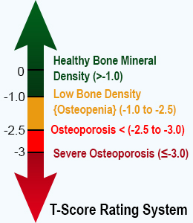
DIAGNOSIS
. A clinical diagnosis of osteoporosis may be made in the presence of a :
●Fragility fracture, particularly at :
the spine, hip, wrist, humerus, rib, and pelvis.
●T-score ≤-2.5 standard deviations (SD)
measurement by;
dual-energy x-ray absorptiometry (DXA).

Slide 48
Fragility fractures are those occurring from a fall from a standing height or less, without major trauma such as a motor vehicle accident. Certain skeletal locations, including the skull, cervical spine, hands, feet, and ankles, are not associated with fragility fractures. Stress fractures are also not considered fragility fractures, as they are due to repetitive injury
In the absence of a fragility fracture, BMD assessment by DXA is the standard test to diagnose osteoporosis, according to the classification of the World Health Organization (WHO)

Slide 49
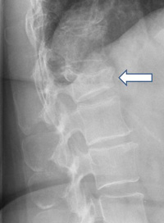
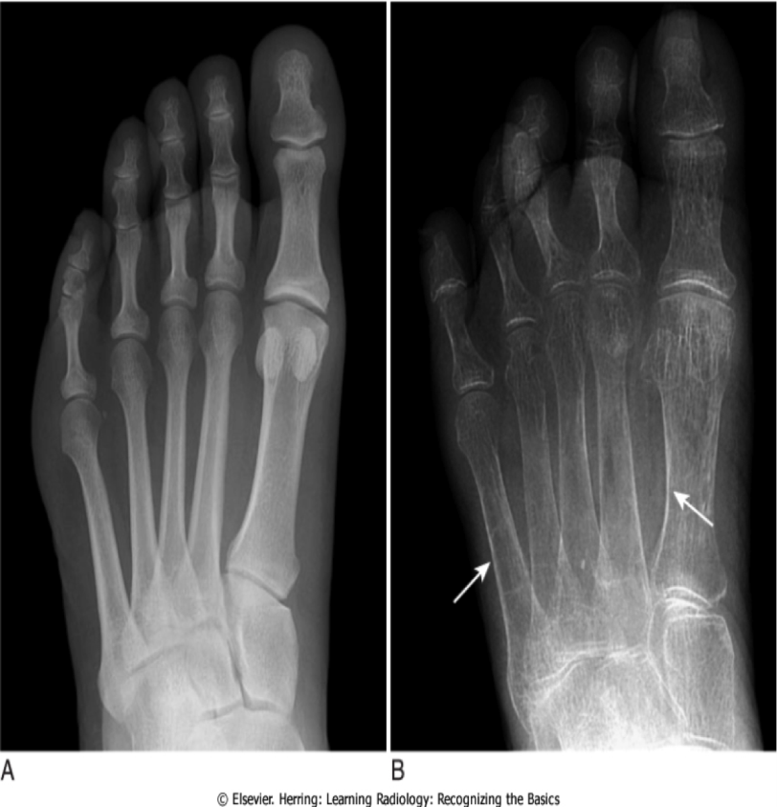
X-ray
Signs of Osteoporosis in an X-ray:
• Cortical thinning
• Increased radiolucency

Slide 50
DEXA
Dual-energy x-ray absorptiometry — DXA is the most widely used method for measuring BMD because it gives very precise measurements at clinically relevant skeletal sites. The major disadvantages of DXA are that the machine is large (not portable) and expensive, and that it uses ionizing radiation.

Slide 51
DEXA
Bone mineral density
T-score : according the SD difference between a patient's BMD and that of a young-adult reference population
●A BMD T-score that is 2.5 SD or more below the young-adult mean BMD is defined as osteoporosis, provided that other causes of low BMD have been ruled out (such as osteomalacia).

Slide 52
●A T-score that is 1 to 2.5 SD below the young-adult mean is termed low bone mass (osteopenia).
●Normal bone density is defined as a value within 1 SD of the mean value in the young-adult reference population.
Z-score — The Z-score is a comparison of the patient's BMD to an age-matched population. A Z-score of -2.0 or lower is considered below the expected range for age [6]. Thus, the presence of Z-score values more than 2 SD below the mean should clarify the presence of coexisting problems (eg, glucocorticoid therapy or alcoholism) that can contribute to osteoporosis.

Slide 53
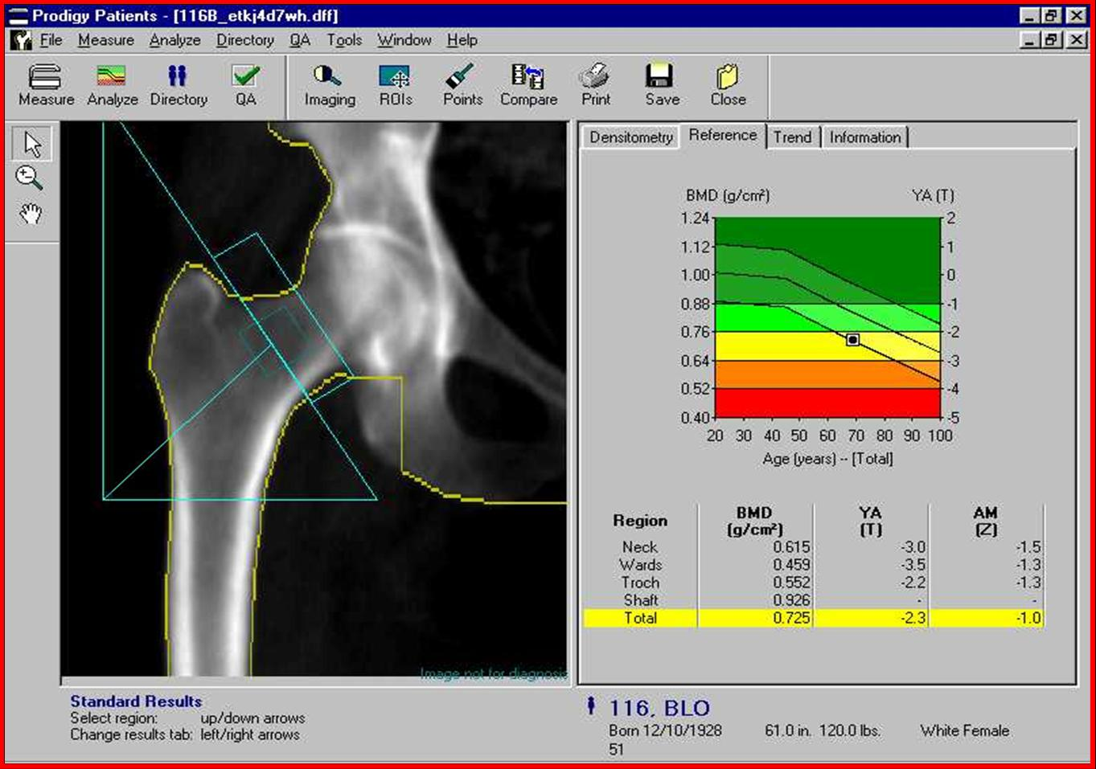
DEXA
http://lexingtondiagnostic.com/dexa/
https://www.cfaortho.com/patient-services/imaging/dexa-scans

Slide 54
labs
●Laboratory evaluation – postmenopausal women with low BMD (T-score below -2.5) and/or fragility fracture have the following basic tests
•Biochemistry profile (especially calcium, phosphorous, albumin, total protein, creatinine, liver enzymes including alkaline phosphatase, electrolytes).
•25-hydroxyvitamin D (25[OH]D).
•Complete blood count (CBC).

Slide 55
Osteoporosis Management

Slide 56
Management Goals
Prevent fractures
Improve Quality of Life
Increase Bone Density and Mineralization
Prevent Further Falls

Slide 57
Nutrition — Good nutrition from infancy through adolescence, with particular attention to adequate daily intake of calcium and vitamin D is a key component in the attainment of maximum peak bone mass.

Slide 58
Physical activity — Observational, retrospective, and prospective randomized trials have demonstrated beneficial effects of exercise on bone accumulation during growth, with particular benefit from high impact exercise
Weight-bearing exercise is associated with small but significant improvement in BMD in premenopausal and postmenopausal women and in men. It may also improve muscle tone and reduce the risk of falls. The Surgeon General recommends a "minimum of 30 minutes of physical activity.

Slide 59
Other lifestyle factors — Cigarette smoking has also been associated with decreased BMD and reduced cortical thickness in young men 18 to 20 years of age

Slide 60
Pharmacological therapy
There is no role for pharmacological therapy as a means to maximize peak bone mass, except in very special circumstances. As an example, pharmacological doses of vitamin D for some children on anticonvulsant therapy or with celiac disease may be necessary to optimize skeletal health

Slide 61
Calcium and vitamin D — 800 international units of vitamin D daily and 1200 mg elemental calcium (ideally from diet, plus supplements if needed) daily for most postmenopausal women .Although the optimal intake (diet plus supplement) has not been clearly established in premenopausal women or in men, 1000 mg of calcium is generally suggested

Slide 62
Candidates for therapy:
— In addition to lifestyle measures, patients at high risk for fracture should receive pharmacologic therapy. Our recommendations for initiation of therapy are largely in agreement with the National Osteoporosis Foundation (NOF) recommendations.
●We recommend pharmacologic therapy for postmenopausal women with a history of fragility fracture or with osteoporosis based upon bone mineral density (BMD) measurement (T-score ≤-2.5).
●We also suggest pharmacologic therapy for the treatment of high-risk postmenopausal women with T-scores between -1.0 and -2.5.

Slide 63
Choice of drug — In the absence of high quality head-to-head drug comparison trials to determine the relative efficacy of the individual drugs, choice of therapy should be based upon efficacy, safety, cost, convenience, and other patient-related factors.
Oral bisphosphonates are the first-line therapy. Oral bisphosphonates is preferred as initial therapy because of their efficacy, favorable cost, and the availability of long-term safety data. We favor alendronate or risedronate over other available bisphosphonates because of clinical trial data .

Slide 64
Pregnancy and Vit D

Slide 65
Low calcium and vitamin D levels have been associated with adverse health outcomes in mother and child, but it is unclear whether low levels are the causal factor or a marker of poor health.
The value of routine vitamin D supplementation in pregnancy is an active and controversial area of investigation, but there is no clear evidence of a reduction in adverse pregnancy outcomes.
In a 2016 Cochrane review including data from seven small trials, pregnant women who received daily vitamin D supplementation had higher 25-hydroxyvitamin D levels than those receiving placebo, but the response was heterogeneous

Slide 67
Osteoporosis is :
A- A disease of children caused by vitamin D deficiency.
B- A condition in which the bones become brittle and fragile from loss of tissue.
C-A condition in which the bones become soft due to decreased in mineralization.
D-All of the above.

Slide 68
prevalence of post-menopausal osteoporosis in Saudi Arabia is:
A- 10% to 20%
B- 20%to30%
C- 30% to 40%
D- 40%to50%

Slide 69
Which of the following are considered signs of Osteoporosis in X- ray:
A- Increased Radiolucency.
B- Cortical Thinning.
C- Cortical thickening.
D- A and B.

Slide 70
To diagnose osteoporosis, bone mineral density must be:
A- 1.5 Standard deviations below the mean.
B- 2.0 Standard deviations below the mean.
C- 2.5 Standard deviations below the mean.
D- 3.0 Standard deviations below the mean.

Slide 71
Take home message
Osteoporosis has a major impact on induvial quality of life .
Physical excersie and movements with appropriate sunlight exposure is an important prevention specially during childhood.
The treatment of osteoporosis consists of lifestyle measures and pharmacologic therapy.

Slide 72
Refrence
https://www.uptodate.com/contents/image?imageKey=ENDO%2F54926&topicKey=ENDO%2F2035&source=outline_link
https://www.uptodate.com/contents/clinical-manifestations-diagnosis-and-evaluation-of-osteoporosis-in-postmenopausal-women?source=related_link#H4
https://www.uptodate.com/contents/causes-of-vitamin-d-deficiency-and-
resistance?source=search_result&search=vitamin%20D%20deficiency&selectedTitle=3~150#H3
Harold N Rosen, MD. (May 27, 2016). Clinical manifestations, diagnosis, and evaluation of osteoporosis in postmenopausal women
Harold N Rosen, MD. (Feb 02, 2016). Calcium and vitamin D supplementation in osteoporosis
Michael Kleerekoper, MD. (Sep 22, 2015). Screening for osteoporosis .
Roger Bouillon, MD, PhD, FRCP. (Mar 09, 2016). Vitamin D and extraskeletal health
Nutr Hosp. 2016 Jul 19;33(4):381. doi: 10.20960/nh.381 Obesity, related diseases and their relationship with vitamin D deﬁciency in adolescents

Slide 73
THANK YOU

