Slide 1
Global Initiative for Asthma (GINA) Teaching slide set 2017 update
© Global Initiative for Asthma

Slide 2
Definition and diagnosis of asthma

Slide 3
What is known about asthma?
Asthma is a common and potentially serious chronic disease that can be controlled but not cured
Asthma causes symptoms such as wheezing, shortness of breath, chest tightness and cough that vary over time in their occurrence, frequency and intensity
Symptoms are associated with variable expiratory airflow, i.e. difficulty breathing air out of the lungs due to
Bronchoconstriction (airway narrowing)
Airway wall thickening
Increased mucus
Symptoms may be triggered or worsened by factors such as viral infections, allergens, tobacco smoke, exercise and stress
GINA 2017

Slide 4
Diagnosis of asthma
The diagnosis of asthma should be based on:
A history of characteristic symptom patterns
Evidence of variable airflow limitation, from bronchodilator reversibility testing or other tests
Document evidence for the diagnosis in the patient’s notes, preferably before starting controller treatment
It is often more difficult to confirm the diagnosis after treatment has been started
GINA 2017

Slide 5
Diagnosis of asthma – symptoms
Increased probability that symptoms are due to asthma if:
More than one type of symptom (wheeze, shortness of breath, cough, chest tightness)
Symptoms often worse at night or in the early morning
Symptoms vary over time and in intensity
Symptoms are triggered by viral infections, exercise, allergen exposure, changes in weather, laughter, irritants such as car exhaust fumes, smoke, or strong smells
Decreased probability that symptoms are due to asthma if:
Isolated cough with no other respiratory symptoms
Chronic production of sputum
Shortness of breath associated with dizziness, light-headedness or peripheral tingling
Chest pain
Exercise-induced dyspnea with noisy inspiration (stridor)
GINA 2017

Slide 6
Diagnosis of asthma – variable airflow limitation
Confirm presence of airflow limitation
Document that FEV₁/FVC is reduced (at least once, when FEV₁ is low)
FEV₁/ FVC ratio is normally >0.75 – 0.80 in healthy adults, and >0.90 in children
Confirm variation in lung function is greater than in healthy individuals
The greater the variation, or the more times variation is seen, the greater probability that the diagnosis is asthma
Excessive bronchodilator reversibility (adults: increase in FEV₁ >12%)
GINA 2017, Box 1-2

Slide 7
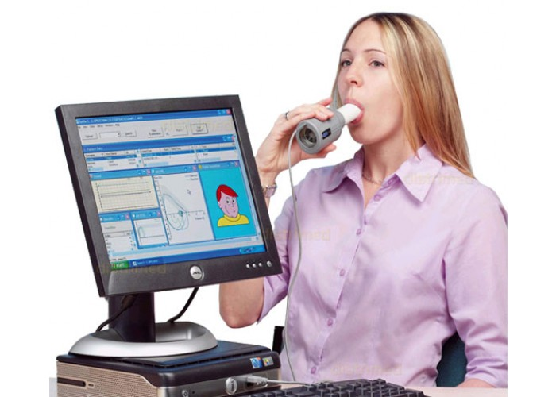

Slide 8
Diagnosis of asthma – physical examination
Physical examination in people with asthma
Often normal
The most frequent finding is wheezing on auscultation, especially on forced expiration
Wheezing is also found in other conditions, for example:
Respiratory infections
COPD
Upper airway dysfunction
Endobronchial obstruction
Inhaled foreign body
Wheezing may be absent during severe asthma exacerbations (‘silent chest’)
GINA 2017

Slide 9
Assessment of asthma

Slide 10
Assessment of asthma
Asthma control - two domains
Assess symptom control over the last 4 weeks
Assess risk factors for poor outcomes, including low lung function
Treatment issues
Check inhaler technique and adherence
Ask about side-effects
Does the patient have a written asthma action plan?
What are the patient’s attitudes and goals for their asthma?
Comorbidities
Think of rhinosinusitis, GERD, obesity, obstructive sleep apnea, depression, anxiety
These may contribute to symptoms and poor quality of life
GINA 2017, Box 2-1

Slide 11
GINA assessment of asthma control
Level of asthma symptom control
A. Symptom control
In the past 4 weeks, has the patient had: | Well-controlled | Partly controlled | Uncontrolled
Daytime asthma symptoms more than twice a week? Yes No | None of these | 1-2 of these | 3-4 of these
Any night waking due to asthma? Yes No
Reliever needed for symptoms* more than twice a week? Yes No
Any activity limitation due to asthma? Yes No
*Excludes reliever taken before exercise, because many people take this routinely
GINA 2017, Box 2-2A

Slide 12
GINA assessment of asthma control
B. Risk factors for poor asthma outcomes
Assess risk factors at diagnosis and periodically Measure FEV₁ at start of treatment, after 3 to 6 months of treatment to record the patient’s personal best, then periodically for ongoing risk assessment ASSESS PATIENT’S RISKS FOR: Exacerbations Fixed airflow limitation Medication side-effects
GINA 2017 Box 2-2B (1/4)

Slide 13
Assessment of risk factors for poor asthma outcomes
Risk factors for exacerbations include:
Ever intubated for asthma Uncontrolled asthma symptoms Having ≥1 exacerbation in last 12 months Low FEV₁ (measure lung function at start of treatment, at 3-6 months to assess personal best, and periodically thereafter) Incorrect inhaler technique and/or poor adherence Smoking Obesity, pregnancy, blood eosinophilia
Independent* risk factors for exacerbations include:
Ever intubated for asthma Uncontrolled asthma symptoms Having ≥1 exacerbation in last 12 months Low FEV₁ (measure lung function at start of treatment, at 3-6 months to assess personal best, and periodically thereafter) Incorrect inhaler technique and/or poor adherence Smoking Elevated FeNO in adults with allergic asthma Obesity, pregnancy, blood eosinophilia
UPDATED 2017
GINA 2017, Box 2-2B (2/4)

Slide 14
Assessment of risk factors for poor asthma outcomes
Risk factors for fixed airflow limitation include:
No ICS treatment, smoking, occupational exposure, mucus hypersecretion, blood eosinophilia
GINA 2017, Box 2-2B (3/4)

Slide 15
Assessment of risk factors for poor asthma outcomes
Risk factors for medication side-effects include:
Frequent oral steroids, high dose/potent ICS, P450 inhibitors
GINA 2017, Box 2-2B (4/4)

Slide 16
Assessing asthma severity
How?
Asthma severity is assessed retrospectively from the level of treatment required to control symptoms and exacerbations
When?
Assess asthma severity after patient has been on controller treatment for several months
Severity is not static – it may change over months or years, or as different treatments become available
Categories of asthma severity
Mild asthma: well-controlled with Steps 1 or 2 (as-needed SABA or low dose ICS)
Moderate asthma: well-controlled with Step 3 (low-dose ICS/LABA)
Severe asthma: requires Step 4/5 (moderate or high dose ICS/LABA ± add-on), or remains uncontrolled despite this treatment
GINA 2017

Slide 17
Treating asthma to control symptoms and minimize risk

Slide 18
Goals of asthma management
The long-term goals of asthma management are
Symptom control: to achieve good control of symptoms and maintain normal activity levels
Risk reduction: to minimize future risk of exacerbations, fixed airflow limitation and medication side-effects
Achieving these goals requires a partnership between patient and their health care providers
Ask the patient about their own goals regarding their asthma
Good communication strategies are essential
Consider the health care system, medication availability, cultural and personal preferences and health literacy
GINA 2017

Slide 19
The control-based asthma management cycle
Diagnosis
Symptom control & risk factors (including lung function)
Inhaler technique & adherence
Patient preference
ASSESS
REVIEW RESPONSE
Symptoms
Exacerbations
Side-effects
Patient satisfaction
Lung function
ADJUST TREATMENT
Asthma medications
Non-pharmacological strategies
Treat modifiable risk factors
GINA 2017, Box 3-2

Slide 20
Initial controller treatment for adults, adolescents and children 6–11 years
Start controller treatment early
For best outcomes, initiate controller treatment as early as possible after making the diagnosis of asthma
Indications for regular low-dose ICS - any of:
Asthma symptoms more than twice a month
Waking due to asthma more than once a month
Any asthma symptoms plus any risk factors for exacerbations
Consider starting at a higher step if:
Troublesome asthma symptoms on most days
Waking from asthma once or more a week, especially if any risk factors for exacerbations
If initial asthma presentation is with an exacerbation:
Give a short course of oral steroids and start regular controller treatment (e.g. high dose ICS or medium dose ICS/LABA, then step down)
GINA 2017, Box 3-4 (1/2)

Slide 21
Initial controller treatment
Before starting initial controller treatment
Record evidence for diagnosis of asthma, if possible
Record symptom control and risk factors, including lung function
Consider factors affecting choice of treatment for this patient
Ensure that the patient can use the inhaler correctly
Schedule an appointment for a follow-up visit
After starting initial controller treatment
Review response after 2-3 months, or according to clinical urgency
Adjust treatment (including non-pharmacological treatments)
Consider stepping down when asthma has been well-controlled for 3 months
GINA 2017, Box 3-4 (2/2)

Slide 22
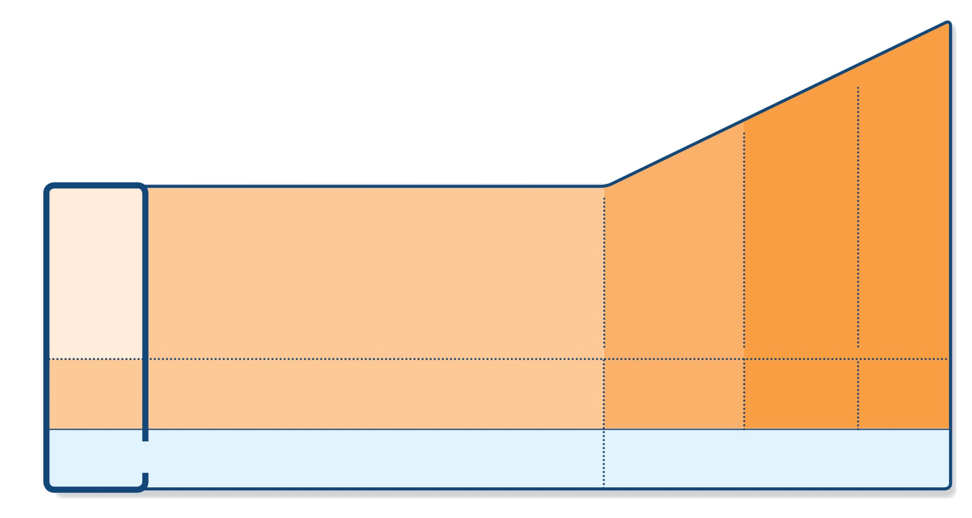
Step 1 – as-needed inhaled short-acting beta₂-agonist (SABA)
STEP 5
STEP 4
PREFERRED CONTROLLER CHOICE
STEP 1
STEP 2
STEP 3
Refer for add-on treatment
e.g.
tiotropium,* anti-IgE, anti-IL5*
Med/high ICS/LABA
Low dose ICS/LABA**
Low dose ICS
Other controller options
Consider low dose ICS
Leukotriene receptor antagonists (LTRA)
Low dose theophylline*
Med/high dose ICS
Low dose ICS+LTRA
(or + theoph*)
Add tiotropium*
High dose ICS + LTRA (or + theoph*)
Add low dose OCS
As-needed short-acting beta₂-agonist (SABA)
As-needed SABA or low dose ICS/formoterol#
RELIEVER
*Not for children <12 years
**For children 6-11 years, the preferred Step 3 treatment is medium dose ICS
#For patients prescribed BDP/formoterol or BUD/ formoterol maintenance and reliever therapy
 Tiotropium by mist inhaler is an add-on treatment for patients ≥12 years with a history of exacerbations
GINA 2017, Box 3-5, Step 1 (4/8)

Slide 23
Step 1 – as-needed reliever inhaler
Preferred option: as-needed inhaled short-acting beta₂-agonist (SABA)
SABAs are highly effective for relief of asthma symptoms
However …. there is insufficient evidence about the safety of treating asthma with SABA alone
This option should be reserved for patients with infrequent symptoms (less than twice a month) of short duration, and with no risk factors for exacerbations
Other options
Consider adding regular low dose inhaled corticosteroid (ICS) for patients at risk of exacerbations
GINA 2017

Slide 24
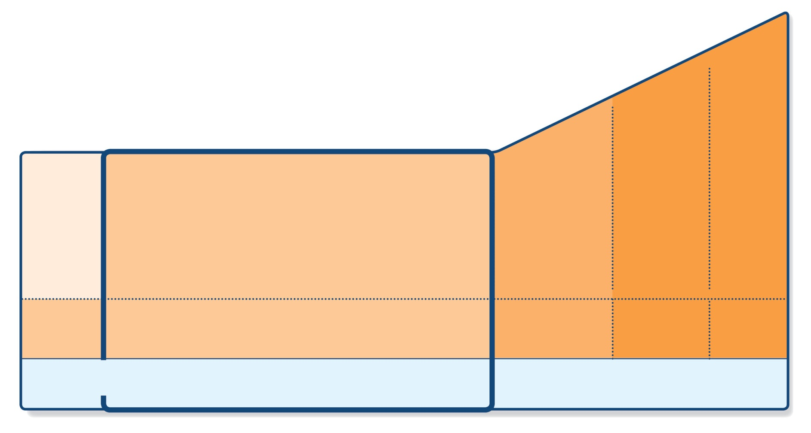
Step 2 – low-dose controller + as-needed inhaled SABA
STEP 5
STEP 4
PREFERRED CONTROLLER CHOICE
STEP 1
STEP 2
STEP 3
Refer for add-on treatment
e.g.
tiotropium,* anti-IgE, anti-IL5*
Med/high ICS/LABA
Low dose ICS/LABA**
Low dose ICS
Other controller options
Consider low dose ICS
Leukotriene receptor antagonists (LTRA)
Low dose theophylline*
Med/high dose ICS
Low dose ICS+LTRA
(or + theoph*)
Add tiotropium*
High dose ICS + LTRA (or + theoph*)
Add low dose OCS
As-needed short-acting beta₂-agonist (SABA)
As-needed SABA or low dose ICS/formoterol#
RELIEVER
*Not for children <12 years
**For children 6-11 years, the preferred Step 3 treatment is medium dose ICS
#For patients prescribed BDP/formoterol or BUD/ formoterol maintenance and reliever therapy
 Tiotropium by mist inhaler is an add-on treatment for patients ≥12 years with a history of exacerbations
GINA 2017, Box 3-5, Step 2 (5/8)

Slide 25
Step 2 – Low dose controller + as-needed SABA
Preferred option: regular low dose ICS with as-needed inhaled SABA
Low dose ICS reduces symptoms and reduces risk of exacerbations and asthma-related hospitalization and death
Other options
Leukotriene receptor antagonists (LTRA) with as-needed SABA
Less effective than low dose ICS
May be used for some patients with both asthma and allergic rhinitis, or if patient will not use ICS
Combination low dose ICS/long-acting beta₂-agonist (LABA) with as-needed SABA
Reduces symptoms and increases lung function compared with ICS
More expensive, and does not further reduce exacerbations
Intermittent ICS with as-needed SABA for purely seasonal allergic asthma with no interval symptoms
Start ICS immediately symptoms commence, and continue for 4 weeks after pollen season ends
GINA 2017

Slide 26
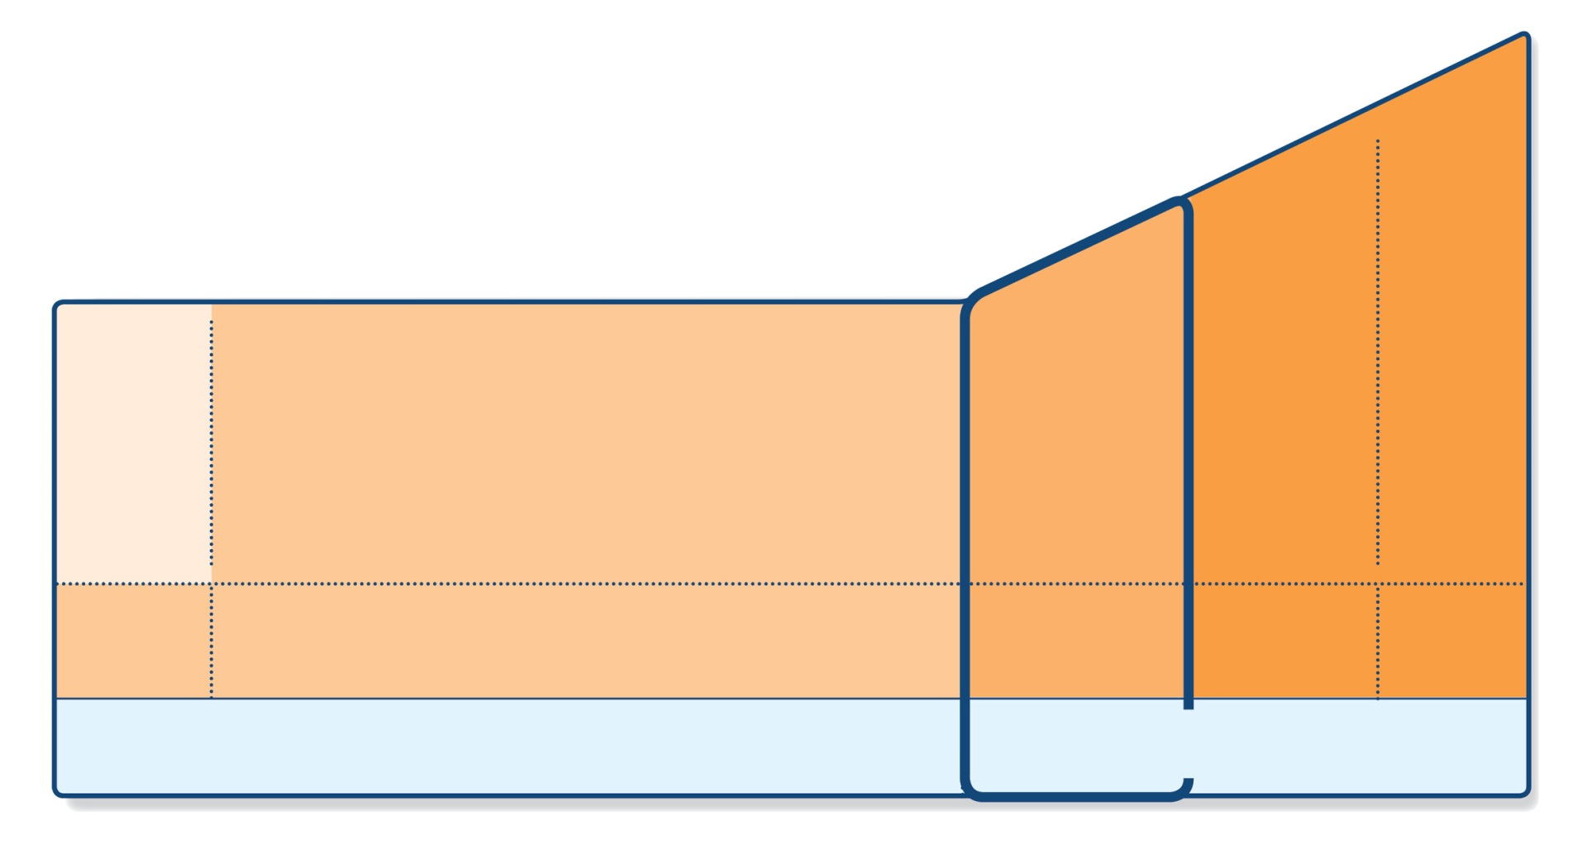
Step 3 – one or two controllers + as-needed inhaled reliever
STEP 5
STEP 4
PREFERRED CONTROLLER CHOICE
STEP 1
STEP 2
STEP 3
Refer for add-on treatment
e.g.
tiotropium,* anti-IgE, anti-IL5*
Med/high ICS/LABA
Low dose ICS/LABA**
Low dose ICS
Other controller options
Consider low dose ICS
Leukotriene receptor antagonists (LTRA)
Low dose theophylline*
Med/high dose ICS
Low dose ICS+LTRA
(or + theoph*)
Add tiotropium*
High dose ICS + LTRA (or + theoph*)
Add low dose OCS
As-needed short-acting beta₂-agonist (SABA)
As-needed SABA or low dose ICS/formoterol#
RELIEVER
*Not for children <12 years
**For children 6-11 years, the preferred Step 3 treatment is medium dose ICS
#For patients prescribed BDP/formoterol or BUD/ formoterol maintenance and reliever therapy
 Tiotropium by mist inhaler is an add-on treatment for patients ≥12 years with a history of exacerbations
GINA 2017, Box 3-5, Step 3 (6/8)
© Global Initiative for Asthma

Slide 27
Step 3 – one or two controllers + as-needed inhaled reliever
Before considering step-up
Check inhaler technique and adherence, confirm diagnosis
Adults/adolescents: preferred options are either combination low dose ICS/LABA maintenance with as-needed SABA, OR combination low dose ICS/formoterol maintenance and reliever regimen*
Adding LABA reduces symptoms and exacerbations and increases FEV₁, while allowing lower dose of ICS
In at-risk patients, maintenance and reliever regimen significantly reduces exacerbations with similar level of symptom control and lower ICS doses compared with other regimens
Children 6-11 years: preferred option is medium dose ICS with as-needed SABA
Other options
Adults/adolescents: Increase ICS dose or add LTRA or theophylline (less effective than ICS/LABA)
Adults: consider adding SLIT (see Non-pharmacological interventions)
Children 6-11 years – add LABA (similar effect as increasing ICS)
UPDATED 2017
*Approved only for low dose beclometasone/formoterol and low dose budesonide/formoterol
GINA 2017

Slide 28
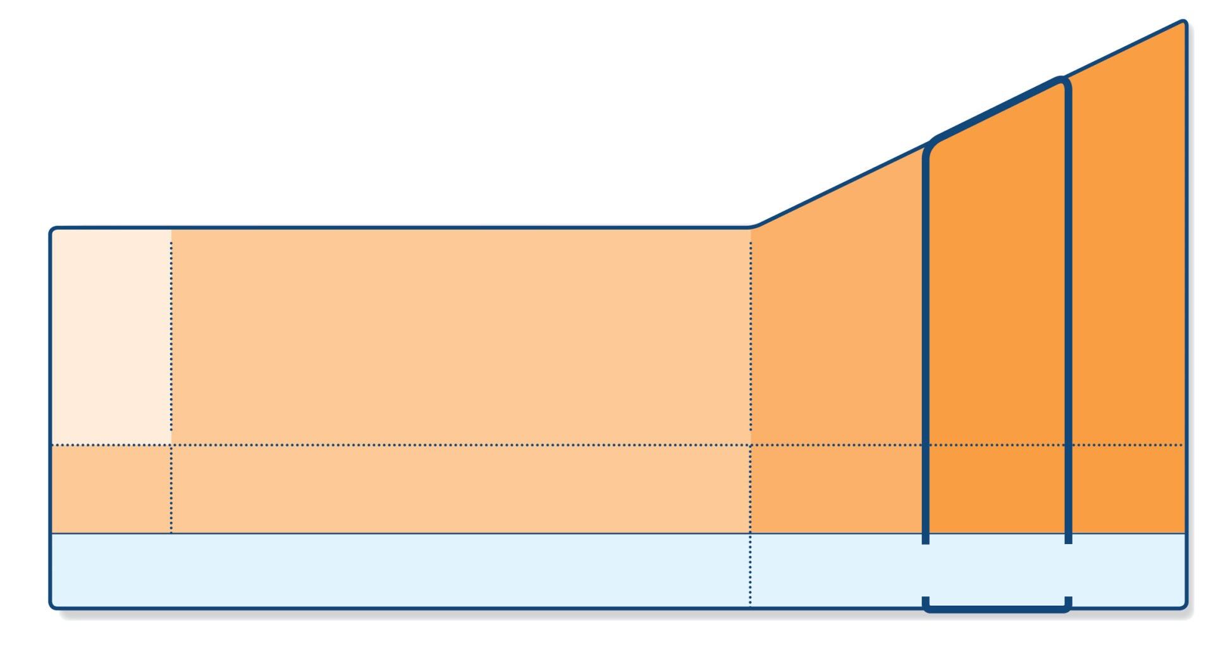
Step 4 – two or more controllers + as-needed inhaled reliever
STEP 5
STEP 4
PREFERRED CONTROLLER CHOICE
STEP 1
STEP 2
STEP 3
Refer for add-on treatment
e.g.
tiotropium,* anti-IgE, anti-IL5*
Med/high ICS/LABA
Low dose ICS/LABA**
Low dose ICS
Other controller options
Consider low dose ICS
Leukotriene receptor antagonists (LTRA)
Low dose theophylline*
Med/high dose ICS
Low dose ICS+LTRA
(or + theoph*)
Add tiotropium*
High dose ICS + LTRA (or + theoph*)
Add low dose OCS
As-needed short-acting beta₂-agonist (SABA)
As-needed SABA or low dose ICS/formoterol#
RELIEVER
*Not for children <12 years
**For children 6-11 years, the preferred Step 3 treatment is medium dose ICS
#For patients prescribed BDP/formoterol or BUD/ formoterol maintenance and reliever therapy
 Tiotropium by mist inhaler is an add-on treatment for patients ≥12 years with a history of exacerbations
GINA 2017, Box 3-5, Step 4 (7/8)
© Global Initiative for Asthma

Slide 29
Step 4 – two or more controllers + as-needed inhaled reliever
Before considering step-up
Check inhaler technique and adherence
Adults or adolescents: preferred option is combination low dose ICS/formoterol as maintenance and reliever regimen*, OR combination medium dose ICS/LABA with as-needed SABA
Children 6–11 years: preferred option is to refer for expert advice
Other options (adults or adolescents)
Tiotropium by mist inhaler may be used as add-on therapy for patients aged ≥12 years with a history of exacerbations
Adults: consider adding SLIT (see Non-pharmacological therapy)
Trial of high dose combination ICS/LABA, but little extra benefit and increased risk of side-effects
Increase dosing frequency (for budesonide-containing inhalers)
Add-on LTRA or low dose theophylline
UPDATED 2017
*Approved only for low dose beclometasone/formoterol and low dose budesonide/formoterol
GINA 2017

Slide 30
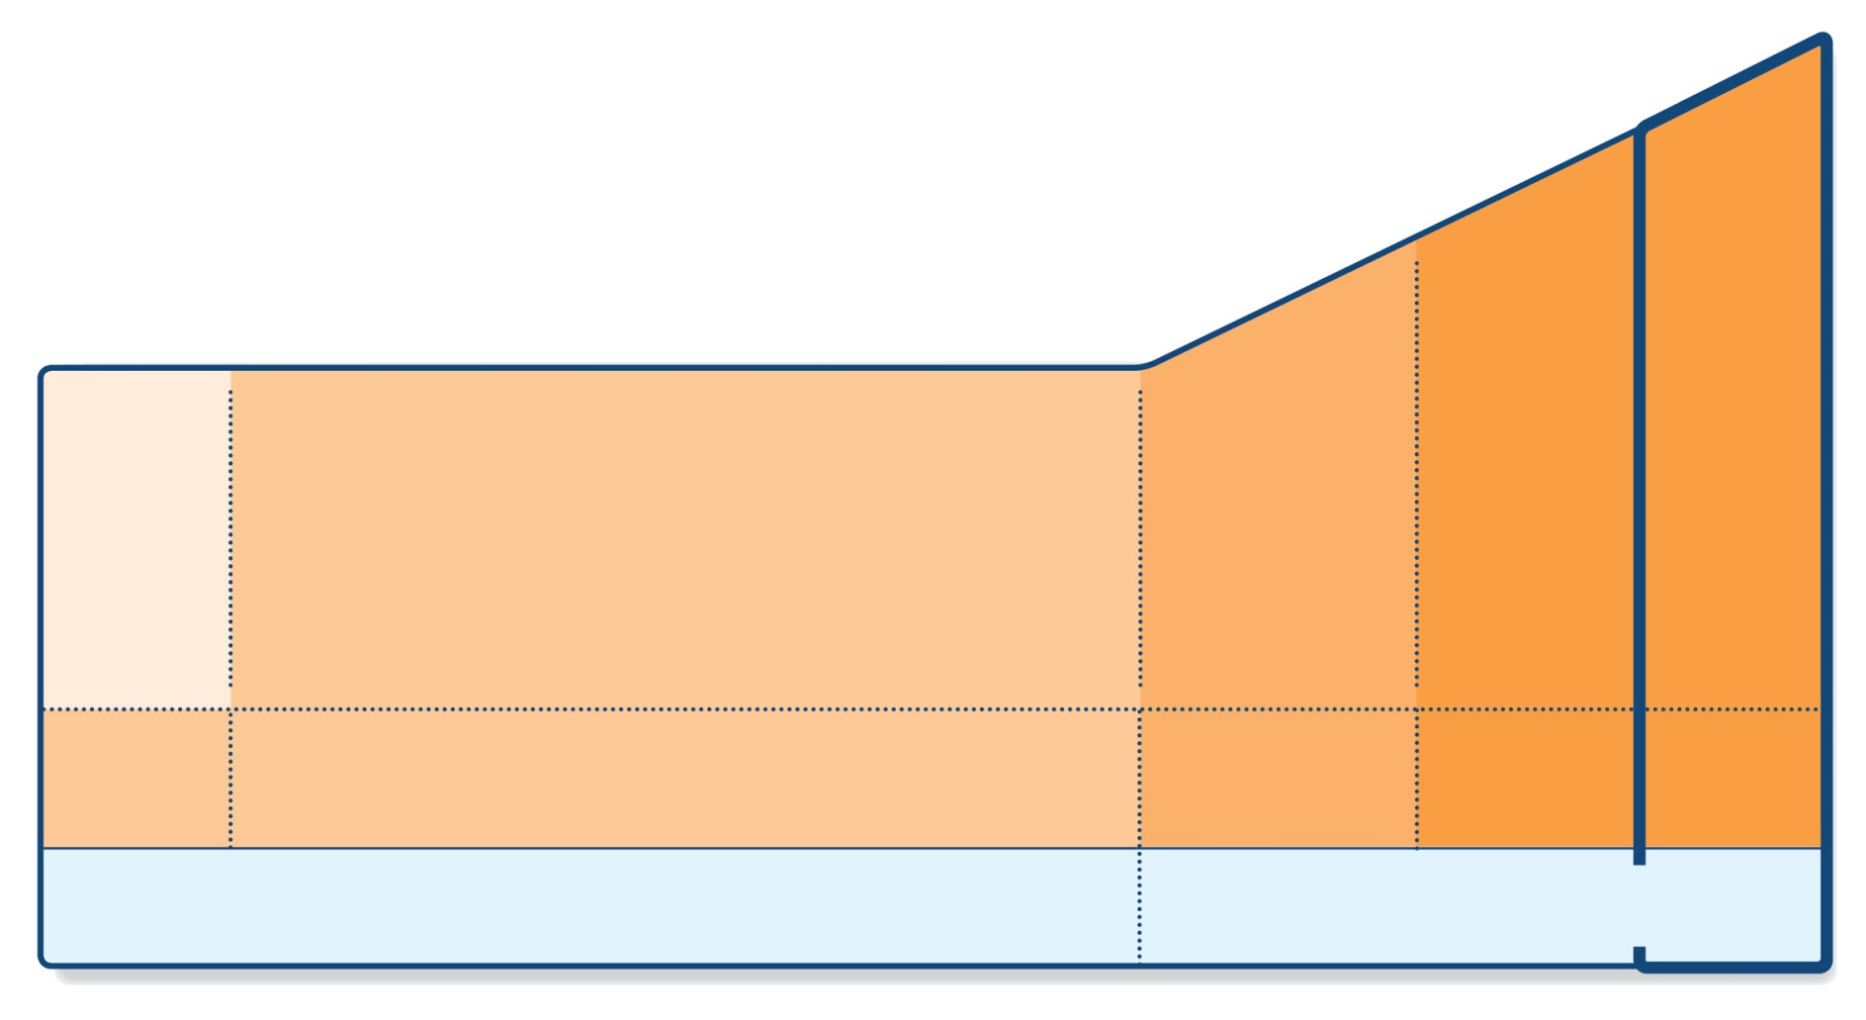
Step 5 – higher level care and/or add-on treatment
UPDATED 2017
STEP 5
STEP 4
PREFERRED CONTROLLER CHOICE
STEP 1
STEP 2
STEP 3
Refer for add-on treatment
e.g.
tiotropium,* anti-IgE, anti-IL5*
Med/high ICS/LABA
Low dose ICS/LABA**
Low dose ICS
Other controller options
Consider low dose ICS
Leukotriene receptor antagonists (LTRA)
Low dose theophylline*
Med/high dose ICS
Low dose ICS+LTRA
(or + theoph*)
Add tiotropium*
High dose ICS + LTRA (or + theoph*)
Add low dose OCS
As-needed short-acting beta₂-agonist (SABA)
As-needed SABA or low dose ICS/formoterol#
RELIEVER
*Not for children <12 years
**For children 6-11 years, the preferred Step 3 treatment is medium dose ICS
#For patients prescribed BDP/formoterol or BUD/ formoterol maintenance and reliever therapy
 Tiotropium by mist inhaler is an add-on treatment for patients ≥12 years with a history of exacerbations
GINA 2017, Box 3-5, Step 5 (8/8)

Slide 31
Step 5 – higher level care and/or add-on treatment
Preferred option is referral for specialist investigation and consideration of add-on treatment
If symptoms uncontrolled or exacerbations persist despite Step 4 treatment, check inhaler technique and adherence before referring
Add-on tiotropium for patients ≥12 years with history of exacerbations
Add-on anti-IgE (omalizumab) for patients with severe allergic asthma
Add-on anti-IL5 (mepolizumab (SC) or reslizumab (IV)) for severe eosinophilic asthma (≥12 yrs)
Other add-on treatment options at Step 5 include:
Sputum-guided treatment: this is available in specialized centers; reduces exacerbations and/or corticosteroid dose
Add-on low dose oral corticosteroids (≤7.5mg/day prednisone equivalent): this may benefit some patients, but has significant systemic side-effects. Assess and monitor for osteoporosis
See ERS/ATS Severe Asthma Guidelines (Chung et al, ERJ 2014) for more detail
UPDATED 2017
GINA 2017

Slide 32
Low, medium and high dose inhaled corticosteroids Adults and adolescents (≥12 years)
Inhaled corticosteroid | Total daily dose (mcg)
 | Low | Medium | High
Beclometasone dipropionate (CFC) | 200–500 | >500–1000 | >1000
Beclometasone dipropionate (HFA) | 100–200 | >200–400 | >400
Budesonide (DPI) | 200–400 | >400–800 | >800
Ciclesonide (HFA) | 80–160 | >160–320 | >320
Fluticasone furoate (DPI) | 100 | n.a. | 200
Fluticasone propionate (DPI or HFA) | 100–250 | >250–500 | >500
Mometasone furoate | 110–220 | >220–440 | >440
Triamcinolone acetonide | 400–1000 | >1000–2000 | >2000
This is not a table of equivalence, but of estimated clinical comparability
Most of the clinical benefit from ICS is seen at low doses
High doses are arbitrary, but for most ICS are those that, with prolonged use, are associated with increased risk of systemic side-effects
GINA 2017, Box 3-6 (1/2)

Slide 33
Low, medium and high dose inhaled corticosteroids Children 6–11 years
Inhaled corticosteroid | Total daily dose (mcg)
 | Low | Medium | High
Beclometasone dipropionate (CFC) | 100–200 | >200–400 | >400
Beclometasone dipropionate (HFA) | 50–100 | >100–200 | >200
Budesonide (DPI) | 100–200 | >200–400 | >400
Budesonide (nebules) | 250–500 | >500–1000 | >1000
Ciclesonide (HFA) | 80 | >80–160 | >160
Fluticasone furoate (DPI) | n.a. | n.a. | n.a.
Fluticasone propionate (DPI) | 100–200 | >200–400 | >400
Fluticasone propionate (HFA) | 100–200 | >200–500 | >500
Mometasone furoate | 110 | ≥220–<440 | ≥440
Triamcinolone acetonide | 400–800 | >800–1200 | >1200
This is not a table of equivalence, but of estimated clinical comparability
Most of the clinical benefit from ICS is seen at low doses
High doses are arbitrary, but for most ICS are those that, with prolonged use, are associated with increased risk of systemic side-effects
GINA 2017, Box 3-6 (2/2)

Slide 34
Reviewing response and adjusting treatment
How often should asthma be reviewed?
1-3 months after treatment started, then every 3-12 months
During pregnancy, every 4-6 weeks
After an exacerbation, within 1 week
Stepping up asthma treatment
Sustained step-up, for at least 2-3 months if asthma poorly controlled
Important: first check for common causes (symptoms not due to asthma, incorrect inhaler technique, poor adherence)
Short-term step-up, for 1-2 weeks, e.g. with viral infection or allergen
May be initiated by patient with written asthma action plan
Day-to-day adjustment
For patients prescribed low-dose ICS/formoterol maintenance and reliever regimen*
Stepping down asthma treatment
Consider step-down after good control maintained for 3 months
Find each patient’s minimum effective dose, that controls both symptoms and exacerbations
ASSESS
REVIEW RESPONSE
ADJUST TREATMENT
*Approved only for low dose beclometasone/formoterol and low dose budesonide/formoterol
GINA 2017

Slide 35
General principles for stepping down controller treatment
Aim
To find the lowest dose that controls symptoms and exacerbations, and minimizes the risk of side-effects
When to consider stepping down
When symptoms have been well controlled and lung function stable for ≥3 months
No respiratory infection, patient not travelling, not pregnant
Prepare for step-down
Record the level of symptom control and consider risk factors
Make sure the patient has a written asthma action plan
Book a follow-up visit in 1-3 months
Step down through available formulations
Stepping down ICS doses by 25–50% at 3 month intervals is feasible and safe for most patients (Hagan et al, Allergy 2014)
See GINA 2017 report Box 3-7 for specific step-down options
Stopping ICS is not recommended in adults with asthma because of risk of exacerbations (Rank et al, JACI 2013)
GINA 2017, Box 3-7

Slide 36
Asthma flare-ups (exacerbations)

Slide 37
Definition and terminology
A flare-up or exacerbation is an acute or sub-acute worsening of symptoms and lung function compared with the patient’s usual status
GINA 2017

Slide 38
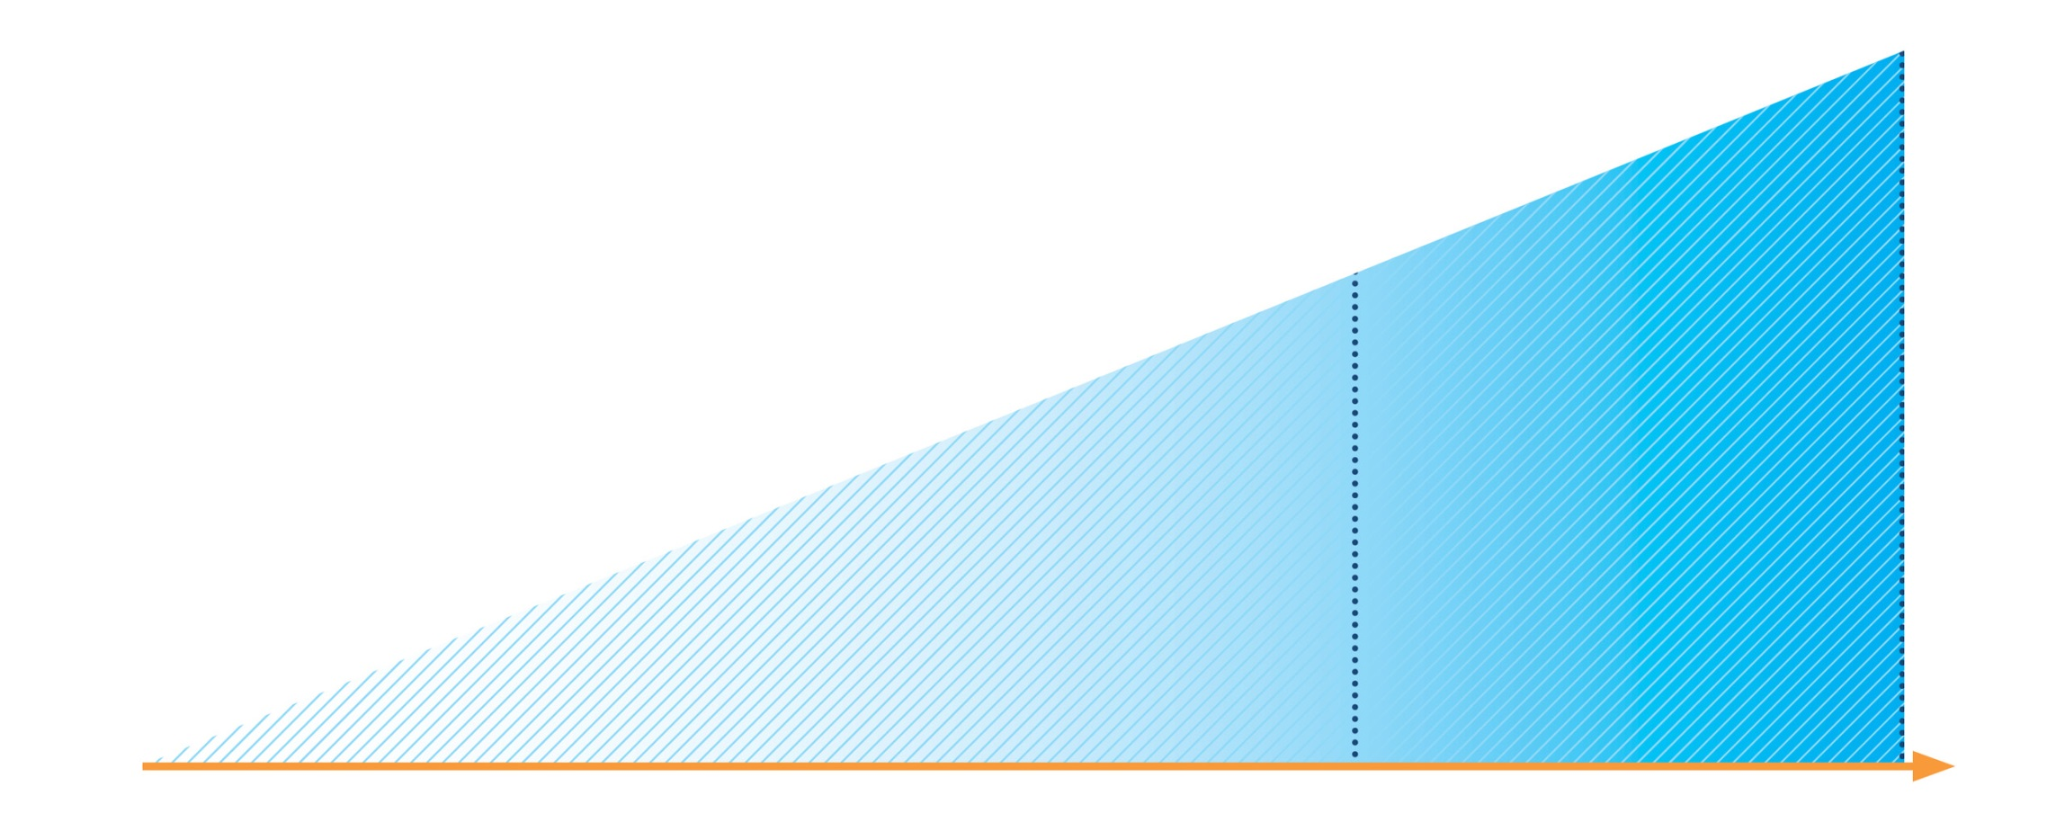
Written asthma action plans
Effective asthma self-management education requires:
• Self-monitoring of symptoms and/or lung function
• Written asthma action plan
• Regular medical review
If PEF or FEV1 <60% best, or not improving after 48 hours
Continue reliever
Continue controller
Add prednisolone 40–50 mg/day
Contact doctor
All patients
Increase reliever
Early increase in controller as below
Review response
EARLY OR MILD
LATE OR SEVERE
GINA 2017, Box 4-2 (1/2)

Slide 39
Written asthma action plans – medication options
Increase inhaled reliever
Increase frequency as needed
Adding spacer for pMDI may be helpful
Early and rapid increase in inhaled controller
Up to maximum ICS of 2000mcg BDP/day or equivalent
Options depend on usual controller medication and type of LABA
Add oral corticosteroids if needed
Adults: prednisolone 1mg/kg/day up to 50mg, usually 5-7 days
Children: 1-2mg/kg/day up to 40mg, usually 3-5 days
Morning dosing preferred to reduce side-effects
Tapering not needed if taken for less than 2 weeks
Remember to advise patients about common side-effects (sleep disturbance, increased appetite, reflux, mood changes)
UPDATED 2017
GINA 2017, Box 4-2 (2/2)

Slide 40
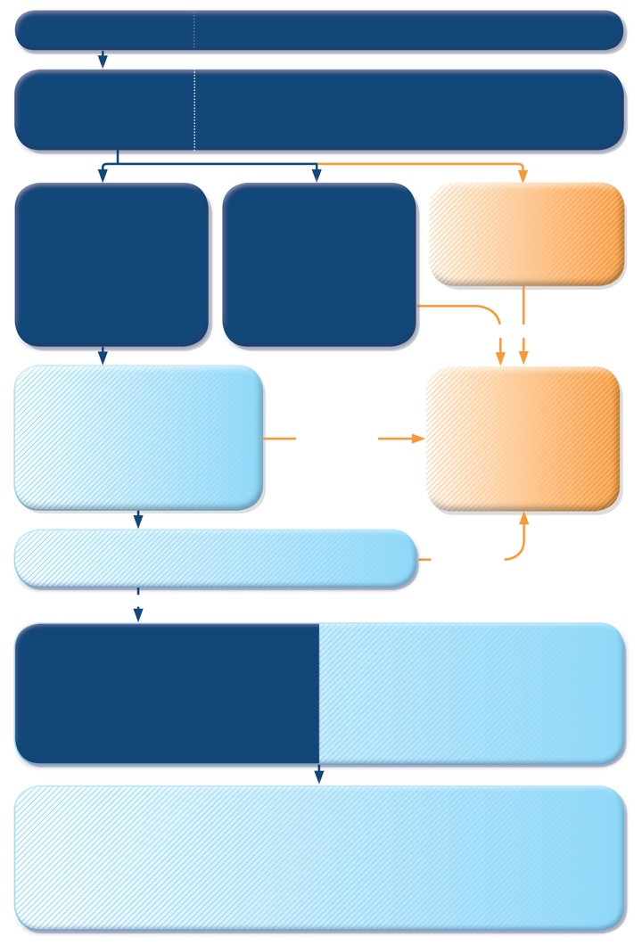
Managing exacerbations in primary care
PRIMARY CARE
Patient presents with acute or sub-acute asthma exacerbation
ASSESS the PATIENT
Is it asthma?
Risk factors for asthma-related death?
Severity of exacerbation?
MILD or MODERATE
Talks in phrases, prefers sitting to lying, not agitated
Respiratory rate increased
Accessory muscles not used
Pulse rate 100–120 bpm
O2 saturation (on air) 90–95%
PEF >50% predicted or best
SEVERE
Talks in words, sits hunched forwards, agitated
Respiratory rate >30/min
Accessory muscles in use
Pulse rate >120 bpm
O2 saturation (on air) <90%
PEF ≤50% predicted or best
LIFE-THREATENING
Drowsy, confused or silent chest
URGENT
START TREATMENT
SABA 4–10 puffs by pMDI + spacer, repeat every 20 minutes for 1 hour
Prednisolone: adults 1 mg/kg, max. 50 mg, children 1–2 mg/kg, max. 40 mg
Controlled oxygen (if available): target saturation 93–95% (children: 94-98%)
TRANSFER TO ACUTE CARE FACILITY
While waiting: give inhaled SABA and ipratropium bromide, O₂, systemic corticosteroid
WORSENING
CONTINUE TREATMENT with SABA as needed
ASSESS RESPONSE AT 1 HOUR (or earlier)
WORSENING
IMPROVING
ASSESS FOR DISCHARGE
Symptoms improved, not needing SABA
PEF improving, and >60-80% of personal best or predicted
Oxygen saturation >94% room air
Resources at home adequate
ARRANGE at DISCHARGE
Reliever: continue as needed
Controller: start, or step up. Check inhaler technique, adherence
Prednisolone: continue, usually for 5–7 days (3-5 days for children)
Follow up: within 2–7 days
FOLLOW UP
Reliever: reduce to as-needed
Controller: continue higher dose for short term (1–2 weeks) or long term (3 months), depending on background to exacerbation
Risk factors: check and correct modifiable risk factors that may have contributed to exacerbation, including inhaler technique and adherence
Action plan: Is it understood? Was it used appropriately? Does it need modification?
GINA 2017, Box 4-3 (1/7)

Slide 41
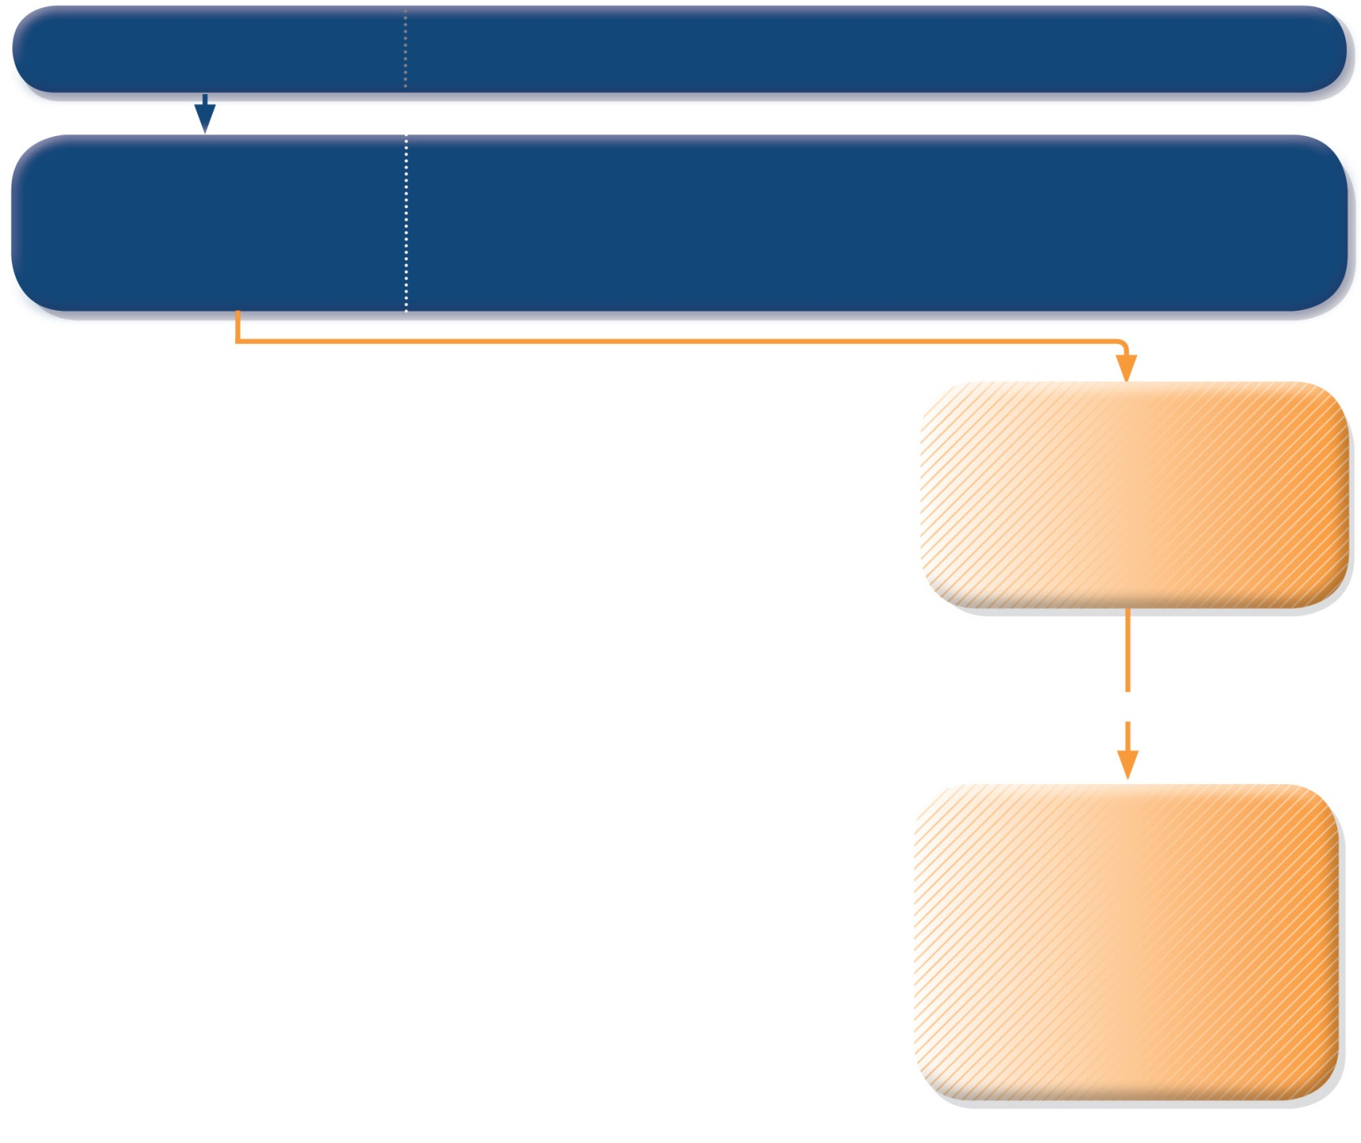
PRIMARY CARE
Patient presents with acute or sub-acute asthma exacerbation
ASSESS the PATIENT
Is it asthma?
Risk factors for asthma-related death?
Severity of exacerbation?
LIFE-THREATENING
Drowsy, confused or silent chest
URGENT
TRANSFER TO ACUTE CARE FACILITY
While waiting: give inhaled SABA and ipratropium bromide, O₂, systemic corticosteroid
GINA 2017, Box 4-3 (2/7)
© Global Initiative for Asthma

Slide 42
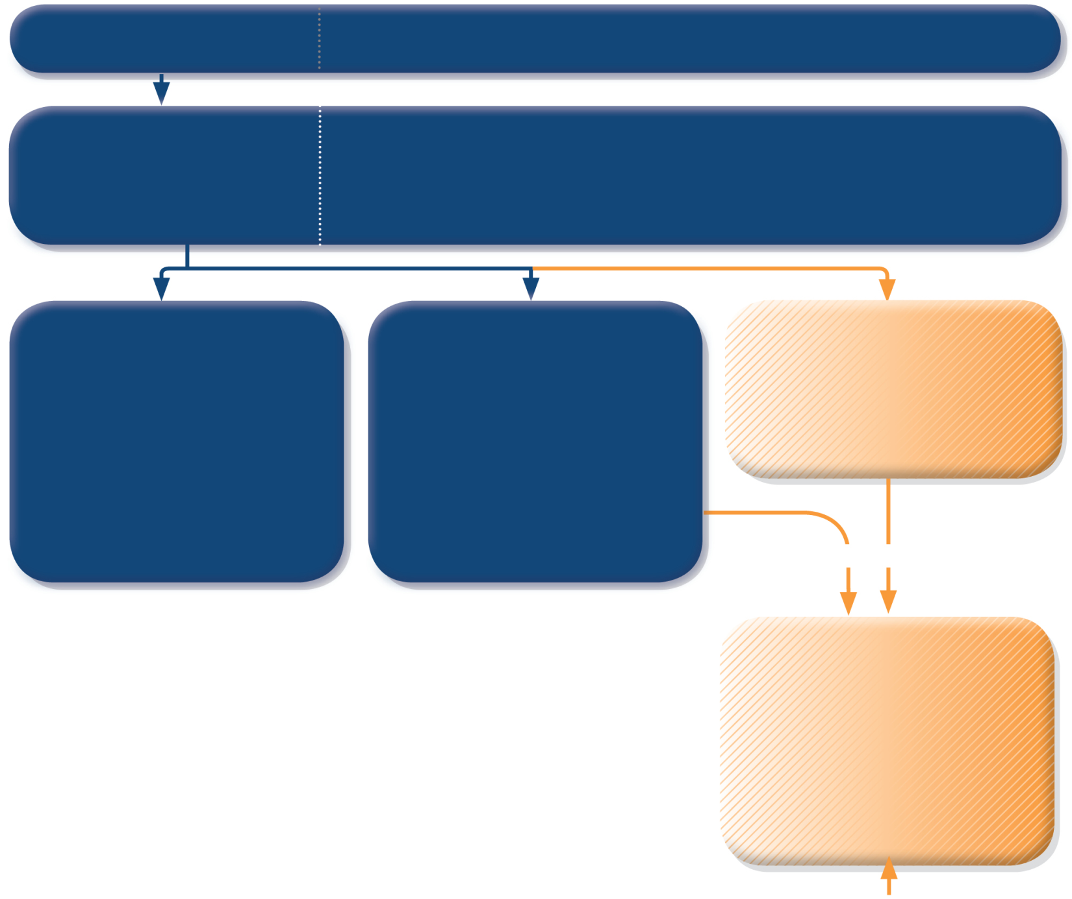
PRIMARY CARE
Patient presents with acute or sub-acute asthma exacerbation
ASSESS the PATIENT
Is it asthma?
Risk factors for asthma-related death?
Severity of exacerbation?
MILD or MODERATE
Talks in phrases, prefers sitting to lying, not agitated
Respiratory rate increased
Accessory muscles not used
Pulse rate 100–120 bpm
O₂ saturation (on air) 90–95%
PEF >50% predicted or best
SEVERE
Talks in words, sits hunched forwards, agitated
Respiratory rate >30/min
Accessory muscles in use
Pulse rate >120 bpm
O₂ saturation (on air) <90%
PEF ≤50% predicted or best
LIFE-THREATENING
Drowsy, confused or silent chest
URGENT
TRANSFER TO ACUTE CARE FACILITY
While waiting: give inhaled SABA and ipratropium bromide, O₂, systemic corticosteroid
GINA 2017, Box 4-3 (3/7)
© Global Initiative for Asthma

Slide 43
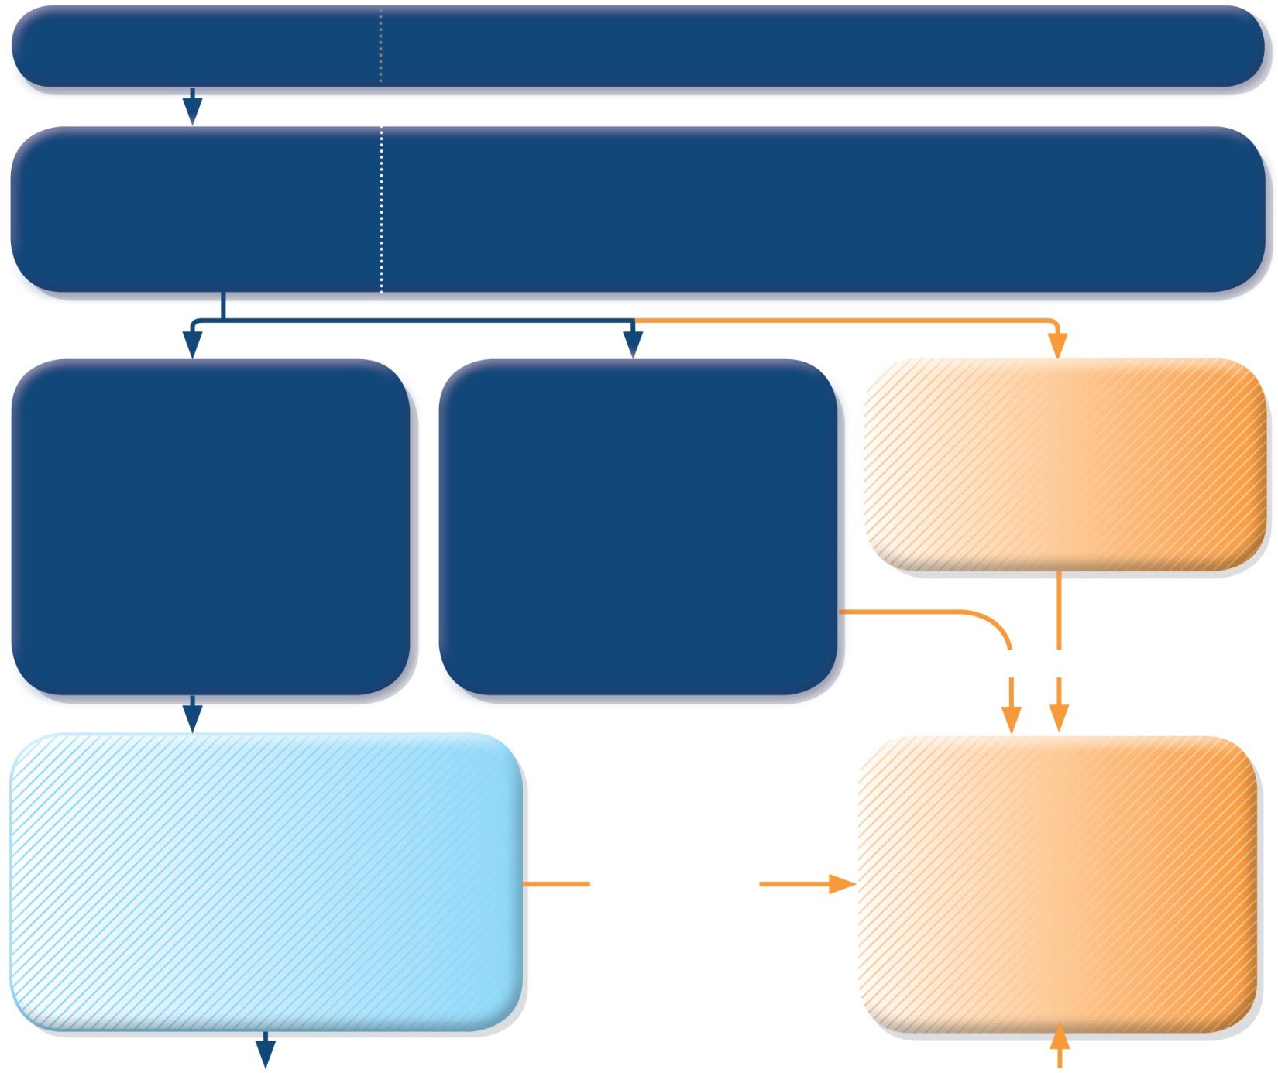
PRIMARY CARE
Patient presents with acute or sub-acute asthma exacerbation
ASSESS the PATIENT
Is it asthma?
Risk factors for asthma-related death?
Severity of exacerbation?
MILD or MODERATE
Talks in phrases, prefers sitting to lying, not agitated
Respiratory rate increased
Accessory muscles not used
Pulse rate 100–120 bpm
O₂ saturation (on air) 90–95%
PEF >50% predicted or best
SEVERE
Talks in words, sits hunched forwards, agitated
Respiratory rate >30/min
Accessory muscles in use
Pulse rate >120 bpm
O₂ saturation (on air) <90%
PEF ≤50% predicted or best
LIFE-THREATENING
Drowsy, confused or silent chest
URGENT
START TREATMENT
SABA 4–10 puffs by pMDI + spacer, repeat every 20 minutes for 1 hour
Prednisolone: adults 1 mg/kg, max. 50 mg, children 1–2 mg/kg, max. 40 mg
Controlled oxygen (if available): target saturation 93–95% (children: 94-98%)
TRANSFER TO ACUTE CARE FACILITY
While waiting: give inhaled SABA and ipratropium bromide, O₂, systemic corticosteroid
WORSENING
GINA 2017, Box 4-3 (4/7)
© Global Initiative for Asthma

Slide 44
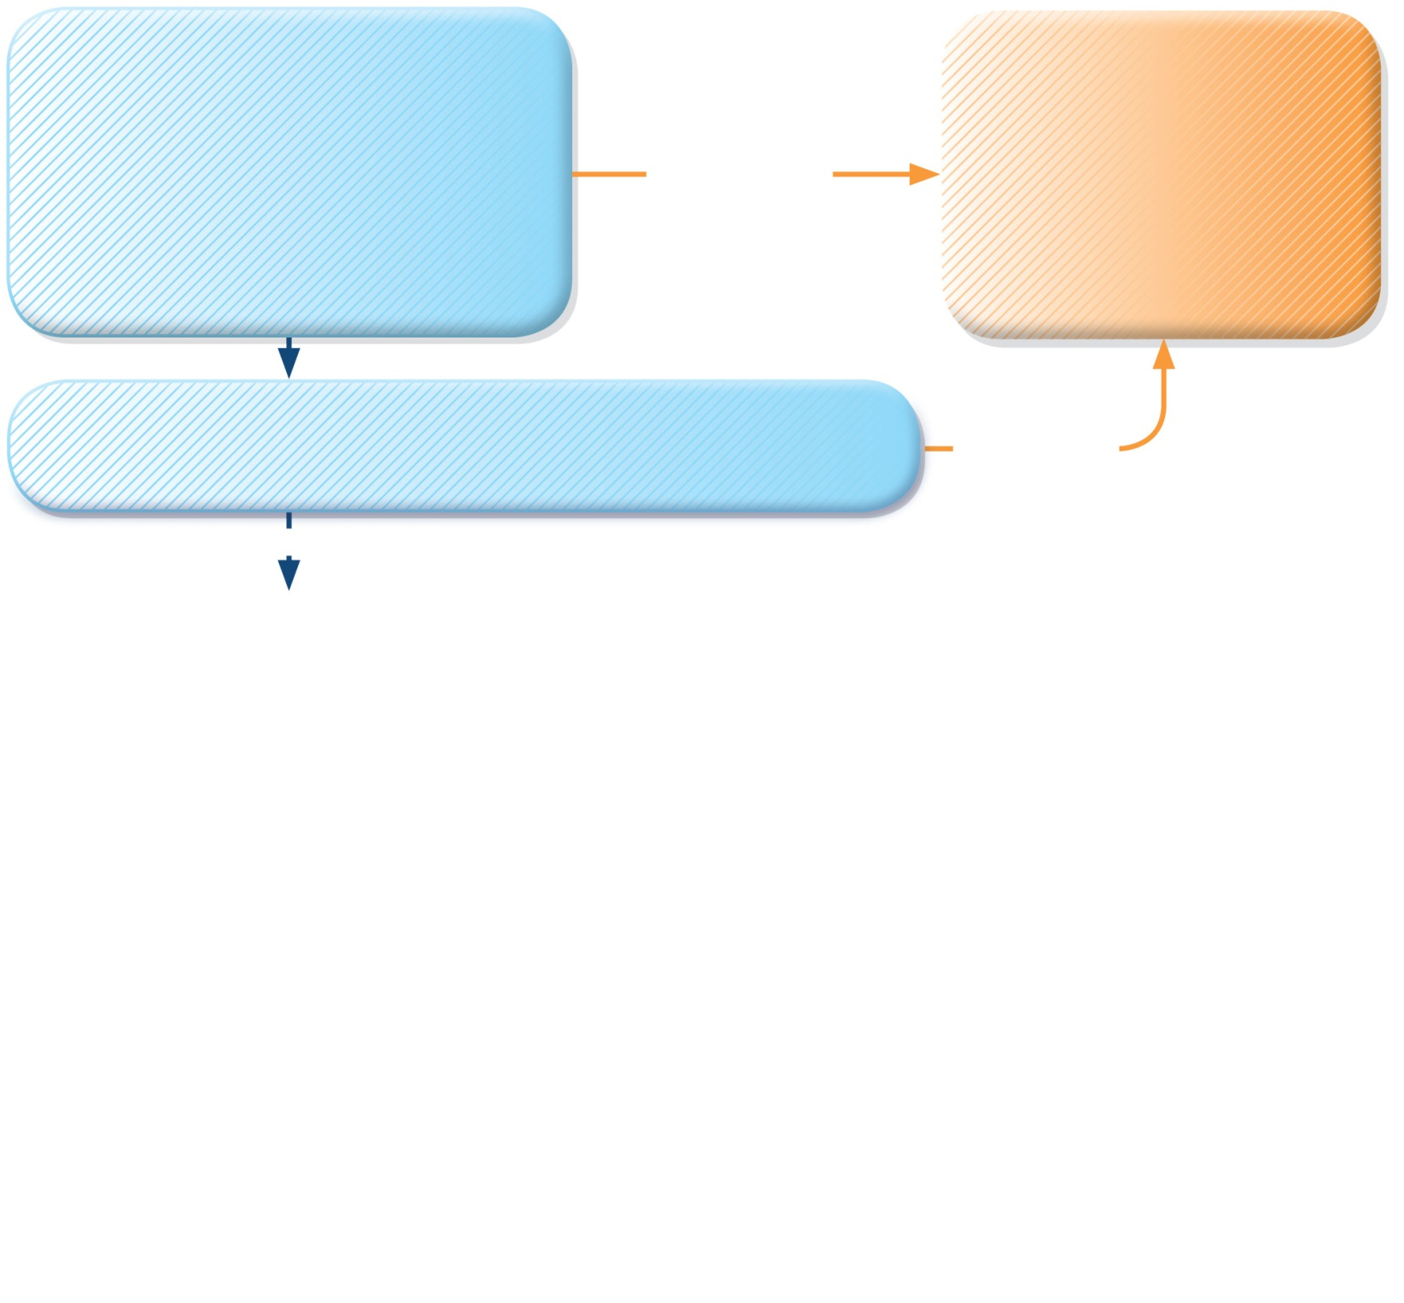
START TREATMENT
SABA 4–10 puffs by pMDI + spacer, repeat every 20 minutes for 1 hour
Prednisolone: adults 1 mg/kg, max. 50 mg, children 1–2 mg/kg, max. 40 mg
Controlled oxygen (if available): target saturation 93–95% (children: 94-98%)
TRANSFER TO ACUTE CARE FACILITY
While waiting: give inhaled SABA and ipratropium bromide, O₂, systemic corticosteroid
WORSENING
CONTINUE TREATMENT with SABA as needed
ASSESS RESPONSE AT 1 HOUR (or earlier)
WORSENING
IMPROVING
ASSESS FOR DISCHARGE
Symptoms improved, not needing SABA
PEF improving, and >60-80% of personal best or predicted
Oxygen saturation >94% room air
Resources at home adequate
GINA 2017, Box 4-3 (5/7)

Slide 45
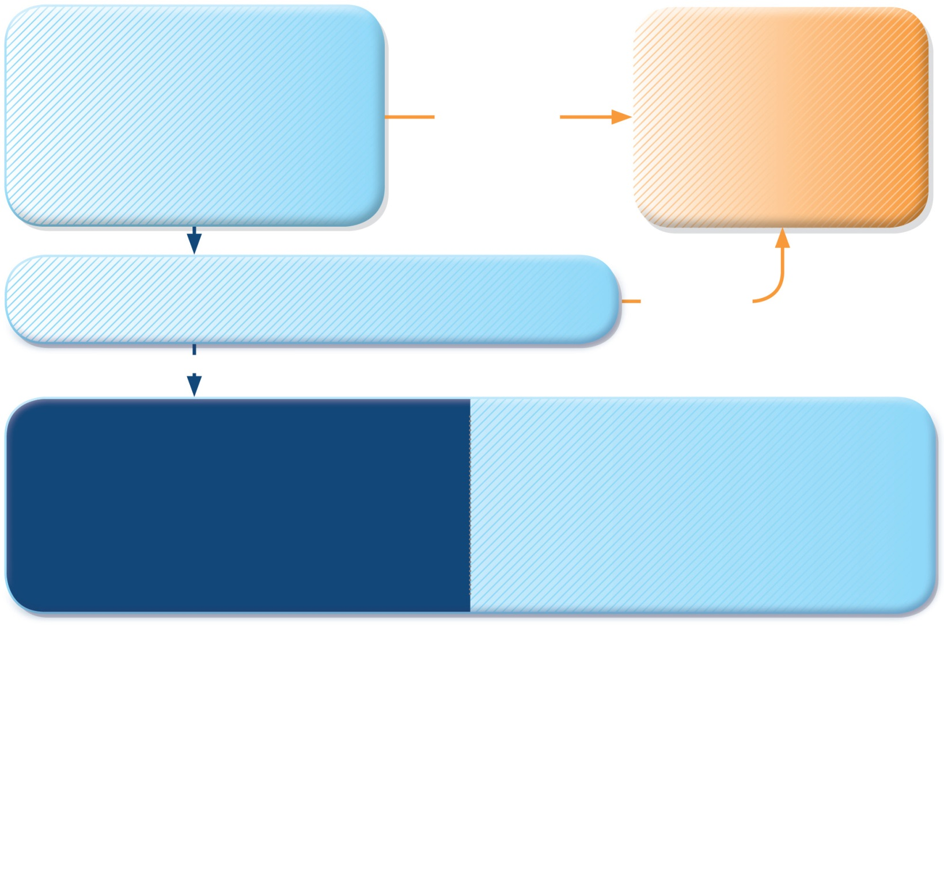
START TREATMENT
SABA 4–10 puffs by pMDI + spacer, repeat every 20 minutes for 1 hour
Prednisolone: adults 1 mg/kg, max. 50 mg, children 1–2 mg/kg, max. 40 mg
Controlled oxygen (if available): target saturation 93–95% (children: 94-98%)
TRANSFER TO ACUTE CARE FACILITY
While waiting: give inhaled SABA and ipratropium bromide, O₂, systemic corticosteroid
WORSENING
CONTINUE TREATMENT with SABA as needed
ASSESS RESPONSE AT 1 HOUR (or earlier)
WORSENING
IMPROVING
ASSESS FOR DISCHARGE
Symptoms improved, not needing SABA
PEF improving, and >60-80% of personal best or predicted
Oxygen saturation >94% room air
Resources at home adequate
ARRANGE at DISCHARGE
Reliever: continue as needed
Controller: start, or step up. Check inhaler technique, adherence
Prednisolone: continue, usually for 5–7 days (3-5 days for children)
Follow up: within 2–7 days
GINA 2017, Box 4-3 (6/7)

Slide 46
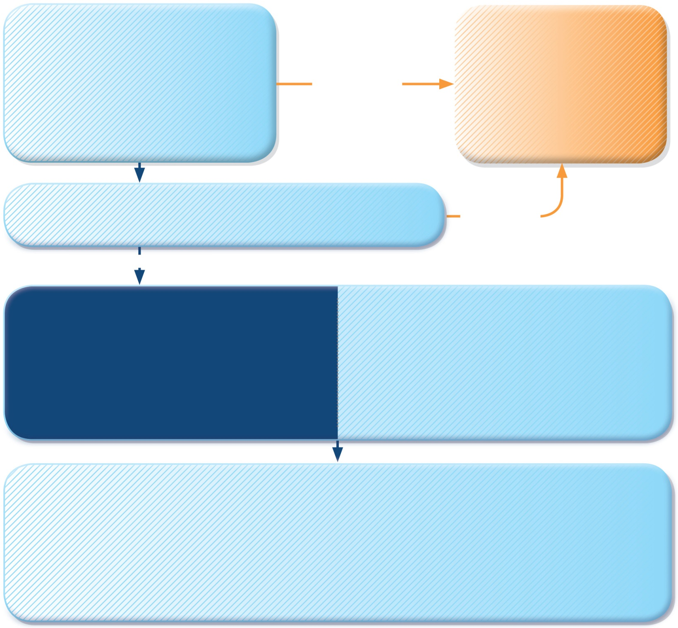
START TREATMENT
SABA 4–10 puffs by pMDI + spacer, repeat every 20 minutes for 1 hour
Prednisolone: adults 1 mg/kg, max. 50 mg, children 1–2 mg/kg, max. 40 mg
Controlled oxygen (if available): target saturation 93–95% (children: 94-98%)
TRANSFER TO ACUTE CARE FACILITY
While waiting: give inhaled SABA and ipratropium bromide, O₂, systemic corticosteroid
WORSENING
CONTINUE TREATMENT with SABA as needed
ASSESS RESPONSE AT 1 HOUR (or earlier)
WORSENING
IMPROVING
ASSESS FOR DISCHARGE
Symptoms improved, not needing SABA
PEF improving, and >60-80% of personal best or predicted
Oxygen saturation >94% room air
Resources at home adequate
ARRANGE at DISCHARGE
Reliever: continue as needed
Controller: start, or step up. Check inhaler technique, adherence
Prednisolone: continue, usually for 5–7 days (3-5 days for children)
Follow up: within 2–7 days
FOLLOW UP
Reliever: reduce to as-needed
Controller: continue higher dose for short term (1–2 weeks) or long term (3 months), depending on background to exacerbation
Risk factors: check and correct modifiable risk factors that may have contributed to exacerbation, including inhaler technique and adherence
Action plan: Is it understood? Was it used appropriately? Does it need modification?
GINA 2017, Box 4-3 (7/7)

