Slide 1

Critical Appraisal of Available Evidence
Dr. Nada A. AlYousefi
Assistant Professor, Postgraduate Trainer and Consultant
Family Medicine Unit
Department of Family and Community Medicine
College of Medicine(KSU)
nalyousefi@ksu.edu.sa
March 2017

Slide 2
Introduction to Critical Appraisal
WHY APPRAISE THE EVIDENCE?
  Where an article is published, or who wrote it should not be an indication of its trustworthiness and relevance. Using critical appraisal skills and tools enables users of research evidence to reach their own judgements.

Slide 3
Introduction to Critical Appraisal
Critical appraisal is the process of carefully and systematically examining research to judge its trustworthiness, and its value and relevance in a particular context.
It is an essential skill for evidence-based practice because it allows public health professionals and clinicians to find and use research evidence reliably and efficiently to inform their decision-making.

Slide 4
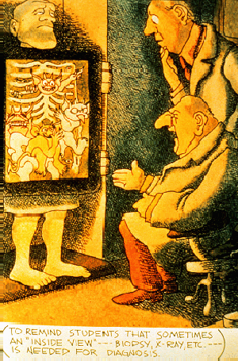

Slide 5

How to read a research article?

Slide 6
Structure of an article
1. Title
2. Abstract
3. Introduction
4. Background / review of literature
5. Methodology
6. Results
7. Discussion

Slide 7
Structure of an article
Title
Not always a good indication of the content of the article
Example: “The Risks of Autonomy: Empirical Evidence for the Necessity of a Balance Management in Promoting Organizational Innovativeness” ??????

Slide 8
Structure of an article
2. Abstract
Sometimes unclear. What should be in it: a summary of the the research question, key methods, results and conclusions of the study

Slide 9
Structure of an article
3. Introduction
Should contain the research question (PICO) or hypotheses tested
4. Background / review of literature
Research questions occur in the context of an already-formed body of knowledge. The background should address this context, help set the rationale for the study, and explain why the questions being asked are relevant.

Slide 10
Structure of an article
5. Methodology
Should describe exactly how the research was carried out:
- Sample: characteristics, selection, number, non-response
- Measures: description of tests / questionnaires (validated?), data, outcome measures
- Procedure: study design (qualitative, quantitative, controlled?)

Slide 11
Structure of an article
6. Results
Should tell the reader what the findings were. All outcome measures must be reported and confidence intervals for effect sizes should be presented.
7. Discussion
Interpretation of the results / relation to theory
Comparison with the results of other studies
Weaknesses / limitations of the study
Implications
Recommendations

Slide 12
In general
Don’t let yourself be taken in by scientific jargon and complex use of language. Good articles are written in plain English!
Even authorative journals with a high impact factor contain bad articles and vice versa.
Focus on research question, study design and outcome.
Be critical!! Always ask yourself: does this make sense?

Slide 14
5-step approach
EBM is a 5-step approach
Formulate an answerable question (PICOC)
Search for the best available evidence
Critically appraise the quality of the found evidence
Integrate the evidence with managerial expertise and organizational concerns and apply
Monitor and evaluate the results

Slide 15
APPRAISING THE EVIDENCE
1. Is the study valid?
  Decide whether studies have been undertaken in a way that makes their findings reliable.
2. What are the results?
  Make sense of the results.
3. Are the results useful?
  Know what these results mean in the context of the decision that needs to be made.
Notes:
1. Is the study valid?
The first step is to decide whether the study was unbiased by evaluating its methodological quality. Different criteria for validity of articles are used for different types of questions on: treatment, diagnosis, prognosis and economic evaluation. Depending on the validity of an article we can classify it within a scale of levels of evidence and degrees of recommendation.
2. What are the results?
If we decide that the study is valid, we can go on to look at the results. At this step we consider whether the study’s results are clinically important. For example, did the experimental group show a significantly better outcome compared with the control group? We also consider how much uncertainty there is about the results, as expressed in the form of p values, confidence intervals and sensitivity analysis.
3. Are the results useful?
Once you have decided that your evidence is valid and important, you need to think about how it applies to your question. It is likely, for example, that your patient or population may have different characteristics to those in the study. Critical appraisal skills provides a framework within which to consider these issues in an explicit, transparent way.

Slide 16

Notes:
This is an ad from Readers Digest. Many other magazines, Sunday newspaper sections, and medical journals carried full page ads. This is certainly where patients heard about it and began to ask for it. For many clinicians, this was also their first exposure, if not from their local neurologist who may even have been a paid speaker to enlighten the locals about the new effective drug.

Slide 17
Clarification
Now let’s say that the same patient has heard from a friend that there is a vitamin that will help prevent migraines. What study design could answer the question of whether there is a vitamin that is useful in preventing migraine headaches in this patient?

Slide 18
Study Methods to Answer This Question
Epidemiology: Patients taking a vitamin are less likely to have migraines
Pharmacology: Drug x affects cerebral vasculature in rat brain isolates
Case report: “It worked on one patient”
Case-series: “It worked on a bunch of patients”
Randomized controlled trial: 1/2 get drug, 1/2 placebo. No one knows who ‘til the end who took what
Notes:
There are various ways that a study could be designed to answer this question. One study might be that a bunch of patients that take vitamins regularly are less likely to report migraine headaches (an epidemiologic approach). Another study might be that a certain drug or a vitamin had an effect on the cerebral vasculature in rat brain isolates (a pharmacologic approach). Another study might be a case report where someone gave a particular vitamin to a patient with migraines and the migraines stopped. Perhaps someone gave a vitamin to a whole bunch of patients with migraine headaches and all of them reported that their headaches improved (Case series). The last approach would be a randomized control trial where half of the patients were given a particular drug and half of them get placebo and no one knows who got what until the end of the study and the outcomes were evaluated.

Slide 19
What’s A Paper on Therapy?
Randomised Control Trials
Objectives
  Understand why randomised controlled trials produce the most reliable evidence for questions about effectiveness
  Understand the important elements of trial design to minimise bias
  Have critically appraised a randomised controlled trial

Slide 20
What’s A Paper on Therapy?
Clinical Trial (Controlled) Compares
INTERVENTION
with
CONTROL

Slide 21
Clinical Trial Compares
  INTERVENTION
    Drug (New)
    Structured exercise program (e.g. osteoporosis)
    Surgical procedure
  CONTROL
    Placebo, old drug or old intervention
    Usual regular advise given (osteoporosis)
    Another surgical procedure / No surgery

Slide 22
Process of RCTs
Preparation: Randomization, Computer generated list
Eligibility assessment (Inclusion/exclusion)
Consent
Allocation to study arms (Concealment)
Baseline assessment
Initiation of intervention (Blind)
Follow-up
Outcome assessment
Data analysis

Slide 23
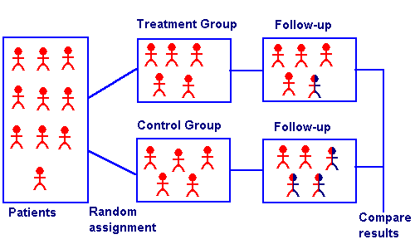

Slide 24
Appraise the Evidence
Assess validity? Correctness (likely to be true)
What are the results? Clinically important
Can we apply the results to our patient? Applicable in and useful for my patients

Slide 25
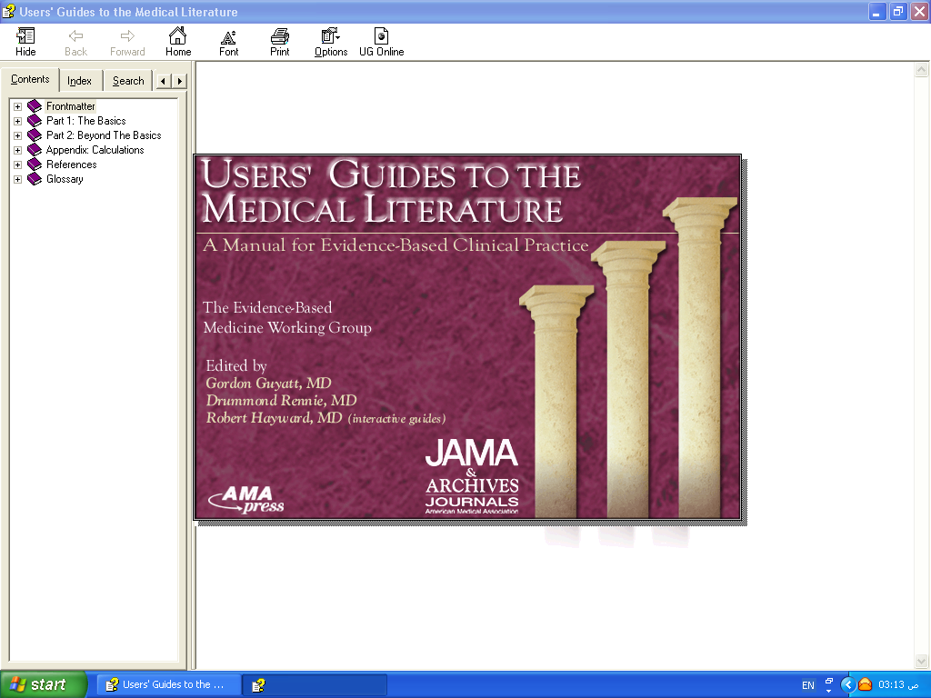
APPLICABILITY
VALIDITY
RESULTS

Slide 26
Validity
Internal validity: How well was the study done? Do the results reflect the truth?
External validity: can I apply these results to MY patients?
Notes:
4
When we consider validity, we really need to look at two types of validity. Internal validity is, basically, how well methodologically was the study performed. In other words, was the study design rigorous enough so that we can be confident that the researchers found what they think they found? We’re asking how well do the results reflect the truth of what actually happens in the world.
External validity asks the results found in the study apply to people not included in the study. In other words, can I apply these results to my patients? We need to determine the generalizability of the study to the population of patients we see. Rarely do we have a study that includes all types of patients and there are usually many types of exclusion and inclusion criteria that frequently do not apply to our patients. It’s important for us to determine whether or not these results really have a probability of similarly affecting our particular patients.
For more on generalizability, see: Altman DG, Bland JM. Generalisation and extrapolation. BMJ 1998;317:409-10.

Slide 27
VALIDITY
Randomization.
Concealment.
Blindness.
Follow up complete.
Intention to treat.
Similar groups at start.
Both groups treated equally.

Slide 28
Are the results of this single preventive or therapeutic trial valid?
 | Was the assignment of patients to treatments randomised? Was the randomisation list concealed?
 | Was follow-up of patients sufficiently long and complete?
 | Were all patients analysed in the groups to which they were randomised?
 | Were patients and clinicians kept "blind" to treatment?
 | Were the groups treated equally, apart from the experimental treatment?
 | Were the groups similar at the start of the trial?

Slide 29
Randomization
Randomisation = similar groups at baseline
Equal (50%) chance to be in either group
How was it randomized?
Was randomization concealed?
- selection
- allocation

Slide 30

Was allocation assignment “concealed”?
Did investigators know to which group the potential subject would be assigned before enrolling them?
Notes:
The gold standard for a therapeutic trial is no longer simply just the concept of randomization, but is also whether or not allocation assignment was concealed from the enrolling investigator (“concealed allocation). It has only been in the last 5 to 8 years that allocation concealment has been discussed or even mentioned in the medical literature. This is a very difficult concept for many and our goal in discussing it now is not for participants to fully understand it, but to grasp its importance. The definition of concealed allocation: Did the investigators know to which group a potential subject would be assigned before they were actually enrolled in this study?

Slide 31
Importance of concealed allocation
Trials with unconcealed allocation consistently overestimate benefit by ~40%
Schulz KF, Chalmers I, Hayes RJ, et al. JAMA 1995;273:408-12
Schulz KF, Grimes DA. Lancet 2002;359:614-18.
Pildal J, et al. Int J Epidemiol 2007;36:847-857
Moher D, et al. Lancet 1998;352:609-13.
Notes:
Dr. Schultz and his colleagues first identified the importance of concealing allocation assignment in 1995. Trials of certain interventions that did not use conceal allocation compared with similar trials that concealed allocation consistently overestimate the benefit of the treatment by 40%. Few clinicians and few studies knew about the importance of allocation concealment before 1995. What we think we know that was published before 1995 may be biased by the lack of allocation concealment.
See: Schulz KF, Chalmers I, Hayes RJ, et al. Subverting randomization in controlled trials. JAMA 1995;273:408-12. Schulz KF, Grimes DA. Allocation concealment in randomised trials: defending against deciphering. Lancet 2002;359:614-18.
Also: Altman DG, Schulz KF. Concealing treatment allocation in randomised trials. BMJ 2001;323:446-7. Schulz KF, Grimes DA. Generation of allocation sequences in randomised trials: change, not choice. Lancet 2002;359:515-9. Torgerson DJ, Roberts C. Randomisation methods: concealment. BMJ 1999;319:375-6.

Slide 32
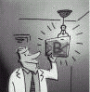
Ensuring Allocation Concealment
BEST – most valid technique
Central computer randomization
DOUBTFUL
Envelopes, etc
NOT RANDOMIZED
Date of birth, alternate days, etc

Slide 33
Conducting a Study
Potential Subjects
Concealed
Allocation
Trial starts
Actual
Subjects
A
Randomization
Blinding, etc
B
Notes:
This is a schematic of the difference between randomization and blindness and concealed allocation. Concealed allocation occurs before the trial even starts. Randomization and blinding occur after the study subjects are enrolled.

Slide 34
Selection bias
Reduced by:
centralised randomisation
on-site computer system with group assignments in a locked file
sequentially numbered, sealed, opaque envelopes
Not: alternation, dates of birth, day of week.

Slide 35
Blindness
Was study “double-blinded”?
Did the patients know to which group they were assigned?
Did the treating physician know?
Did investigators assessing outcomes know (“triple-blinding” – up to 7 levels!)?
  Judicial assessor blind + allocation concealment = surgery RCTs
Schulz KF. Ann Int Med 2002;136:254-9.
Notes:
Do the patients know to which group they were actually assigned? Did they know what treatment they received? Did the physician who gave the treatment know what treatment the patient received? Did the individual assessing the outcome know what treatment the patient received? This is called “triple blinding” when all three don’t know the group assignment. There are actually seven levels of blinding, but the most important are these three.

Slide 36
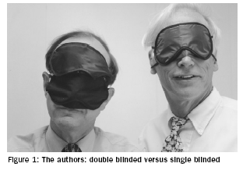
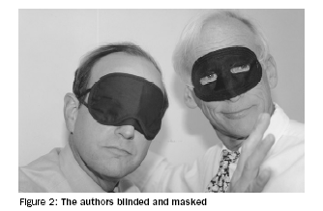
Measurement Bias - minimizing differential error
Blinding – Who?
  Participants?
  Investigators?
  Outcome assessors?
  Analysts?
Most important to use "blinded" outcome assessors when outcome is not objective!
Papers should report WHO was blinded and HOW it was done
Schulz and Grimes. Lancet, 2002

Slide 37
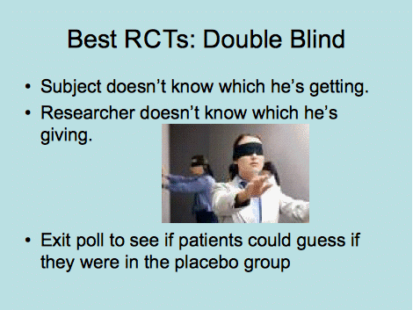

Slide 38
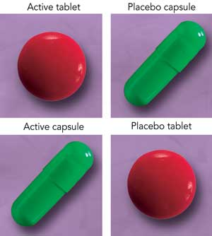
Notes:
38

Slide 39
Blindness
If patient knows: Placebo effect Those who are on effective treatment perform better than those who receive Placebo
If Physician knows: Overestimate Treatment effect (More care, Co-intervention)

Slide 40
Selection bias
Performance bias
Rx
Follow-up
Potential
Subjects
Outcome
Concealed
Allocation
Blindness
C
Intervention starts

Slide 41

Two balanced groups:
Start Balanced: All prognostic factors are equally distributed at the start (Concealed Randomization)
Run Balanced: All prognostic factors are maintained balanced throughout the study (Blindness and the 3C)
End Balanced: All prognostic factors are maintained balanced at the end of the study (ITT)
Intervention

Slide 42
INTENTION TO TREAT
All patients analyzed in the groups
to which they were allocated

Slide 43
INTENTION TO TREAT (ITT)
200
intervention
control
100
100
50
30
Drop out
Drop out
50
70
40
IMPROVED
40
80%
OR
40%
57%
OR
40%

Slide 44
Were all patients analysed in the groups to which they were randomised?

Slide 45
2000 RANDOMIZED
A
1000
B
1000
200
100
800
270=IMPROVED
900
IMPROVED= 130
EER= 270/?
CER=130/?

Slide 46
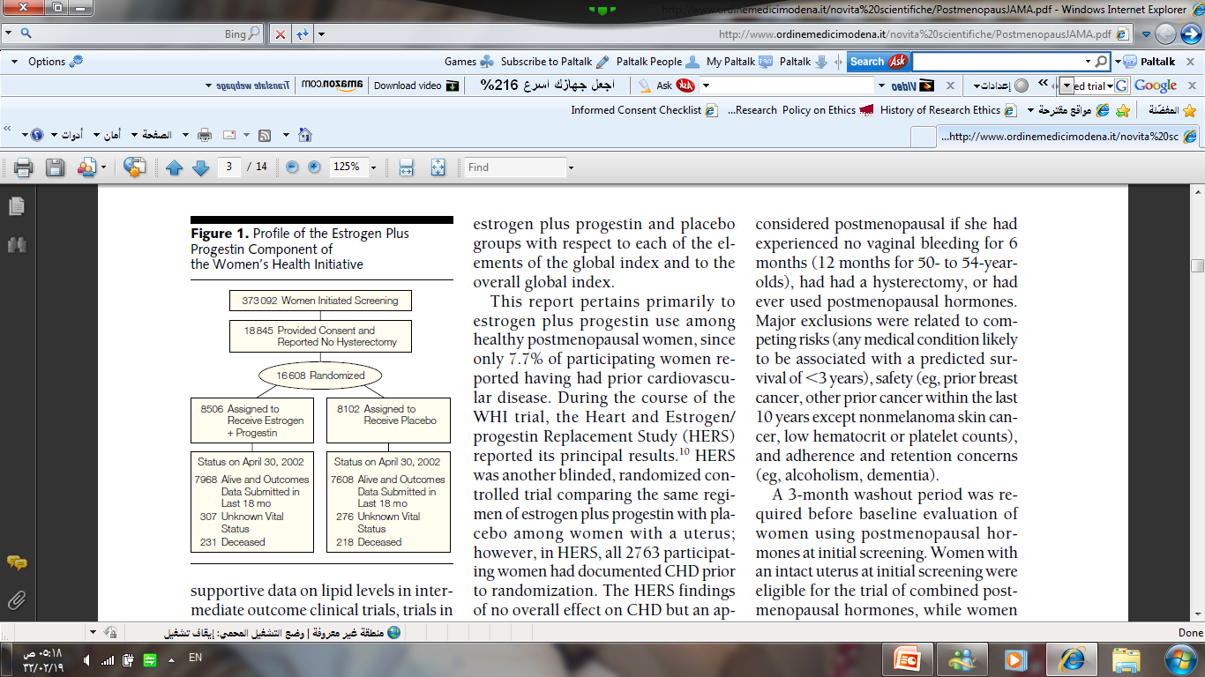
Notes:
46

Slide 47
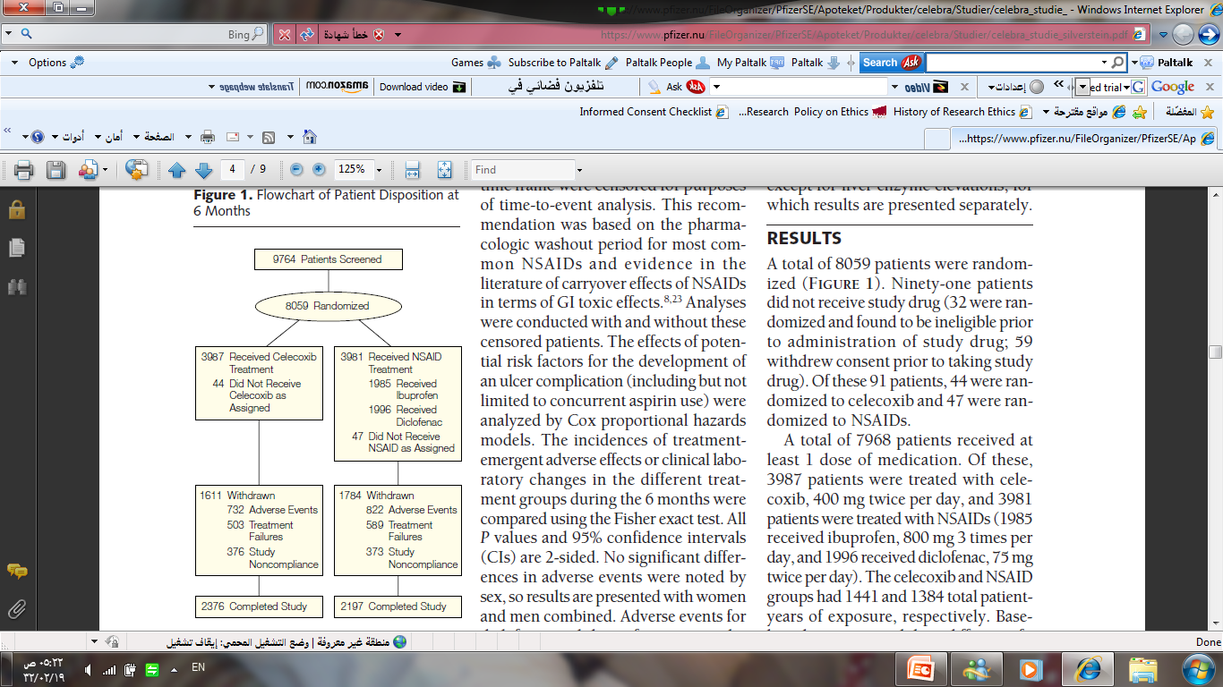
Notes:
47

Slide 48
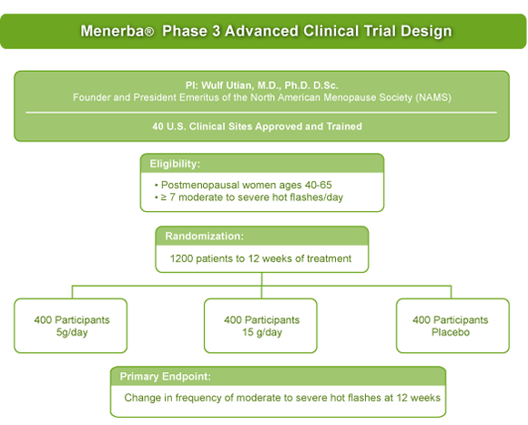

Slide 49
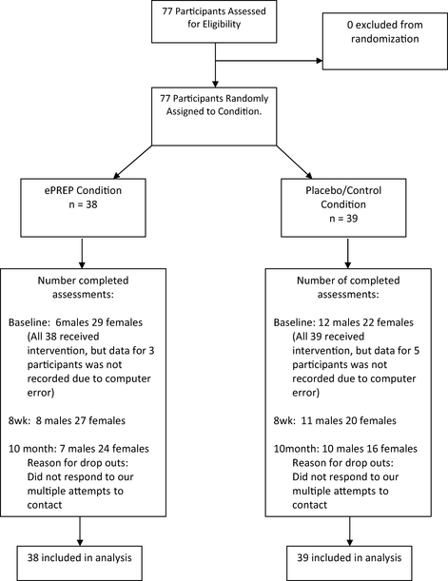

Slide 50
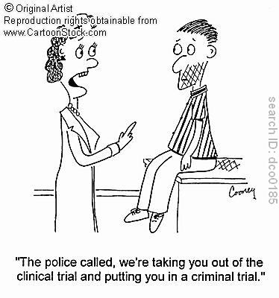

Slide 51
Follow up
● duration of study.
● drop out < 20%.

Slide 52
Was follow-up of patients sufficiently long and complete?

Slide 53
Losses-to-follow-up
How many is too many?
“5-and-20 rule of thumb”
  5% probably leads to little bias
  >20% poses serious threats to validity

Slide 54
Were the groups treated equally, apart from the experimental treatment?

Slide 55
Were the groups similar at the start of the trial?

Slide 56
Results
“Importance”
Magnitude (treatment effect)

Slide 57
Definition
Number Needed to Treat (NNT):
  Number of persons who would have to receive an intervention for 1 to benefit.
  NNT=1/ARR

Slide 58
2000 RANDOMIZED
A
1000
B
1000
200
100
800
270=IMPROVED
900
IMPROVED= 130
EER= 270/?
CER=130/?

Slide 59
EER=270/800 = 33%= 0.33
CER= 130/900=14 %=0.14
ARR= 0.33-0.14= 0.19
NNT=1/0.19= 5.2=6
EER=270/1000=27%=0.27
CEER=130/1000= 13%=0.13
ARR=0.27-0.13=0.14
NNT=1/0.14=7

Slide 60
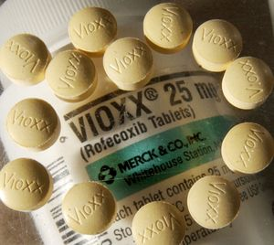
NUMBER NEED TO HARM(NNH)
WHAEN THE OUTCOME IS UNFAVOURABLE

Slide 61
Magnitude (treatment effect):
Absolute effects (ARR & NNT)
Relative effects (RR, RRR )
Precision:
P value.
Confidence interval?

Slide 62
Result Tabulation
 | Event + Ve | Event - Ve | Total
Experimental | a | b | a+b
Control | c | d | c+d
EER = Experimental Event Rate (a/a+b)
CER = Control Event Rate (c/c+d)

Slide 63
Result Tabulation
 | Bleeding present | Bleeding Absent | Total
Drug A | 20 | 80 | 100
Drug B | 40 | 60 | 100
EER-A (Risk A) = 20/100 = 20% (0.2)
CER-B (Risk B) = 40/100 = 40% (0.4)

Slide 64
Calculations
ARR = CER - EER
NNT = 1 / ARR
RR = EER/CER (Risk A/Risk B)
RRR = 1- RR

Slide 65
Result Tabulation
 | Bleeding present | Bleeding Absent | Total
Drug A | 20 | 80 | 100
Drug B | 40 | 60 | 100
ARR = CER - EER NNT = 1 / ARR
RR = EER/CER RRR = 1- RR

Slide 66
Calculations
ARR = CER – EER = 0.4 – 0.2 = 0.2 (20%)
NNT = 1 / ARR = 1/0.2 = 5
RR = EER/CER = 0.2/0.4 = 0.5
RRR = 1- RR = 1- 0.5= 0.5 (50%)

Slide 67
Confidence intervals?
The range within which the likelihood of a true value is expected to be within a given degree of certainty, usually evaluated at 95% CI.
Precision

Slide 68
APPLICABILITY

Slide 69
CAN I APPLY THESE VALID, IMPORTANT RESULTS TO MY PATIENT?
Do these results apply to my patient?
- IS OUR PATIENT SO DIFFERENT?
- IS THE TREATMENT FEASIBLE?
- POTENTIAL BENEFITS AND HARMS
Are my patient’s values and preferences satisfied by the intervention offered?

Slide 70

Summary
Validity - is the paper likely to be true
Importance - size of effect
  NNT
  Percision
Applicability - can it work for me/my setting

Slide 71

Evaluating Research about Diagnostic Tests

Slide 72
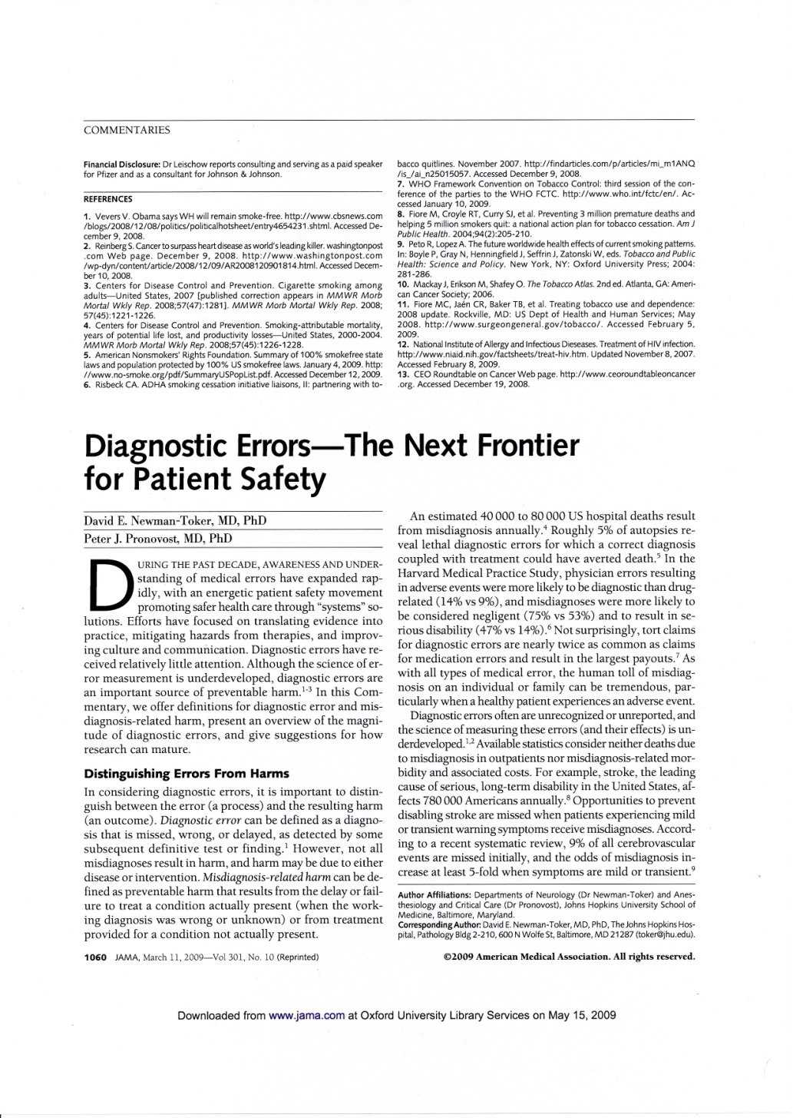
2/3 malpractice claims against GPs in UK
40,000-80,000 US hospital deaths from misdiagnosis per year
Diagnosis uses <5% of hospital costs, but influences 60% of decision making

Slide 73
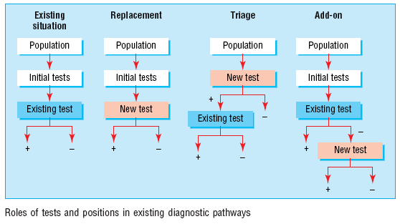
Roles of a new test
Replacement – new replaces old
  E.g., CT colonography for barium enema
Triage – new determines need for old
  E.g., B-natriuretic peptide for echocardiography
Add-on – new combined with old
  ECG and myocardial perfusion scan
Bossuyt et al BMJ 2006;332:1089–92

Slide 74
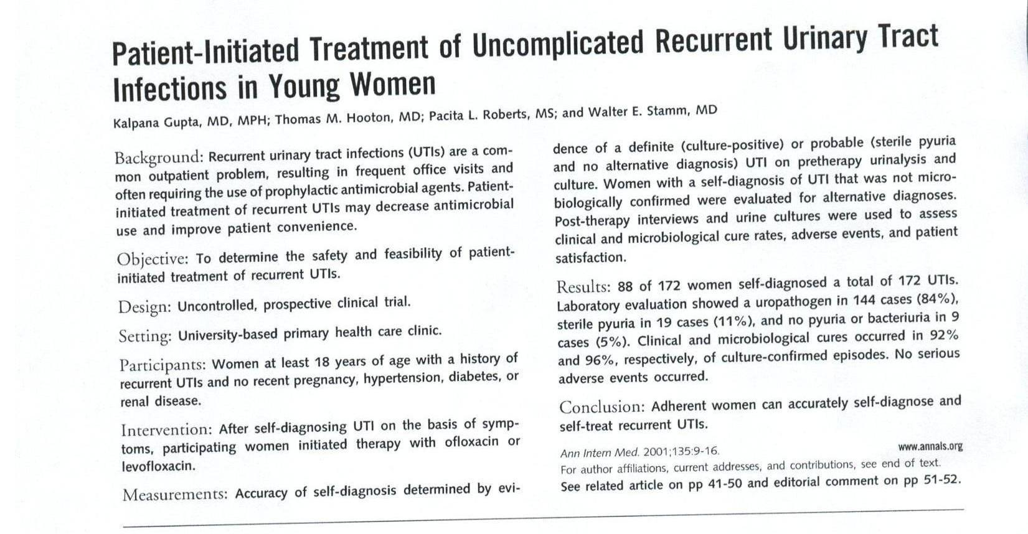
Read this abstract
Scan in UTI abstract

Slide 75
Series of patients
Index test
Reference (“gold”) standard
Compare the results of the index test with the reference standard, blinded

Slide 76
Reference standard
Scan in UTI abstract
Accuracy
Series of patients
Index test

Slide 77

Appraising a diagnostic test study using a critical appraisal checklist
Mahilum-Tapay L, et al. New point of care Chlamydia Rapid Test – bridging the gap between diagnosis and treatment: performance evaluation study. BMJ 2007;335:1190.

Slide 78
Why are we looking at the test?
The problem:
An 18-year-old women comes to your clinic because she has pain when passing urine and has noticed a change in her vaginal discharge. You suspect that she has might have Chlamydia, but the women hates the idea of going to the hospital or being examined by a clinician and asks if there is a test she can do herself instead
So, we research alternative test methods for Chlamydia

Slide 79
Results of our search
We find this reference, which assesses a new Chlamydia Rapid Test:
Mahilum-Tapay L, et al. New point of care Chlamydia Rapid Test – bridging the gap between diagnosis and treatment: performance evaluation study. BMJ 2007;335:1190
The objective of this study is to evaluate the performance of a new Chlamydia Rapid Test with vaginal swab specimens as a potential tool for Chlamydia diagnosis and screening compared with nucleic acid amplification tests with first void urine, and vulvo-vaginal swab specimens.
Importantly for us, the study also assessed if there is any difference between results of the Chlamydia Rapid Test when the swabs are self collected compared with clinician collected

Slide 80
Critical appraisal
Now we have found a study that may give a solution to our current problem, we need to assess the quality of the research we have found in terms of validity and the importance of the results to see if we can apply this test to the patient. To do this we can use the critical appraisal checklist to evaluate the study

Slide 81
Series of patients
Index test
Reference (“gold”) standard
Compare the results of the index test with the reference standard, blinded

Slide 82
Is the study valid? Screening
Was there a clear question for the study to address?
  the population, test, setting, and outcome
In this case yes, the study asked:
“What is the diagnostic accuracy of the Chlamydia Rapid Test compared with polymerase chain reaction and strand displacement amplification assays in the diagnosis of Chlamydia in women presenting to a sexual health centre (site 1) and genitourinary medicine clinics (site 2 and 3)?”
“Is there a difference in the diagnostic accuracy of the Chlamydia Rapid Test between self-collected samples and clinician-collected samples?”
This information can usually be found in the abstract or the introduction to the study

Slide 83
Defining the clinical question: PICO or PIRT
Patient/Problem
  How would I describe a group of patients similar to mine?
Index test
  Which test am I considering?
Comparator… or …Reference Standard
  What is the best reference (gold) standard to diagnose the target condition?
Outcome….or….Target condition
  Which condition do I want to rule in or rule out?

Slide 84
Is the study valid? Screening
Is there comparison with an appropriate (gold) reference standard for diagnosing the disorder under assessment?
The reference standard comparison should be the best available indicator of the target disorder

Slide 85
Is the study valid? Screening
Is there comparison with an appropriate (gold) reference standard for diagnosing the disorder under assessment?
The reference standard comparison should be the best available indicator of the target disorder
In this case yes, the study stated that:
“We assessed the performance of the Chlamydia Rapid Test in order to meet the requirements for Conformité Européenne licensure, which stipulate that the comparator test should be a “state of the art” assay and use specimens approved for the test. Participants from site 1 did not provide endocervical swabs, preventing the pooling of data from all three sites. Given this condition, we chose polymerase chain reaction testing, which is licensed for both urine and endocervical specimens, as the “gold standard” for the study. Studies of Chlamydia trachomatis polymerase chain reaction testing have shown equal performance with cervical and urine specimens, across all volumes of urine tested (<20-90 ml), and good reproducibility. For the genitourinary medicine clinics, endocervical specimens were additionally collected by the clinician and were tested by strand displacement amplification assay at the hospital laboratory.”
As the answer is yes to both of our initial screening questions, we should continue with our analysis of the diagnostic test study

Slide 86
Is the study valid? Population
Did the study include people with all the common presentations of the target disorder?
For example, symptoms of early manifestations as well as people with more severe symptoms, and/or people with other disorders that are commonly confused with the target disorder when diagnosing?

Slide 87
Is the study valid? Population
Did the study include people with all the common presentations of the target disorder? For example, symptoms of early manifestations as well as people with more severe symptoms, and/or people with other disorders that are commonly confused with the target disorder when diagnosing?
Yes, the study states that:
“All women 16 years and over presenting to any of the three sites were invited to participate in the study . Most participants at site 1 were asymptomatic [663 women], in contrast with 441/662 [67%] of the participants from the genitourinary medicine clinics presented with symptoms that included vaginal discharge 305/662 [46%], and lower abdominal pain 149/657 [23%]. In addition 23/668 [3%] of women were diagnosed as having pelvic inflammatory disease.”

Slide 88
Is the study valid? Blinding
Were the people assessing the results of the index diagnostic test blinded to the results of the reference standard?

Slide 89
Is the study valid? Blinding
Were the people assessing the results of the index diagnostic test blinded to the results of the reference standard?
Yes, while the study does not explicitly state blinding, it is very specific about were the samples were analysed for the three different tests. These were:
Chlamydia Rapid Test: “Clinic staff tested vaginal swabs on site; all staff had passed testers’ requirements in accordance with the National Committee on Clinical Laboratory Standards.”
Polymerase chain reaction assay: “We sent urine specimens to a laboratory accredited by the UK Accreditation Service for testing for Chlamydia trachomatis with the Amplicor Chlamydia trachomatis polymerase chain reaction assay.”
Transcription mediated assay: “Samples that yielded discordant results between the Chlamydia Rapid Test and the polymerase chain reaction assay were tested by transcription mediated assay at the Sexually Transmitted Bacteria Reference Laboratory.”

Slide 90
Is the study valid? Testing
Was the reference standard applied regardless of the index test result?
Yes, as already discussed, all samples were tested with both the Chlamydia Rapid test and polymerase chain reaction assay. With discordant samples further tested with transcription mediated assay
Was the diagnostic test validated in a second independent group of patients?
Yes, as the test was given in three different sites, a total of three populations were tested

Slide 91
Is the study valid? Methods
Were the methods of the diagnostic test described in sufficient detail? Consider if descriptions of the following are included:
Rationale for the ref standard.
Technical specifications or references for running the index test and reference standard (e.g., including enough information that the tests could be replicated).
Methods for calculating or comparing measures of diagnostic accuracy and statistical uncertainty (95% CI).

Slide 92
Is the study valid? Methods
Were the methods of the diagnostic test described in sufficient detail? Consider if descriptions of the following are included:
Rationale for the ref standard. “We assessed the performance of the Chlamydia Rapid Test in order to meet the requirements for Conformité Européenne licensure, which stipulate that the comparator test should be a “state of the art” assay and use specimens approved for the test. Participants from site 1 did not provide endocervical swabs, preventing the pooling of data from all three sites. Given this condition, we chose polymerase chain reaction testing, which is licensed for both urine and endocervical specimens, as the “gold standard” for the study. Studies of Chlamydia trachomatis polymerase chain reaction testing have shown equal performance with cervical and urine specimens, across all volumes of urine tested (<20-90 ml),16 and good reproducibility. For the genitourinary medicine clinics, endocervical specimens were additionally collected by the clinician and were tested by strand displacement amplification assay at the hospital laboratory.”
Technical specifications or references for running the index test and reference standard (e.g., including enough information that the tests could be replicated) Yes, the study outlined in detail how each different type of sample was analysed for each test. See pages 2 and 3 for descriptions of sample collection, storage, and testing.
Methods for calculating or comparing measures of diagnostic accuracy and statistical uncertainty (95% CI). Yes, 95% confidence intervals were included for all comparisons discussed.

Slide 93
Now that we have established that the study is valid, we should consider the results

Slide 94
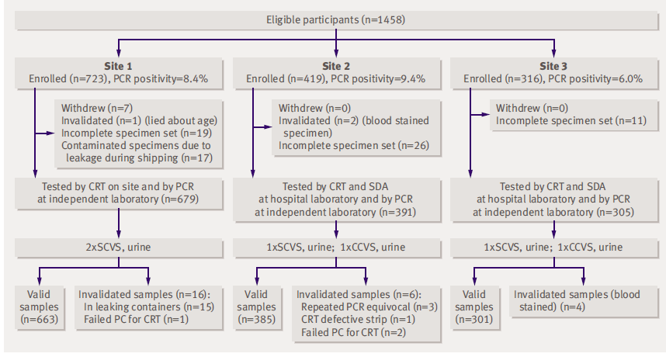
Results
Do the results include information about people who satisfied inclusion criteria for the study but did not receive the diagnostic index or reference standard test?
Notes:
In this case yes, the study includes a flow chart for all three sites, which specifies how many women were enrolled and explicit reasons for any withdrawals. From this flow chart it appears that all withdrawals were excluded from the final analysis which only included valid specimens

Slide 95
Results
Do the results include how indeterminate results, missing results, and outliers of the index test were handled?
The study states that samples that had discordant results were further tested by transcription mediated essay, in addition 100 of the total number of polymerase chain reaction negative specimens and 20 of the concordant positive samples were also randomly tested by the assay to minimise potential bias introduced by testing discordant samples only. The study only included valid samples in the analysis with explicit reasons for any samples not included (please see table on previous slide)

Slide 96
Results
Do the results include criteria for defining the severity of the target disorder?
In this case no — infection and sequelae may be asymptomatic in cases of Chlamydia

Slide 97
Results
Do the results include cross tabulation of the index test results by the reference standard results? Or enough information to generate this table?
Yes, the study includes sensitivity, specificity, and positive and negative predictive values for all of the comparisons made, and the calculations used. Using these results, you could if needed generate the cross tabulation table, for example below:
Site 1, Chlamydia Rapid Test with self collected vaginal swab specimens versus polymerase chain reaction
 | Reference Standard
Index test |  | Positive | Negative | Total
 | Positive | 47 | 7 | 54
 | Negative | 9 | 600 | 609
 | Total | 56 | 607 | 663

Slide 98
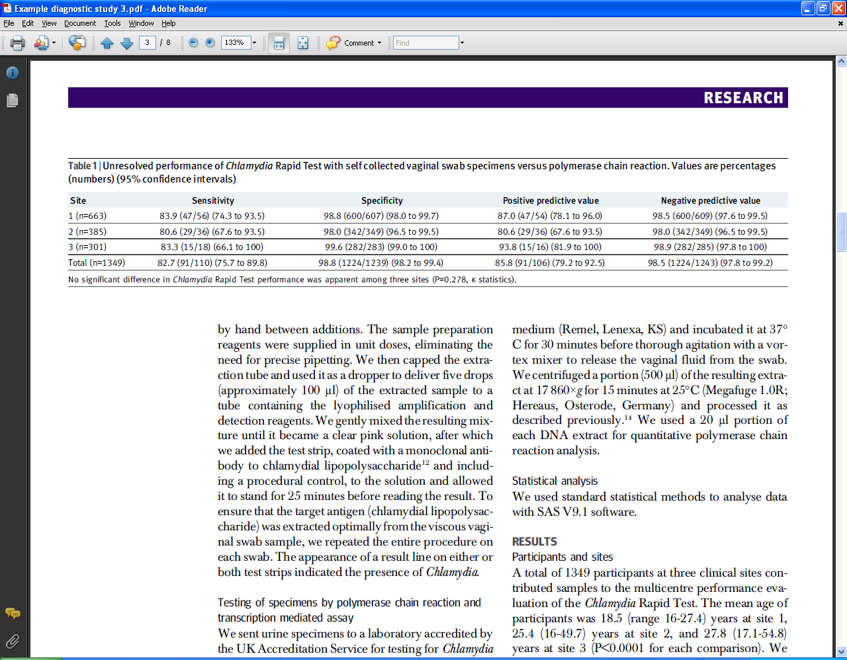
Results
Do the results include estimates of diagnostic test accuracy and statistical uncertainty (95% CI)?
Yes the study includes 95% CI for all comparisons made. For example:

Slide 99
Does this diagnostic test apply to your specific patient?
Is your patient similar to the people in the study in terms of clinical and demographic characteristics?
Yes, in this case our patient is a young woman, the study population is women 16 years and over
Is the diagnostic test available, and if so, does it reflect current practice?
To answer this question you would need to check availability, and also how current the research is at the time of assessment
Will the test result change the way the patient is managed?
Yes, with the Rapid Chlamydia test, diagnosis and treatment (if needed) is much quicker

Slide 100
In conclusion
This study seems to be valid with no major methodological flaws
The results of the study indicate that compared with the polymerase chain reaction testing, the Chlamydia Rapid Test has moderate sensitivity and good specificity for screening and diagnosis of Chlamydia whether the vaginal swab was collected by a participant of the study or a clinician
The study population does in this case match our patient, so we can be reasonably comfortable in the knowledge that if the patient is allowed to collect her own vaginal swab, the test result will be accurate, and also as an added bonus if the test is positive for Chlamydia, treatment can be started immediately

Slide 101
2 by 2 table
Reference test
+
-
+
Index Test
-

Slide 102
2 by 2 table
Reference test
+
-
True positive
False positive
+
Test
False negative
True negative
-

Slide 103
IF only a test had perfect discrimination…
Reference test
+
-
True positive
+
Test
True negative
-

Slide 104
Sensitivity
Disease
+
-
Proportion of people with the disease who have a positive test.
+
a
b
Test
c
d
-
Sensitivity = a / a + c

Slide 105
Specificity
Disease
Proportion of people without the disease who have a negative test.
+
-
+
a
b
Test
c
d
-
Specificity = d / b + d

Slide 106
Tip…..
Sensitivity is useful to me
  ‘The new chlamydia test was positive in 47 out of 56 women with chlamydia (sensitivity =83.9%)’
Specificity seems a bit confusing
  ‘The new chlamydia test was negative in 600 of the 607 women who did not have chlamydia (specificity = 98.8%)’
So…false positive rate is sometimes easier
  False positive rate = 1 – specificity
  So a specificity of 98.8% means that the new test is wrong (or falsely positive) in 1.2% of women

Slide 107
Maybe forget sensitivity and specificity?..
True positive rate ( = Sensitivity)
False positive rate ( = 1 – Specificity)

Slide 108
How about this? SnNOUT
Disease
Highly sensitive tests = good for screening
or
SnNOUT
Highly sensitive test, negative result rules out.
+
-
+
a
b
Test
c
d
-
Sensitivity = a / a + c

Slide 109
SpPIN
Disease
Highly specific tests = good for ruling in
or
SpPIN
Highly specific test, positive result rules in.
+
-
+
a
b
Test
c
d
-
Specificity = d / b + d

Slide 110
ROC curves (Receiver Operating Characteristic curves) – What are they and what aren’t they?

Slide 111
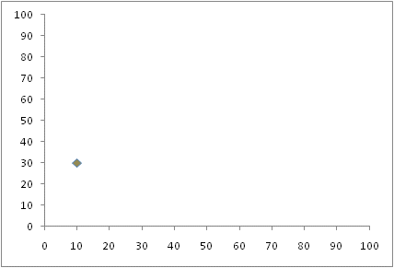
ROC curves – provide accuracy results over a range of thresholds
A test with 30% sensitivity and 90% specificity (10% false positive rate) at one cut-point is plotted in the lower left corner.
Sensitivity
1-Specificity or false positive rate

Slide 112
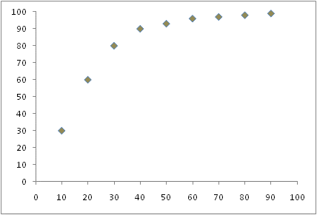
Perfect test = upper left hand corner
Diagonal = no discrimination
Area under the curve (AUC)
0.5 = useless
1.0 = perfect
Sensitivity
1-Specificity

Slide 113
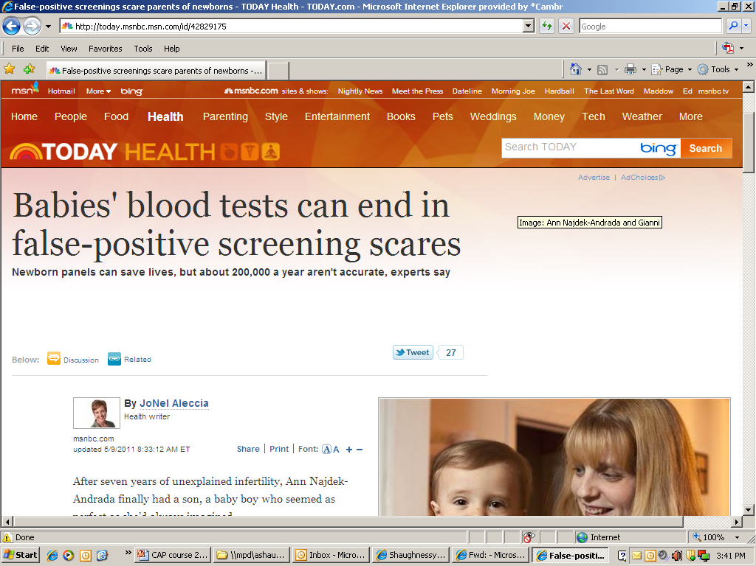
Why this is important
http://today.msnbc.msn.com/id/42829175

Slide 114

Appraisal
Critical appraisal questionnaires
www.cebma.org/ebp-tools

Slide 115
http://ktclearinghouse.ca/cebm/practise/ca/prognosis

Slide 116
Appraisal of a cohort
Did the study address a clearly focused issue?
Was the cohort / panel recruited in an acceptable way? (selection bias)
Was the cohort/ panel representative of a defined population?
Was a control group used? Should one have been used?
Are objective and validated measurement methods used and were they similar in the different groups? (misclassification bias)
Was the follow up of cases/subjects long enough?
Could there be confounding?
Is the size of effect practically relevant?
Are the conclusions applicable?

Slide 117
Take-home messages:
Different types of question require different study designs.
Does the study address a clearly focused question?
Did the study use valid methods to address this question?
Are the valid results of this study important?
Are these valid, important results applicable to my patient or population?

Slide 118
Critical Appraisal (MA/SR
Guidelines)
Dr. Nada A. AlYousefi
Assistant Professor, Postgraduate Trainer & Consultant
Family Medicine Unit
Department of Family and Community Medicine
College of Medicine(KSU)
nalyousefi@ksu.edu.sa
March 2017

Slide 119
Types of reviews
Reviews
(narrative/literature/
traditional)
Systematic reviews
Meta-analysis

Slide 120
Narrative reviews
Usually written by experts in the field
Use informal and subjective methods to collect and interpret information
Usually narrative summaries of the evidence
Read: Klassen et al. Guides for Reading and Interpreting Systematic Reviews. Arch Pediatr Adolesc Med 1998;152:700-704.
Notes:
Do not confuse with narrative systematic reviews, which describes the type of synthesis of data.

Slide 121
What is a systematic review?
A review of the evidence on a clearly formulated question that uses systematic and explicit methods to identify, select and critically appraise relevant primary research, and to extract and analyse data from the studies that are included in the review*
*Undertaking Systematic Reviews of Research on Effectiveness. CRD’s Guidance for those Carrying Out or Commissioning Reviews. CRD Report Number 4 (2nd Edition). NHS Centre for Reviews and Dissemination, University of York. March 2001.

Slide 122
Key elements of a systematic review
Structured, systematic process involving several steps :
  Formulate the question
  Plan the review
  Comprehensive search
  Unbiased selection and abstraction process
  Critical appraisal of data
  Synthesis of data (may include meta-analysis)
  Interpretation of results
  All steps described explicitly in the review

Slide 123

The Cochrane Collaboration
International non-profit organisation that prepares, maintains, and disseminates systematic up-to-date reviews of health care interventions
Notes:
The Cochrane Collaboration was established in October 1992.
The Collaboration relies on funding from a number of different sources to complete its work.
I like to think of a review as starting out as a jigsaw puzzle – especially if there is heterogeneity – ie. differences in interventions, settings, study designs, outcomes.

Slide 124
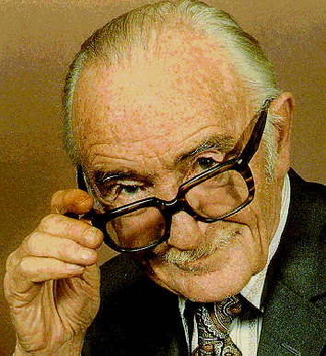
Cochrane Collaboration
Named in honour of Archie Cochrane, a British researcher
In 1979:
“It is surely a great criticism of our profession that we have not organised a critical summary, by specialty or subspecialty, adapted periodically, of all relevant randomised controlled trials”

Slide 125
The Cochrane Library
Cochrane Systematic reviews : Cochrane reviews and protocols
Database of Reviews of Effects: Other systematic reviews appraised by the Centre for Reviews and Dissemination.
Cochrane Central Register of Controlled Trials:
Bibliography of controlled trials (some not indexed in MEDLINE).
Health Technology Assessment Database: HTA reports
NHS Economic evaluation database:
Economic evaluations of health care interventions.
Notes:
DATABASES:
Cochrane Systematic reviews : Cochrane reviews
Database of Reviews of Effectiveness
Other systematic reviews from around the world which have been appraised by the NHS Centre for Reviews and Dissemination.
Cochrane Central Register of Controlled Trials
Bibliography of controlled trials (some not indexed in MEDLINE).
Cochrane database of Methodology Reviews
Cochrane reviews of methodological studies.
The Cochrane Methodology register
Bibliography of studies relating to methodological aspects of research synthesis
About the Cochrane Collaboration: Information about review groups, Fields, Centres, etc. Contact details provided.
Health Technology Assessment Database:
Health Technology Assessment reports from around the world.
NHS Economic evaluation database:
Economic evaluations of health care interventions.

Slide 126
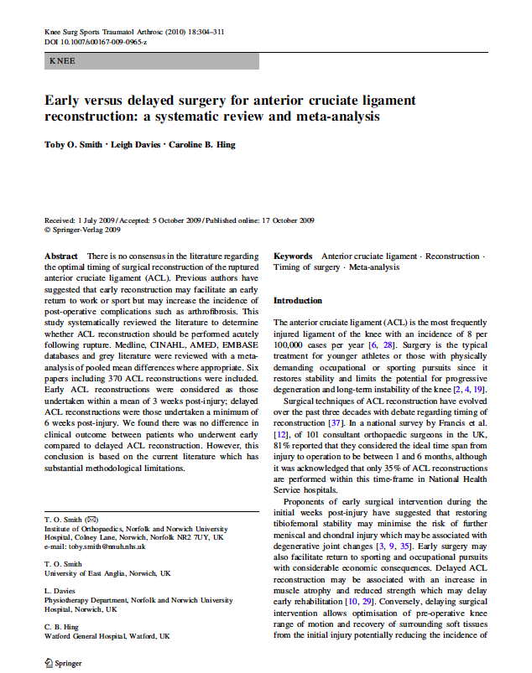
Appraising a systematic review
?

Slide 127

Tools for critical appraisal
CASP: Critical Appraisal Skills Programme Checklists
Critically Appraised Topics: generic systematic reviews (ACP Journal club)
SIGN: Scottish Intercollegiate Guidelines Network
GATE Frame
Notes:
AMSTAR = A measurement tool to assess systematic reviews
Shea et al. BMC Medical Research Methodology 2007 7:10uality of Systematic Reviews

Slide 128

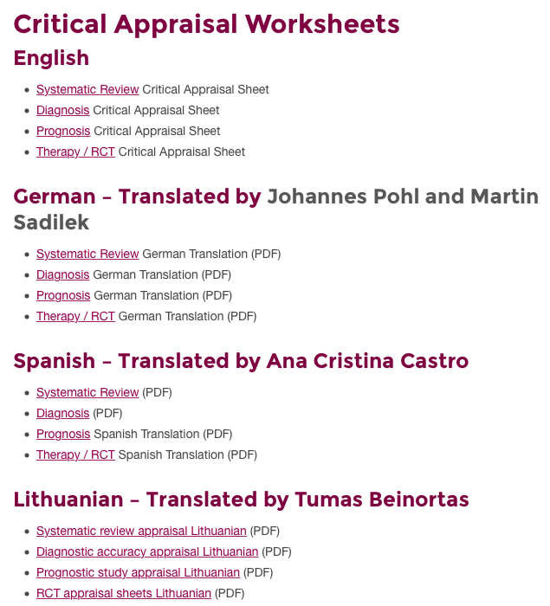

Slide 129
Appraisal of a systematic review
10 questions
  Clearly-focused question
  The right type of study included
  Identifying all relevant studies
  Assessment of quality of studies
  Reasonable to combine studies
  What were the results
  Preciseness of results
  Application of results to local population
  Consideration of all outcomes
  Policy or practice change as a result of evidence
CASP

Slide 130
Appraising a systematic review
3 minutes

Slide 131
Step 1 – Are the results of the review valid?
Question – what is the PICO (etc.)
Finding – comprehensive?
Appraise – did they select good ones?
Synthesise – numerically/appropriate?

Slide 132
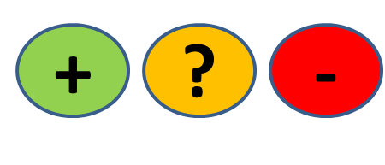
QUESTION
FIND
APPRAISE
SYNTHESISE
1. What question (PICO) did the systematic review address?
  Is question clearly stated early on?
  Treatment/exposure described?
  Comparator/control described?
  Outcome(s) described?
Title, abstract, introduction
Notes:
1 min them, 1 min feedback
Title, abstract or final paragraph of the introduction should state the question.
Our PICO:
P = patients with ACL injury = yes (initial injury suggests not chronic condition but no info on age)
I = Early ACL reconstruction = yes
C = Delayed reconstruction = yes
O = clinical and radiological = unclear
So overall we happy to say yes?
Tip = If cannot ascertain what the focused question is after reading these sections, search for another paper.

Slide 133
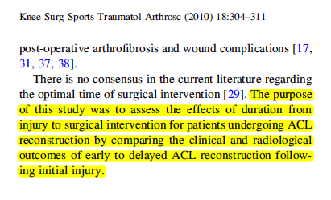
QUESTION
FIND
APPRAISE
SYNTHESISE
P
O’s
I
C
Notes:
1 min them, 1 min feedback
Title, abstract or final paragraph of the introduction should state the question.
Our PICO:
P = patients with ACL injury = yes (initial injury suggests not chronic condition but no info on age)
I = Early ACL reconstruction = yes
C = Delayed reconstruction = yes
O = clinical and radiological = unclear
So overall we happy to say yes?
Tip = If cannot ascertain what the focused question is after reading these sections, search for another paper.

Slide 134
QUESTION
FIND
APPRAISE
SYNTHESISE
2. Is it unlikely that important, relevant studies were missed?
Look for
  Which bibliographic databases were used? More than 1?
  Search terms used (text and MeSH)?
  Search for unpublished as well as published studies?
  Search for non-English studies?
Methods
Notes:
1 min them, 1 min feedback
Title, abstract or final paragraph of the introduction should state the question.
Our PICO:
P = patients with ACL injury = yes (initial injury suggests not chronic condition but no info on age)
I = Early ACL reconstruction = yes
C = Delayed reconstruction = yes
O = clinical and radiological = unclear
So overall we happy to say yes?
Tip = If cannot ascertain what the focused question is after reading these sections, search for another paper.

Slide 135
Is finding all published studies enough?
QUESTION
FIND
APPRAISE
SYNTHESISE
Negative studies less likely to be published than ‘Positive’ ones
How does this happen?
Positive studies SUBMITTED 2.5x more often than negative (Dickersin, JAMA, 1992)

Slide 136
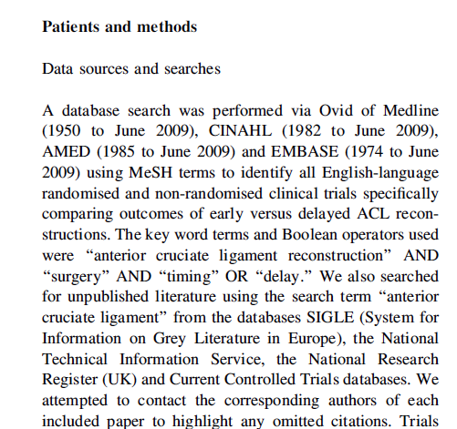
QUESTION
FIND
APPRAISE
SYNTHESISE
Notes:
2 min + 1
Methods and results sections.
1. Was the search strategy described sufficiently? Major bibliographic databases but also reference lists from relevant studies, Citation index, experts. Did they use MESH terms? = yes
2. Search terms used = yes
3. Limited = Yes - English language only. We should use all studies, getting non-English translated. Maybe resources did not allow for this.
4. Unpublished = yes – contacted authors
Results section will tell you numbers of titles/abstracts etc – in this case they also present a nice flow chart which tells us that an additional paper was found by contacting the authors (page 306)
One more aspect of the search strategy that was good and ensured studies were not missed = two investigators selected articles.
Overall it is unlikely important/relevant studies were missed.
Boolean operators – if anyone brings this up these are = AND, OR, NOT as you learnt with Nia last Thursday/Friday?

Slide 137
QUESTION
FIND
APPRAISE
SYNTHESISE
3. Were the criteria used to select articles for inclusion appropriate?
Look for
  Inclusion/exclusion criteria a priori?
  Are eligibility criteria related to PICO?
  Types of studies?
Methods
Notes:
1 min them, 1 min feedback
Title, abstract or final paragraph of the introduction should state the question.
Our PICO:
P = patients with ACL injury = yes (initial injury suggests not chronic condition but no info on age)
I = Early ACL reconstruction = yes
C = Delayed reconstruction = yes
O = clinical and radiological = unclear
So overall we happy to say yes?
Tip = If cannot ascertain what the focused question is after reading these sections, search for another paper.

Slide 138
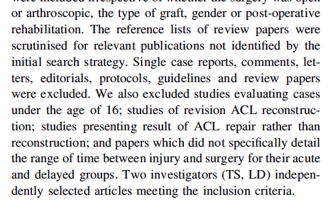
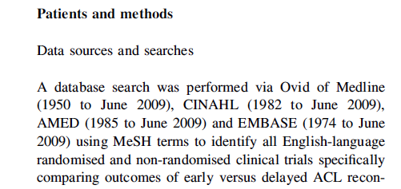
QUESTION
FIND
APPRAISE
SYNTHESISE
Notes:
2 min + 1
1st = Yes in methods section
2nd = Excluded all non-trial studies, under age 16, studies on revised ACL reconstruction, studies that did not detail time between injury and surgery for acute and delayed groups; are they related to PICO = yes.
3rd = Can anyone see a major point about the types of studies selected? = Non-randomised trials also included.
Anyone willing to suggest why? = Nature of the study – impossible to blind patients to early or delayed surgery. But…
…could have blinded surgeons to this (although ethically and logistically difficult)
…but could easily have blinded the assessors.

Slide 139
QUESTION
FIND
APPRAISE
SYNTHESISE
4. Were the included studies sufficiently valid for the type of question?
Look for
  Criteria for quality assessment defined?
  Appropriate for the question?
  Were the assessment results provided?
Methods, Results
Notes:
1 min them, 1 min feedback
Title, abstract or final paragraph of the introduction should state the question.
Our PICO:
P = patients with ACL injury = yes (initial injury suggests not chronic condition but no info on age)
I = Early ACL reconstruction = yes
C = Delayed reconstruction = yes
O = clinical and radiological = unclear
So overall we happy to say yes?
Tip = If cannot ascertain what the focused question is after reading these sections, search for another paper.

Slide 140
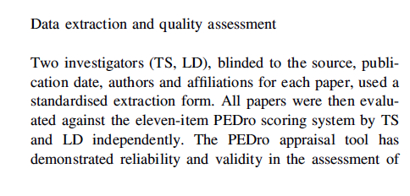
QUESTION
FIND
APPRAISE
SYNTHESISE
  Criteria for quality assessment defined?
Notes:
2 min + 1
Yes = the PEDro scale
Yes = validated for RCTs (unclear whether this holds for non-RCT)
Yes = table in the results section and appraisal page 307
[PEDro: gives score out of 11
Concealment allocation = person(s) deciding eligibility is unaware which arm of study subject is assigned to. If randomization is done at a central location then concealment is typicall assured.
Baseline comparability =must provide demographic details including details of severity of condition and minimum 1 outcome measure
Adequate follow up = score given if study provides info on #allocated to treatment and #assessed for final outcomes plus this #must be at least 85% of overall n.
Intention-to-treat = analysis is based on data from all subjects allocated to treatment and not just those completing the study]….
So are we happy that the studies were sufficiently valid = No or unclear
Okay if you turn over your appraisal sheets we’re now going to look at the actual results themselves.

Slide 141
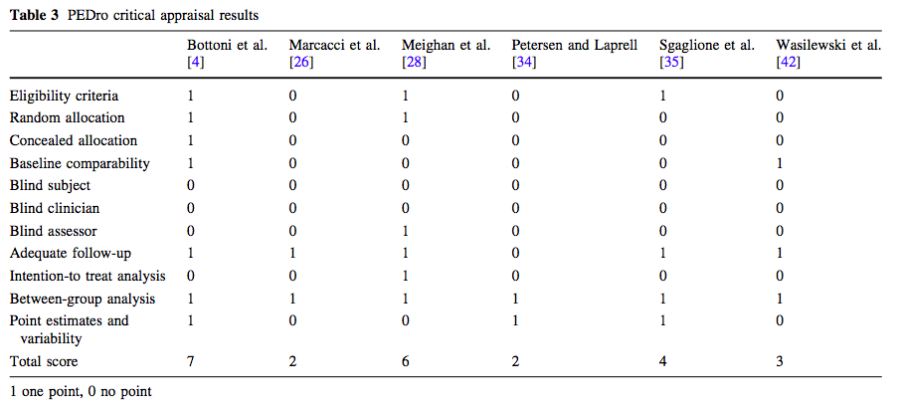
Appropriate for the question?
Were assessment results provided?
QUESTION
FIND
APPRAISE
SYNTHESISE
Notes:
2 min + 1
Yes = the PEDro scale
Yes = validated for RCTs (unclear whether this holds for non-RCT)
Yes = table in the results section and appraisal page 307
[PEDro: gives score out of 11
Concealment allocation = person(s) deciding eligibility is unaware which arm of study subject is assigned to. If randomization is done at a central location then concealment is typically assured.
Baseline comparability =must provide demographic details including details of severity of condition and minimum 1 outcome measure
Adequate follow up = score given if study provides info on #allocated to treatment and #assessed for final outcomes plus this #must be at least 85% of overall n.
Intention-to-treat = analysis is based on data from all subjects allocated to treatment and not just those completing the study]….
So are we happy that the studies were sufficiently valid = No or unclear
Okay if you turn over your appraisal sheets we’re now going to look at the actual results themselves.

Slide 142
QUESTION
FIND
APPRAISE
SYNTHESISE
5. Were the results similar from study to study?
Consider whether
  The results of all the included studies are clearly displayed
  The results are combined (meta-analysis)
    Are studies sufficiently similar
  The reasons for any variations in results are discussed
Notes:
1 min them, 1 min feedback
Title, abstract or final paragraph of the introduction should state the question.
Our PICO:
P = patients with ACL injury = yes (initial injury suggests not chronic condition but no info on age)
I = Early ACL reconstruction = yes
C = Delayed reconstruction = yes
O = clinical and radiological = unclear
So overall we happy to say yes?
Tip = If cannot ascertain what the focused question is after reading these sections, search for another paper.

Slide 143
Meta-analysis
QUESTION
FIND
APPRAISE
SYNTHESISE
= calculated “best guess” of the true effect size
The statistical combination of the results gives a pooled, weighted average of the primary results
It weights the effect size (result) of each study in relation to sample size of the study
Optional part of SR
Systematic
reviews
Meta
analyses
Notes:
P1 - ….from each of the studies included in the meta-analysis
P2 -

Slide 144

FOREST PLOTS
Line of no effect
trials
Confidence interval
Overall effect
Measure of effect

Slide 145
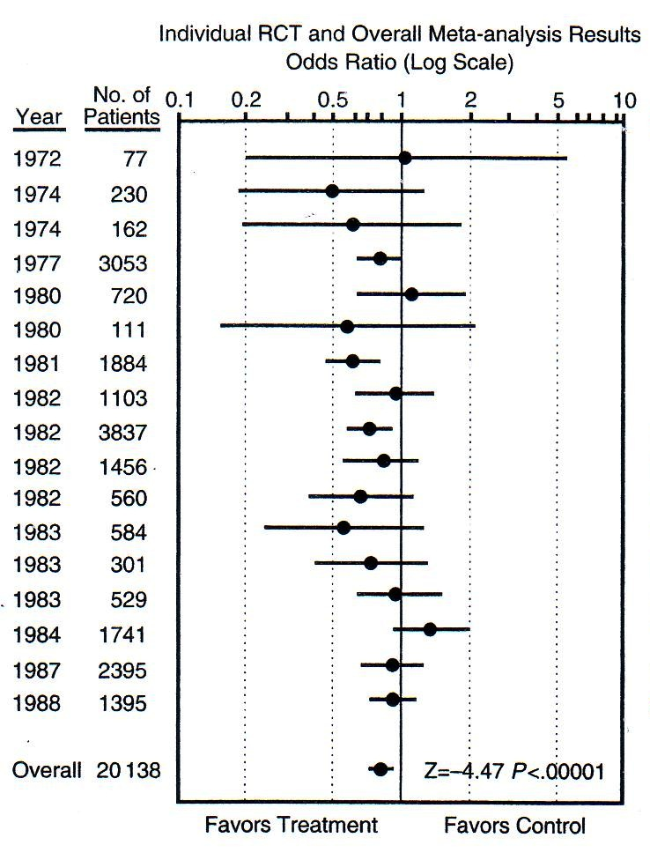
QUESTION
FIND
APPRAISE
SYNTHESISE
Which is the smallest study?
Which is the largest study?
How many are statistically significant?
Smallest
P<0.05
P<0.05
Largest
Is treatment better than control?
How much better?
Notes:
Smallest, largest, significant etc….
Can anyone tell the acute illness of our patient? = MI (streptokinase for reducing risk of mortality post MI from thrombotic event)
Now, based on this forest plot do we give an antithrombotic drug for reperfusion (in this case streptokinase) = YES

Slide 146
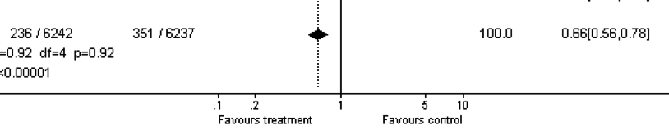

QUESTION
FIND
APPRAISE
SYNTHESISE
Effect size =
1 – 0.66 = 0.34
0.34 x 100 = 34%
There is a 34% reduced risk of mortality in the treatment compared to the control group
Notes:
1 = The overall effect is represented by the diamond at the bottom (labelled ‘Total’) and represents the combined or pooled ratio. The ends of the diamond represent the 95% CI. Here we can see that treatment reduces mortality by 34%

Slide 147
Heterogeneity
QUESTION
FIND
APPRAISE
SYNTHESISE
“The quality or state of being diverse in character or content”

Slide 148
Heterogeneity (diversity)
QUESTION
FIND
APPRAISE
SYNTHESISE
Clinical heterogeneity
Variability in the participants, interventions and/or outcomes studied
Methodological heterogeneity
Variability in study deign and risk of bias
Statistical heterogeneity
The observed intervention effects being more different from each other than we would expect due to random error (chance) alone

Slide 149
High heterogeneity
= appropriate to pool data?
QUESTION
FIND
APPRAISE
SYNTHESISE

Slide 150
QUESTION
FIND
APPRAISE
SYNTHESISE
Are the results similar across studies? 3 tests:
  ‘Eyeball’ test – do they look they same?
  Formal tests
    Proportion of variation not due to chance (I²)
      Variation between tests, now preferred estimate
        0% to 40%: might not be important;
        30% to 60%: may represent moderate heterogeneity;
        50% to 90%: may represent substantial heterogeneity;
        75% to 100%: considerable heterogeneity
    Test of ‘Null hypothesis’ of no variation (p-value)
      Cochrane Chi-square: p<0.10 = heterogeneity
Notes:
Best done when there is a forest plot. In our knee study we don’t have this option. If we go back to example on sheet, the dotted vertical line running through the combined estimate crosses the horizontal lines of all the individual studies = studies are homogenous.
Formal statistical tests = cochrane chi squared test. If this is statistically significant there is definite heterogeneity. Significance set at 0.1 (rather than usual 0.05) as the chi-square test has low power to detect heterogeneity.
Can also use something called I-squared = more recently developed. Ranges between 0 and 100%, measures the variability between studies. As a rule of thumb I2<25% means studies regarded as homogenous and I2>75% means heterogeneity is very high.

Slide 151
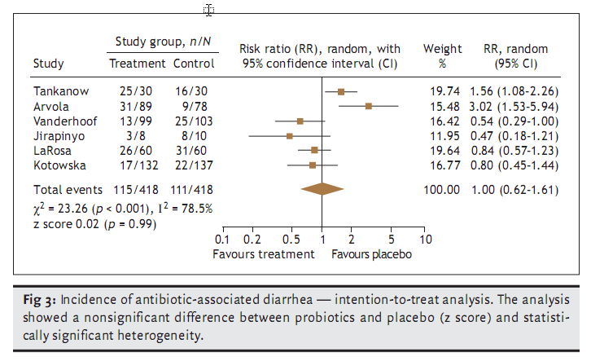
Are these trials different?
QUESTION
FIND
APPRAISE
SYNTHESISE
Notes:
Show of hands if you think there is heterogeneity present between these studies?

Slide 152
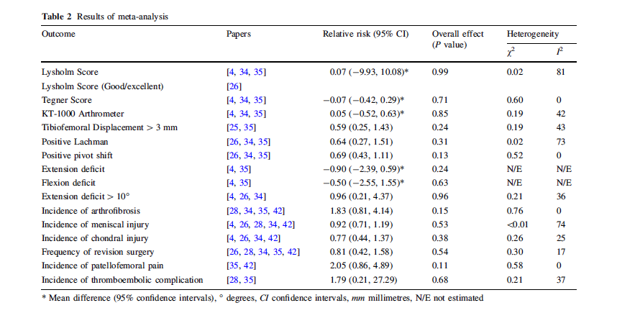
QUESTION
FIND
APPRAISE
SYNTHESISE
5. Were the results similar from study to study?
Notes:
1 min
So what do we think about the similarity of studies in our knee paper?
Indications are that there is high heterogeneity for 2 out of the 7 measures, none for 3 and some for remaining 1.
Do the authors discuss the heterogeneity? = small mention in results and a bit around studies of isokinetic strength, however, no discussion of scores in table 2.
Overall, results similar from study to study = yes and no.

Slide 153
QUESTION
FIND
APPRAISE
SYNTHESISE
Step 2 – What were the results?
Consider
  What these are (numerically if appropriate)
  How were the results presented/expressed (risk ratio, odds ratio, etc.)
  If you are clear about the review’s ‘bottom line’ results
Notes:
1 min them, 1 min feedback
Title, abstract or final paragraph of the introduction should state the question.
Our PICO:
P = patients with ACL injury = yes (initial injury suggests not chronic condition but no info on age)
I = Early ACL reconstruction = yes
C = Delayed reconstruction = yes
O = clinical and radiological = unclear
So overall we happy to say yes?
Tip = If cannot ascertain what the focused question is after reading these sections, search for another paper.

Slide 154
What are we interested in?
Notes:
2 min
Summary table: missing info on treatment and control (how many events, weight of studies?) = therefore weakness of paper.
The main things were interested in are the effect measure and the significant of the effect. In this case the effect measure is relative risk because we are mainly looking at dichotomous outcomes (yes/no) or frequencies (numbers of events/incidence). When we’re looking at continuous measures as outcomes we would assess the mean difference between the groups. An example is given here for first two outcome measures (Lysholm and Tegner scores).
Effect measures = Relative risk: “Are we all happy with relative risks”? More or less?” Okay, so RR is the probability of an event in one group divided by the probability of the event in another group.
A RR of 1 means no difference in risk/probability of an event between groups;
RR <1 = event is less likely to occur in treatment group than control (i.e. favours early surgery);
RR >1 = event is more likely to occur in treatment group (i.e. favours delayed surgery);
So, looking at an example using revision surgery, the relative risk of 0.81 suggests a more favourable outcome for the treatment group and suggests that the risk of revision surgery is 19% lower in the group who received early surgery. But…look at the significance for the effect. Can anyone tell me if it is statistically significant or not? Answer = not because it is greater than the cut-off of 0.05 so we would conclude that there is no difference between groups.
Recall what we said we were interested in:
Return to activity – did anyone find information on this? If you look carefully in the text of first paragraph on page 306 = Marcacci et al paper. Also, Lysholm and Tegnar scores give an indication of the level of PA an individual may return to = no difference.
Recurrent injury – we have three measures. Delaying surgery appears to decrease the risk of arthrofibrosis but again not significant. Risk of other injuries appears higher if surgery delayed but non-significant.
SO OVERALL – appears that delaying surgery will not affect any of the outcomes of concern to me.
“Can anyone think of another way in which these results could have been presented that might have made assessing them easier” = Forest plot. Give praise if someone says this then mention that there is example of a forest plot on their sheet. If no one answers, then say “one way is to use something called a forest plot.”
So our study did not use a forest plot. Any reasons why not?
one reason I can think of is because of the number of outcomes. Each one would require a forest plot = 16. This would most likely have been way beyond the editorial specifications of the journal although they could have put them as a data supplement online.
Authors don’t know how to do them…
Others = ????
So if you turn back to your appraisal sheet, there’s one more thing we need to look at = similarity of the included studies.

Slide 155
Our clinical question
Amongst adults with acute ACL injuries, does
early reconstructive surgery compared with
delayed reconstructive surgery lead to
favourable return to former activity and/or risk of recurrent knee injury?
Population
Intervention
Control
Outcome 1
Outcome 2

Slide 156
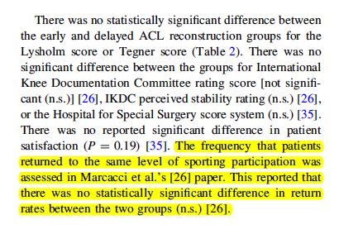
Return to former activity (page 306):

Slide 157
Risk of recurrent knee injury
Notes:
2 min
Summary table: missing info on treatment and control (how many events, weight of studies?) = therefore weakness of paper.
The main things were interested in are the effect measure and the significant of the effect. In this case the effect measure is relative risk because we are mainly looking at dichotomous outcomes (yes/no) or frequencies (numbers of events/incidence). When we’re looking at continuous measures as outcomes we would assess the mean difference between the groups. An example is given here for first two outcome measures (Lysholm and Tegner scores).
Effect measures = Relative risk: “Are we all happy with relative risks”? More or less?” Okay, so RR is the probability of an event in one group divided by the probability of the event in another group.
A RR of 1 means no difference in risk/probability of an event between groups;
RR <1 = event is less likely to occur in treatment group than control (i.e. favours early surgery);
RR >1 = event is more likely to occur in treatment group (i.e. favours delayed surgery);
So, looking at an example using revision surgery, the relative risk of 0.81 suggests a more favourable outcome for the treatment group and suggests that the risk of revision surgery is 19% lower in the group who received early surgery. But…look at the significance for the effect. Can anyone tell me if it is statistically significant or not? Answer = not because it is greater than the cut-off of 0.05 so we would conclude that there is no difference between groups.
Recall what we said we were interested in:
Return to activity – did anyone find information on this? If you look carefully in the text of first paragraph on page 306 = Marcacci et al paper. Also, Lysholm and Tegnar scores give an indication of the level of PA an individual may return to = no difference.
Recurrent injury – we have three measures. Delaying surgery appears to decrease the risk of arthrofibrosis but again not significant. Risk of other injuries appears higher if surgery delayed but non-significant.
SO OVERALL – appears that delaying surgery will not affect any of the outcomes of concern to me.
“Can anyone think of another way in which these results could have been presented that might have made assessing them easier” = Forest plot. Give praise if someone says this then mention that there is example of a forest plot on their sheet. If no one answers, then say “one way is to use something called a forest plot.”
So our study did not use a forest plot. Any reasons why not?
one reason I can think of is because of the number of outcomes. Each one would require a forest plot = 16. This would most likely have been way beyond the editorial specifications of the journal although they could have put them as a data supplement online.
Authors don’t know how to do them…
Others = ????

Slide 158
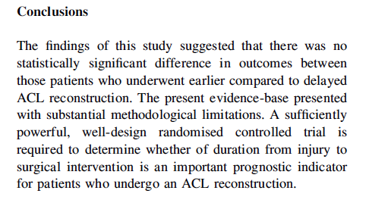
What’s the ‘bottom line’ of the review?
Notes:
Are we happy with the conclusions of the paper?
Are they based on the data they have provided in the paper? = yes

Slide 159
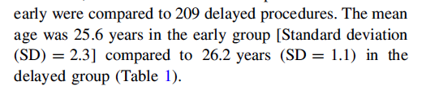
Can I apply these results to my case?
Is my patient so different to those in the study that the results cannot apply?
Notes:
Look back in results section on page 305 – mean age of approx. 26 years suggest very close to my age with acute injury, so results do apply.

Slide 160
‘Clinical pearls’
Don’t forget to ask “Is it worth continuing?”
Look for ‘key’ references: Cochrane Risk of Bias, GRADE, PRISMA
I² >50%: adequate statistical heterogeneity to suggest looking deeper into clinical, methodological heterogeneity reported
Would your patient meet the inclusion criteria of trials/studies in the review?

Slide 161

Publication Bias: Solution
All trials registered at inception,
    The National Clinical Trials Registry: Cancer Trials
    National Institutes of Health Inventory of Clinical Trials and Studies
    International Registry of Perinatal Trials
Meta-Registry of trial Registries
  www.clinicaltrials.org
  www.controlled-trials.com

Slide 162


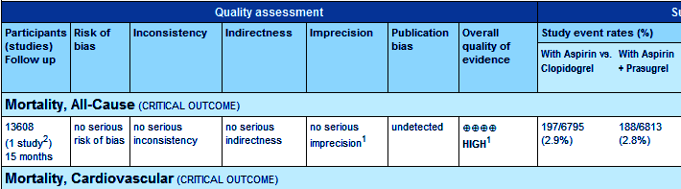
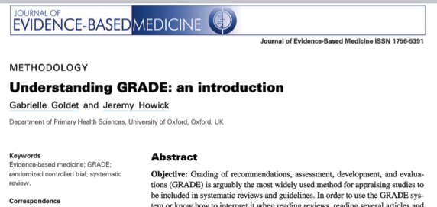
COCHRANE & GRADE
JEBM; 6:50-54
Notes:
This diagram shows the results of a systematic review of RCTs of a short, inexpensive course of a corticosteroid given to women about to give birth too early. The first of these RCTs was reported in 1972. The diagram summarises the evidence that would have been revealed had the available RCTs been reviewed systematically. A decade later it indicates strongly that corticosteroids reduce the risk of babies dying from the complications of immaturity. By 1991, seven more trials had been reported, and the picture had become still stronger. This treatment reduces the odds of the babies of these women dying from the complications of immaturity by 30 to 50 per cent.
Because no systematic review of these trials had been published until 1989, most obstetricians had not realised that the treatment was so effective. As a result, tens of thousands of premature babies have probably suffered and died unnecessarily (and needed more expensive treatment than was necessary). This is just one of many examples of the human costs resulting from failure to perform systematic, up-to-date reviews of RCTs of health care.

Slide 163
PRISMA (QUORUM)
Preferred Reporting Items for Systematic Reviews and Meta-Analyses
Consists of a 27-item checklist and four phase flow diagram
Evidence-based minimum set of items for reporting in systematic reviews and meta-analyses
Can be used for critical appraisal but not designed for it
http://www.prisma-statement.org/

Slide 164
Publication bias
Occurs when publication of research results depends on their nature and direction
Often happens because smaller (n and effect size) studies not submitted/rejected, selective reporting, selective citation (of +ve results)
Funnel plots help identify if there is a bias:
  Treatment effect vs. study size
  Smaller the study = wider the effects
  Largest studies will be near the average (truth), small studies will spread on both sides = symmetric funnel
  Asymetric funnel indicates publication bias – but not all the time (e.g. heterogeneity)
  Interpretation difficult if only a few studies in meta-analysis

Slide 165
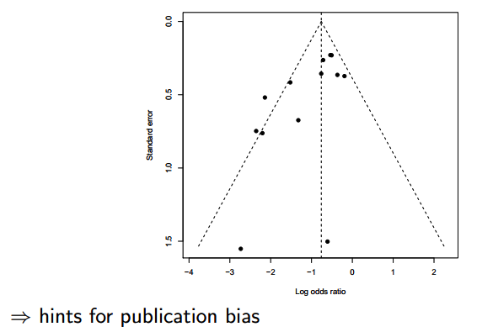
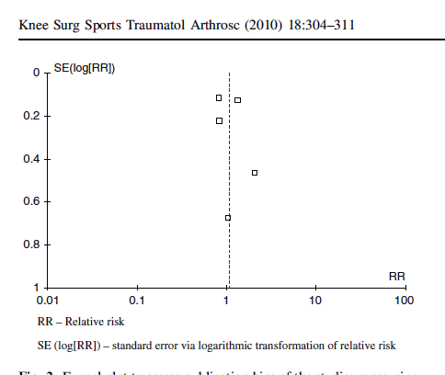
Funnel plots

Slide 166
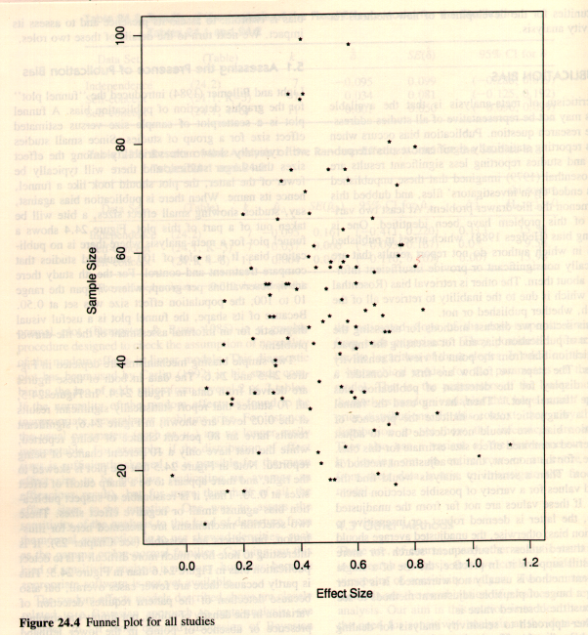
Funnel plot examples
From: Cooper & Hedges: The handbook of research synthesis. 1994

Slide 167
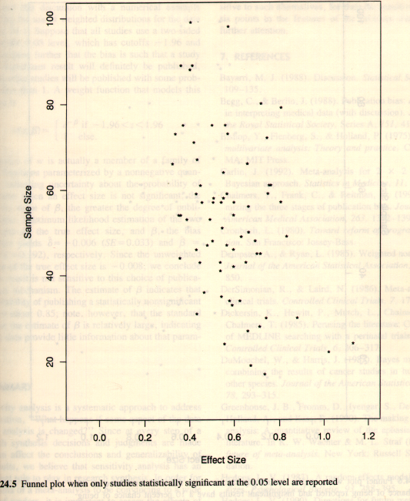
From: Cooper & Hedges: The handbook of research synthesis. 1994

Slide 168
Practice Guidelines

Slide 169
Find Clinical Practice Guidelines:
Search the National Guideline Clearinghouse
Go to ClinicalKey and click on the link to "Practice Guidelines" at the top of the page.
When searching MEDLINE, click on "Additional Limits", and limit by publication type (Practice Guideline).

Slide 170
National Guideline Clearinghouse
www.ngc.gov
Vetted guidelines from various groups
Standard organization so that information can be compared across various guidelines
170
Notes:
170
The new thinking: probabilistic thinking. What we’re going to do is introduce the idea that the mechanistic approach to medicine – that the body is simply a complexly-engineered machine that has to be tweaked and adjusted – is a limited concept. The new paradigm of outcomes medicine requires us to think in terms of probabilities – not why something works, but what is the likelihood that it will work or, overall, be good for patients. We tend to think in absolutes rather than in probabilities, and it’s a difficult transition.

Slide 171
Practice Guidelines
171
The Good,
The Not-So-Good
The Ugly

Slide 172


Slide 174
Refrences
Critical Appraisal tools and Work sheets http://www.cebm.net/critical-appraisal/
Jane M Young & Michael J Solomo. How to critically appraise an article. Nature Reviews Gastroenterology and Hepatology 6, 82-91 (February 2009) | doi:10.1038/ncpgasthep1331
What is a critical appraisal? http://www.medicine.ox.ac.uk/bandolier/painres/download/whatis/what_is_critical_appraisal.pdf
The BMJ - How to Read a Paper http://www.bmj.com/about-bmj/resources-readers/publications/how-read-paper
Evidently Cochrane http://www.evidentlycochrane.net/
CEBM http://www.cebm.net/

Slide 175
Refrences
http://www.casp-uk.net/e-learning
http://www.casp-uk.net/checklists
http://clinicalevidence.bmj.com/x/set/static/ebm/toolbox/665061.html
Critical Appraisal tools and Work sheets http://www.cebm.net/critical-appraisal/
Jane M Young & Michael J Solomo. How to critically appraise an article. Nature Reviews Gastroenterology and Hepatology 6, 82-91 (February 2009) | doi:10.1038/ncpgasthep1331
What is a critical appraisal? http://www.medicine.ox.ac.uk/bandolier/painres/download/whatis/what_is_critical_appraisal.pdf
The BMJ - How to Read a Paper http://www.bmj.com/about-bmj/resources-readers/publications/how-read-paper
Evidently Cochrane http://www.evidentlycochrane.net/
CEBM http://www.cebm.net/

Slide 176


