Slide 1
Approach to the “Difficult” Patient
Lemmese AlWatban
MBBS, CCFP,
AS Women’s Health, AS Academic Family Medicine
Sexual Health Specialist
MCISc (Family Medicine Education)

Slide 2
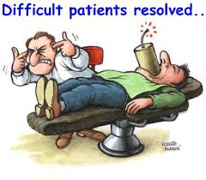
Objectives:
What does “difficult patient” mean?
Why is it important?
Contributing factors
General management
Specific situations

Slide 3
Who is a “difficult patient” ?

Slide 4
The difficult patient:
The "difficult" medical patient experiences emotions and demonstrates behaviours that interfere with effective medical care. These emotions and behaviours typically evoke negative feelings in caregivers, and this aversive reaction leads to the designation of such patients as "difficult."

Slide 5
How common is it ?
Fifteen per cent of clinical interactions with patients are perceived as “difficult” by doctors
1 in 6 medical encounters is labeled as 'difficult' by the physician

Slide 6
Why challenging interactions are bad for everyone
Take up a lot of time, resources, and emotional energy.
Cause the doctor to feel stress, anxiety, anger, and helplessness.
Can even lead to a dislike of the patient and the use of avoidance strategies - ? Medical mistakes
Can leave both the doctor and the patient feeling frustrated and dissatisfied, and can decrease the trust in the doctor-patient relationship – ER visits , Dr shopping
Doctors who experience many of their patients as difficult are more likely to experience burnout

Slide 7
Another look:
Your clinic is running late, your computer has crashed for the third time today, you missed lunch, and then a patient with multiple complex medical problems comes in with a long list of new symptoms. He demands that you prescribe a new drug that is still being tested in clinical trials and refuses to listen to your explanation as to why you cannot do so. Voices become raised, and the consultation reaches a stalemate. How do you resolve this situation?

Slide 8
Contributing Factors:
broadly grouped into the following categories:
Patient
Doctor
Disease
System

Slide 9
The patient:
Uncooperative, hostile, demanding, disruptive, and unpleasant
They might have unrealistic expectations
Unwilling to take responsibility for their health

Slide 10
The Doctor:
If the doctor is hungry, angry, late, or tired (HALT).
Personal factors could be a distraction for some doctors,
The doctor’s personality traits could clash with those of the patient
Doctor’s lack of experience

Slide 11
The Disease:
Some conditions can be more challenging to deal with—such a
chronic pain
ill defined diagnoses
with little prospect of improvement
Psychiatric conditions ?

Slide 12
The System:
Limited resources, finances and support
Time pressures and interruptions

Slide 13
Being aware of factors that contribute to difficult clinical encounters and being prepared to address them will go a long way toward preventing them.

Slide 14
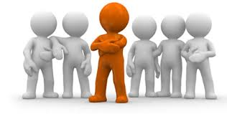
Management

Slide 15
The patient centered approach
The biopsychosocial model
ICE ( ideas, concerns, expectations)
The illness experience
Shared decision making

Slide 16
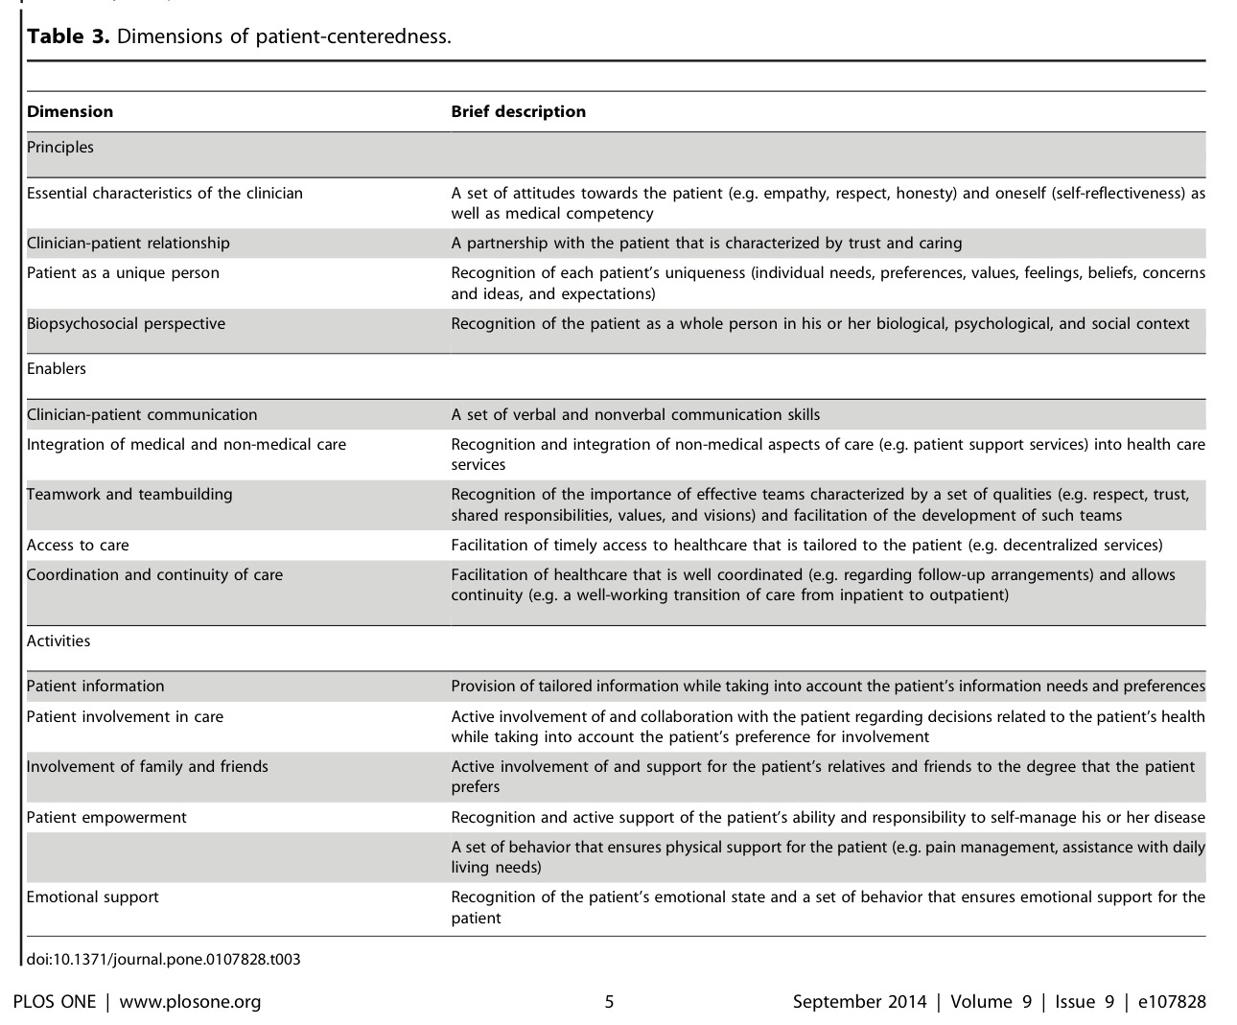

Slide 17
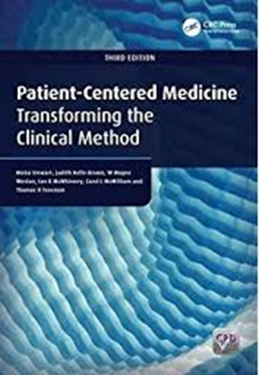
My bias of the patient- centered approach

Slide 18
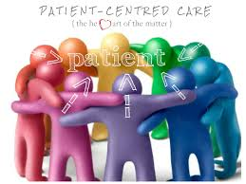
Practice Patient-Centered medicine
Enquiring into the illness experience
Understand the whole person
Finding Common Ground
Enhancing the physician-patient relationship

Slide 19
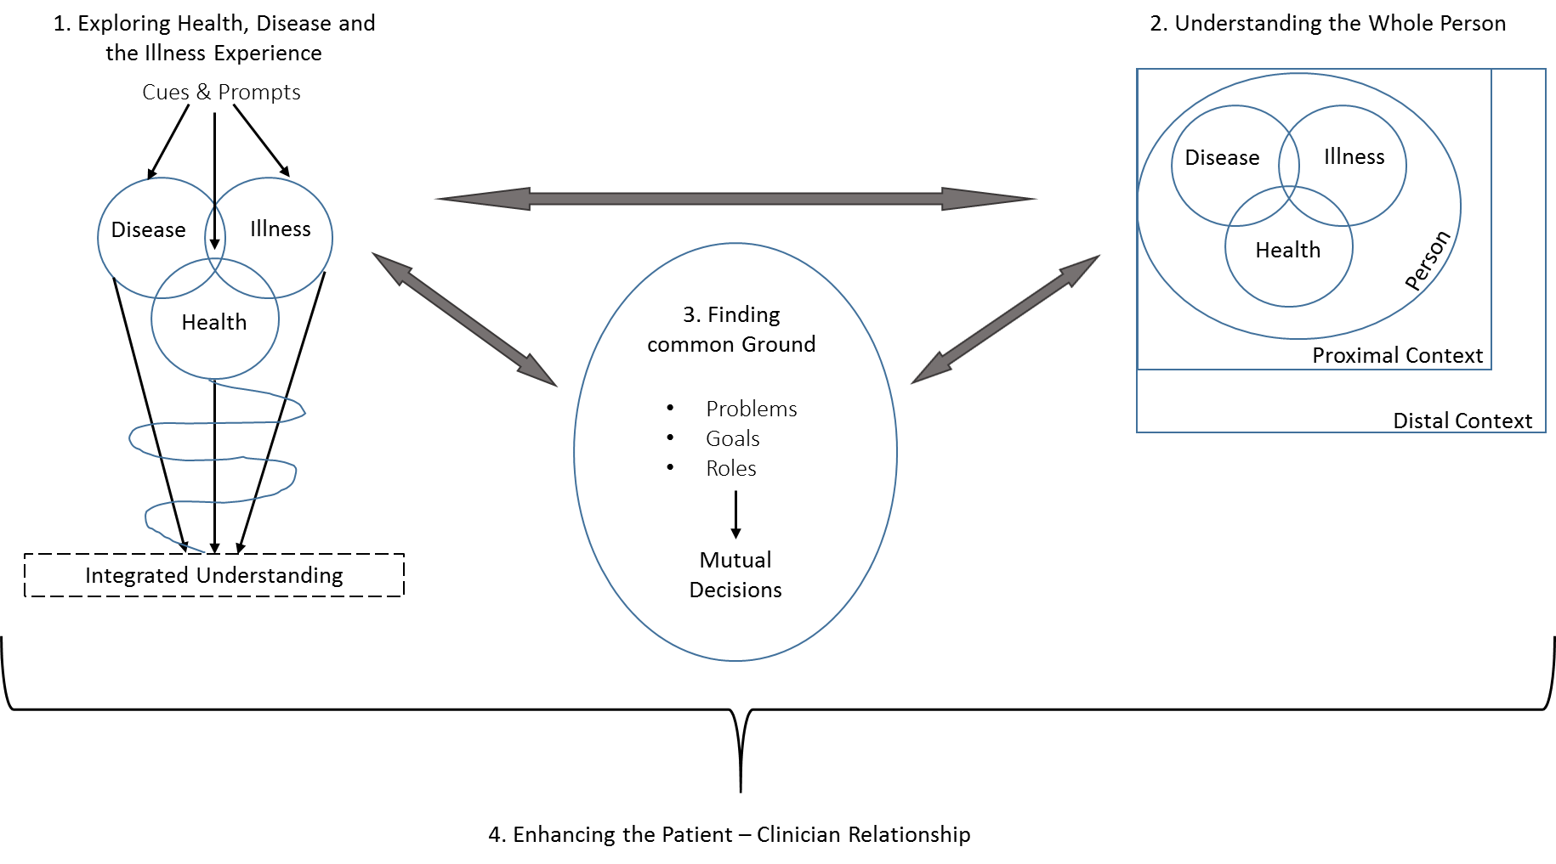

Slide 20
General steps of Management
Identifying that you are in the midst of a difficult consultation – Dx the difficulty before Dx the condition
Verbalizing the difficulty with the patient - It externalizes the problem and creates a sense of shared ownership
Consider alternative explanations for the patient’s behavior (Anxiety vs Anger? )
“reframing” - Find explanations through respectful questioning
Support the patient - by listening carefully and showing empathy
Set boundaries - should be applied consistently and by everyone
Find some common ground- As soon as there is some overlap and common ground, the difficulty rapidly diminishes.
Focus on finding solutions rather than areas of disagreement

Slide 21
The Art of Emotional Response:
5 Skills:
Reflection
Legitimization
Support
Partnership
Respect

Slide 22
Example
28-year-old woman with abdominal pain and no apparent physical etiology after an extensive GI work-up. She became furious when you asked her permission to request a psychiatric consultation, saying, You really don’t believe I have this pain. You think it's all in my head. Well, I’ll just check out of the hospital and find a doctor who believes me!

Slide 23
Reflection
The first, and most important, intervention in dealing with the emotions of patients is reflection
Empathy is the ability to recognize someone's emotional reactions and communicate your understanding of these reactions.
" state the observed patient emotion." - reflective comments might seem oversimplified, obvious, or trivial, they actually can communicate a deep sense of understanding to a patient
communication of empathy is most effective through simple statements and not through questions

Slide 24
*
There are several reactions that doctors could have to this situation:
defensive arguments like, "Well, go ahead and see someone else,“
more explanatory statements such as, "I know you have pain, but I need the psychiatrist's help.“
questioning ? “why are you so mad”
BUT
"You seem to be very unhappy with the suggestion that I call a psychiatrist"

Slide 25
Legitimization
Once a doctor has demonstrated his empathic understanding of the patient's emotion >> has shown that he can tolerate that emotion >>, it is often useful to express some legitimization, or sense of the understand ability of the emotion
Don't Just "say" that you understand if you really do not

Slide 26
*
After several simple reflective comments, the doctor could point out,
“I can certainly understand why you’d be upset. You came to me to find some physical cause for your pain. I couldn’t find any problem and now I’m sending you to a psychiatrist. I might be upset also, if I were in your position”

Slide 27
Support
Doctors usually offer their patients a great deal of emotional support through intuitive relationship skills
Doctors often forget how important they are to patients as sources of emotional support, and the direct acknowledgment of caring is often effective in difficult-patient-care situations.

Slide 28
*
the use of a direct supportive comment like:
“I want you to know that even though I’ve asked the psychiatrist to see you, I’m still your doctor and I will do everything I can to try to help you with your problem”

Slide 29
Partnership
There is considerable literature that suggests that collaborative doctor–patient relationships are generally more effective than authoritarian relationships

Slide 30
*
Saying something like :
“After you’ve talked to the psychiatrist, you and I can get together and review his recommendations. We can then decide together on the next step to take with respect to your stomach pain”

Slide 31
Respect
Explicitly compliment the patient on whatever he or she is doing well
It is extremely important for the doctor to be honest in these discussions because most patients will be able to detect lack of genuineness on the doctor's part.

Slide 32
*
I realize how much pain you’ve been having, and I’m impressed by how well you’ve been coping in spite of all the suffering you’ve been experiencing. You’re still able to help with the housework (or go to work) and you’re determined to get an answer to your problem. Those are good, positive qualities and I’m going to help you in whatever way I can.

Slide 33
Special situations

Slide 34
Angry, rude and defensive patients:
Remain seated and professional
Don't get drawn into a conflict.
Try to uncover the source of difficulty for the patient
Recognize your “triggers”
Apologize if suitable
If you sense a potential for harm ask for assistance
Strong negative emotions directed at you are often misplaced (transference)
Be aware of your own biases and emotional reactions ( counter-transference)

Slide 35
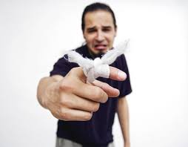
Somatising Patients
chronic multiple vague or exaggerated symptoms “doctor-shopped” and multiple diagnostic tests.
Manage any co-morbid psychological conditions
Refrain from suggesting that “it's all in your head,”
Avoid the cycle of vigorous diagnostic testing and referrals.
Address the issue directly at the beginning of the encounter
“I noticed that you have seen several physicians and have had extensive medical tests .. I recognize that the symptoms are a real difficulty for you, but I believe that these tests have ruled out any serious medical problems… I would like to make a contract with you to see you every two to four weeks

Slide 36
“Frequent fliers”
Big medical charts. may be lonely, dependent or too afraid or embarrassed to ask the questions. “worried well” or misinformation
Identify the underlying reasons for the frequent visits.
Begin by acknowledging that you notice the pattern of frequent visits,
Explain patients different reasons, eg. concern , reassurance, chronic pain relief or to talk.
Showing understanding of the patient's reasons often will foster an open discussion of the “reasons behind the reasons.”
Contract with the patient for regularly scheduled return visits
Use patient education and support personnel as needed.

Slide 37
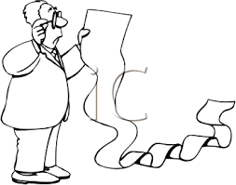
“Multiple Issues” “ Lists of Complaints”

Slide 38
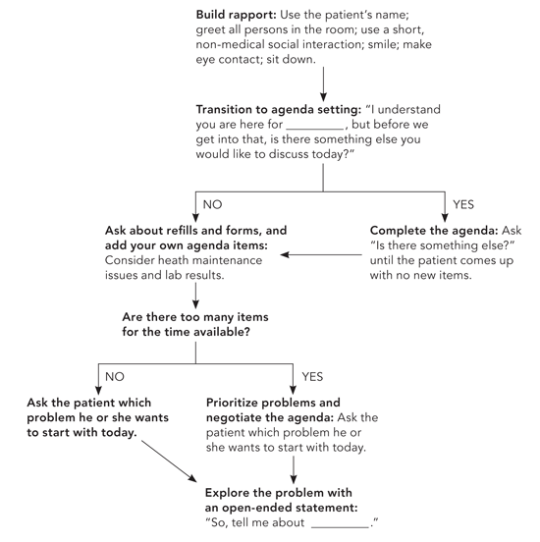
Agenda-Setting Algorithm

Slide 39
Dogmatic or Arrogant Physicians
Each of us has things we feel strongly about. Personal beliefs and values, as well as our beliefs and values about medical care, can lead us to overemphasize our own beliefs and emotions in ways that disempower patients or prevent them from providing us with adequate information about their care.

Slide 40
Can we avoid difficult encounters?

Slide 41
7 skills to successful patient encounters
Prepare for the encounter. (set the stage )
Connection with the patient. (connect with the patient – before opening the electronic health record)
Assess the patient’s illness experience
Communicate to foster healing ( authentic, accepting, understanding)
Use the power of touch ( always touch the part that hurts, but never first)
Laugh a little
Show empathy

Slide 42
"All patients make me happy," "some when they come to the office, others when they leave”
Anonymous Plastic Surgeon

